Slide 1
Analyzing crime data for venues in tourist spots
This project is for the safety measures of new tourists while visiting any venues of a tourist place.

Slide 2
Planning tour program well in advance by considering safety measures is necessary
This project is about important venues of different states of India and also analyzing crime rate of those states.

Slide 3
Source Of Data
For top venues information of states of India, the travel site FourSquare.com has been used.
For crime rate data of India, the website https://data.gov.in has been used.
For latitude, longitude information and for plotting maps and marking states as per their crime rate, the geopy library and folium map function has been used.

Slide 4
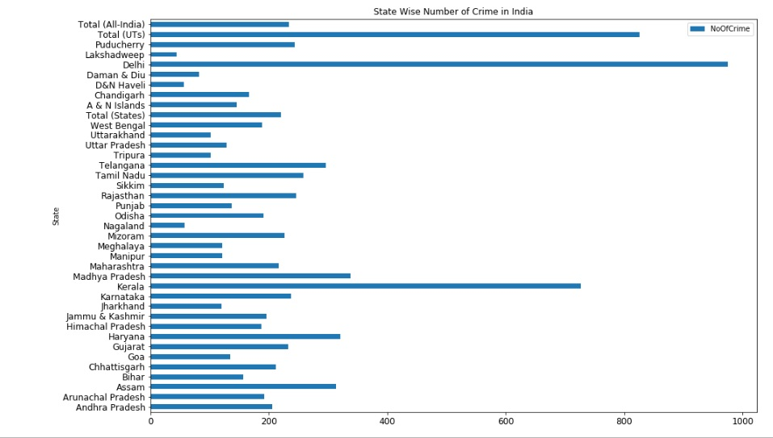
Crime rate data of different states

Slide 5
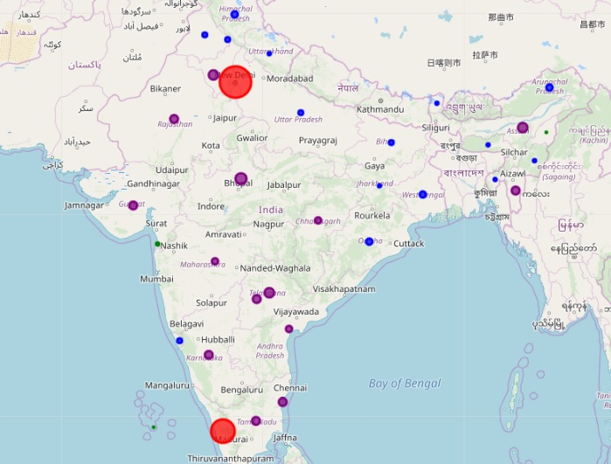
Indian Map with crime rate of states

Slide 6
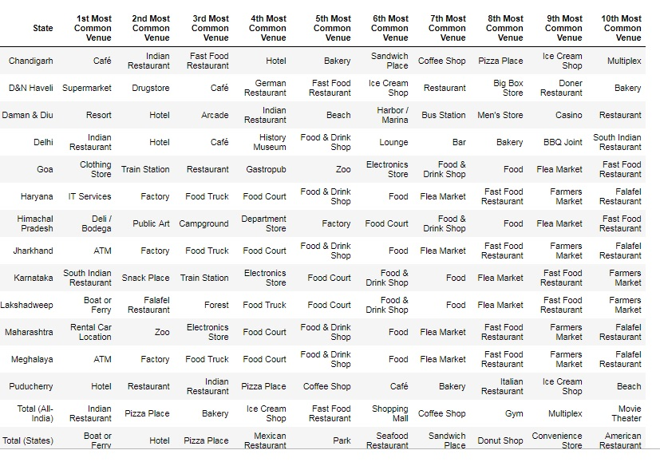
Top venues of different states

Slide 7
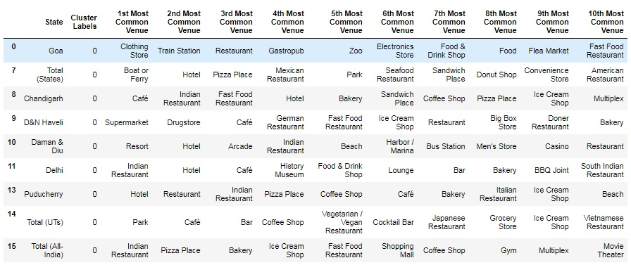
Clusters of States based of venues

Slide 8
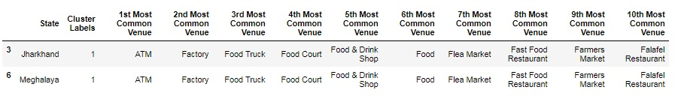
Cluster of Venues

Slide 9
Conclusion and future direction
Here only crime data has been used for analyzing besides top venues options. There are also scopes of improvements for considering more dimensions like law and order, average traffic conditions, weather conditions, activities of Govt’s tourism departments etc. to give more options of choice to the new tourists.

