Slide 1
Immuno Compass
Predicting and explaining how often patients develop anti-drug antibodies to biologic medicines
Foundations of Data Science · course project
Notes:
Hello everyone. My project is called Immuno Compass. It is about a safety and effectiveness problem with modern biologic medicines: sometimes the patient's immune system attacks the drug. I used a newly consolidated public database of clinical trials to ask two questions: can we predict how often this happens for a drug, and which factors are linked to it? I will walk you through the data, the three modelling approaches, an honest comparison, and what the models agree on.

Slide 2
When the immune system attacks the medicine
1
Biologic drugs
2
Seen as foreign
3
Why it matters
Proteins such as therapeutic antibodies, produced by living cells, used in cancer, autoimmune disease and more.
The immune system can recognise the drug as a stranger and make anti-drug antibodies (ADAs).
ADAs can neutralise the drug, clear it faster, or cause infusion and allergic reactions.
Research question Can information about the drug, the treatment and the trial predict the share of patients who develop ADAs, and which factors are associated with it?
Notes:
Biologics are protein drugs, for example monoclonal antibodies. Because they are proteins, the immune system can sometimes see them as foreign and produce anti-drug antibodies, which I will call ADAs. ADAs can block the drug, remove it from the body faster, or cause reactions. Every new biologic is tested for ADAs in clinical trials, but the results were scattered. The Immunogenicity Database Collaborative recently collected them. My question: using what we know about the drug, the treatment and the trial, can we predict the ADA frequency, and what is it linked to? I am not claiming immunogenicity prediction is new; the contribution is an integrated statistical, Bayesian and machine-learning analysis of this new resource.

Slide 3
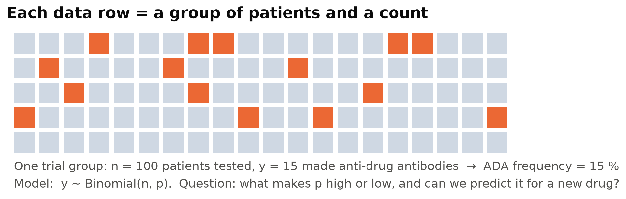
Each data row is a count: y of n patients
Not classification, not plain regression. We know how many patients were tested (n) and how many were ADA-positive (y), so the natural model is y ~ Binomial(n, p), and the models learn what makes p high or low. Big groups tell us more than small ones.
Notes:
Here is what one row of data means. A trial group of, say, 100 patients was tested, and 15 were ADA-positive: a frequency of 15 percent. Because we know both counts, this is neither a yes/no classification nor ordinary regression on a percentage. The natural model is the Binomial distribution: each patient is like a coin flip with probability p of being ADA-positive. Our models try to learn how p depends on the drug and the trial. An important consequence: a group of 1,000 patients carries more information than a group of 10, so groups must be weighted.

Slide 4
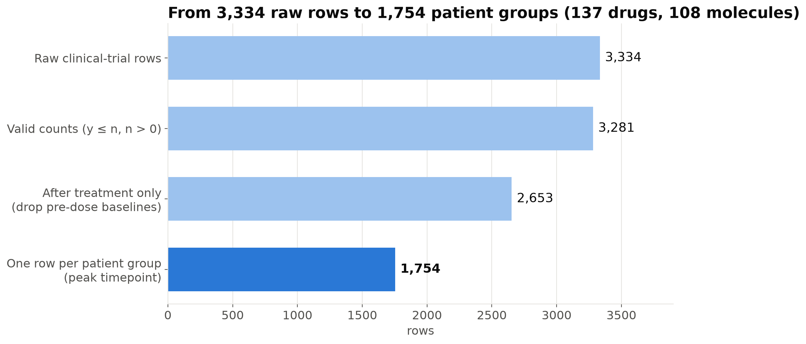
From 3,334 raw rows to 1,754 patient groups
1,754
patient groups after cleaning
108
molecules (137 drug products)
211,018
patients tested for ADA
Pre-dose baseline rows removed · same patients measured at many timepoints collapsed to one row per group · dose parsed from free text (≈ mg/kg)
Notes:
The clinical trials table has 3,334 rows. I removed 53 rows without usable counts. Then an important discovery: rows labelled 'therapeutic naive' are measurements taken before the drug was given, with only 4 percent ADA, so they can't tell us about the drug and were removed. Next, the same patients were often measured at many timepoints, up to 36 rows for one group; counting them all would count the same people many times, so I kept one row per group, at the peak ADA timepoint, and checked that using the last timepoint gives the same conclusions. The result: 1,754 patient groups, 137 drug products from 108 molecules, and over 211,000 patients.

Slide 5
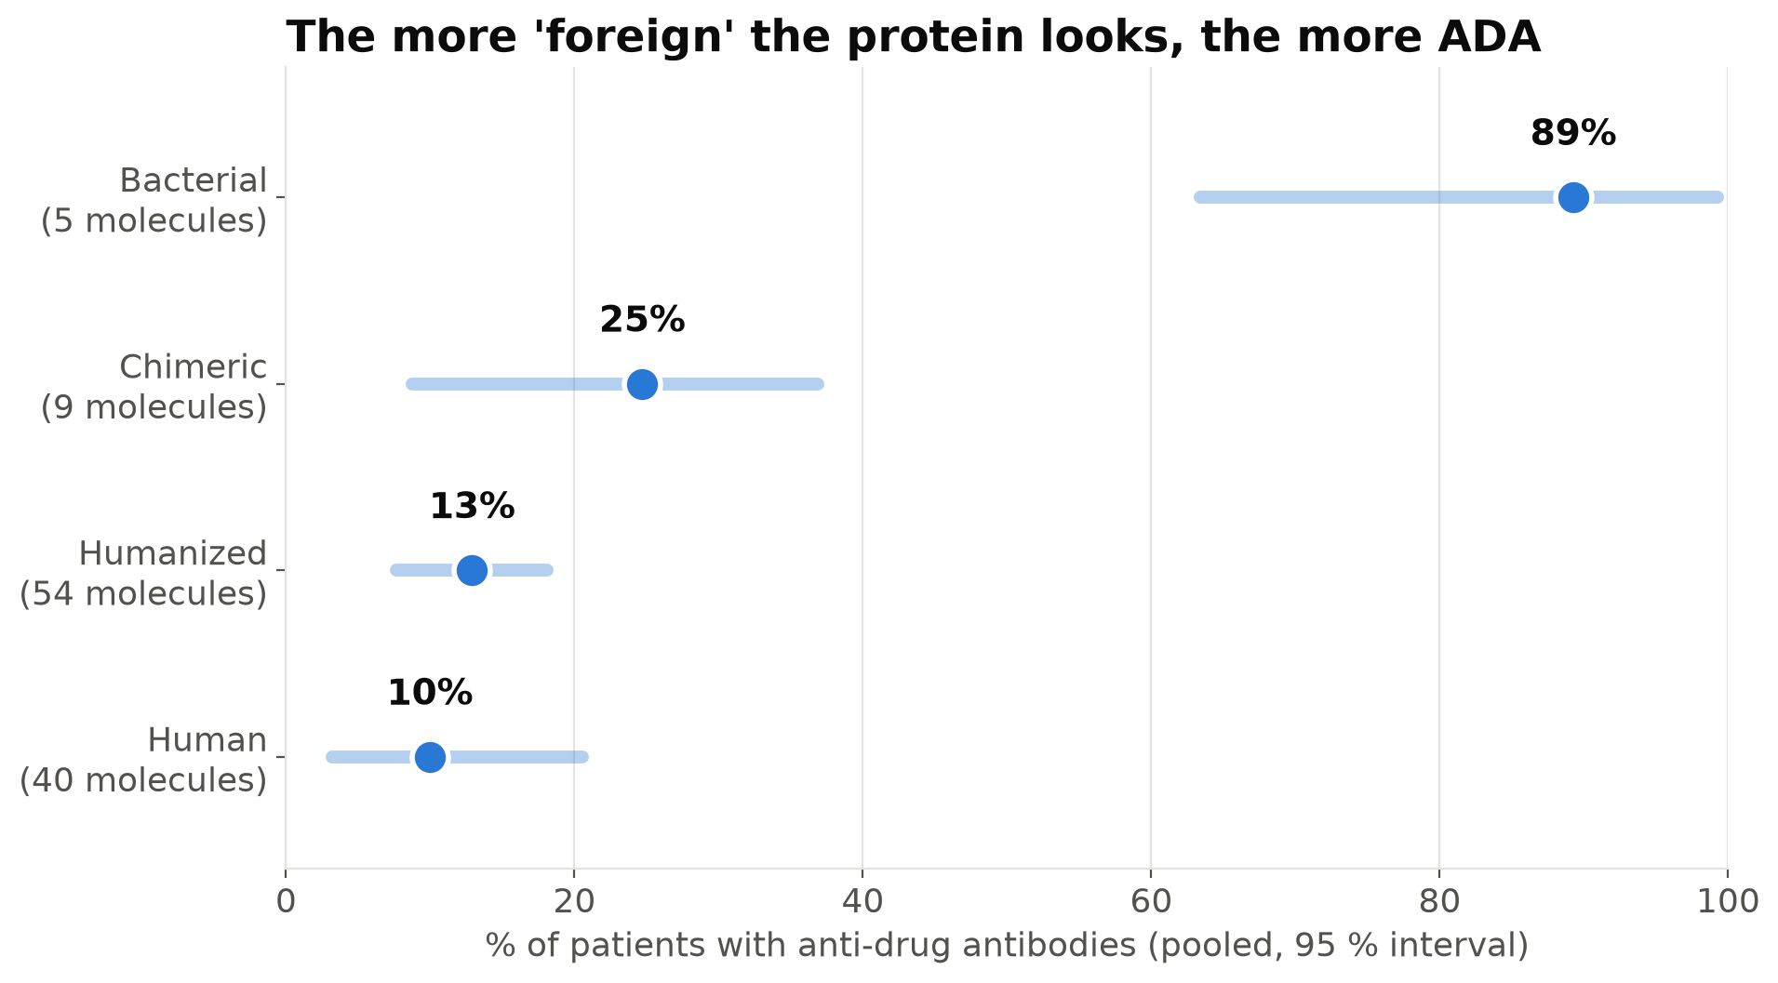
The more 'foreign' the protein, the more ADA
Human 10 % → humanized 13 % → chimeric 25 % → bacterial 89 %
Matches immunology: the less human the protein looks, the stronger the reaction
Intervals from re-sampling molecules, because groups of the same molecule are not independent
Overall: 12.9 % of patients ADA-positive
Notes:
This chart already tells a biological story. Fully human antibodies have about 10 percent ADA, humanized ones 13, chimeric antibodies, which are partly mouse, 25 percent, and drugs derived from bacteria almost 90 percent. The less human the protein looks, the more the immune system reacts. The horizontal lines are 95 percent intervals. I computed them by re-sampling molecules rather than individual trial groups, because many groups belong to the same molecule and are not independent. That idea of grouping by molecule comes back several times.

Slide 6
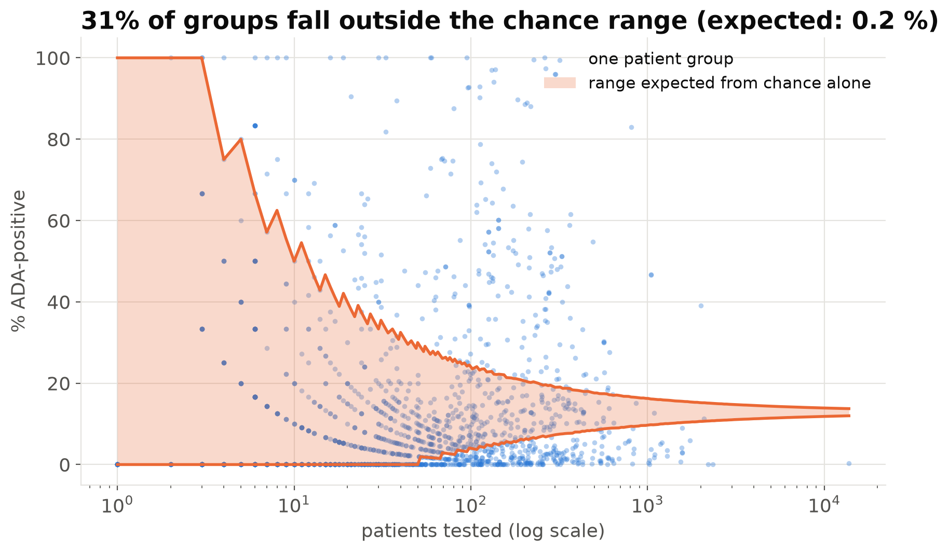
Patient groups vary far more than chance allows
≈ 5
patients' worth of information in a 1,000-patient group (φ ≈ 3.6)
31 % of groups lie outside the chance-only funnel (0.2 % expected)
Cause: assays, populations and the drug itself differ between trials
Consequence: models that treat every patient as independent become over-confident
Notes:
If all groups shared one ADA probability, results would scatter only by chance, inside this orange funnel: wide for small groups, narrow for big ones. In reality 31 percent of groups fall outside, where we would expect only 0.2 percent. This is called overdispersion. In the Bayesian Beta-Binomial model, the dispersion parameter phi is about 3.6, which means patients in the same group are correlated: a 1,000-patient trial carries roughly as much information about the average rate as five independent patients. This one fact explains most of what follows.

Slide 7
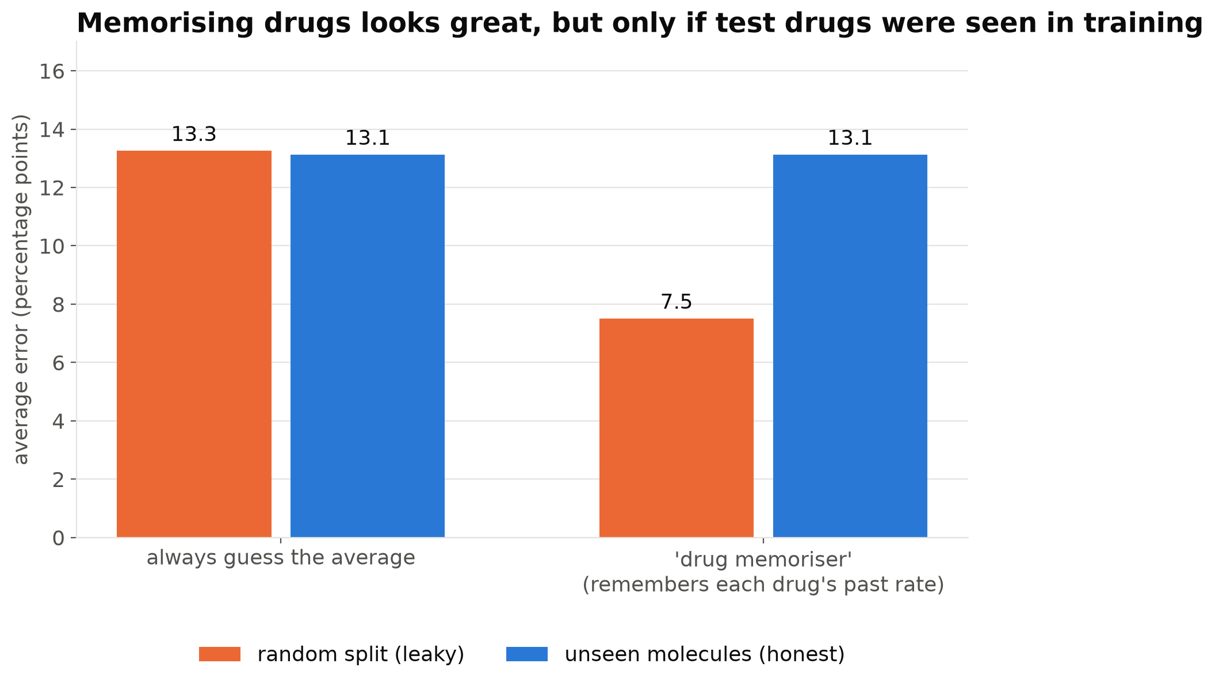
A fair test: predict unseen molecules
5-fold cross-validation grouped by molecule
Biosimilar copies stay with their original drug
A random split lets models 'recognise' drugs and roughly halves the apparent error
Every model uses the same folds, features and scores
Notes:
How do we test fairly? If we split trial groups randomly, the same drug appears in both training and test data. This bar chart shows a 'drug memoriser' that knows no biology and only remembers each drug's past ADA rate. With a random split it looks brilliant, 7.5 points of error. With an honest split it is no better than guessing the average. So all models are evaluated on molecules they have never seen. One lesson from the project: I first grouped by drug product, but biosimilars are copies of the same molecule. When the sequence features exposed this, I regrouped by molecule and re-ran everything.

Slide 8
Three models, one question
1
Binomial GLM
2
Bayesian model
3
XGBoost
A weighing scale for clues
A weather forecaster
Twenty questions
Logistic regression on counts. Odds ratios; cluster-robust errors; L1/L2 regularisation tuned by nested CV.
Beta-Binomial in PyMC. Priors + likelihood → posterior. Each group gets its own 'coin', so uncertainty is honest.
Hundreds of small decision trees; finds non-linear patterns. Explained with SHAP.
Scores on unseen molecules: patient-weighted error (wMAE), held-out log-likelihood, calibration, and coverage of 90 % predictive ranges. Baseline: always predict the training average.
Notes:
I compared three families of models. First, the Binomial GLM, a classic weighing scale where each clue gets a weight; it gives odds ratios. I used cluster-robust errors and tried L1 and L2 regularisation, choosing the penalty with nested cross-validation. Second, the Bayesian model in PyMC. Instead of one number per effect it gives a whole distribution, like a weather forecaster saying 70 percent chance of rain. The Beta-Binomial version lets every trial group have its own probability, which handles the overdispersion. Third, XGBoost, which builds hundreds of small decision trees, like playing twenty questions. All were scored the same way, against a simple baseline: always predict the training average.

Slide 9
The Bayesian model in one picture
Prior
Before data: effects are probably modest
α ~ N(0, 1.5), β ~ N(0, 1), φ ~ Exp(0.1)
Likelihood
How probable are the counts?
pᵢ ~ Beta(μᵢφ, (1−μᵢ)φ), yᵢ ~ Binomial(nᵢ, pᵢ)
Posterior
Plausible effects after the data
NUTS: 4 chains × 1,000 draws
r̂ = 1.00, 0 divergences
×
→
Plain Binomial: every patient in a group flips the same coin → over-confident (its 90 % ranges catch only 47 % of unseen groups)
Beta-Binomial: first draw the group's own coin around the prediction, then flip it n times → matches the real spread of the data
Posterior predictive check: Beta-Binomial reproduces the 35 % of groups with zero ADA; Binomial predicts only 21–24 %
Notes:
Bayes' theorem in one picture: the posterior is proportional to the likelihood times the prior. The priors say effects are probably modest. The likelihood is Beta-Binomial: each group first gets its own probability drawn around the model's prediction, then its patients are counted. PyMC samples the posterior with NUTS; the diagnostics were clean, with r-hat of 1.00 and no divergences. Why Beta-Binomial? A plain Binomial version assumes every patient in a group flips the same coin. Its uncertainty ranges were far too narrow. The Beta-Binomial passes the posterior predictive check: simulated data look like the real data, including the share of groups with zero ADA.

Slide 10
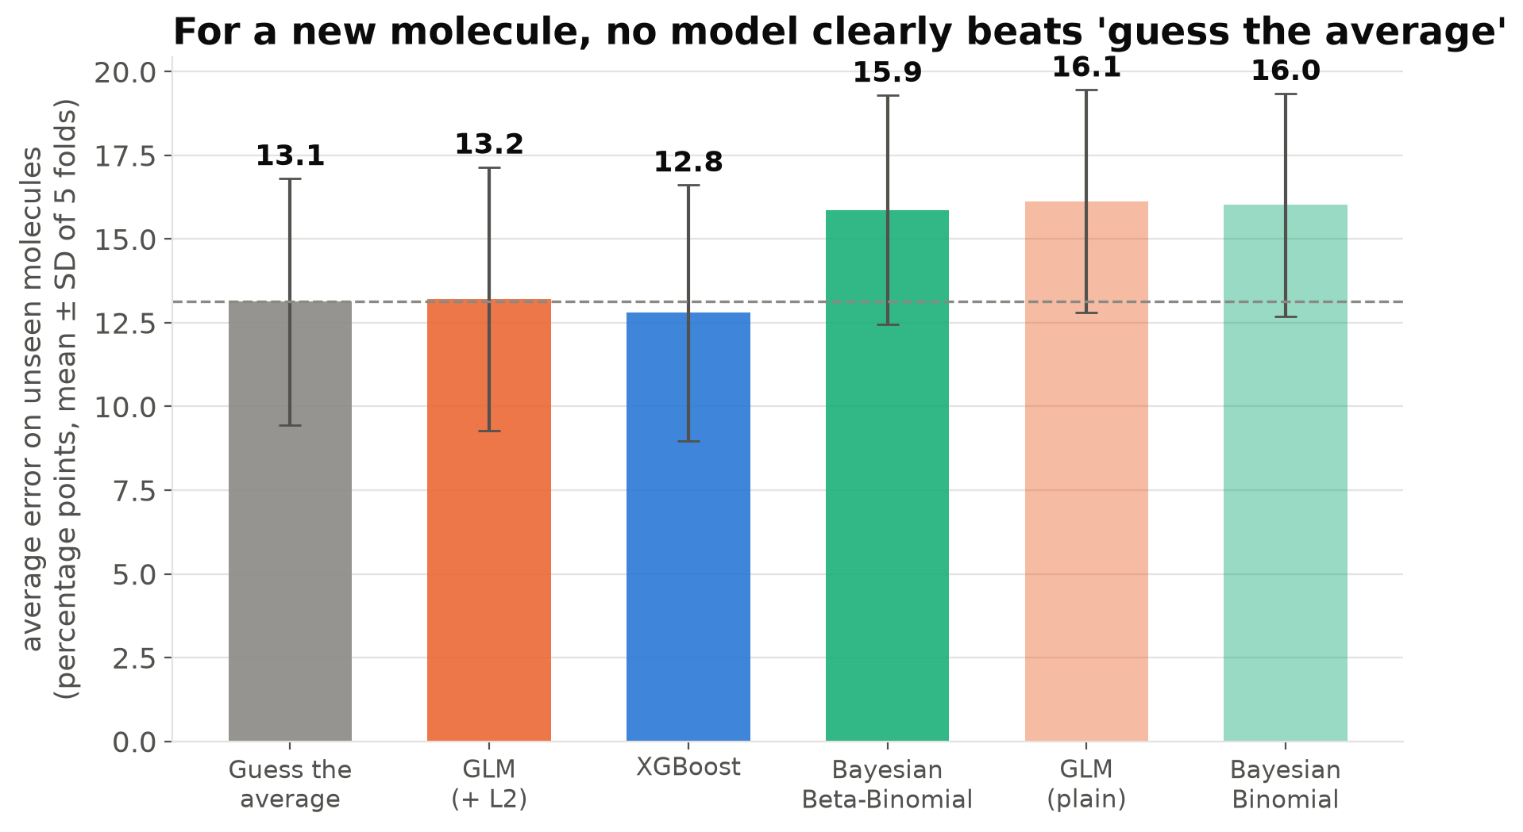
For a new molecule, no model beats the average
Best: XGBoost 12.8 vs 13.1 points for 'guess the average'
The gain is smaller than the fold-to-fold spread, and absent in log-likelihood
Plain GLM and Bayesian Binomial over-fit the largest trials
Sequence features: no consistent gain
Notes:
This is the central and honest result. Bars show the average prediction error on molecules never seen in training, with spread across the five folds. Guessing the average gives 13.1 percentage points. XGBoost is best at 12.8, but that small gain is less than the variation between folds, and it does not improve the probability score. Models that treat every patient as independent, the plain GLM and the Bayesian Binomial, do worse than the average. So, with these clues, ADA for a brand-new molecule is barely predictable. Most of the variation is specific to each molecule.

Slide 11
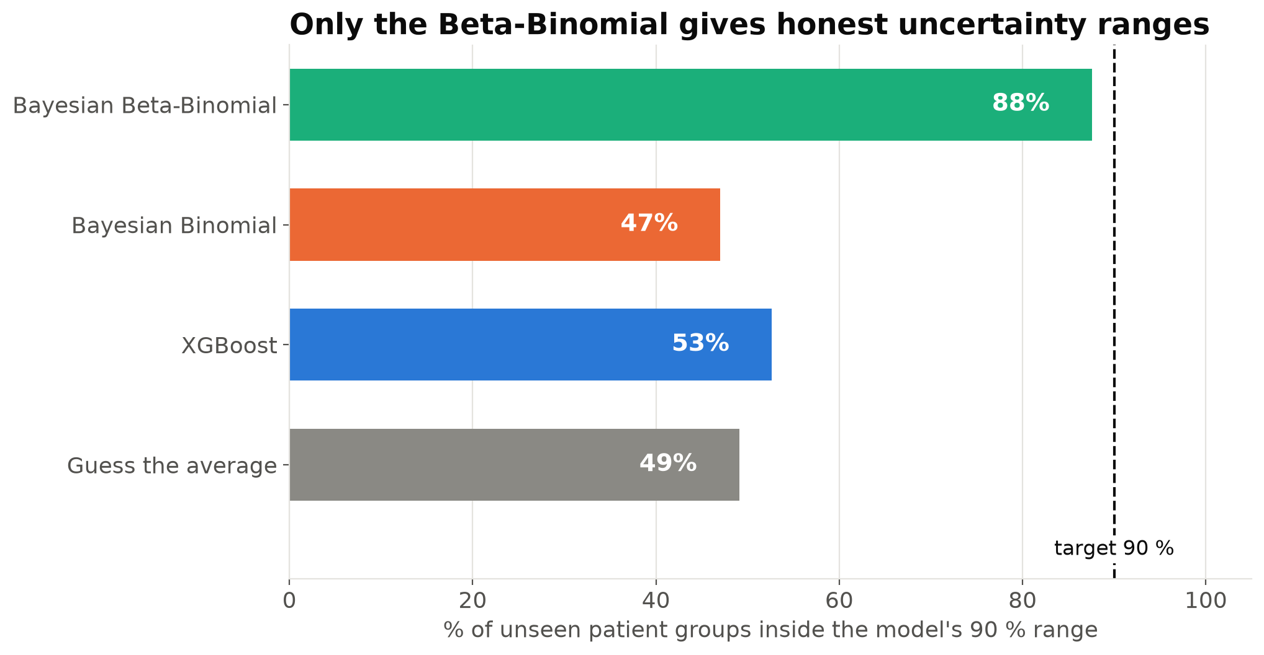
Only the Beta-Binomial gives honest uncertainty
A 90 % range should contain the truth about 90 % of the time
Models assuming Binomial spread: about 50 %
Beta-Binomial: 88 %; the no-clue Beta-Binomial reaches 95 %
Modelling overdispersion matters more than any single clue
Notes:
Prediction is not only about the middle guess; it is also about honest uncertainty. A 90 percent range should contain the real result about 90 percent of the time. Every model that assumes plain Binomial spread manages only about half. The Beta-Binomial reaches 88 percent. Interestingly, a Beta-Binomial with no clues at all does slightly better still. So the most honest forecast for a new molecule is: around 13 to 14 percent on average, with a wide range. The take-home message: getting the noise model right mattered more than any clue.

Slide 12
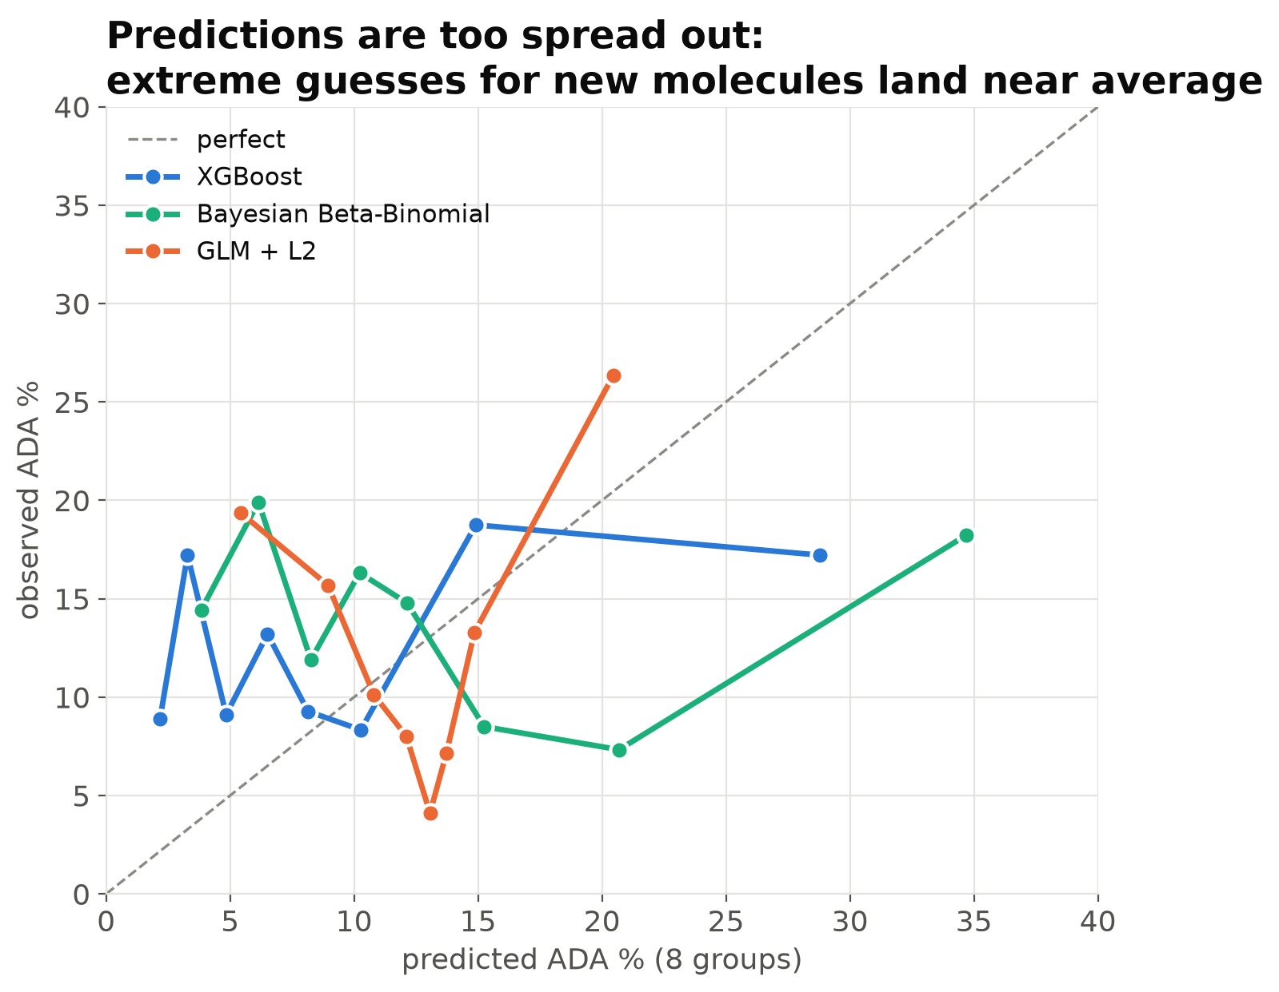
Predictions are too spread out
Cohorts are sorted into 8 groups by predicted ADA; dots compare prediction with what was observed
Perfect calibration = the dashed diagonal
When a model predicts very low or very high ADA for a new molecule, reality usually lands near the average
Models are over-confident about differences between molecules, the same overdispersion story
Notes:
Calibration asks: when the model says 20 percent, is it 20 percent? I sorted held-out groups by their predicted ADA into eight bins and compared the average prediction with what was observed. A perfect model sits on the diagonal. Our models predict a range from about 2 to 35 percent, but the observed rates in those bins stay between about 4 and 26 percent, closer to the middle. The models are over-confident about how different a new molecule will be. That is consistent with everything else: limited information about each molecule, and a lot of noise.

Slide 13
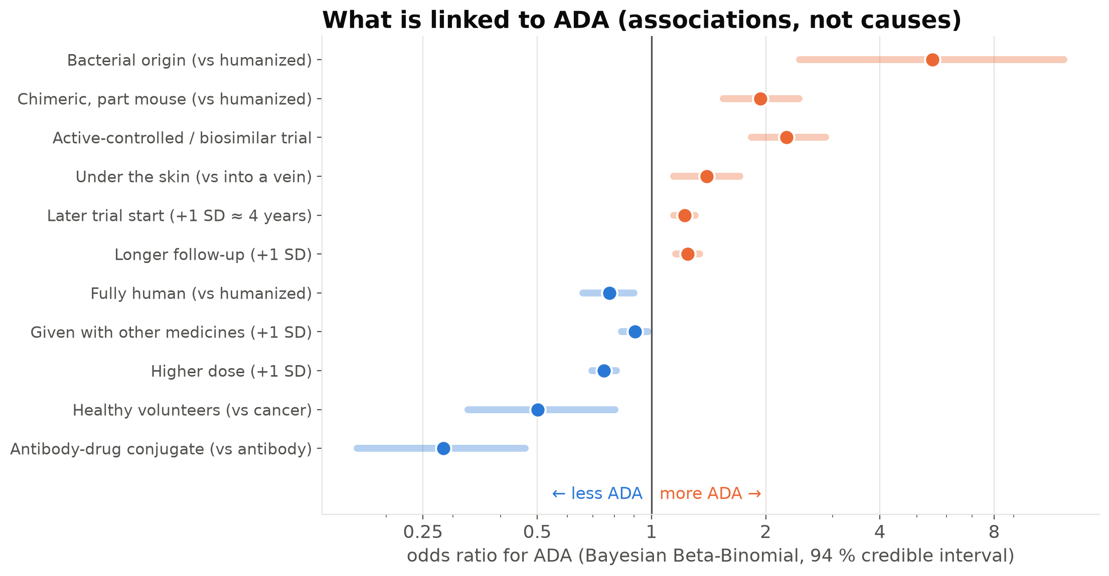
What is linked to ADA (associations, not causes)
Higher: bacterial or chimeric origin, active-controlled / biosimilar trials, later trial start, subcutaneous route
Lower: higher dose, co-medication, healthy volunteers, antibody-drug conjugates
Later start year likely reflects more sensitive ADA tests, not worse drugs
Notes:
Even if prediction for new molecules is hard, the models can still describe patterns. These are odds ratios from the Bayesian Beta-Binomial with 94 percent credible intervals. Orange means more ADA, blue less. More foreign proteins, bacterial or chimeric, have more ADA, and so does injection under the skin compared with into a vein. Later trials report more ADA, which is most likely because newer tests are more sensitive. Higher doses and co-medication go with less ADA, consistent with immune tolerance and suppression. These are associations in observational data, not causes.

Slide 14
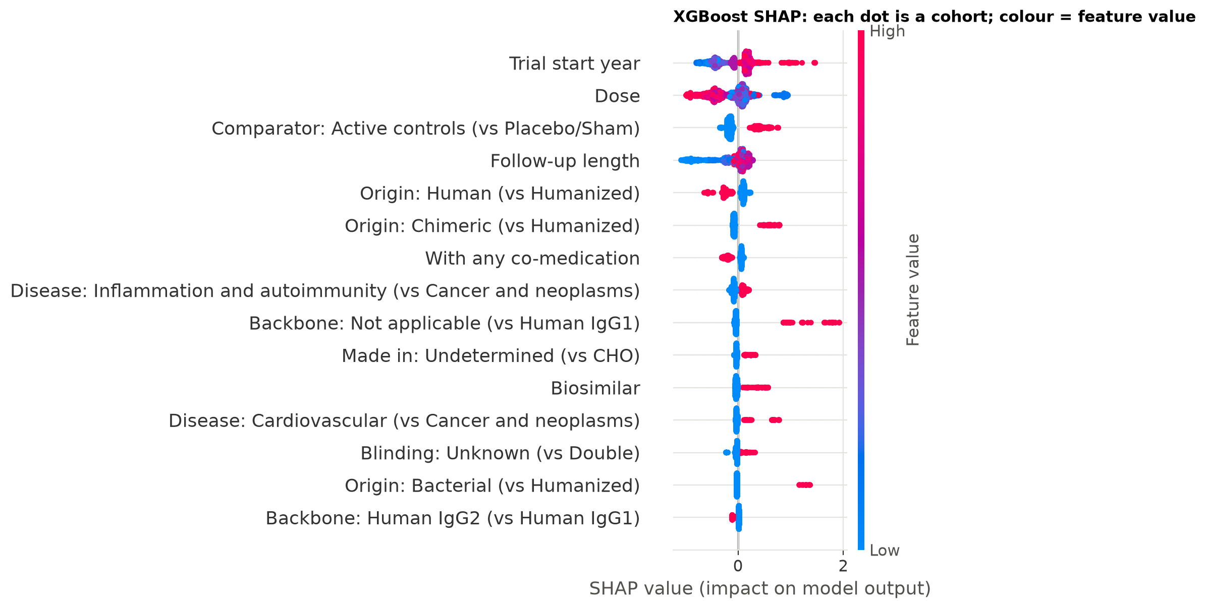
Three methods agree on the core factors
32 / 42
features point the same way in GLM, Bayesian model and XGBoost (SHAP)
9
robust: same direction and confident in both statistical models
Year, dose, trial type, co-medication, bacterial origin, healthy volunteers, biosimilar
Notes:
To check these patterns, I compared three very different explanations: GLM odds ratios with cluster-robust errors, Bayesian posteriors, and SHAP values from XGBoost. On the left, the SHAP plot: each dot is a trial group, and its position shows how much a clue pushed that group's prediction up or down. Across all 42 feature columns, 32 point in the same direction in all three methods, and 9 are confidently non-zero in both statistical models. That agreement gives me more confidence that these are real patterns in the database, while still being associations.

Slide 15
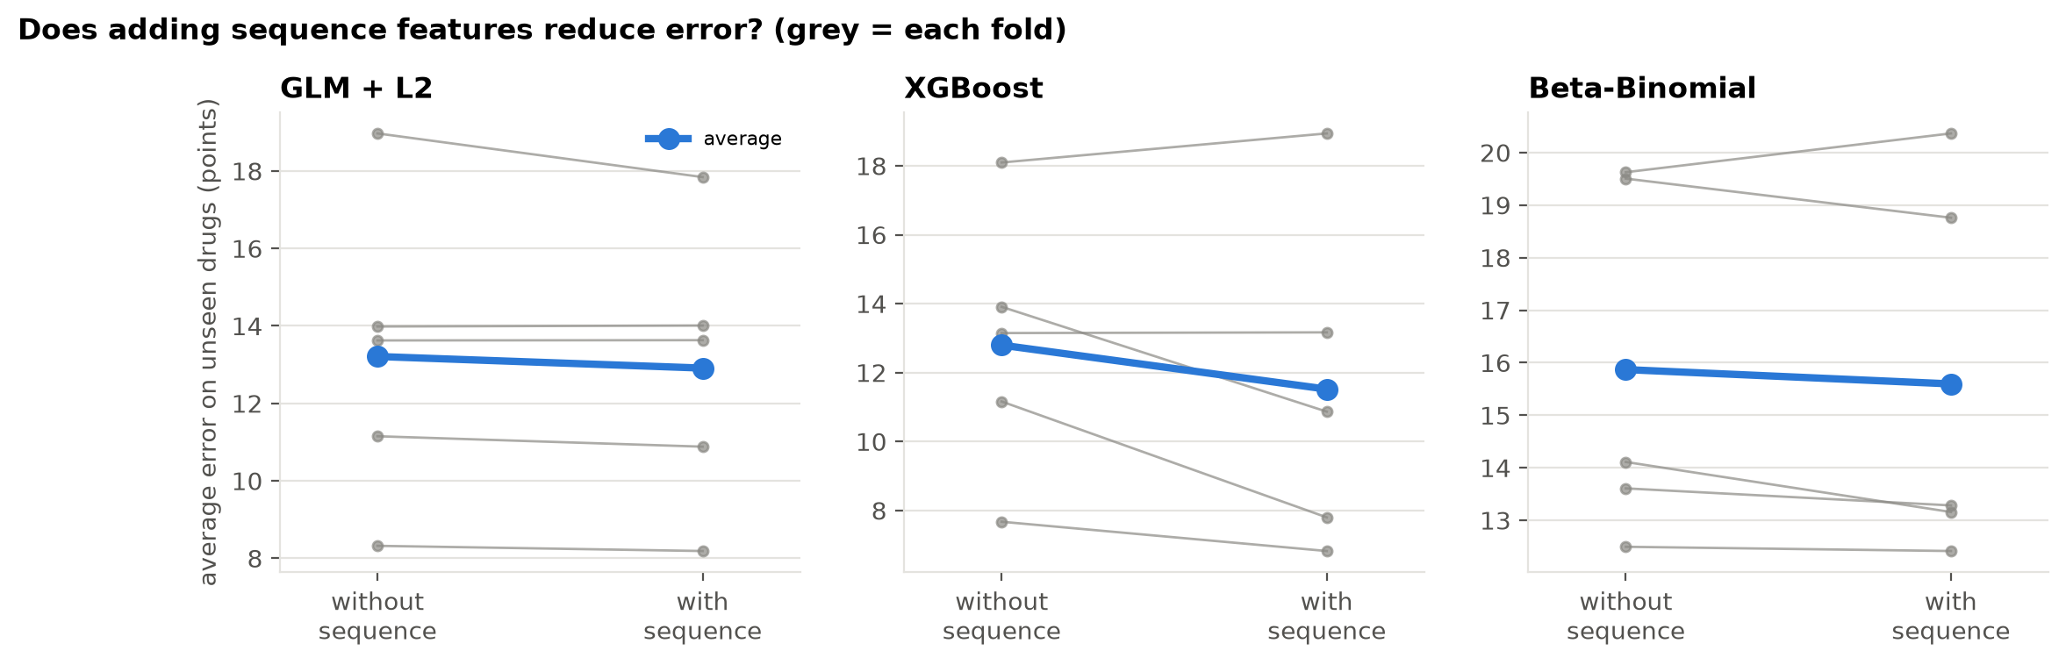
Protein-sequence features: tested, not adopted
Pre-registered rule
Keep only if better on average and in at least 4 of 5 folds
Result
XGBoost error 12.8 → 11.5 but only 3/5 folds; GLM and Bayesian no consistent gain
Lesson
Grouping by product had inflated the gain: biosimilars share sequences
Notes:
I also promised to try molecular features. From the sequence table I computed five whole-molecule properties with Biopython: size, charge balance, hydrophobicity, aromaticity and an instability index, for 89 percent of groups. Before looking at results I fixed a rule: keep them only if they improve the error on average and in at least four of the five folds. No model passed. XGBoost improved on average but in only three folds. So the honest report is: tested, no consistent improvement. The experiment also revealed the biosimilar leak I mentioned, which made the first, product-grouped result look much better than it really was.

Slide 16
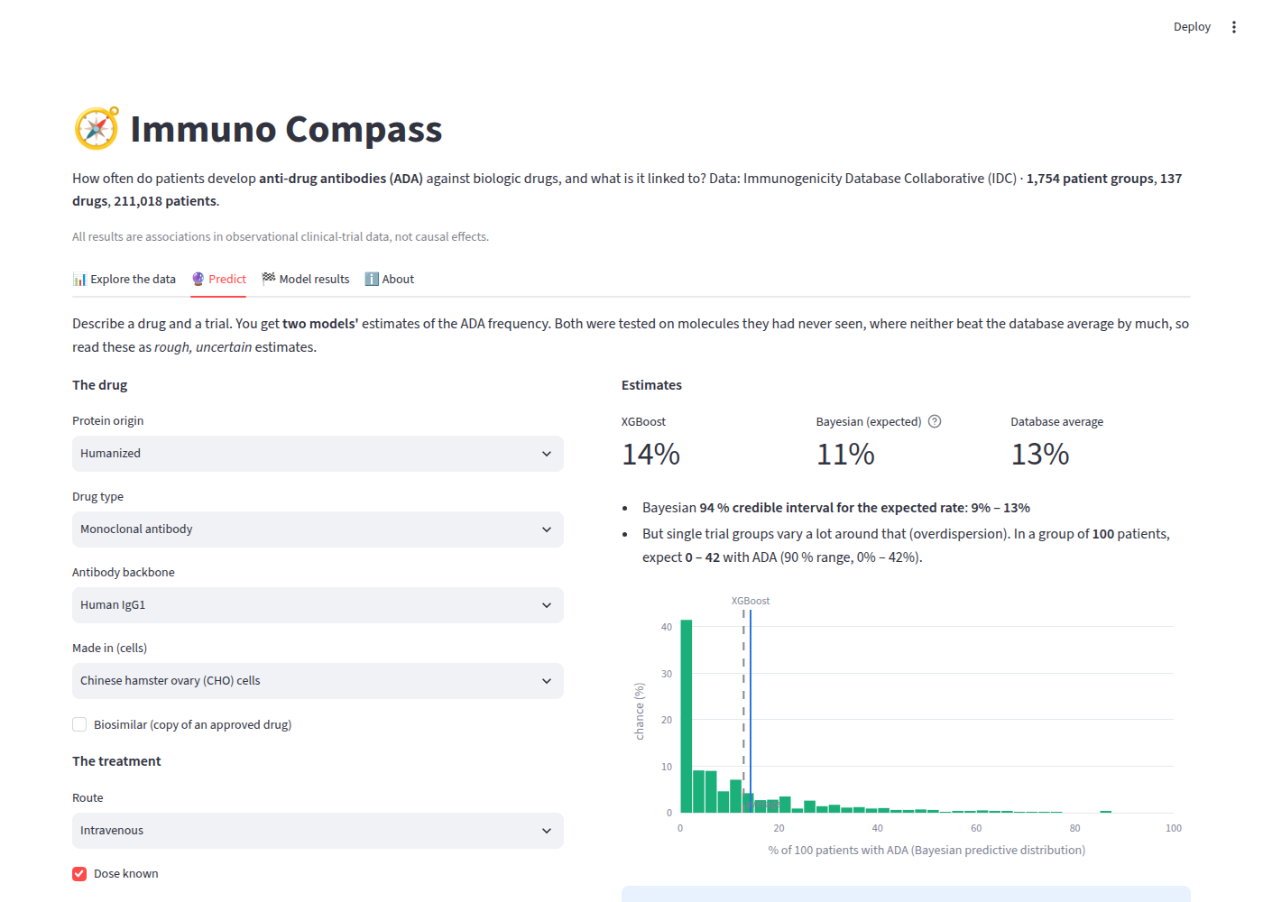
Interactive dashboard
Explore: ADA by origin, route, disease, dose, trial period, with filters
Predict: describe a drug and a trial → XGBoost estimate plus Bayesian range for a group of any size
Model results: scoreboard and key charts
Loads the saved models, so it uses exactly the training preprocessing
Notes:
The fourth deliverable is an interactive Streamlit dashboard. In the Explore tab you can group ADA frequency by origin, route, disease area or dose and filter the data. In the Predict tab you describe a drug and a trial and get the XGBoost estimate and the Bayesian Beta-Binomial range, including how many patients out of a group of your chosen size might be ADA-positive. The app never retrains; it loads the saved models together with their preprocessing, which avoids the classic mismatch between training and the app. If time allows, I can show it live.

Slide 17
Limitations and next steps
!
Limitations
→
Next steps
Observational trials with different ADA assays
Dose parsed approximately from free text
Only ~108 molecules to learn from
No per-molecule random effect in the Bayesian model
Associations only, no causal claims
Add assay type and sensitivity as covariates
Per-molecule random effects (hierarchical model)
Variable-region and humanness sequence features
T-cell epitope predictions
Validate on newly added IDC trials
Notes:
Some limitations. The trials used different ADA tests over two decades, which is probably why trial year matters so much. Dose had to be extracted from text and is approximate. With only about 108 molecules there is limited information about drug-specific effects, and the Bayesian model does not yet include a per-molecule random effect; I used cluster-robust GLM errors as a conservative check. Everything is association, not causation. Natural next steps: add assay information, build a hierarchical model, and try more targeted sequence features such as humanness scores and T-cell epitopes.

Slide 18
Take-home messages
1 Overdispersion dominates: a Beta-Binomial is needed for honest uncertainty
2 For a brand-new molecule, ADA is barely predictable beyond the average (~13 %)
3 Methods agree on assay era, dose, protein foreignness, trial type and co-medication
4 Fair evaluation (grouped by molecule) changes the story; leakage is easy to miss
Notes:
To summarise. First, these data are strongly overdispersed, and only a Beta-Binomial model gives honest uncertainty. Second, for a brand-new molecule, the clues we have predict ADA barely better than the database average of about 13 percent. Third, despite that, three very different methods agree on a short list of associated factors: assay era, dose, how foreign the protein is, the type of trial, and co-medication. And fourth, a methodological lesson: fair evaluation by molecule changes the conclusions, and leakage is easy to miss. Thank you, I am happy to take questions.

