Slide 1
Power BI Installation

Slide 2
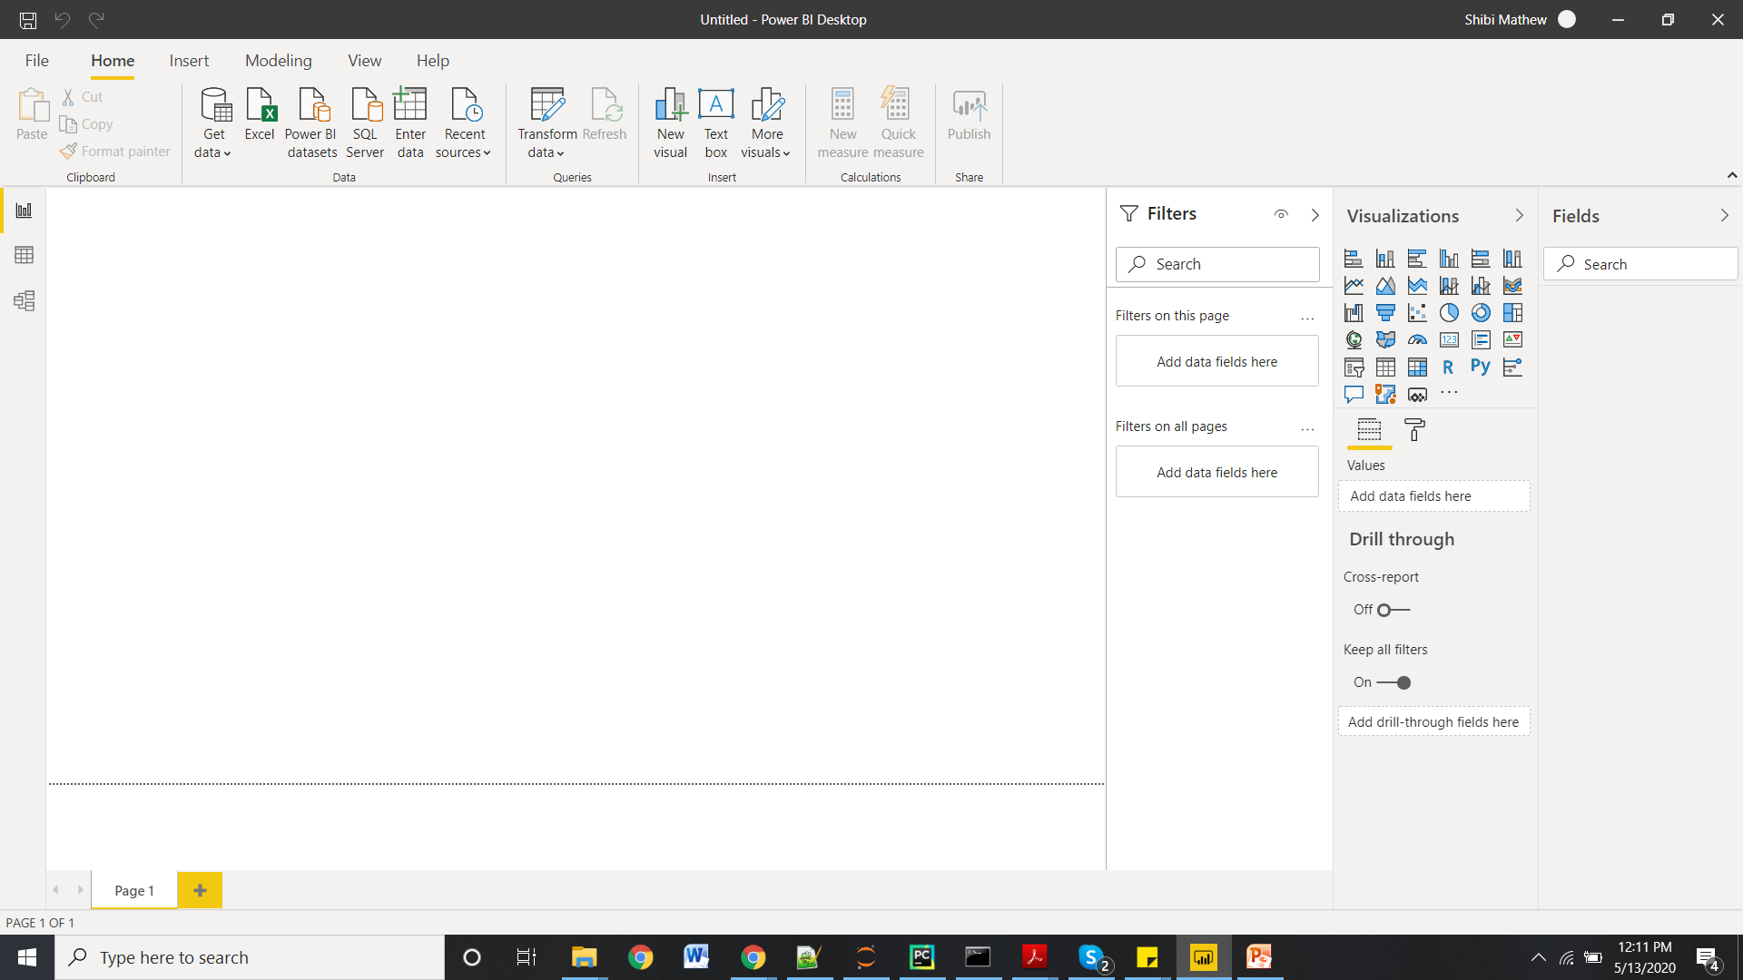
Report view page

Slide 3
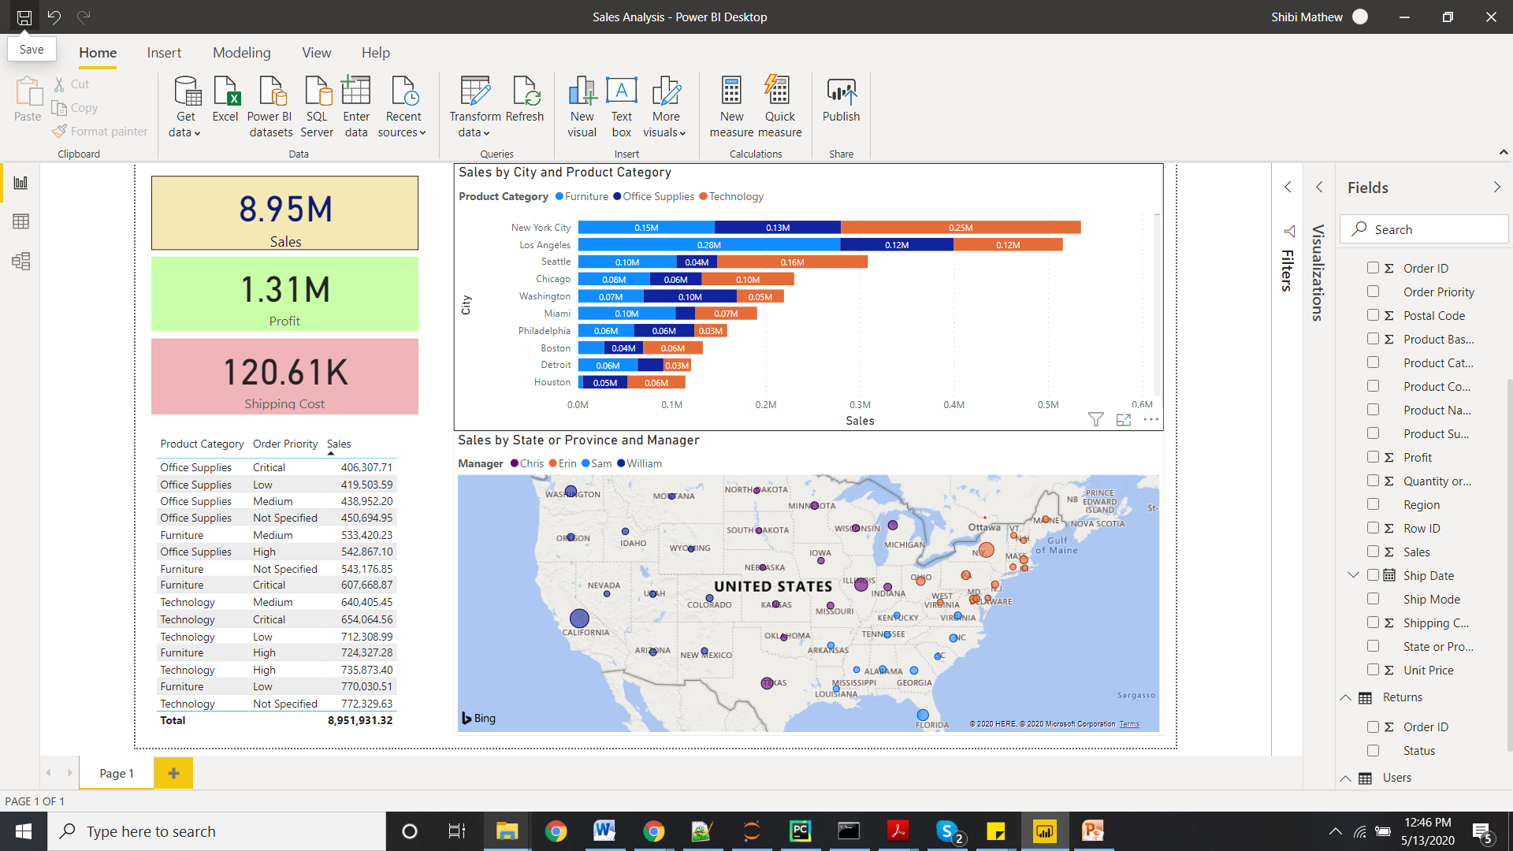
Report View

Slide 4
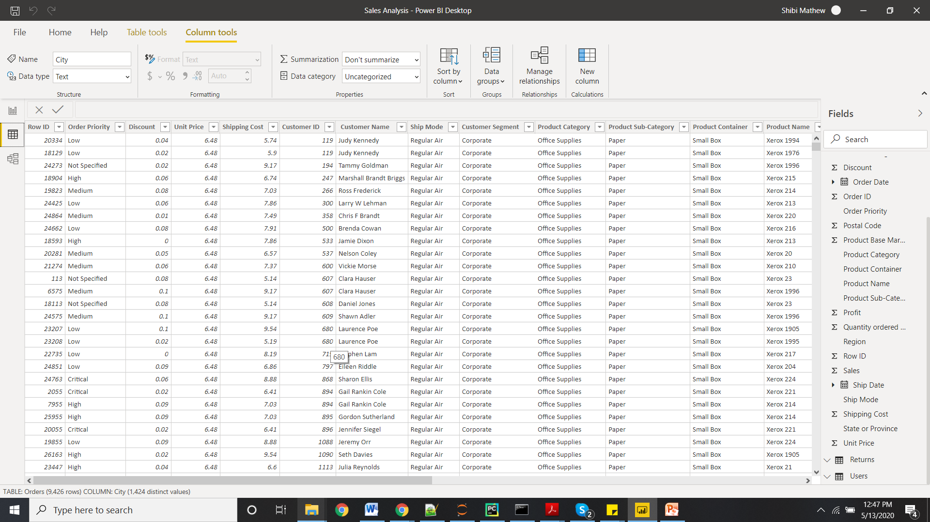
Data View

Slide 5
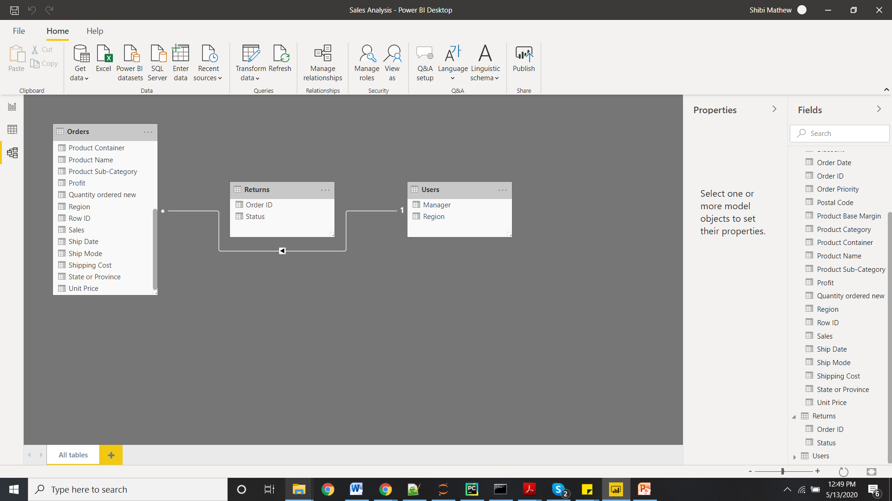
Model View

Slide 6
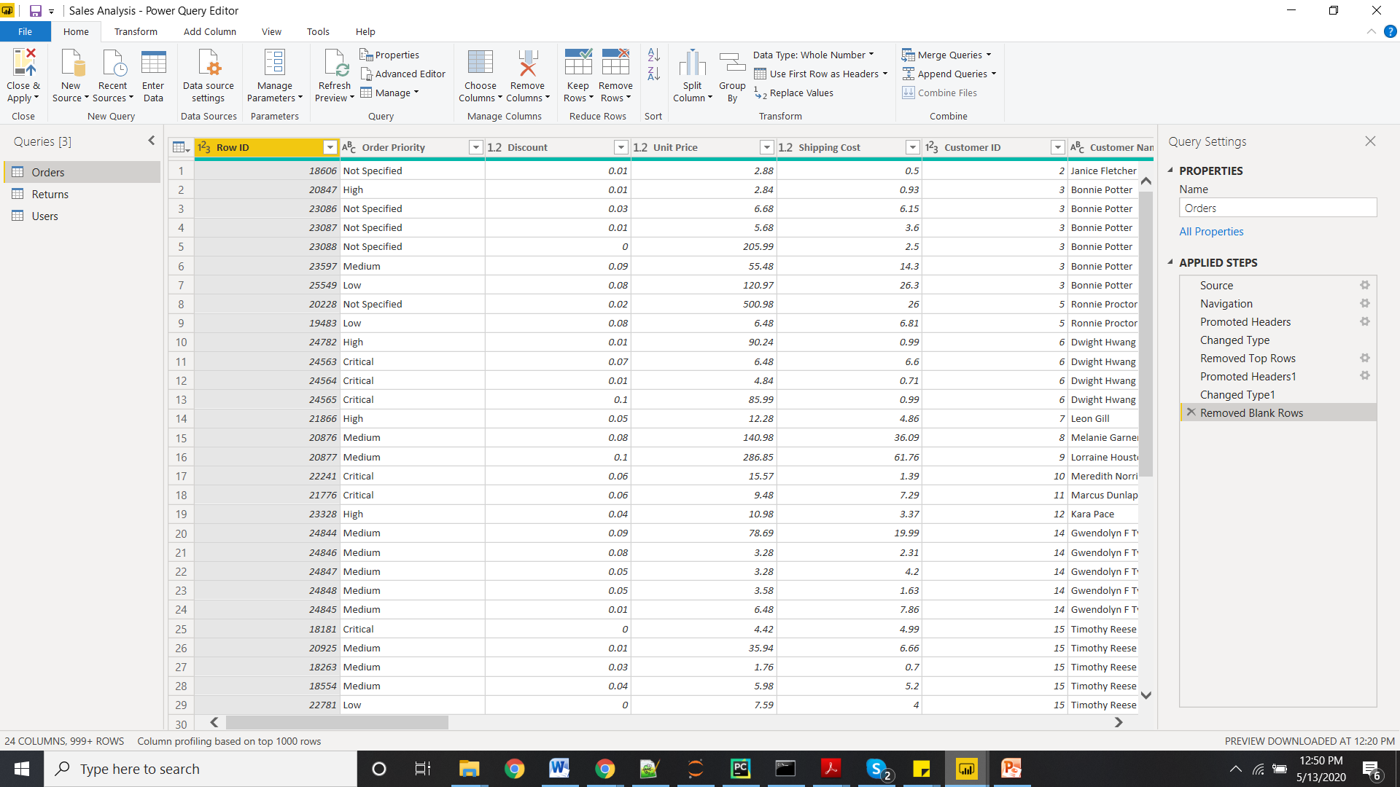
Power Query Editor

Slide 7
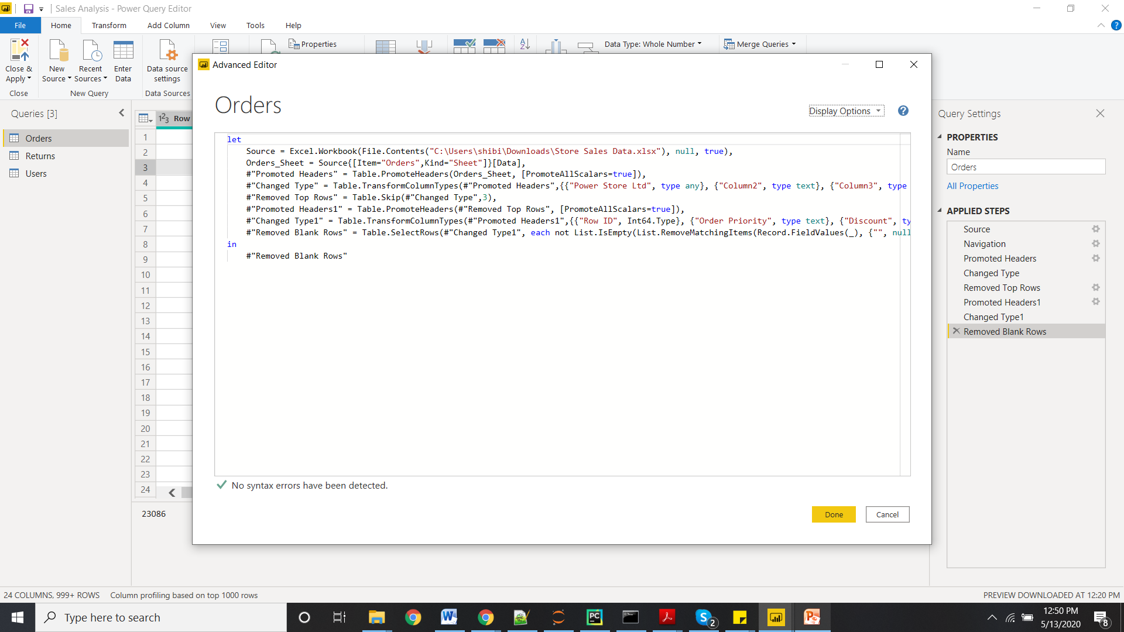
Advance Editor

Slide 8

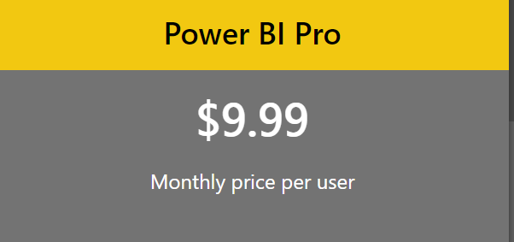
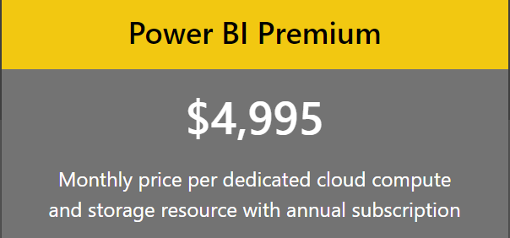
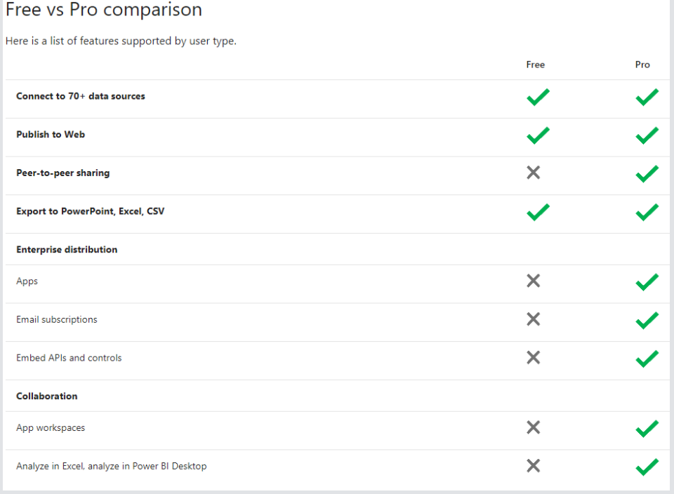
Power BI comes in three levels – Desktop, Pro, and Premium. The Desktop level is free for individual users, while the Pro plan costs $9.99 per user per month. The Premium plan starts at $4,995 a month per dedicated cloud compute and storage resource.

