Slide 1
MEDICAL SUPPLY CHAIN
Inventory Risk & Revenue Analysis
A Power BI Project
Submitted by
Shibla Nasreen

Slide 2
Introduction
Supply chain analytics helps organizations understand how products move from supplier to customer, and where risk, delay, or inefficiency enters that flow. In healthcare and medical retail, this matters even more directly — a stockout isn't just a lost sale, it can mean a delayed procedure or an unavailable treatment.
This project analyzes one year of transaction data from a medical and optical retail supplier, using Power BI to build an interactive dashboard that tracks revenue performance, flags at-risk inventory, and connects supplier lead time to business risk — turning 1,415 raw transaction records into a tool decision-makers can use.
By analyzing patterns such as revenue by category, stock levels against reorder points, and supplier lead time, the dashboard empowers inventory managers and decision-makers to prioritize restocking and reduce stockout risk with real, current data.
Medical Supply Chain: Inventory Risk & Revenue Analysis
2

Slide 3
Objectives of the Study
1
2
Identify revenue drivers
Quantify inventory risk
Which products, categories, and regions generate the most revenue — and why.
Which SKUs are below their reorder point right now, and how severe the shortfall is.
3
4
Connect risk to operations
Support real decisions
Whether supplier lead time is actually driving the High Risk classification, or unrelated.
Translate every chart into a specific, actionable recommendation — not just a number.
Medical Supply Chain: Inventory Risk & Revenue Analysis
3

Slide 4
Datasets
Two connected CSV files sourced from Kaggle
TRANSACTION LOG
PRODUCT CATALOG
Inventory_Transactions.csv
Product_Master_List.csv
1,415 rows • 9 columns
7 rows • 9 columns
One row per sale — order, date, product, quantity, location, staff, revenue, lead time, and risk level.
One row per product — description, category, supplier, cost, stock level, and reorder point.
Both files are joined by a shared SKU field — see "Connections Used" for details.
Medical Supply Chain: Inventory Risk & Revenue Analysis
4

Slide 5
Key Details
Inventory_Transactions.csv
Columns – 9 Rows – 1,415
Order_ID
Unique identifier for each transaction
Date
Calendar date the transaction occurred
SKU
Product code sold — links to Product_Master_List
Qty_Sold
Number of units sold in the transaction
Location
Region where the sale occurred (North/South/East/West)
Staff_ID
Optician who handled the sale
Revenue
Total gross sales amount for the order
Lead_Time
Days taken to restock/deliver for this order
Risk_Level
Assigned risk classification: Low / Medium / High
Medical Supply Chain: Inventory Risk & Revenue Analysis
5

Slide 6
Key Details
Product_Master_List.csv
Columns – 9 Rows – 7
SKU
Unique product code — links to Inventory_Transactions
Description
Plain-English product name
Category
Product type: Contact Lenses, Frames, Solutions, Surgical
Supplier
Company that supplies the product
Unit_Cost
Wholesale cost per unit to the business
Lead_Time_Days
Standard days to restock this product
Stock_Level
Current quantity in the warehouse
Reorder_Point
Threshold below which restocking is needed
Total_Value
Current stock value (Stock_Level × Unit_Cost)
Medical Supply Chain: Inventory Risk & Revenue Analysis
6

Slide 7
Connections Used
Inventory_Transactions
Product_Master_List
"many" side
1,415 rows
"one" side
7 rows
SKU
Each row references one
product via its SKU
Each SKU appears exactly
once, holding cost, stock,
and reorder details
One-to-many relationship, joined on SKU
One product in Product_Master_List can appear across many rows of Inventory_Transactions — this made it possible to enrich every sale with product-level context (cost, stock level, reorder point) without duplicating that data 1,415 times.
Medical Supply Chain: Inventory Risk & Revenue Analysis
7

Slide 8
Criterias Used
Chart types selected for each analysis
Revenue by Category
Clustered bar chart
Revenue trend across 2025
Line chart
Risk Level distribution
Donut chart
Stock Level vs Reorder Point by SKU
Clustered bar chart
Revenue by Location
Clustered bar chart
Average Lead Time by Supplier
Clustered column chart
Total Units Sold by Category
Clustered bar chart
Average Lead Time by Risk Level
Clustered column chart
Medical Supply Chain: Inventory Risk & Revenue Analysis
8

Slide 9
Criterias Used
KPI cards and slicers
KPI Cards
Slicers
Total Revenue
Category
Total Orders
Location
Total Stock Value
Month
High Risk %
KPI cards were used (instead of the Power BI "KPI" visual) because the dataset has no target/goal values — using the KPI visual would have required fabricating targets, which was avoided for data integrity.
Products Below Reorder Point
Medical Supply Chain: Inventory Risk & Revenue Analysis
9

Slide 10
Criterias Used
Key DAX measures written
Total Revenue
SUM(Inventory_Transactions[Revenue])
Total Orders
COUNT(Inventory_Transactions[Order_ID])
Total Stock Value
SUM(Product_Master_List[Total_Stock_Value])
High Risk %
DIVIDE([High Risk Orders], [Total Orders])
Products Below Reorder Point
CALCULATE(DISTINCTCOUNT(SKU), Stock_Level < Reorder_Point)
Inventory Status (column)
IF(Stock_Level < Reorder_Point, "Need Reorder", "Healthy Stock")
Medical Supply Chain: Inventory Risk & Revenue Analysis
10

Slide 11
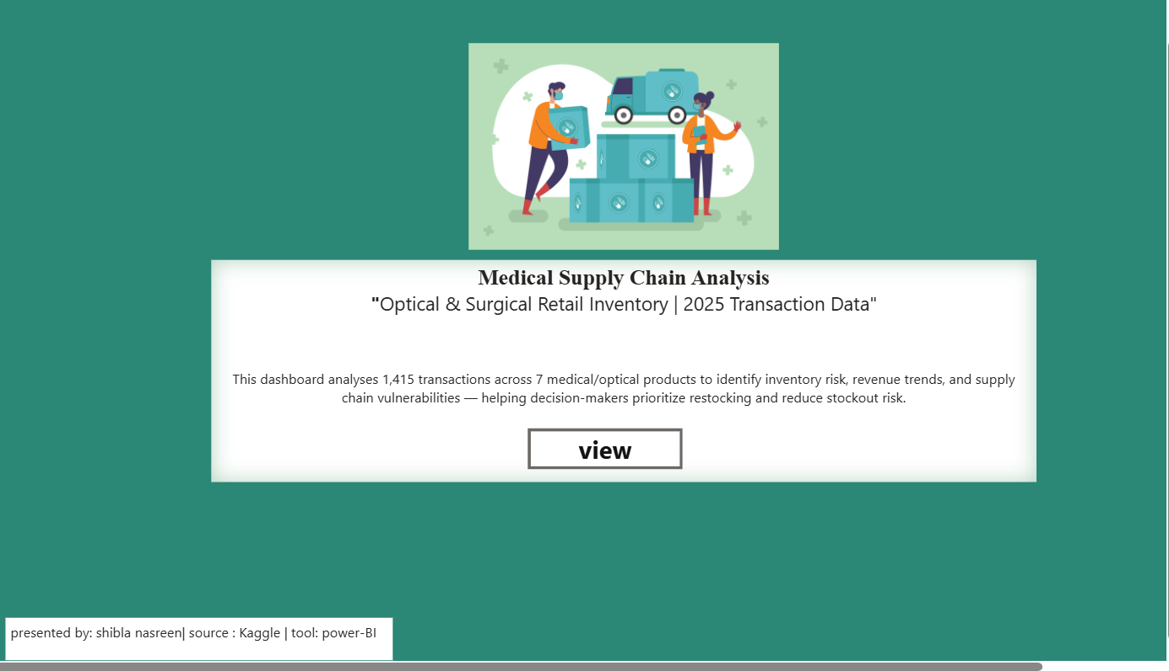
Dashboard
Landing page
Medical Supply Chain: Inventory Risk & Revenue Analysis
11

Slide 12
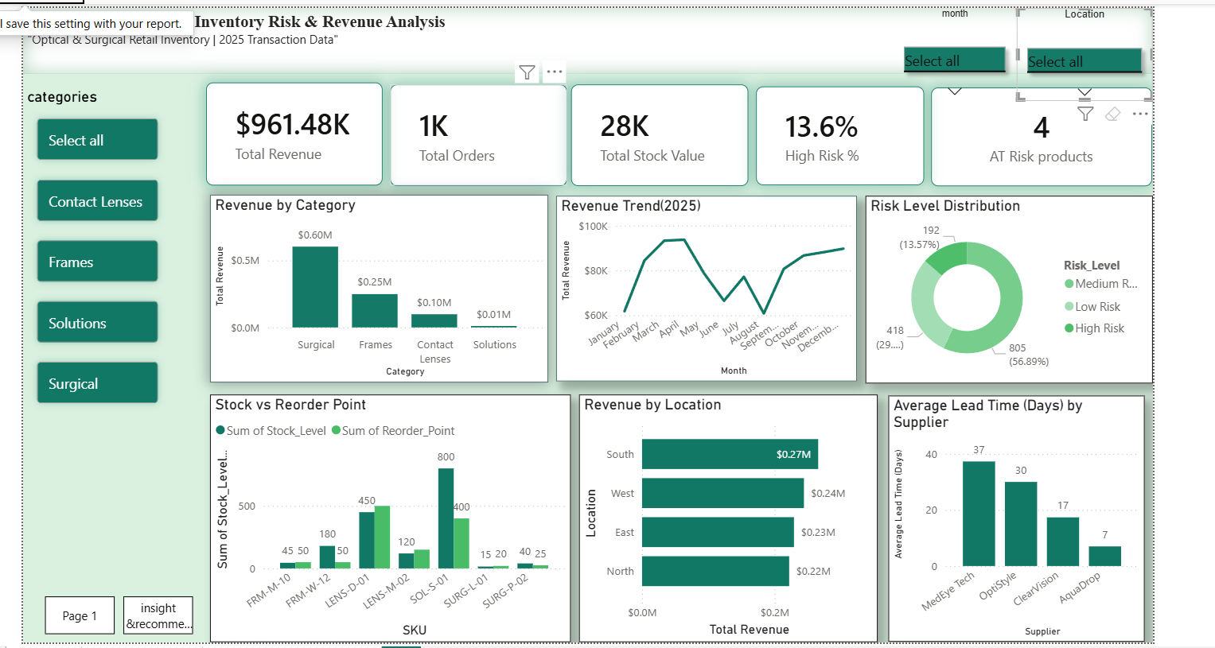
Dashboard
Overview page
Medical Supply Chain: Inventory Risk & Revenue Analysis
12

Slide 13
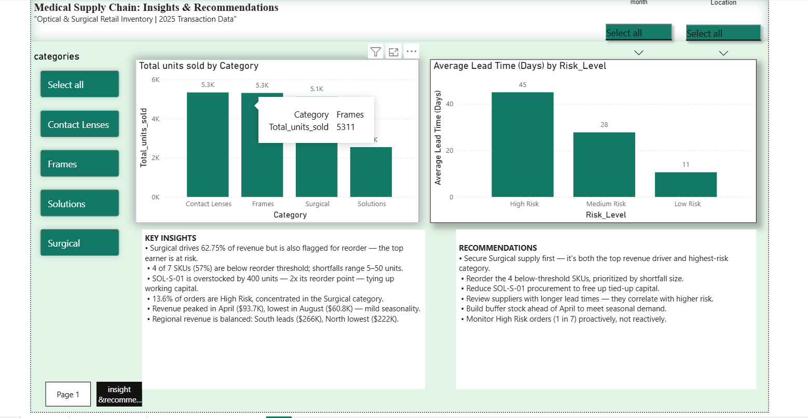
Dashboard
Insights & recommendations page
Medical Supply Chain: Inventory Risk & Revenue Analysis
13

Slide 14
Conclusion
1
Surgical products drive 62.75% of total revenue but are also flagged for reorder — the business's top revenue source carries meaningful risk.
2
4 of 7 SKUs (57%) are currently below their reorder threshold; one SKU is overstocked by 400 units.
3
High Risk orders average 45-day supplier lead times — 4x longer than Low Risk orders — confirming a direct link between delay and risk.
4
Revenue shows mild seasonality, peaking in April and dipping in August, with fairly balanced performance across all four regions.
Medical Supply Chain: Inventory Risk & Revenue Analysis
14

Slide 15
Suggestions
What the business should do next
1
Secure Surgical supply first — it's both the top revenue driver and the highest-risk category.
2
Reorder the 4 below-threshold SKUs, prioritized by shortfall size.
3
Reduce procurement for the overstocked SKU to free up tied-up working capital.
4
Review suppliers with longer lead times — they correlate directly with higher risk.
5
Build buffer stock ahead of April to meet the seasonal demand pattern.
6
Monitor High Risk orders (1 in 7) proactively, not reactively.
Medical Supply Chain: Inventory Risk & Revenue Analysis
15

Slide 16
References
Dataset source
Kaggle — Medical Supply Chain and Inventory Risk Analysis
kaggle.com/datasets/nevinfritsch/medical-supply-chain-and-inventory-risk-analysis
Visualization tool
Microsoft Power BI Desktop
Medical Supply Chain: Inventory Risk & Revenue Analysis
16

Slide 17
Thank you
Shibla Nasreen •

