Slide 1
Marketing Environment
Unit2

Slide 2

Environment
The term "environment" generally refers to the surrounding conditions and influences that affect the existence, development, and behavior of living organisms or systems. It encompasses all external factors, both living and non-living, that interact with a community, or an ecological system. The environment can be considered at various scales, from the immediate surroundings of an individual organism to the broader planetary context.
The environment of an organization refers to the array of external and internal factors that influence its operations, decision-making processes, and overall performance. These factors shape how an organization functions, competes, and adapts to changes. The organizational environment can be broadly categorized into the internal environment and the external environment.

Slide 3

Marketing Environment
The marketing environment refers to the external and internal factors that influence an organization's marketing activities. These factors shape the way companies interact with their customers and manage their marketing strategies. Understanding the marketing environment is crucial for businesses to effectively plan and implement marketing strategies that can adapt to changes and capitalize on opportunities.
“A company’s marketing environment consists of the actors and forces outside of marketing that affect marketing management ability to build and maintain successful relationships with target customers”. – Philip Kotler

Slide 4
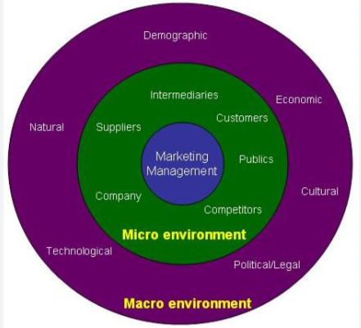
There are several factors which affect a firm. All the factors which affect the operations of a firm are known as marketing environment. Few of these factors can be controlled by the firm but not all. To deal with these factors, firm must understand their market environment. so that positive and negative factors would be managed accordingly.

Slide 5
The marketing environment encompasses all the forces and factors, both internal and external, that affect a company's ability to establish and maintain successful relationships with target customers. These factors can either provide opportunities or pose threats to the organization.
Generally, marketers attempt to predict future changes by analyzing the marketing environment. These changes could present both challenges and opportunities for the firm. With the help of these changes, marketers keep changing their strategies and plans. Besides, the marketing team of an organization must stay informed about the marketing activities of the competitors as it is essential for the long-term success of the firm.

Slide 6
Importance
The marketing environment is a critical concept in marketing management that involves analyzing both the internal and external factors influencing a company's marketing strategies. It helps businesses to navigate the complexities of the market, adapt to changes, and maintain a competitive edge.
Strategic Planning: Helps in identifying opportunities and threats, allowing companies to adjust their strategies accordingly. For instances opportunities, threats, adaptation etc.
Customer Insight: A deeper understanding of the environment helps businesses to meet customer needs more effectively. For instance, market research, customization, customer satisfaction etc.

Slide 7
Competitive Advantage: By staying aware of changes in the environment, companies can anticipate and respond to competitors' actions. For instance, benchmarking, innovation, differentiation etc.
Risk Management: Awareness of potential risks in the environment enables companies to develop contingency plans. For instance, identification of risk, preparedness, resilience etc.
A thorough understanding of the organizational environment is vital for strategic planning, gaining customer insight, achieving a competitive advantage, and managing risks. These elements collectively contribute to a company's ability to navigate the complexities of the market, capitalize on opportunities, and ensure long-term success.

Slide 8
Features
The marketing environment is characterized by several key features that shape the way organizations plan and implement their marketing strategies. Understanding these features is crucial for businesses to navigate effectively within their market and adapt to changes. Here are the main features of the marketing environment:
Dynamic: The marketing environment has a dynamic and ever-changing nature. Environmental factors influence the operation of a company, as a result, the organization’s form and character continue to keep changing. For instance, technological advancements, changes in consumer preferences, and economic fluctuations. Organizations must be flexible and adaptive to keep up with these changes and maintain their market position.

Slide 9
Complexity: The marketing environment is composed of several factors that are interrelated and interdependent. This makes the environment complex to understand. Even a small change in one aspect has an immediate impact on the other. The interdependence between these components varies depending on the situation. Therefore, it becomes extremely difficult to predict the environment. For instance, economic, social, technological, and political elements, making it complex to analyze and understand. It involves both the microenvironment (immediate factors) and the macroenvironment (broader forces), adding to its complexity.
Relevance: The marketing environment of a business has an impact on its marketing decisions. Thus, every element of the marketing environment must be considered by a marketer when making an ideal choice. Simply, a marketing programme cannot be developed or successfully implemented without considering the marketing environment.

Slide 10
Uncertainty: The nature of market factors is uncertain, so they can not be predicted accurately. A good marketer is continually working to predict various factors and develop effective strategies over time. But since they change fast, certain factors are difficult to predict in advance. This is also because of the fact, that technology and fashion have changed more often recently than ever before.
Storehouse of Opportunity: Marketing not only offers a threat to the company, but it also provides new opportunities. Discovering these opportunities is challenging. Only a skilled and effective marketer can appropriately spot these opportunities. The marketing manager should continuously watch and study the environment to uncover these opportunities. Successful businesses take opportunities and get rid of threats.

Slide 11
Sensitive to a Variety of Factors: The marketing environment is highly sensitive to a variety of factors. These factors may include the mindset or preferences of the consumer, the rising market demand for goods or services, changing marketing trends, etc. This atmosphere is highly sensitive to these aspects in the marketing field. The success of marketing primarily depends on the satisfaction of customers. For this, marketers need to know how consumer needs, tastes, and preferences change constantly. As a result, marketing organizations must be highly sensitive to consumer needs, desires, and demands.
The marketing environment is dynamic, complex, and influenced by a multitude of internal and external factors. Organizations must be adaptable, customer-centric, and strategically savvy to successfully navigate and thrive in this environment.

Slide 12

Thank you

