Slide 1
Targeting
Unit 5

Slide 2

Market Targeting
A target market consists of different groups of individuals, households, and organizations towards which a company aims to offer its products and services. Businesses can create and implement effective marketing strategies once they know about the needs and preferences of specific clients. It increases sales revenue and market share of the brand.
Target market segmentation involves dividing the larger market into smaller, more specific segments based on characteristics such as demographics, psychographics, and behavior. Understanding the target market helps businesses connect with potential customers who are most likely to be interested in their offerings. It's the first step in building a loyal customer base.

Slide 3
Key Takeaways
Businesses must segment consumer groups based on geography, demography, psychography, and purchasing behavior to target a potential market. Even the best marketing efforts will fail and cost, time and money to the company if it does not articulate markets. Consumer research and limited product offerings are common ways for brands to evaluate the market and consumer behavior before launching.
A target market is a specific market segment consisting of different groups of individuals, households, and organizations with select product preferences and budgets and to whom a company wants to offer its goods and services.
It enables businesses to develop and implement effective marketing plans, acquire new clients and expand in new markets, resulting in increased sales revenue and market share of brands.

Slide 4
Brands commonly use consumer surveys, market research, competition analysis, and limited product offerings to assess the market and consumer behavior before launching.
Geographic, demographic, psychographic, and buying habits are examples of target market segmentation.
Target markets are segments of potential customers willing to spend money on products and services. In addition, each customer has a specific product choice and budget. Therefore, the company matches consumer demands with its offerings and develops marketing strategies accordingly. It, thus, enables a business to acquire new clients and expand in new markets, making it a profitable segment.

Slide 5

Example of Target Market
Let’s examine how big brands and businesses define and use their target markets in marketing. Nike Target Market: Nike sells equipment, apparel, shoes, and accessories to athletes and sports enthusiasts. Their products are of high quality and last longer, so their prices are high enough that only those with disposable income can afford them. They specifically target young aspiring runners and athletes, two groups of people who need to be motivated to continue pushing themselves beyond their normal limits. Nike targets these groups by creating motivational ads, campaigns, and posts that appeal to their target market’s motivation to pursue a win.

Slide 6
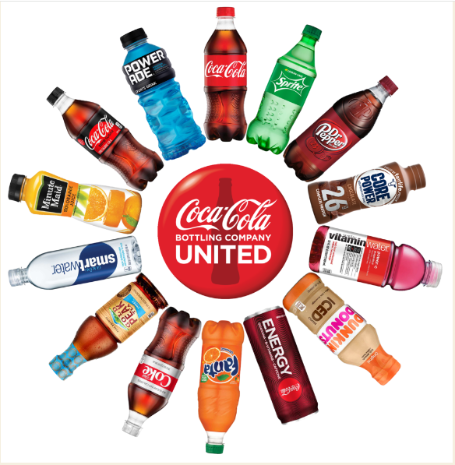
Coca-Cola Target Market: Coca-Cola’s targeting strategy is broader due to its global market presence and the various products they offer. But their primary target market is younger customers between 10 and 25 years old, and a secondary market of people between 25 and 40 years old. The company targets regular cola drinks for people who desire an intense flavor. Meanwhile, diet cola drinks and their variants cater to health-conscious customers. Coca-Cola has also expanded its product line to include non-cola beverages to appeal to those who don’t enjoy its traditional cola drinks. For example, Sprite is specifically designed to target college students and teens, while others target the young working group.

Slide 7
The target market for TATA NANO is people who want to shift from scooters/motorbikes to cars and people with low and medium family income. On the other hand, target market for Mercedes or BMW are those who are looking to travel in luxury. The same product can cater to the needs to different types of target markets. Laptops can cater to the needs of the professionals or businessman for work and can be used for youth for entertainment. Thus, ensuring that the correct target market is identified is important for any business.
Your marketing strategy starts with determining your business’s primary target market and defining specific audiences. This will empower you to understand whom you’re selling to and their buying journey. This, in turn, enables you to tailor your messaging and offer specifically to their needs, maximizing the chances of conversions and sales.

Slide 8
Segmentation Evaluation
The target markets involves the examination of various aspects and measures of a market segment in comparison to the firm’s goals and resources. Typically, the firm assesses whether this target market logically fits with the firm’s strategic direction, whether it is the best use of its resources, and to what degree with a firm be able to successfully compete in the segment. The following main factors that are considered when evaluating potential target markets:
Segment size and growth: When a company looks at different market segments, it needs to check how big each segment is, how fast it's growing, and how profitable it could be. However, what's "right" for one company might not be right for another. For example, a large and fast-growing segment might seem attractive. But if a smaller company doesn't have the resources to compete with bigger companies in that segment, it might struggle. Instead, this smaller company might do better by focusing on a smaller, less competitive segment where it can be more successful.

Slide 9
Let’s assume there are two market segments for a new type of Health Drink:
Segment 1: Young Adults (18-25 years old)
Large segment with high growth.
Many big companies are already targeting this segment.
Segment 2: Senior Citizens (65+ years old)
Smaller segment with moderate growth.
Few companies are targeting this segment.
A small health drink company might choose to focus on the senior citizen's segment. Even though it's smaller and not growing as fast, there's less competition. The company can tailor its products and marketing specifically to the needs of seniors, potentially leading to higher profitability and a stronger market presence in that segment.

Slide 10
Segment Structural Attractiveness : When deciding if a market segment is attractive, a company needs to look at some important factors that can affect long-term success: Competition: If a segment already has many strong competitors, it might be hard to succeed. Substitute Products: If there are many other products that can replace yours, it can be hard to keep prices and profits high. Buyer Power: If buyers have a lot of power, they can push prices down and demand more, which reduces your profits. Supplier Power: If suppliers have a lot of control, they can raise prices or lower the quality of what they provide, which can hurt your business. For instance: Let us assume a company that makes eco-friendly packaging and is looking at two segments: First segment: Large Corporations; Competition: Many big packaging companies are already competing here. Substitute Products: There are many alternative packaging solutions. Buyer Power: Large corporations have strong bargaining power and can demand lower prices and better services. Supplier Power: Suppliers might control prices or quality since they know big companies need a lot of materials.

Slide 11
Second segment: Small Local Businesses
Competition: Fewer competitors in this niche.
Substitute Products: Fewer alternatives specifically for eco-friendly solutions.
Buyer Power: Small businesses have less bargaining power compared to large corporations.
Supplier Power: Suppliers might be more flexible because the demand from small businesses is lower.
The company might find the small local businesses segment more attractive because there's less competition, fewer substitutes, and buyers and suppliers have less power over them. This can lead to better prices and higher profits.

Slide 12
Organizational objective and resources: When a company is considering entering a market segment, it must also think about its own goals and resources. Even if a segment looks promising in terms of size, growth, and structure, it might not be the right fit if it doesn't align with the company's long-term objectives or if the company doesn't have the necessary skills and resources to succeed. For instance, the luxury carmaker BMW, let us imagine the economy segment of the automobile market is large and growing due to current economic conditions. However, BMW specializes in luxury and performance cars. Entering the economy car market would not align with BMW's long-term goal of being a premium brand. Additionally, BMW might not have the necessary resources or expertise to compete effectively in this segment, which focuses on affordability and efficiency.
Instead, BMW should focus on segments where it can offer superior value to customers and outperform competitors, such as the luxury and performance car segments. This strategy ensures BMW remains true to its brand and leverages its strengths effective.

Slide 13
Segment Selection
After evaluating market segments, the suitable market segments should be selected to enter there. Analysis of market segments, market coverage, ethical considerations, inter-segment relationship etc. also should be considered for the selection of suitable market segments.
Market Segment Analysis: At first market segments should be analyzed for selecting the best market. While analyzing the market segments, their size, growth rate and long-term profitability should be studied carefully. Besides this, weak and strong aspects of present and possible competitors should also be studied and analyzed. Information about possible market mix, possible total demand, weak and strong aspects of competitors, opportunities and threats of market segments, brand loyalty of customers, means and resources necessary to face threats in the market segments etc. should be collected and analyzed. Only then the selection of market segment becomes effective.

Slide 14
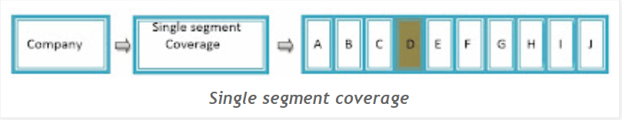
Market Coverage: Market coverage plays a vital role to select the best market segment. Alternatives of market coverage are as follows:
Single segment coverage: Single market segment coverage is market centered strategy. Under this strategy, a company selects only one market segment and prepares marketing mix for this.
In the above example, the company has taken single segment coverage and has selected only one market segment D from A – J segments. Adopting such centralized strategy the company gets both benefits and loss. Its positive aspects are achievement of specialization in market segment, effective marketing mix, increase in reputation/goodwill etc. whereas no distribution of risk, not to be able to go to more attractive market segment from less attractive segment etc. are its negative aspects

Slide 15
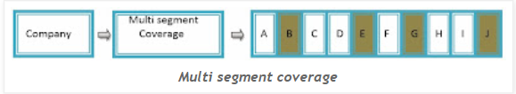
Multi segment coverage: In this alternative, a company selects two or more segments at a time and prepares separate market strategies accordingly. This strategy helps the company to distribute risk in different market segments. In this, the company becomes successful to promote sale and earn profit. While adopting multi segment coverage, it becomes easy for the company to go to more attractive segment from less attractive ones. But this strategy is more expensive. Preparing separate strategies for each marketing mix becomes costly.
In the above example, the company has taken multi segment coverage alternative and has selected several market segments – B, E, G and J.

Slide 16
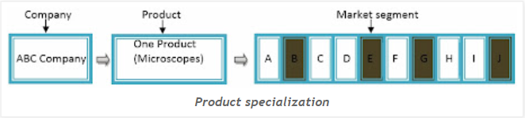
Product specialization: In this alternative, the company sells one types of product in several market segments. In other words, the company supplies only one kind of product to many market segments. The company uses slightly different marketing mix for each market segment. While adopting such strategy, the company can achieve specialization in one product. Marketing mix can be changed in less expense and risk is distributed in different segments.
From the above example, ABC Company has supplied the single product that is microscope in different segments for sale.

Slide 17
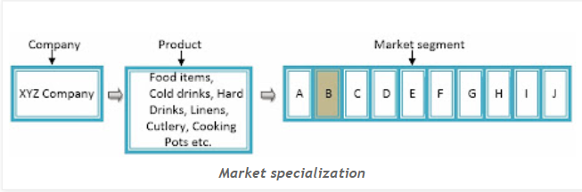
Market specialization: In this alternative, the company selects only one market segment and deals with different types of products by specializing in them. While adopting such strategy, goodwill of the company can be increased but the market cannot be expanded depending on only one market segment.
The above example has adopted market specialization strategy because XYZ company has supplied different types of goods to only one market segment that is B, or only those products which are used in hotels according to the nature of products.

Slide 18
Full market coverage: Under the full market coverage, one company selects all the market segments as far as possible and deals with all the products under one line. For example: Nepal Bottlers Company has been selling its products in all market's segments. Similarly, IBM has adopted the strategy of full market coverage. The Coca-Cola Company is a prime example of a company employing a full market coverage strategy. Nepal Telecom, the largest telecommunications company in Nepal, employs a full market coverage strategy by offering a wide range of services to cater to different customer segments. Ncell, Unilever Nepal, Himalayan Java, Bajeko Sekuwa, Shree Airlines etc.

Slide 19
Ethical consideration: While selecting a best market segment, the interest of the society and customers also should be considered. No any harm should be made to society, customers and nation. So, a company should not consider profit only, it should be careful about ethical aspects also. Social responsibility should be given priority and social audit should be done. For instance, fair labor practices, ethical marketing, environment sustainability, data privacy and protection etc.
Inter-segment relationship: While selecting market segment, inter-segment relationship should be maintained in performance and technical aspects through this relationship cost can be minimized by using same technology, same production process and same distribution channel. For instance, Disney leverages inter-segment relationships across its various entertainment and media segments to create a powerful and integrated brand experience. P&G, Microsoft, Amazon etc. These examples illustrate how inter-segment relationships can create value by leveraging synergies across different parts of a business, enhancing customer experiences, driving sales, and improving operational efficiencies.

Slide 20

Thank you

