Slide 1
Finding App
(Developed using Flutter and Django)
Presented by: …………

Slide 2
1. Introduction
Learners can find the tutors more specifically nearer to them through this app .
Proposed App
It consists of three actors.
- Student - Tutor -Admin
i) Student
- Login.
- Search(Class and Subjects)
- View Tutor Details.
- Request for Enrollment.
- View Requested Enrollment Status(mail and dashboard).
- View Enrollment History.
- Edit Profile.
- Reset Password.

Slide 3
Tutor
- Login.
- Add and Update details(profile and teaching details).
- Add time slots.
- View Requested Enrollments.
- Accept/Reject Enrollments.
- View notification from admin.(if any).
- Reset password.
Admin
- Login.
- Add tutors.
- Verify Registered tutors.
- Notify Tutor.
- Reset password.

Slide 4
2. Problem Statement
Depending on the location and subject, it becomes difficult to find qualified and experienced tutor.
One who is willing to teach tuition , it becomes hard to find students.

Slide 5
3. Objectives
To show the nearest tutor location on map based on the search parameters grade and subjects.
To provide details to students about their enrollment request status through email.

Slide 6
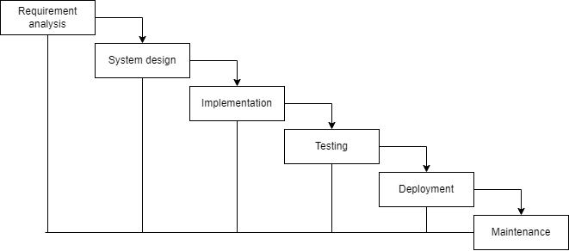
Methodology
Fig:Iterative Waterfall Model

Slide 7
System Analysis
Functional Requirements
It defines functioning or behavior of the system.
Register/Login to the Tutor App with valid email and password.
User can search for tutor .
Student can proceed for enrollment request.
Student can view enrollment history and enrollment request status can be received in email.
Tutor can view the requested enrollments and can accept/reject it.

Slide 8
Non-Functional Requirements
It defines the criteria according to which the system must work.
Availability
Security
Usability
Feasibility Study
Technical feasibility
Economical feasibility
Schedule

Slide 9
Weeks Work | 1 | 2 | 3 | 4 | 5 | 6 | 7 | 8 | 9
Planning
Analysis
Data Modelling
Process Modelling
Database Implementation
Coding
Testing
Documentation
Fig: Gantt Chart

Slide 10
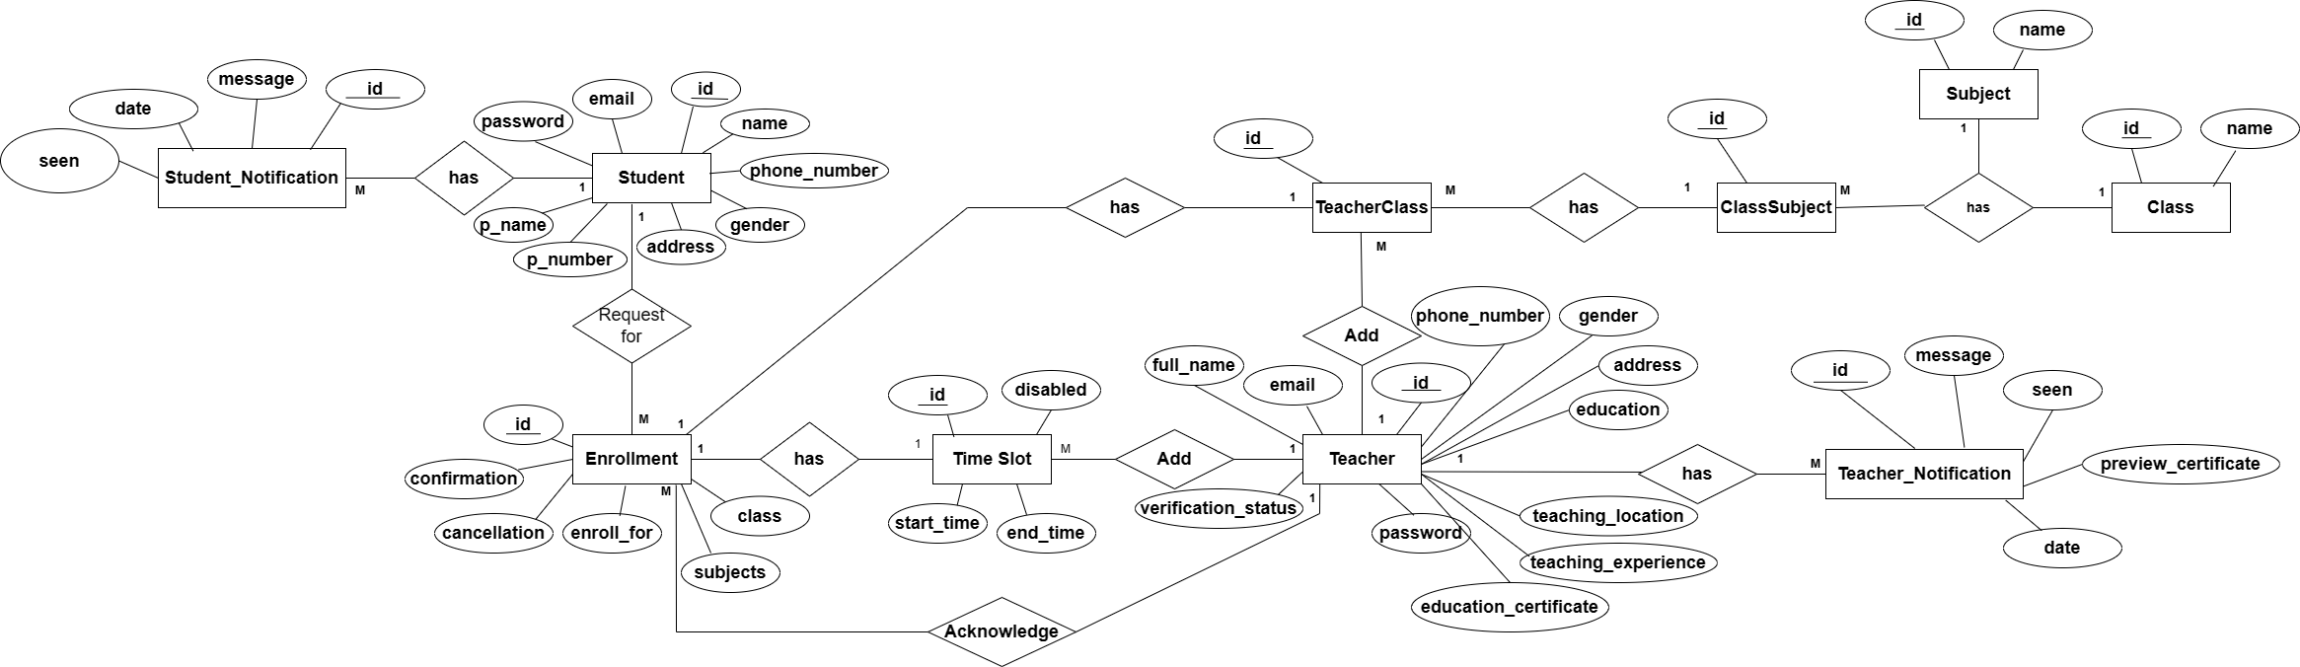
Data Modelling
Fig: ER Diagram

Slide 11
Relations
Teacher (id(PK),…)
Class (id(PK),…)
Subject (id(PK),…)
ClassSubject (id(PK), class_id(FK), subject_id(FK))
TeacherClass (id(PK), teacher_id(FK), class_subject_id(FK))
TimeSlot (id(PK),teacher_id(FK))
TeacherNotification (id(PK),teacher_id(FK))
Student(id(PK))
Enrollment(id(PK),student_id(FK),teacher_id(FK))
StudentNotification(id(PK),student_id(FK),teacher_id(FK),enrollmet_id(FK))

Slide 12
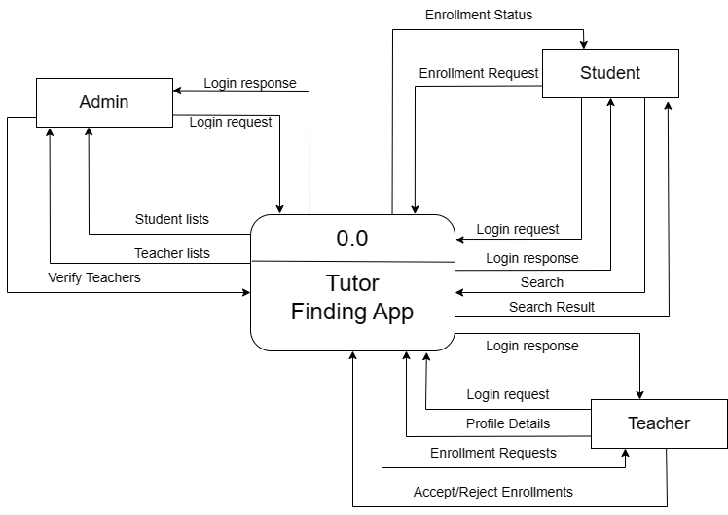
Process Modelling -Logical DFD
Fig: Context Diagram

Slide 13
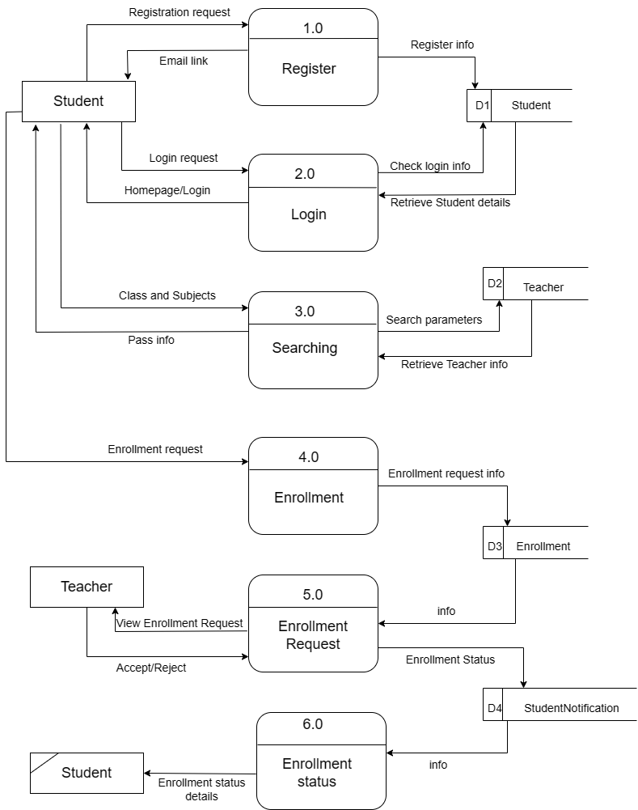
Process Modelling
Fig: Level 1 DFD

Slide 14
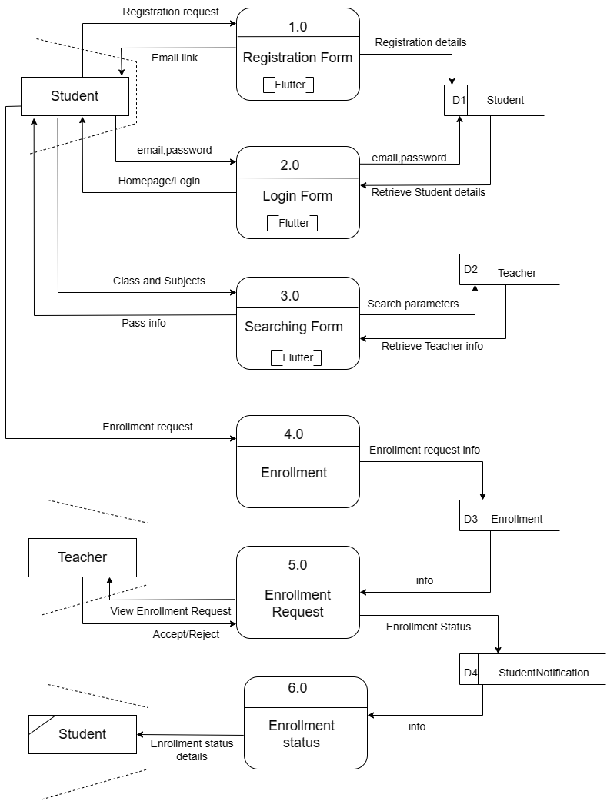
Process Modelling -Physical DFD
Level 1 DFD of Tutor Finding App

Slide 15
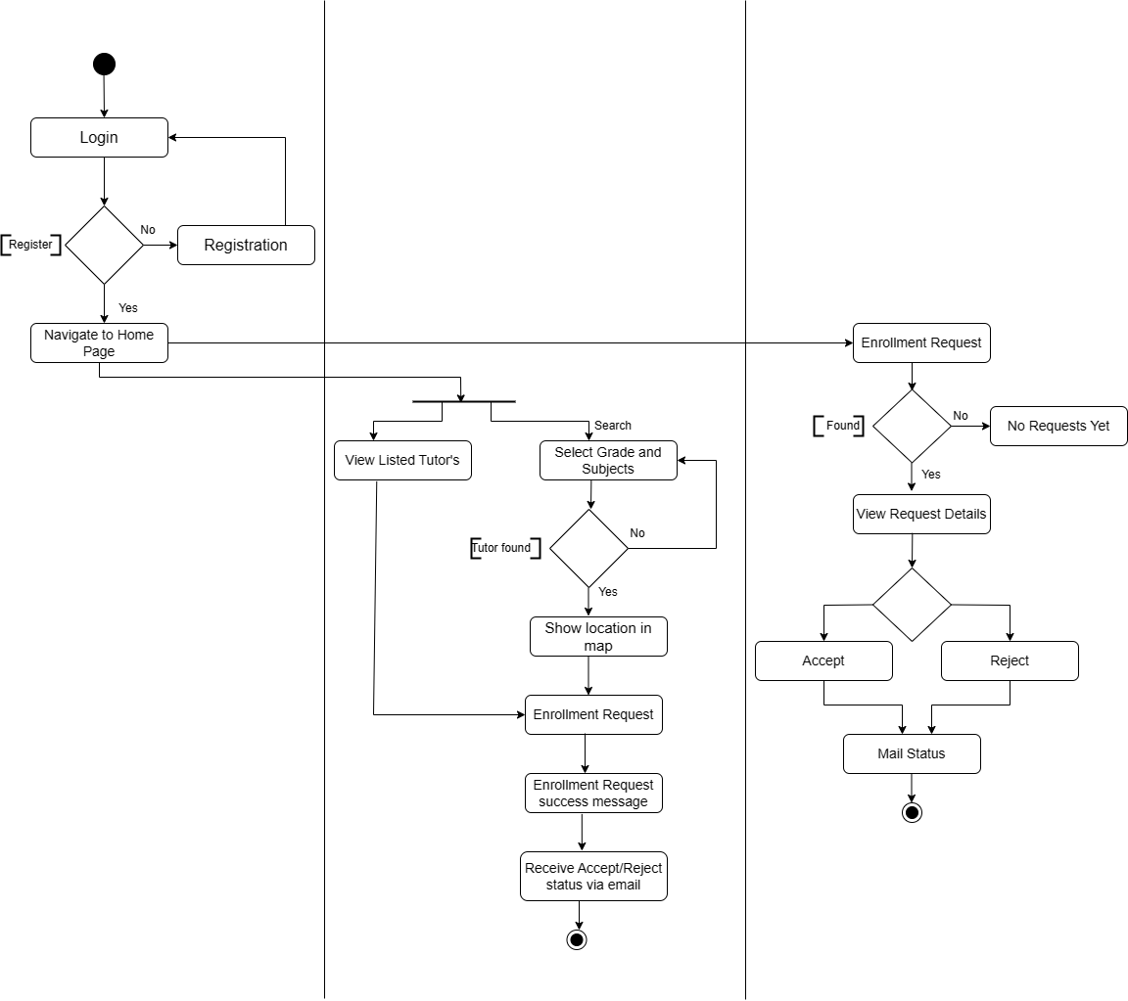
Process Modelling
Student
Tutor
Fig: Activity Diagram

Slide 16
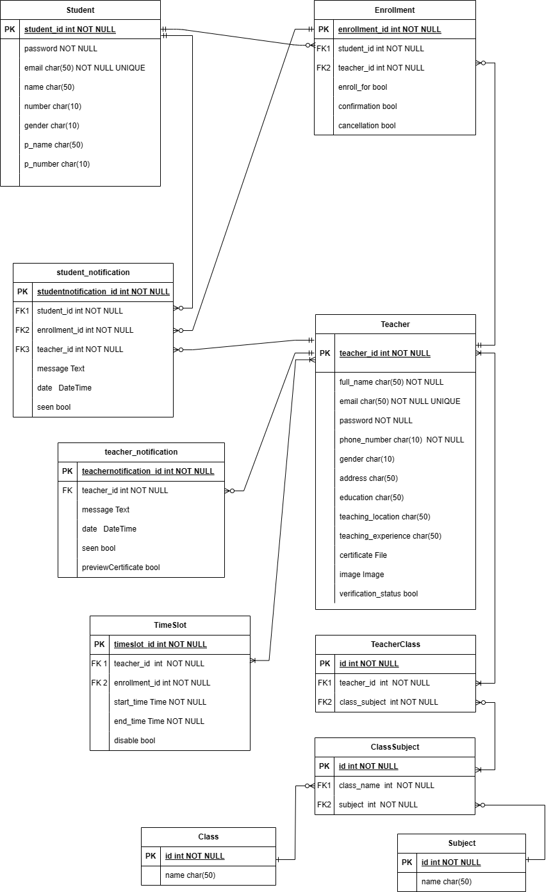
Database Schema Design

Slide 17
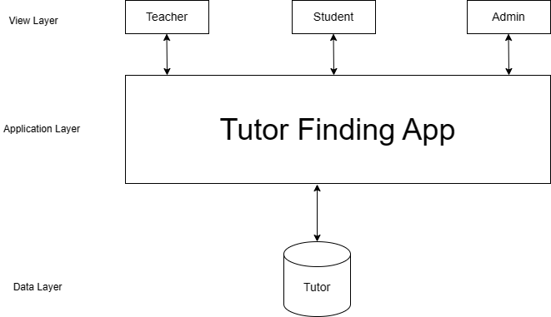
Architectural Design
Fig: Architectural Design

Slide 18
Algorithm Used
Haversine formula
Haversine formula determines the great circle distance (i.e., the shortest distance) between two points on sphere, such as the earth. It is based on the law of haversines, which relates the sides and angles of a spherical triangle. To calculate the great circle distance between two points it uses the central angle between the two points.
Code snippet:
def calculate_distance(lat1,lon1,lat2,lon2):
R = 6371.0
dlat = radians(lat2-lat1)
dlon = radians(lon2-lon1)
a = sin(dlat/2)**2+cos(radians(lat1))*cos(radians(lat2))*sin(dlon/2)**2
c = 2*atan2(sqrt(a),sqrt(1-a))
distance = R*c
return distance

Slide 19
System Implementation and Testing
1.Implementation Tools and Technologies used.
Case tools:
Draw.io
Balsamiq
API Testing Tool: Postman
Programming languages
Front End Tool: Flutter
Backend Tool: Django

Slide 20
Testing
Unit Testing
System Testing
Unit Testing:
- Registration form
- Login form
- Algorithm
- Enrollment Form
System Testing:
- Proceeding for Enrollment

Slide 21
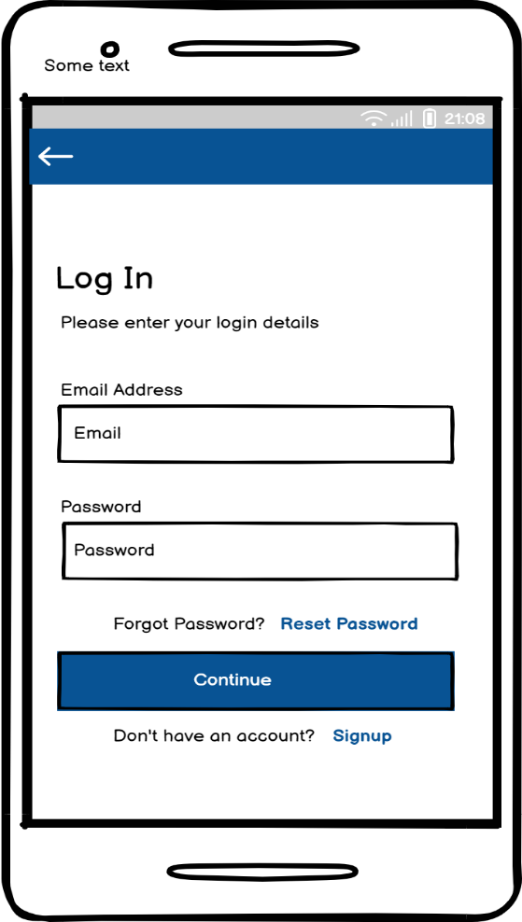
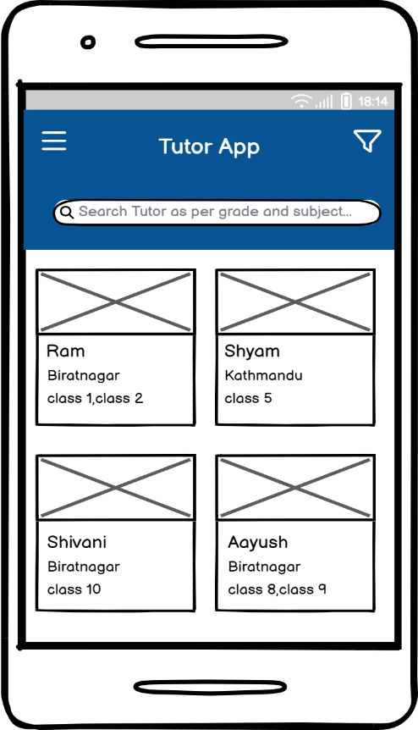
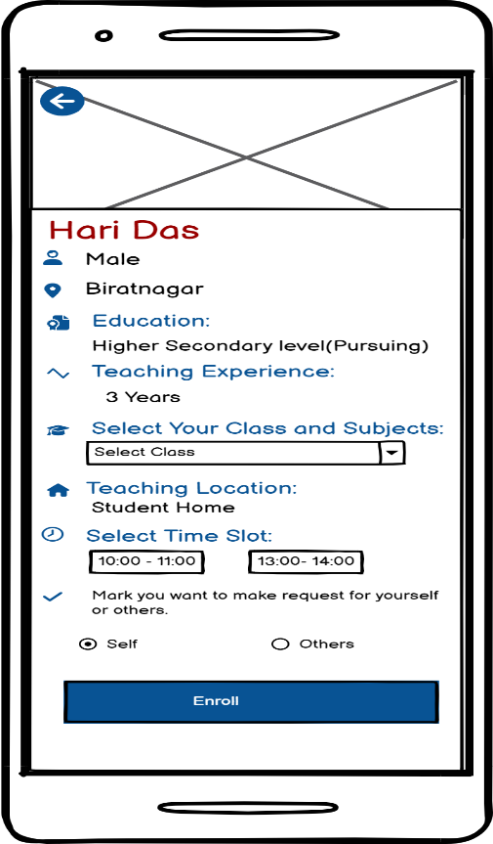
Interface Design
Login Page UI
Home Page UI
Tutor Detail Page UI

Slide 22
Limitation
For particular time slot, only one student can be enrolled.
No online teaching and payment feature.
Future Enhancement
Communication establishment (Online teaching).
To add Payment.
Push Notification.
Manage Time Slot.

Slide 23
References
[1] | J. B. Barbosa , A. V. Dinagsao and A. M. V. M. Calo , ""GrabTutor: A web and mobile application for tutor appointment system with GPS security feature."," IJST, vol. 13, p. 148996, 2020.
[2] | T. W, L. R, K. N and V. V, "An Android Application for Matching," Third ICT International Student Project Conference (ICT-ISPC), pp. (pp. 5-8), 2014, March. https://ieeexplore.ieee.org/abstract/document/6923205

Slide 24
Any Query??

Slide 25
Thank You!!

