Slide 1
Serverside Scripting Language using PHP
Presented by: Rishav Malla Thakuri
Himalaya Darshan College

Slide 2
Introduction
PHP is a server scripting language, and a powerful tool for making dynamic and interactive Web pages.
PHP is a widely-used, free, and efficient alternative to competitors such as Microsoft's ASP.
PHP is an acronym for "PHP: Hypertext Preprocessor"
PHP is a widely-used, open source scripting language
PHP scripts are executed on the server
PHP is free to download and use

Slide 3
What is a PHP File?
PHP files can contain text, HTML, CSS, JavaScript, and PHP code
PHP code is executed on the server, and the result is returned to the browser as plain HTML
PHP files have extension ".php“
What Can PHP Do?
PHP can generate dynamic page content
PHP can create, open, read, write, delete, and close files on the server
PHP can collect form data
PHP can send and receive cookies
PHP can add, delete, modify data in your database
PHP can be used to control user-access
PHP can encrypt data

Slide 4
Why PHP?
PHP runs on various platforms (Windows, Linux, Unix, Mac OS X, etc.)
PHP is compatible with almost all servers used today (Apache, IIS, etc.)
PHP supports a wide range of databases
PHP is free. Download it from the official PHP resource: www.php.net
PHP is easy to learn and runs efficiently on the server side

Slide 5
PHP Installation
What Do I Need?
To start using PHP, you can:
Find a web host with PHP and MySQL support
Install a web server on your own PC, and then install PHP and MySQL

Slide 6
PHP Syntax
A PHP script is executed on the server, and the plain HTML result is sent back to the browser.
Basic PHP Syntax
A PHP script can be placed anywhere in the document.
A PHP script starts with <?php and ends with ?>:
<?php // PHP code goes here ?>
The default file extension for PHP files is ".php".
A PHP file normally contains HTML tags, and some PHP scripting code.

Slide 7
Example
<!DOCTYPE html> <html> <body> <h1>My first PHP page</h1> <?php echo "Hello World!"; ?> </body> </html>
Note: PHP statements end with a semicolon (;).

Slide 8
PHP Variables
Variables are "containers" for storing information.
Creating (Declaring) PHP Variables
In PHP, a variable starts with the $ sign, followed by the name of the variable:
After the execution of the statements above, the variable $txt will hold the value Hello world!, the variable $x will hold the value 5, and the variable $y will hold the value 10.5.
Note: When you assign a text value to a variable, put quotes around the value.
Note: Unlike other programming languages, PHP has no command for declaring a variable. It is created the moment you first assign a value to it.

Slide 9
Example
<!DOCTYPE html>
<html>
<body>
<?php
$txt = "Hello world!";
$x = 5;
$y = 10.5;
echo $txt;
echo "<br>";
echo $x;
echo "<br>";
echo $y;
?>
</body>
</html>
Output:
Hello world! 5 10.5

Slide 10
PHP Variables
A variable can have a short name (like x and y) or a more descriptive name (age, carname, total_volume).
Rules for PHP variables:
A variable starts with the $ sign, followed by the name of the variable
A variable name must start with a letter or the underscore character
A variable name cannot start with a number
A variable name can only contain alpha-numeric characters and underscores (A-z, 0-9, and _ )
Variable names are case-sensitive ($age and $AGE are two different variables)
Remember that PHP variable names are case-sensitive!

Slide 11
PHP Data Types
Variables can store data of different types, and different data types can do different things.
PHP supports the following data types:
String
Integer
Float (floating point numbers - also called double)
Boolean
Array
Object
NULL

Slide 12
PHP String
A string is a sequence of characters, like "Hello world!".
A string can be any text inside quotes. You can use single or double quotes:
<?php
$x = "Hello world!";
$y = 'Hello world!';
echo $x;
echo "<br>";
echo $y;
?>

Slide 13
PHP Integer
PHP Integer
An integer data type is a non-decimal number between -2,147,483,648 and 2,147,483,647.
Rules for integers:
An integer must have at least one digit
An integer must not have a decimal point
An integer can be either positive or negative
Integers can be specified in: decimal (base 10), hexadecimal (base 16), octal (base 8), or binary (base 2) notation
In the following example $x is an integer. The PHP var_dump() function returns the data type and value:
<?php
$x = 5985;
var_dump($x);
?>
Output:
int(5985)

Slide 14
PHP String Functions
In this chapter we will look at some commonly used functions to manipulate strings.
strlen() - Return the Length of a String
The PHP strlen() function returns the length of a string.
<?php
echo strlen("Hello world!");
?>
Output:
142

Slide 15
str_word_count() - Count Words in a String
The PHP str_word_count() function counts the number of words in a string.
<?php
echo str_word_count("Hello world!");
?>
Output:
2

Slide 16
strrev() - Reverse a String
The PHP strrev() function reverses a string.
<?php
echo strrev("Hello world!");
?>
Output:
!dlrow olleH

Slide 17
strpos() - Search For a Text Within a String
The PHP strpos() function searches for a specific text within a string.
Search for the text "world" in the string "Hello world!":
<?php echo strpos("Hello world!", "world"); // outputs 6 ?>
Tip: The first character position in a string is 0 (not 1).

Slide 18
str_replace() - Replace Text Within a String
str_replace() - Replace Text Within a String
Replace the text "world" with "Dolly":
<?php echo str_replace("world", "Dolly", "Hello world!"); // outputs Hello Dolly! ?>

Slide 19
PHP Constants
Constants are like variables except that once they are defined they cannot be changed or undefined.
A constant is an identifier (name) for a simple value. The value cannot be changed during the script.
A valid constant name starts with a letter or underscore (no $ sign before the constant name).
Note: Unlike variables, constants are automatically global across the entire script.

Slide 20
Create a PHP Constant
To create a constant, use the define() function.
Syntax
define(name, value, case-insensitive)
Parameters:
name: Specifies the name of the constant
value: Specifies the value of the constant
case-insensitive: Specifies whether the constant name should be case-insensitive. Default is false

Slide 21
Example
<?php
// case-sensitive constant name
define("GREETING", "Welcome to W3Schools.com!");
echo GREETING;
?>
Output:
Welcome to W3Schools.com!
<?php define("GREETING", "Welcome to W3Schools.com!", true); echo greeting; ?>
Output:
Welcome to W3Schools.com!

Slide 22
PHP Operators
Operators are used to perform operations on variables and values.
PHP divides the operators in the following groups:
Arithmetic operators
Assignment operators
Comparison operators
Increment/Decrement operators
Logical operators
String operators
Array operators
Conditional assignment operators

Slide 23
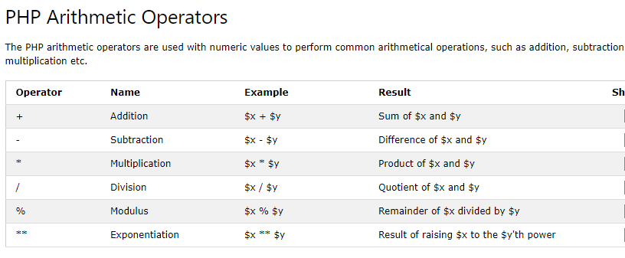
PHP Arithmetic Operators

Slide 24
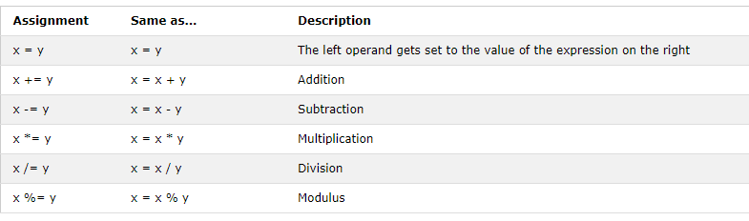
PHP Assignment Operators
The PHP assignment operators are used with numeric values to write a value to a variable.
The basic assignment operator in PHP is "=". It means that the left operand gets set to the value of the assignment expression on the right.

Slide 25
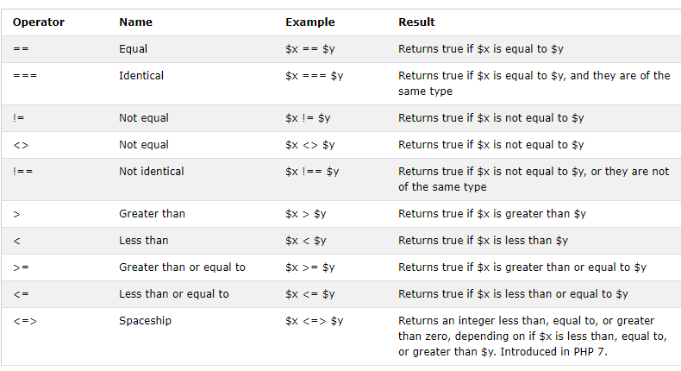
PHP Comparison Operators
The PHP comparison operators are used to compare two values (number or string):

Slide 26
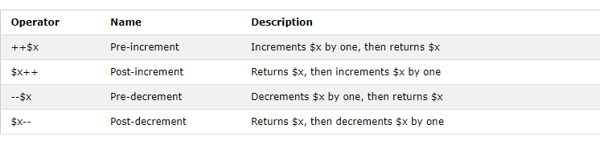
PHP Increment / Decrement Operators
The PHP increment operators are used to increment a variable's value.
The PHP decrement operators are used to decrement a variable's value.

Slide 27
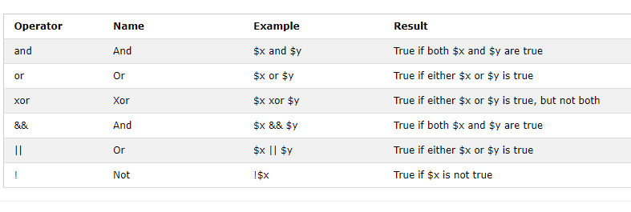
PHP Logical Operators
The PHP logical operators are used to combine conditional statements.

Slide 28
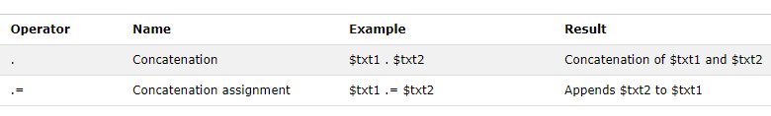
PHP String Operators
PHP has two operators that are specially designed for strings.

Slide 29
PHP Conditional Statements
Very often when you write code, you want to perform different actions for different conditions. You can use conditional statements in your code to do this.
In PHP we have the following conditional statements:
if statement - executes some code if one condition is true
if...else statement - executes some code if a condition is true and another code if that condition is false
if...elseif...else statement - executes different codes for more than two conditions
switch statement - selects one of many blocks of code to be executed

Slide 30
PHP - The if Statement
The if statement executes some code if one condition is true.
Syntax
if (condition) { code to be executed if condition is true; }

Slide 31
Example
<?php
$t = 2;
if ($t < "20") {
echo "Have a good day!";
}
?>
Output:
Have a good day!

Slide 32
PHP - The if...else Statement
The if...else statement executes some code if a condition is true and another code if that condition is false.
Syntax
if (condition) { code to be executed if condition is true; } else { code to be executed if condition is false; }

Slide 33
Example
<?php
$t = 22;
if ($t < "20") {
echo "Have a good day!";
} else {
echo "Have a good night!";
}
?>
Output:
Have a good night!

Slide 34
PHP - The if...elseif...else Statement
The if...elseif...else statement executes different codes for more than two conditions.
Syntax
if (condition) { code to be executed if this condition is true; } elseif (condition) { code to be executed if first condition is false and this condition is true; } else { code to be executed if all conditions are false; }

Slide 35
Example
<?php
$t = 25;
if ($t < "10") {
echo "Have a good morning!";
} elseif ($t < "20") {
echo "Have a good day!";
} else {
echo "Have a good night!";
}
?>
Output:
Have a good night.

Slide 36
Php Switch statement
The switch statement is used to perform different actions based on different conditions.
The PHP switch Statement
Use the switch statement to select one of many blocks of code to be executed.
Syntax
switch (n) { case label1: code to be executed if n=label1; break; case label2: code to be executed if n=label2; break; case label3: code to be executed if n=label3; break; ... default: code to be executed if n is different from all labels; }

Slide 37
Example
<?php $favcolor = "red"; switch ($favcolor) { case "red": echo "Your favorite color is red!"; break; case "blue": echo "Your favorite color is blue!"; break; case "green": echo "Your favorite color is green!"; break; default: echo "Your favorite color is neither red, blue, nor green!"; } ?>
This is how it works: First we have a single expression n (most often a variable), that is evaluated once. The value of the expression is then compared with the values for each case in the structure. If there is a match, the block of code associated with that case is executed. Use break to prevent the code from running into the next case automatically. The default statement is used if no match is found.

Slide 38
PHP Loops
Often when you write code, you want the same block of code to run over and over again a certain number of times. So, instead of adding several almost equal code-lines in a script, we can use loops.
Loops are used to execute the same block of code again and again, as long as a certain condition is true.
In PHP, we have the following loop types:
while - loops through a block of code as long as the specified condition is true
do...while - loops through a block of code once, and then repeats the loop as long as the specified condition is true
for - loops through a block of code a specified number of times
foreach - loops through a block of code for each element in an array

Slide 39
The PHP while Loop
The while loop - Loops through a block of code as long as the specified condition is true.
Syntax
while (condition is true) { code to be executed; }

Slide 40
Example
The example below displays the numbers from 1 to 5:
<?php
$x = 1;
while($x <= 5) {
echo "The number is: $x <br>";
$x++;
}
?>
Output:
The number is: 1 The number is: 2 The number is: 3 The number is: 4 The number is: 5

Slide 41
The PHP do...while Loop
The do...while loop will always execute the block of code once, it will then check the condition, and repeat the loop while t
Syntax
do { code to be executed; } while (condition is true);
The specified condition is true.

Slide 42
Example
The example below first sets a variable $x to 1 ($x = 1). Then, the do while loop will write some output, and then increment the variable $x with 1. Then the condition is checked (is $x less than, or equal to 5?), and the loop will continue to run as long as $x is less than, or equal to 5:
<?php
$x = 1;
do {
echo "The number is: $x <br>";
$x++;
} while ($x <= 5);
?>
Output:
The number is: 1 The number is: 2 The number is: 3 The number is: 4 The number is: 5

Slide 43
PHP for Loop
The for loop is used when you know in advance how many times the script should run.
Syntax
for (init counter; test counter; increment counter) { code to be executed for each iteration; }
Parameters:
init counter: Initialize the loop counter value
test counter: Evaluated for each loop iteration. If it evaluates to TRUE, the loop continues. If it evaluates to FALSE, the loop ends.
increment counter: Increases the loop counter value

Slide 44
Example
The example below displays the numbers from 0 to 10:
<?php
for ($x = 0; $x <= 10; $x++) {
echo "The number is: $x <br>";
}
?>
Output:
The number is: 0 The number is: 1 The number is: 2 The number is: 3 The number is: 4 The number is: 5 The number is: 6 The number is: 7 The number is: 8 The number is: 9 The number is: 10

Slide 45
The PHP foreach Loop
The foreach loop works only on arrays, and is used to loop through each key/value pair in an array.
Syntax
foreach ($array as $value) { code to be executed; }
For every loop iteration, the value of the current array element is assigned to $value and the array pointer is moved by one, until it reaches the last array element.

Slide 46
Example
The following example will output the values of the given array ($colors):
<?php
$colors = array("red", "green", "blue", "yellow");
foreach ($colors as $value) {
echo "$value <br>";
}
?>
red green blue yellow

Slide 47
PHP Functions
PHP Built-in Functions.
PHP User Defined Functions
Besides the built-in PHP functions, it is possible to create your own functions.
A function is a block of statements that can be used repeatedly in a program.
A function will not execute automatically when a page loads.
A function will be executed by a call to the function.

Slide 48
Create a User Defined Function in PHP
A user-defined function declaration starts with the word function:
Syntax
function functionName() { code to be executed; }
<?php
function writeMsg() {
echo "Hello world!";
}
writeMsg();
?>
Output:
Hello World

Slide 49
PHP Arrays
An array stores multiple values in one single variable:
Example
<?php
$cars = array("Volvo", "BMW", "Toyota");
echo "I like " . $cars[0] . ", " . $cars[1] . " and " . $cars[2] . ".";
?>
Output:
I like Volvo, BMW and Toyota.

Slide 50
What is an Array?
An array is a special variable, which can hold more than one value at a time.
If you have a list of items (a list of car names, for example), storing the cars in single variables could look like this:
$cars1 = "Volvo"; $cars2 = "BMW"; $cars3 = "Toyota";
However, what if you want to loop through the cars and find a specific one? And what if you had not 3 cars, but 300?
The solution is to create an array!
An array can hold many values under a single name, and you can access the values by referring to an index number.

Slide 51
Get The Length of an Array - The count() Function
The count() function is used to return the length (the number of elements ) of an array:
Example:
<?php $cars = array("Volvo", "BMW", "Toyota"); echo count($cars); ?>
Output:
3

Slide 52
PHP Global Variables - Superglobals
Some predefined variables in PHP are "superglobals", which means that they are always accessible, regardless of scope - and you can access them from any function, class or file without having to do anything special.
The PHP superglobal variables are:
$GLOBALS
$_SERVER
$_REQUEST
$_POST
$_GET
$_FILES
$_ENV
$_COOKIE
$_SESSION

Slide 53
PHP Forms
The PHP superglobals $_GET and $_POST are used to collect form-data.
PHP - A Simple HTML Form
<html> <body> <form action="welcome.php" method="post"> Name: <input type="text" name="name"><br> E-mail: <input type="text" name="email"><br> <input type="submit"> </form> </body> </html>

Slide 54
Post method
When the user fills out the form above and clicks the submit button, the form data is sent for processing to a PHP file named "welcome.php". The form data is sent with the HTTP POST method.
To display the submitted data you could simply echo all the variables. The "welcome.php" looks like this:
<html> <body> Welcome <?php echo $_POST["name"]; ?><br> Your email address is: <?php echo $_POST["email"]; ?> </body> </html>
The output could be something like this:
Welcome John Your email address is john.doe@example.com

Slide 55
PHP Get method
<html> <body> <form action="welcome.php" method=“get"> Name: <input type="text" name="name"><br> E-mail: <input type="text" name="email"><br> <input type="submit"> </form> </body> </html>
Welcome.php
<html> <body> Welcome <?php echo $_GET["name"]; ?><br> Your email address is: <?php echo $_GET["email"]; ?> </body> </html>

Slide 56
The Form Element
The HTML code of the form looks like this:
<form method="post" action="<?php echo htmlspecialchars($_SERVER["PHP_SELF"]);?>">
When the form is submitted, the form data is sent with method="post".
What is the $_SERVER["PHP_SELF"] variable? The $_SERVER["PHP_SELF"] is a super global variable that returns the filename of the currently executing script.
So, the $_SERVER["PHP_SELF"] sends the submitted form data to the page itself, instead of jumping to a different page. This way, the user will get error messages on the same page as the form.

Slide 57
What is the htmlspecialchars() function?
The htmlspecialchars() function converts special characters to HTML entities. This means that it will replace HTML characters like < and > with &lt; and &gt;. This prevents attackers from exploiting the code by injecting HTML or Javascript code (Cross-site Scripting attacks) in forms.

Slide 58
Validate Form Data With PHP
The first thing we will do is to pass all variables through PHP's htmlspecialchars() function.
When we use the htmlspecialchars() function; then if a user tries to submit the following in a text field:
<script>location.href('http://www.hacked.com')</script>
- this would not be executed, because it would be saved as HTML escaped code, like this:
&lt;script&gt;location.href('http://www.hacked.com')&lt;/script&gt;
The code is now safe to be displayed on a page or inside an e-mail.
We will also do two more things when the user submits the form:
Strip unnecessary characters (extra space, tab, newline) from the user input data (with the PHP trim() function)
Remove backslashes (\) from the user input data (with the PHP stripslashes() function)
The next step is to create a function that will do all the checking for us (which is much more convenient than writing the same code over and over again).
We will name the function test_input().
Now, we can check each $_POST variable with the test_input() function, and the script looks like this:

Slide 59
PHP Forms - Validate E-mail and URL
This chapter shows how to validate names, e-mail
PHP - Validate Name
The code below shows a simple way to check if the name field only contains letters and whitespace. If the value of the name field is not valid, then store an error message:
$name = test_input($_POST["name"]); if (!preg_match("/^[a-zA-Z ]*$/",$name) { $nameErr = "Only letters and white space allowed"; }
The preg_match() function searches a string for pattern, returning true if the pattern exists, and false otherwise.

Slide 60
PHP - Validate E-mail
The easiest and safest way to check whether an email address is well-formed is to use PHP's filter_var() function.
In the code below, if the e-mail address is not well-formed, then store an error message:
$email = test_input($_POST["email"]); if (!filter_var($email, FILTER_VALIDATE_EMAIL)) { $emailErr = "Invalid email format"; }

Slide 61
PHP - Validate URL
The code below shows a way to check if a URL address syntax is valid (this regular expression also allows dashes in the URL). If the URL address syntax is not valid, then store an error message:
$website = test_input($_POST["website"]);
if (!preg_match("/\b(?:(?:https?|ftp):\/\/|www\.)[-a-z0-9+&@#\/%?=~_|!:,.;]*[-a-z0-9+&@#\/%=~_|]/i",$website)) { $websiteErr = "Invalid URL"; }

Slide 62
PHP - Validate Name, E-mail, and URL
Check here: https://tryphp.w3schools.com/showphp.php?filename=demo_form_validation_special

Slide 63
PHP Cookies
What is a Cookie?
A cookie is often used to identify a user. A cookie is a small file that the server embeds on the user's computer. Each time the same computer requests a page with a browser, it will send the cookie too. With PHP, you can both create and retrieve cookie values.

Slide 64
Create Cookies With PHP
A cookie is created with the setcookie() function.
Syntax
setcookie(name, value, expire, path, domain, secure, httponly);
Only the name parameter is required. All other parameters are optional.

Slide 65
PHP Create/Retrieve a Cookie
The following example creates a cookie named "user" with the value "John Doe". The cookie will expire after 30 days (86400 * 30). The "/" means that the cookie is available in entire website (otherwise, select the directory you prefer).
We then retrieve the value of the cookie "user" (using the global variable $_COOKIE). We also use the isset() function to find out if the cookie is set:

Slide 66
Example
<!DOCTYPE html> <?php $cookie_name = "user"; $cookie_value = "John Doe"; setcookie($cookie_name, $cookie_value, time() + (86400 * 30), "/"); // 86400 = 1 day ?> <html> <body> <?php if(!isset($_COOKIE[$cookie_name])) { echo "Cookie named '" . $cookie_name . "' is not set!"; } else { echo "Cookie '" . $cookie_name . "' is set!<br>"; echo "Value is: " . $_COOKIE[$cookie_name]; } ?> <p><strong>Note:</strong> You might have to reload the page to see the value of the cookie.</p> </body> </html>
Note: The setcookie() function must appear BEFORE the <html> tag.

Slide 67
Delete a Cookie
To delete a cookie, use the setcookie() function with an expiration date in the past:
<!DOCTYPE html> <?php // set the expiration date to one hour ago setcookie("user", "", time() - 3600); ?> <html> <body> <?php echo "Cookie 'user' is deleted."; ?> </body> </html>

Slide 68
PHP Sessions
A session is a way to store information (in variables) to be used across multiple pages.
Unlike a cookie, the information is not stored on the users computer.

Slide 69
What is a PHP Session?
When you work with an application, you open it, do some changes, and then you close it. This is much like a Session. The computer knows who you are. It knows when you start the application and when you end. But on the internet there is one problem: the web server does not know who you are or what you do, because the HTTP address doesn't maintain state.
Session variables solve this problem by storing user information to be used across multiple pages (e.g. username, favorite color, etc). By default, session variables last until the user closes the browser.
So; Session variables hold information about one single user, and are available to all pages in one application.
Tip: If you need a permanent storage, you may want to store the data in a database.

Slide 70
Start a PHP Session
session is started with the session_start() function.
Session variables are set with the PHP global variable: $_SESSION.

Slide 71
Example
Now, let's create a new page called "demo_session1.php". In this page, we start a new PHP session and set some session variables:
<?php // Start the session session_start(); ?> <!DOCTYPE html> <html> <body> <?php // Set session variables $_SESSION["favcolor"] = "green"; $_SESSION["favanimal"] = "cat"; echo "Session variables are set."; ?> </body> </html>
Note: The session_start() function must be the very first thing in your document. Before any HTML tags.

Slide 72
Get PHP Session Variable Values
Next, we create another page called "demo_session2.php". From this page, we will access the session information we set on the first page ("demo_session1.php").
Notice that session variables are not passed individually to each new page, instead they are retrieved from the session we open at the beginning of each page (session_start()).
Also notice that all session variable values are stored in the global $_SESSION variable:

Slide 73
Destroy a PHP Session
To remove all global session variables and destroy the session, use session_unset() and session_destroy():
<?php session_start(); ?> <!DOCTYPE html> <html> <body> <?php // remove all session variables session_unset(); // destroy the session session_destroy(); echo "All session variables are now removed, and the session is destroyed." ?> </body> </html>

Slide 74
Working with Mysql and php
With PHP, you can connect to and manipulate databases.
MySQL is the most popular database system used with PHP.

Slide 75
What is MySQL?
MySQL is a database system used on the web
MySQL is a database system that runs on a server
MySQL is ideal for both small and large applications
MySQL is very fast, reliable, and easy to use
MySQL uses standard SQL
MySQL compiles on a number of platforms
MySQL is free to download and use
MySQL is developed, distributed, and supported by Oracle Corporation
MySQL is named after co-founder Monty Widenius's daughter: My
The data in a MySQL database are stored in tables. A table is a collection of related data, and it consists of columns and rows.
Databases are useful for storing information categorically. A company may have a database with the following tables:
Employees
Products
Customers
Orders

Slide 76
Database Queries
A query is a question or a request.
We can query a database for specific information and have a recordset returned.
Look at the following query (using standard SQL):
SELECT LastName FROM Employees
The query above selects all the data in the "LastName" column from the "Employees" table.

Slide 77
PHP Create a MySQL Database
A database consists of one or more tables.
You will need special CREATE privileges to create or to delete a MySQL database.
Create a MySQL Database Using MySQL
The CREATE DATABASE statement is used to create a database in MySQL.

Slide 78
<?php $servername = "localhost"; $username = "username"; $password = "password"; // Create connection $conn = mysqli_connect($servername, $username, $password); // Check connection if (!$conn) { die("Connection failed: " . mysqli_connect_error()); } // Create database $sql = "CREATE DATABASE myDB"; if (mysqli_query($conn, $sql)) { echo "Database created successfully"; } else { echo "Error creating database: " . mysqli_error($conn); } mysqli_close($conn); ?>

Slide 79
PHP MySQL Create Table
A database table has its own unique name and consists of columns and rows.
Create a MySQL Table Using MySQL
The CREATE TABLE statement is used to create a table in MySQL.
We will create a table named "MyGuests", with five columns: "id", "firstname", "lastname", "email"
CREATE TABLE MyGuests ( id INT(6) UNSIGNED AUTO_INCREMENT PRIMARY KEY, firstname VARCHAR(30) NOT NULL, lastname VARCHAR(30) NOT NULL, email VARCHAR(50) )

Slide 80
Notes on the table above:
The data type specifies what type of data the column can hold. For a complete reference of all the available data types,.
After the data type, you can specify other optional attributes for each column:
NOT NULL - Each row must contain a value for that column, null values are not allowed
DEFAULT value - Set a default value that is added when no other value is passed
UNSIGNED - Used for number types, limits the stored data to positive numbers and zero
AUTO INCREMENT - MySQL automatically increases the value of the field by 1 each time a new record is added
PRIMARY KEY - Used to uniquely identify the rows in a table. The column with PRIMARY KEY setting is often an ID number, and is often used with AUTO_INCREMENT
Each table should have a primary key column (in this case: the "id" column). Its value must be unique for each record in the table.

Slide 81
<?php $servername = "localhost"; $username = "username"; $password = "password"; $dbname = "myDB"; // Create connection $conn = mysqli_connect($servername, $username, $password, $dbname); // Check connection if (!$conn) { die("Connection failed: " . mysqli_connect_error()); } // sql to create table $sql = "CREATE TABLE MyGuests ( id INT(6) UNSIGNED AUTO_INCREMENT PRIMARY KEY, firstname VARCHAR(30) NOT NULL, lastname VARCHAR(30) NOT NULL, email VARCHAR(50) )"; if (mysqli_query($conn, $sql)) { echo "Table MyGuests created successfully"; } else { echo "Error creating table: " . mysqli_error($conn); } mysqli_close($conn); ?>

Slide 82
Insert Data Into MySQL Using php
After a database and a table have been created, we can start adding data in them.
Here are some syntax rules to follow:
The SQL query must be quoted in PHP
String values inside the SQL query must be quoted
Numeric values must not be quoted
The word NULL must not be quoted
The INSERT INTO statement is used to add new records to a MySQL table:
INSERT INTO table_name (column1, column2, column3,...) VALUES (value1, value2, value3,...)

Slide 83
<?php $servername = "localhost"; $username = "username"; $password = "password"; $dbname = "myDB"; // Create connection $conn = mysqli_connect($servername, $username, $password, $dbname); // Check connection if (!$conn) { die("Connection failed: " . mysqli_connect_error()); } $sql = "INSERT INTO MyGuests (firstname, lastname, email) VALUES ('John', 'Doe', 'john@example.com')"; if (mysqli_query($conn, $sql)) { echo "New record created successfully"; } else { echo "Error: " . $sql . "<br>" . mysqli_error($conn); } mysqli_close($conn); ?>

Slide 84
Delete Data From a MySQL Table Using MySQL
The DELETE statement is used to delete records from a table:
DELETE FROM table_name WHERE some_column = some_value

Slide 85
The following examples delete the record with id=3 in the "MyGuests" table:
<?php $servername = "localhost"; $username = "username"; $password = "password"; $dbname = "myDB"; // Create connection $conn = new mysqli($servername, $username, $password, $dbname); // Check connection if ($conn->connect_error) { die("Connection failed: " . $conn->connect_error); } // sql to delete a record $sql = "DELETE FROM MyGuests WHERE id=3"; if ($conn->query($sql) === TRUE) { echo "Record deleted successfully"; } else { echo "Error deleting record: " . $conn->error; } $conn->close(); ?>

Slide 86
PHP MySQL Select Data
Select Data From a MySQL Database
The SELECT statement is used to select data from one or more tables:
SELECT column_name(s) FROM table_name
or we can use the * character to select ALL columns from a table:
SELECT * FROM table_name

Slide 87
<?php $servername = "localhost"; $username = "username"; $password = "password"; $dbname = "myDB"; // Create connection $conn = mysqli_connect($servername, $username, $password, $dbname); // Check connection if (!$conn) { die("Connection failed: " . mysqli_connect_error()); } $sql = "SELECT id, firstname, lastname FROM MyGuests"; $result = mysqli_query($conn, $sql); if (mysqli_num_rows($result) > 0) { // output data of each row while($row = mysqli_fetch_assoc($result)) { echo "id: " . $row["id"]. " - Name: " . $row["firstname"]. " " . $row["lastname"]. "<br>"; } } else { echo "0 results"; } mysqli_close($conn); ?>

Slide 88
First, we set up an SQL query that selects the id, firstname and lastname columns from the MyGuests table. The next line of code runs the query and puts the resulting data into a variable called $result.
Then, the function num_rows() checks if there are more than zero rows returned.
If there are more than zero rows returned, the function fetch_assoc() puts all the results into an associative array that we can loop through. The while() loop loops through the result set and outputs the data from the id, firstname and lastname columns.

Slide 89
PHP MySQL Update Data
The UPDATE statement is used to update existing records in a table:
UPDATE table_name SET column1=value, column2=value2,... WHERE some_column=some_value

Slide 90
<?php $servername = "localhost"; $username = "username"; $password = "password"; $dbname = "myDB"; // Create connection $conn = mysqli_connect($servername, $username, $password, $dbname); // Check connection if (!$conn) { die("Connection failed: " . mysqli_connect_error()); } $sql = "UPDATE MyGuests SET lastname='Doe' WHERE id=2"; if (mysqli_query($conn, $sql)) { echo "Record updated successfully"; } else { echo "Error updating record: " . mysqli_error($conn); } mysqli_close($conn); ?>

Slide 91
PHP MySQL Insert Multiple Records
Multiple SQL statements must be executed with the mysqli_multi_query() function.

Slide 92
<?php $servername = "localhost"; $username = "username"; $password = "password"; $dbname = "myDB"; // Create connection $conn = mysqli_connect($servername, $username, $password, $dbname); // Check connection if (!$conn) { die("Connection failed: " . mysqli_connect_error()); } $sql = "INSERT INTO MyGuests (firstname, lastname, email) VALUES ('John', 'Doe', 'john@example.com');"; $sql .= "INSERT INTO MyGuests (firstname, lastname, email) VALUES ('Mary', 'Moe', 'mary@example.com');"; $sql .= "INSERT INTO MyGuests (firstname, lastname, email) VALUES ('Julie', 'Dooley', 'julie@example.com')"; if (mysqli_multi_query($conn, $sql)) { echo "New records created successfully"; } else { echo "Error: " . $sql . "<br>" . mysqli_error($conn); } mysqli_close($conn); ?>

Slide 93
codeIgniter,Laravel,Wordpress
Read yourself.

