Slide 1

CSS (Cascading Style Sheet)
Presentation by: Rishav Malla Thakuri
Himalaya Darshan College

Slide 2
What is CSS?
CSS is a language that describes the style of an HTML document.
CSS stands for Cascading Style Sheets
CSS describes how HTML elements are to be displayed on screen, paper, or in other media
CSS saves a lot of work. It can control the layout of multiple web pages all at once
External stylesheets are stored in CSS files

Slide 3
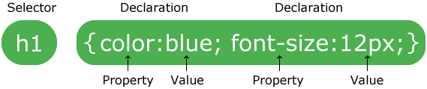
CSS Syntax
A CSS rule-set consists of a selector and a declaration block:
The selector points to the HTML element you want to style.
The declaration block contains one or more declarations separated by semicolons.
Each declaration includes a CSS property name and a value, separated by a colon.
A CSS declaration always ends with a semicolon, and declaration blocks are surrounded by curly braces.

Slide 4
Example
h1{
color:red;
text-align: center;
}
p{
color: blue;
}

Slide 5
Inserting CSS
We can use style sheets in three different ways in out HTML document. There are external style sheet, internal style sheet and inline style.
External CSS
With an external style sheet, you can change the look of an entire website by changing just one file!
Each HTML page must include a reference to the external style sheet file inside the <link> element, inside the head section.
Example:
<head>
<link rel="stylesheet" type="text/css" href="mystyle.css" />
</head>

Slide 6
External CSS
An external style sheet can be written in any text editor. The file should not contain any html tags. Your style sheet should be saved with a .css extension.
Example:
hr {
color:sienna;
}
p
{
margin-left:20px;
} /*Note: Do not leave space between property value and units*/
body {
background-image:url("images/back40.gif");
}

Slide 7
Internal CSS
An internal style sheet may be used if one single HTML page has a unique style.
The internal style is defined inside the <style> element, inside the head section.
Example:
<html>
<head>
<style>
body {
background-color: linen;
}
h1 {
color: maroon;
margin-left: 40px;
}
</style>
</head>
<body>
<h1>This is a heading</h1>
<p>This is a paragraph.</p>
</body>
</html>

Slide 8
Inline CSS
An inline style may be used to apply a unique style for a single element.
To use inline styles, add the style attribute to the relevant element. The style attribute can contain any CSS property.
Example:
<body> <h1 style="color:blue;text-align:center;">This is a heading</h1> <p style="color:red;">This is a paragraph.</p> </body>

Slide 9
Cascading Order
What style will be used when there is more than one style specified for an HTML element?
All the styles in a page will "cascade" into a new "virtual" style sheet by the following rules, where number one has the highest priority:
Inline style (inside an HTML element)
internal style sheets (in the head section)
External style sheet
Browser default
So, an inline style has the highest priority, and will override external and internal styles and browser defaults.

Slide 10
CSS Selectors
CSS selectors are used to "find" (or select) the HTML elements you want to style.
The CSS id Selector
The id selector uses the id attribute of an HTML element to select a specific element.
The id of an element is unique within a page, so the id selector is used to select one unique element!
To select an element with a specific id, write a hash (#) character, followed by the id of the element.

Slide 11
The CSS id Selector
Example:
The CSS rule below will be applied to the HTML element with id="para1":
<html>
<head>
<style>
#para1 {
text-align: center;
color: red;
}
</style>
</head>
<body>
<p id="para1">Hello World!</p>
<p>This paragraph is not affected by the style.</p>
</body>
</html>

Slide 12
2 . The CSS class Selector
The class selector selects HTML elements with a specific class attribute.
To select elements with a specific class, write a period (.) character, followed by the class name.

Slide 13
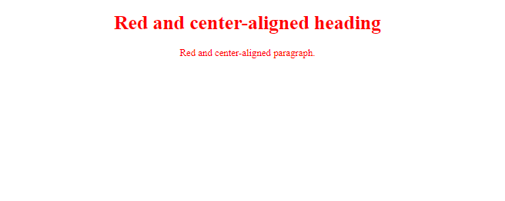
Example:
<html>
<head>
<style>
.center {
text-align: center;
color: red;
}
</style>
</head>
<body>
<h1 class="center">Red and center-aligned heading</h1>
<p class="center">Red and center-aligned paragraph.</p>
</body>
</html>

Slide 14
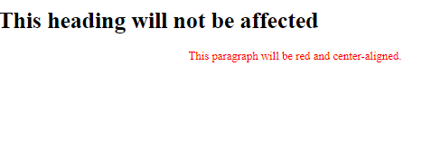
Example In this example only <p> elements with class="center" will be center-aligned:
<html>
<head>
<style>
p.center {
text-align: center;
color: red;
}
</style>
</head>
<body>
<h1 class="center">This heading will not be affected</h1>
<p class="center">This paragraph will be red and center-aligned.</p>
</body>
</html>

Slide 15
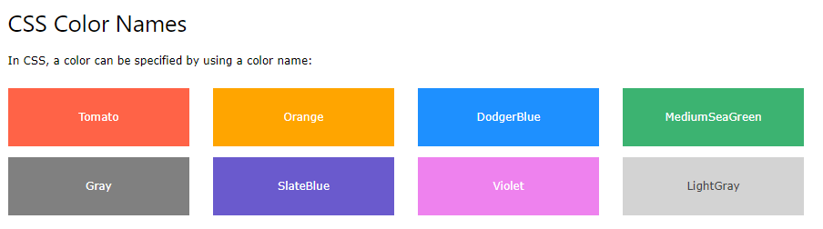
CSS Colors
Colors are specified using predefined color names, or RGB, HEX, HSL, RGBA, HSLA values.

Slide 16
CSS Backgrounds
The CSS background properties are used to define the background effects for elements.
CSS background properties:
background-color
background-image
background-repeat
background-attachment
background-position

Slide 17
1.CSS background-color
The background-color property specifies the background color of an element.
body { background-color: lightblue; }
2. CSS background-image
The background-image property specifies an image to use as the background of an element.
By default, the image is repeated so it covers the entire element.
body { background-image: url("paper.gif"); }

Slide 18
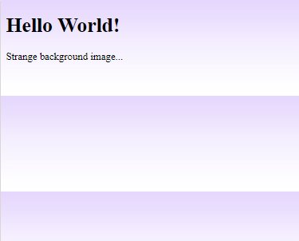
CSS background-repeat
By default, the background-image property repeats an image both horizontally and vertically. Some images should be repeated only horizontally or vertically. Looks like this:
If the image is repeated only horizontally (repeat-x), the background will look better:
body
{
background-image:url('gradient2.png');
background-repeat:repeat-x;
}

Slide 19
Background Image - no-repeat
Showing the background image only once is also specified by the background-repeat property:
body { background-image: url("img_tree.png"); background-repeat: no-repeat; }

Slide 20
CSS background-position
The background-position property is used to specify the position of the background image.
body { background-image: url("img_tree.png"); background-repeat: no-repeat; background-position: right top; }

Slide 21
CSS background-attachment
The background-attachment property specifies whether the background image should scroll or be fixed (will not scroll with the rest of the page):
body { background-image: url("img_tree.png"); background-repeat: no-repeat; background-position: right top; background-attachment: fixed; }
body { background-image: url("img_tree.png"); background-repeat: no-repeat; background-position: right top; background-attachment: scroll; }

Slide 22
CSS background - Shorthand property
To shorten the code, it is also possible to specify all the background properties in one single property. This is called a shorthand property.
The shorthand property for background is background.
body { background: #ffffff url("img_tree.png") no-repeat right top; }

Slide 23
CSS Borders
CSS Border Properties
The CSS border properties allow you to specify the style, width, and color of an element's border.
CSS Border Style
The border-style property specifies what kind of border to display.
The following values are allowed:
dotted - Defines a dotted border
dashed - Defines a dashed border
solid - Defines a solid border
double - Defines a double border

Slide 24
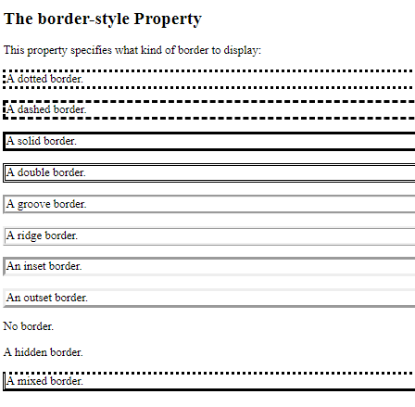
Example:
<style>
p.dotted {border-style: dotted;}
p.dashed {border-style: dashed;}
p.solid {border-style: solid;}
p.double {border-style: double;}
p.groove {border-style: groove;}
p.ridge {border-style: ridge;}
p.inset {border-style: inset;}
p.outset {border-style: outset;}
p.none {border-style: none;}
p.hidden {border-style: hidden;}
p.mix {border-style: dotted dashed solid double;}
</style>

Slide 25
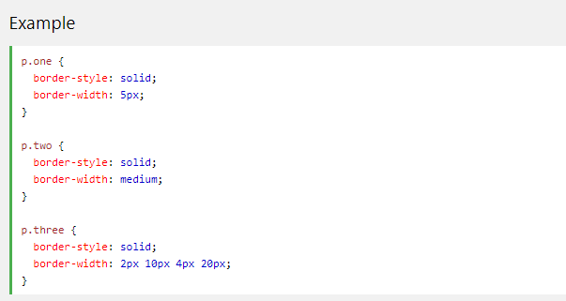
CSS Border Width
The border-width property specifies the width of the four borders.
The width can be set as a specific size (in px, pt, cm, em, etc) or by using one of the three pre-defined values: thin, medium, or thick.
The border-width property can have from one to four values (for the top border, right border, bottom border, and the left border).

Slide 26
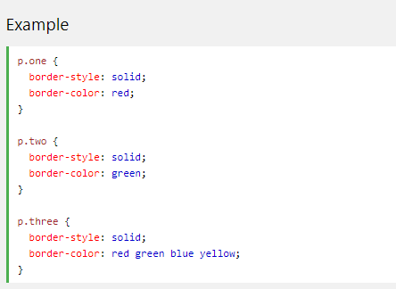
CSS Border Color
The border-color property is used to set the color of the four borders.
The border-color property can have from one to four values (for the top border, right border, bottom border, and the left border).

Slide 27
CSS Border - Shorthand Property
The border property is a shorthand property for the following individual border properties:
border-width
border-style (required)
border-color
p { border: 5px solid red; }

Slide 28
CSS Text
Text Color
The color property is used to set the color of the text. The color is specified by:
a color name - like "red“
a HEX value - like "#ff0000"
an RGB value - like "rgb(255,0,0)"

Slide 29
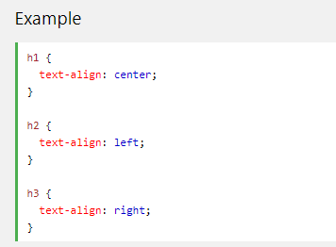
Text Alignment
The text-align property is used to set the horizontal alignment of a text.
A text can be left or right aligned, centered, or justified.
When the text-align property is set to "justify", each line is stretched so that every line has equal width, and the left and right margins are straight (like in magazines and newspapers):

Slide 30
Text Decoration
The text-decoration property is used to set or remove decorations from text.
The value text-decoration: none; is often used to remove underlines from links:
<style>
a {
text-decoration: none;
}
</style>
Note: this removes underline from the links.

Slide 31
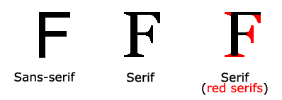
CSS Fonts
The CSS font properties define the font family, boldness, size, and the style of a text.
Difference Between Serif and Sans-serif Fonts

Slide 32
Font Family
The font family of a text is set with the font-family property.
The font-family property should hold several font names as a "fallback" system. If the browser does not support the first font, it tries the next font, and so on.
<style>
p.serif {
font-family: "Times New Roman", Times, serif;
}
p.sansserif {
font-family: Arial, Helvetica, sans-serif;
}

Slide 33
Font Style
The font-style property is mostly used to specify italic text.
This property has three values:
normal - The text is shown normally
italic - The text is shown in italics
oblique - The text is "leaning" (oblique is very similar to italic, but less supported)

Slide 34
Font Size
The font-size property sets the size of the text.
h1 { font-size: 40px; } h2 { font-size: 30px; } p { font-size: 14px; }

Slide 35
CSS Lists
Different List Item Markers
The list-style-type property specifies the type of list item marker.
ul.a { list-style-type: circle; } ul.b { list-style-type: square; } ol.c { list-style-type: upper-roman; } ol.d { list-style-type: lower-alpha; }

Slide 36

CSS Tables
Table Borders
To specify table borders in CSS, use the border property.
The example below specifies a black border for <table>, <th>, and <td> elements:
<style>
table, th, td {
border: 1px solid black;
}

Slide 37
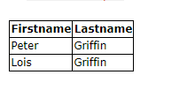
CSS Tables
Collapse Table Borders
The border-collapse property sets whether the table borders should be collapsed into a single border:
table { border-collapse: collapse; } table, th, td { border: 1px solid black; }

Slide 38
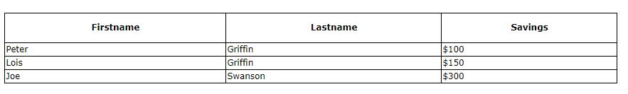
CSS Tables
Table Width and Height
Width and height of a table are defined by the width and height properties.
The example below sets the width of the table to 100%, and the height of the <th> elements to 50px:
table { width: 100%; } th { height: 50px; }

Slide 39
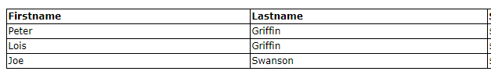
Horizontal Alignment
The text-align property sets the horizontal alignment (like left, right, or center) of the content in <th> or <td>.
By default, the content of <th> elements are center-aligned and the content of <td> elements are left-aligned.
The following example left-aligns the text in <th> elements:
th { text-align: left; }

Slide 40
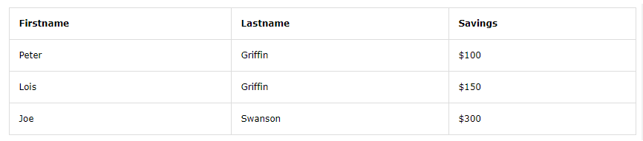
Table Padding
To control the space between the border and the content in a table, use the padding property on <td> and <th> elements:
th, td { padding: 15px; text-align: left; }

Slide 41
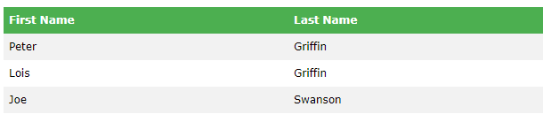
Hoverable Table
Use the :hover selector on <tr> to highlight table rows on mouse over:
tr:hover {background-color: #f5f5f5;}
Table Color
The example below specifies the background color and text color of <th> elements:
th { background-color: #4CAF50; color: white; }

Slide 42
The CSS Box Model
All HTML elements can be considered as boxes. In CSS, the term "box model" is used when talking about design and layout.
The CSS box model is essentially a box that wraps around every HTML element. It consists of: margins, borders, padding, and the actual content. The image below illustrates the box model:

Slide 43
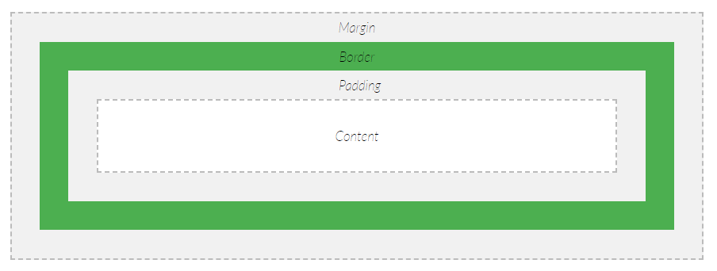
The CSS Box Model
Explanation of the different parts:
Content - The content of the box, where text and images appear
Padding - Clears an area around the content. The padding is transparent
Border - A border that goes around the padding and content
Margin - Clears an area outside the border. The margin is transparent
The box model allows us to add a border around elements, and to define space between elements.

Slide 44
CSS Layout - The display Property
The display property is the most important CSS property for controlling layout.
The display property specifies if/how an element is displayed.
Every HTML element has a default display value depending on what type of element it is. The default display value for most elements is block or inline.

Slide 45
Block-level Elements
A block-level element always starts on a new line and takes up the full width available (stretches out to the left and right as far as it can).
The <div> element is a block-level element.
Examples of block-level elements:
<div>
<h1> - <h6>
<p>
<form>
<header>
<footer>
<section>

Slide 46
Inline Elements
An inline element does not start on a new line and only takes up as much width as necessary.
This is an inline <span> element inside a paragraph.
Examples of inline elements:
<span>
<a>
<img>

Slide 47
Display: none
display: none; is commonly used with JavaScript to hide and show elements without deleting and recreating them. Take a look at our last example on this page if you want to know how this can be achieved.
The <script> element uses display: none; as default.
h1{
display:none; }

Slide 48
CSS Padding
The CSS padding properties are used to generate space around an element's content, inside of any defined borders.
With CSS, you have full control over the padding. There are properties for setting the padding for each side of an element (top, right, bottom, and left).
Padding - Individual Sides
CSS has properties for specifying the padding for each side of an element:
padding-top
padding-right
padding-bottom
padding-left

Slide 49
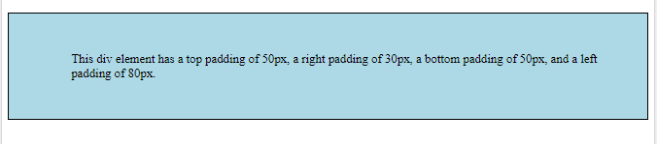
Css Padding
<style>
div {
border: 1px solid black;
background-color: lightblue;
padding-top: 50px;
padding-right: 30px;
padding-bottom: 50px;
padding-left: 80px;
}
</style>

Slide 50
CSS Margins
The CSS margin properties are used to create space around elements, outside of any defined borders.
With CSS, you have full control over the margins. There are properties for setting the margin for each side of an element (top, right, bottom, and left).
Margin - Individual Sides
CSS has properties for specifying the margin for each side of an element:
margin-top
margin-right
margin-bottom
margin-left

Slide 51
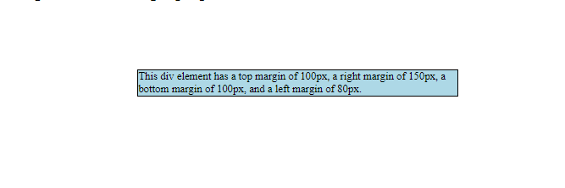
<style>
div {
border: 1px solid black;
margin-top: 100px;
margin-bottom: 100px;
margin-right: 150px;
margin-left: 200px;
background-color: lightblue;
}
</style>

Slide 52
CSS position Property
The position property specifies the type of positioning method used for an element.
The position property specifies the type of positioning method used for an element (static, relative, absolute, fixed, or sticky).

Slide 53
Position: static;
HTML elements are positioned static by default.
Static positioned elements are not affected by the top, bottom, left, and right properties.
An element with position: static; is not positioned in any special way; it is always positioned according to the normal flow of the page:
Eg: This <div> element has position: static;
div.static { position: static; border: 3px solid #73AD21; }

Slide 54
position: relative;
An element with position: relative; is positioned relative to its normal position.
Setting the top, right, bottom, and left properties of a relatively-positioned element will cause it to be adjusted away from its normal position. Other content will not be adjusted to fit into any gap left by the element.
Eg:
div.relative { position: relative; left: 30px; border: 3px solid #73AD21; }

Slide 55
position: fixed;
An element with position: fixed; is positioned relative to the viewport, which means it always stays in the same place even if the page is scrolled. The top, right, bottom, and left properties are used to position the element.
A fixed element does not leave a gap in the page where it would normally have been located.
div.fixed { position: fixed; bottom: 0; right: 0; width: 300px; border: 3px solid #73AD21; }

Slide 56
position: absolute;
An element with position: absolute; is positioned relative to the nearest positioned ancestor (instead of positioned relative to the viewport, like fixed).
However; if an absolute positioned element has no positioned ancestors, it uses the document body, and moves along with page scrolling.
Note: A "positioned" element is one whose position is anything except static.

Slide 57
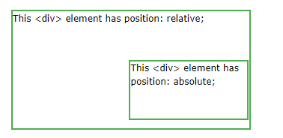
position: absolute;
div.relative { position: relative; width: 400px; height: 200px; border: 3px solid #73AD21; } div.absolute { position: absolute; top: 80px; right: 0; width: 200px; height: 100px; border: 3px solid #73AD21; }

Slide 58
position: sticky;
An element with position: sticky; is positioned based on the user's scroll position.
A sticky element toggles between relative and fixed, depending on the scroll position. It is positioned relative until a given offset position is met in the viewport - then it "sticks" in place (like position:fixed).

Slide 59
CSS Layout - float
With CSS float, an element can be pushed to the left or right, allowing other elements to wrap around it. Float is very often used for images, but it is also useful when working with layouts.
How Elements Float
Elements are floated horizontally; this means that an element can only be floated left or right, not up or down. A floated element will move as far to the left or right as it can.
Usually this means all the way to the left or right of the containing element. The elements after the floating element will flow around it. The elements before the floating element will not be affected. If an image is floated to the right, a following text flows around it, to the left.

Slide 60
The float property can have one of the following values:
left - The element floats to the left of its container
right - The element floats to the right of its container
none - The element does not float (will be displayed just where it occurs in the text). This is default
inherit - The element inherits the float value of its parent
In its simplest use, the float property can be used to wrap text around images.
Eg: https://www.w3schools.com/css/css_float.asp

Slide 61
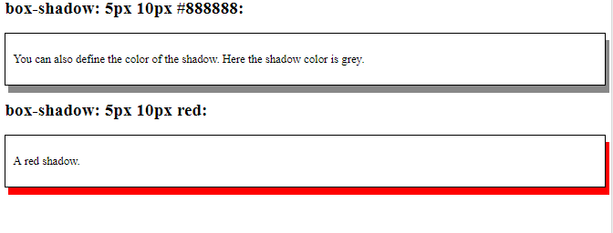
CSS box-shadow Property
The box-shadow property attaches one or more shadows to an element.
#example1 { box-shadow: 5px 10px; } #example2 { box-shadow: 5px 10px #888888; }

Slide 62
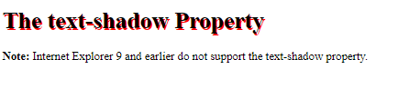
CSS text-shadow Property
The text-shadow property adds shadow to text.
h1 { text-shadow: 2px 2px #ff0000; }

Slide 63
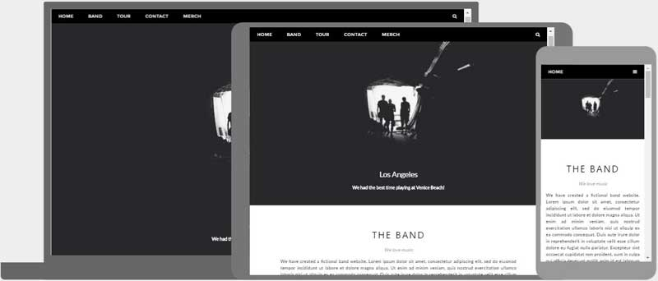
What is Responsive Web Design?
Responsive Web Design is about using HTML and CSS to automatically resize, hide, shrink, or enlarge, a website, to make it look good on all devices (desktops, tablets, and phones):

Slide 64
Web pages can be viewed using many different devices: desktops, tablets, and phones. Your web page should look good, and be easy to use, regardless of the device.
Web pages should not leave out information to fit smaller devices, but rather adapt its content to fit any device:
Eg: https://www.w3schools.com/css/tryit.asp?filename=tryresponsive_col-s

Slide 65
Responsive Web Design - Media Queries
What is a Media Query?
Media query is a CSS technique introduced in CSS3.
It uses the @media rule to include a block of CSS properties only if a certain condition is true.
<style>
body {
background-color: lightgreen;
}
@media only screen and (max-width: 600px) {
body {
background-color: lightblue;
}
}
</style>

Slide 66
Bootstrap Get Started
What is Bootstrap?
Bootstrap is a free front-end framework for faster and easier web development
Bootstrap includes HTML and CSS based design templates for typography, forms, buttons, tables, navigation, modals, image carousels and many other, as well as optional JavaScript plugins
Bootstrap also gives you the ability to easily create responsive designs

Slide 67
Why Use Bootstrap?
Advantages of Bootstrap:
Easy to use: Anybody with just basic knowledge of HTML and CSS can start using Bootstrap
Responsive features: Bootstrap's responsive CSS adjusts to phones, tablets, and desktops
Mobile-first approach: In Bootstrap 3, mobile-first styles are part of the core framework
Browser compatibility: Bootstrap is compatible with all modern browsers (Chrome, Firefox, Internet Explorer, Edge, Safari, and Opera)

