Slide 1

Hyper Text markup Language
Himalaya Darshan College
Prepared by: Rishav Malla Thakuri

Slide 2
What is HTML?
HTML is the standard markup language for creating Web pages.
HTML stands for Hyper Text Markup Language
HTML describes the structure of a Web page
HTML consists of a series of elements
HTML elements tell the browser how to display the content
HTML elements are represented by tags
HTML tags label pieces of content such as "heading", "paragraph", "table", and so on
Browsers do not display the HTML tags, but use them to render the content of the page

Slide 3
A Simple HTML Document
Example Explained
The <!DOCTYPE html> declaration defines this document to be HTML5
The <html> element is the root element of an HTML page
The <head> element contains meta information about the document
The <title> element specifies a title for the document
The <body> element contains the visible page content
The <h1> element defines a large heading
The <p> element defines a paragraph
<!DOCTYPE html>
<html>
<head>
<title>Page Title</title>
</head>
<body> <h1>My First Heading</h1>
<p>My first paragraph.</p> </body>
</html>

Slide 4
HTML Tags
HTML tags are element names surrounded by angle brackets:
<tagname>content goes here...</tagname>
HTML tags normally come in pairs like <p> and </p>
The first tag in a pair is the start tag, the second tag is the end tag
The end tag is written like the start tag, but with a forward slash inserted before the tag name

Slide 5
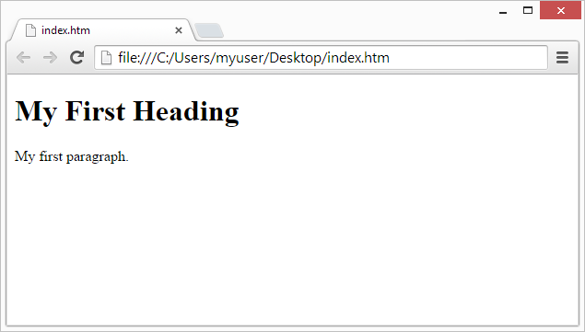
Web Browsers
The purpose of a web browser (Chrome, Edge, Firefox, Safari) is to read HTML documents and display them.
The browser does not display the HTML tags, but uses them to determine how to display the document:

Slide 6
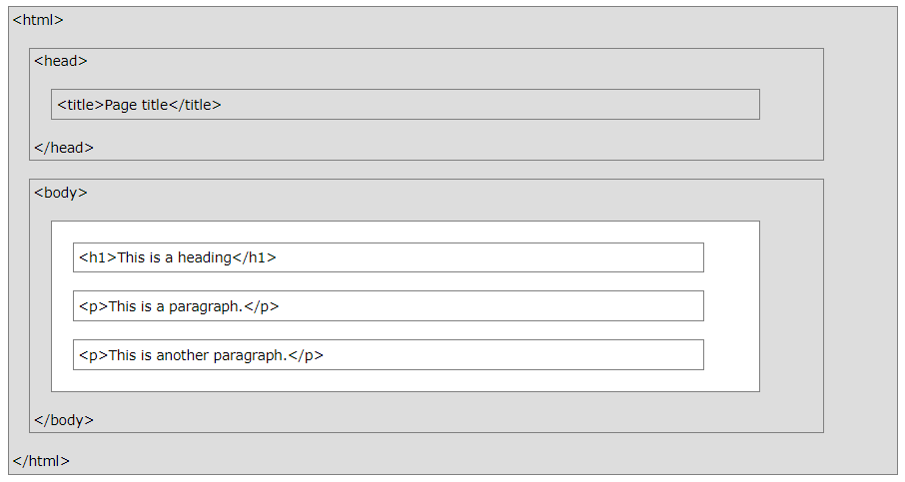
HTML Page Structure
This is a visualization of an HTML page structure.
Note: Only the content inside the <body> section (the white area above) is displayed in a browser.

Slide 7
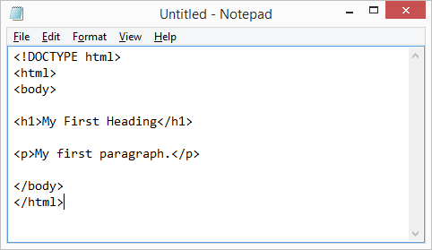
Write HTML Using Notepad
Step 1: Open Notepad (PC)
Step 2: Write Some HTML
Step 3: Save the HTML Page.
You can use either .htm or .html as file extension.
Step 4: View the HTML Page in Your Browser.

Slide 8
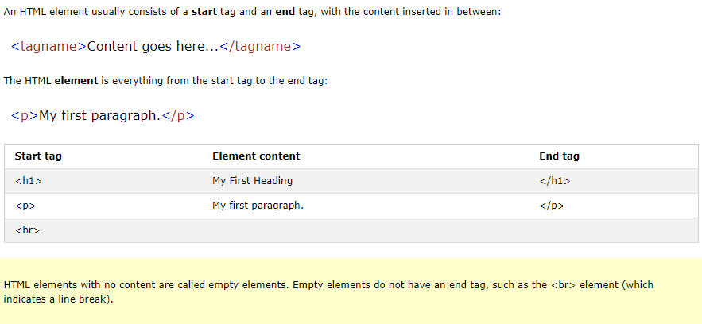
HTML Elements

Slide 9
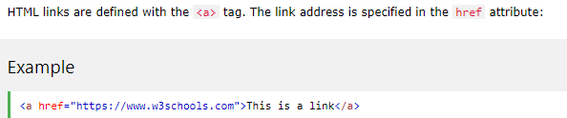
HTML Attributes
All HTML elements can have attributes
Attributes provide additional information about an element
Attributes are always specified in the start tag
Attributes usually come in name/value pairs like: name="value“.
a) The href Attribute

Slide 10
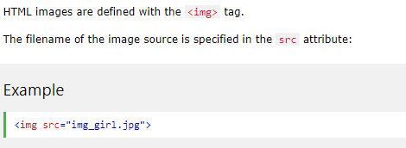
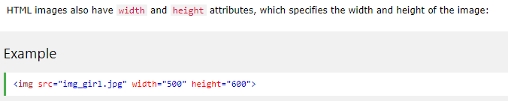
HTML Attributes
The src Attribute
The width and height Attributes

Slide 11
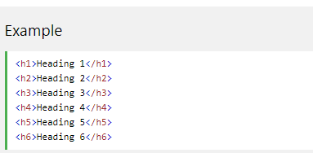
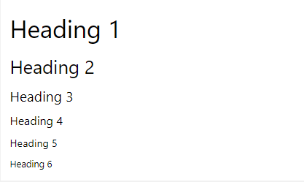
HTML Headings
Headings are defined with the <h1> to <h6> tags.
<h1> defines the most important heading. <h6> defines the least important heading.
Output:

Slide 12
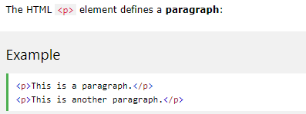
HTML Paragraphs
Output:
This is a paragraph.
This is another paragraph.

Slide 13
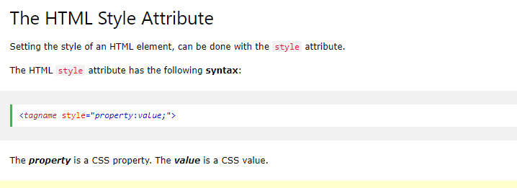
HTML Rules (Lines)
We use <hr /> tag to create horizontal line.
HTML Line Breaks
If you want a new line (line break) without starting a
new paragraph, use <br /> tag.
HTML Styles

Slide 14
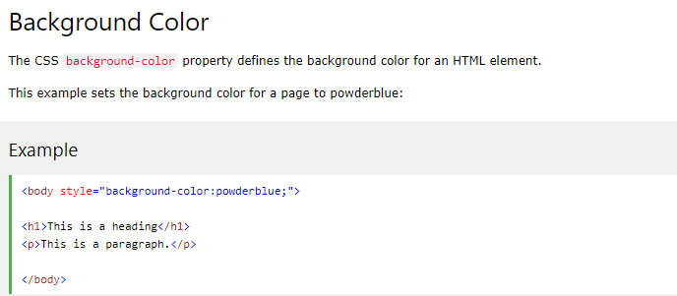

HTML Style

Slide 15
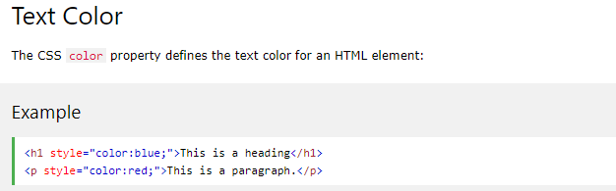
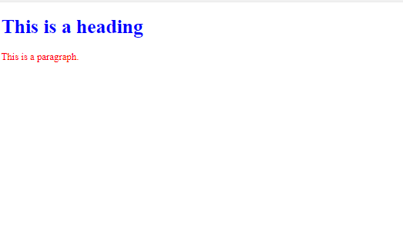
HTML Style

Slide 16
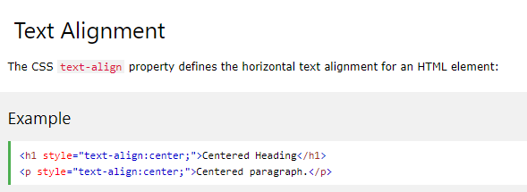

Html style

Slide 17
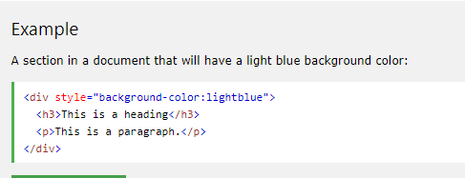
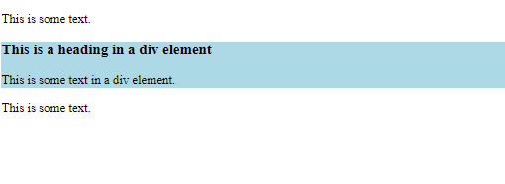
HTML DIVISION (DIV)
The <div> element defines logical divisions within the document. When you use a <div> element, you are indicating that the enclosed content is specific section of the page and you can format the section with CSS (Cascading Style Sheet). For example,

Slide 18
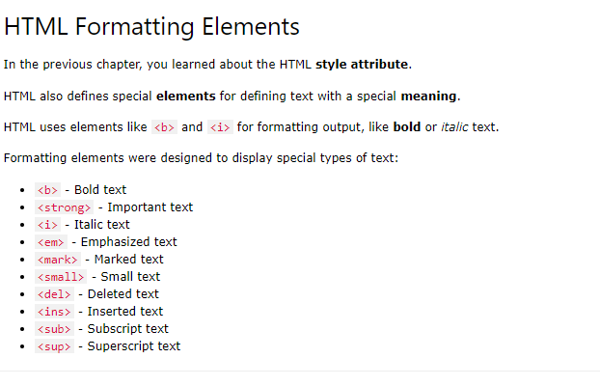
HTML Text Formatting

Slide 19



HTML Text Formatting
<b>This text is bold</b>
<i>This text is italic</i>
<p>This is <sub>subscripted</sub> text.</p>

Slide 20

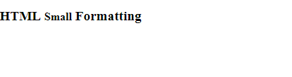
HTML Text Formatting
<p>This is <sup>superscripted</sup> text.</p>
<h2>HTML <small>Small</small> Formatting</h2>

Slide 21
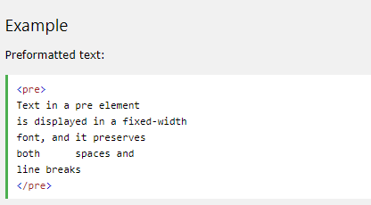
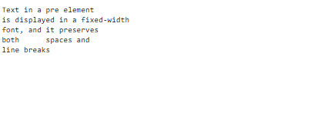
HTML Spacing
Pre tag
The <pre> tag defines preformatted text

Slide 22
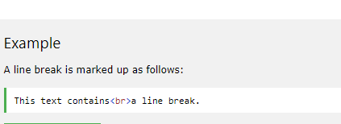
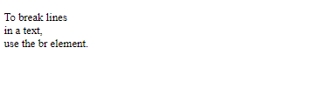
HTML Spacing
The <br> tag inserts a single line break.
The <br> tag is an empty tag which means that it has no end tag.

Slide 23

Formatting text phrases
Span tag <span>
The <span> tag is used to group inline-elements in a document.
The <span> tag provides no visual change by itself.
The <span> tag provides a way to add a hook to a part of a text or a part of a document.

Slide 24
Formatting text phrases
<strong> Tag
<strong>Strong text</strong>
<tt> Tag (Teletype)
<p><tt>Teletype text</tt></p>
Note: <tt> tag not supported in HTML5.

Slide 25
Image Elements
HTML <img> Tag
The <img> tag defines an image in an HTML page.
The <img> tag has two required attributes: src and alt.
We can also use width and height attributes with img tag. For example, <img src = “photo1.jpg” width = “104” height = “142” />.
We can use alt attribute to define an alternate text for an image. For example, <img src= “photo1.jpg” width = “104” height = “142” alt = “My best poto”/>.
The "alt" attribute tells the reader what he or she is missing on a page if the browser can't load images.
The browser will then display the alternate text instead of the image. It is a good
practice to include the "alt" attribute for each image on a page, to improve the display
and usefulness of your document for people who have text-only browsers.

Slide 26
Anchor Tag
<a> Tag
The <a> tag defines a hyperlink, which is used to link from one page to another.
The most important attribute of the <a> element is the href attribute, which indicates the link's destination.
Example:
<a href=http://google.com”>Visit our Website</a>
We can use target attribute to define where the linked document will be opened. For example, <a href = “http://www.cdcsit.tu.edu.np” target = “_blank”>cdcsit</a> will open the document in a new window.

Slide 27
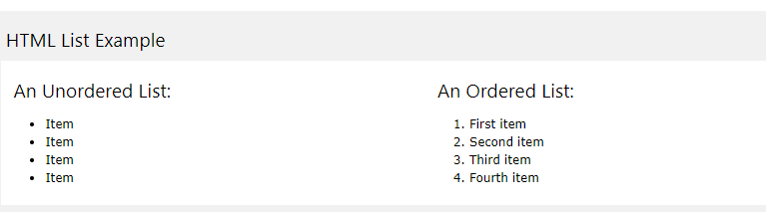
HTML Lists
HTML supports ordered, unordered and definition lists. Ordered lists items are marked with numbers, letter etc. We use <ol> tag for ordered list and each list item starts with <li> tag. For example,

Slide 28
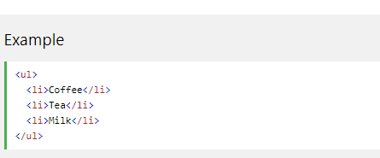
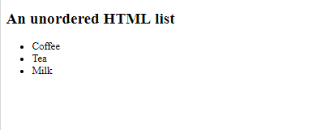
HTML Lists
Unordered HTML List
An unordered list starts with the <ul> tag. Each list item starts with the <li> tag.
The list items will be marked with bullets (small black circles) by default:

Slide 29
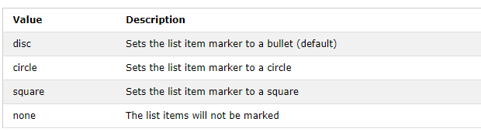
Unordered HTML List
Example:
<ul type="disc"> <li>Coffee</li> <li>Tea</li> <li>Milk</li> </ul>

Slide 30
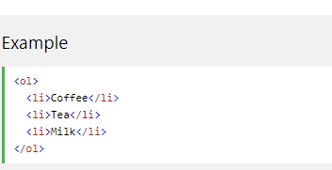
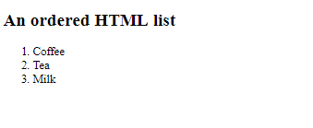
Ordered HTML List
An ordered list starts with the <ol> tag. Each list item starts with the <li> tag.
The list items will be marked with numbers by default:

Slide 31
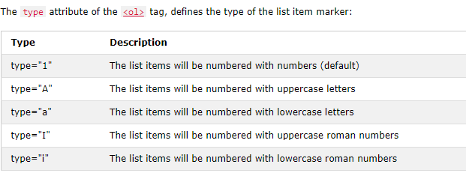
Ordered HTML List
<ol type="1"> <li>Coffee</li> <li>Tea</li> <li>Milk</li> </ol>

Slide 32
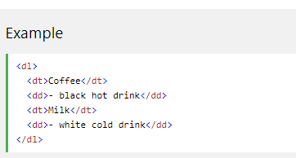
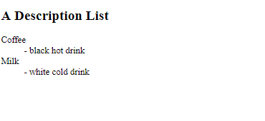
HTML Description Lists
HTML also supports description lists.
A description list is a list of terms, with a description of each term.
The <dl> tag defines the description list, the <dt> tag defines the term (name), and the <dd> tag describes each term:

Slide 33
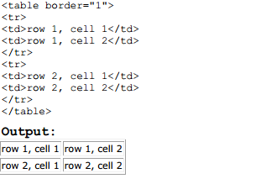
HTML Table
Tables are defined with the <table> tag. A table is divided into rows (with the <tr> tag),
and each row is divided into data cells (with the <td> tag). The letters td stands for "table
data," which is the content of a data cell. A data cell can contain text, images, lists,
paragraphs, forms, horizontal rules, tables, etc. For example,

Slide 34
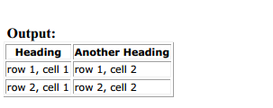
HTML Table
We use border attribute to display table with border as shown in the above example.
Headings in a table are defined with <th> tag. For example,
<table border="1">
<tr>
<th>Heading</th>
<th>Another Heading</th>
</tr>
<tr>
<td>row 1, cell 1</td>
<td>row 1, cell 2</td>
</tr>
<tr>
<td>row 2, cell 1</td>
<td>row 2, cell 2</td>
</tr>
</table>

Slide 35
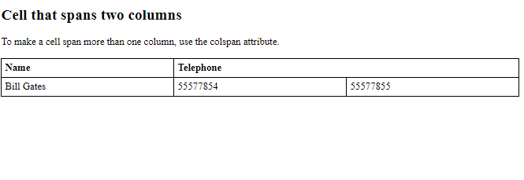
HTML Table - Cells that Span Many Columns
To make a cell span more than one column, use the colspan attribute:
<table style="width:100%"> <tr> <th>Name</th> <th colspan="2">Telephone</th> </tr> <tr> <td>Bill Gates</td> <td>55577854</td> <td>55577855</td> </tr> </table>

Slide 36
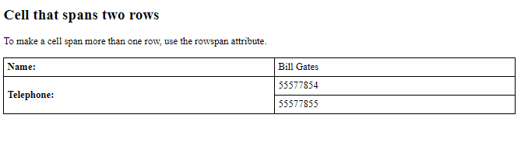
HTML Table - Cells that Span Many Rows
To make a cell span more than one row, use the rowspan attribute:
<table style="width:100%"> <tr> <th>Name:</th> <td>Bill Gates</td> </tr> <tr> <th rowspan="2">Telephone:</th> <td>55577854</td> </tr> <tr> <td>55577855</td> </tr> </table>

Slide 37
HTML Frames
We can use frames to display more than one web page in the same browser window. Each HTML document is called a frame, and each frame is independent of the others.
Disadvantages of using frames are:
- The web developer must keep track of more HTML documents.
- It is difficult to print the entire page.
We use <frameset> tag to define how to divide the window into frames.
Each frameset defines a set of rows or columns. Within frameset, we use <frame> tag to define what HTML document to put into each frame.

Slide 38
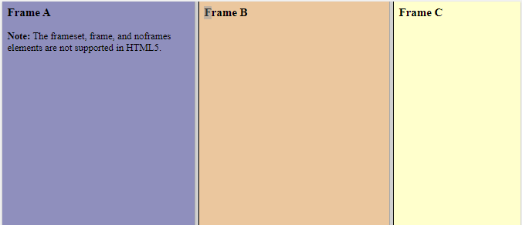
HTML Frames
<!DOCTYPE html>
<html>
<frameset cols="25%,*,25%">
<frame src="frame_a.htm">
<frame src="frame_b.htm">
<frame src="frame_c.htm">
</frameset>
</html>

Slide 39
The <form> Element
The HTML <form> element defines a form that is used to collect user input:
Syntax:
<form> form elements </form>
An HTML form contains form elements.
Form elements are different types of input elements, like text fields, checkboxes, radio buttons, submit buttons, and more.

Slide 40
The <input> Element
The <input> element is the most important form element.
The <input> element can be displayed in several ways, depending on the type attribute.
Here are some examples:
Type | Description
<input type="text"> | Defines a one-line text input field
<input type="radio"> | Defines a radio button (for selecting one of many choices)
<input type="submit"> | Defines a submit button (for submitting the form)

Slide 41
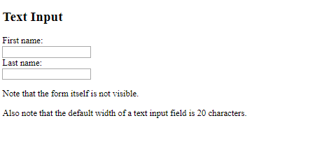
Text Input
<input type="text"> defines a one-line input field for text input:
<form>
First name:<br>
<input type="text" name="firstname">
<br>
Last name:<br>
<input type="text" name="lastname">
</form>

Slide 42
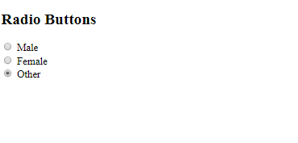
Radio Button Input
<input type="radio"> defines a radio button.
Radio buttons let a user select ONE of a limited number of choices:
<form>
<input type="radio" name="gender" value="male" checked> Male<br>
<input type="radio" name="gender" value="female"> Female<br>
<input type="radio" name="gender" value="other"> Other
</form>

Slide 43
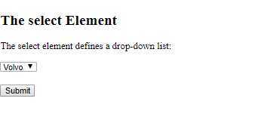
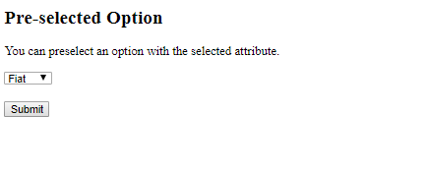
The <select> Element
The <select> element defines a drop-down list:
Example
<select name="cars"> <option value="volvo">Volvo</option> <option value="saab">Saab</option> <option value="fiat">Fiat</option> <option value="audi">Audi</option> </select>
To define a pre-selected option, add the selected attribute to the option:
<option value="fiat" selected>Fiat</option>

Slide 44
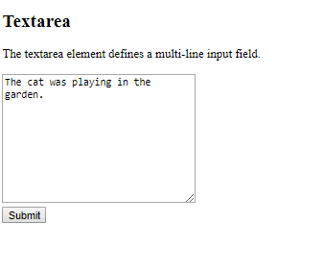
The <textarea> Element
The <textarea> element defines a multi-line input field (a text area):
<textarea name="message" rows="10" cols="30">
The cat was playing in the garden. </textarea>

Slide 45
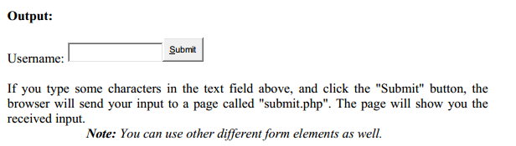
The Submit Button
<input type="submit"> defines a button for submitting the form data to a form-handler.
When the user clicks on the "Submit" button, the content of the form is sent to the server.
The form's action attribute defines the name of the file to send the content to.
The file defined in the action attribute usually does something with the received input.
For example,
<form name="input" action=" submit.php" method="get">
Username:
<input type="text" name="user" />
<input type="submit" value="Submit" />
</form>

Slide 46
The Method Attribute
The method attribute specifies the HTTP method (GET or POST) to be used when submitting the form data:
The method attribute of <form> tag specifies how to send form-data (the form-data is sent
to the page specified in the action attribute). We can use “get” and “post” as values of
method attribute. When we use get, form-data can be sent as URL variables and when we
use post, form-data are sent as HTTP post.

Slide 47
GET & Post Method
Notes on the "get" method:
• This method appends the form-data to the URL in name/value pairs
• There is a limit to how much data you can place in a URL (varies between browsers), therefore, you cannot be sure that all of the form-data will be correctly transferred
• Never use the "get" method to pass sensitive information! (password or other sensitive information will be visible in the browser's address bar)
Notes on the "post" method:
• This method sends the form-data as an HTTP post transaction
• The "post" method is more robust and secure than "get", and "post" does not have size limitations.

Slide 48
HTML Input Types
Here are the different Input types you can use in HTML:
<input type="button">
<input type="checkbox">
<input type="color">
<input type="date">
<input type="datetime-local">
<input type="email">
<input type="file">
<input type="hidden">
<input type="image">
<input type="month">
<input type="number">
<input type="password">
<input type="radio">
<input type="range">
<input type="reset">
<input type="search">
<input type="submit">
<input type="tel">
<input type="text">
<input type="time">
<input type="url">
<input type="week">

Slide 49
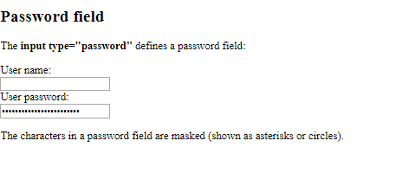
HTML Input Types
Input Type Text
Input Type Submit
Input Type Password
<form> User name:<br> <input type="text" name="username"><br> User password:<br> <input type="password" name="psw"> </form>

Slide 50
HTML Input Types
Input Type Reset
<input type="reset"> defines a reset button that will reset all form values to their default values:
<form >
First name:<br>
<input type="text" name="firstname" value="Mickey">
Last name:<br>
<input type="text" name="lastname" value="Mouse">
<br><br>
<input type="submit" value="Submit">
<input type="reset">
</form>

Slide 51
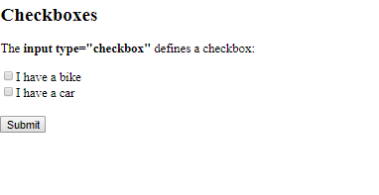
HTML Input Types
Input Type Radio
Input Type Button
Input Type Checkbox
<input type="checkbox"> defines a checkbox.
<form action="/action_page.php">
<input type="checkbox" name="vehicle1" value="Bike">I have a bike
<br>
<input type="checkbox" name="vehicle2" value="Car">I have a car
<br><br>
<input type="submit">
</form>

Slide 52
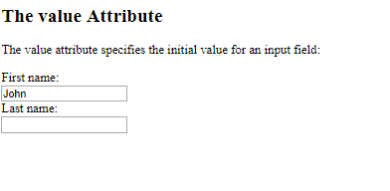
HTML Input Attributes
The value Attribute
The value attribute specifies the initial value for an input field:
<form action="">
First name:<br>
<input type="text" name="firstname" value="John">
<br>
Last name:<br>
<input type="text" name="lastname">
</form>

Slide 53
HTML Input Attributes
The readonly Attribute
<form action=""> First name:<br> <input type="text" name="firstname" value="John" readonly> </form>
The disabled Attribute
The disabled attribute specifies that the input field is disabled.
<form action=""> First name:<br> <input type="text" name="firstname" value="John" disabled> </form>

Slide 54
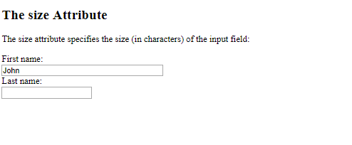
HTML Input Attributes
The size Attribute
<form action=""> First name:<br> <input type="text" name="firstname" value="John" size="40"> </form>

Slide 55
HTML The id Attribute
The id attribute specifies a unique id for an HTML element (the value must be unique within the HTML document)
#(hash) is used to identity ID attribute.
HTML class Attribute
The class attribute specifies one or more class names for an element.
.(dot) is used to identity Class attribute.

Slide 56
HTML <meta> Tag
Metadata is data (information) about data.
HTML includes a meta element that goes inside the head element. The purpose of the meta element is to provide meta-information about the document.
Meta elements are purely used for search engine’s use and to provide some additional information about your pages. We use three attributes (name, content, and http-equiv) with <meta> tag.
For Example:
<head> <meta charset="UTF-8"> <meta name="description" content="Free Web tutorials"> <meta name="keywords" content="HTML,CSS,XML,JavaScript"> <meta name="author" content="John Doe"> <meta name="viewport" content="width=device-width, initial-scale=1.0"> </head>

Slide 57
HTML <meta> Tag
We use name = “keywords” to provide information for a search engine. If the keywords
you have chosen are the same as the ones they have put in, you come up in the search
engine’s result pages. For example,
<meta name="keywords" content="HTML, DHTML, CSS, XML, XHTML, JavaScript" />
We use name = “description” to define a description of your page. It is sort summary of
the content of the page. Depending on the search engine, this will be displayed along with
the title of your page in an index. For example,
<meta name="description" content="Free Web tutorials on HTML, CSS, XML, and
XHTML" />

Slide 58
HTML <meta> Tag
We use name = “generator” to define a description for the program you used to write
your pages. For example,
<meta name="generator" content="Homesite 4.5" />
We use name = “author” and name = “copyright” for author and copyright details. For
example,
<meta name="author" content="W3schools" />
<meta name="copyright" content="W3schools 2005" />
We use name = “expires” to give the browsers a data, after which the page is deleted from
the browsers cache, and must be downloaded again. This is useful if you want to make sure
your visitors are reading the most current version of a page. For example,
<meta name="expires" content="13 July 2008" />

Slide 59


The HTML <audio> Element
To play an audio file in HTML, use the <audio> element:
<audio controls> <source src="horse.ogg" type="audio/ogg"> <source src="horse.mp3" type="audio/mpeg"> Your browser does not support the audio element. </audio>
HTML <video> Tag
The <video> tag specifies video, such as a movie clip or other video streams.
<video width="320" height="240" controls>
<source src="movie.mp4" type="video/mp4">
<source src="movie.ogg" type="video/ogg">
Your browser does not support the video tag.
</video>

