Slide 1
Internet

Slide 2
Internet is aglobal communication system that links together thousands of individual network. It allows exchange of information between two or more computers on a network. Thus internet helps in transfer of message through mail,chat,video and audio conference etc.
Internet was evolved in 1969 under the project called ARPANET(Advance Research Projects Agency Network) to connect computers at different universities and U.S defense.
Component of the internet:
Network Infrastructure:
Routers and Switches: These devices manage the flow of data between different networks.
Modems: Convert digital data from computers into signals that can be transmitted over communication lines and vice versa.
Cables and Wireless Signals: Physical infrastructure like fiber-optic cables and wireless signals that facilitate data transmission.

Slide 3
Protocols:
TCP/IP (Transmission Control Protocol/Internet Protocol): The fundamental suite of protocols that enables communication between devices on the Internet.
HTTP/HTTPS (Hypertext Transfer Protocol/Secure): Protocols for transferring web pages and other data on the World Wide Web
Servers and Clients:
Servers: Computers that provide services or resources to other computers (clients) on the network. This can include web servers, email servers, file servers, etc.
Clients: Devices that request and use services or resources from servers.
Domain Name System (DNS):
Translates human-readable domain names (e.g., www.example.com) into IP addresses that computers use to identify each other on the network.

Slide 4
Internet Service Providers (ISPs):
Companies that provide access to the Internet for individuals and organizations. They connect users to the broader Internet infrastructure.
Browsers:
Software applications that allow users to access and navigate the World Wide Web. Examples include Chrome, Firefox, Safari, and Edge.
etc..

Slide 5
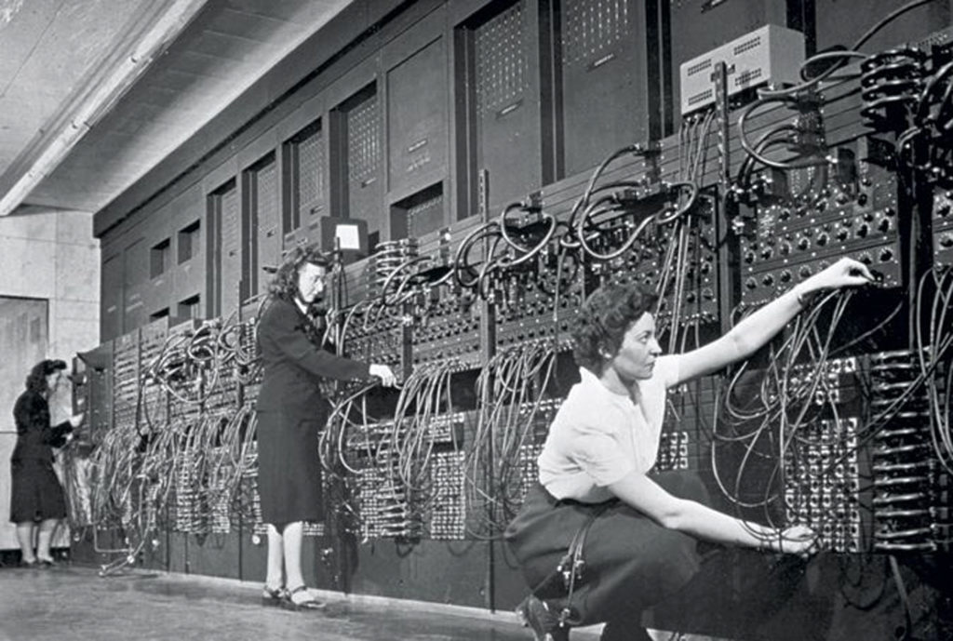
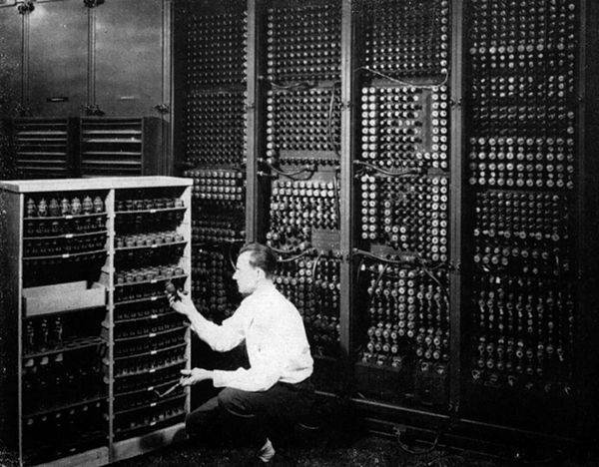
History of Internet
ENIAC(Electronic Numerical integrator and Computer)
Feb. 14,1946

Slide 6

Mid 1960s:
The Advanced Research Projects Agency (ARPA) in the Department of Defense (DOD) was interested in finding a way to connect computers together.
So that the researchers they funded could share their funded, thereby reducing costs and eliminating duplicating of effort.
By 1969 ARPANET
Four nodes, at the university of California at los Angels
(UCLA),the university at Santa Barbara(USCB),Standford research institute (SRI),and the university of Utah were
connected

Slide 7
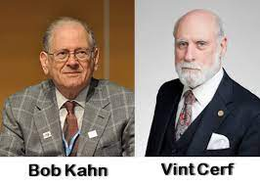
1972
Birth of Internet
Vint Cert Bob Kahn. Both of whom were part of the core ARPANET group, collaborated on what they called the internetting Project.
They wanted to link different networks together so that ahost on one network could communicate with a host on a second, different network.
They developed a hardware device named as
Gateway to connect different Network.
They develop TCP(Transmission Control Protocol)
Which splits into TCP and IP and then called
TCP/IP.

Slide 8
1981:CSNET(Computer Science Network )
It was developed by National Science foundation.
1983 ARPANET
-divided into two groups
MILNET for military user
ARPANET for non-military users

Slide 9
Architecture of Internet:
The architecture of the Internet is ever-changing due to continuous changes in the technologies as well as the nature of the service provided. The heterogeneity and vastness of the Internet make it difficult to describe every aspect of its architecture.
The overall architecture can be described in three levels −
Backbone ISP (Internet Service Provider)
Regional ISPs
Clients

Slide 10
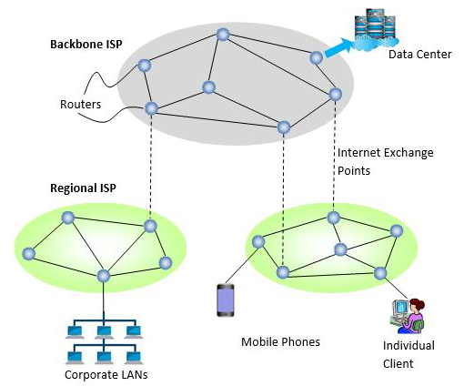

Slide 11
Backbone ISP (Internet Backbone):
A backbone ISP is a high-capacity network that forms the core infrastructure of the Internet. It consists of major data routes and high-speed communication lines that interconnect various networks and regions globally.
Regional ISP:
A regional ISP is an Internet Service Provider that operates at a more localized or regional level. Unlike backbone ISPs that span large distances, regional ISPs focus on providing connectivity within a specific geographic area or region.
Clients:
Clients are the local individual mechine which is capable to sent request on the internet .

Slide 12
The internet Today:
The Internet today comprises hundreds of thousands of local area networks (LANs) worldwide, interconnected by a backbone wide area network (WAN). LANs typically operate at rates of 10 to 100 Mbps. Until 1995 links of the WAN supported lower bit rates, but the dramatic increase in traffic combined with the reduction in the cost of optical links have increased backbone link rates to as much as 10 Gbps. To deal with these large link rates, some network service providers deploy IP routers interconnected by ATM switched networks.
Today, te backbone circuit of the different country's ISP's operate at SONET (Synchronous optical network) OC-48 (optical carrier) and OC-192. Most of the largest national ISP's plan to convert their principal backbone to OC-192(10Gbps).A few are now experimenting OC-768(80 Gbps), and several are in the planning stages with OC-3072(160 Gbps). This is good becaus of amout of traffinc has been growing rapidly. The inrernet traffic in the US is expected to reach 80 Tbps (80 trillion bits pwe second)by 2011.
Network vendors such as Cisco and Juniper are making larger switches capable of handling these high-capacity circuit.When circuit capacities increases by 100% , swirtches manufacture also must increase their capacities by 100%.

Slide 13
Internet Access Technology:
DSL(Digital Subscriber LAN):
DSL stands for Digital Subscriber Line, and it is a technology that provides high-speed internet access over traditional copper telephone lines. DSL works by utilizing the unused frequency spectrum on the telephone line to transmit data, allowing users to access the internet without disrupting their telephone service.
There are different types of DSL, with the most common ones being:
Asymmetric DSL (ADSL): This type of DSL provides faster download speeds than upload speeds. It is well-suited for typical internet usage where users often download more data than they upload.
Symmetric DSL (SDSL): SDSL provides equal upload and download speeds, making it suitable for applications that require consistent performance in both directions, such as video conferencing.

Slide 14
RADSL
RADSL stands for Rate-Adaptive Digital Subscriber Line. It is a variation of the Digital Subscriber Line (DSL) technology that allows the internet service provider to adapt the speed of the DSL connection based on the quality and length of the telephone line. RADSL is designed to provide more flexibility in adjusting the data transmission rates to optimize performance under varying line conditions.
HDSL
HDSL stands for High-Bit-Rate Digital Subscriber Line. It is a type of digital subscriber line (DSL) technology that was developed to provide high-speed, symmetrical data transmission over traditional copper telephone lines. HDSL was primarily designed for business applications and dedicated lines

Slide 15
Different Terms used in DSL Architecture:
Local Loop
Customer Premises(CP)
Modem/Router
Line Splitter
DSLAM (digital subscriber line access multiplexer)
Working of DSL technology.
Local Loop: It is the physical link that connects customer to the service provider.
Customer Premises: It is the customer part that includes all the devices of customer like modem,PC,splitter etc.
Modem: It is the device that modulates and demodulates signals . IN today's networks modem and router is combined in one device as home router.
Line Splitter: It is the small equipment that divide voice and data traffic.
DSLAM: is the device in service provider port that collects the traffice and then distinguishes data and voice traffic. After that ot send the related traffic to its destination.

Slide 16
Cable Modem:
A cable modem is a device that connects a computer system to the Internet via the cable television network. This technology are different standards but the most common one is DOCSIS (Data over cable Service Interface Specification) standard. There are differents used with cable Internet technology. These are:
Customer Premises
Line Splitter
Cable Modem
Provider Fiber node
Cable modem termination system
Combiner

Slide 17
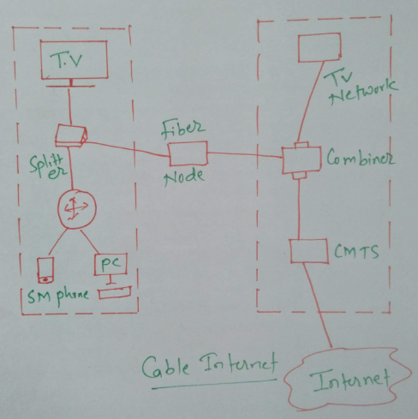

Slide 18
Advantage of Cable Modem;
High Sppeed: Cable INternet provides high speed internt acess,espically in ares where fiber optic connection are not available.
widespread Availability:Cable internet is widely available,particularly in urban and suburban areas. This availability makes it accessible to a larger portion of the population.
Bundled Service: Cable providers often offer bundled packages that include Internet, Cble TV, and sometimes phone service.
Reliable connection: Cable Interrnet connection are generally stable and reliable, providing a consistent experiences for users.
Shared infrastructure: Cable Internt uses the same infrastructure as cable television, If you already have cable TV service setting up cable Internt is often conveninet.

Slide 19
Disadvantage:
Share Bandwidth:
Limited upload speed:
Pricing

Slide 20
Fiber to the Home (FTTH)
FTTH stands for Fiber to the Home, which is a technology that involves the installation and use of optical fiber cables to provide high-speed internet, television, and telephone services directly to residential buildings. In FTTH networks, optical fibers are used to transmit data as pulses of light, offering much higher bandwidth and faster data transfer rates compared to traditional copper-based systems.
Fiber to the home architecture is very similar to DSL adn cable modem. At each subscriber location an opptical network unit(ONU) also called an optical netwrok terminal (ONT) acts like a DSL modem or cable modem and converts signal in the opical network into an ethernet format.
FTTH provides several advantages, including:
High Speeds: Fiber-optic cables can transmit data at extremely high speeds, providing faster internet connections for users.
Reliability: Fiber-optic cables are less susceptible to interference and signal degradation compared to copper cables, resulting in more reliable and consistent internet connections.

Slide 21
Greater Bandwidth: Fiber-optic cables have a much higher capacity for data transmission, allowing for greater bandwidth to support the increasing demand for data-intensive applications and services.
Symmetrical Upload and Download Speeds: Unlike some traditional broadband technologies, FTTH typically offers symmetrical upload and download speeds, providing consistent performance for both upstream and downstream data.
Future-Proofing: The high capacity and efficiency of fiber-optic technology make it a future-proof solution that can accommodate the growing demand for higher internet speeds and emerging technologies.

Slide 22
Disadvantage:
Installation Costs: The initial setup cost of deploying FTTH infrastructure can be high. Laying fiber-optic cables to individual homes requires significant investment in materials, labor, and equipment.
Deployment Time: Building FTTH networks can be a time-consuming process. The installation of fiber-optic infrastructure may require digging up streets, sidewalks, and other public spaces, leading to disruptions and inconveniences for residents.
Existing Infrastructure: In regions where there is already established copper or coaxial cable infrastructure, the transition to FTTH may involve additional challenges and costs, as the existing infrastructure may need to be replaced or upgraded.
Service Provider Competition: In some areas, competition among service providers offering FTTH services may be limited. This lack of competition can affect pricing and service quality for consumers.

Slide 23
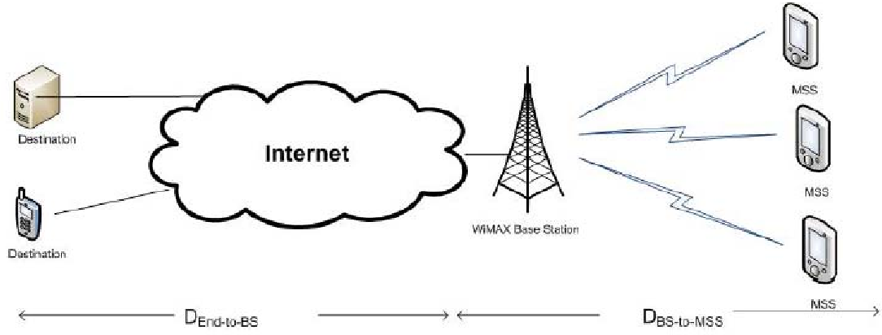
WIMAX
WiMAX, which stands for Worldwide Interoperability for Microwave Access, is a wireless communication standard that provides high-speed, long-range broadband connectivity. It is based on the IEEE 802.16 family of standards and is designed to deliver wireless broadband access over longer distances compared to traditional Wi-Fi networks.

Slide 24
The Architecture consists of :
WiMax Base station:
Radio Access Netwrok (RAN):Teh base station is part of the Radio Access Netwrok, ersponisble for manageing the wireless communication with subscriberr station.
Connection to core network:The base station connects to the core network, which can include elements like routers, switches etc. This connection allows user data to flow between the wireless network and the broader internet or provate networks.
Wimax subscriber Station::
Wireless link: The subscriber station communicates with the base station using a wireless link, enabling users t access the network without physical link.
User device:Subscriber station cna be integrated into various user devices, such as WiMax modems,routers or embedded modules in smartphones and laptops.

Slide 25
Future of the Internet
5G and beyond
Internet of Things
Artificial intelligence (AI) and machine learnign
Augmented reality and Virtual reality
etc
Internet Governance:
Internet governance refers to the processes, principles, and institutions that shape how the Internet is managed and operated. It involves a wide range of stakeholders, including governments, private sector entities, technical experts, civil society organizations, and individual users. The goal of internet governance is to ensure the stable and secure functioning of the global Internet while promoting an open, accessible, and inclusive digital environment. Here are some key aspects of internet governance:

Slide 26
Technical Coordination: Organizations such as the Internet Corporation for Assigned Names and Numbers (ICANN) and the Internet Engineering Task Force (IETF) play critical roles in the technical coordination of the Internet. ICANN manages domain names and IP addresses, while the IETF develops and maintains Internet standards.
Policy Development: Governments and regulatory bodies may develop policies that impact the use and management of the Internet within their jurisdictions. International organizations, such as the International Telecommunication Union (ITU), may also play a role in coordinating global policies related to telecommunications.
Cybersecurity: Internet governance includes efforts to address cybersecurity challenges and threats. This involves the development of policies, standards, and collaboration among stakeholders to enhance the security of the Internet infrastructure and protect users from cyber threats.
Digital Rights and Freedoms: Internet governance encompasses issues related to digital rights and freedoms, including freedom of expression, privacy, and access to information. Discussions around net neutrality, censorship, and online surveillance fall within this domain.

Slide 27
Building the Future:
Building the future of the internet involves a combination of technological advancements, policy considerations, and societal collaboration. Here are some key areas and strategies to consider in shaping the future of the internet:
Enhancing Connectivity:
Cybersecurity and Trust:
AI and Automation:
International Collaboration:

