Slide 1
Unit-1
Introduction

Slide 2
Network as an Infrastructure for Data Communication:
Communication is the process of transferring the information from one point to another. Information can be in any form i.e. in the form of data, audio,video,messages etc.
“Data Communication is the process of sending and receiving digital data between two or more computer via transmission medium such as wire or wireless.”
Information is defined as the knowledge or intelligence. Data communications can be summarized as the transmission, reception, and processing of digital information. For data communications to occur, the communicating devices must be part of a communication system made up of a combination of hardware (physical equipment) and software (programs). The effectiveness of a data communications system depends on four fundamental characteristics: delivery, accuracy, timeliness, and jitter.
Point A
Information
Point B
Exchange

Slide 3
For successful transmission of data we can use some hardware and software devices such as:
Sending devices
Receiving devices
Intermediate devices
And software like protocols.
Characteristics of Data Communication:
Delivery: Data should be transfer to the correct user and in the correct time.
Accuracy: Data should be transfer with 100% of accuracy without any error.
Timeliness: Without delay data should be transferred to the user. Ex: audio, Video.
Jitter: It is a variation of packet arrival time. If there will be a delay to arriving the packet to the destination that is called as jitter. So jitter can not allowed.

Slide 4
Components of Data Communication:
A data communications system has five components:
1. Message: The message is the information (data) to be communicated. Popular forms of
information include text, numbers, pictures, audio, and video.
2. Sender: The sender is the device that sends the data message. It can be a computer,
workstation, telephone handset, video camera, and so on.
3. Receiver: The receiver is the device that receives the message. It can be a computer,
workstation, telephone handset, television, and so on.
4. Transmission medium: The transmission medium is the physical path by which a message travels from sender to receiver. Some examples of transmission media include twisted-pair wire, coaxial cable, fiber-optic cable, and radio waves.
5. Protocol: A protocol is a set of rules that govern data communications. It represents an
agreement between the communicating devices.

Slide 5
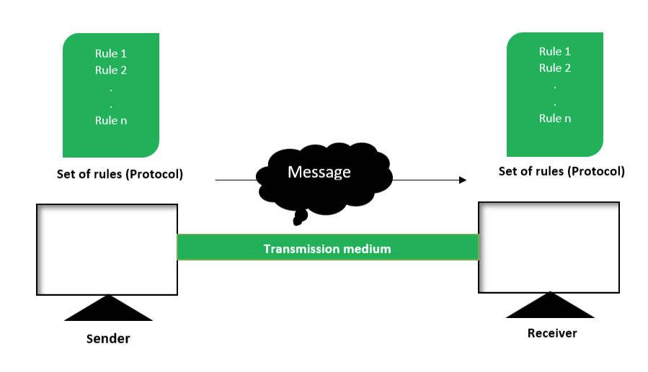

Slide 6
Data Transmission mode
Data Transmission mode defines the direction of the flow of information between two communication devices. It is also called Data Communication or Directional Mode.
The data transmission modes can be characterized in the following three types based on the direction of exchange of information:
Simplex
Half-Duplex
Full Duplex

Slide 7
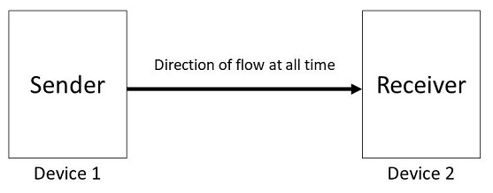
1. Simplex
Simplex is the data transmission mode in which the data can flow only in one direction, i.e., the communication is unidirectional. In this mode, a sender can only send data but can not receive it. Similarly, a receiver can only receive data but can not send it.
For Example, Radio and TV transmission, keyboard, mouse, etc.

Slide 8
Following are the advantages of using a Simplex transmission mode:
It utilizes the full capacity of the communication channel during data transmission.
It has the least or no data traffic issues as data flows only in one direction.
Following are the disadvantages of using a Simplex transmission mode:
It is unidirectional in nature having no inter-communication between devices.
There is no mechanism for information to be transmitted back to the sender(No mechanism for acknowledgement).

Slide 9
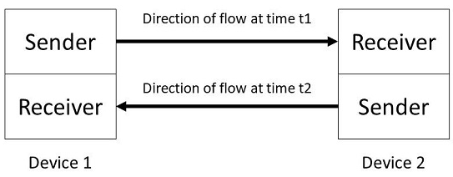
2. Half-Duplex
Half-Duplex is the data transmission mode in which the data can flow in both directions but in one direction at a time. It is also referred to as Semi-Duplex. In other words, each station can both transmit and receive the data but not at the same time. When one device is sending the other can only receive and vice-versa.
For Example, Walkie-Talkie, Internet Browsers, etc.

Slide 10
Following are the advantages of using a half-duplex transmission mode:
It facilitates the optimum use of the communication channel.
It provides two-way communication.
Following are the disadvantages of using a half-duplex transmission mode:
The two-way communication can not be established simultaneously at the same time.
Delay in transmission may occur as only one way communication can be possible at a time.

Slide 11
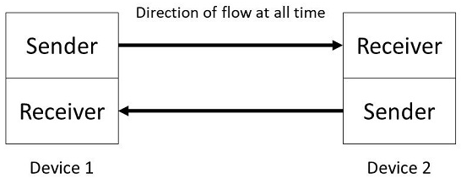
3. Full-Duplex
Full-Duplex is the data transmission mode in which the data can flow in both directions at the same time. It is bi-directional in nature. It is two-way communication in which both the stations can transmit and receive the data simultaneously.
For Example, a Telephone Network, in which both the persons can talk and listen to each other simultaneously.

Slide 12
Following are the advantages of using a full-duplex transmission mode:
The two-way communication can be carried out simultaneously in both directions.
It is the fastest mode of communication between devices.
Following are the disadvantages of using a half-duplex transmission mode:
The capacity of the communication channel is divided into two parts. Also, no dedicated path exists for data transfer.
It has improper channel bandwidth utilization as there exist two separate paths for two communicating devices.

Slide 13
Standards making process:
Standards are the set of rules for data communication that are needed for exchange of information among devices. It is important to follow Standards which are created by various Standard Organization like IEEE , ISO , ANSI etc.
Types of Standards :
Standards are of two types :
De Facto Standard.
De Jure Standard.
De Facto Standard : The meaning of the word ” De Facto ” is ” By Fact ” or “By Convention”. These are the standard s that have not been approved by any Organization , but have been adopted as Standards because of it’s widespread use. Also , sometimes these standards are often established by Manufacturers.
For example : Apple and Google are two companies which established their own rules on their products which are different . Also they use some same standard rules for manufacturing for their products.
De Jure Standard : The meaning of the word “De Jure” is “By Law” or “By Regulations” . Thus , these are the standards that have been approved by officially recognized body like ANSI , ISO , IEEE etc. These are the standard which are important to follow if it is required or needed.
For example : All the data communication standard protocols like SMTP , TCP , IP , UDP etc. are important to follow the same when we needed them.

Slide 14
Importance of network protocol standards
Protocols and standards make networks work together. Protocols make it possible for the various components of a network to communicate with each other, and standards make it possible for different manufacturers' network components to work together.
Network protocols and standards are important because they enable different devices and systems to communicate with each other on a network, regardless of their hardware, software, or location. They also ensure consistency, efficiency, and quality of service for network users and applications.

Slide 15
These are some common standards
ISO(International Organization for Standardization)
Formation: 23 February 1947
Headquarter: Geneva(Switzerland)
Work in 164 Countries
Develops standard to ensure the Quality,safety,Efficiency of products,
and services and system.
New Certification ISO 9001:2015
9000 family refers to the quality of management
It Helps business and organizations be more efficient and improve customer
satisfaction

Slide 16
2. ITU(International Telecommunication Union)
Initially as International Telegraph Union
Formation: 17 may 1865
Rename: 1932
Headquarter: Geneva(Switzerland)
193 Countries are member
ITU Sector:
1. ITU-R (Radio Communication)
2. ITU-T (Telegraph and telephone)
3.ITU-D (Development)

Slide 17
3. IEEE (Institute of Electrical and Electronics Engineer)
Formation 1 Jan 1963
AIEE(American institute of electrical engineers) merged with IRE(Institute of radio engineers).
Headquarter: New Jersay (US)
Member in more than 160 countries.
IEEE is the world largest technical professional society.
Best known for developing standards for the computer and electronic industry.eg: IEEE 802

Slide 18
4. ANSI(American National Standards Institute):
Formation 1 October 1918
Headquarter: Washington(USA)
125,000 companies and 3.5 million professionals are member.
Create standard for the computer industries.(ANSI C)
In addition to programming languages,ANSI sets standards for a wide range of technical areas. From electrical specification to communication protocol (FDDI).

Slide 19
5. Internet Engineering Task Force (IETF)
Formation January 14, 1986
Headquarter: Fremont, California, United States
The mission of the IETF is to make the Internet work better by producing high quality, relevant technical documents that influence the way people design, use, and manage the Internet.
6. Internet Research Task Force(IETF):
Founded : 1986
Purpose: Promoting research into the evolution of the Internet

Slide 20
Key element of Protocol
A protocol are the fundamental aspect of digital communication as they dictate how to format , transmit and receive data . they are a set of rules that determines how the data will be transmitted over the network.
It can also be defined as a communication standard followed by the two key parties ( sender and receiver ) in a computer network to communicate with each other.
It specifies what type of data can be transmitted , what commands are used to send and receive data and how data transfer are confirmed.
In simple terms , a protocol is similar to a language . Every language has its own rules and vocabulary . Protocol have their own rules , specifications and implementation . If 2 people share the same language , they can communicate very easily and effectively.
Similarly two hosts implementing the same protocol can connect and communicate easily with each other . Hence protocols provide a common language for network device participating in data communication.

Slide 21
The key element of protocols :
Syntax : Syntax relates to the structure or format of the data meaning the order in which they are presented. For example, A simple protocol may expect the first 8 bit of data to be the address of the sender , the second 8 bits to be the address or receiver , and the rest of the stream to be the massage itself.
Semantics : Semantics relates to the meaning of each section of bits . How is specified pattern to be interpreted and what action is to be taken based on that interpretation . For instance dose an address. Identify the route to be taken or the final destination of the massage.
Timing : Timing refers to two vital characteristic when data should be sent and how fast can be sent . For example, If a sender produces data at 100 mbps but receiver can process data at only 1 mbps , the transmissions will overload the receiver and data will be largely lost.

Slide 22
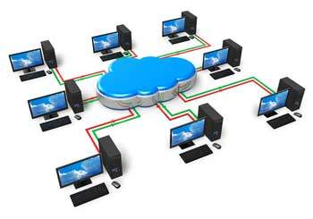
Computer Network

Slide 23
Computer network is a set of device or nodes connected through links
A node can be a computer, printers, or any other device capable of sending and receiving the data.
The links connecting the nodes are known as communication channel.
Features of computer network
Communication channel
Network provides us to communicate over the Network in a fast and efficient manner for ex: we can do, video conferencing, email messaging etc.
File sharing:
Computer network provides us to share the files with each other.

Slide 24
Software and hardware sharing:
We can install the applications on the main server . Therefor user can access the application centrally. So we do not need to install the software on every machine.
Hardware like printers can be accessible from any computer of our network.
Security:
Network allows the security by ensuring that the user has the right to access the certain files and applications.
Scalability:
Scalability means that we can add new components in the network. Network must be scalable so that we can extend the network by adding new devices but it decreases the speed of the connection and data of the transmission speed also decrease.
Reliablilty:
Computer network can use the alternative sources for the data communication in case of any hardware failure.

Slide 25
Types of Computer Network
LAN (Local area network)
MAN (Metropolitan Area Network)
WAN (Wide Area Network)
PAN (Personal Area Network)
CAN (Campus Area Network)

Slide 26
Local Area Network
Local Area Network is a group of computers connected to each other in a small area such as building, office.
LAN is used for connecting two or more personal computers through a communication medium such as twisted pair, coaxial cable, etc.
It is less costly as it is built with inexpensive hardware such as hubs, network adapters, and ethernet cables.
The data is transferred at an extremely faster rate in Local Area Network.
Local Area Network provides higher security.
It offers bandwidth of 10- 100 mbps.

Slide 27
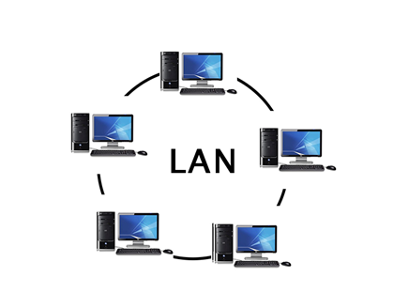
Distance range from 10m – 1km.

Slide 28
MAN(Metropolitan Area Network)
MAN covers a large geographic area by interconnecting a different LAN to form a large network. It spread over a metropolitan area such as within a city.
Government agencies uses MAN to connect the citizens and private industries.
It uses cables or wireless communication
Distance range is not more than 10km
The best example of MAN is the cable television available in many cities.

Slide 29
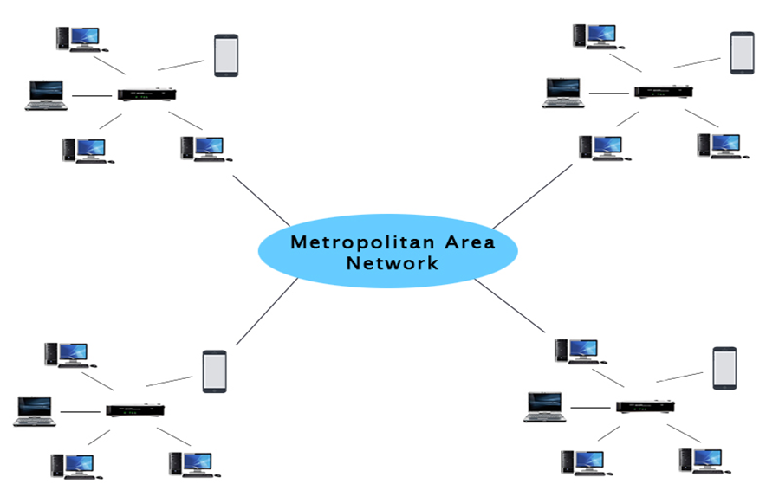

Slide 30
WAN (Wide Area Network)
Wide area network is a network that extends over a large geographical area such as states or countries.
Wide area network is not limited to a single location but it spans over a large geographical area through am telephone line,fiber optic cable or satellite links.
The internet is the one of the biggest WAN in the world.
Wide are network is widely used in the field of Business, government and education.

Slide 31
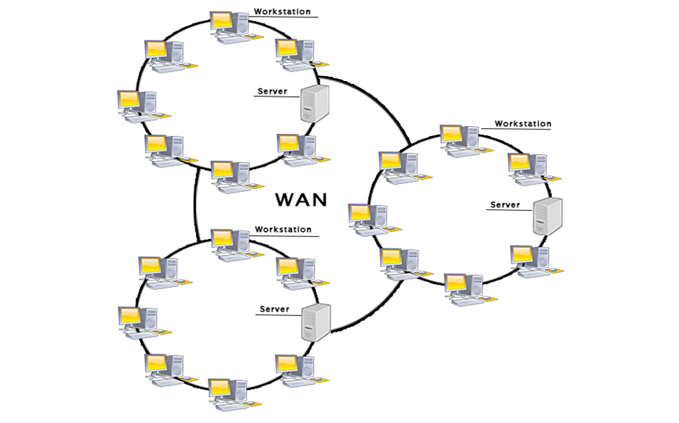

Slide 32
PAN(Personal Area Network)
Personal Area Network is a network arranged within an individual person, typically within a range of 10 meters.
Personal Area Network is used for connecting the computer devices of personal use is known as Personal Area Network.
Thomas Zimmerman was the first research scientist to bring the idea of the Personal Area Network.
Personal Area Network covers an area of 30 feet.
Personal computer devices that are used to develop the personal area network are the laptop, mobile phones, media player and play stations.

Slide 33
CAM(Campus Area Network)
A campus area network known as (CAN) is used to inter-connect networks in limited geographical locality like university campus, military bases, or organizational campuses etc.
CANs are smaller than metropolitan area networks (MAN) and wide area networks (WAN),

Slide 34
Types of communication Channel
Transmission Mode
Transmission Mode
Simplex ( Unidirectional)
Full-Duplex (Bi-directional)
Half-Duplex (Bi-directional)

Slide 35
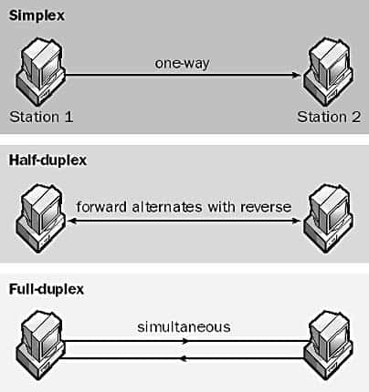
Simplex Example:
the radio or tv
Duplex Example:
Telephone system
Half duplex:
walkie-talki

Slide 36
Types of Network topologies
(Structure of Network)
Network topology is the way a network is arranged, including the physical or logical description of how links and nodes are set up to relate to each other. In other words, the arrangement of a network which comprises of nodes and connecting lines via sender and receiver is referred as network topology
BUS
RING
STAR
TREE (combines the characteristics of bus topology and star topology )
MESH
HYBRID

Slide 37
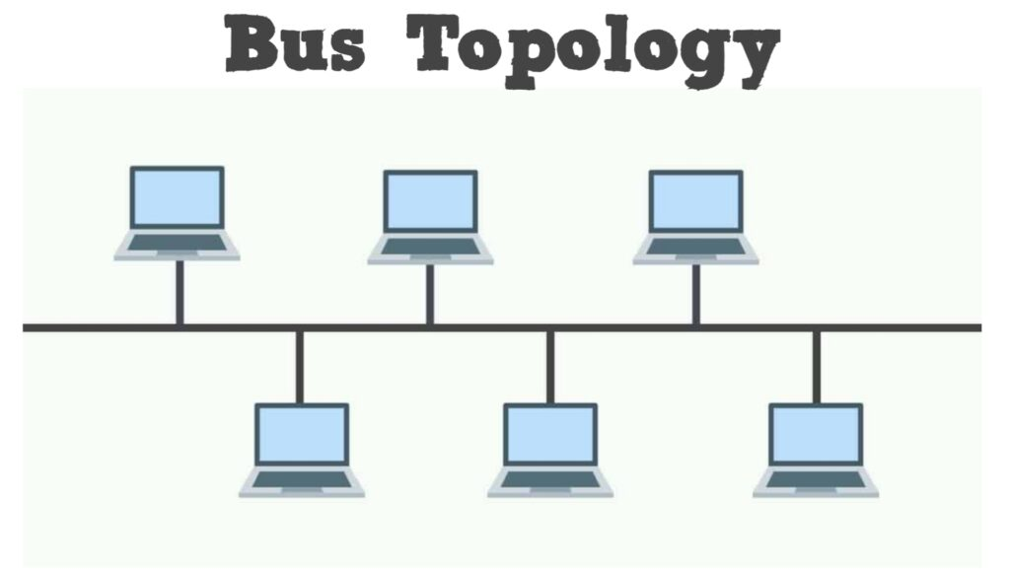
BUS Topology:
The bus topology is design in such a way that all the stations are connected through a single cable known as backbone cable.
Each node is either connected to the backbone cable by drop or directly connected to the back bone cable.
When a node wants to send a message over the network, it puts a message over a network. All the station available in the network will receive the message whether it has been addressed or not.
The configuration of bus topology is quite simpler than as compared to other topologies.

Slide 38
Advantage:
Low cost cable:
In bus topology nodes are directly connected to the cable without passing through hub. Therefore the initial cost of installation is low.
Moderate data speed:
Coaxial or twisted pair cable is used in bus-based network that support up to 10 mbps.
Limited failure:
Failure in one node will not have any effect on other nodes.

Slide 39
Disadvantage:
Extensive Cabling:
Bus topology is quite simpler, but still it requires a lot of cabling.
Difficult troubleshooting
It require specialized test equipment to determine the cable fault. If any fault in cable then it would disrupt the communication for all the node.
Single interference
If two nodes send a message simultaneously, then the signals of both the nodes collide with each other.
Adding the new device to the network would slow down the n/w.

Slide 40
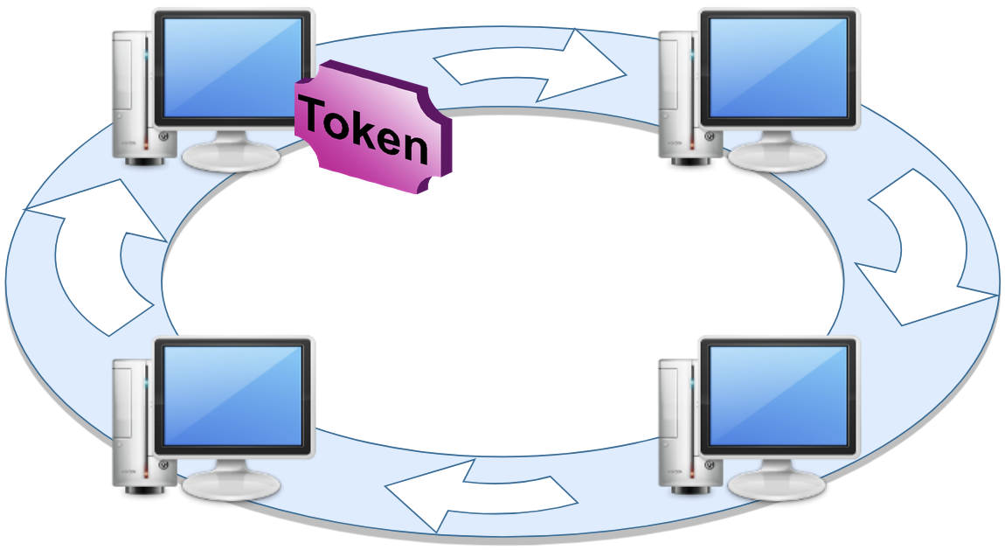
RING TOPOLOGY:
-Ring topology like a bus topology, but
with connected ends
-The data flows in one direction that it is
Unidirectional.
-the data flows in a single loop continuously
known as endless loop.
It has no terminated ends. Ie. Each node is connected to other node and having no termination point.
The data in ring topology flows in clockwise direction.
The most common access method of ring topology is token passing.
Token is the frame that circulates around the network.

Slide 41
Advantage of ring topology:
Network Management:
Faulty device can be removed from the network without bringing the network down.
Product Availability:
Many hardware and software tools for network operation and monitoring are available.
Cost:
Twisted pair cabling is inexpensive and easily available .therefore, the installation cost is very easy.

Slide 42
Disadvantage:
Difficult troubleshooting:
It requires specialized test equipment to determine the cable faults. If any fault occurs in the cable, then it would disrupt the communication for all the nodes.
Failure:
The breakdown in one station leads to the failure of the overall network.
Reconfiguration difficult:
Adding new devices to the network would slow down the network.
Delay:
Communication delay is directly proportional to the number of nodes. Adding new devices increases the communication delay.

Slide 43
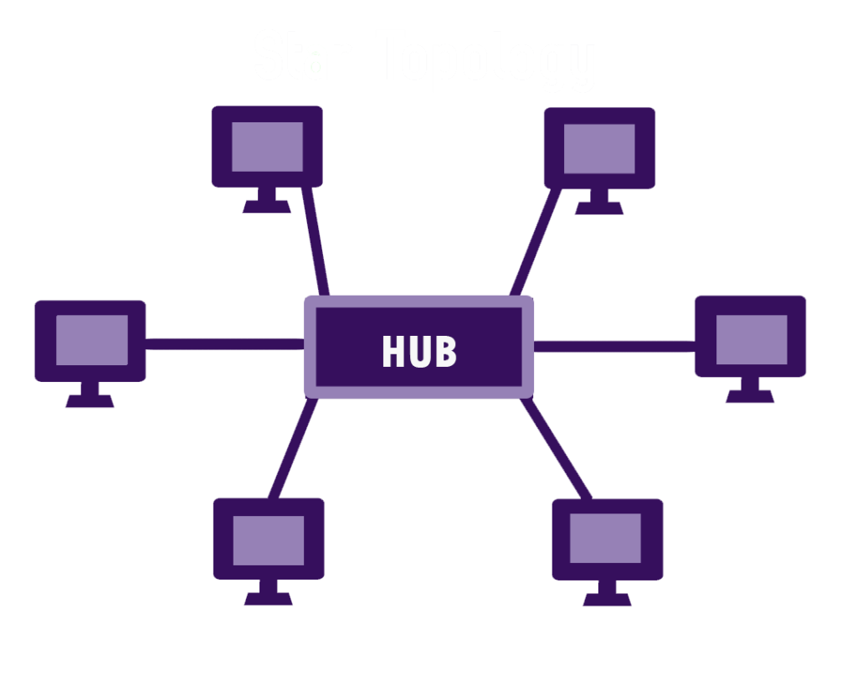
Star topology:
Star topology is an arrangement of the network
Which every node is connected to the central
Hub, switch or a central computer.
Central computer may be a server and
The attached to the server is known as clients.
Coaxial cable or RJ45cables are used to connect
the computers.
Hubs and switches are mainly uses as connecting devices in a physical star topology.

Slide 44
Advantages:
Efficient troubleshooting:
Troubleshooting is quite efficient in a star topology as compared to bus
Topology, the manager has to inspect the kilometers of cable. In the star topology all the station are connected to the centralized network.
Therefore the network administrator has to go to the single station to troubleshoot the problem.
Limited Failure:
As each station is connected to the central hub with its own cable, therefore failure in one cable will not affect the entire network.
Easily expandable:
It is easily expandable as new station can be added to the open ports on the hub.

Slide 45
High data Speed:
It support bandwidth of approx. 100mbps. Ethernet 100 Base T is one of the most popular star topology network.
Cost effective:
Star topology networks are cost-effective as it uses inexpensive coaxial cable.
Disadvantage:
Central point of Failure:
If the central hub or switch goes down then all the connected nodes will not be able to communicate with each other.

Slide 46
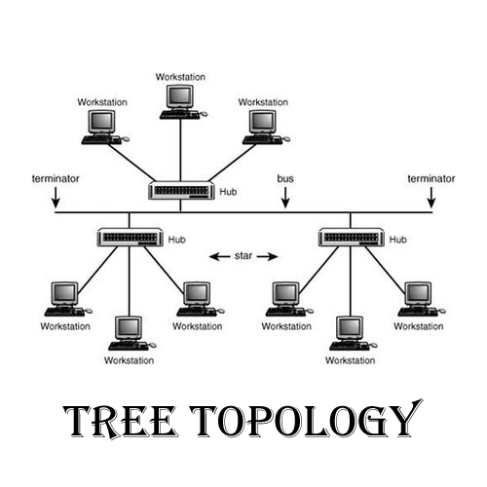
Tree topology:
Tree topology mainly combines the
characteristics of bus topology and star
topology.
All the computer are connected with
each other in hierarchical fashion.
There is only one path exists between
two nodes for data communication.

Slide 47
Advantage :
Easy expandable:
We can add the new device to the existing network.
Easy manageable:
In tree topology, the whole network is divided into segments know as star network which can be easily managed and maintained.
Error detection:
Error detection and error correction are very easy like star and bus topology.
Limited failure
The breakdown in one station does not affect the entire network.

Slide 48
Disadvantage
High Cost:
Devices required for broad band transmission are very high
Failure:
A tree topology mainly relies on main bus cable and failure in main bus cable will damage the overall network.

Slide 49
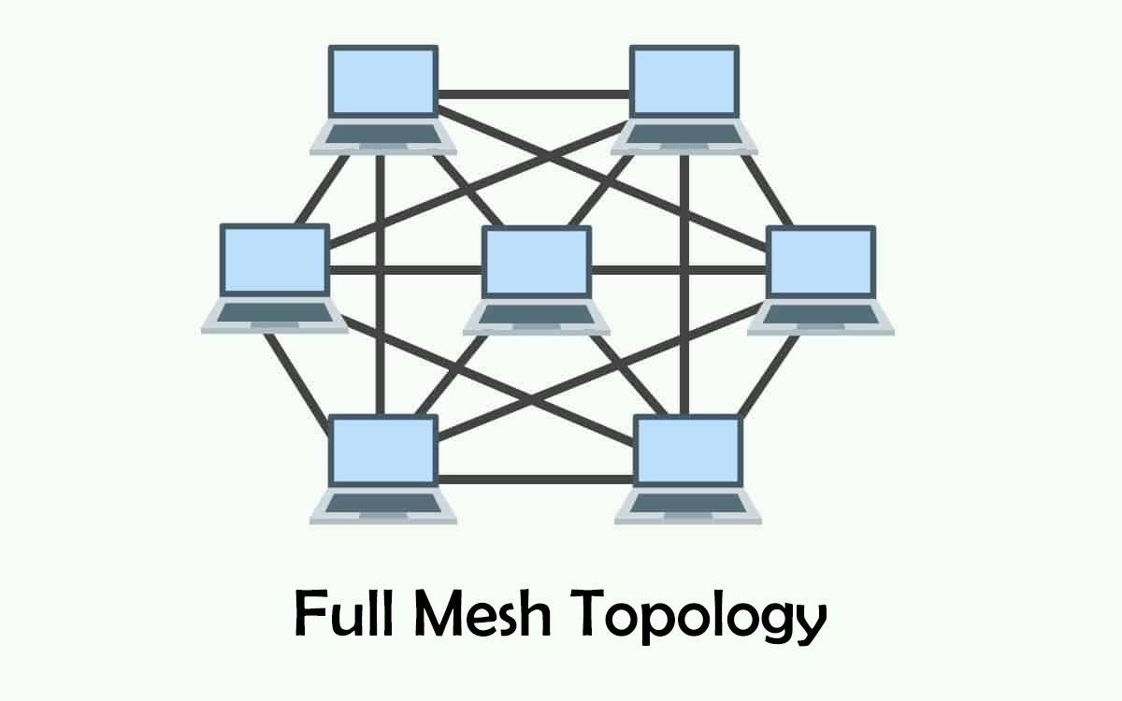
Mesh topology:
Mesh topology is an arrangement of the network in which computer are interconnected with each other
Through various connections.
There are multiple path from one
computer to another computer.
It does not contain the switch,hub
or any central computer which act
As central point of communication.
The internet is an example of mesh topology.
Mesh topology is mainly used for wireless
neteork.
Mesh topology can be formed by using
the formula
Number of cables = (n*(n-1)/2)
Where n represents the number of nodes represent in network.

Slide 50
Mesh topology is divided into two categories.
Fully connected mesh topology → Each computer is connected to all the computer available in the network.
Partially connected mesh topology → In this not all but certain computer are connected to those computers with which they communicate frequently.
Advantages:
Reliable: The mesh topology network are very reliable as if any link breakdown will not affect the communication between computer.
Fast communication: Communication is very fast between the nodes.
Easier Reconfiguration :Adding an new device would not effect the communication between other devices.

Slide 51
Disadvantage:
Cost:
Mesh topology contains large number of connected device such as a router and more transmission media than other topology.
Management:
Mesh topology is very larger and difficult to maintain and manage.

Slide 52
Hybrid topology:
The combination of different topologies is known as hybrid topology.
When two or more topologies are connected together as hybrid topology and if similar topology are connected with each other will not result in hybrid topology, for example: if there exist a ring topology in one branch of everest college and bus topology in another branch of Everest connecting these topologies will result in hybrid topology.
Advantage:
Reliable: If a fault occurs in any part of the network will not affect the functioning of the rest of the network.
Scalable: Size of network can be easily expanded by adding new devices without affecting the functionality if the existing network.

Slide 53
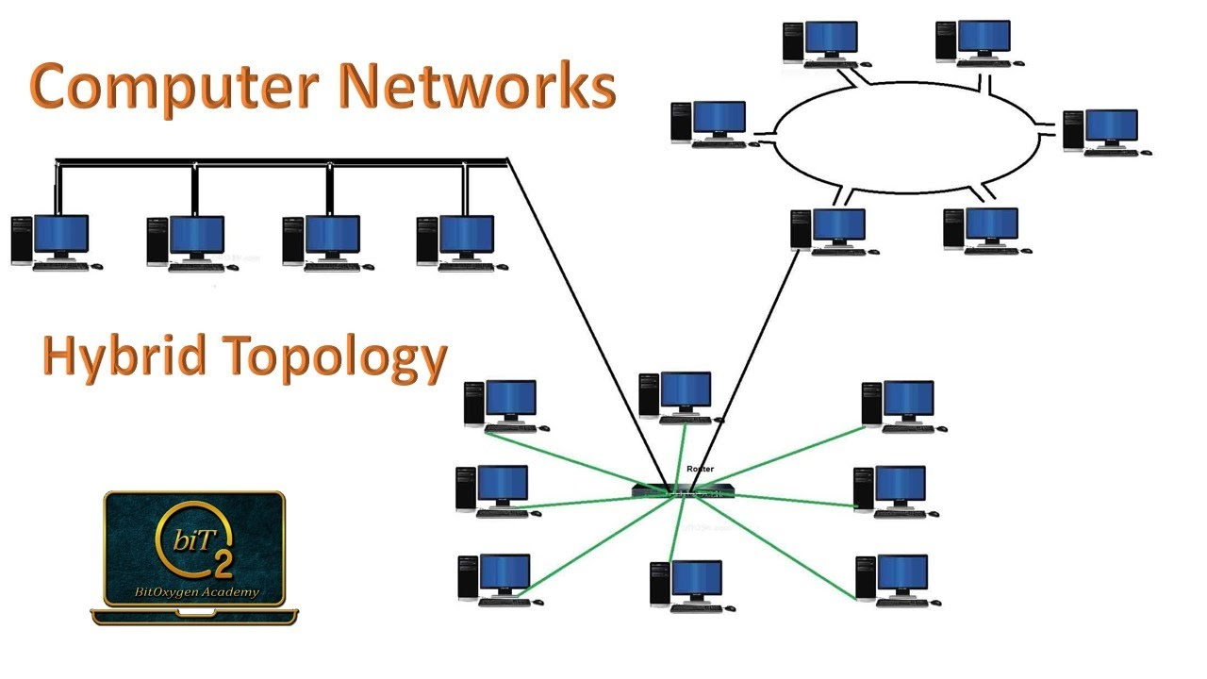

Slide 54
Flexible: This topology is very flexible as it can be designs according to the requirement of the organizations.
Effective: Hybrid topology is very effective as it can be designed in such a way that the strength of the network is maximized and weakness if the network is minimized.
Disadvantage:
Complex design: It is very difficult to design the architecture.
Costly: The infrastructure cos is very high as a hybrid network requires a lots of cabling, network device etc.

Slide 55
Network Architecture
Computer Network Architecture is defined as the physical and logical design of the software, hardware, protocols, and media of the transmission of data. Simply we can say that how computers are organized and how tasks are allocated to the computer.
The two types of network architectures are used:
Peer-To-Peer network
Client/Server network

Slide 56
Peer-To-Peer network
Peer-To-Peer network is a network in which all the computers are linked together with equal privilege and responsibilities for processing the data.
Peer-To-Peer network is useful for small environments, usually up to 10 computers.
Peer-To-Peer network has no dedicated server.
Special permissions are assigned to each computer for sharing the resources, but this can lead to a problem if the computer with the resource is down.

Slide 57
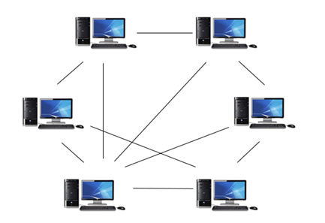
Peer to peer network

Slide 58
Advantages Of Peer-To-Peer Network:
It is less costly as it does not contain any dedicated server.
If one computer stops working but, other computers will not stop working.
It is easy to set up and maintain as each computer manages itself.
Disadvantages Of Peer-To-Peer Network:
In the case of Peer-To-Peer network, it does not contain the centralized system . Therefore, it cannot back up the data as the data is different in different locations.
It has a security issue as the device is managed itself.

Slide 59
Client/Server Network
Client/Server network is a network model designed for the end users called clients, to access the resources such as songs, video, etc. from a central computer known as Server.
The central controller is known as a server while all other computers in the network are called clients.
A server performs all the major operations such as security and network management.
A server is responsible for managing all the resources such as files, directories, printer, etc.
All the clients communicate with each other through a server. For example, if client1 wants to send some data to client 2, then it first sends the request to the server for the permission. The server sends the response to the client 1 to initiate its communication with the client 2.

Slide 60
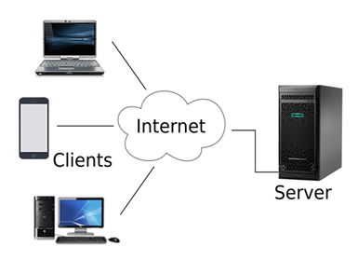
Client/Server

Slide 61
Advantages Of Client/Server network:
A Client/Server network contains the centralized system. Therefore we can back up the data easily.
A Client/Server network has a dedicated server that improves the overall performance of the whole system.
Security is better in Client/Server network as a single server administers the shared resources.
It also increases the speed of the sharing resources.
Disadvantages Of Client/Server network:
Client/Server network is expensive as it requires the server with large memory.
A server has a Network Operating System(NOS) to provide the resources to the clients, but the cost of NOS is very high.
It requires a dedicated network administrator to manage all the resources.

Slide 62
OSI reference model
OSI stands for Open Systems Interconnection. It has been developed by ISO – ‘International Organization for Standardization‘, in the year 1984. It is a 7 layer architecture with each layer having specific functionality to perform. All these 7 layers work collaboratively to transmit the data from one person to another across the globe.

Slide 63
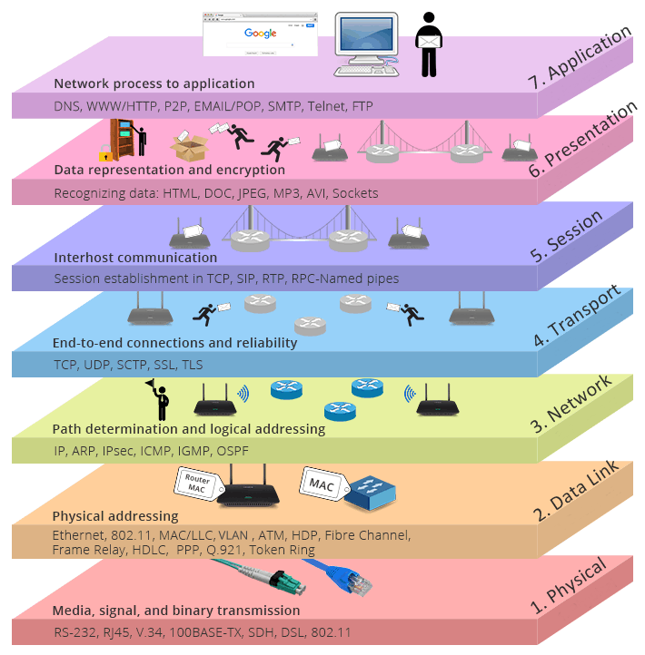
Software layers
Heart of OSI
segmentation
packets
Hardware layers
frame
bits

Slide 64

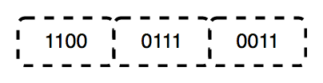
1. Physical Layer (Layer 1) :
The lowest layer of the OSI reference model is the physical layer.
It is responsible for the actual physical connection between the devices.
The physical layer contains information in the form of bits.
It is responsible for transmitting individual bits from one node to the next. When receiving data, this layer will get the signal received and convert it into 0s and 1s and send them to the Data Link layer, which will put the frame back together.

Slide 65
The functions of the physical layer are :
Bit synchronization: The physical layer provides the synchronization of the bits by providing a clock. This clock controls both sender and receiver thus providing synchronization at bit level.
Bit rate control: The Physical layer also defines the transmission rate i.e. the number of bits sent per second.
Physical topologies: Physical layer specifies the way in which the different, devices/nodes are arranged in a network i.e. bus, star, or mesh topology.
Transmission mode: Physical layer also defines the way in which the data flows between the two connected devices. The various transmission modes possible are Simplex, half-duplex and full-duplex.
* Hub, Repeater, Modem, Cables are Physical Layer devices. ** Network Layer, Data Link Layer, and Physical Layer are also known as Lower Layers or Hardware Layers.

Slide 66
2. Data Link Layer (DLL) (Layer 2) :
The data link layer is responsible for the node-to-node delivery of the message. The main function of this layer is to make sure data transfer is error-free from one node to another, over the physical layer. When a packet arrives in a network, it is the responsibility of DLL to transmit it to the Host using its MAC address. Data Link Layer is divided into two sublayers:
Logical Link Control (LLC)
Media Access Control (MAC)
The packet received from the Network layer is further divided into frames depending on the frame size of NIC(Network Interface Card). DLL also encapsulates Sender and Receiver’s MAC address in the header.
The Receiver’s MAC address is obtained by placing an ARP(Address Resolution Protocol) request onto the wire asking “Who has that IP address?” and the destination host will reply with its MAC address.

Slide 67
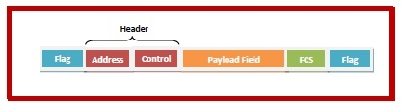


Fields of a Data Link Layer Frame
A data link layer frame has the following parts:
Frame Header: It contains the source and the destination addresses of the frame and the control bytes.
Payload field: It contains the message to be delivered.
Trailer: It contains the error detection and error correction bits. It is also called a Frame Check Sequence (FCS).
Flag: Two flag at the two ends mark the beginning and the end of the frame.
MAC 1
MAC 2
Frame

Slide 68
The functions of the Data Link layer are :
Framing: Framing is a function of the data link layer. It provides a way for a sender to transmit a set of bits that are meaningful to the receiver. This can be accomplished by attaching special bit patterns to the beginning and end of the frame.
Physical addressing: After creating frames, the Data link layer adds physical addresses (MAC address) of the sender and/or receiver in the header of each frame.
Error control: Data link layer provides the mechanism of error control in which it detects and retransmits damaged or lost frames.
Flow Control: The data rate must be constant on both sides else the data may get corrupted thus, flow control coordinates the amount of data that can be sent before receiving acknowledgement.
Access control: When a single communication channel is shared by multiple devices, the MAC sub-layer of the data link layer helps to determine which device has control over the channel at a given time.
* Packet in Data Link layer is referred to as Frame. ** Data Link layer is handled by the NIC (Network Interface Card) and device drivers of host machines. *** Switch & Bridge are Data Link Layer devices.

Slide 69
Network layer:
Network layer is responsible for data transmission from one network to another.
The network layer is responsible for receiving frames from the data link layer,
and delivering them to their intended destinations among based on the addresses contained inside the frame.
It also takes care of packet routing i.e. selection of the shortest path to transmit the packet, from the number of routes available. The sender & receiver’s IP addresses are placed in the header by the network layer.
Functions of network layer
Routing: The network layer protocols determine which route is suitable from source to destination. This function of the network layer is known as routing.
Logical Addressing: In order to identify each device on internetwork uniquely, the network layer defines an addressing scheme. The sender & receiver’s IP addresses are placed in the header by the network layer. Such an address distinguishes each device uniquely and universally.
*Segment in Network layer is referred to as Packet.
** Network layer is implemented by networking devices such as routers.

Slide 70


Transport Layer:
Transport layer is responsible for end-to-end connectivity. It is also known as the heart of OSI layer.
Following task are performed by OSI layer
Identifying services
Multiplexing and DE multiplexing
Segmentation
Sequencing and reassembling
Error correction
Flow control
How are you ?
How
are
you
?
Segmentation
How are you ?
How
you
are
?
Sequencing and reassembling using number

Slide 71
Session Layer
Session layer is responsible for
establishing,
maintaining and
terminating session
Presentation Layer :
The presentation layer is also called the Translation layer. The data from the application layer is extracted here and manipulated as per the required format to transmit over the network. The functions of the presentation layer are :
Translation: For example, ASCII to EBCDIC.
Encryption/ Decryption: Data encryption translates the data into another form or code. The encrypted data is known as the ciphertext and the decrypted data is known as plain text. A key value is used for encrypting as well as decrypting data.
Compression: Reduces the number of bits that need to be transmitted on the network.

Slide 72
Application Layer:
Application layer is responsible for providing Networking Services to the user. It is also known as desktop Layer. Identification of services is done using Port Numbers.
The functions of the Application layer are :
Network Virtual Terminal
FTAM-File transfer access and management
Mail Services
Directory Services

Slide 73
It was developed by the DoD (Department of Defense) in the 1960s. It is named after the two main protocols that are used in the model, namely, TCP and IP. TCP stands for Transmission Control Protocol and IP stands for Internet Protocol.
Support client-server and peer-to-peer.
TCP/IP(Internet model)

Slide 74
Application Layer
Transport Layer (Host-to-Host)
Network Layer
Data link layer
Physical layer
Application Layer
Presentation Layer
Session Layer
Transport Layer
Network Layer
Datalink Layer
Physical layer
Application Layer
Transport Layer (Host-to-Host)
Internet Layer
Network Access Layer
TCP/IP
OSI
TCP/IP

Slide 75
Network Access Layer –
This layer corresponds to the combination of Data Link Layer and Physical Layer of the OSI model.
It looks out for hardware addressing and the protocols present in this layer allows for the physical transmission of data.
Data processes in the form of frames and bits.
This layer concerned about the physical transmission of data.
Internet Layer -
This layer parallels the functions of OSI’s Network layer.
It defines the protocols which are responsible for logical transmission of data over the entire network. The main protocols residing at this layer are :

Slide 76
IP – stands for Internet Protocol and it is responsible for delivering packets from the source host to the destination host by looking at the IP addresses in the packet headers. IP has 2 versions: IPv4 and IPv6. IPv4 is the one that most of the websites are using currently. But IPv6 is growing as the number of IPv4 addresses are limited in number when compared to the number of users.
ICMP – stands for Internet Control Message Protocol. It is encapsulated within IP datagrams and is responsible for providing hosts with information about network problems.
ARP – stands for Address Resolution Protocol. Its job is to find the hardware address of a host from a known IP address. ARP has several types: Reverse ARP, Proxy ARP, Gratuitous ARP and Inverse ARP.

Slide 77
Host-to-Host Layer –
This layer is analogous to the transport layer of the OSI model. It is responsible for end-to-end communication and error-free delivery of data. It shields the upper-layer applications from the complexities of data. The two main protocols present in this layer are :
Transmission Control Protocol (TCP) – It is known to provide reliable and error-free communication between end systems. It performs sequencing and segmentation of data. It also has acknowledgment feature and controls the flow of the data through flow control mechanism. It is a very effective protocol but has a lot of overhead due to such features. Increased overhead leads to increased cost.
User Datagram Protocol (UDP) – On the other hand does not provide any such features. It is the go-to protocol if your application does not require reliable transport as it is very cost-effective. Unlike TCP, which is connection-oriented protocol, UDP is connectionless.

Slide 78
Application Layer
An application layer is the topmost layer in the TCP/IP model.
It is responsible for handling high-level protocols, issues of representation.
This layer allows the user to interact with the application.
When one application layer protocol wants to communicate with another application layer, it forwards its data to the transport layer.
There is an ambiguity occurs in the application layer. Every application cannot be placed inside the application layer except those who interact with the communication system. For example: text editor cannot be considered in application layer while web browser using HTTP protocol to interact with the network where HTTP protocol is an application layer protocol.
Following are the main protocols used in the application layer:
HTTP: HTTP stands for Hypertext transfer protocol. This protocol allows us to access the data over the world wide web. It transfers the data in the form of plain text, audio, video. It is known as a Hypertext transfer protocol as it has the efficiency to use in a hypertext environment where there are rapid jumps from one document to another.
SNMP: SNMP stands for Simple Network Management Protocol. It is a framework used for managing the devices on the internet by using the TCP/IP protocol suite.

Slide 79
SMTP: SMTP stands for Simple mail transfer protocol. The TCP/IP protocol that supports the e-mail is known as a Simple mail transfer protocol. This protocol is used to send the data to another e-mail address.
DNS: DNS stands for Domain Name System. An IP address is used to identify the connection of a host to the internet uniquely. But, people prefer to use the names instead of addresses. Therefore, the system that maps the name to the address is known as Domain Name System.
FTP: FTP stands for File Transfer Protocol. FTP is a standard internet protocol used for transmitting the files from one computer to another computer.

Slide 80
Difference between OSI Model and TCP/IP Model
OSI Layer | TCP/IP
It has 7 layers | It has 4 layers
It is a reference model | It is implementation model
It has separate presentation and session layer | Presentation and session layer both combined in a Application layer
It is developed by ISO (International organization for standardization) | It is developed by DOD (department of defense)
Network Layer is both Connection Oriented and Connection less. | Network Layer is Connection less.
OSI uses the network layer to define routing standards and protocols | Internet layer uses for the routing purpose.

Slide 81
OSI | TCP/IP
In OSI model the transport layer guarantees the delivery of packets. | In TCP/IP model the transport layer does not guarantees delivery of packets.
Model was developed before the development of protocol | Protocol were developed first then the model was developed
In the OSI model, the transport layer is only connection-oriented. | A layer of the TCP/IP model is both connection-oriented and connectionless
OSI model defines services, interfaces and protocols very clearly and makes clear distinction between them. It is protocol independent. | In TCP/IP, services, interfaces and protocols are not clearly separated. It is also protocol dependent.

Slide 82
Similarities OSI reference model and TCP/IP:
Both are logical models.
Both define standards for networking.
Both provide a framework for creating and implementing networking standards and devices.
Both divide the network communication process into layers.
In both models, a single layer defines a particular functionality and sets standards for that functionality only.
Both models allow a manufacturer to make devices and network components that can coexist and work with the devices and components made by other manufacturers.
Both models simplify the troubleshooting process by dividing complex functions into simpler components.

Slide 83
WLAN:
WLAN stands for Wireless Local Area Network. WLAN is a local area network that uses radio communication to provide mobility to the network users while maintaining the connectivity to the wired network. A WLAN basically, extends a wired local area network. WLAN’s are built by attaching a device called the access point(AP) to the edge of the wired network. Clients communicate with the AP using a wireless network adapter which is similar in function to an ethernet adapter. It is also called a LAWN is a Local area wireless network.
WLAN Architecture
Components in Wireless LAN architecture as per IEEE standards are as follows:

Slide 84
Working of WLAN
WLAN transmits data over radio signals and the data is sent in the form of a packet. Each packet consists of layers, labels, and instructions with unique MAC addresses assigned to endpoints. This enables routing data packets to correct locations.
Characteristics of WLAN
Seamless operation.
Low power for battery use.
Simple management, easy to use for everyone.
Protection of investment in wired networks.
Robust transmission technology.

Slide 85
Advantages of WLAN
Installation speed and simplicity.
Installation flexibility.
Reduced cost of ownership.
Reliability.
Mobility.
Robustness.
Disadvantages of WLAN
Slower bandwidth.
Security for wireless LANs is the prime concern.
Less capacity.
Wireless networks cost four times more than wired network cards.
Wireless devices emit low levels of RF which can be harmful to our health.

Slide 86
BYOD (bring your own device) is a policy that allows employees in an organization to use their personally owned devices for work-related activities.
Those activities include tasks such as accessing emails, connecting to the corporate network, and accessing corporate apps and data. Smartphones are the most common mobile device an employee might take to work, but employees also take their own tablets, laptops and USB drives into the workplace.
This rise in the use of personal devices encourages companies to implement BYOD policies. BYOD is not simply to eliminate the need for employees to carry two phones; a BYOD policy is designed to ensure that the employees use strong security practices when connecting to the company network.

Slide 87
IOT(Internet of Things)
Internet of Things (IoT) is a system of interconnected objects, usually called smart devices, through the Internet. The object can be a heart monitor, a remote, or an automobile with built-in sensors. That is objects that have been assigned an IP address and have the capability to collect and transfer data over a network. The objects interact with the external environment with the help of embedded technology, which helps them in taking decisions. Since these devices can now represent themselves digitally.
In other words “The globally ruling technology acts as a single key to shrinking this whole universe to a tiny globally connected village, whereas IoT comprises just two words that precisely depict its definition.”

Slide 88
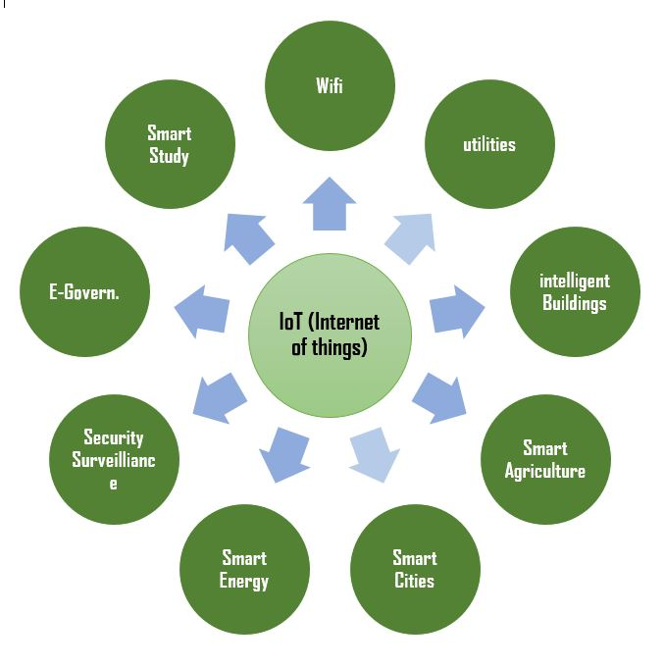
IOT uses some Sensors, actuators, RF signals to make things more smarter. And it will also help to communicate to each other around the globe.

