Slide 1
Backbone Network

Slide 2
Backbone Network is as a Network containing a high capacity connectivity infrastructure that backbone to the different part of the network. Actually a backbone network allows multiple LANs to get connected in a backbone network, not a single station is directly connected to the backbone but the stations are part of LAN, and backbone connect those LANs.
There are two basic components to a BN: The network cable and the hardware devices that connec tother networks to the BN.
Hardware consists of :
Switches:
a "switch" refers to a networking device that operates at the data link layer (Layer 2) of the OSI (Open Systems Interconnection) model. The primary function of a switch is to connect multiple devices within a local area network (LAN) and facilitate the efficient and intelligent forwarding of data between them.

Slide 3
Routers:
A router is a crucial networking device that operates at the network layer (Layer 3) of the OSI (Open Systems Interconnection) model. Its primary function is to connect different networks together, such as connecting a local area network (LAN) to the internet or linking multiple LANs within an enterprise. Routers use logical addressing (such as IP addresses) to forward data between networks.
VLAN Switches: These are special combination of layer 2 switches and routers. They are comples devices intended for use in large networks that have speciala requirements.

Slide 4
Switched Backbone
A switched backbone refers to a network architecture where a high-speed switch is used to interconnect multiple segments or subnetworks within an organization or enterprise. This type of backbone network is designed to provide efficient and scalable communication between different parts of the network, allowing for high-performance data transfer and improved network management. The switch in a switched backbone operates at the data link layer (Layer 2) of the OSI model and is responsible for forwarding data based on MAC (Media Access Control) addresses.

Slide 5
Here are key characteristics and advantages of a switched backbone:
Segmentation: A switched backbone allows for the segmentation of a larger network into smaller segments or VLANs (Virtual LANs). Each segment can have its own switch or switches, and communication between segments occurs through the high-speed switch in the backbone.
Reduced Collision Domain: Unlike shared network segments (such as those connected by hubs), a switched backbone reduces the collision domain. Each port on a switch is its own collision domain, meaning that devices connected to those ports can transmit and receive data without contention, leading to improved network efficiency.
Improved Bandwidth: By using a high-speed switch in the backbone, organizations can achieve significantly higher data transfer rates between different segments. This is particularly beneficial for handling large amounts of data, supporting multimedia applications, and ensuring low-latency communication.
Enhanced Network Security: Segmentation provided by a switched backbone contributes to enhanced network security. By logically separating different parts of the network, organizations can implement security policies and control access more effectively.

Slide 6
Quality of Service (QoS): Switched backbones can support QoS features, allowing network administrators to prioritize certain types of traffic over others. This is crucial for ensuring optimal performance for critical applications, such as voice and video communication.
Routed Backbone:
A routed backbone refers to a network architecture where routers are used to interconnect different subnetworks or segments within an organization or enterprise. Unlike a switched backbone, which operates at the data link layer (Layer 2) and uses switches for interconnection, a routed backbone operates at the network layer (Layer 3) and relies on routers for forwarding data between different segments. In a routed backbone, IP addresses are used for routing decisions, and each router is responsible for making routing decisions based on destination IP addresses.

Slide 7
Here are key characteristics and advantages of a routed backbone:
Routing at Layer 3: Routers in a routed backbone operate at the network layer and make forwarding decisions based on IP addresses. This allows for the creation of distinct IP subnets for different segments, enabling more granular control over routing and network addressing.
Logical Segmentation: A routed backbone facilitates logical segmentation of the network into different IP subnets. Each subnet may represent a separate department, floor, or functional area within an organization, providing a way to logically organize and manage the network.
Support for Multiple Protocols: Routers can support multiple network protocols, allowing for the coexistence of different network technologies within the same network infrastructure. This flexibility is beneficial when integrating diverse systems or accommodating legacy equipment.
Enhanced Security: Routers provide a level of security by controlling traffic flow between different subnets. Access control lists (ACLs) and other security features on routers allow administrators to define rules for permitting or denying specific types of traffic.
Quality of Service (QoS): Routers in a routed backbone can implement Quality of Service policies to prioritize certain types of traffic over others. This is essential for ensuring optimal performance for applications with specific bandwidth and latency requirements.

Slide 8
Vlan Basics:
Virtual LAN (VLAN) is a concept in which we can divide the devices logically on layer 2 (data link layer). Generally, layer 3 devices divide the broadcast domain but the broadcast domain can be divided by switches using the concept of VLAN.
How VLAN works
Here is step by step details of how VLAN works:
VLANs in networking are identified by a number.
A Valid range is 1-4094. On a VLAN switch, you assign ports with the proper VLAN number.
VLAN 2-1001:It is a normal VLAN range. You can create, edit, and delete it.
The switch then allows data which needs to be sent between various ports having the same VLAN.
Since almost all networks are larger than a single switch, there should be a way to send traffic between two switches.
One simple and easy way to do this is to assign a port on each network switch with a VLAN and run a cable between them.

Slide 9
Benefits:
It solves a broadcast problem.
VLAN reduces the size of broadcast domains.
VLAN allows you to add an additional layer of security.
It can make device management simple and easier.
You can make a logical grouping of devices by function rather than location.
It allows you to create groups of logically connected devices that act like they are on their own network.
You can logically segment networks based on departments, project teams, or functions.
VLAN helps you to geographically structure your network to support the growing companies.
Higher performance and reduced latency.
VLANs provide increased performance.

Slide 10
The best practice Backbone Design:
The past few years have seen radical changes in the backbone, both in terms of new technologies (e.g., gigabit Ethernet) and in architectures (e.g., switched backbones, VLANs). Ten years ago, the most common backbone architecture was the routed backbone, connected to a series of shared 10Base-T hubs in the LAN.
Today, the most effective architecture for the distribution layer in terms of cost and performance is a switched backbone (either rack-mounted or using a chassis switch) because it provides the best performance at the least cost. For the core layer, most organizations use a routed backbone. Many large organizations are now implementing VLANs, especially those which have departments spread over multiple buildings, but VLANs add considerable cost and complexity to the network.

Slide 11
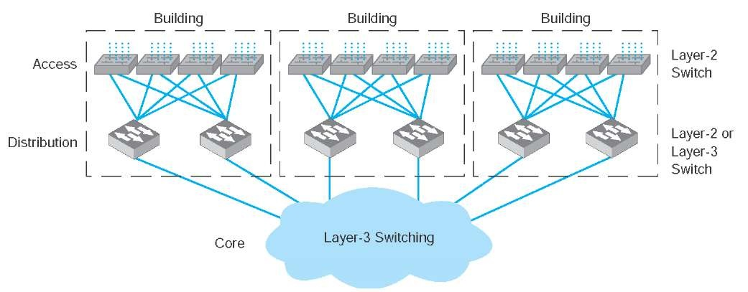

Slide 12
Improving backbone performance
The method for improving the performance of BNs is similar to that for improving LAN performance. First, find the bottleneck, then solve it (or, more accurately, move the bottleneck somewhere else). You can improve the performance of the network by improving the performance of the computers and other devices in the network, by upgrading the circuits between computers, and by changing the demand placed on the network.
Improving Computer and Device Performance
The primary functions of computers and devices in BNs are routing and protocol translations. If the devices and computers are the bottleneck, routing can be improved with faster devices or a faster routing protocol. Static routing is accomplished faster than dynamic routing but obviously can impair circuit performance in high-traffic situations. Dynamic routing is usually used in WANs and MANs because there are many possible routes through the network. BNs often have only a few routes through the network, so dynamic routing may not be too helpful since it will delay processing and increase the network traffic because of the status reports sent through the network. Static routing will often simplify processing and improve performance.

Slide 13
Improving Circuit Capacity
If network circuits are the bottlenecks, there are several options. One is to increase overall circuit capacity (e.g., by going from 100Base-T Ethernet to gigabit Ethernet). Another option is to add additional circuits alongside heavily used ones so that there are several circuits between some devices.
In many cases, the bottleneck on the circuit is only in one place—the circuit to the server. A switched network that provides 100 Mbps to the client computers but a faster circuit to the server (e.g., 1000Base-T) can improve performance at very little cost.
Reducing Network Demand
One way to reduce network demand is to restrict applications that use a lot of network capacity, such as desktop videoconferencing, medical imaging, or multimedia. In practice, it is often difficult to restrict users. Nonetheless, finding one application that places a large demand on the network and moving it can have a significant impact.
Much network demand is caused by broadcast messages, such as those used to find data link layer.Some application software packages and NOS modules written for use on LANs also use broadcast messages to send status information to all computers on the LAN. For example, broadcast messages inform users when printers are out of paper, or when the server is running low on disk space. When used in a LAN, such messages place little extra demand on the network because every computer on the LAN gets every message.

