Slide 1

HDC VOTING SYSTEM
(Developed using HTML,CSS,JS and PHP)
Presented by:
Group Name: The Study Circle
Members : Kajal Kumari Mehta
Shibu Sharma

Slide 2
1. Introduction
The HDC Voting System is designed for facilitating HDC CR voting. The primary goal of this system is to enable voters to cast their votes online and make the better version website of HDC and view the election results of their own Program and semester as well.
It consists of two actors:
Admin
- Voter

Slide 3
Admin
Voter
- Login.
- Vote For candidate
- View Profile
- Sees the Results after Vote
- Provide Feedback
- Login.
- Add/Delete Program
- Add/Edit/Delete Students
- Add/Delete Candidates
- Dashboard(Contains all list of Candidates)
- Results(Provide the as a whole results )
- View all Details of Student/Candidates
- Log Out
-Generate Results
- View all Candidates
- Log Out

Slide 4

2. Problem Statement
The voting process by traditional method is time consuming.
Not easy for College Administration to conduct election for each batches.

Slide 5
3. Objectives
To simplify and enhance the convenience of voting
To provide details to students about their enrollment through email.
To increasing voter turnout
To improve the accuracy and efficiency

Slide 6
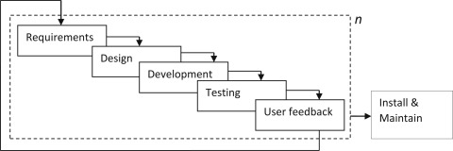
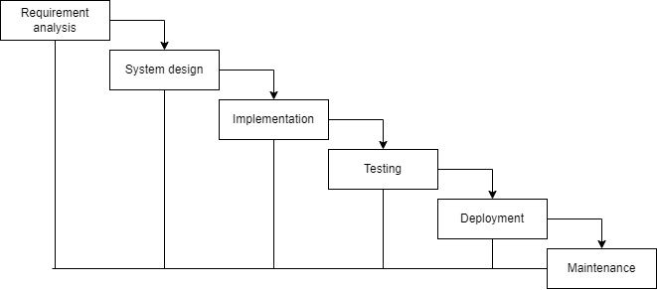
Methodology
Fig: Incremental Model

Slide 7

System Analysis
Functional Requirements
It defines functioning or behavior of the system.
Add for program.
Add for student.
Add for candidate.
Start or Place a vote and view the results.
Generate and Download Report
Sends Emails to the Students

Slide 8
Non-Functional Requirements
It defines the criteria according to which the system must work.
Availability
Security
Usability
Feasibility Study
Technical feasibility
Economical feasibility

Slide 9
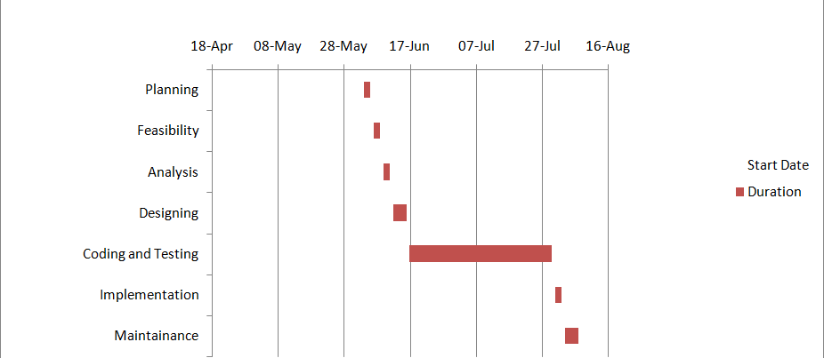
Gantt Chart
Fig: Gantt Chart

Slide 10
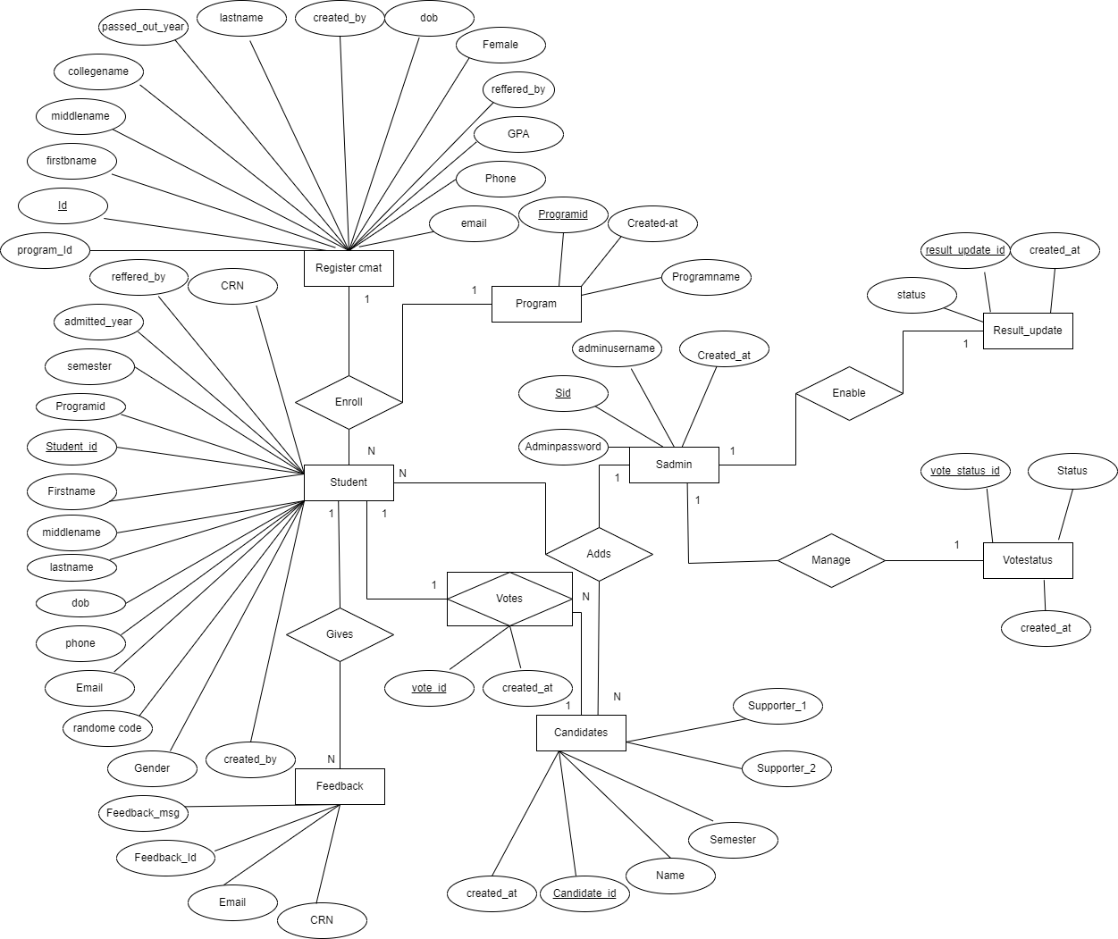
Data Modelling
Fig: ER Diagram

Slide 11
Relations:
registercmat(id(PK), program_id(fk),…)
student (student_id(PK), program_id(fk),…)
feedback (feedback_id(PK),feedback_msg,email…)
votes (vote_id(PK),student_id(FK),candidate_id(FK),…)
candidate(candidate_id(PK),Name,CRN,..)
program(program_id(PK),programname,…)
sadmin(sid (PK), adminusername, adminpassword,…)
Result_update (result_update_id(PK),status,…)
Vote_status(vote_status_id(PK),status,..)

Slide 12
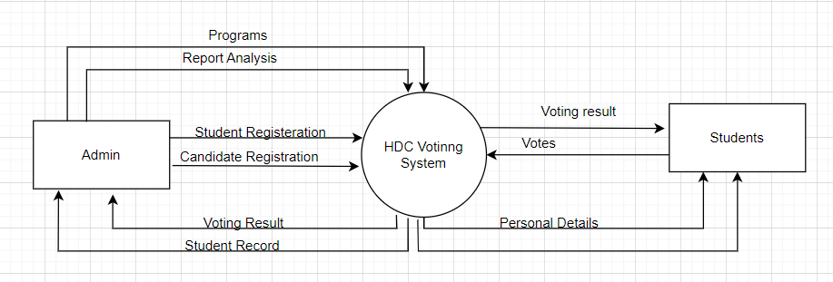
Process Modelling
Fig: Context Diagram

Slide 13
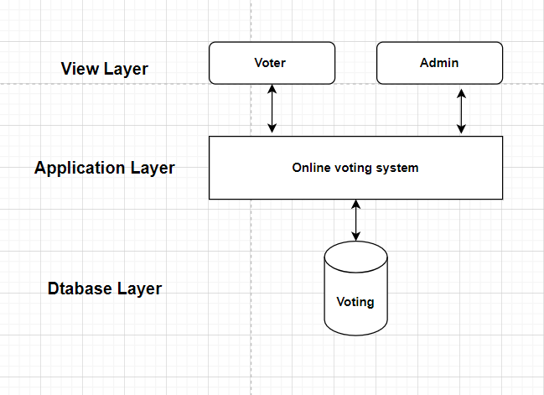
Architectural Design
Fig: Architectural Design

Slide 14

System Implementation and Testing
1.Implementation Tools and Technologies used.
Case tools:
Draw.io
Programming languages:
Front End Tool: HTML,CSS and JS
Backend Tool: PHP

Slide 15
Testing
1. Unit Testing
2. System Testing
1. Unit Testing:
- Registration form
- Login form
- Candidate Form
2. System Testing:
- Proceeding for Add candidate and Voting procedures

Slide 16
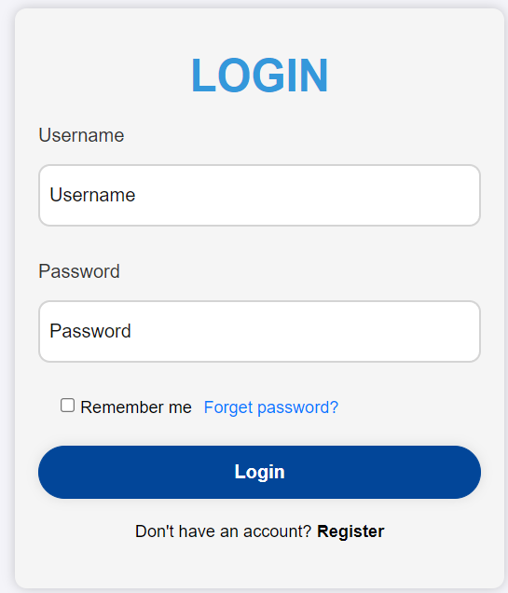
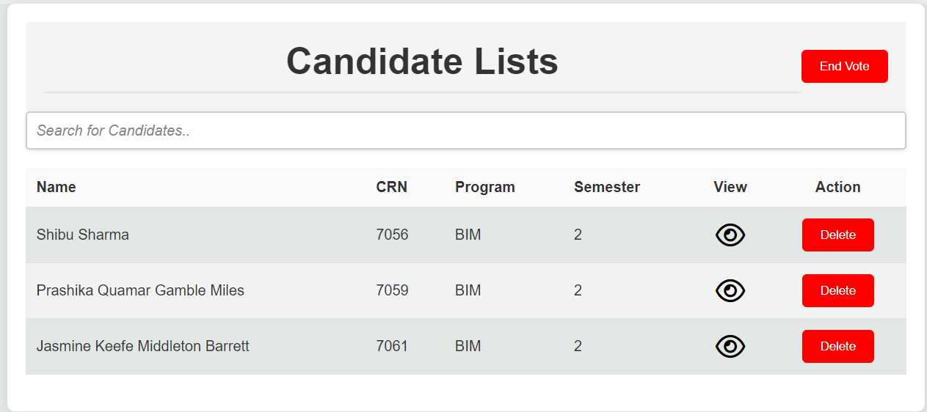
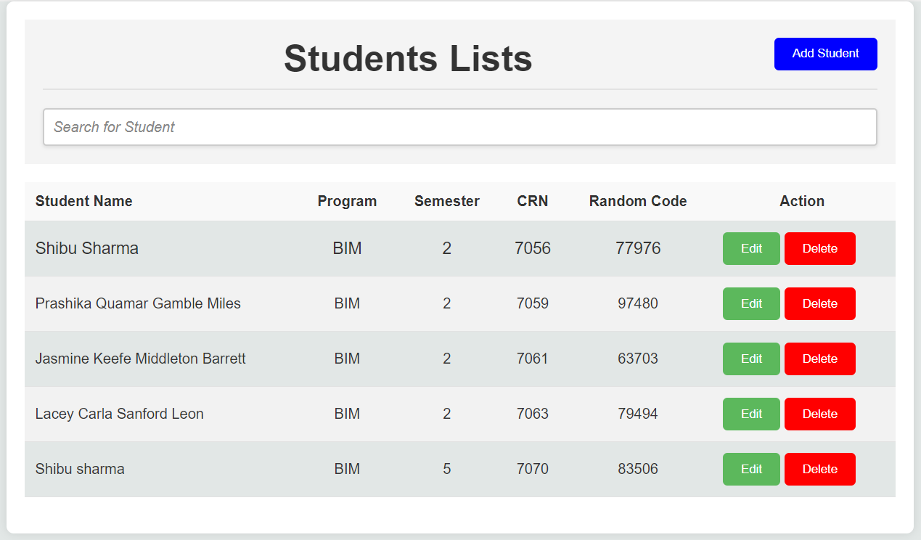
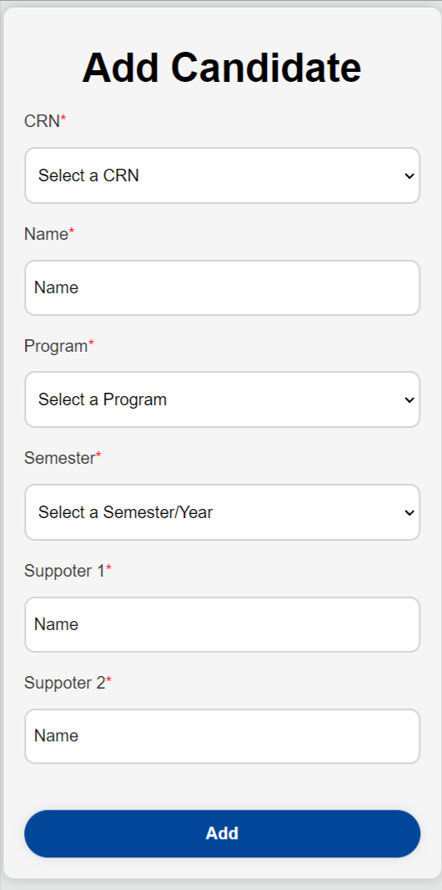
Admin Interface Design
Login Page UI
Home Page UI
Student Detail Page UI
Add Candidate UI

Slide 17
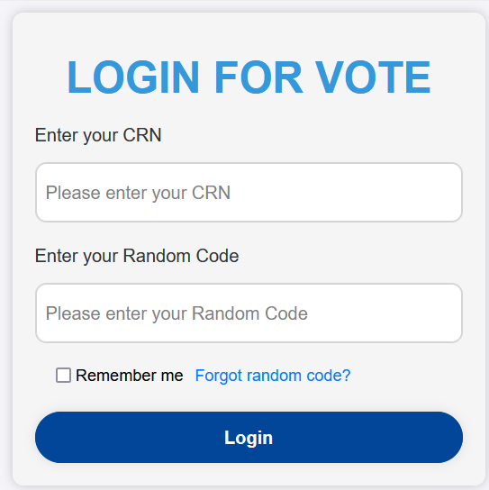
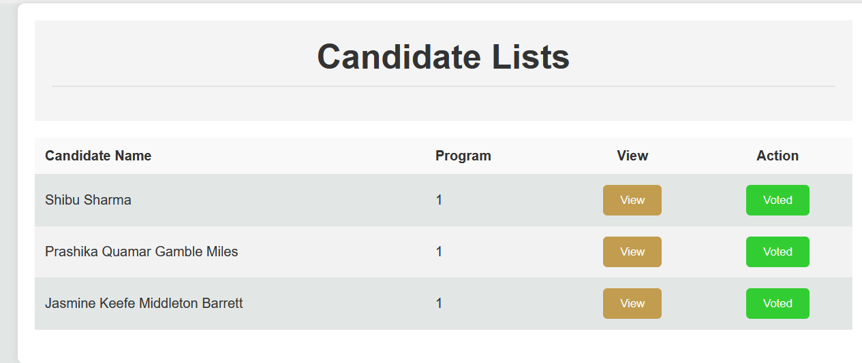
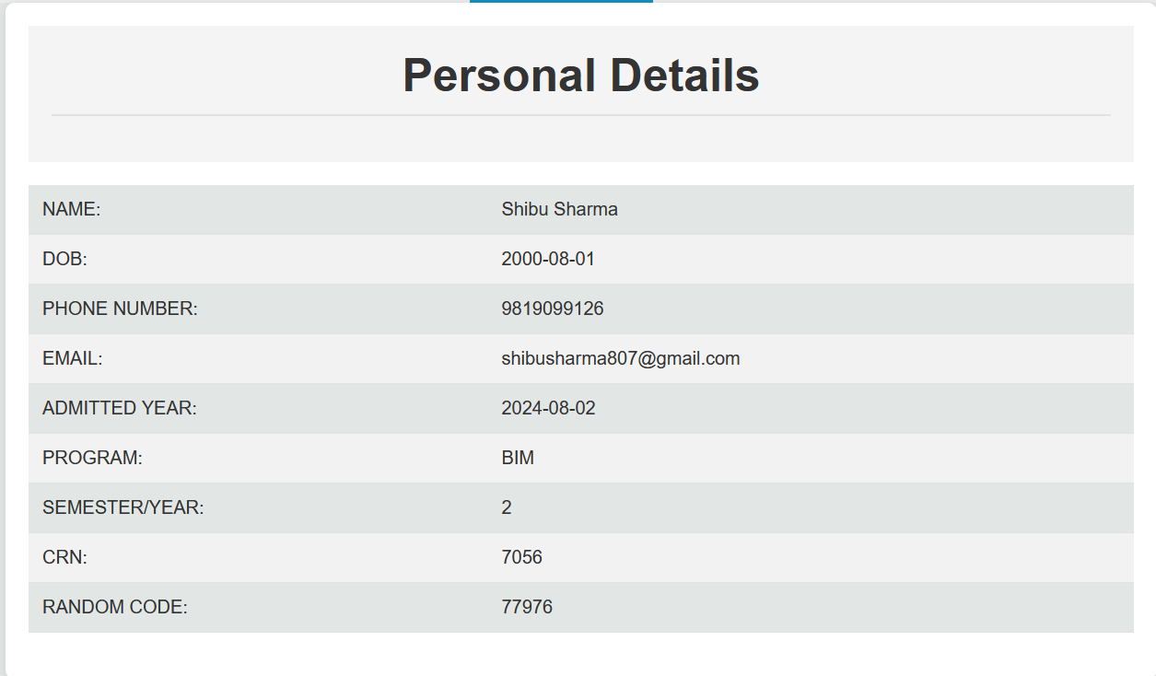
User Interface Design
Login Page UI
Home Page UI
Profile Page UI

Slide 18
Limitation
Couldn’t add multiple Admins
Lacks the Password reset form for admin
Couldn’t preschedule the election and result publication automatically.

Slide 19
Future Enhancement
Enable the automatic Scheduling of the Voting
Providing SMS alert about the Election and its Result
Add the multiple Admin and Create the Separate Roles for admin along with various permissions
Enhance the Overall website by make it’s all contents dynamic and adding more contents.

Slide 20

References
YojanaSubedi,HDCClassRepresentativevotingsystem,2022
https://www.typeform.com/

Slide 21

Any Query??

Slide 22

Thank You!!!

