Slide 1
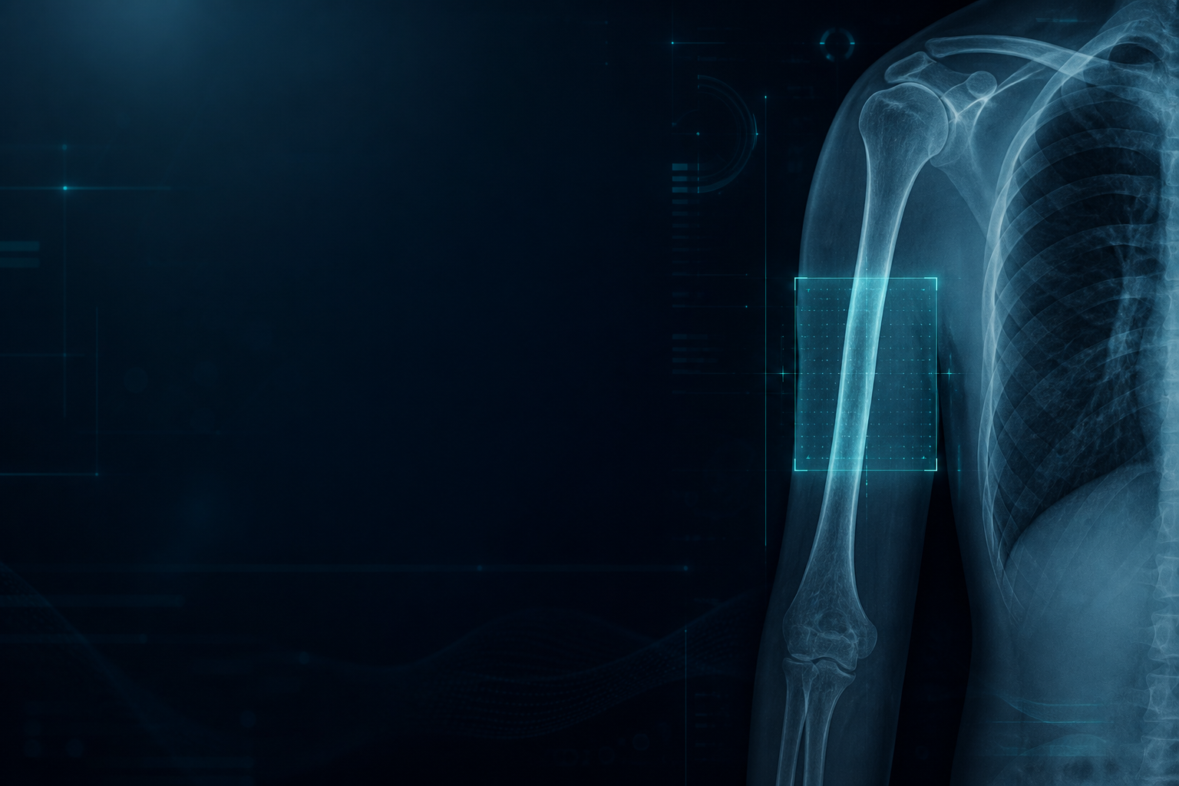
MAJOR PROJECT · ACADEMIC PRESENTATION
Medical Image Analysis for Bone Fracture Detection Using Deep Learning
YOLOv8 · VGG-16 Ensemble · Grad-CAM · Surgical Refixation Simulation
Submitted by
SHIBIN ANTONY
Enrollment No. 811241013
Under the Guidance of
Project Guide
(Insert faculty name and designation)

Slide 2
SLIDE 02 · OVERVIEW
Abstract
Bone fractures are among the most common musculoskeletal injuries and require timely, accurate diagnosis for effective treatment. This project presents a web-based clinical workstation that assists medical professionals in detecting and classifying fractures from X-ray and DICOM images with high precision.
The core detector is YOLOv8, trained and validated on 3,316 training and 399 validation images covering anatomical sites such as elbow, fingers, forearm, humerus, shoulder, and wrist, achieving a mean Average Precision (mAP50) of 86%. Fracture morphology is classified using the IEEE Access 2025 stack: VGG-16 with Softmax, VGG-16 with Random Forest (both 95% accuracy), ResNet-50 with SVM (93%), and EfficientNetB0 with XGBoost (comparative baseline).
Explainable AI (Grad-CAM) highlights suspected fracture regions, while severe or displaced patterns automatically generate an educational post-surgical refixation overlay (plates, screws, or intramedullary rods). A Flask dashboard with secure admin login, audit logs, and dark/light clinical UI makes the system usable in local, Jupyter, and Google Colab environments—supporting screening where radiology expertise is limited.
Medical Image Analysis for Bone Fracture Detection Using Deep Learning | SHIBIN ANTONY | 811241013

Slide 3
SLIDE 03 · AGENDA
Contents
01
Title
08
Proposed System
02
Abstract
09
Software Requirements
03
Contents
10
Hardware Requirements
04
Introduction
11
System Architecture
05
Problem Statement
12
Dataset
06
Objectives
13
Algorithms Used
07
Existing System
14
Conclusion
Medical Image Analysis for Bone Fracture Detection Using Deep Learning | SHIBIN ANTONY | 811241013

Slide 4
SLIDE 04 · CONTEXT
Introduction
Clinical burden
Diagnostic gap
Role of deep learning
• Millions of fractures occur yearly from trauma, sports, falls, and osteoporosis.
• Correct type and site decide conservative care versus operative fixation.
• Delay or misclassification can lead to malunion, non-union, or joint damage.
• Manual radiograph reading is time-consuming and observer-dependent.
• Hairline, greenstick, and overlapping anatomy are easy to miss.
• Many regions lack round-the-clock specialist radiology support.
• CNNs extract subtle cortical disruption that is hard to verbalize.
• Object detection localizes the injury; classifiers name the pattern.
• XAI heatmaps keep the clinician in the loop instead of a black box.
Medical Image Analysis for Bone Fracture Detection Using Deep Learning | SHIBIN ANTONY | 811241013

Slide 5
SLIDE 05 · NEED
Problem Statement
01 Subjectivity
02 Latency
03 Narrow tools
Inter-observer variability: the same X-ray may be labelled differently by two readers, especially for hairline and pathological fractures.
Emergency and trauma workflows need seconds-level triage, not a long queue for specialist review.
Many published systems handle binary “fracture vs normal” or a few limb sites, not 10+ morphology classes plus full-body anatomy.
04 No action layer
05 Weak explainability
06 Deployment gap
Detection alone does not communicate likely fixation strategy (plate, rod, screws) for severe displaced injuries.
Pure accuracy scores do not show where the model looked, reducing clinical trust.
Research notebooks rarely become a secure, auditable hospital-style web workstation.
Medical Image Analysis for Bone Fracture Detection Using Deep Learning | SHIBIN ANTONY | 811241013

Slide 6
SLIDE 06 · GOALS
Objectives
01
Design a medical-grade Flask workstation for real-time X-ray / DICOM fracture analysis.
02
Localize fractures with YOLOv8 bounding boxes across anatomical sites (upper limb, shoulder, pelvis).
03
Classify 10 morphological types using VGG-16 Softmax and VGG-16 + Random Forest as primary models.
04
Benchmark ResNet-50 + SVM and EfficientNetB0 + XGBoost as comparative ensembles (IEEE Access 2025).
05
Integrate Grad-CAM heatmaps so clinicians can verify the region driving the prediction.
06
Auto-generate an educational post-surgical refixation overlay for severe / displaced patterns.
07
Provide secure admin authentication, user roles, metric monitoring, and audit logging.
08
Support training and inference on local machines, Jupyter, and Google Colab at 20,000+ image scale.
Medical Image Analysis for Bone Fracture Detection Using Deep Learning | SHIBIN ANTONY | 811241013

Slide 7
SLIDE 07 · PRIOR ART
Existing System
Conventional practice
Limitations observed
• Radiologists inspect radiographs manually using experience and side markers.
• Reports depend on lighting, fatigue, and case mix; subtle fractures are missed.
• Earlier CAD tools were often binary (fracture / no fracture) on a single bone.
• Transfer-learning papers used VGG-16 or ResNet-50 in isolation, without a clinical UI.
• Few systems couple detection, multi-class typing, XAI, and fixation education.
• IEEE Access 2025: EfficientNetB0 + XGBoost lagged (~41% accuracy) on grayscale X-rays.
• Small, imbalanced public sets under-represent longitudinal and oblique fractures.
• No standard pathway from a notebook metric to an auditable hospital dashboard.
• Absence of surgical-context visualization for comminuted, spiral, and dislocation injuries.
• Limited DICOM ingest and no role-based access in typical academic demos.
Medical Image Analysis for Bone Fracture Detection Using Deep Learning | SHIBIN ANTONY | 811241013

Slide 8
SLIDE 08 · SOLUTION
Proposed System
FractureNet workstation
Dual-head AI
Explainability
Flask + HTML/CSS/JS clinical UI with dark/light mode, canvas viewer, and admin governance.
YOLOv8 finds where the injury is; VGG-16 ensembles decide what type it is.
Grad-CAM overlays the last convolutional evidence so predictions are visually inspectable.
Refixation demo
Comparative science
Ops-ready
Severe classes trigger plate / IM-rod / screw simulation via OpenCV blending and an interactive canvas.
Same data protocol as the paper: VGG-16, VGG-16+RF, ResNet-50+SVM, EfficientNetB0+XGBoost.
SQLite users, hashed passwords, inference history, audit trail; Colab notebook for large-scale training.
Medical Image Analysis for Bone Fracture Detection Using Deep Learning | SHIBIN ANTONY | 811241013

Slide 9
SLIDE 09 · STACK
Software Requirements
Language & web
Deep learning
• Python 3.10+
• Flask, Jinja2, Werkzeug
• HTML5, CSS3, JavaScript
• SQLite (users, audits, studies)
• PyTorch + Ultralytics YOLOv8
• TensorFlow / Keras VGG-16, ResNet-50, EfficientNetB0
• CUDA GPU builds when available
Classical ML & imaging
Training & ops
• Scikit-learn (Random Forest, SVM)
• XGBoost
• OpenCV, Pillow, pydicom
• NumPy, Pandas, Matplotlib
• Jupyter / Google Colab notebook
• Joblib model serialization
• TensorBoard + ModelCheckpoint
• Git version control
Medical Image Analysis for Bone Fracture Detection Using Deep Learning | SHIBIN ANTONY | 811241013

Slide 10
SLIDE 10 · INFRASTRUCTURE
Hardware Requirements
Minimum (demo / CPU)
Recommended training
Colab / cloud
4-core CPU, 8 GB RAM, 20 GB disk. Runs the Flask UI and OpenCV demo pipeline without trained heavyweights.
NVIDIA GPU (T4 / RTX 8 GB+), 16–32 GB RAM, 50+ GB SSD for 20k-scale datasets, checkpoints, and YOLO runs.
Google Colab GPU runtime or equivalent cloud VM; optional Google Drive for dataset and weight export.
Clinical workstation
Network
Peripherals
Full-HD display for side-by-side original / YOLO / Grad-CAM / refixation; optional DICOM-capable storage.
Localhost for on-prem demo; HTTPS reverse proxy if exposed on a hospital LAN (change default secrets).
Keyboard/mouse for canvas hardware placement; scanner or PACS export for radiograph ingest.
Medical Image Analysis for Bone Fracture Detection Using Deep Learning | SHIBIN ANTONY | 811241013

Slide 11
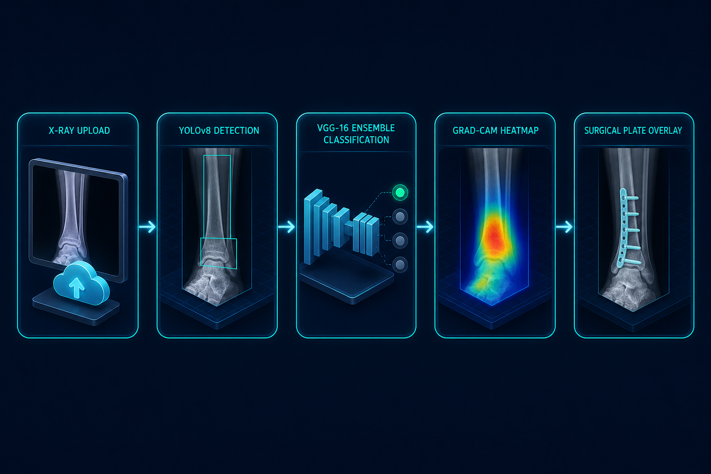
SLIDE 11 · DESIGN
System Architecture
Pipeline
1. Authenticated upload (PNG/JPEG/DICOM)
2. Preprocess & CLAHE enhancement
3. YOLOv8 localization
4. VGG-16 / RF classification
5. Comparative heads (optional)
6. Grad-CAM explanation
7. Severity gate → refixation overlay
8. Persist study + audit log
9. Clinical dashboard review
Medical Image Analysis for Bone Fracture Detection Using Deep Learning | SHIBIN ANTONY | 811241013

Slide 12
SLIDE 12 · DATA
Dataset
10
8
3,316 / 399
20k+
256²
Morphology classes (IEEE Access 2025)
Anatomical sites (+ pelvis)
YOLO train / val (abstract protocol)
Target scale (Colab / multi-source)
Classifier input RGB X-rays
Morphological classes
Avulsion · Comminuted · Fracture-Dislocation · Greenstick · Hairline · Impacted · Longitudinal · Oblique · Pathological · Spiral
Anatomical classes
Elbow Positive · Fingers Positive · Forearm Fracture · Humerus · Humerus Fracture · Shoulder Fracture · Wrist Positive · Pelvic Fracture
Paper set: 1,129 labelled X-rays (989 train / 140 test, 80/20 val split), grayscale converted to 256×256×3. YOLO set uses Ultralytics labels. Public Kaggle fracture collections can be merged to reach 20,000+ images; class imbalance (longitudinal / oblique under-represented) is handled with augmentation and balanced forests.
Medical Image Analysis for Bone Fracture Detection Using Deep Learning | SHIBIN ANTONY | 811241013

Slide 13
SLIDE 13 · METHODS
Algorithms Used
YOLOv8
VGG-16 + Softmax
VGG-16 + Random Forest
Primary detector. Single-pass localization and anatomical labels. Abstract mAP50 = 86%.
Frozen ImageNet backbone, Dense–ReLU–Dropout–Softmax, Adam 5e-4, CCE, 20 epochs. Accuracy 0.95.
Avg-pooled VGG features → 300-tree balanced RF. Top hybrid in the reference paper (0.95).
ResNet-50 + SVM
EfficientNetB0 + XGBoost
Grad-CAM + Refixation
Residual features + linear SVM. Comparative ensemble, ~0.93 accuracy.
Compound-scaled CNN features + gradient boosting. Paper baseline (~0.41) kept for fair comparison.
Last-conv heatmaps for XAI. AO-style plate / IM nail / screw overlay for severe classes.
Medical Image Analysis for Bone Fracture Detection Using Deep Learning | SHIBIN ANTONY | 811241013

Slide 14
SLIDE 14 · CLOSING
Conclusion
95%
86%
93%
18
VGG-16 / VGG-16+RF classification accuracy
YOLOv8 mAP50 real-time detection
ResNet-50 + SVM comparative hybrid
Unified classes morphology + anatomy
This work delivers an end-to-end, IEEE-aligned platform: YOLOv8 finds the fracture, VGG-16 ensembles name it, Grad-CAM explains it, and a refixation module illustrates likely hardware for severe injuries—inside a secure clinical web app.
Results align with published evidence that VGG-16-based models outperform lighter hybrids on this X-ray taxonomy. The system is intended as decision support and education—not a certified medical device—and every output requires licensed clinical review.
Future work
• Multi-centre 20k+ labelled set · Unfreeze later VGG blocks · 3D CT/MRI fusion · Prospective reader study · PACS/HL7 integration · Regulatory-grade validation
Thank you · Questions welcome
Medical Image Analysis for Bone Fracture Detection Using Deep Learning | SHIBIN ANTONY | 811241013

