Slide 1
Application of Information Extraction To Automate Research On Chinese Corruption
Shidan Xu, Tingtao Zhou

Slide 2
Introduction
NLP with the Chinese language has some unique aspects
Word segmentation
Encoding
Research on Chinese corruption based on publicly available articles.
Regional difference in punishment, trend of polarization, etc.
Need to extract relevant information and output structured data as a first step

Slide 3
Dataset
People’s Daily public news articles
460 news articles on financial crimes in 1990 ~ 2010
Data courtesy to Prof. Karen Zheng of Sloan School of Management
Segmentation and annotation courtesy to Karen
Goal:
Extract name, crime, job position, punishment, time, money, location of crime, with respect to each culprit.

Slide 4
Approach
1. Named Entity Recognition
Boson NLP for person’s name and location names.
Feature Vectors for crime, money amount, time, position extraction. Learn from law documentation, list of cities in China
2. Word Alignment
Different APIs return different word segmentation.
3. De-noise
Remove irrelevant persons by occupation features
Journalists, Judges, Police officers are filtered.
4. Correspondence
Distance Metric

Slide 5
MaxEnt
Learn time crime / time discovery
Supervised learning
Training set 50 articles
Test set 400 articles

Slide 6
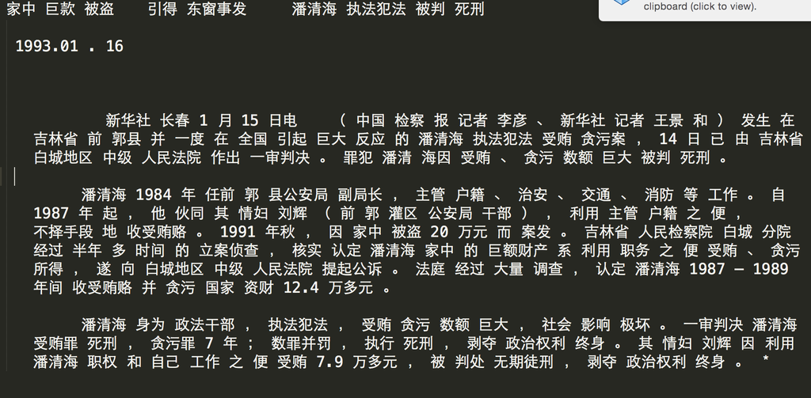
Example Text Corpus

Slide 7
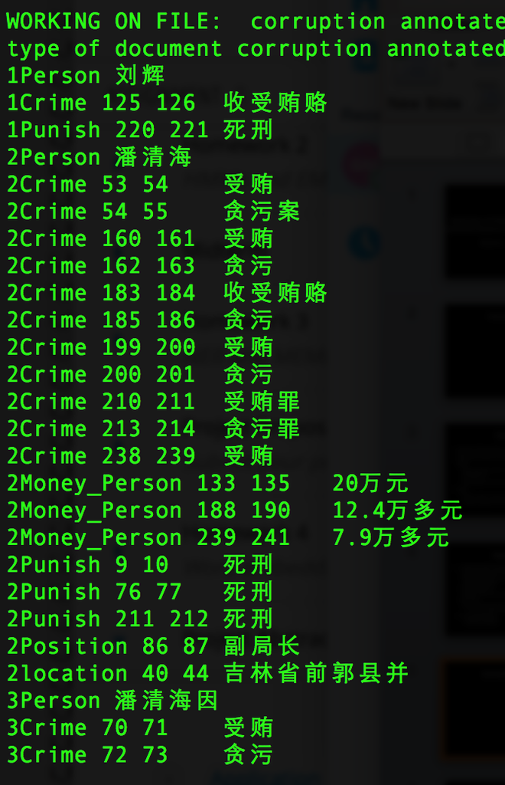
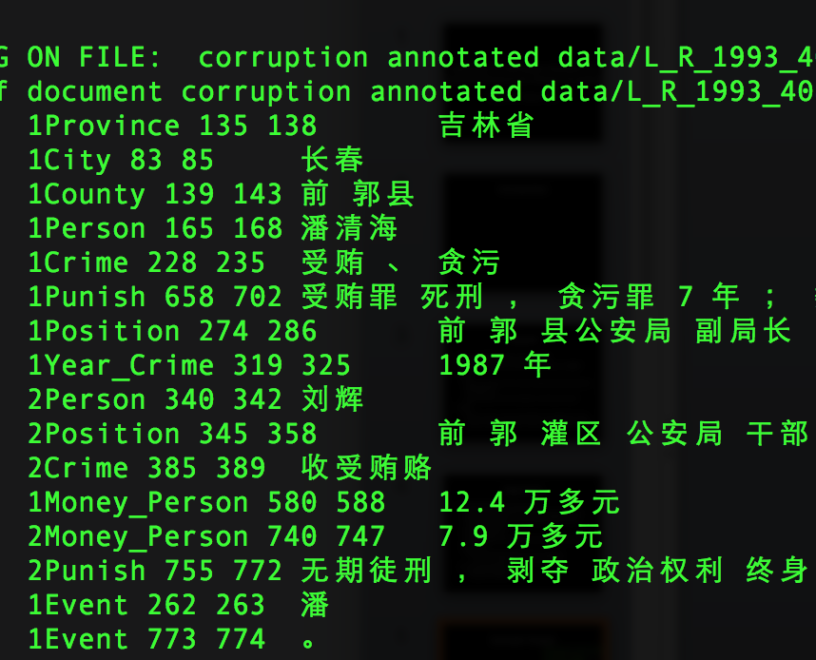
Example Output

Slide 8
Baseline
Feature vector
nearest distance matching
NER

Slide 9
Challenges
Encoding
Chinese language needs to be encoded as Unicode strings
Word Alignment
Chinese has no spaces between characters, word segmentation from different API return different results
Named entity correspondence
Who did what
Filter out reporters and law enforcement officials

Slide 10
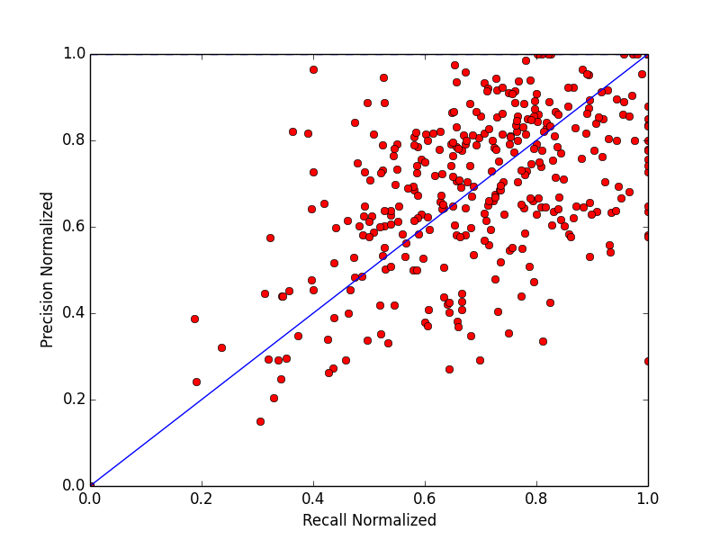
Results

Slide 11
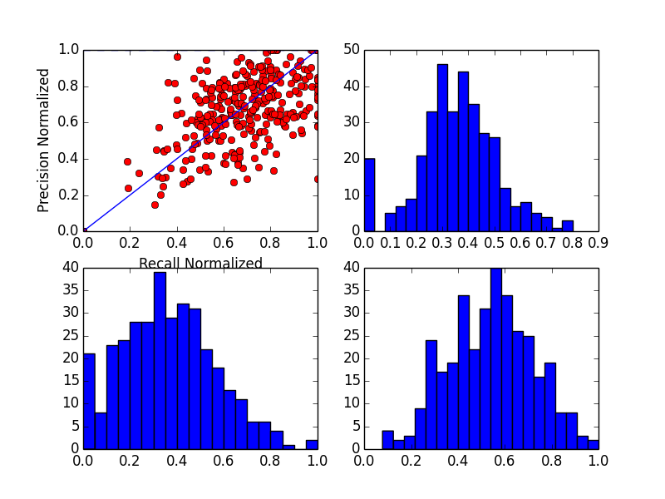

Slide 12
Results
 | Avg Recall | Avg Precision | Extraction Precision | ExtractionRecall | Normalized Precision | Normalized Recall
Baseline | 11% | 3% | N/A | N/A | N/A | N/A
Word Align | 17% | 9% | 34% | 48% | 26% | 35%
Final Occupation Filtering | 38% | 39% | 54% | 53% | 67% | 65%

Slide 13
Future Works
Syntactic Parsing
Juxtaposition of culprits
Relation disambiguity with dependency parsing
Word Embedding
Automate feature discovery
Extend to a general framework for correspondence based information extraction
Change feature vectors

