Slide 1
Update
3/25/16

Slide 2
Clustering
Why?
Separate users into classes
How?
KMeans algorithm to separate dataset, 3 components
The features are avgStartTime, apple or android, avgDuration
The distribution of each components mainly differs on average session duration

Slide 3
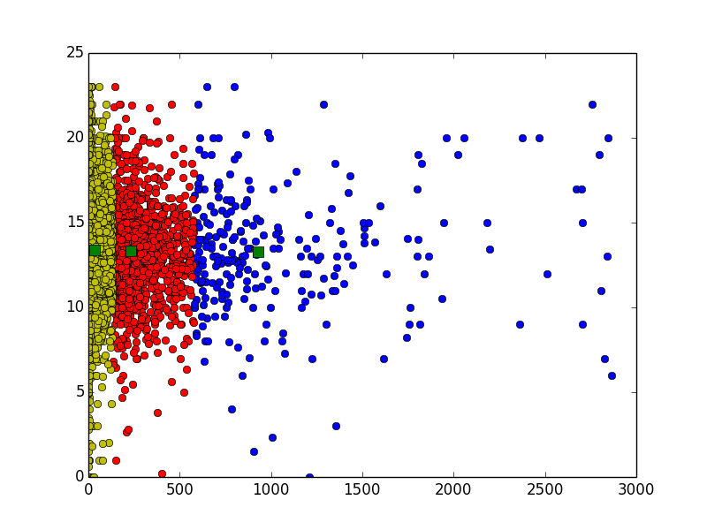
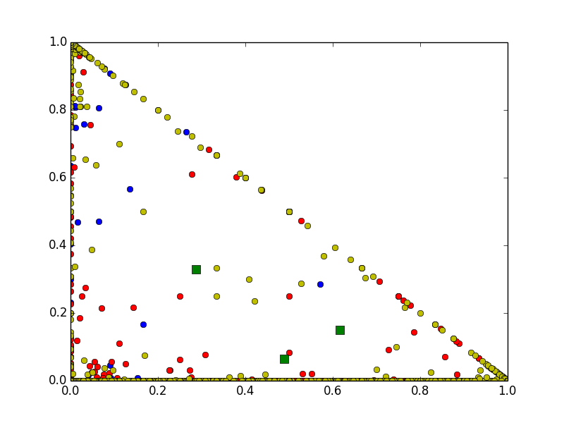
X = Apple
Y = Android
X = duration avg.
Y = start Time avg.

Slide 4
Pros and Cons
Cons:
Using clustering algorithm does not give additional information, and so the clusters we produce might not help us.
It might thus hurt performance in the inference stage.

Slide 5
Other works
Related works is almost done
~5 hours
Started on PYMC detailed analysis section
~3 hours
Still working on the script that generates each type of user’s behavior
~Takes 10 more hours

Slide 6
Writing
Turn in Related works by Monday
Turn in PYMC Draft by Monday
Turn in the MEng seminar 4/8?

Slide 7
Outlook
300 hours of work left in 26 days
100 hours for writing
200 hours for working
~12 hours per day.

