Slide 1
Update

Slide 2
Predict Duration
Regression
Ridge Regression (alpha penalty on norm of weights)
Logistic Regression (Classifier)

Slide 3
Features
Apple = {iphone, ipad, mac, etc}
Android
timeStartBucket {0 ~ 23}
Day of week
Ip by bits (32 bits)
(Not done) Group by ID

Slide 4
Output
In ridge regression case
Output prediction is duration in seconds
In Logistic regression case
Output prediction is one of three classes: durationShort, durationMid, or durationLong
(<5s, 5s ~ 60 min, >=60 min)

Slide 5
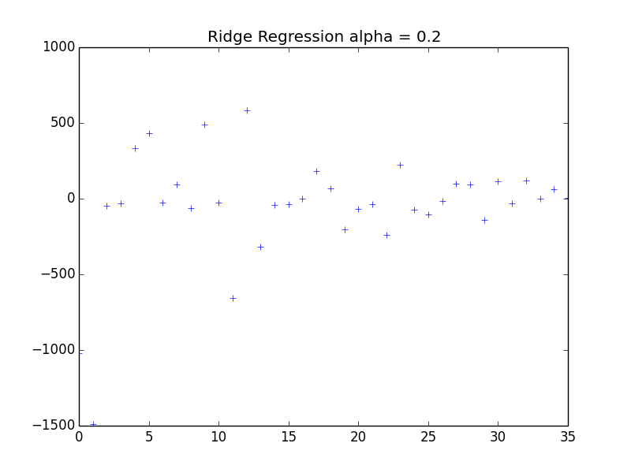
Results

Slide 6
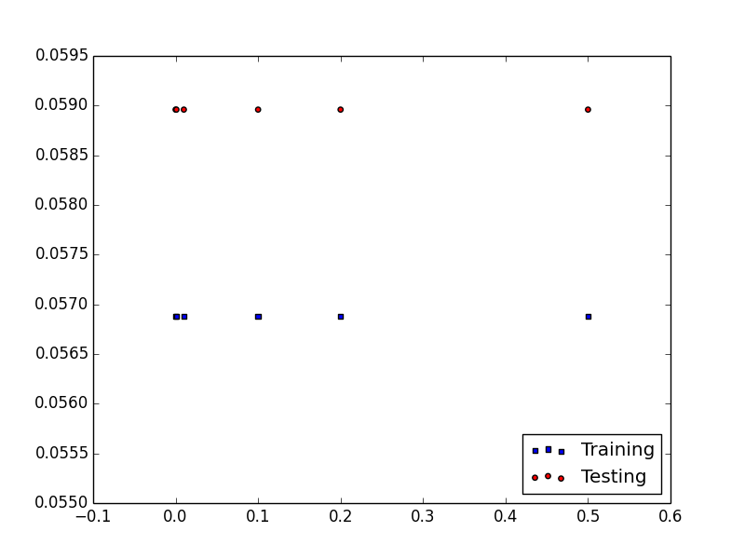
Results x = alpha penalty y = training, testing scores

Slide 7
Logistic Regression
Duration broken into 3 classes :
<5s, 5s ~ 1h, >=1h
Training set score is: 0.672675
Testing set score is: 0.671965
Better than chance (1/3)

Slide 8
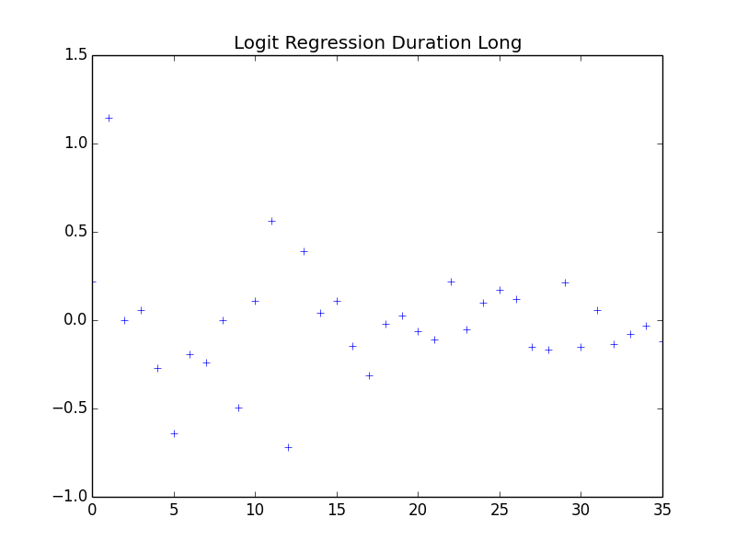

Slide 9
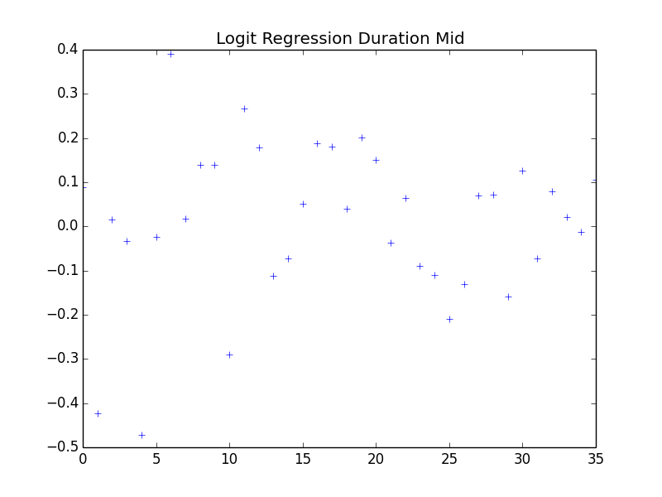

Slide 10
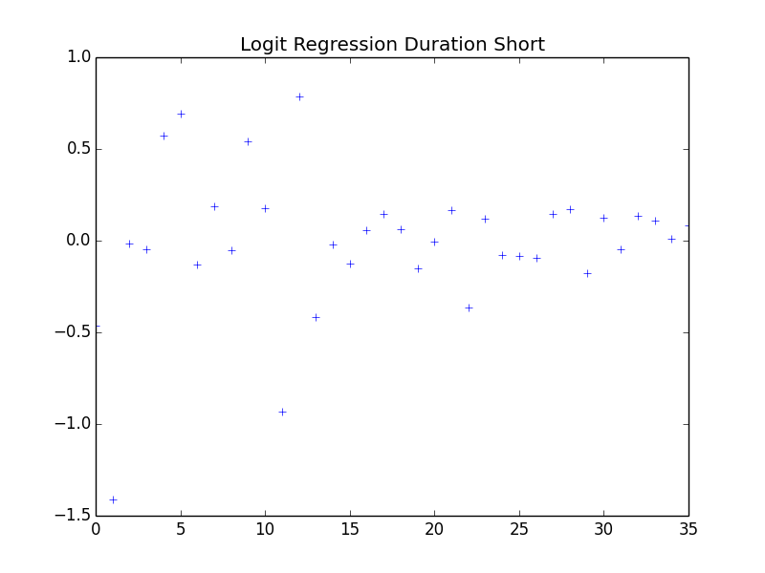

Slide 11
Summary
Day of week do not affect length of duration

Slide 12
This week
Both the classifier and the generative regression can benefit from more features
Features shall not capture specific behavior, as it will get lost in a sea of data.
Neural net approach – currently debugging a tf.variable matrix multiplication dimension problem

