Slide 1
Mastering the Game of Go with Deep Neural nets and Tree Search
Vision
Deep neural nets and a collection of systems can combine to reach human level in a perfect information game.
AlphaGo can compete with human champions in games with astronomically large number of possible configurations.

Slide 2
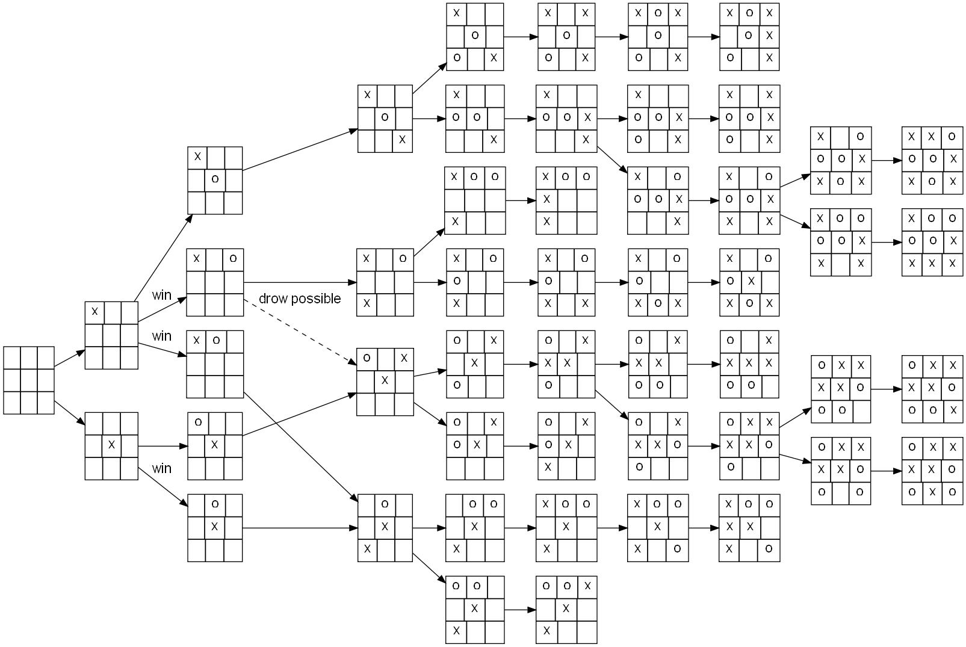
News
In March 2016, AlphaGo won 4-1 against Lee Sedol, the top Go player in the world over the last decade.
Go is a two player game with up to 3 ^ 361 different board settings. Big search space requires clever strategies.

Slide 3
AlphaGo Systems
Policy Network
Self Play
Value Network
Monte Carlo Tree Search
AlphaGo is a comprehensive engineering system that combines different yet interesting strategies.

Slide 4
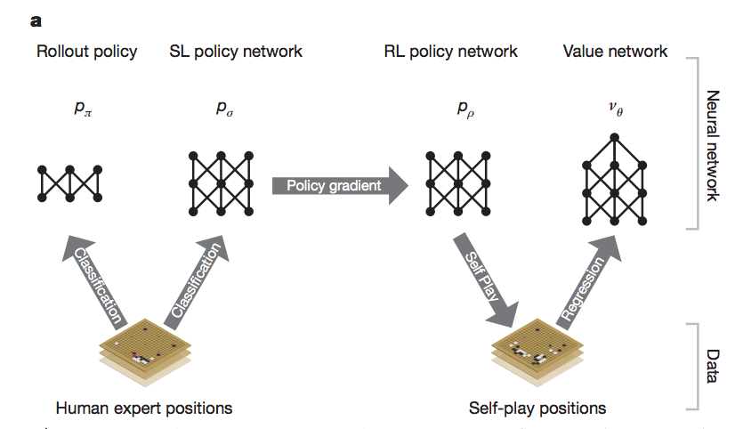
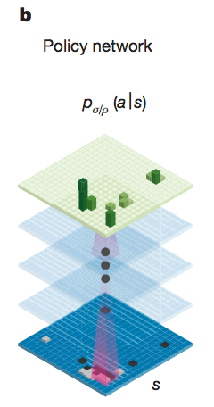
Policy Network
Calculates where the human is likely to place next move based on human expert historical games.
Self play allows AlphaGo to play against itself to gain more mastery.

Slide 5
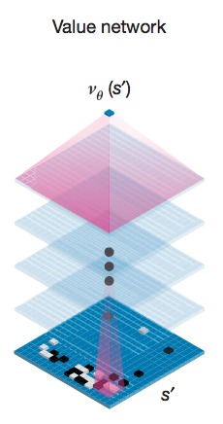
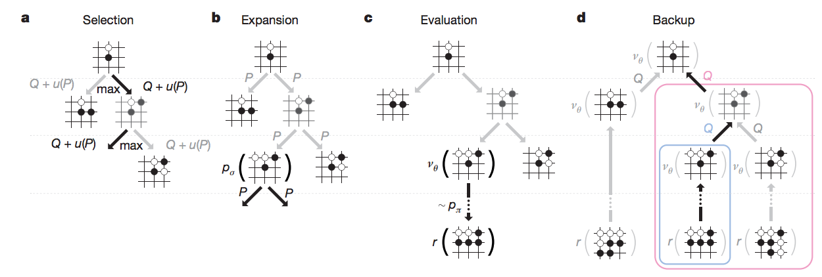
Value Network
Which legal move I take yields the highest chance of winning.
Calculates a chance of winning for each legal move on the board through Monte Carlo simulations.

Slide 6
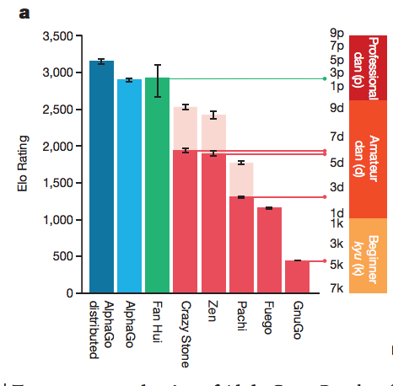
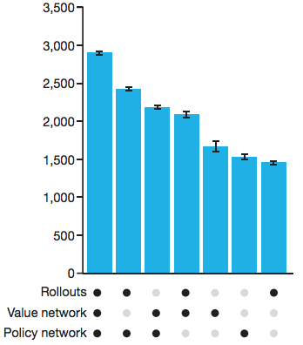
Elo Ratings For AlphaGo vs. Other programs
AlphaGo reaches human champion ratings at Go and systems combine to produce a higher rating.

