Slide 1
Update
1/25

Slide 2
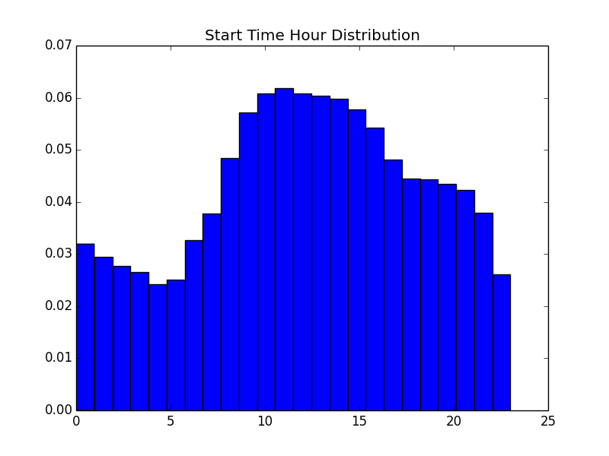
Start Time Hour Distribution
Peak around class hours
In general, less night owls
Would be interesting to separate into night owls and morning persons.

Slide 3
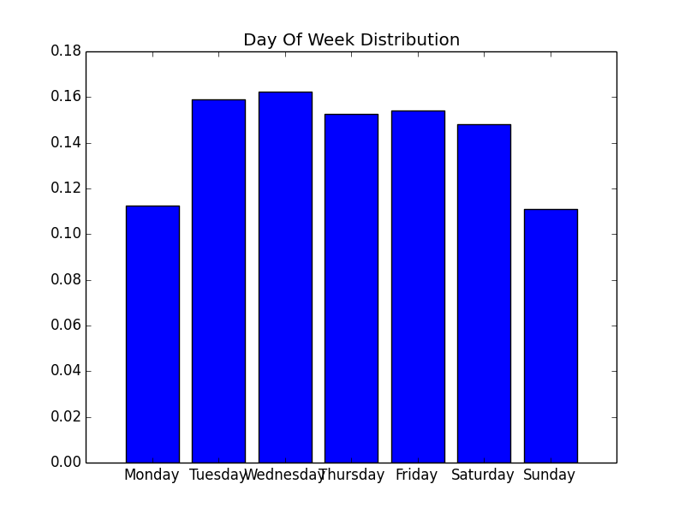
Day Of Week
Monday and Sunday low.
Otherwise equivalent.

Slide 4
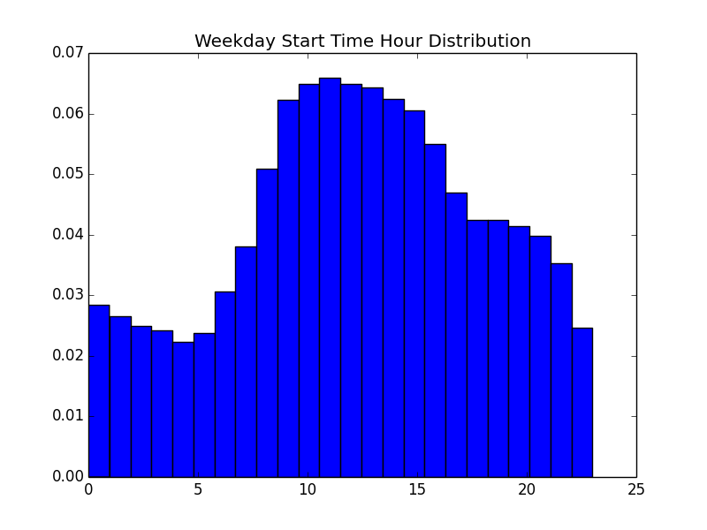
Start Time Distribution Given Weekend/weekday
Class time shows increased entries

Slide 5
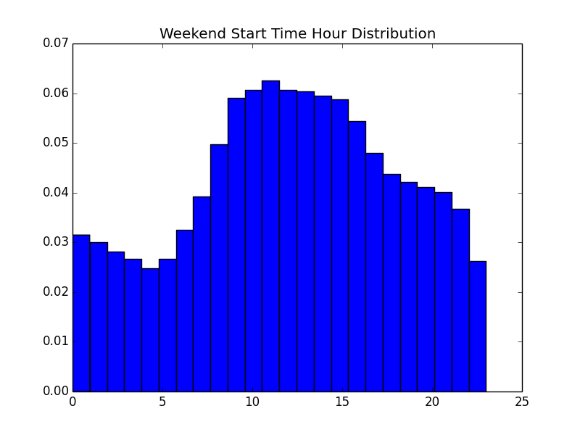
Start Time Distribution Given Weekend/weekday

Slide 6
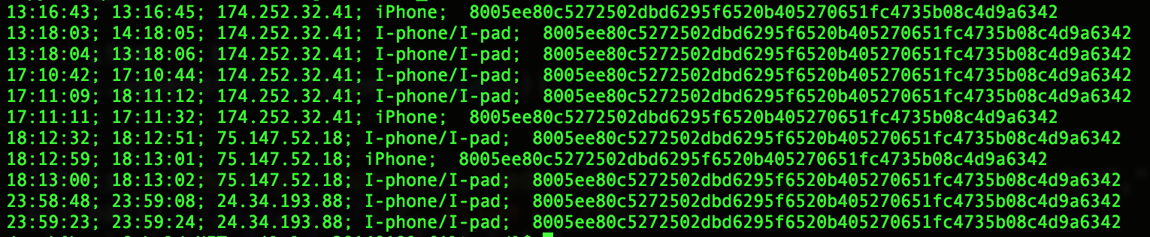
One Hour Duration Issue
Issue: Look into 13:18:03 ~ 14:18:05 by lookup of IMAPS id

Slide 7
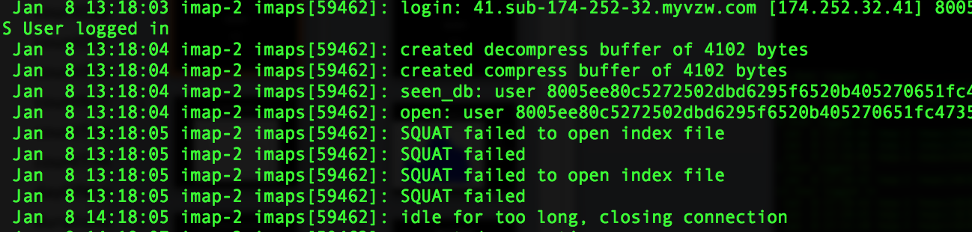
The 1 hour sessions are simply “Idle for too long”.
Takeaway is 1 hour sessions may not be different from 5 seconds sessions, except one logs out.

Slide 8
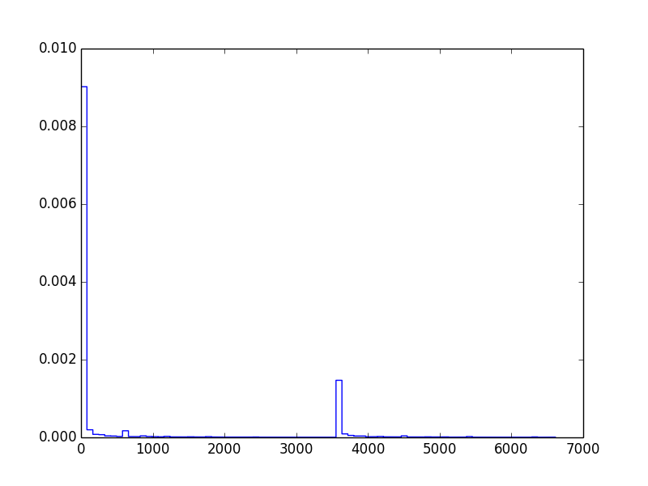

Slide 9
Bayesian Probability PYMC3
Emailed Thomas Wiecki, lead data scientist who wrote Pymc3. He hasn’t responded
Modeled startTime as normal distributions for weekdays and weekends.
Mu1 = 9.4, mu2 = 9.5, sigma1 = 5.6, sigma2 = 5.8. 1 = Weekend, 2 = weekday

Slide 10
This week
HARD deadline: BUILD the model! No matter how simplistic, let it run.

