Slide 1
Update 2/4
Working!

Slide 2
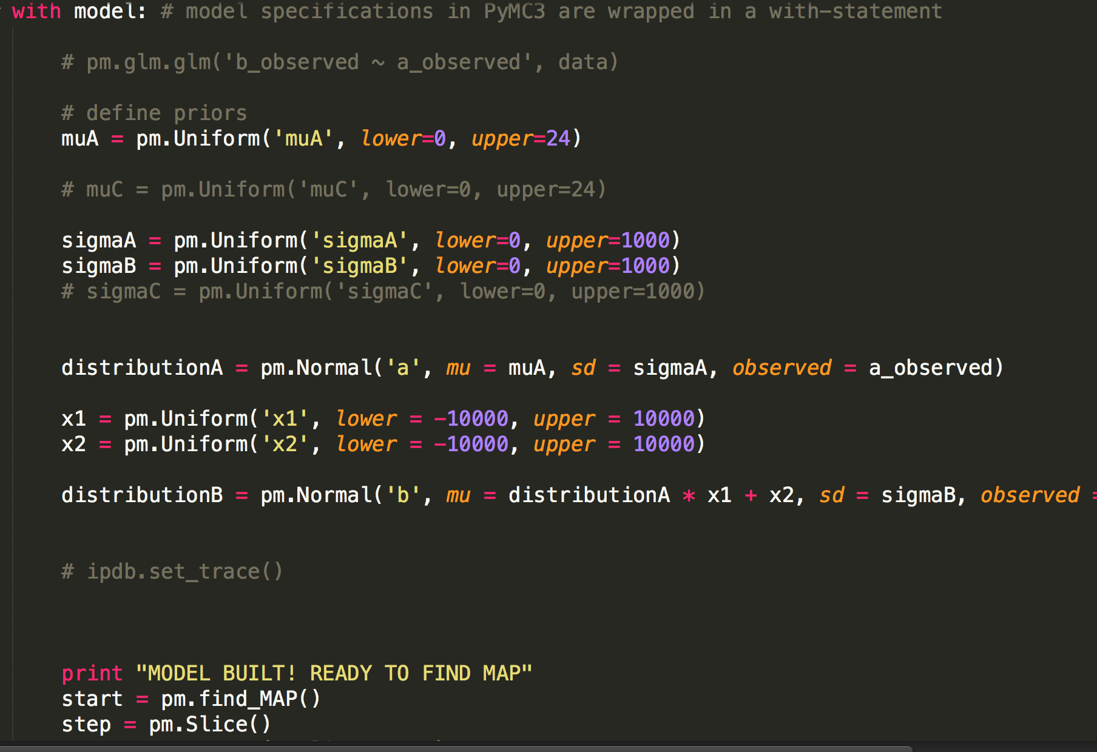
Model Building
Now works!
My mistake is…

Slide 3
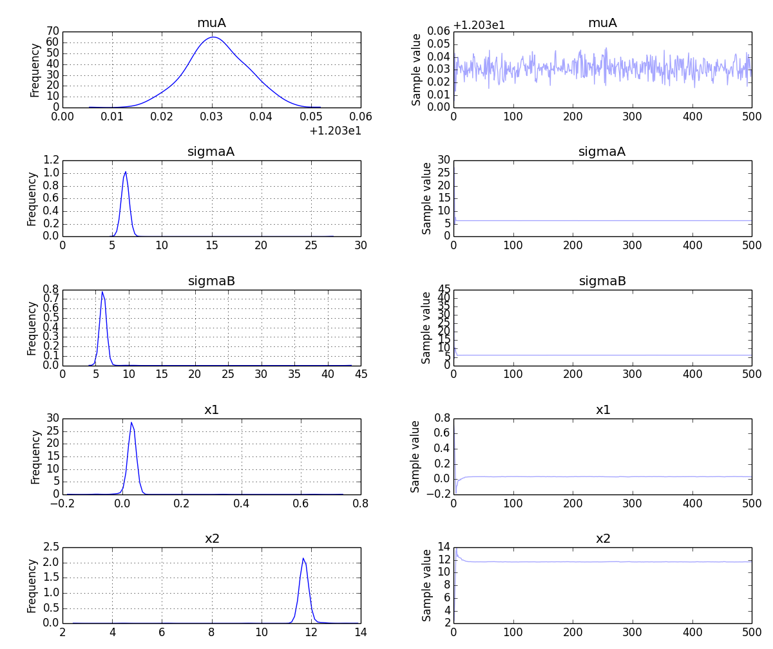
Some Results

Slide 4
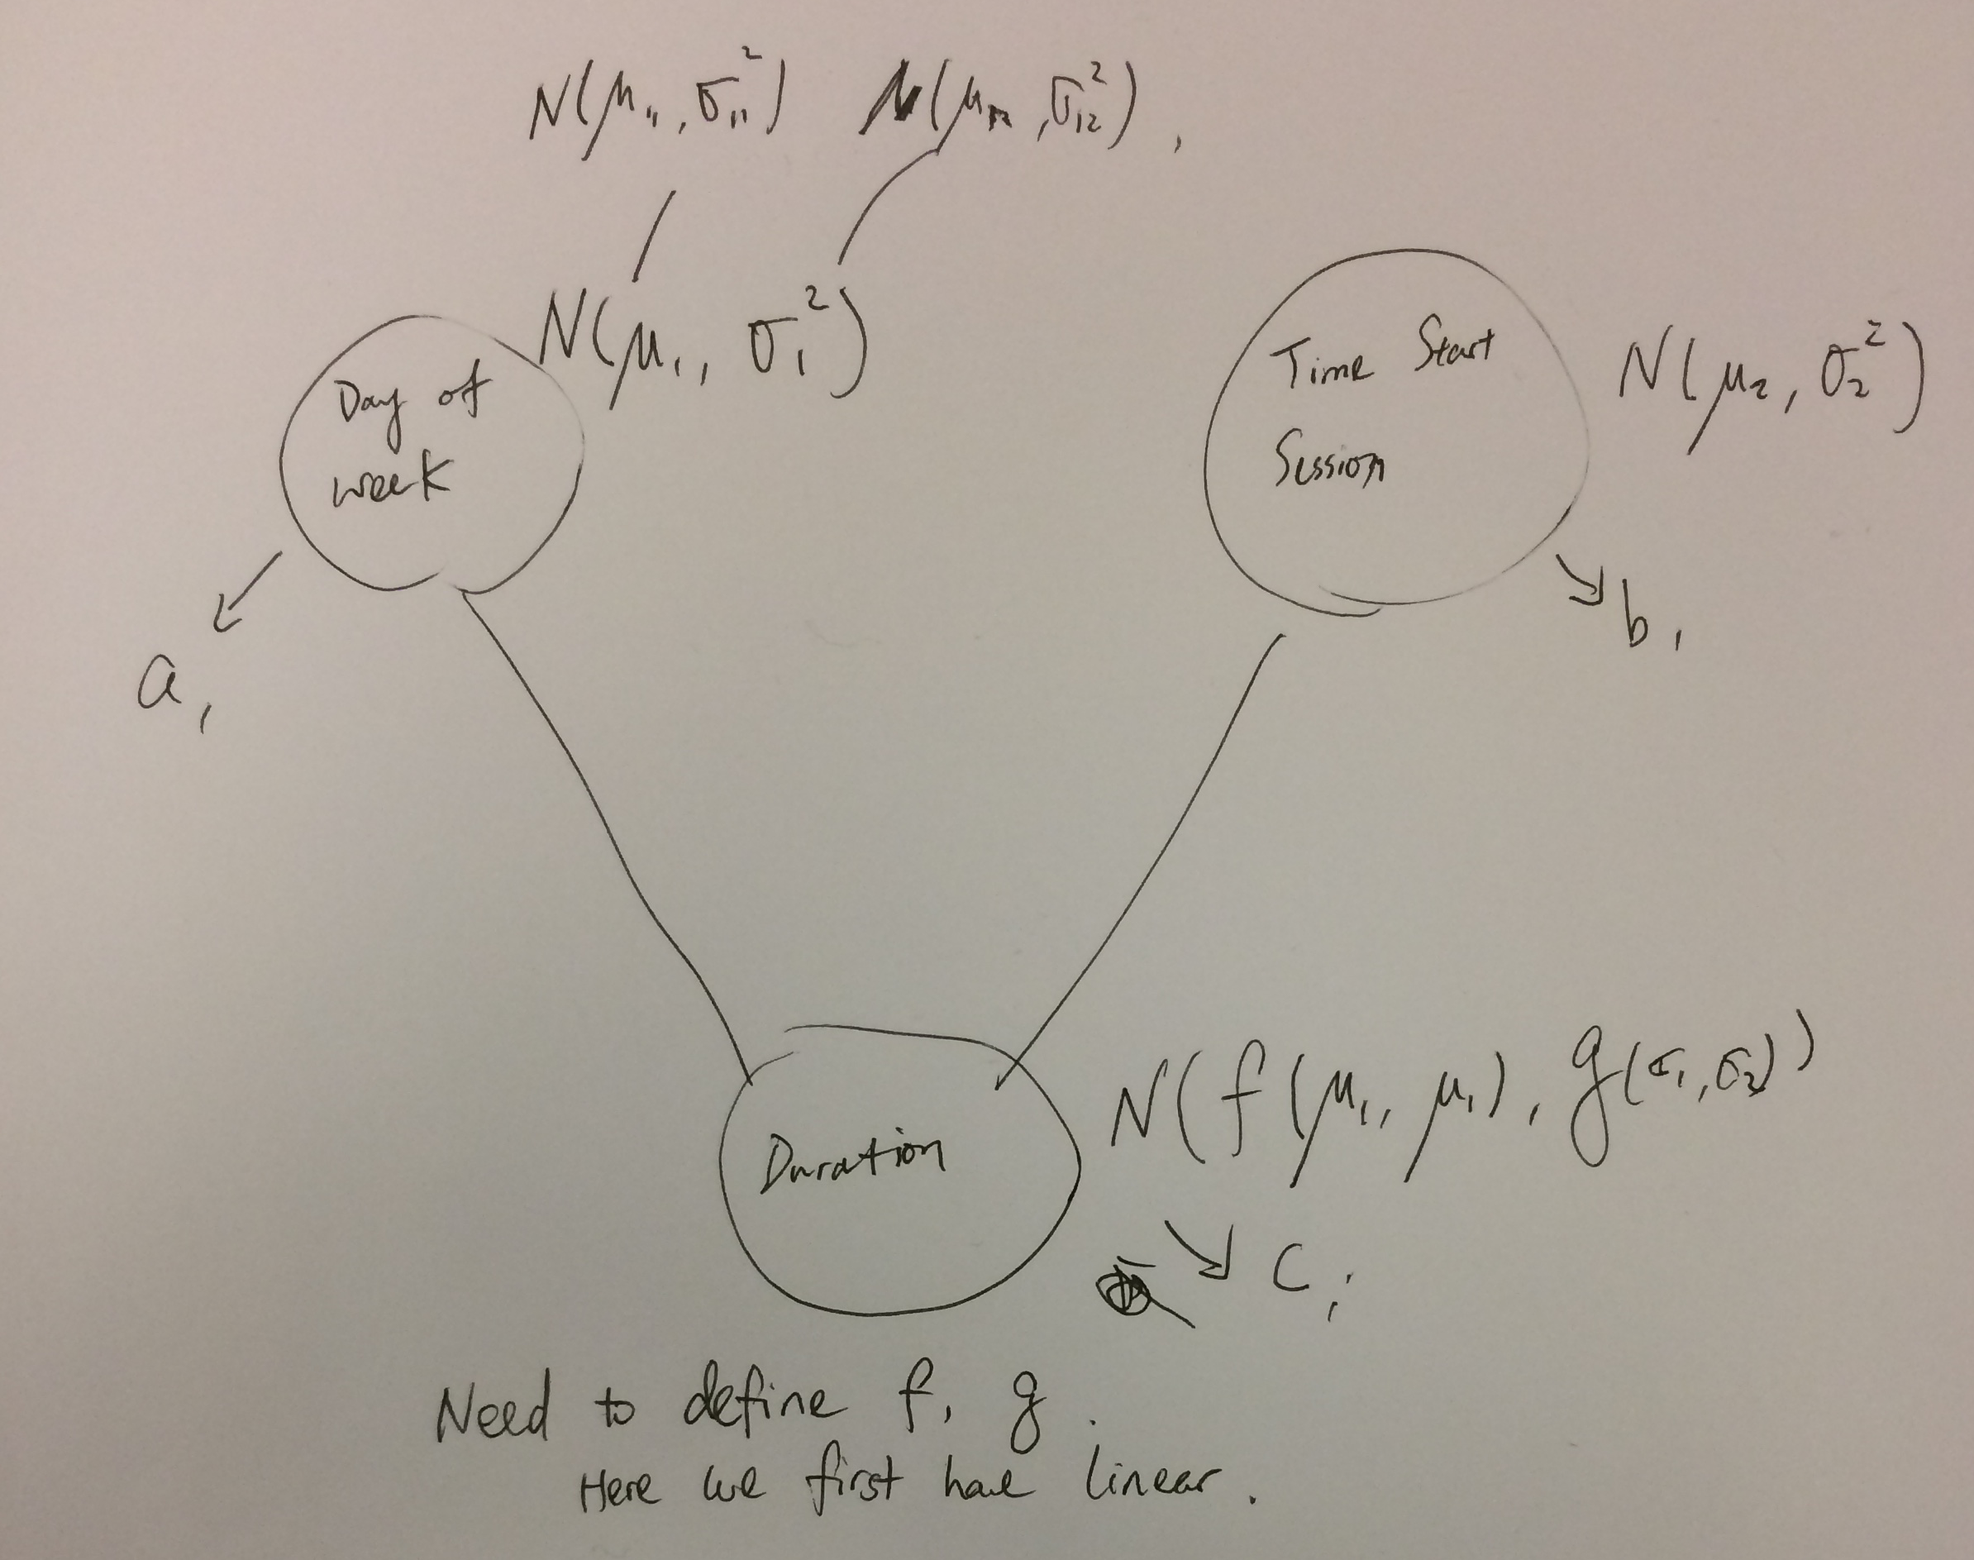
Model Explained

Slide 5
Next Steps
Some plotting techniques for presentation purposes
Plot Predicted vs. Actual
Store models into files
Pickle.dump dataframe
Data processing to append missing terms, etc
pandas
Id | Device | Start time | Duration | Date | ip
xxxxx | Iphone | 12:15 | 20 mins | 1.2.2014 | 18.183.2.1
Xfad | Ipad | 12:13 | 30 mins | 1.23.2014 | 18.4.4.4

Slide 6
Schedule
12/15 Simple working 3-state HMM model, with baseline metrics
1/8 First new model
1/15 Multiple working models
2/1 Extracting relevant data for UMass dataset
2/15 Multiple evaluations
3/15 Analysis of pros and cons of each model; possible extension to new datasets

Slide 7
Writeup Timeline
2/08 Draft Introductory
2/22 Discussion of evaluation techniques
3/22 Draft Modeling and Evaluation
4/15 Draft Conclusion
4/22 Thesis

Slide 8
Sources
https://groups.google.com/forum/#!topic/pymc/gAImsliT34o

