Slide 1


ANDROID PROOF OF CONCEPT
AI implementation
of two Android flows
EDTS / POC REPORT / 2026
Promotion detail and search / 8 October 2026
01
Notes:
Audience: a design manager with previous engineering experience. Two connected Android flows implemented in the sample app. Human inputs were designs, project context, constraints and approval. PoC evidence: 1 October 2026. Report revision: 8 October 2026.

Slide 2
TIME COMPARISON
Time across the two flows
Flow | Recorded AI task time
Promotion detail | Approximately 1h 31m
Promotion search | Approximately 1h 12m
Combined | Approximately 2h 43m
EDTS / POC REPORT / 2026
Traditional estimate: approximately three working days, supplied by the developer.
AI time includes planning, builds and QA. Human preparation/review and existing design work are excluded.
02
Notes:
Recorded task time: detail 1h 30m 54s, search 1h 11m 39s, total 2h 42m 33s. Figures are rounded on the slide. Includes planning, implementation, builds and QA. Excludes session gaps, unrecorded human preparation/review, existing design/UI-kit creation and this report. Three working days is the developer estimate. These figures do not establish a measured productivity gain.

Slide 3
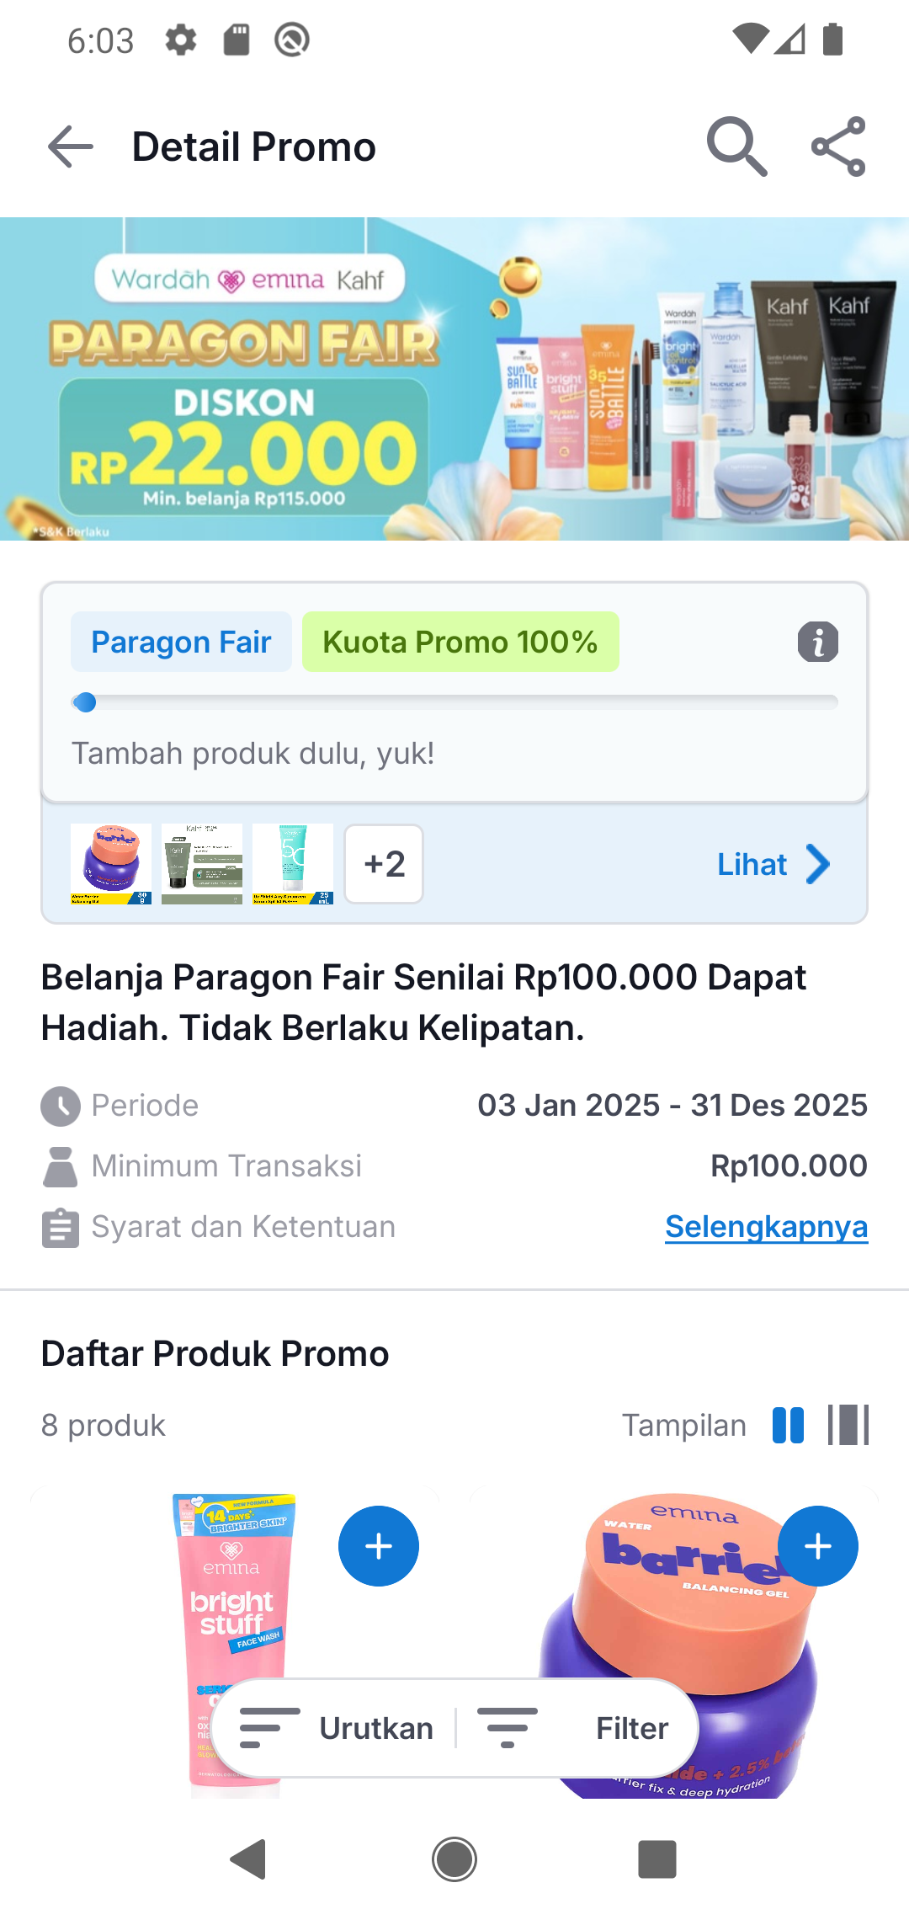
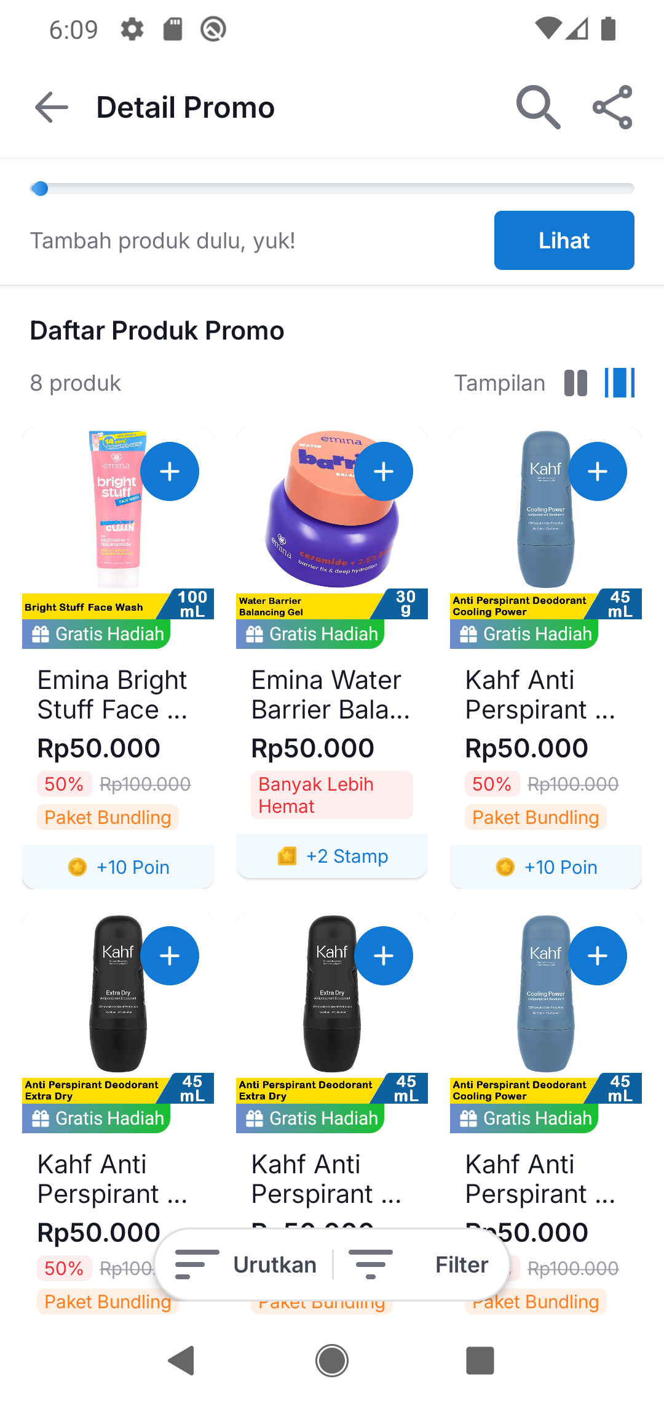
FLOW 1
Promotion detail
Shopping and rewards
Quantities update totals
and reward eligibility.
Gift selection supports
one-time and repeat rewards.
Scroll shows a compact
progress summary.
EDTS / POC REPORT / 2026
Initial detail and reward preview
Compact summary and three columns
03
Notes:
Detail includes promotion terms, quantities and totals, one-time/repeatable gifts, local product/gift/cart sheets, sort/filter and two/three columns. Shopping state is shared with search. Screenshot evidence: docs/images/paragon-fair. Source: docs/ParagonFairDemo.md.

Slide 4
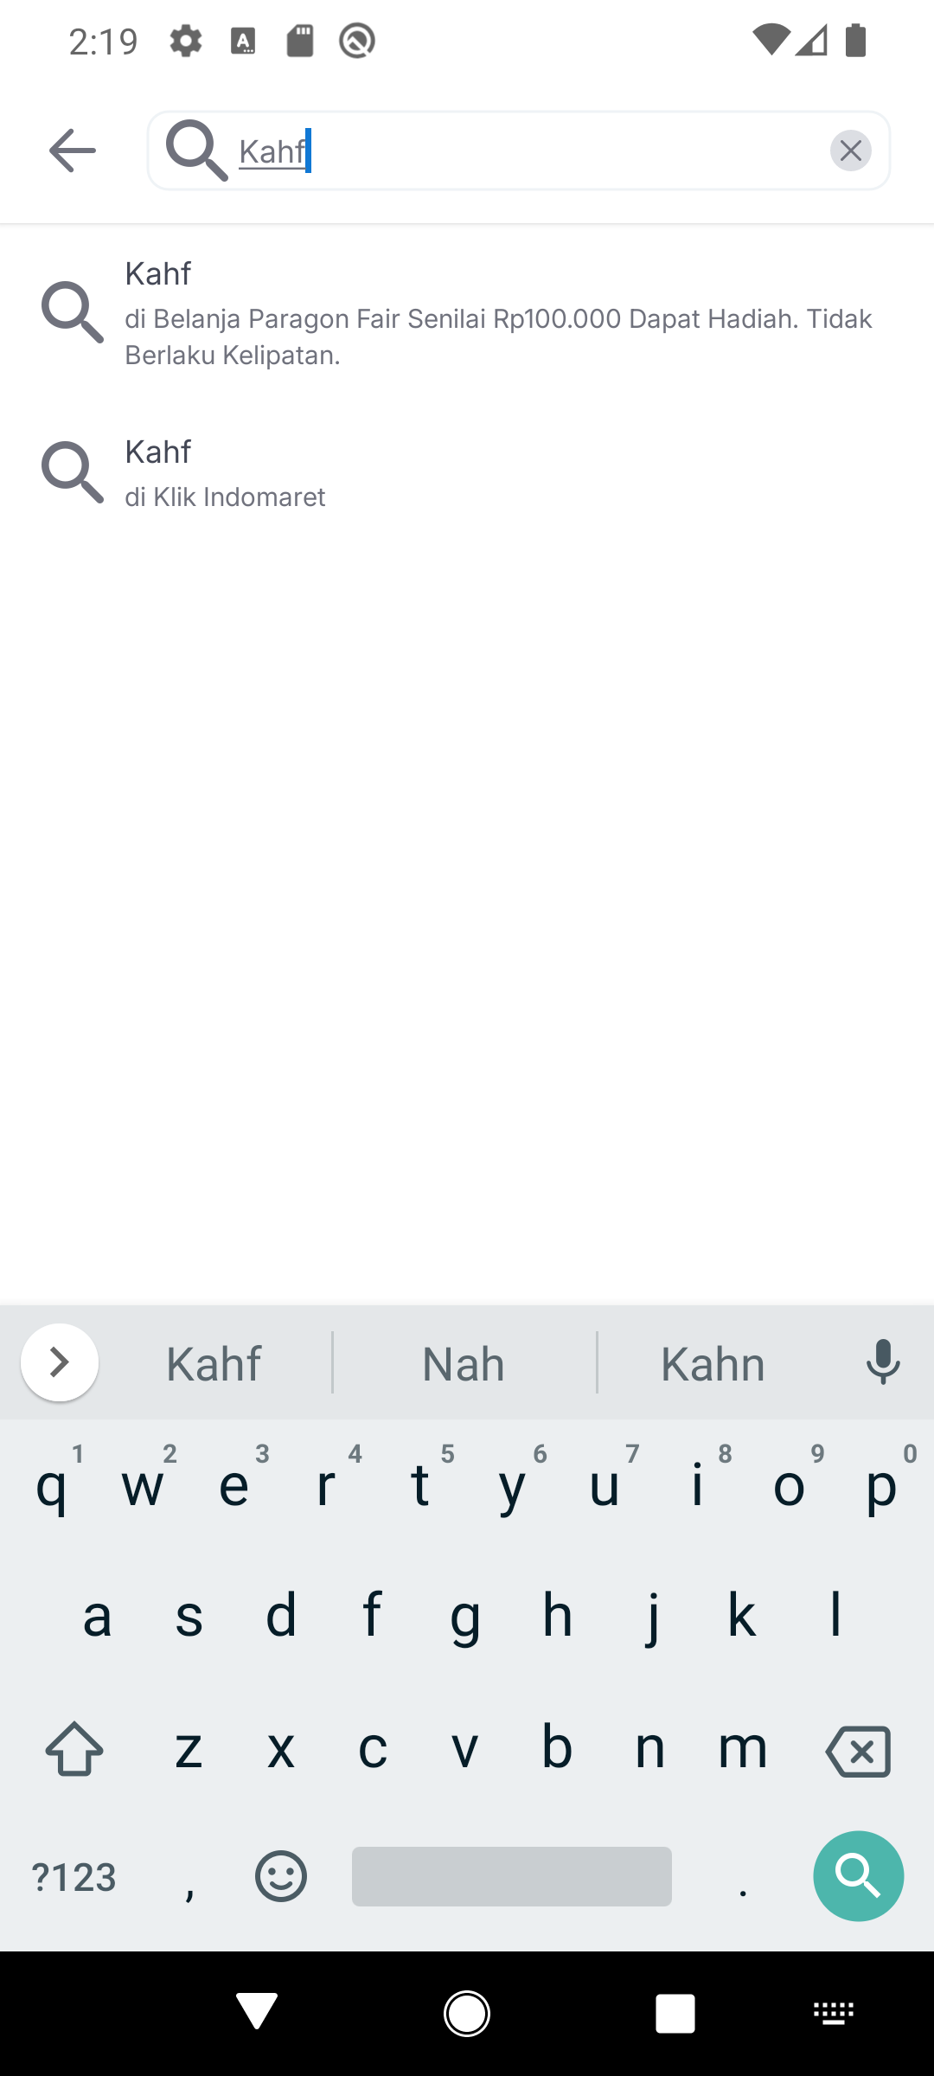
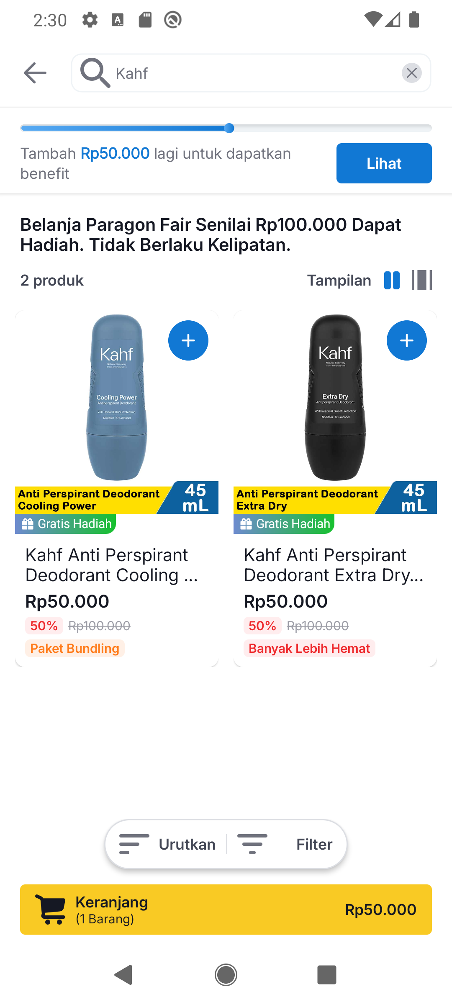
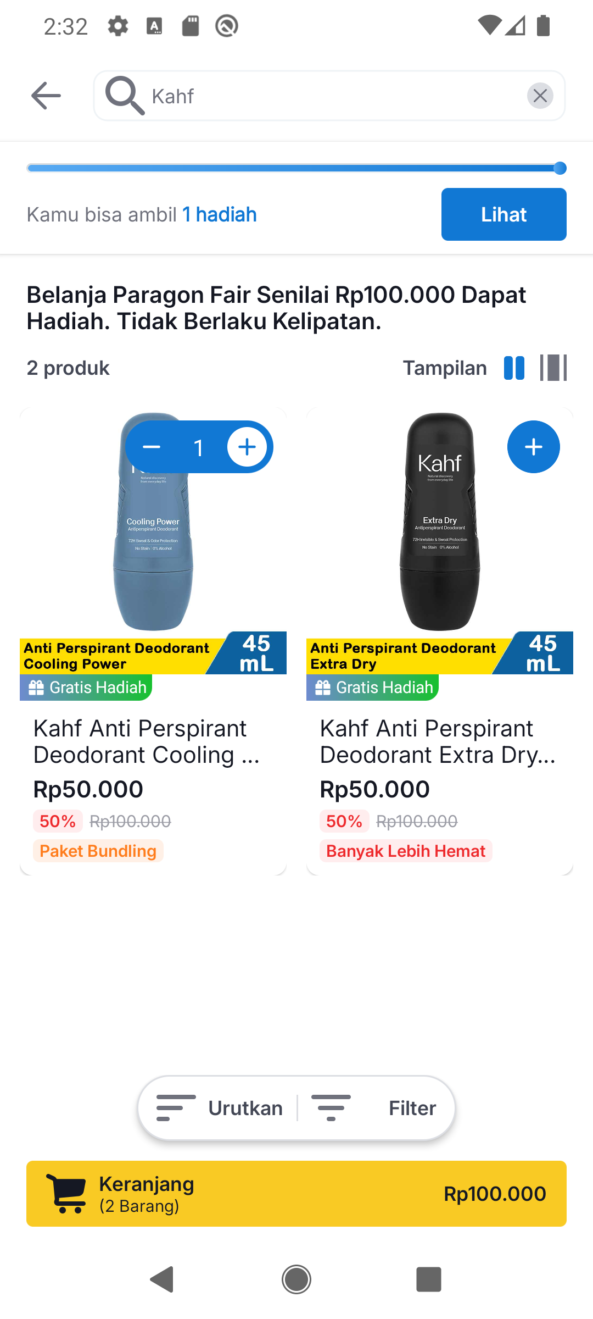
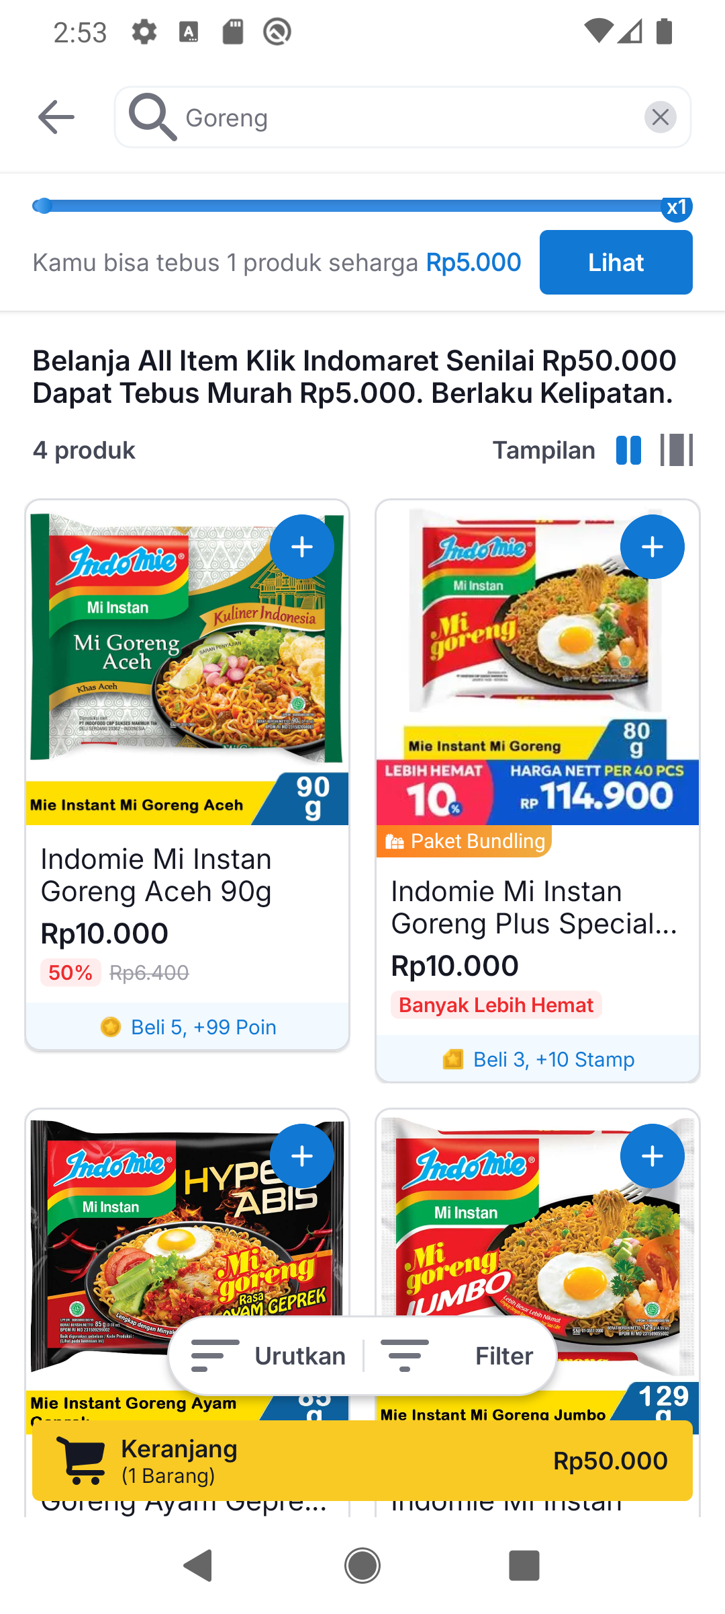
FLOW 2
Promotion search
Scoped results, empty states and retry; cart and reward state persist across queries.
EDTS / POC REPORT / 2026
Scope suggestions
Two Kahf results
Cart and gift eligibility
Four Tebus Murah results
04
Notes:
Search includes Hadiah Gratis and Tebus Murah results, native editing and scope suggestions, local loading/empty/error/retry states, general-search handoff and website intent. Query and shopping state restore after process recreation. Screenshot evidence: docs/images/promo-search. Source: docs/PromoSearchDemo.md.

Slide 5
MOTION DETAILS
Quantity, rewards and cart
Trigger | Timing | Behavior
Quantity zero / positive | 300 ms; width 32–90 dp Internal fades: 150 ms | Expand or collapse; update quantity immediately
Qualifying spend changes | 450 ms; cubic easing (0.2, 0.8, 0.2, 1) | Retarget from displayed progress, including decreases
Reward message changes | 160 ms fade; 4 dp movement | Replace message; cancel the previous animation
Reward preview scrolls away | Enter: 160 ms / 4 dp Exit: 120 ms | Show compact summary; threshold buffer prevents flicker
Cart becomes visible | 240 ms fade; 16 dp movement | Animate the first appearance
Quantity changes | Scale 1 → 1.12 → 1 100 ms then 120 ms | Pulse the cart icon; replace any active pulse
EDTS / POC REPORT / 2026
Timings are PoC implementation choices; the inspected Figma sections supplied no motion specification.
05
Notes:
Timings are implemented PoC choices rather than verified Figma motion specifications. Existing kit stepper behavior is reused. Progress and feedback cancel or retarget active animations so the latest state remains visible.

Slide 6
MOTION AND INTERACTION
Search and motion controls
Event | Timing / behavior | Interaction
New repeat milestone | Scale 1 → 1.12 → 1 120 ms then 140 ms | Runs when a new reward interval is earned
Search mode changes | 160 ms content fade-in | Suggestion updates avoid per-character cascades
Search submission | Loading, results, empty or error state | Retry keeps the query; cart state persists
Sheets / keyboard | Existing kit / Android transitions | Native text selection, copy and paste
Animator scale zero | Immediate state and label updates | Custom motion and loading spinner are disabled
EDTS / POC REPORT / 2026
Tap updates state. Scroll reveals the compact summary. Long tap supports text editing and product inspection.
06
Notes:
Local search pending time is a fixture delay, not an animation or a production performance result. Back preserves shopping state. Long tap also opens demo scenario selection; quantity controls do not repeat on hold. With animator scale zero, custom motion and the loading spinner are disabled.

Slide 7
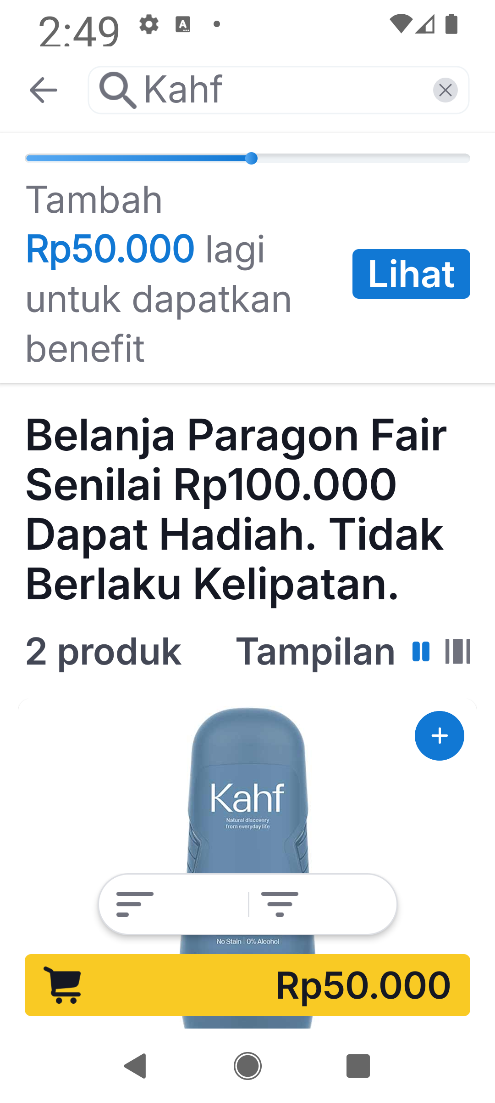
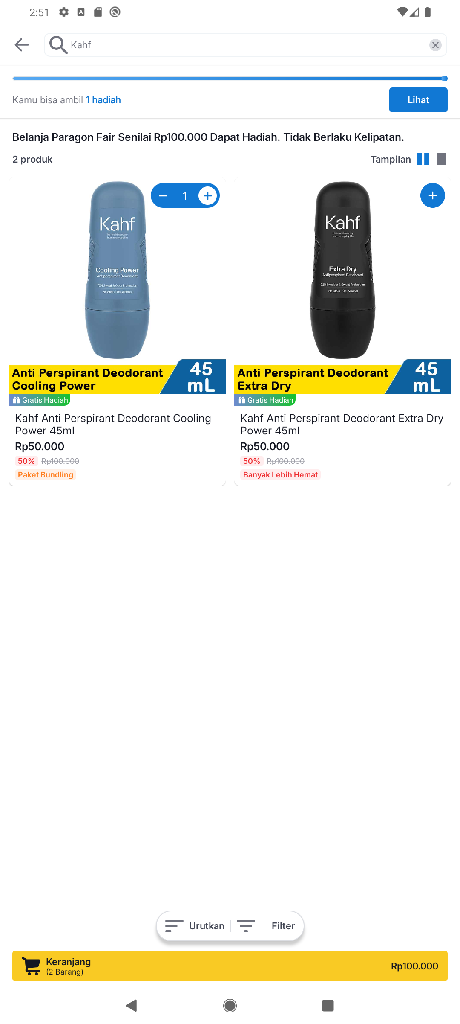
VALIDATION / 1 OCTOBER 2026
Checks and responsive layouts
14 tests
All app tests passed.
10 cover the PoC state models.
EDTS / POC REPORT / 2026
Debug build and code checks completed
0 lint errors, 293 warnings
Search, cart and reward state
restored after the app restarted.
320 dp / 200% text
600 dp portrait
07
Notes:
Checks recorded on 1 October 2026: debug build, app unit tests and lint completed. 14 tests passed, including 10 PoC state tests. Lint: 0 errors and 293 warnings. Pixel 4 API29 emulator widths: 320, 360, approximately 393 and 600 dp portrait. Includes 200% text, reduced motion and app process restart. Screen-reader labels were inspected in the UI structure. Live TalkBack/Switch Access remains outstanding. App checks were not rerun for the report edit.

Slide 8
SUMMARY
AI execution with human direction
Contribution
Humans supplied designs, constraints and approval. AI implemented, repaired and checked the two flows.
Model and access
GPT-6.1 Sol (developer-stated). Temporary subsidy reported, with terms unverified.
EDTS / POC REPORT / 2026
PoC scope
Sample data and demo navigation. Backend integration, checkout and redemption charging are outside scope.
Remaining checks
Confirm business rules and test live accessibility, more devices and animation performance before production.
08
Notes:
GPT-6.1 Sol is the developer-stated model for prototyping. A temporary subsidy is developer-reported, with its exact rate and expiry unverified. The official pricing page identifies a promotion for GPT-5.6 Sol, which does not establish a GPT-6.1 Sol subsidy. No project cost or savings are calculated. Sources: https://learn.chatgpt.com/docs/pricing and https://developers.openai.com/api/docs/models/gpt-6.1-sol (checked 7 October 2026). Original control sizes and touch areas remain. Accessibility labels are screen-reader descriptions. Production follow-up: business rules, live accessibility, more devices and measured animation performance.

