Slide 1
I2C Basic principles

Slide 2
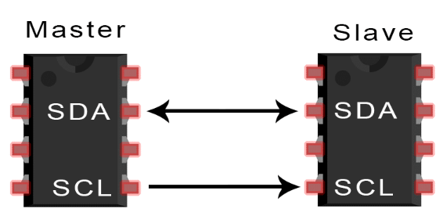
I2C Basics
I2C combines the best features of SPI and UARTs
I2C lets user to connect multiple slaves to single master or multiple masters controlling single slave or controlling multiple slaves
This helps when multiple microcontrollers logging data into single memory card or displaying text to single LCD
There will be only two wires in i2C – SDA and SCL
The connection setup is as follows:
SDA – Line for master and slave to send data
SCL – Line that carries the clock signal

Slide 3
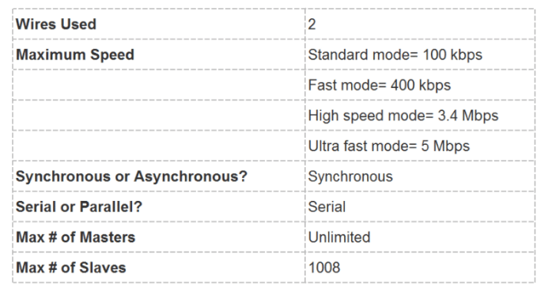
I2C Basics
I2C is serial communication protocol –so data is transmitted bit by bit along with single line
I2C is synchronous – output bits will be synchronized to the sampling of bits by clock signal shared between master and slave
The clock signal is always controlled by Master
The properties of I2C

Slide 4
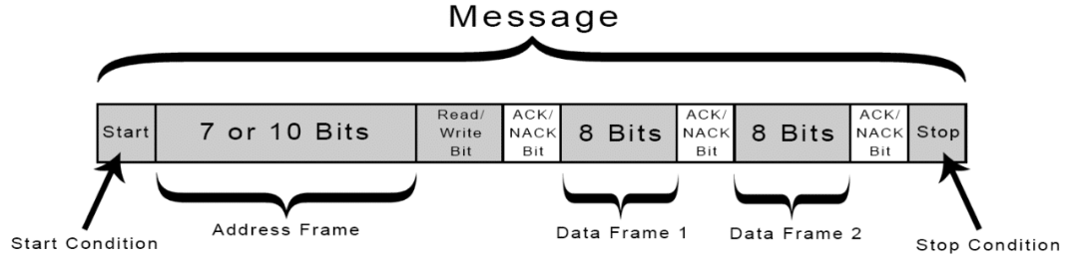
How i2c works?
With I2C, the data is transmitted in messages
The messages are broken up into frames of data
Each message has an address frame that contains the binary address of slave
Each message contains start/stop conditions, read/write bits, ACK/NACK bits between each of the data frame
Start Condition
The SDA line switch from high voltage level to low voltage level before the SCL line switch from high to low
Stop Condition
The SDA line switch from low voltage to high voltage after the SCL line switch from low to high

Slide 5
How i2c works?
Read/Write Bit
A single bit indicates the master is sending data to the slave(low voltage) or requesting data from it(high voltage)
Each frame followed by ack/nack bit
ACK/NACK
Addressing
The I2C doesn’t have slave select pins like SPI
It uses concept of addressing – The address frame is always sent after “start bit” in new message
The master sends the address of the slave it wants to communicate to every slave connected to it
Each slave compares the address sent from master to its own address
If address matches it sends low voltage Ack bit back to master
If address doesn’t match slave does nothing and SDA line remains high
Read/Write bit
The address frame includes a single bit that indicates to slave whether master wants to read the data or write the data
If master wants to send the data to slave – Read/Write is: Low voltage
If master wants to read the data from slave – Read/Write bit is: High voltage

Slide 6
Data Frame
The data frame is always 8-bit long
First MSB bit will send followed by LSB bit
Each data frame immediately followed by ACK/NACK bit to verify that data being received successfully
The ACK bit must be received by master or slave before next data transfer
After all data being send – master can send stop condition to the slave to halt the transmission
Stop condition is – Voltage transition from low to high on the SDA line

Slide 7
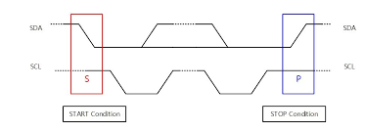
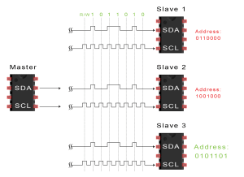
Steps to I2C Data Transmission
Step-1
The master sends the start condition to every connected slave by switching SDA line from high voltage->low voltage before switching SCL line from high to low
Step-2
The master sends each slave the 7- or 10-bit address of the slave it wants to communicate with along with read/write bit

Slide 8
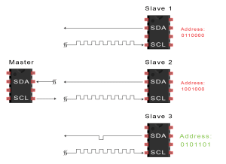
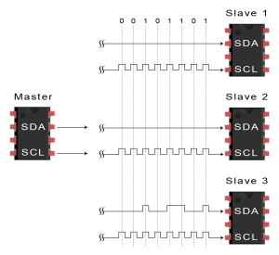
Steps to I2C Data Transmission continue..
Each slave compares the address sent from the master to its own address.. The address matches it sends ACK bit by pulling SDA line low for one bit.
If the address doesn’t match for slave SDA line remains high
Step-3
Step-4
Master sends /receive the data

Slide 9
Steps to I2C Data Transmission continue..
Step-5
After each data frame has been transferred, the receiving device returns another ACK bit to sender to acknowledge successful receipt of the frame
Step-6
To stop the data transmission, the sends stop condition to slave by switching SCL high before SDA high

Slide 10
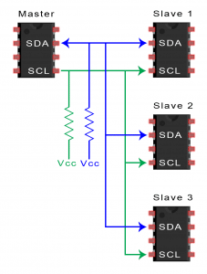
Single Master with multiple slaves
I2C uses addressing – multiple slaves can be controlled from single master
With 7 bit addressing – 128(2 pow 7) unique addresses are available
To connect multiple slaves to single master, wire using 4.7K ohm pull-up resistors connecting the SDA and SCL lines to VCC

Slide 11
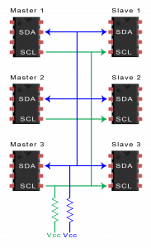
Multi Master with multiple slaves
Multiple masters can be connected to the single slave or multiple slaves
When two masters needs to send data to single slave – SDA line might be already busy with other master device – need to wait for SDA line availability

Slide 12
Advantages
Only two wires
Supports multiple master and multiple slaves
ACK/NACK bit gives information about each frame is transferred success or failure
Hardware is less compared to UART
Disadvantages
Slow compared to SPI
The size of data frame is 8 bits
More complicated hardware needed to implement than SPI

