Slide 1
Today is…
Materials Needed
Thursday, October 15
Notebook and vocabulary card
Pencil
The source sheet (handed out)
Week 7 · The Intolerable Acts
Do Now
Your whole class gets punished for what one group did. How would you react?
Start with: “If my whole class got punished, I would ___ because ___.”
Agenda
1. Do Now
2. The Tea Party (1773)
3. Britain punishes Boston (1774)
4. Three voices, with a partner
5. The cartoon, up close
6. Exit Ticket
Learning Target
WALT: Analyzing how people and movements changed history (H2.6-8.5)
I can: You explain and analyze how an individual or a movement shaped U.S. history.
Notes:
The Do Now is the day in small: one colony did it, Parliament punished it hard to scare the rest. Come back to it at the end: did your answers match what the colonies did? The source sheet comes in Level 1 (Look at, Start with, word bank) and Level 2 (Look at only, four lines each); side 1 is the same on both.

Slide 2
Today's Story
Three Steps, One Question
1773
1774
Then
Boston throws the tea into the harbor.
Britain punishes Boston.
What do the other colonies do?
The big question: when Britain punished Boston, did it work?
Notes:
Point at each box as you say it. The third box is a question on purpose: students answer it themselves from the sources.

Slide 3
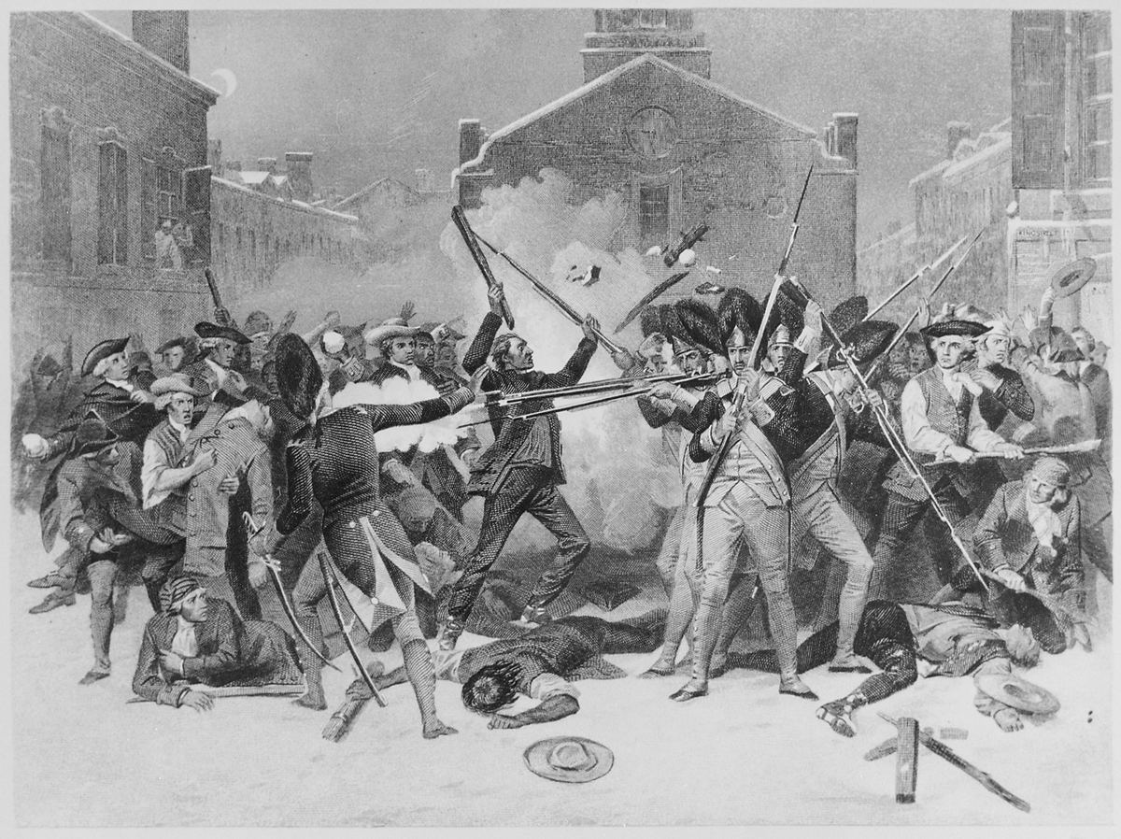
Card 5 · March 5, 1770
Soldiers fire on a crowd. Five colonists die.
One of them: Crispus Attucks.
Colonial leaders call it the Boston Massacre.
What number did you give it?
Image: “The Boston Massacre,” engraving after Alonzo Chappel, about 1878. Public domain.
Notes:
Britain had sent soldiers to Boston in 1768 to enforce its laws. Paul Revere's engraving spread the Patriot version of the night across the colonies.

Slide 4
Between Card 5 and Card 6
Three Quiet Years, Then Tea
1770
1771–1772
1773
Parliament cancels the Townshend taxes, all but one: the tax on tea.
Things calm down. Most colonists buy British goods again.
The Tea Act: cheaper tea from one company, but the tea tax stays.
Boston's answer: we still won't pay a tax we never voted for.
Notes:
This fills the gap between card 5 and card 6. The tea tax is the one Townshend tax Parliament kept on purpose, to show it still had the right to tax the colonies.

Slide 5
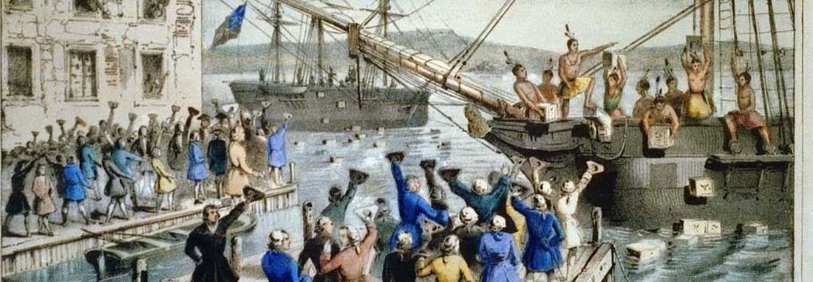
Card 6 · December 16, 1773
One Night in Boston Harbor
3
340+
46
$1.7M+
ships boarded
chests of tea
tons of tea
in today's money
Image: “The Destruction of Tea at Boston Harbor,” Currier lithograph, 1846. Public domain.
Notes:
Numbers: the Boston Tea Party Ships & Museum (bostonteapartyship.com): about 340 chests, over 92,000 pounds, valued by the East India Company at £9,659, more than $1.7 million today. Many books say 342 chests; "more than 340" is true either way. Three ships: Dartmouth, Eleanor, Beaver.

Slide 6

Why Massachusetts?
Boston Kept Pushing Back
1770
Dec 1773
Jan 1774
Soldiers fire on a Boston crowd.
Boston dumps the tea.
A Boston crowd tars and feathers a tax officer.
Parliament's plan: punish Boston hard, so every other colony backs down.
Images: Chappel engraving, about 1878; Currier lithograph, 1846; “The Bostonians Paying the Excise-Man,” Philip Dawe, London, 1774 (Met Museum). Public domain.
Notes:
Malcolm: John Malcolm, a customs officer, was tarred and feathered in Boston on January 25, 1774. Dawe's print is a London view of it, made that October. Lord North's line, more or less: Boston will pay for every chest of tea, or Boston will not trade at all.

Slide 7

Your Vocabulary Card, Word 5
Intolerable
in-TOL-er-uh-bull
Means: so bad that you cannot put up with it.
Parliament called the 1774 laws the Coercive Acts (coerce: to force).
Colonists gave them their own name: the Intolerable Acts.
Image: “The Bostonians in Distress,” Philip Dawe, London, 1774. Met Museum, public domain.
Notes:
Define the word before the laws. Parliament called them the Coercive Acts (coerce: to force); the colonists' name stuck. The print: "The Bostonians in Distress," Philip Dawe, London, November 1774 (Met Museum, CC0).

Slide 8
Four Laws
The Intolerable Acts, 1774
1. Boston's port is closed until the tea is paid for.
2. Massachusetts loses much of its right to govern itself.
3. British officials accused of crimes can be tried in another colony, or in Britain.
4. More soldiers can be quartered in colonists' buildings.

Slide 9
Predict
Will the other colonies help Boston, or stay out of it?
Thumbs up: they help Boston.
Thumbs down: they stay out of it.
Then you'll find out from three real voices from outside Massachusetts.
Notes:
Count the thumbs and leave the answer open. Students find it in the sources; the reveal comes at the end.

Slide 10
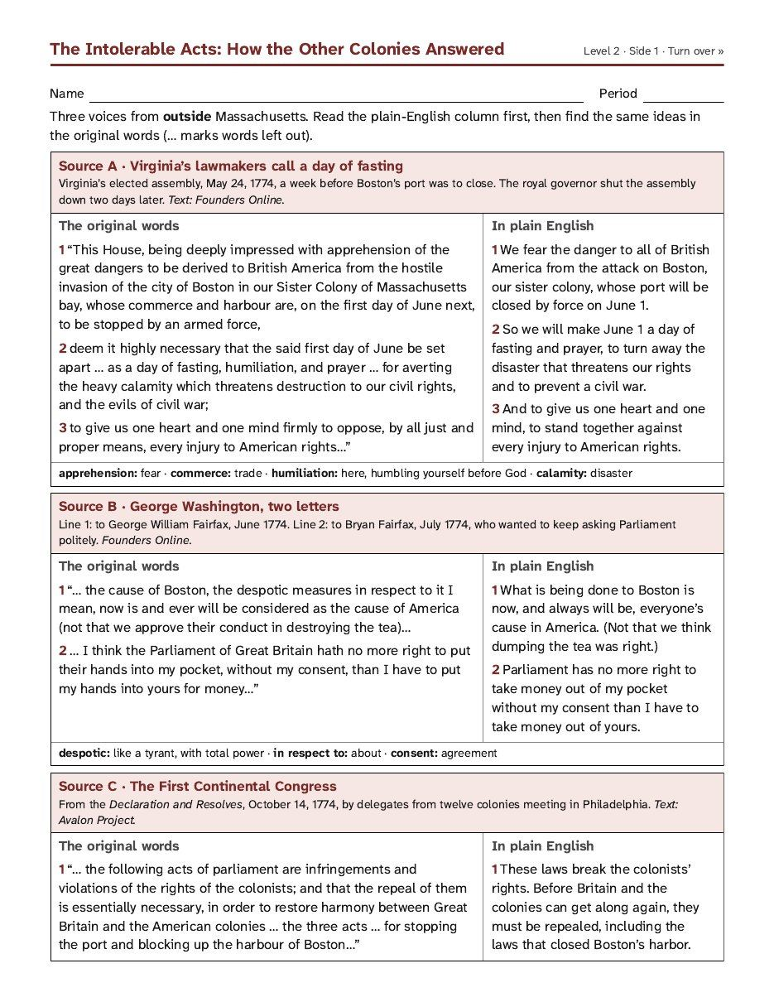
Your Source Sheet · Side 1 · 15 Minutes
Read Three Voices With a Partner
1. Sit with your partner. Each of you gets your own sheet.
2. Read the plain-English column first. Then find the same idea in the original words. The line numbers match.
3. Stuck on a word? The meanings are under each source.
Notes:
Pairs read; everyone writes. Set a 15-minute timer for reading plus questions 1-3. Source B is two Washington letters: line 1 June 1774 to George William Fairfax, line 2 July 1774 to Bryan Fairfax.

Slide 11
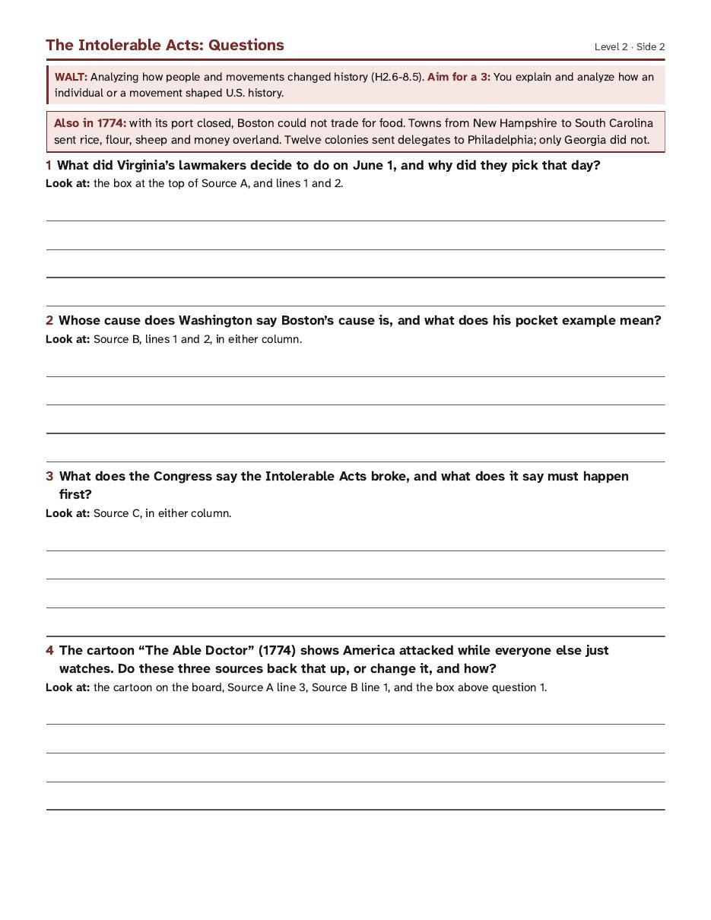
Your Source Sheet · Side 2
Then Write Your Own Answers
1. Talk it over with your partner, but write your own answers.
2. Answer questions 1 to 3. Each one tells you where to look.
3. Skip question 4 for now. We look at a cartoon first.
Notes:
The picture shows the Level 2 side. Level 1 sheets have the same questions with a Start with frame and a word bank under each.

Slide 12
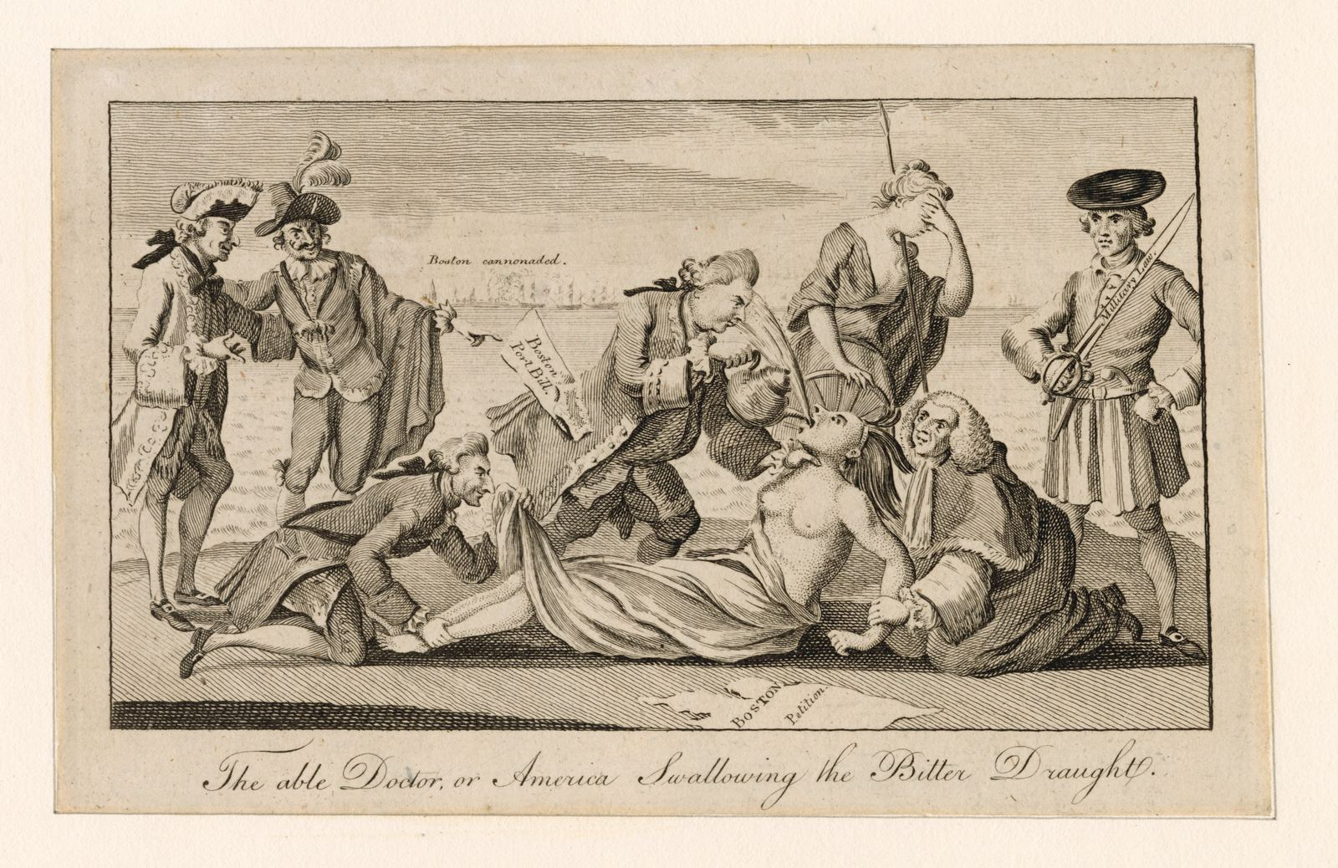
“The able Doctor, or America Swallowing the Bitter Draught.” Paul Revere's engraving of a London print, 1774. Public domain.
Notes:
Full screen, no talking for 30 seconds. Ask: what do you notice? Then zoom in, one part per slide.

Slide 13
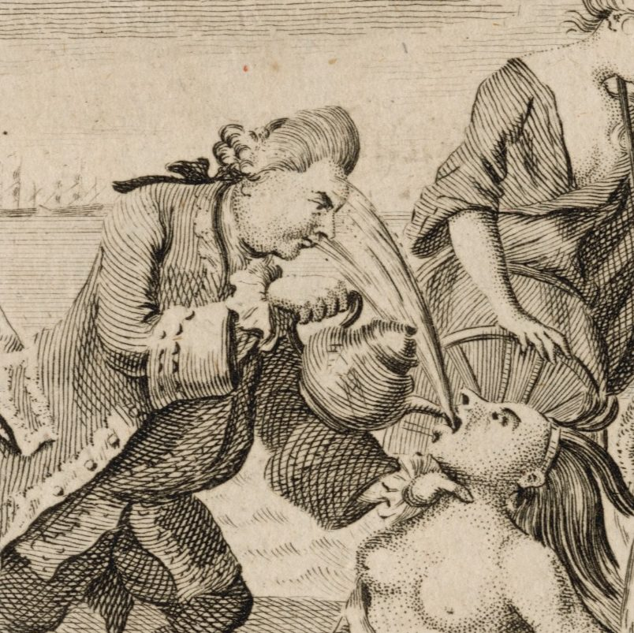
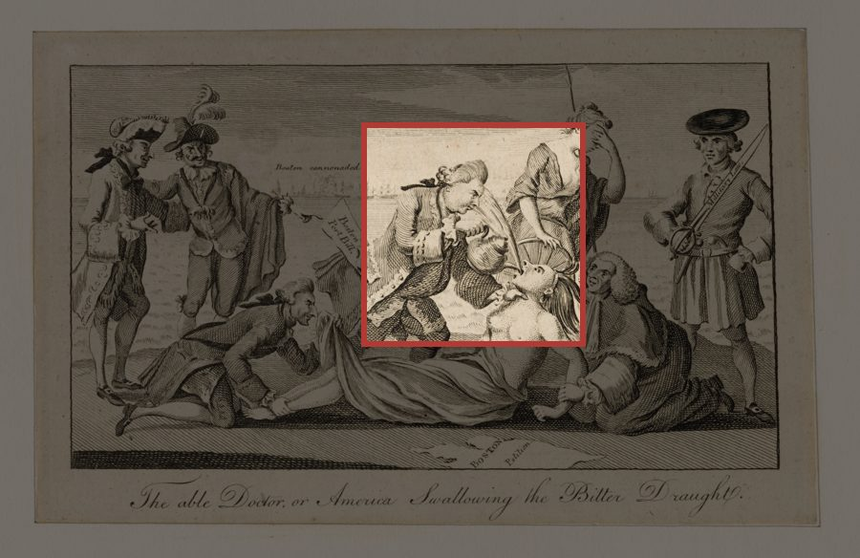
Zoom In · 1 of 7
Lord North Pours the Tea
The prime minister forces tea down America's throat.
America spits it back at him.
Notes:
Lord North led the Intolerable Acts through Parliament.

Slide 14
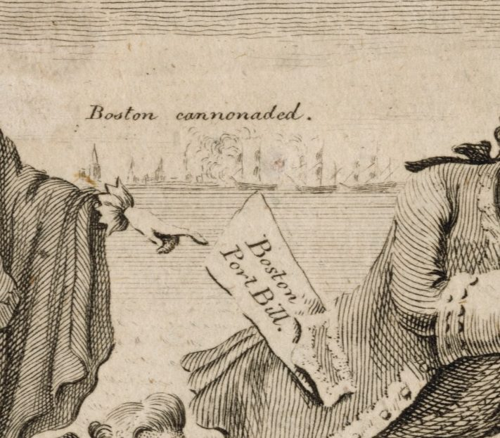
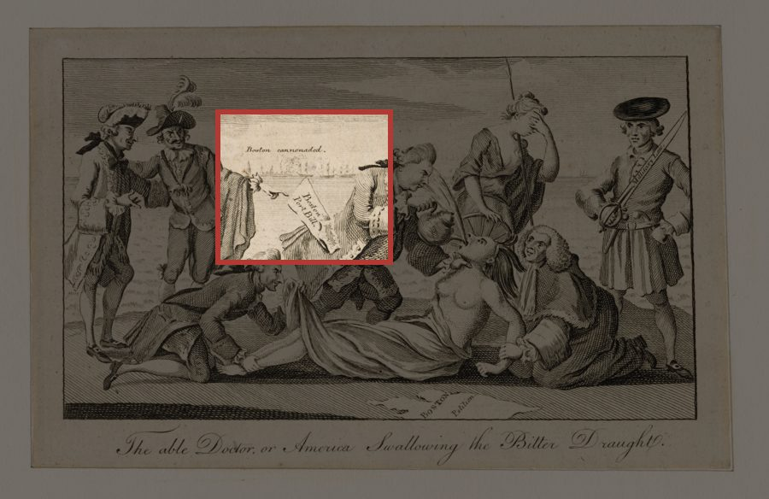
Zoom In · 2 of 7
Boston Port Bill
The paper names the first Intolerable Act: Boston's harbor is closed.
Behind it, a label over the town: Boston cannonaded.
Notes:
The paper hangs from North's pocket. "Boston cannonaded" is a threat in the picture, not something that happened in 1774.

Slide 15
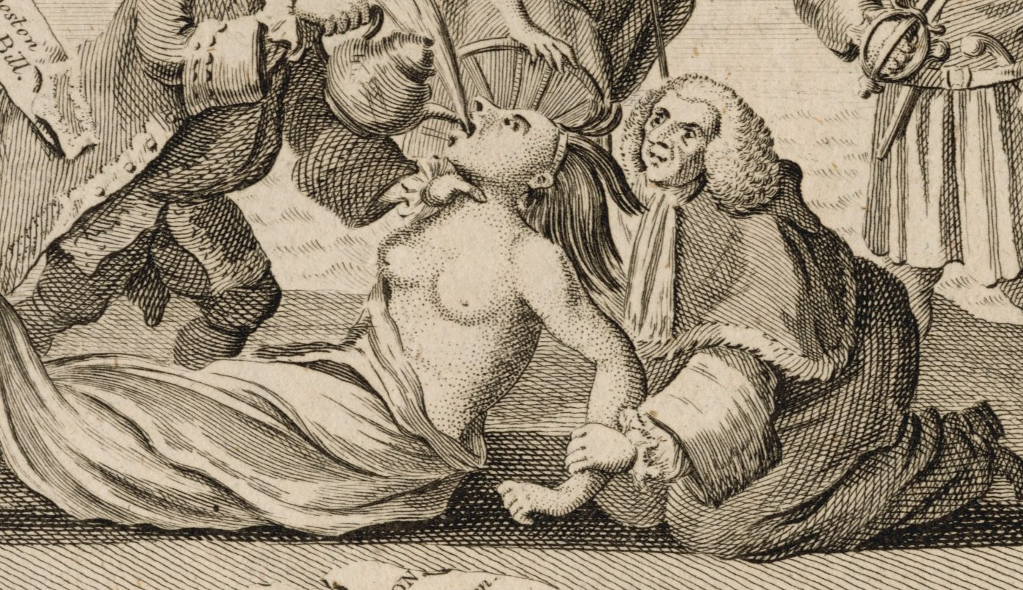
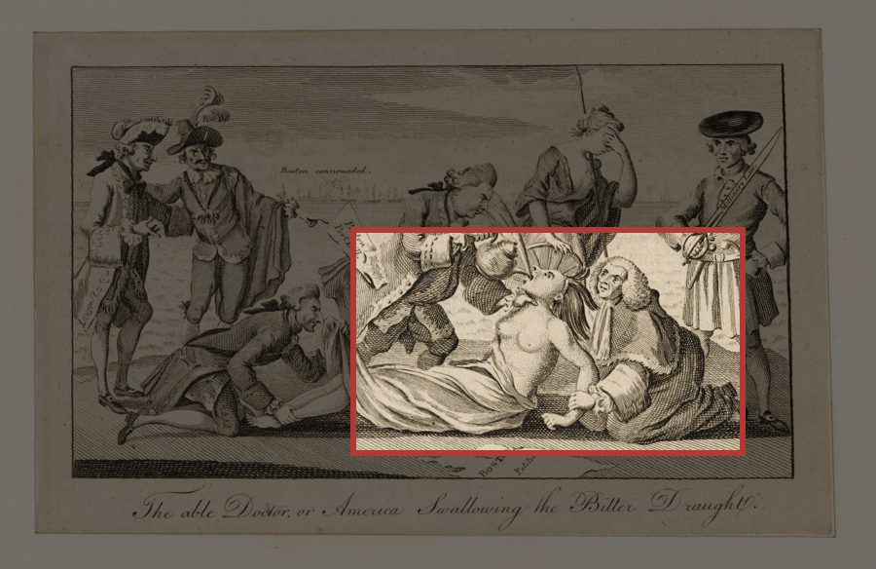
Zoom In · 3 of 7
America, Held Down
America is a woman pinned to the ground.
A British lord in a judge's wig holds her down.
Notes:
Left, kneeling: Lord Sandwich. Right, in the wig: Lord Mansfield, the chief justice.

Slide 16
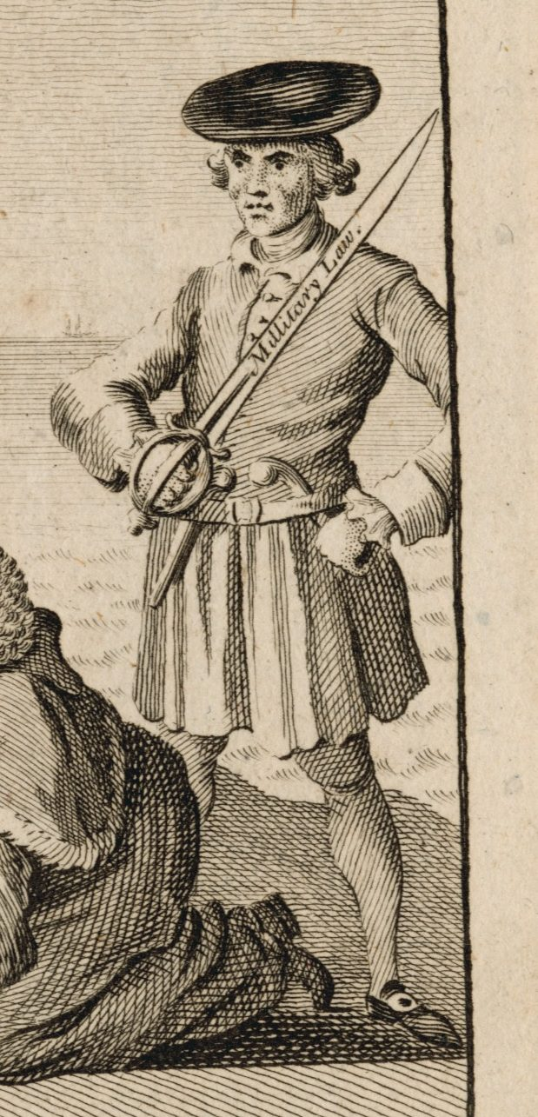
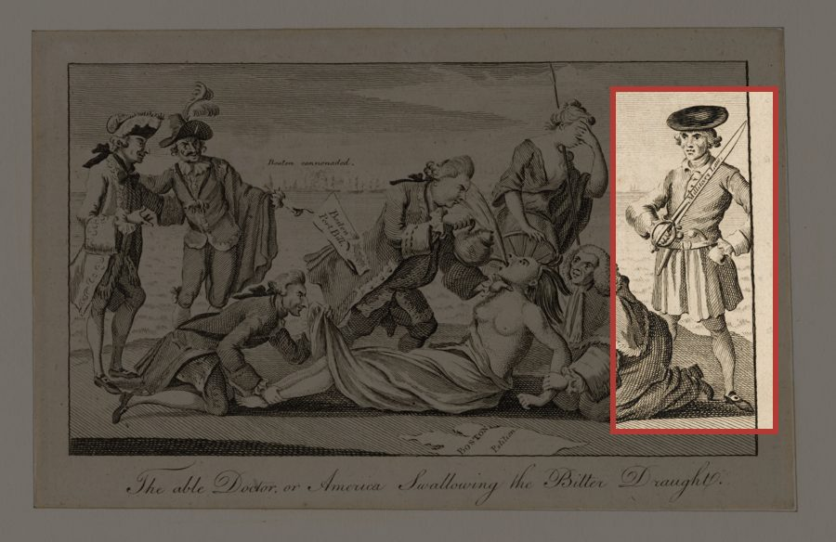
Zoom In · 4 of 7
Military Law
A British lord holds a sword marked Military Law.
In 1774, a British general became governor of Massachusetts.
Notes:
The figure is Lord Bute, in Scottish dress. General Thomas Gage became governor in May 1774.

Slide 17
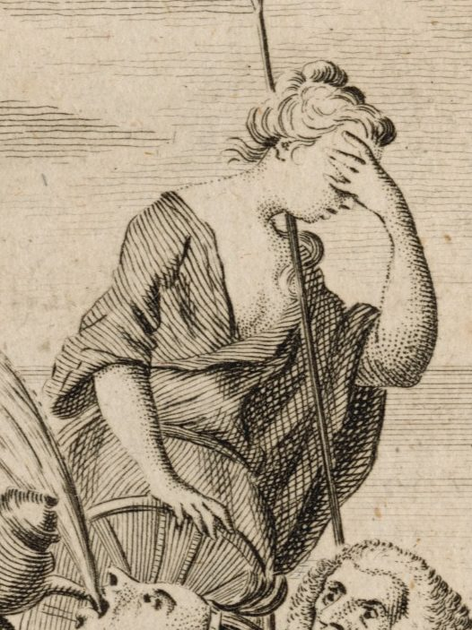
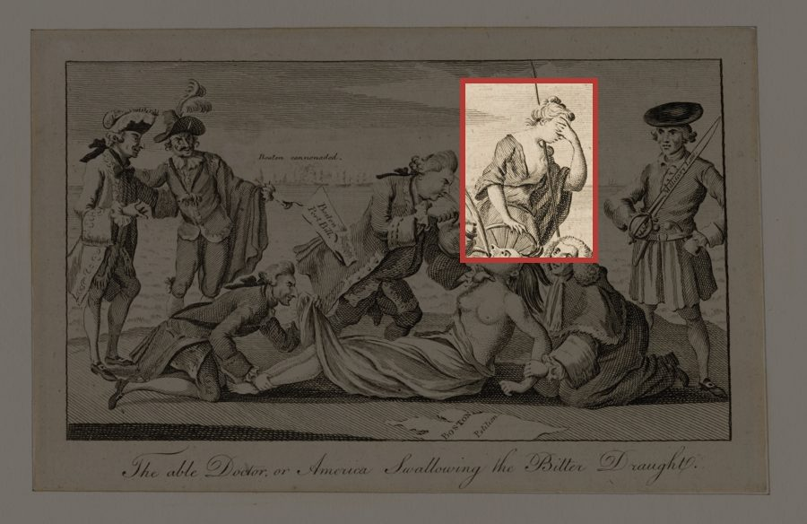
Zoom In · 5 of 7
Britannia Looks Away
Britannia stands for Britain itself.
She hides her eyes. What does that say about the punishment?
Notes:
Let a student answer the question on the slide.

Slide 18
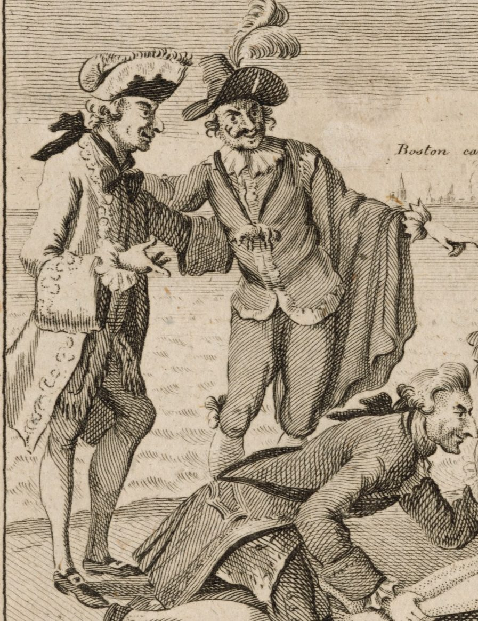
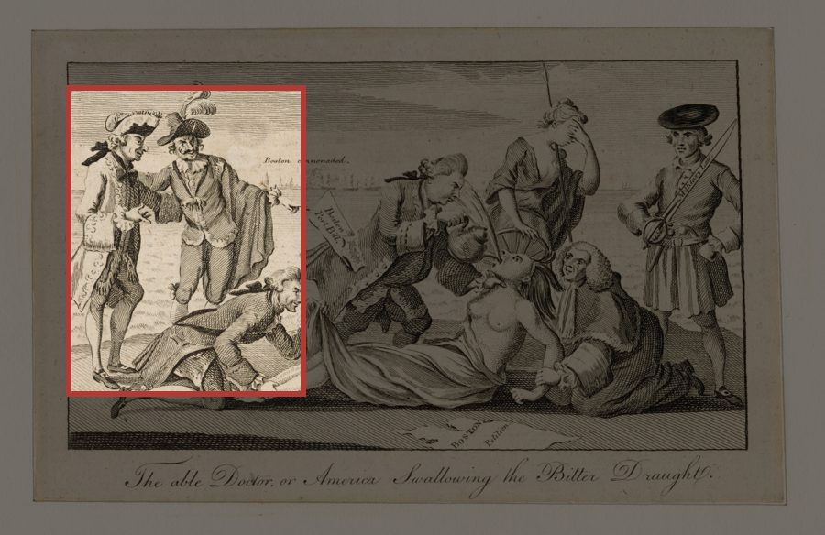
Zoom In · 6 of 7
France and Spain Watch
Two men dressed as France and Spain point and watch.
They were Britain's old rivals. Who wins if Britain fights its own colonies?
Notes:
Push: France and Spain both later joined the war against Britain.

Slide 19
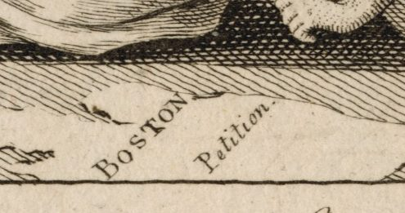
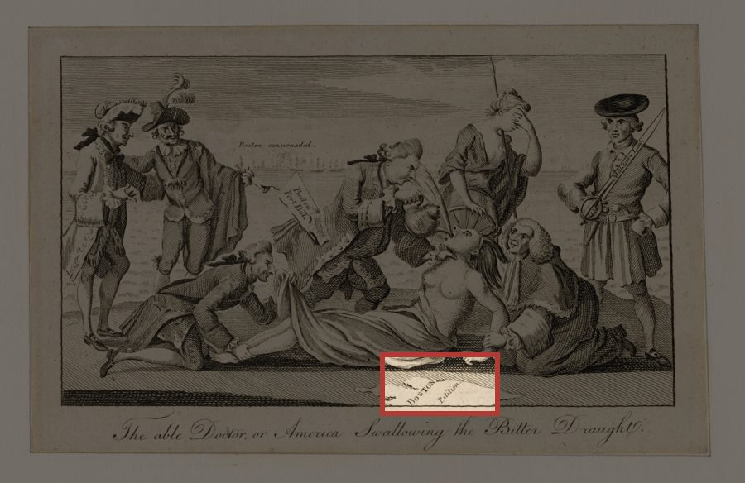
Zoom In · 7 of 7
Boston's Petition
On the ground: a paper that says Boston Petition.
Boston's request to Parliament, left lying in the dirt.
Notes:
A petition is a formal request. Last slide of the zoom: ask what the cartoonist wants us to feel.

Slide 20
Sourcing
Source It Before You Believe It
1. Who: Paul Revere, a Boston Patriot, copying a cartoon first printed in London.
2. When: 1774, the year of the Intolerable Acts.
3. Why: to make the punishment look like an attack. An argument, not a photograph.
Notes:
The first version ran in the London Magazine: some people in Britain opposed the Acts too.

Slide 21
Read the Picture · With Your Partner
What is the cartoon saying about the Intolerable Acts?
Think about every part we zoomed in on. Talk it over with your partner, then be ready to share.
The cartoon says Britain ___. I can tell because ___.
Notes:
Listen for: Britain is attacking America, not punishing a criminal; Britain itself (Britannia) is ashamed; Britain's enemies are enjoying it. Then: who is NOT in the picture? The other colonies.

Slide 22
Question 4 · On Your Own · 5 Minutes
Does the cartoon hold up?
The cartoon shows everyone else just watching. Use the three sources and the box at the top of side 2.
Write question 4 on your own.
The cartoon says ___, but the sources show ___.
Notes:
Level 1 sheets have a fuller starter on the page. Show the next slide only after most pencils stop.

Slide 23
Question 4
One Way to Answer It
Check yours: did you use at least one source?
A finished answer to question 4
The cartoon says everyone just watches. Source A shows Virginia's lawmakers set a day of fasting for Boston, so the cartoon is not the whole story.

Slide 24
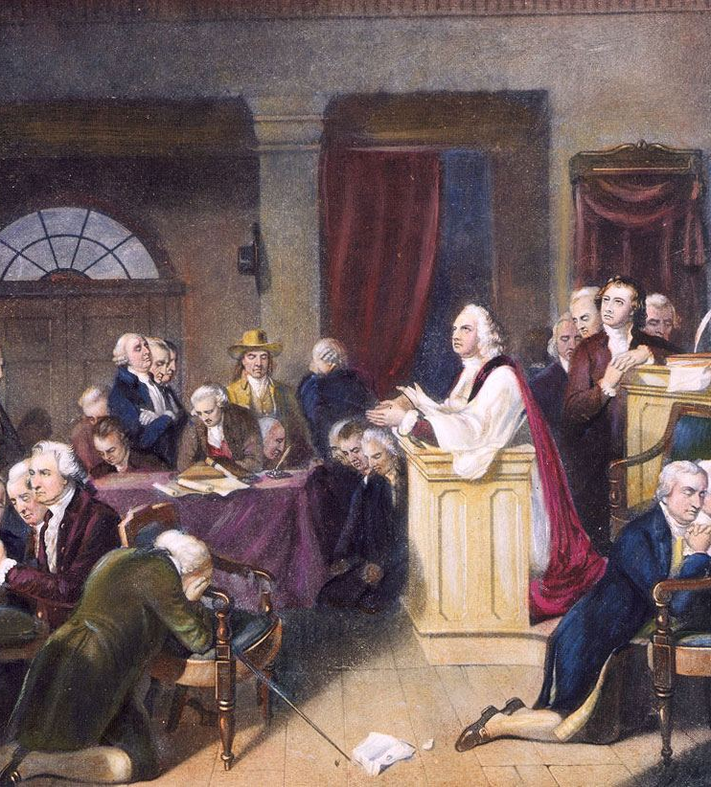
The Punishment Backfired
It pulled the colonies together.
Other colonies sent food and money to Boston.
September 1774: twelve colonies send delegates to Philadelphia.
They call a new boycott and ask Parliament to reverse the acts.
Image: “The First Prayer in Congress,” September 1774. Engraving after T. H. Matteson, 1848. Public domain.
Notes:
Back to the prediction: how many thumbs were right? And back to the Do Now: punish the group to scare everyone else, and the group pulls together. Made 74 years later, so source the picture too.

Slide 25
Exit Ticket
How did punishing Massachusetts affect the other colonies?
Use your source sheet and today's slides.
Answer on your own in one or two sentences.
Before the Intolerable Acts, the colonies ___. After them, the colonies ___.
Notes:
The starter is the study site reading's own check-in starter, so the site and the exit ticket match.

