Slide 1
Marketing Attribution
Analyzing Data with SQL
Will Shields
01/20/2020

Slide 2
CoolTShirts
CoolTShirts, an innovative apparel shop, is running a bunch of marketing campaigns. In this project, I attempted to help them answer these questions about their campaigns:
Get familiar with the company.
What is the user journey?
Optimize the campaign budget.

Slide 3
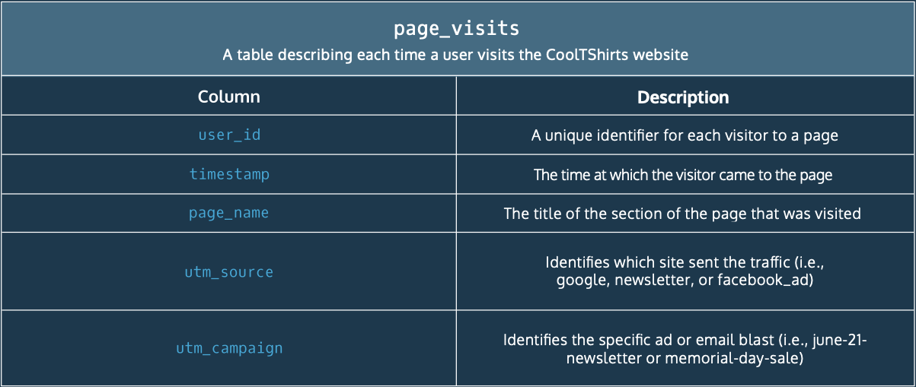

Marketing Attribution Database Schema
Fig. 1–Database schema for the CoolTshirts page_visits table

Slide 4
Project Tasks
Get familiar with the company.
How many campaigns does CoolTShirts use? Sources?
How are they related?
What pages are on their website?
What is the user journey?
How many first touches is each campaign responsible for? Last touches?
How many visitors make a purchase?
How many last touches on the purchase page is each campaign responsible for?
Optimize the campaign budget.
CoolTShirts can re-invest in 5 campaigns. Which should they pick and why?

Slide 5
Project Task 1.1
COUNT(DISTINCT utm_campaign)
8
utm_campaign
cool-tshirts-search
getting-to-know-cool-tshirts
interview-with-cool-tshirts-founder
paid-search
retargetting-ad
retargetting-campaign
ten-crazy-cool-tshirts-facts
weekly-newsletter
CoolTshirts utilized eight campaigns:
cool-tshirts-search
getting-to-know-cool-tshirts
interview-with-cool-tshirts-founder
paid-search
retargetting-ad
retargetting-campaign
ten-crazy-cool-tshirts-facts
weekly-newsletter
How many campaigns does CoolTShirts use?
Fig. 2–Query results for Project Task 1.1 (campaigns)
SELECT COUNT(DISTINCT utm_campaign)
FROM page_visits;
SELECT DISTINCT utm_campaign
FROM page_visits
ORDER BY 1;
Fig. 3–Query code for Project Task 1.1 (campaigns)

Slide 6
Task 1.1 (cont.)
CoolTshirts was sent traffic from six sources:
buzzfeed
email
facebook
google
medium
nytimes
COUNT(DISTINCT utm_source)
6
utm_source
buzzfeed
email
facebook
google
medium
nytimes
How many sources does CoolTShirts use?
Fig. 4–Query results for Project Task 1.1 (sources)
SELECT COUNT(DISTINCT utm_source)
FROM page_visits;
SELECT DISTINCT utm_source
FROM page_visits
ORDER BY 1;
Fig. 5–Query code for Project Task 1.1 (sources)

Slide 7
Project Task 1.2
utm_source | utm_campaign
buzzfeed | ten-crazy-cool-tshirts-facts
email | weekly-newsletter
email | retargetting-campaign
facebook | retargetting-ad
google | paid-search
google | cool-tshirts-search
medium | interview-with-cool-tshirts-founder
nytimes | getting-to-know-cool-tshirts
How are these elements related,
i.e. which source was used for each campaign?
Fig. 6–Query results for Project Task 1.2
SELECT DISTINCT utm_source,
utm_campaign
FROM page_visits
ORDER BY 1;
Fig. 7–Query code for Project Task 1.2

Slide 8
Project Task 1.3
CoolTshirts has 4 pages on their website:
Landing page
Shopping Cart
Checkout
Purchase
page_name
1 - landing_page
2 - shopping_cart
3 - checkout
4 - purchase
What pages are on the CoolTshirts website?
Fig. 8–Query results for Project Task 1.3
SELECT DISTINCT page_name
FROM page_visits;
Fig. 9–Query code for Project Task 1.3

Slide 9
Project Task 2.1
Fig. 10–Query results for Project Task 2.1 (first touch)
utm_campaign | COUNT(*)
interview-with-cool-tshirts-founder | 622
getting-to-know-cool-tshirts | 612
ten-crazy-cool-tshirts-facts | 576
cool-tshirts-search | 169
-------------First touch table
WITH first_touch AS (
SELECT user_id,
MIN(timestamp) AS first_touch_at
FROM page_visits
GROUP BY user_id),
-------------First touch attribution table
ft_attr AS (
SELECT ft.user_id,
ft.first_touch_at,
pv.utm_source,
pv.utm_campaign
FROM first_touch AS ft
JOIN page_visits AS pv
ON ft.user_id = pv.user_id
AND ft.first_touch_at = pv.timestamp)
-------------Queries
SELECT ft_attr.utm_campaign,
COUNT(*)
FROM ft_attr
GROUP BY 1
ORDER BY 2 DESC;
For how many first touches is each campaign responsible?
Created a table, first_touch, of the latest timestamp a user visited the website
Created a 2nd table, ft_attr, by joining that table with the original table, matching both the user_id and timestamp
Selected the campaigns used and the count, grouping by the utm_campaign to get the total
Fig. 11–Query code for Project Task 2.1 (first touch)

Slide 10
Task 2.1 (cont.)
Fig. 12–Query results for Project Task 2.1 (last touch)
utm_campaign | COUNT(*)
weekly-newsletter | 447
retargetting-ad | 443
retargetting-campaign | 245
getting-to-know-cool-tshirts | 232
ten-crazy-cool-tshirts-facts | 190
interview-with-cool-tshirts-founder | 184
paid-search | 178
cool-tshirts-search | 60
-------------Last touch table
WITH last_touch AS (
SELECT user_id,
MAX(timestamp) AS last_touch_at
FROM page_visits
GROUP BY user_id),
-------------Last touch attribution table
lt_attr AS (
SELECT lt.user_id,
lt.last_touch_at,
pv.utm_source,
pv.utm_campaign
FROM last_touch AS lt
JOIN page_visits AS pv
ON lt.user_id = pv.user_id
AND lt.last_touch_at = pv.timestamp)
-------------Queries
SELECT lt_attr.utm_campaign,
COUNT(*)
FROM lt_attr
GROUP BY 1
ORDER BY 2 DESC;
For how many last touches is each campaign responsible?
Created a table, last_touch, of the earliest timestamp a user visited the website
Created a 2nd table, lt_attr, by joining that table with the original table, matching both the user_id and timestamp
Selected the campaigns used and the count, grouping by the utm_campaign to get the total
Fig. 13–Query code for Project Task 2.1 (last touch)

Slide 11
Project Task 2.2
Only 25.2% of visitors who made it to the checkout page ultimately purchased from CoolTshirts, or 361 distinct visitors
Possible reasons for attrition at this step could be:
Change of mind
Hidden fees or shipping costs added on to the price
Mandatory account-creation, i.e. no “Check-out as Guest”
How many visitors make a purchase?
-------------Query 1
SELECT COUNT(DISTINCT user_id) AS ‘total_visitors’
FROM page_visits
WHERE page_name = '4 - purchase';
-------------Alternate Query
SELECT page_name, COUNT(DISTINCT user_id) AS 'total_visitors'
FROM page_visits
GROUP BY 1;
total_visitors
361
page_name | total_visitors
1 - landing_page | 1979
2 - shopping_cart | 1881
3 - checkout | 1431
4 - purchase | 361
Fig. 14–Query results for Project Task 2.2
Fig. 15–Query code for Project Task 2.2

Slide 12
Project Task 2.3
Fig. 16–Query results for Project Task 2.3
utm_campaign | utm_source | COUNT(*)
weekly-newsletter | email | 115
retargetting-ad | facebook | 113
retargetting-campaign | email | 54
paid-search | google | 52
ten-crazy-cool-tshirts-facts | buzzfeed | 9
getting-to-know-cool-tshirts | nytimes | 9
interview-with-cool-tshirts-founder | medium | 7
cool-tshirts-search | google | 2
How many last touches on the purchase page is each campaign responsible for?
WITH last_touch AS (
SELECT user_id,
MAX(timestamp) AS last_touch_at
FROM page_visits
-------------Additional drill-down
WHERE page_name = '4 - purchase'
-------------
GROUP BY user_id),
--Last touch attribution table--,
SELECT lt_attr.utm_source,
lt_attr.utm_campaign,
COUNT(*)
FROM lt_attr
GROUP BY 2
ORDER BY 3 DESC;
Fig. 17–Query code for Project Task 2.3

Slide 13
Project Task 3.1
From Figure 16 in Project Task 2.3, we can see that the five campaigns which resulted in the most purchases were:
The weekly newsletter – through email
A retargeting ad – on Facebook
A retargeting campaign – through email
A paid search advertisement – through Google
“10 Crazy Cool T-shirts Facts” – on Buzzfeed
“Getting to Know CoolTshirts” – from the New York Times
CoolTShirts can re-invest in 5 campaigns. Which should they pick and why?
These would be good campaigns to reinvest in from the perspective of final purchases.
But let’s dive a bit deeper…

Slide 14
Task 3.1(cont.)
Of the top five campaigns, four are retargeting campaigns.
But all retargeting campaigns need a first touch campaign.
first_touch_campaigns
getting-to-know-cool-tshirts
ten-crazy-cool-tshirts-facts
interview-with-cool-tshirts-founder
cool-tshirts-search
CoolTShirts can re-invest in 5 campaigns. Which should they pick and why?
Fig. 18–Query results for Project Task 3.1
last_touch_campaign | campaign_type | COUNT(last_touch_campaign)
weekly-newsletter | retargeting | 115
retargetting-ad | retargeting | 113
retargetting-campaign | retargeting | 54
paid-search | retargeting | 52
ten-crazy-cool-tshirts-facts | first_touch | 9
getting-to-know-cool-tshirts | first_touch | 9
interview-with-cool-tshirts-founder | first_touch | 7
cool-tshirts-search | first_touch | 2
Fig. 19–Query results for Project Task 3.1

Slide 15
WITH --First touch table--,
--First touch attribution table--,
--Last touch table--,
--Last touch attribution table—,
users AS (SELECT ft_attr.user_id,
ft_attr.first_touch_at AS first_touch,
lt_attr.last_touch_at AS last_touch,
ft_attr.utm_campaign AS first_touch_campaign,
lt_attr.utm_campaign AS last_touch_campaign,
CASE
WHEN lt_attr.utm_campaign = 'ten-crazy-cool-tshirts-facts'
OR lt_attr.utm_campaign = 'interview-with-cool-tshirts-founder'
OR lt_attr.utm_campaign = 'getting-to-know-cool-tshirts'
OR lt_attr.utm_campaign = 'cool-tshirts-search'
THEN 'first_touch'
ELSE 'retargeting'
END AS campaign_type
FROM ft_attr
JOIN lt_attr
ON ft_attr.user_id = lt_attr.user_id)
SELECT last_touch_campaign, campaign_type, COUNT(last_touch_campaign)
FROM users
GROUP BY 1
ORDER BY 3 DESC;
Created a final table, users
WITH --First touch table--,
--First touch attribution table--,
SELECT DISTINCT ft_attr.utm_campaign AS first_touch_campaigns
FROM ft_attr;
Fig. 20–Query code for Project Task 3.1
Fig. 21–Query code for Project Task 3.1

Slide 16
Task 3.1 (cont.)
Of the First Touch campaigns, we see one is significantly less successful than the others:
first_touch_campaign | First Touch to Purchase
interview-with-cool-tshirts-founder | 118
ten-crazy-cool-tshirts-facts | 109
getting-to-know-cool-tshirts | 103
cool-tshirts-search | 31
CoolTShirts can re-invest in 5 campaigns. Which should they pick and why?
Fig. 22–Query results for Project Task 3.1
WITH --First touch table--,
--First touch attribution table--,
--Last touch table--,
--Last touch attribution table--,
--Users table--
SELECT first_touch_campaign,
COUNT(first_touch_campaign)
AS 'First Touch to Purchase'
FROM users
GROUP BY 1
ORDER BY 2 DESC;
Fig. 23–Query code for Project Task 3.1

Slide 17
Final Recommendation
Both successful First Touch and Last Touch (retargeting) campaigns are necessary to securing purchases for CoolTshirts. I recommend the following campaigns are reinvested in:
“Interview with Cool T-shirts Founder” – through Medium
Weekly newsletter – through email
Retargeting Ad – on Facebook
“10 Crazy Cool T-shirts Facts” – on Buzzfeed
“Getting to Know CoolTshirts” – from the New York Times

