Slide 1
PART 01 Model basis
PART 02 MDP
outline
PART 03 DP
PART 04 MC
PART 05 TD

Slide 2
01
Model Basis

Slide 3
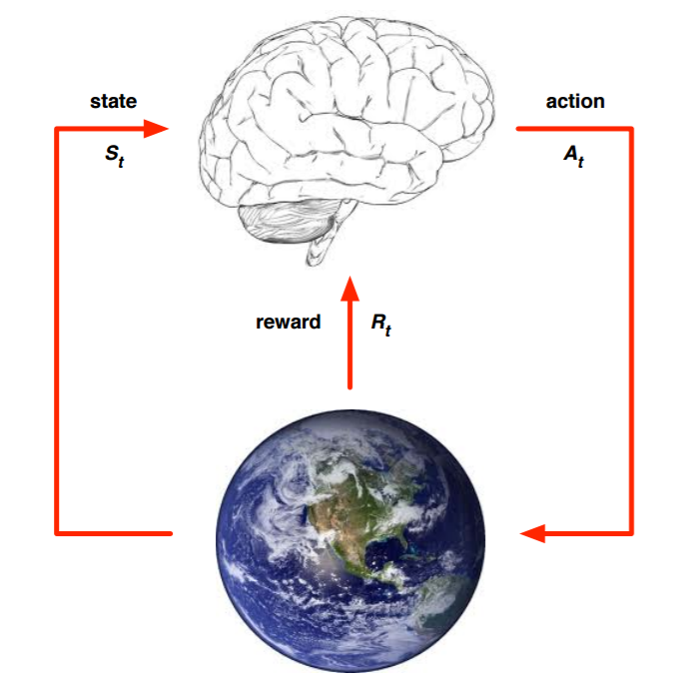
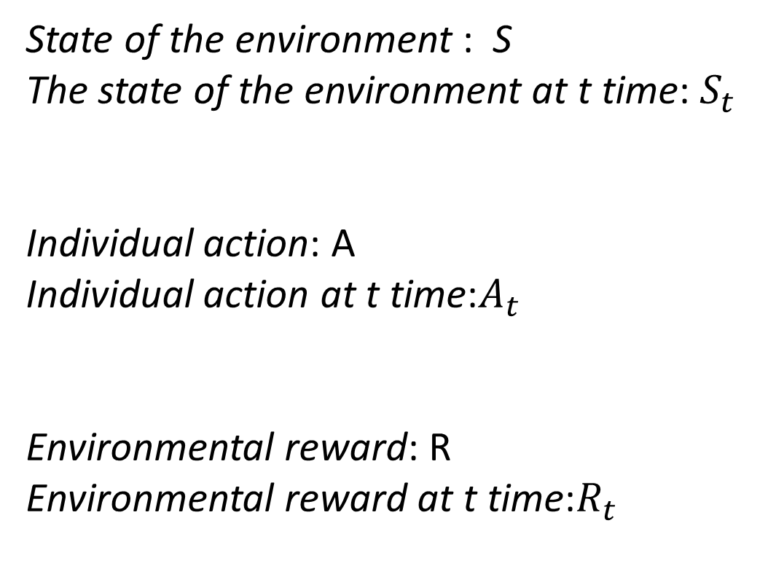
Model of Reinforcement learning
State of the environment : S
The state of the environment at t time: $S_{t}$
Individual action: A
Individual action at t time:$A_{t}$
Environmental reward: R
Environmental reward at t time:$R_{t}$

Slide 4
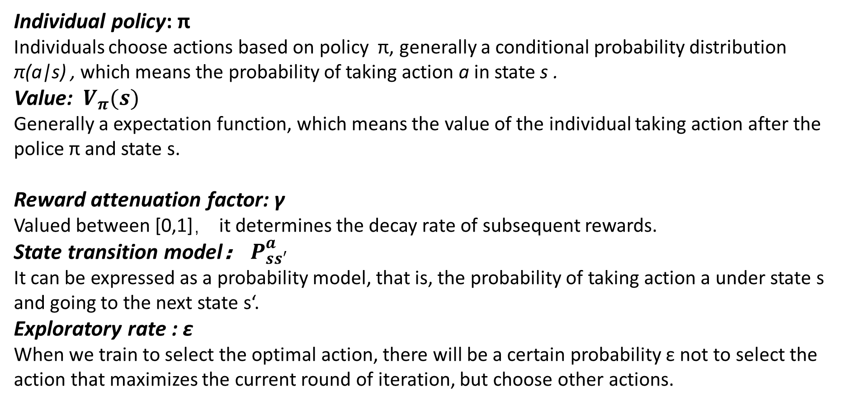
Model of Reinforcement Learning
Individual policy: π
Individuals choose actions based on policy π, generally a conditional probability distribution π(a|s) , which means the probability of taking action a in state s .
Value: $V_{π}(s)$
Generally a expectation function, which means the value of the individual taking action after the police π and state s.
Reward attenuation factor: γ
Valued between [0,1]， it determines the decay rate of subsequent rewards.
State transition model： $P_{ss′}^{a}$
It can be expressed as a probability model, that is, the probability of taking action a under state s and going to the next state s‘.
Exploratory rate : ε
When we train to select the optimal action, there will be a certain probability ε not to select the action that maximizes the current round of iteration, but choose other actions.

Slide 5
02
Markov Decision Process
（MDP）

Slide 6


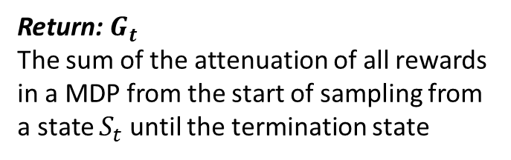
Why MDP
The real environment transformation process causes the environmental transformation model to be complex and unable to model.
Return: $G_{t}$
The sum of the attenuation of all rewards in a MDP from the start of sampling from a state $S_{t}$ until the termination state

Slide 7

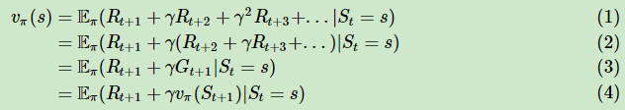
The Value Function of MDP and Bellman Equation
Action value function: $q_{π}\left(s,a\right)$
The value brought by action a under state s
Bellman equation: according to the expression of the value function, we can deduce the recursive relationship of the value function based on the state, for $v_{π}\left(s\right),$
The value of a state is composed of the reward of the state and the subsequent state value combined in a certain attenuation ratio.

Slide 8




Recursive relationship

Slide 9





Optimal value function
Defining the optimal state value function and the optimal action value function is the largest of many similar functions generated under all policies：
Optimal policy: π*
The optimal strategy allows individuals to gain more than always other strategies in the process of interacting with the environment.
For an optimal policy, based on the action value function we can define:
As long as we find the largest state value function or action value function, the corresponding strategy π* is the solution to our reinforcement learning problem.

Slide 10
03
Dynamic Planning
（DP）

Slide 11
Basic questions of reinforcement learning
1、Forecast problem
Input：state set S, action set A, instant reward R, attenuation factor γ, given policy π, model state transition probability matrix P
Output：State value function v(π)
2、Control problem
Input: state set S, action set A, instant reward R, attenuation factor γ, exploration rate ε, model state transition probability matrix P
Output: optimal action value function q* , optimal strategy π*

Slide 12



Forecast problem
Basic idea: Starting from any state value function, according to the given policy, the state value function is updated iteratively with the Bellman expectation equation, state transition probability and reward synchronization until it converges, and the final state value function under the policy is obtained.
If we have calculated the state value of all states in the k-th iteration, then in the (k+1)-th round we can use the state value calculated in the k-th round to calculate the state value of the k+1th round:
$$V_{π}\left(S\right)$$

Slide 13
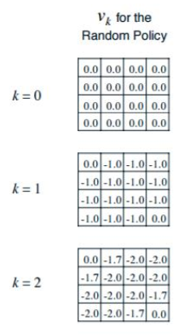
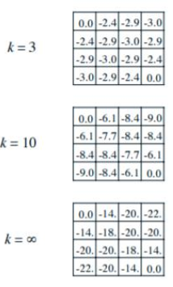
Example of forecast problem
the value of the end grid : 0
Instant reward R = -1
Attenuation factor γ = 1
State transition probability P = 1

Slide 14


Example of forecast problem
First we initialize the state value of all the grids to 0 (k = 0).
When k = 1 :
…
When k = 2 :
…

Slide 15
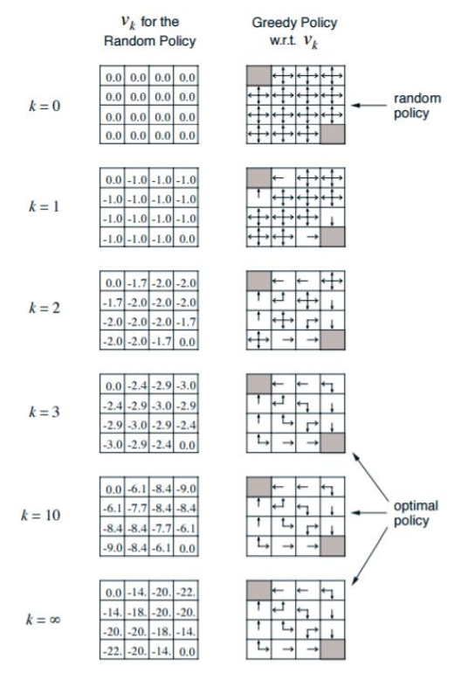
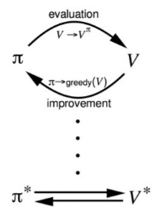
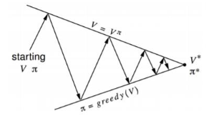
Control problem
Greedy strategy :
The behavior that an individual chooses in a certain state is the state in which it can reach the state in which all of the possible states are of the greatest value.
Basic idea:

Slide 16
04
Monte Carlo
（MC）

Slide 17


Forecast problem
Basic idea: estimates the true value of the state by sampling several complete state episodes.
A sequence of states with a complete T state for a given policy π is as follows:
Value function $V_{π}\left(s\right):$
Find the average of all the complete episodes in the state when they occur and then average:

Slide 18


Forecast problem
incremental mean:
The average value of the harvest is calculated in an iterative process, that is, the average value and the number of harvests obtained in the previous round of iteration are saved. When the current round of harvest is calculated, the current round harvest average and number of times can be calculated.
Rewrite state value formula:

Slide 19

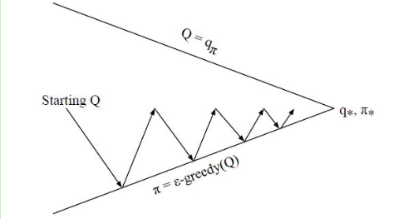
ε - greedy algorithm
The ε-greedy algorithm greedily chooses the behavior that is currently considered to be the maximum behavioral value by setting a small ε value, using the probability of 1−ε, and randomly choosing the behavior from all m optional behaviors with the probability of ε.

Slide 20
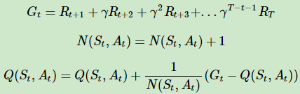


Control problem
Initialize all the action values Q(s, a) = 0, the number of states N(s, a) = 0, the number of samples k = 0, randomly initialize a strategy π
2. k=k+1, the k-th Monte Carlo sampling based on the strategy π, to obtain a complete episode of states:
3. For each state behavior pair ($S_{t}$, $A_{t}$) appearing in the episodes of states, calculate its harvest $G_{t}$, update its count N(s, a) and behavior value function Q(s, a):
4. Update the current ε-greedy algorithm based on the newly calculated action value:
5. If all Q(s, a) converge, then all corresponding Q(s, a) is the optimal action value function q*. The corresponding strategy π(a|s) is the optimal strategy π*. Otherwise go to the second step.

Slide 21
05
Timing Difference
(TD)

Slide 22





Timing Difference
Monte Carlo :
All sample episodes are undergoing a complete episode of states
Timing Difference :
Only need two consecutive states and corresponding rewards
Return in Monte Carlo :
Bellman equation :
We can use $R_{t+1}$+$γV_{π}(S_{t+1})$ to approximate $G_{t}$ instead of $G_{t}$.
G(t) in Timing Difference:
Value function iterative expression of Monte Carlo method:
In the Timing Difference we have no complete sequence and the corresponding number of times $N(S_{t})$, we replace it with a coefficient α of [0,1]:

Slide 23





Forecast problem
States : A , B ,Model : Unknown , Attenuation factor γ=1.A total of 8 complete status episodes are as follows:
Forecast problem with Monte Carlo :
( )
( )
Forecast problem with Timing Difference :
( )
( )

Slide 24



N step Timing Difference
In TD ,
Two steps more,
N steps more,
When n $→ ∞$ , Timing Difference $→$ Monte Carlo

Slide 25


TD(λ)
N Step Timing Difference How many steps to select as a better calculation parameter is a hyperparameter tuning problem that needs to be tried.
$λ∈\left[0,1\right]$ , Defining λ− return is the sum of n from 1 to ∞ all steps multiplied by the sum of the weights, The weight of each step is $(1−λ)λ^{n−1}$.
Iterative formula for the value function of TD(λ):
The TD must undergo a complete episode of states to obtain an instant reward for each state including the termination state in order to update the value of the current state. This is the same as the Monte Carlo method, so TD(λ) has the same disadvantages as the Monte Carlo method.

Slide 26


Control problem
SARSA : Using Time Series Difference Solving to Reinforce Learning Control Problems, belongs to online control, that is, always use a strategy(ϵ-greedy algorithm) to update the value function and select new actions.
In the current state S select an action A, the system goes to state S', in the new state S', selects an action A' based on the ε-greedy method, we do not perform this action A', just to update our Value function
Update formula of value function:

Slide 27
Control problem
Randomly initialize the value of all states and actions. Q. For the termination state, its Q value is initialized to 0.
for i from 1 to T,
a) Initialize S to be the first state of the current state sequence. Set A to the action selected by the ε-greedy method in the current state S.
b) Execute current action A in state S, get new state S' and reward R.
c) Select a new action A' in state S' using the ε-greedy method
d) Update the value function Q(S,A):
e) S=S′,A=A′ f) If S' is the termination state, the current round is iterated, otherwise go to step b)

Slide 28
THANK YOU FOR LISTENING !

