Slide 1



Introduction to Artificial Intelligence – Day 2
Mustafa Ümit ÖNER, PhD
Department of Artificial Intelligence Engineering
Faculty of Engineering and Natural Sciences
Bahçeşehir University
Mustafaumit.oner@eng.bau.edu.tr
https://onermustafaumit.github.io

Slide 2

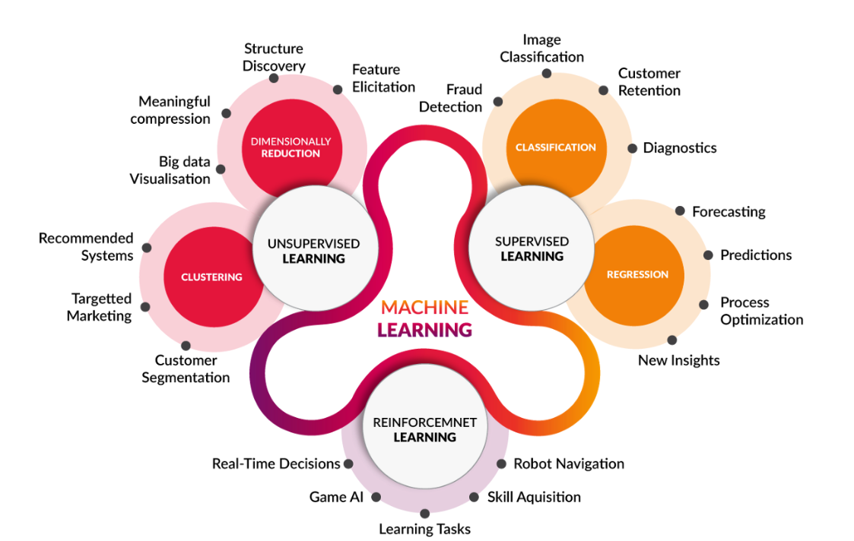
Machine Learning
https://medium.com/@yadavdeepika729/different-machine-learning-models-2387575e64cd

Slide 3
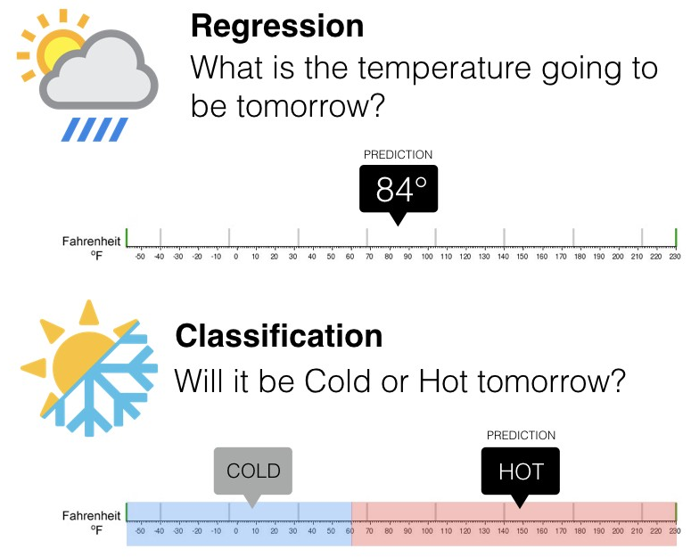
Regression
Pause and think about some possible example on regression problem.
https://www.springboard.com/blog/data-science/regression-vs-classification/
Notes:
Before go into Machine Learning, we learn on the terminology first.

Slide 4
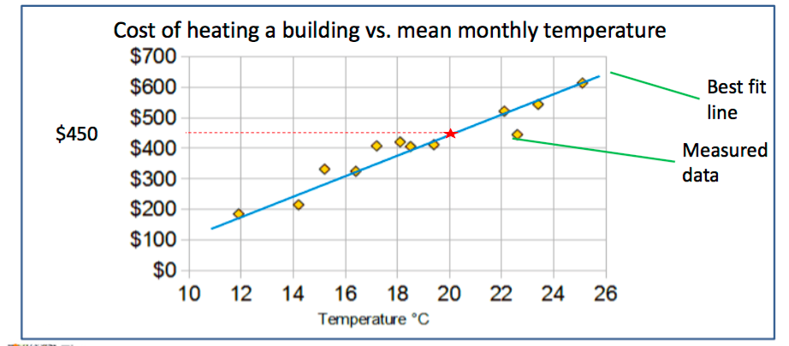
Regression
Regression predicts a target attribute which is a number (as opposed to a category)
The simplest regression is a best fit line
Notes:
Before go into Machine Learning, we learn on the terminology first.

Slide 5
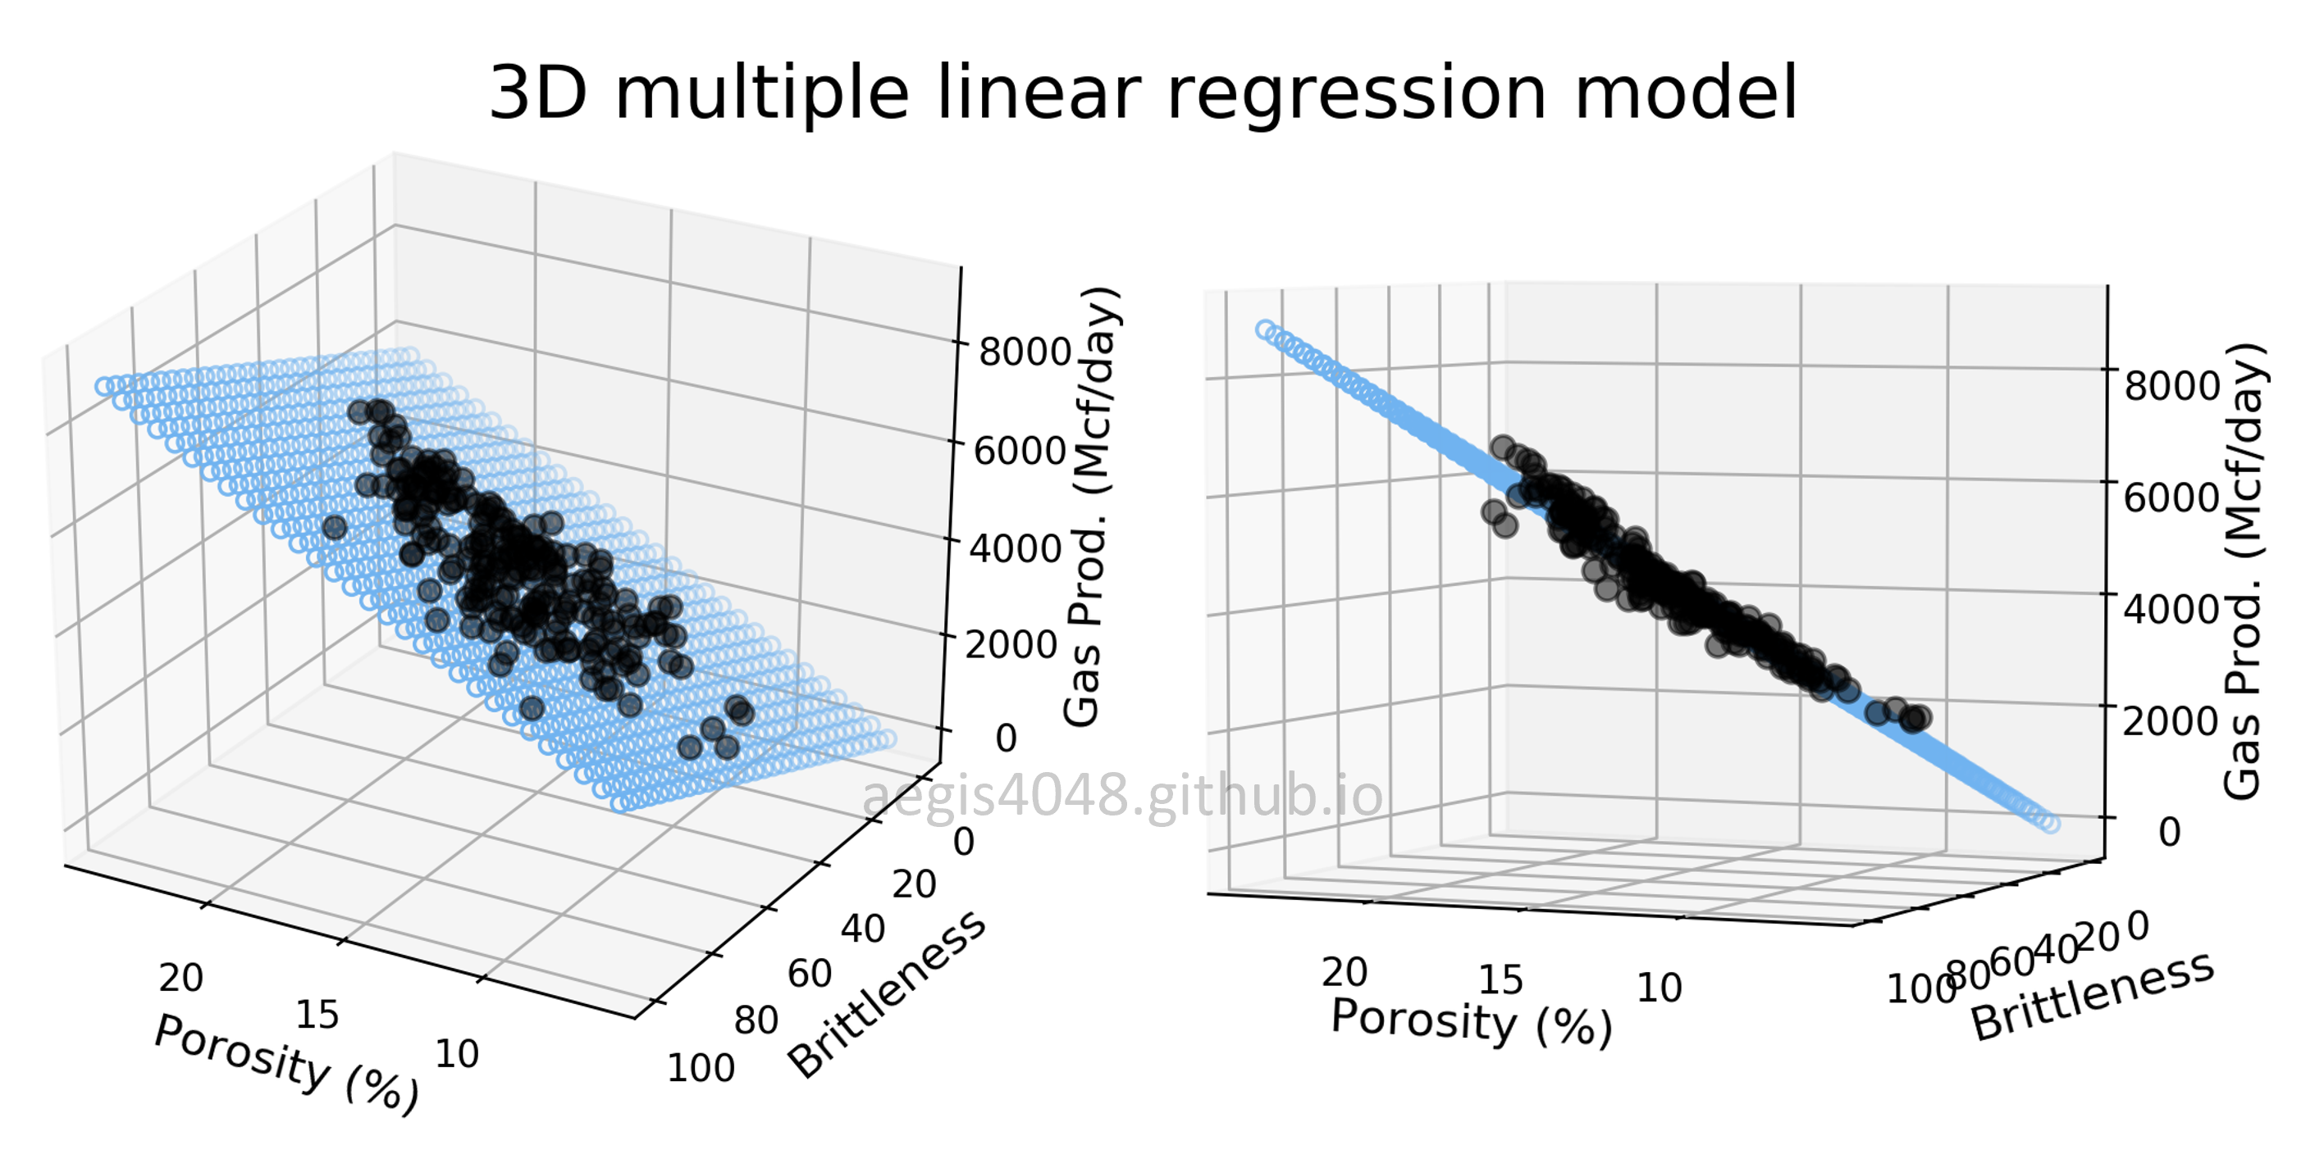
Regression
https://aegis4048.github.io/mutiple_linear_regression_and_visualization_in_python

Slide 6
Regression – Developing ML model
Data Preparation
Data Splitting (Train/Test)
Model Training
Model Evaluation
Data | Feature1 | Feature2 | Prediction | Temp.
Data1 | 23 | 3 |  | 32
Data2 | 12 | 51 |  | 29
Data3 | 1 | 12 |  | 24
… | … | … |  | …
DataN | 15 | 65 |  | 38

Slide 7
Regression – Developing ML model
Data Preparation
Data Splitting (Train/Test)
Model Training
Model Evaluation
Data | Feature1 | Feature2 | Prediction | Temp.
Data1 | 23 | 3 |  | 32
Data2 | 12 | 51 |  | 29
Data3 | 1 | 12 |  | 24
… | … | … |  | …
DataN | 15 | 65 |  | 38
70%
Training
30%
Test

Slide 8
Regression – Developing ML model
Data Preparation
Data Splitting (Train/Test)
Model Training
Model Evaluation
Use only training data to train the model
Data | Feature1 | Feature2 | Prediction | Temp.
Data1 | 23 | 3 |  | 32
Data2 | 12 | 51 |  | 29
Data3 | 1 | 12 |  | 24
… | … | … |  | …
DataN | 15 | 65 |  | 38
70%
Training

Slide 9
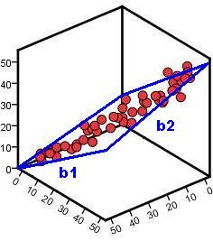
Regression – Developing ML model
Data Preparation
Data Splitting (Train/Test)
Model Training
Model Evaluation
Example of linear regression
Temperature
Feature 1
Feature 2

Slide 10
ML Model – Regression Evaluation Metrics
Data Preparation
Data Splitting (Train/Test)
Model Training
Model Evaluation
Use only testing data to evaluate the model
Data | Feature1 | Feature2 | Prediction | Label
Data1 | 23 | 3 | Cold | Cold
Data2 | 12 | 51 | Cold | Hot
Data3 | 1 | 12 | Hot | Hot
… | … | … | … | …
DataN | 15 | 65 | Hot | Cold
30%
Test
https://en.wikipedia.org/wiki/Confusion_matrix

Slide 11
ML Model – Regression Evaluation Metrics
Data Preparation
Data Splitting (Train/Test)
Model Training
Model Evaluation
A perfect model should predict all testing data correctly → Mean Square Error = 0
Data | Feature1 | Feature2 | Prediction | Label
Data1 | 23 | 3 | Cold | Cold
Data2 | 12 | 51 | Cold | Hot
Data3 | 1 | 12 | Hot | Hot
… | … | … | … | …
DataN | 15 | 65 | Hot | Cold
30%
Test

Slide 12
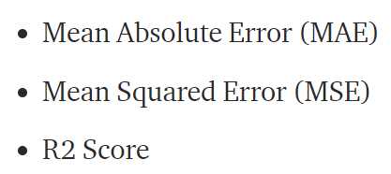
ML Model – Regression Evaluation Metrics
Data Preparation
Data Splitting (Train/Test)
Model Training
Model Evaluation
https://medium.com/@parag.jain164/performance-matrix-for-regression-model-c9ba0d2cae33

Slide 13
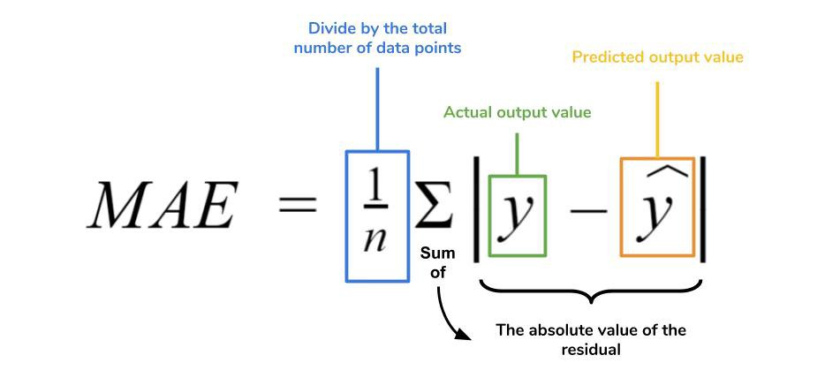
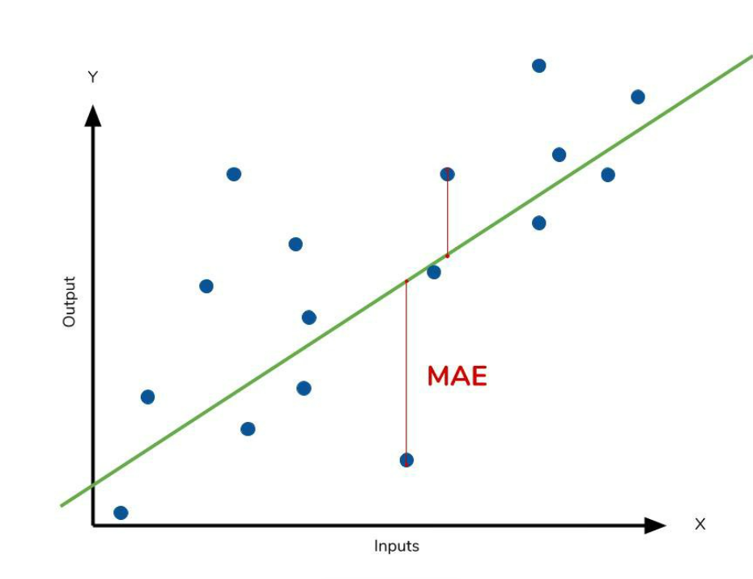
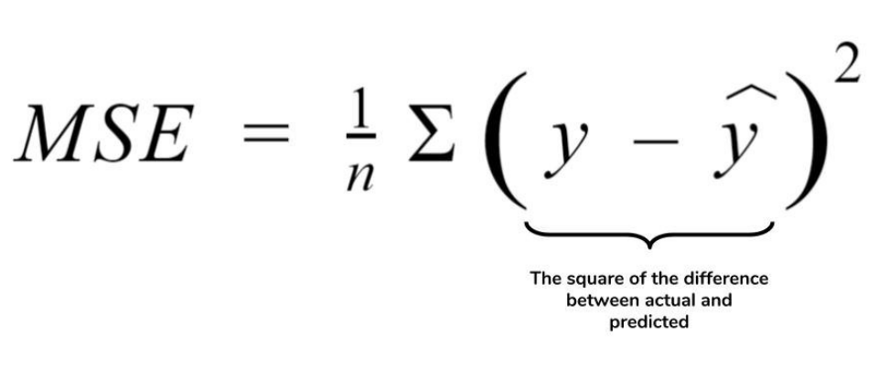
ML Model – Regression Evaluation Metrics
Data Preparation
Data Splitting (Train/Test)
Model Training
Model Evaluation
https://medium.com/ml-cheat-sheet/machine-learning-evaluation-metrics-b89b8832e275

Slide 14
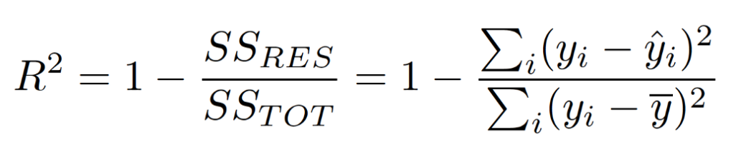
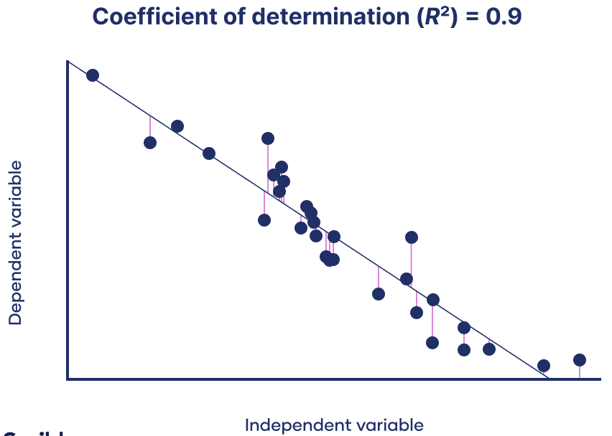
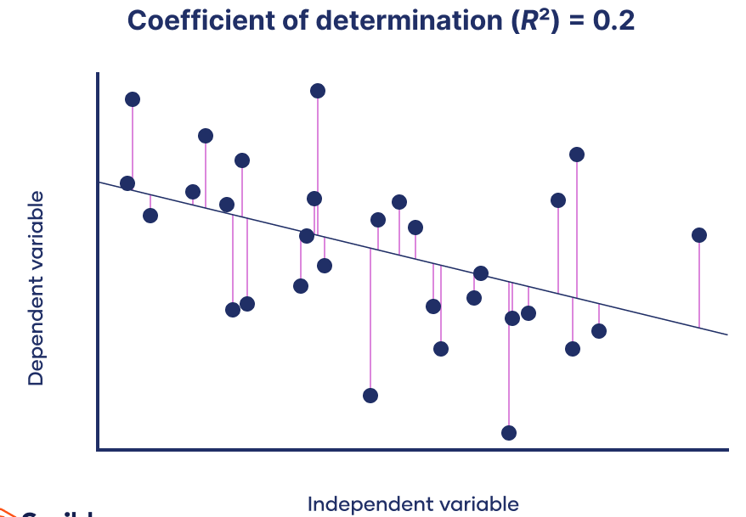
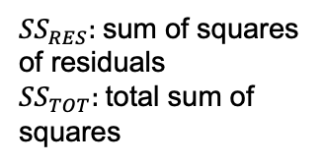
ML Model – Regression Evaluation Metrics
Data Preparation
Data Splitting (Train/Test)
Model Training
Model Evaluation
${SS}_{RES}:$sum of squares of residuals
${SS}_{TOT}:$total sum of squares
https://www.scribbr.com/statistics/coefficient-of-determination/

Slide 15
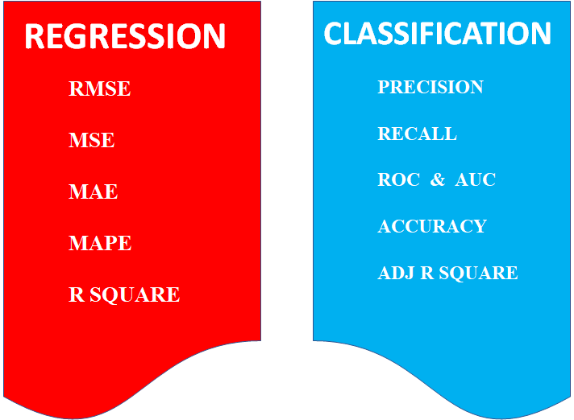
ML Model – Evaluation Metrics
https://medium.com/odscjournal/are-we-choosing-the-right-evaluation-metrics-how-to-choose-it-ee01fcf34b9

Slide 16
Corresponding Code
Data Preparation
Data Splitting (Train/Test)
Model Training
Model Evaluation
pd.read_csv()
sklearn.model_selection.train_test_split()
model.fit()
model.predict()

Slide 17
Additional Reading
scikit-learn Linear Regression documentation
https://scikit-learn.org/stable/modules/generated/sklearn.linear_model.LinearRegression.html
Hands-on exercise on linear regression
https://colab.research.google.com/github/csmastersUH/data_analysis_with_python_2020/blob/master/linear_regression.ipynb

