Slide 1

22nd ACOMP Online Workshop March 2024
Faculty of Computer Science and Information Technology
A Beginner's Guide to Hands-On
AI Concepts and Coding
Shier Nee Saw, PhD
Department of Artificial Intelligence,
Faculty of Computer Science and Information Technology,
Universiti Malaya
sawsn@um.edu.my
https://shiernee.com
Notes:
Konichiwa

Slide 2
Outline
Faculty of Computer Science and Information Technology
Artificial Intelligence Overview
Classification Concept
Hands-on Python Workshop

Slide 3
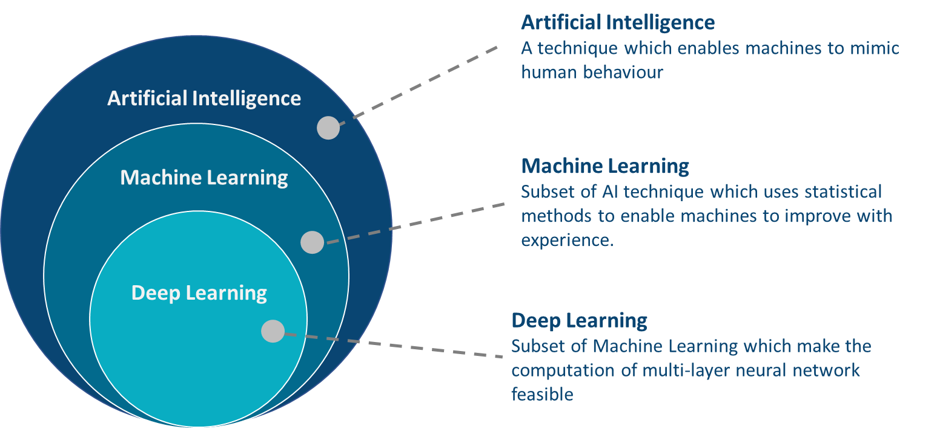
What is AI? ML? DL?

Slide 4
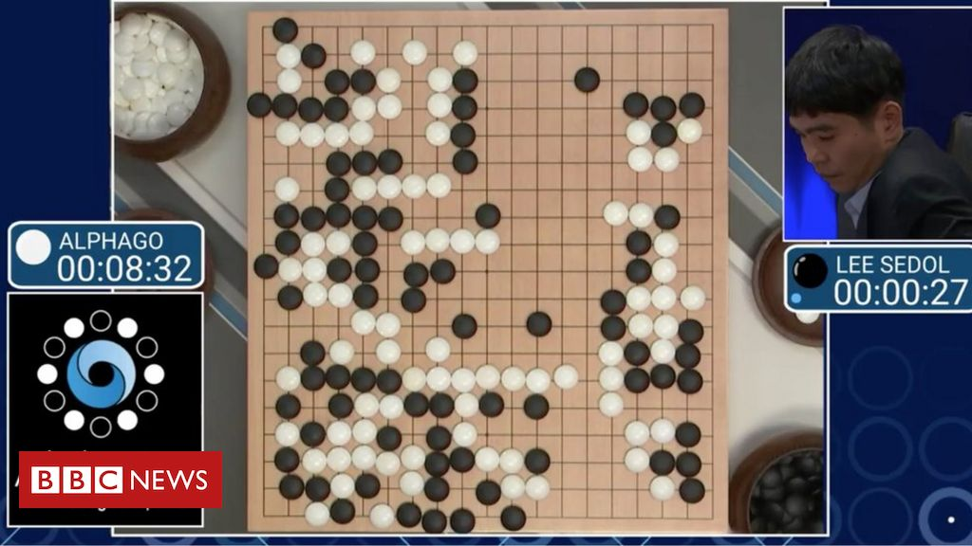
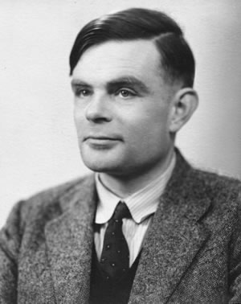
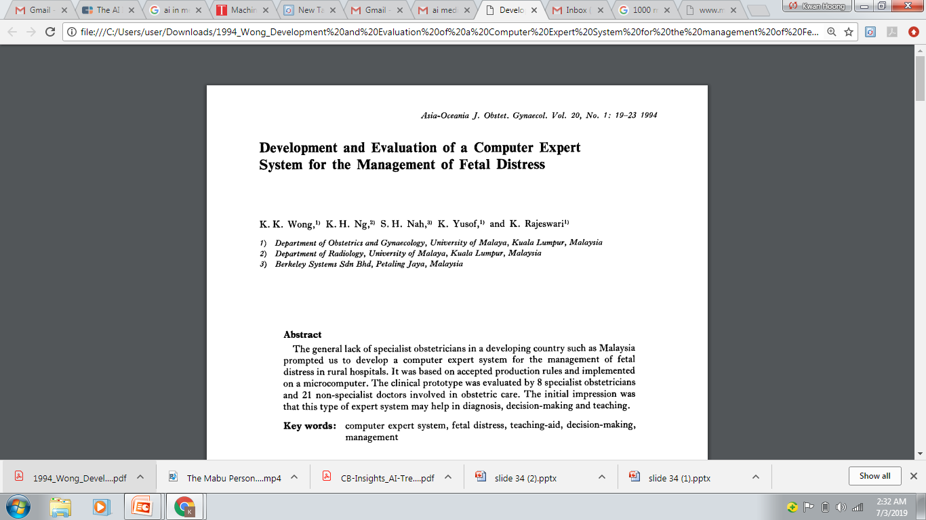
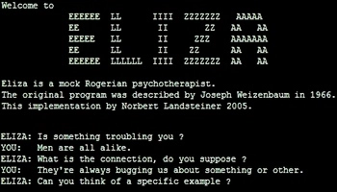
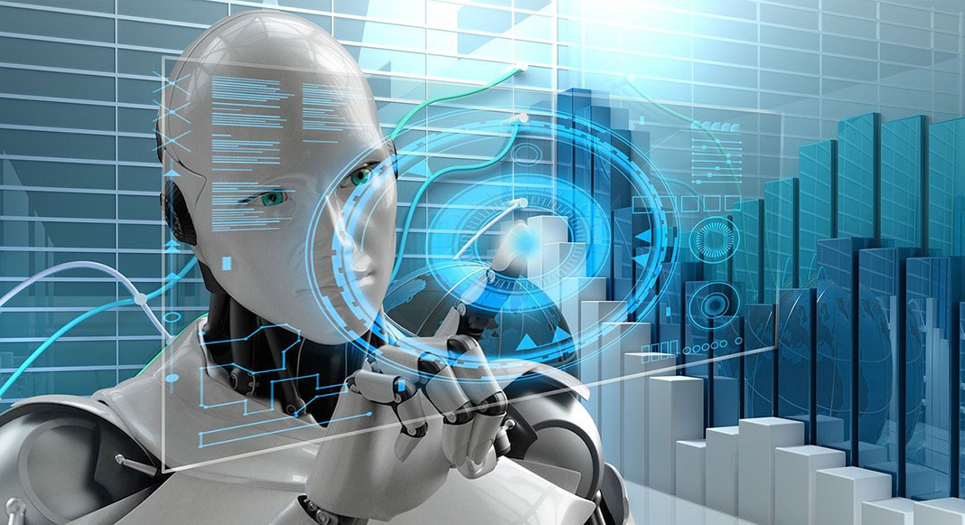
History of AI
“Can machines think?”
Alan Turing introduce a method for machine intelligence
First AI Winter
Second AI Winter
Alpha Go defeated Lee Sedol, world champion of Go
https://www.bbc.com/news/technology-35785875
https://editions.covecollective.org/chronologies/alan-turing-%E2%80%9Ccomputing-machinery-and-intelligence%E2%80%9D-1950
1950
1966
1975
1980
1987
2016
Now
First Chatbot: ELIZA
Expert System
AI in everywhere
https://www.computerhope.com/jargon/e/eliza.htm
Notes:
The history of AI starts very early. In 1950s, at the dawn of computing, Alan Turing asked the question: "Can machines think?“ and he then introduced a method to test machine intelligence. This was at a time when the first general purpose computers had only just been built. In 1966, the first chatbox – ELIZA was built. Unfortunately, AI entered the first winter in 1975 where not much people were interested in such topics and no fundings were available to support this research. In 1980, it started to gain attraction again where expert system were built. In fact, UM also involved in this where they had developed a computer expert system to manage fetal distress. In 1987, AI entered the second winter again because the system was too difficult to maintain, to update and was unable to learn. Until 2016, Alpha GO was announced to defeat Lee Sedol, the world champion of GO. This shows the world how powerful a computer can be. And then, now AI in everywhere, be it in automotive, manufacturing or healthcare.

Slide 5
AI Techniques
Supervised Learning
Reinforcement Learning
Unsupervised Learning
Labelled data with guidance
No labelled without guidance
Interacts with environment, decide action, learns by trial and error method
Notes:
Predictor/features/covariates
Label/target/response

Slide 6
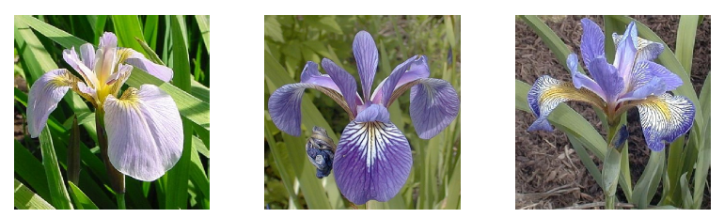
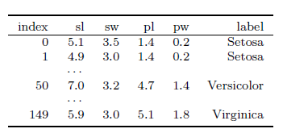
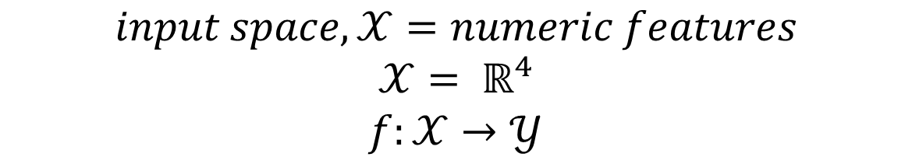
Supervised Learning - Classification
$$input space,𝒳=numeric features$$
$$𝒳= ℝ^{4}$$
$$f:𝒳→𝒴$$
Notes:
Tabular data

Slide 7
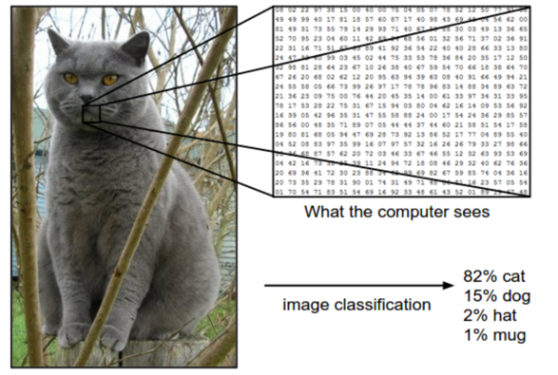

Convolutional Neural Network
When your input is a Grey Scaled Image
$$input space,𝒳= set of images$$
$$𝒳= ℝ^{D}, where D=2$$
$$f:𝒳→𝒴$$
Notes:
Tabular data

Slide 8
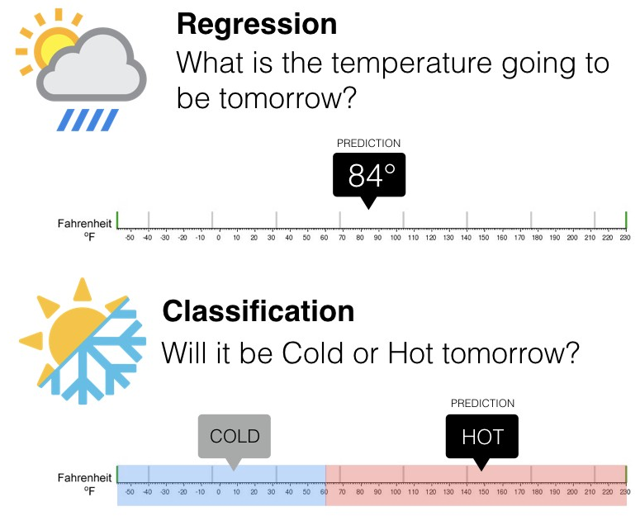
Supervised Learning - Classification
Output: Categorical data
Output: Continuous data
Notes:
Tabular data

Slide 9
Machine Learning Pipeline
Data Preparation
Data Splitting (Train/Test)
Model Training
Model Evaluation
Classification
y=f(x)
Y = mx+c
Y =σ(mx+c)
Regression:
y = f(x)
y = mx+c
Activation function:
Convert to probabilities
Notes:
Tabular data

Slide 10
Machine Learning Pipeline
Data Preparation
Data Splitting (Train/Test)
Model Training
Model Evaluation
Data | Outlook | Humidity | Windy | Label
Data1 | Sunny | High | False | Cold
Data2 | Overcast | Normal | True | Hot
Data3 | Rainy | High | False | Hot
… | … | … |  | …
DataN | Rainy | Normal | False | Cold
Notes:
Tabular data

Slide 11
Machine Learning Pipeline
Data Preparation
Data Splitting (Train/Test)
Model Training
Model Evaluation
Data | Outlook | Humidity | Windy | Label
Data1 | Sunny | High | False | Cold
Data2 | Overcast | Normal | True | Hot
Data3 | Rainy | High | False | Hot
… | … | … |  | …
DataN | Rainy | Normal | False | Cold
70%
Training
30%
Test
Notes:
Tabular data

Slide 12
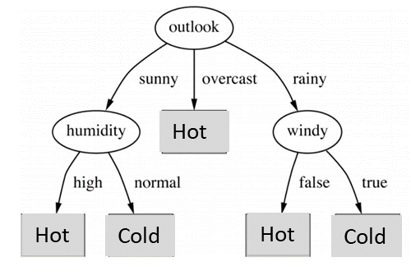
Machine Learning Pipeline
Data Preparation
Data Splitting (Train/Test)
Model Training
Model Evaluation
Data | Outlook | Humidity | Windy | Label | Prediction
Data1 | Sunny | High | False | Cold | Cold
Data2 | Overcast | Normal | True | Hot | Hot
Data3 | Rainy | High | False | Hot | Hot
… | … | … |  | …
DataN | Rainy | Normal | False | Cold
70%
Training
Notes:
Tabular data

Slide 13
Machine Learning Pipeline
Data Preparation
Data Splitting (Train/Test)
Model Training
Model Evaluation
Data | Outlook | Humidity | Windy | Label | Prediction
Data1 | Sunny | High | False | Cold | Cold
Data2 | Overcast | Normal | True | Hot | Hot
Data3 | Rainy | High | False | Hot | Hot
… | … | … |  | …
DataN | Rainy | Normal | False | Cold | Hot
30%
Test
Notes:
Tabular data

Slide 14
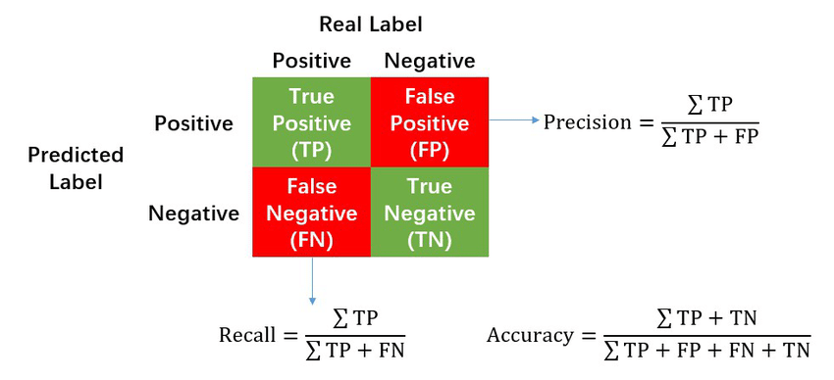
Model Evaluation
A perfect model should predict all testing data correctly → Accuracy = 100% (the higher the better)
Notes:
Tabular data

Slide 15
Hands-on Python Workshop

Slide 16
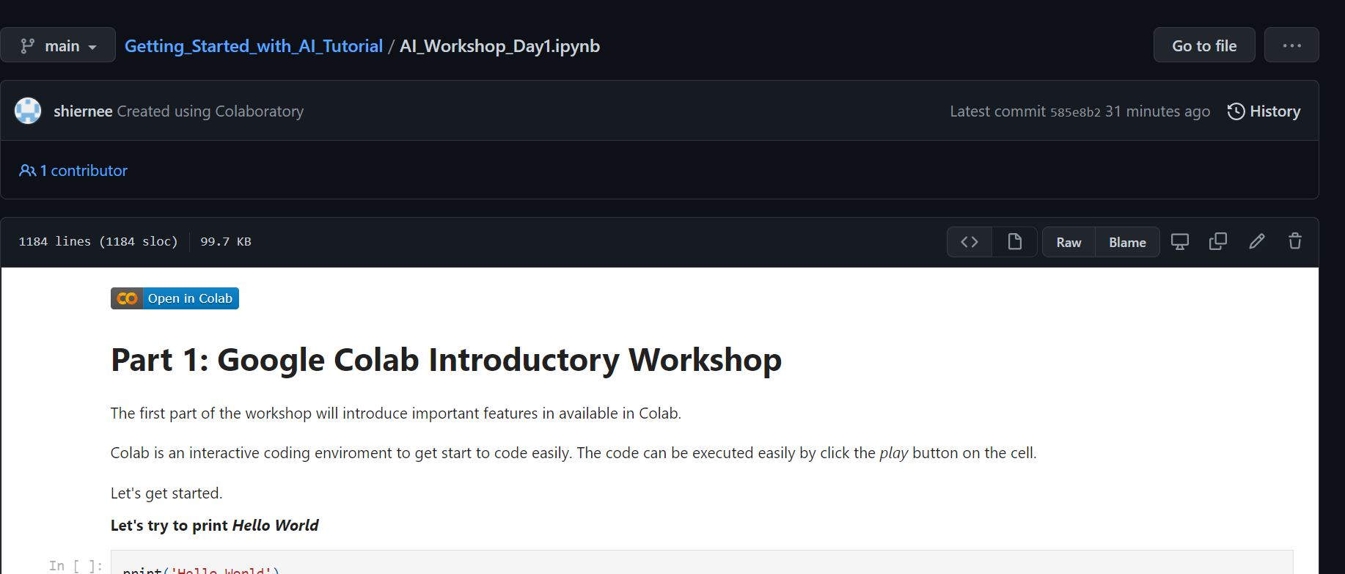
Course Materials
Google Colab Introduction Hands-on Workshop
Faculty of Computer Science and Information Technology
Please go to this link. We will go through the code here.
https://github.com/shiernee/2024_ACOMP_WORKSHOP/blob/main/2024ACOMP_AI_Workshop.ipynb
2. Click “Open in Colab”
3. Save a copy in your drive.
File
Save a copy in Drive

Slide 17
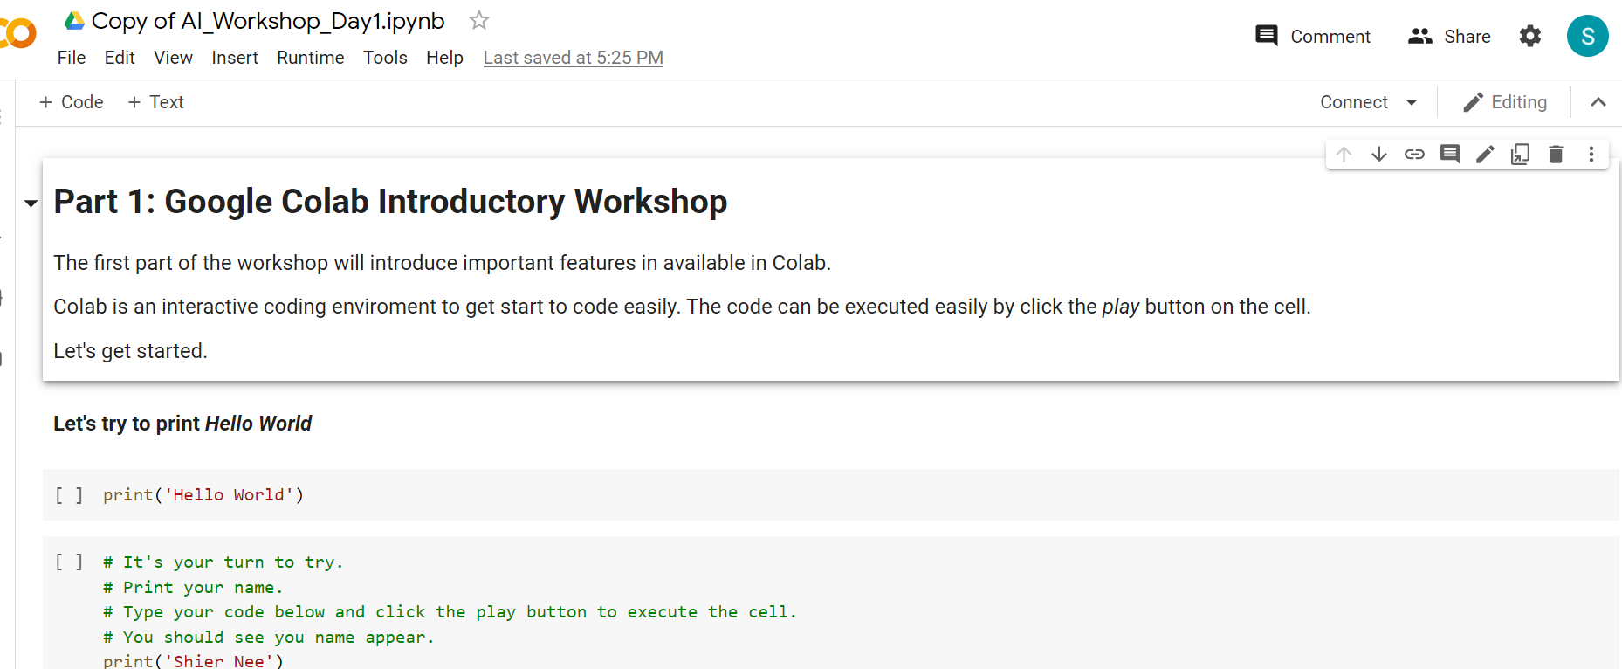
Google Colab
Google Colab Introduction Hands-on Workshop
Faculty of Computer Science and Information Technology
Please go to this link. We will go through the code here.
https://github.com/shiernee/2024_ACOMP_WORKSHOP/blob/main/2024ACOMP_AI_Workshop.ipynb
2. Click “Open in Colab”
3. Save a copy in your drive.
File
Save a copy in Drive
You should see the name change to
“Copy of AI_Workshop_Day1.ipynb”

Slide 18
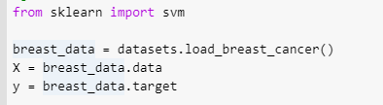
Classification
Faculty of Computer Science and Information Technology
To try with your datasets. Replace the datasets to your datasets for
X, y

Slide 19
Day 1 Conclude
Faculty of Computer Science and Information Technology
Artificial Intelligence Overview
Classification Concept
Hands-on Python Workshop
Notes:
Arigatogozai-i-mas, matarai-su

Slide 20
Additional Info
Faculty of Computer Science and Information Technology
K-fold cross validation - https://machinelearningmastery.com/k-fold-cross-validation/
Hyperparameter Tuning – https://machinelearningmastery.com/hyperparameter-optimization-with-random-search-and-grid-search/
AutoML Framework - https://nbviewer.org/github/pycaret/pycaret/blob/master/tutorials/Binary%20Classification%20Tutorial%20Level%20Beginner%20-%20%20CLF101.ipynb
Notes:
Arigatogozai-i-mas, matarai-su

