Slide 1


Faculty of Computer Science and Information Technology
Getting started with Artificial intelligence – Day 1
Shier Nee Saw, PhD
Department of Artificial Intelligence,
Faculty of Computer Science and Information Technology,
Universiti Malaya
October 22, 2021

Slide 2
Outline
Faculty of Computer Science and Information Technology
Google Colab Introduction Hands-on Workshop
Solving classification problem hands-on Workshop

Slide 3
Google Colab
Google Colab Introduction Hands-on Workshop
Faculty of Computer Science and Information Technology
Please go to this link. We will go through the code here.
https://colab.research.google.com/drive/1yh-DAcRT51NRDcHWLm6f2aT-uiDsG7Na?usp=sharing

Slide 4
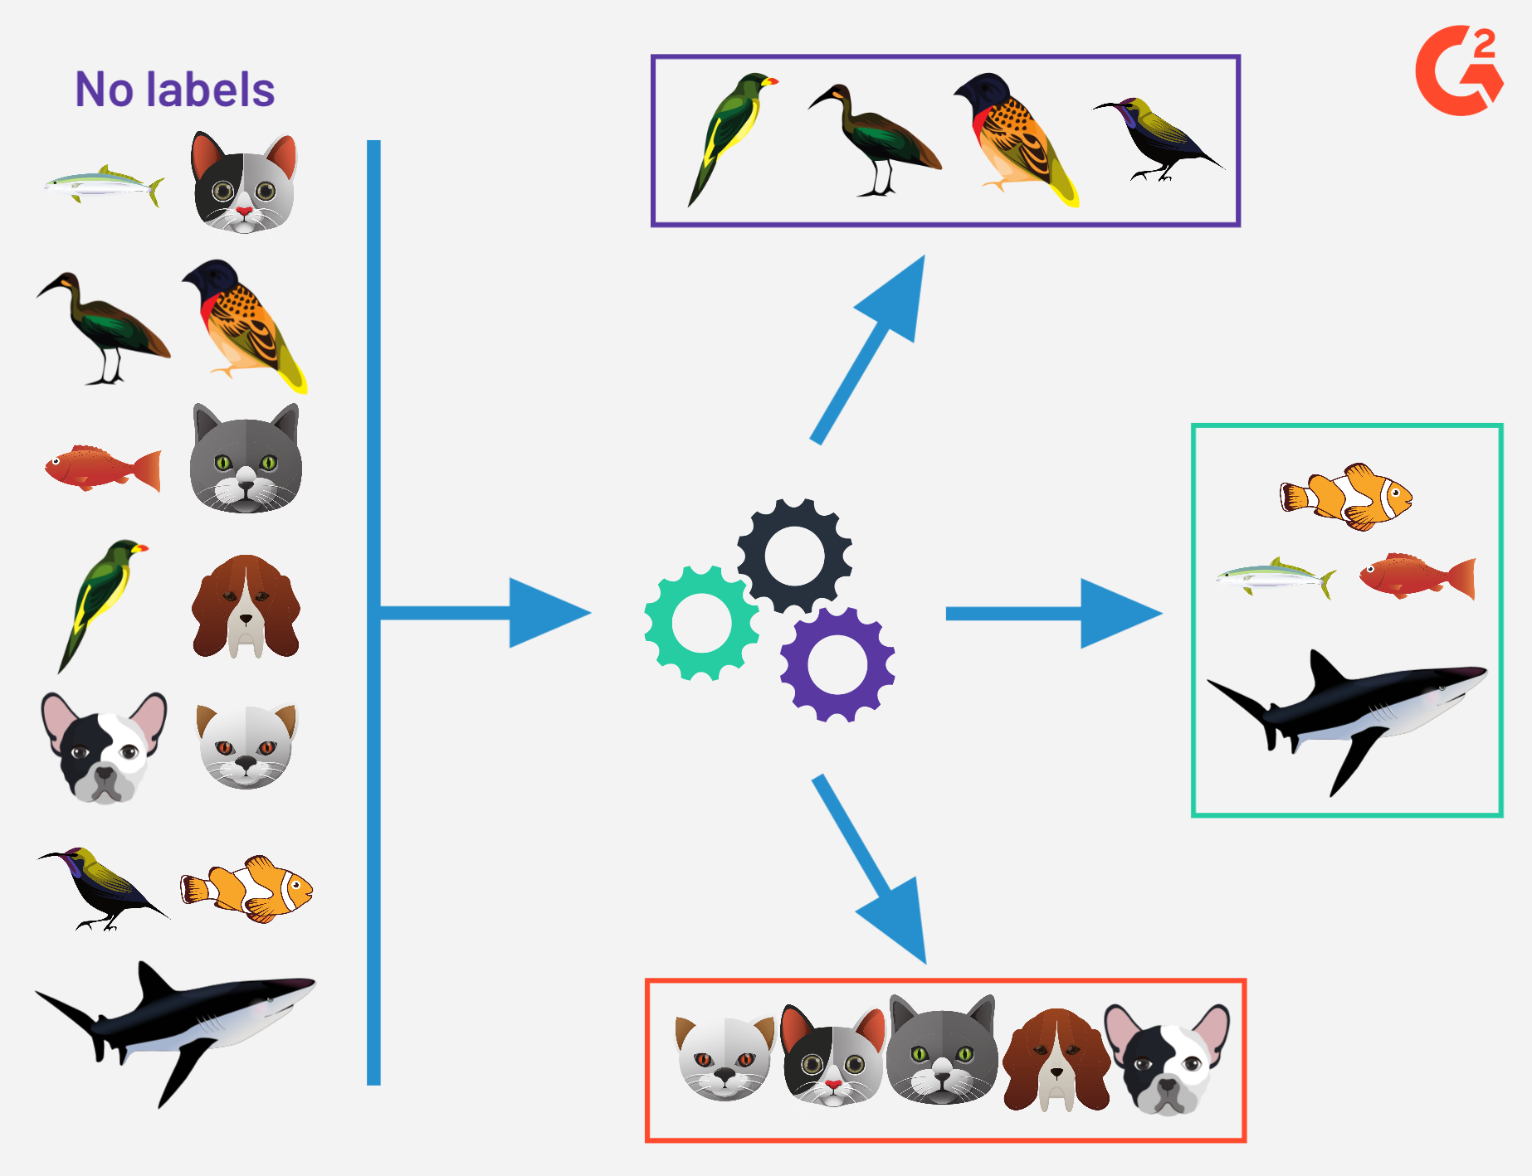
Supervised Learning - Classification
Faculty of Computer Science and Information Technology
1. Data Preparation: Labelled Data
2. Model Training
Swim
Walk
Swim
Model will learn the features for classification
Swim → fin
Walk → two ears
Fly → peak, two legs.
Fly
Fly
Walk
Swim
Walk
Fly
Fly
Fly
Walk
Swim
Walk
Walk
Walk
Fly
Walk
Fly
Swim
Walk
Walk
Model Training
Swim
Training Data
3. Model Testing
Evaluation Metrics:
Accuracy
Sensitivity
Specificity
Predict
Walk
Fly
Swim
Future / Unseen / Testing Data
Trained Model
Image taken from https://learn.g2crowd.com/hubfs/unsupervised-learning.png

Slide 5
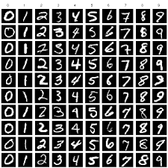
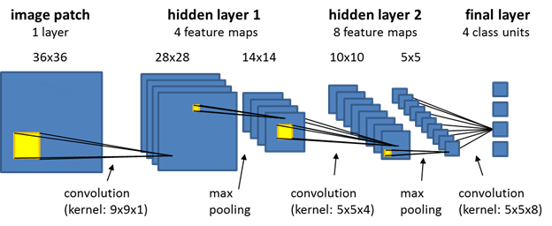
Machine Learning Process
Faculty of Computer Science and Information Technology
Data Preparation
Data Splitting
Training
Testing
CNN
Model Evaluation using Testing Data
MNIST Dataset

Slide 6
Classification
Google Colab Introduction Hands-on Workshop
Faculty of Computer Science and Information Technology
Please go back to this link. We will go through the code here.
https://colab.research.google.com/drive/1yh-DAcRT51NRDcHWLm6f2aT-uiDsG7Na?usp=sharing

Slide 7
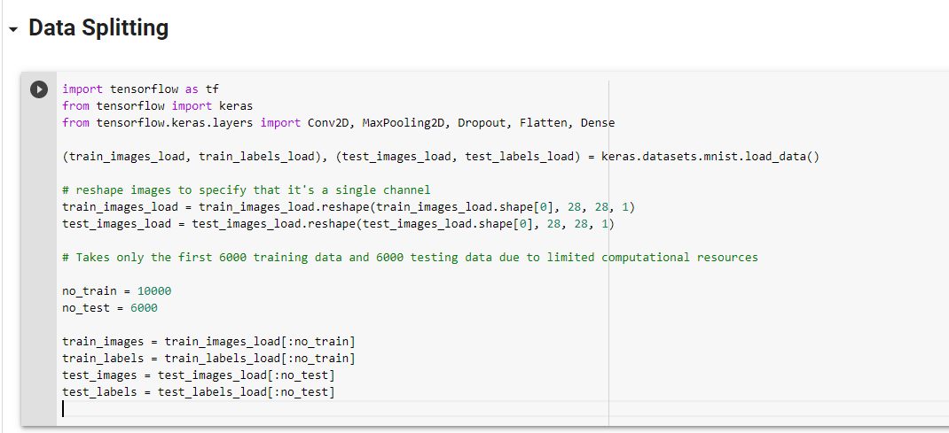
Classification
Google Colab Introduction Hands-on Workshop
Faculty of Computer Science and Information Technology
To try with your datasets. Replace the datasets to your datasets for
train_image,
train_labels,
test_images,
test_labels

Slide 8
Faculty of Computer Science and Information Technology
Getting started with Artificial intelligence – Day 2
Shier Nee Saw, PhD
Department of Artificial Intelligence,
Faculty of Computer Science and Information Technology,
Universiti Malaya
October 23, 2021

Slide 9
Outline
Faculty of Computer Science and Information Technology
Recap
Regression Concept Lecture
Solving regression problem hands-on Workshop
Develop machine learning model for medical problems

Slide 10
Recap
Faculty of Computer Science and Information Technology
Supervised Learning - Classification
Data Preparation
Data Splitting
Training
Testing
CNN
Model Evaluation using Testing Data
MNIST Dataset

Slide 11
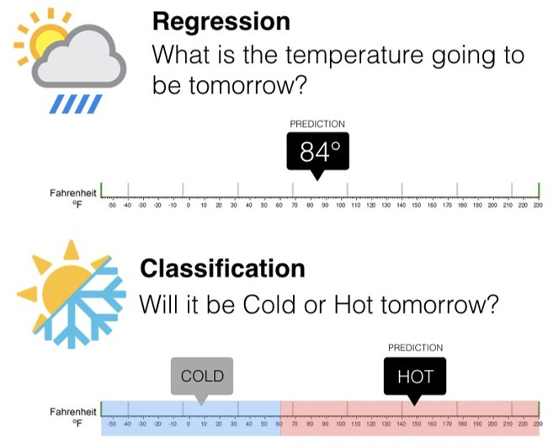
Classification vs Regression
Faculty of Computer Science and Information Technology
https://colab.research.google.com/github/lexfridman/mit-deep-learning/blob/master/tutorial_deep_learning_basics/deep_learning_basics.ipynb#scrollTo=Fb27fZNhp3jr

Slide 12
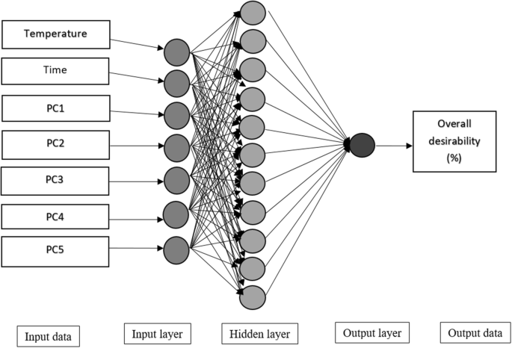
Boston’s Housing Prices Prediction
Faculty of Computer Science and Information Technology
Boston’s Housing Prices

Slide 13
Google Colab
Google Colab Introduction Hands-on Workshop
Faculty of Computer Science and Information Technology
Please go to this link. We will go through the code here.
https://colab.research.google.com/drive/1yh-DAcRT51NRDcHWLm6f2aT-uiDsG7Na?usp=sharing

Slide 14
Source
The code and datasets are available here
https://github.com/shiernee/AI_Tutorial

