Slide 1
Faculty of Computer Science and Information Technology
Getting started with Artificial intelligence – Day 2
Shier Nee Saw, PhD
Department of Artificial Intelligence,
Faculty of Computer Science and Information Technology,
Universiti Malaya
sawsn@um.edu.my
https://shiernee.com

Slide 2
Outline
Faculty of Computer Science and Information Technology
Recap
Regression Concept Lecture
Solving regression problem hands-on Workshop
Develop machine learning model for medical problems
SGA babies' prediction
Pneumonia prediction from CT scan [Optional]

Slide 3
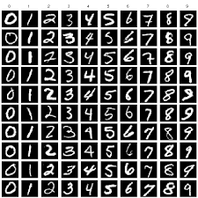
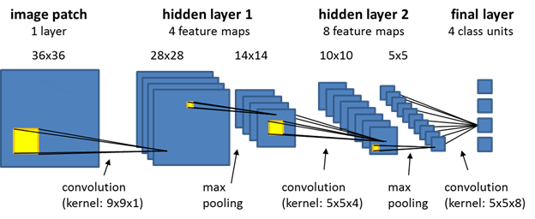
Recap
Faculty of Computer Science and Information Technology
Supervised Learning - Classification
Data Preparation
Data Splitting
Training
Testing
CNN
Model Evaluation using Testing Data
MNIST Dataset

Slide 4
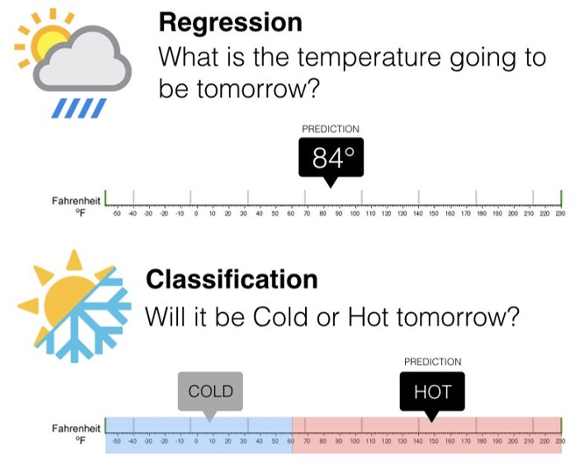
Classification vs Regression
Faculty of Computer Science and Information Technology
https://colab.research.google.com/github/lexfridman/mit-deep-learning/blob/master/tutorial_deep_learning_basics/deep_learning_basics.ipynb#scrollTo=Fb27fZNhp3jr

Slide 5
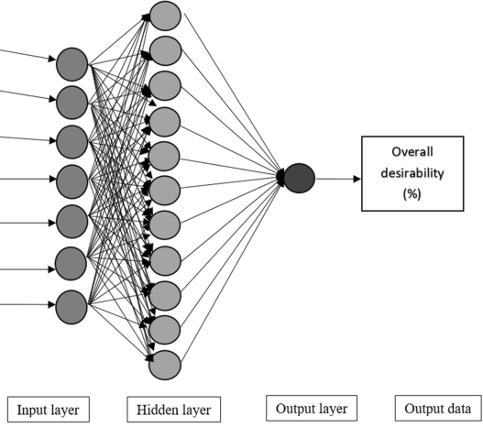
Part 1: Regression - Boston’s Housing Prices Prediction
Faculty of Computer Science and Information Technology
per capita crime rate by town
proportion of residential land zoned for lots over 25,000 sq.ft.
proportion of non-retail business acres per town
Charles River dummy variable (= 1 if tract bounds river; 0 otherwise)
nitric oxides concentration (parts per 10 million)
average number of rooms per dwelling
…
A total of 13 features
Boston’s Housing Prices

Slide 6
Google Colab
Faculty of Computer Science and Information Technology
Please go to this link. We will go through the code here.
https://github.com/shiernee/Getting_Started_with_AI_Tutorial
2. Do the same thing. Open it in colab --> Create a copy to your drive.

Slide 7
Your Task:
Google Colab Introduction Hands-on Workshop
Faculty of Computer Science and Information Technology
Create a ANN model to predict the normal / small baby based on the second trimesters data.
Features:
1. Age
2. Ethnics
3. Head Circumference
4. Abdominal Circumference
2. Femur
Label:
1. Labels

Slide 8

Task:
Google Colab Introduction Hands-on Workshop
Faculty of Computer Science and Information Technology
Step 1: Import data from github: https://raw.githubusercontent.com/shiernee/AI_Tutorial/main/fetal_dataset.csv
Use the following function. Change the url to the above url.
import pandas as pd df = pd.read_csv('https://raw.githubusercontent.com/insaid2018/Term-1/master/Data/Casestudy/titanic_train.csv')
Step 2: Data Splitting.
Refer to this. https://scikit-learn.org/stable/modules/generated/sklearn.model_selection.train_test_split.html

Slide 9
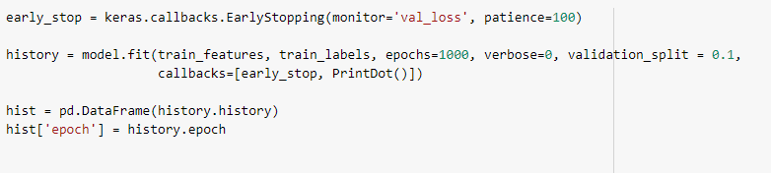
Task:
Google Colab Introduction Hands-on Workshop
Faculty of Computer Science and Information Technology
Step 3: Build Modelhttps://raw.githubusercontent.com/shiernee/AI_Tutorial/main/fetal_dataset.csv
Build a model with
First layer with 20 nodes, relu activation, input_shape = no of features
Last layer with 1 nodes, softmax activation
Refers to our previous build model example in Day 1.
Step 4: Train Model
Use the following code.

Slide 10
Task:
Google Colab Introduction Hands-on Workshop
Faculty of Computer Science and Information Technology
Step 5: Plot the validation accuracy and training accuracy
Refers to the function used today in regression problem.
Step 6: Evaluate accuracy with testing datasets
Refer to the evaluate function used yesterday in classification problem.

Slide 11
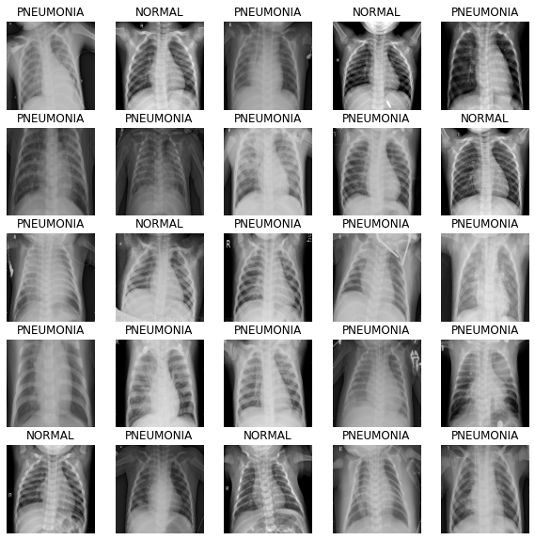
Additional: Develop Machine Learning Model for Medical Problems
Google Colab Introduction Hands-on Workshop
Faculty of Computer Science and Information Technology
Objective: To build a Convolutional neural network (CNN) to predict the presence of pneumonia in X-ray scans.
We will be using datasets from Kaggle.
Classification / Regression?

Slide 12
Additional Reference
Applied Machine Learning Process - https://machinelearningmastery.com/start-here/#process
Basic Convolutional Neural Network - https://towardsdatascience.com/basics-of-the-classic-cnn-a3dce1225add
How do Convolutional Neural Networks work? https://e2eml.school/how_convolutional_neural_networks_work.html

Slide 13
Feedback
https://docs.google.com/forms/d/e/1FAIpQLSfGPN3u7DwpN00KtBrahcpVRU0YEBLxyZElbyU9HrVSxLSYog/viewform

