Slide 1
Faculty of Computer Science and Information Technology
Getting started with Artificial intelligence – Day 2
Shier Nee Saw, PhD
Department of Artificial Intelligence,
Faculty of Computer Science and Information Technology,
Universiti Malaya
sawsn@um.edu.my
https://shiernee.com

Slide 2
Outline
Faculty of Computer Science and Information Technology
Recap
Neural Network
Artificial Neural Network
Convolutional Neural Network
Hands-on Python Workshop

Slide 3
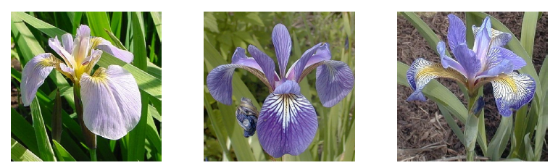
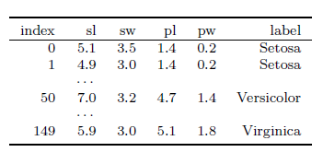
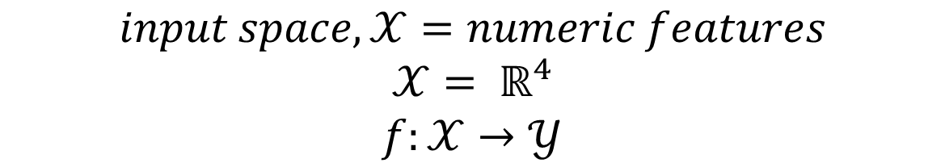
Recap
$$input space,𝒳=numeric features$$
$$𝒳= ℝ^{4}$$
$$f:𝒳→𝒴$$
Notes:
Tabular data

Slide 4
Artificial Neural Network
Made up of multiple layers of nodes
Input layer
Hidden layer
Output layer
Notes:
Tabular data

Slide 5
Artificial Neural Network
Made up of multiple layers of nodes.
Each layer make simple decisions using different weights, w, bias, b and activation function, σ.
Learnable parameters
Input layer
Hidden layer
Output layer
b¹₁
σ
W²₁₁
W¹₁₁
b²₁
W¹₁₂
b¹₂
W²₁₂
σ
σ
b¹₃
b²₂
σ
σ
b¹₄
σ
Notes:
Tabular data

Slide 6
Artificial Neural Network
Made up of multiple layers of nodes.
Each layer make simple decisions using different weights, w, bias, b and activation function, σ.
Learnable parameters
Input layer
Hidden layer
Output layer
σ
W²₁₁
W¹₁₁
Age
W¹₁₂
W²₁₂
σ
Normal Blood Pressure
σ
BMI
σ
σ
High Blood Pressure
Cholesterol level
σ
Notes:
Tabular data

Slide 7
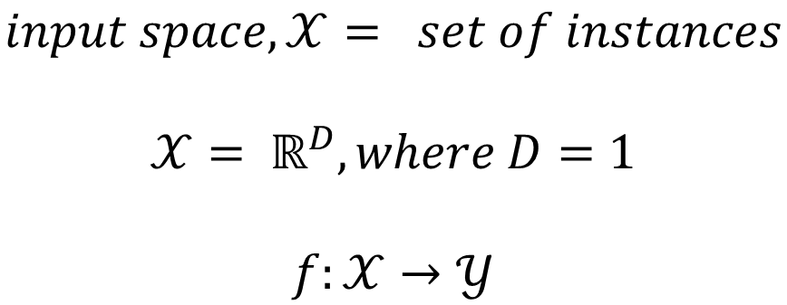
Artificial Neural Network
Input layer
Hidden layer
Output layer
σ
W²₁₁
W¹₁₁
Age
W¹₁₂
W²₁₂
σ
Normal Blood Pressure
σ
BMI
σ
σ
High Blood Pressure
Cholesterol level
σ
$$input space,𝒳= set of instances$$
$$𝒳= ℝ^{D}, where D=1$$
$$f:𝒳→𝒴$$
Notes:
Tabular data

Slide 8
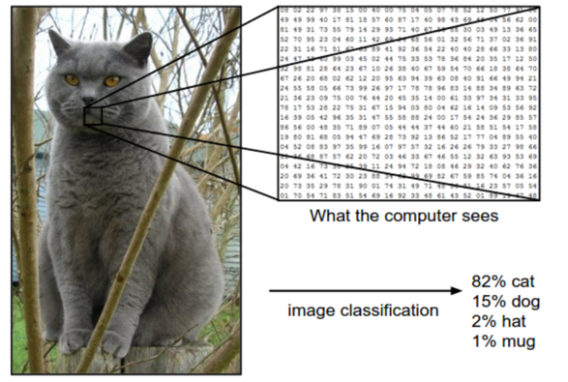

Convolutional Neural Network
When your input is a Grey Scaled Image
$$input space,𝒳= set of images$$
$$𝒳= ℝ^{D}, where D=2$$
$$f:𝒳→𝒴$$
Notes:
Tabular data

Slide 9
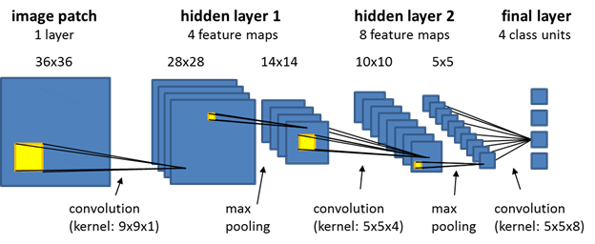
Convolutional Neural Network
Notes:
Image data

Slide 10
Convolution
CNN
1 | 0 | 1 | 1 | 0 | 1
1 | 1 | 1 | 1 | 1 | 0
0 | 0 | 0 | 1 | 1 | 1
0 | 0 | 1 | 1 | 1 | 0
1 | 1 | 1 | 1 | 0 | 0
0 | 1 | 0 | 1 | 0 | 0
Convolution
4
Layer i
Layer i+1

Slide 11
CNN
Convolution
CNN
1 | 0 | 1 | 1 | 0 | 1
1 | 1 | 1 | 1 | 1 | 0
0 | 0 | 0 | 1 | 1 | 1
0 | 0 | 1 | 1 | 1 | 0
1 | 1 | 1 | 1 | 0 | 0
0 | 1 | 0 | 1 | 0 | 0
Convolution
4 | 4
Layer i
Layer i+1

Slide 12
CNN
Convolution
CNN
1 | 0 | 1 | 1 | 0 | 1
1 | 1 | 1 | 1 | 1 | 0
0 | 0 | 0 | 1 | 1 | 1
0 | 0 | 1 | 1 | 1 | 0
1 | 1 | 1 | 1 | 0 | 0
0 | 1 | 0 | 1 | 0 | 0
Convolution
4 | 4 | 4
Layer i
Layer i+1

Slide 13
CNN
Convolution
CNN
1 | 0 | 1 | 1 | 0 | 1
1 | 1 | 1 | 1 | 1 | 0
0 | 0 | 0 | 1 | 1 | 1
0 | 0 | 1 | 1 | 1 | 0
1 | 1 | 1 | 1 | 0 | 0
0 | 1 | 0 | 1 | 0 | 0
Convolution
4 | 4 | 4 | 5
Layer i
Layer i+1

Slide 14
CNN
Convolution
CNN
1 | 0 | 1 | 1 | 0 | 1
1 | 1 | 1 | 1 | 1 | 0
0 | 0 | 0 | 1 | 1 | 1
0 | 0 | 1 | 1 | 1 | 0
1 | 1 | 1 | 1 | 0 | 0
0 | 1 | 0 | 1 | 0 | 0
4 | 4 | 4 | 5
4
Convolution
Layer i
Layer i+1

Slide 15
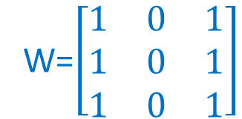
CNN
Convolution
CNN
1 | 0 | 1 | 1 | 0 | 1
1 | 1 | 1 | 1 | 1 | 0
0 | 0 | 0 | 1 | 1 | 1
0 | 0 | 1 | 1 | 1 | 0
1 | 1 | 1 | 1 | 0 | 0
0 | 1 | 0 | 1 | 0 | 0
Repeat the rest
4 | 4 | 4 | 5
4 | 4 | 5 | 4
3 | 3 | 4 | 4
3 | 5 | 3 | 3
W=$\left[\begin{matrix}1 & 0 & 1 \\ 1 & 0 & 1 \\ 1 & 0 & 1\end{matrix}\right]$
Feature extraction
Layer i
Layer i+1

Slide 16

CNN
Convolution
CNN
Repeat the rest
1 | 0 | 1 | 1 | 0 | 1
1 | 1 | 1 | 1 | 1 | 0
0 | 0 | 0 | 1 | 1 | 1
0 | 0 | 1 | 1 | 1 | 0
1 | 1 | 1 | 1 | 0 | 0
0 | 1 | 0 | 1 | 0 | 0
4 | 4 | 4 | 5
4 | 4 | 5 | 4
3 | 3 | 4 | 4
3 | 5 | 3 | 3
W=$\left[\begin{matrix}1 & 0 & 1 \\ 1 & 0 & 1 \\ 1 & 0 & 1\end{matrix}\right]$
Feature extraction
Layer i
Layer i+1

Slide 17
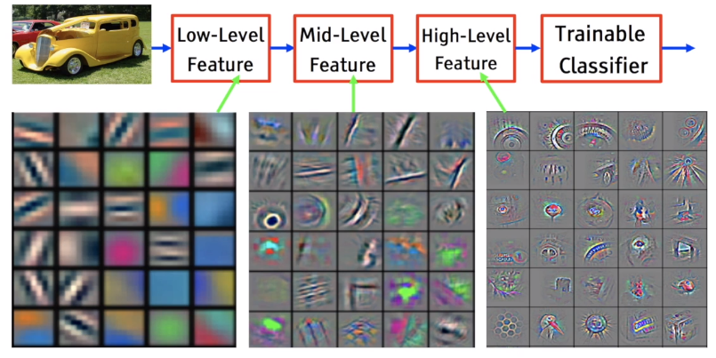
Feature Extraction

Slide 18
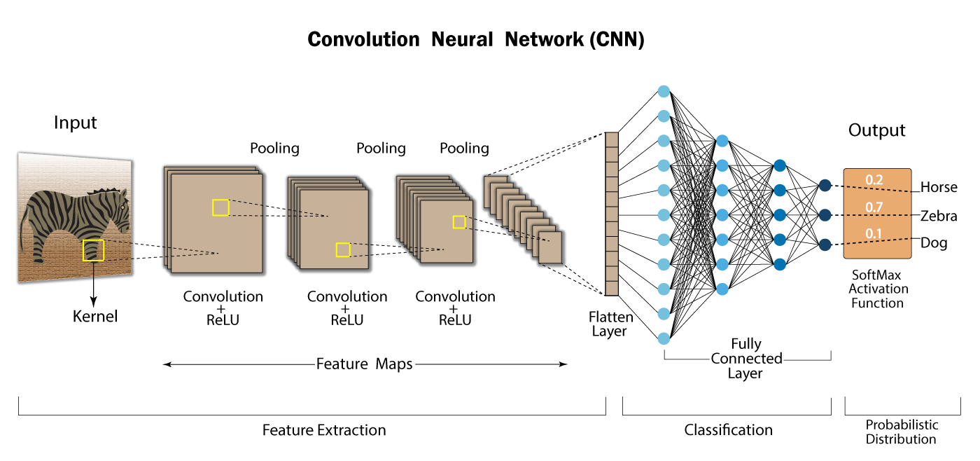
CNN
Supervised Learning - Classification
From https://developersbreach.com/convolution-neural-network-deep-learning/

Slide 19
Hands-on Python Workshop

Slide 20
Classification - ANN
Faculty of Computer Science and Information Technology
Data Preparation
Data Splitting
Training
Testing
ANN
Model Evaluation using Testing Data
σ
W²₁₁
W¹₁₁
Age
W¹₁₂
W²₁₂
σ
Normal Blood Pressure
σ
BMI
σ
σ
High Blood Pressure
Cholesterol level
σ

Slide 21
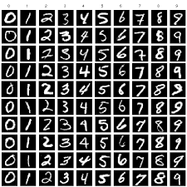
MNIST Classification - CNN
Faculty of Computer Science and Information Technology
Data Preparation
Data Splitting
Training
Testing
CNN
Model Evaluation using Testing Data
MNIST Dataset

Slide 22
Additional Reference
Applied Machine Learning Process - https://machinelearningmastery.com/start-here/#process
Basic Convolutional Neural Network - https://towardsdatascience.com/basics-of-the-classic-cnn-a3dce1225add
How does Convolutional Neural Networks work? https://e2eml.school/how_convolutional_neural_networks_work.html

