Slide 1
Faculty of Computer Science and Information Technology
Getting started with Artificial intelligence – Day 1
Shier Nee Saw, PhD
Department of Artificial Intelligence,
Faculty of Computer Science and Information Technology,
Universiti Malaya
sawsn@um.edu.my
https://shiernee.com
Notes:
Konichiwa

Slide 2
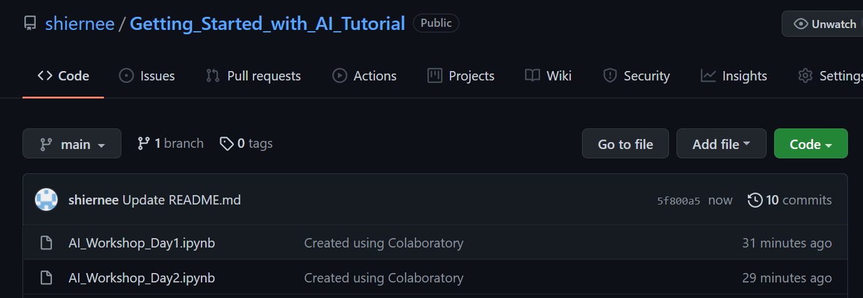
Source
All the materials are available here.
https://github.com/shiernee/Getting_Started_with_AI_Tutorial

Slide 3
Outline
Faculty of Computer Science and Information Technology
Google Colab Introduction Hands-on Workshop
Solving classification problem hands-on Workshop

Slide 4
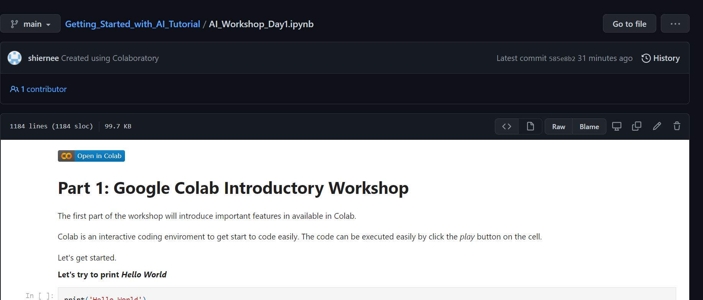
Google Colab
Google Colab Introduction Hands-on Workshop
Faculty of Computer Science and Information Technology
Please go to this link. We will go through the code here.
https://github.com/shiernee/Getting_Started_with_AI_Tutorial/blob/main/AI_Workshop_Day1.ipynb
2. Click “Open in Colab”
3. Save a copy in your drive.
File
Save a copy in Drive

Slide 5
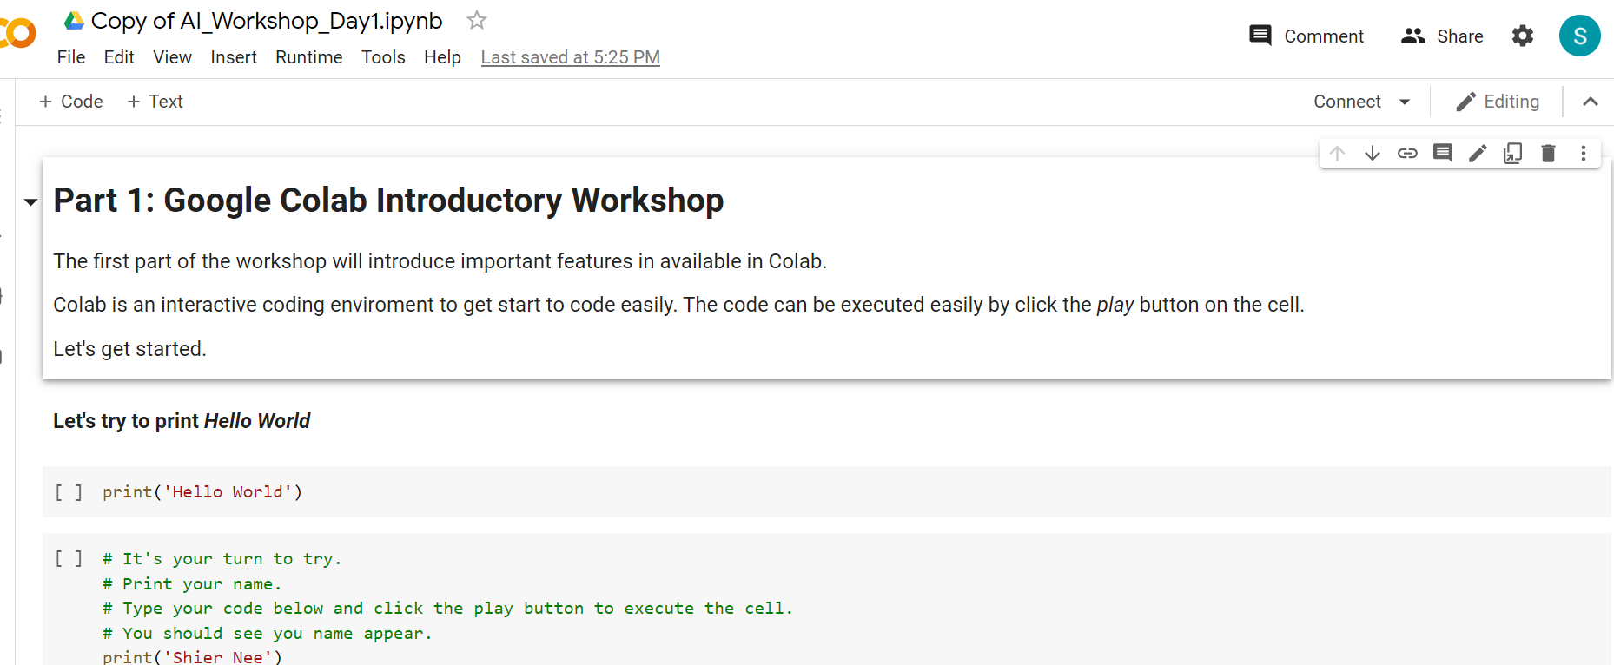
Google Colab
Google Colab Introduction Hands-on Workshop
Faculty of Computer Science and Information Technology
Please go to this link. We will go through the code here.
https://github.com/shiernee/Getting_Started_with_AI_Tutorial/blob/main/AI_Workshop_Day1.ipynb
2. Click “Open in Colab”
3. Save a copy in your drive.
File
Save a copy in Drive
You should see the name change to
“Copy of AI_Workshop_Day1.ipynb”

Slide 6
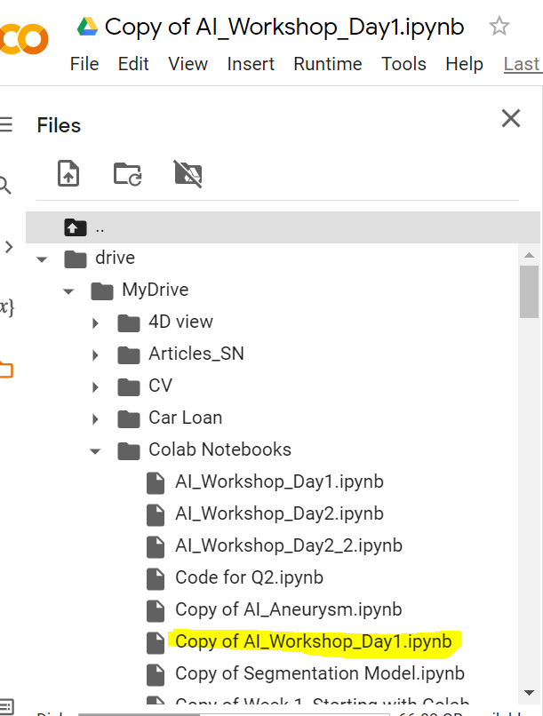
Google Colab
Google Colab Introduction Hands-on Workshop
Faculty of Computer Science and Information Technology
Please go to this link. We will go through the code here.
https://github.com/shiernee/Getting_Started_with_AI_Tutorial/blob/main/AI_Workshop_Day1.ipynb
2. Click “Open in Colab”
3. Save a copy in your drive.
File
Save a copy in Drive
You should see the name change to
“Copy of AI_Workshop_Day1.ipynb”
You should also see your ipynb file
Is in your google drive

Slide 7
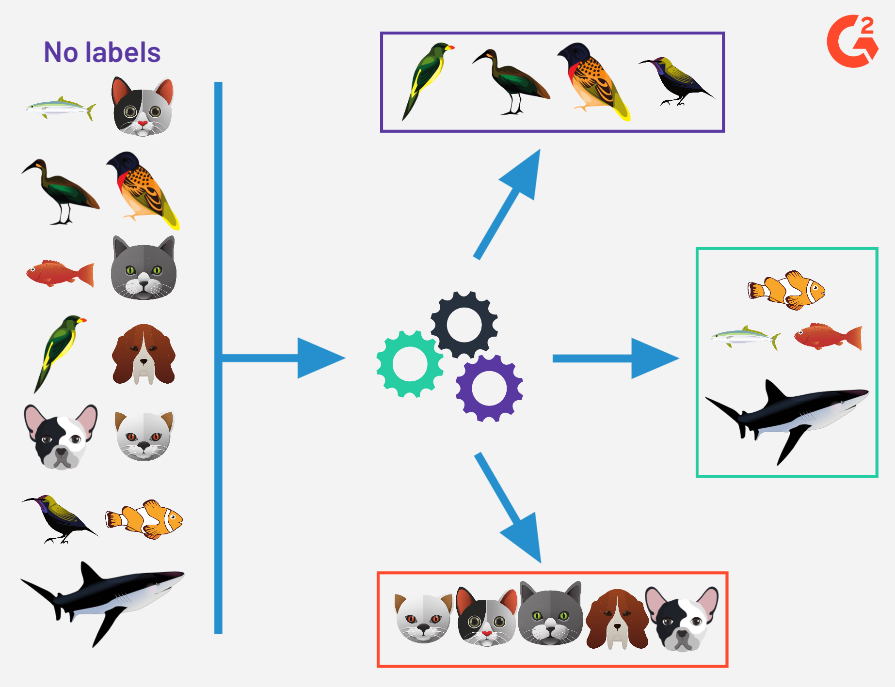
Supervised Learning - Classification
Faculty of Computer Science and Information Technology
1. Data Preparation: Labelled Data
2. Model Training
Swim
Walk
Swim
Model will learn the features for classification
Swim → fin
Walk → two ears
Fly → peak, two legs.
Fly
Fly
Walk
Swim
Walk
Fly
Fly
Fly
Walk
Swim
Walk
Walk
Walk
Fly
Walk
Fly
Swim
Walk
Walk
Model Training
Swim
Training Data
3. Model Testing
Evaluation Metrics:
Accuracy
Sensitivity
Specificity
Predict
Walk
Fly
Swim
Future / Unseen / Testing Data
Trained Model
Image taken from https://learn.g2crowd.com/hubfs/unsupervised-learning.png

Slide 8
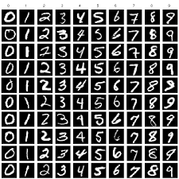
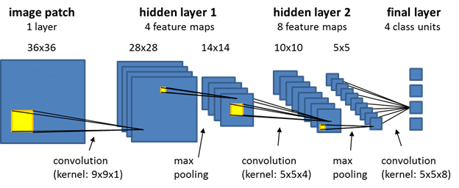
Machine Learning Process
Faculty of Computer Science and Information Technology
Data Preparation
Data Splitting
Training
Testing
CNN
Model Evaluation using Testing Data
MNIST Dataset

Slide 9
Classification
Google Colab Introduction Hands-on Workshop
Faculty of Computer Science and Information Technology
Please go back to colab.

Slide 10
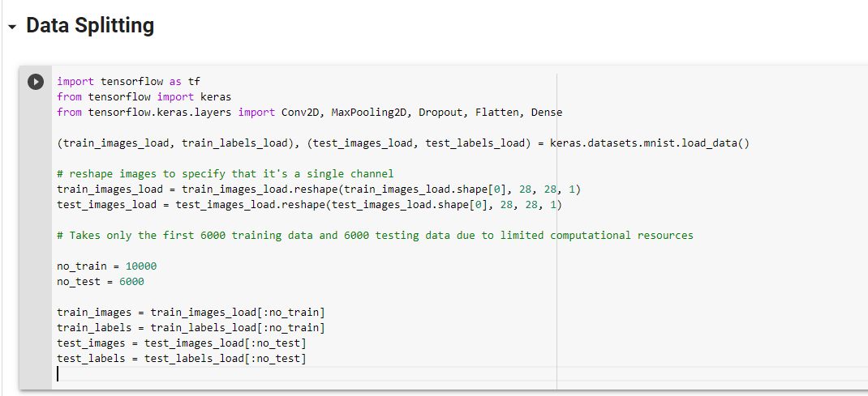
Classification
Google Colab Introduction Hands-on Workshop
Faculty of Computer Science and Information Technology
To try with your datasets. Replace the datasets to your datasets for
train_image,
train_labels,
test_images,
test_labels

Slide 11
Day 1 Conclude
Google Colab Introduction Hands-on Workshop
Faculty of Computer Science and Information Technology
Google Colab Introduction Hands-on Workshop
Solving classification problem hands-on Workshop
Notes:
Arigatogozai-i-mas, matarai-su

