Slide 1
Faculty of Computer Science and Information Technology
Getting started with Artificial intelligence – Day 2
Shier Nee Saw, PhD
Department of Artificial Intelligence,
Faculty of Computer Science and Information Technology,
Universiti Malaya
sawsn@um.edu.my
https://shiernee.com

Slide 2


Join at slido.com #1241943
ⓘ Start presenting to display the joining instructions on this slide.

Slide 3

Is deep learning subset of Artificial Intelligence?
ⓘ Start presenting to display the poll results on this slide.

Slide 4
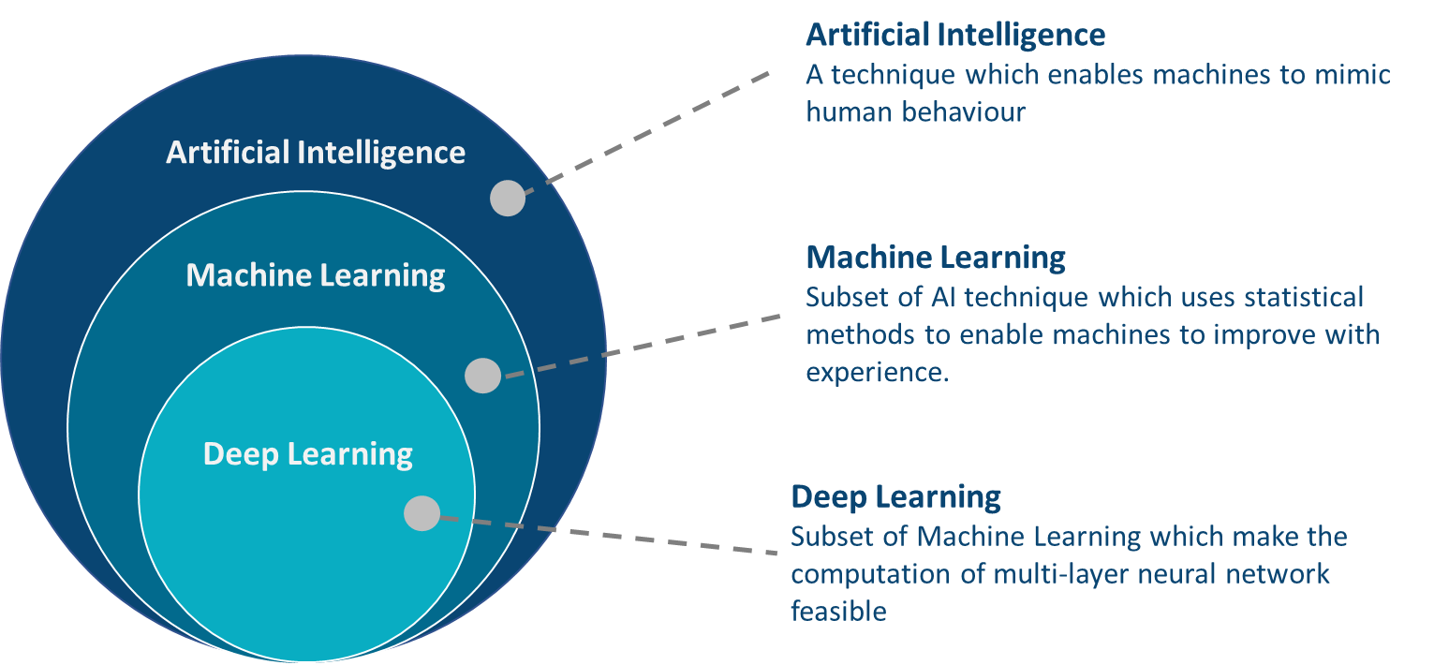
Recap

Slide 5
Which of the following is a classification problem?
ⓘ Start presenting to display the poll results on this slide.

Slide 6
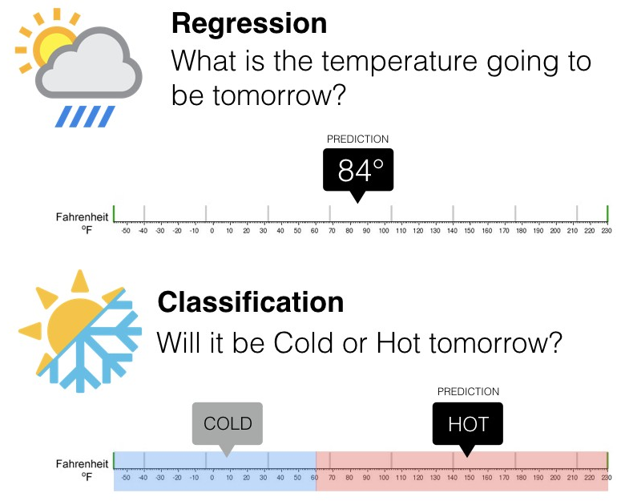
Recap

Slide 7
Which of the statement is correct?
ⓘ Start presenting to display the poll results on this slide.

Slide 8
In machine learning process, which of the following sequence is correct?
ⓘ Start presenting to display the poll results on this slide.

Slide 9
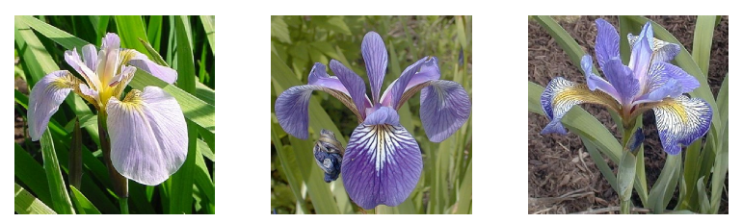
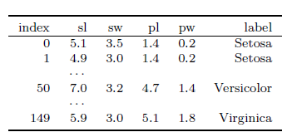
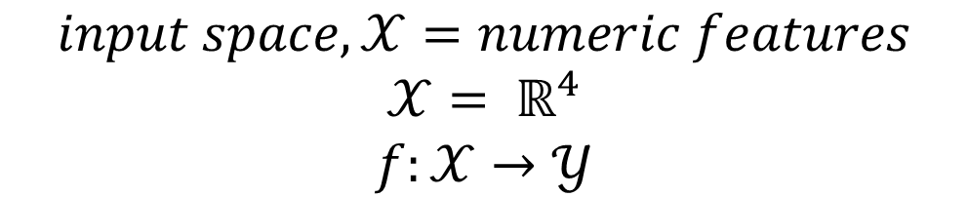
Recap - Classification
$$input space,𝒳=numeric features$$
$$𝒳= ℝ^{4}$$
$$f:𝒳→𝒴$$
Models:
Decision Tree
Support Vector Machine
Notes:
Tabular data

Slide 10
Today Outline
Faculty of Computer Science and Information Technology
Neural Network Models
Artificial Neural Network / Multilayer Perceptron
Convolutional Neural Network
Hands-on Python Workshop

Slide 11
Artificial Neural Network
Made up of multiple layers of nodes
Input layer
Hidden layer
Output layer
Notes:
Tabular data

Slide 12
Artificial Neural Network
Made up of multiple layers of nodes.
Each layer make simple decisions using different weights, w, bias, b and activation function, σ.
Trainable parameters
Input layer
Hidden layer
Output layer
b¹₁
σ
W²₁₁
W¹₁₁
b²₁
W¹₁₂
b¹₂
W²₁₂
σ
σ
b¹₃
b²₂
σ
σ
b¹₄
σ
Notes:
Tabular data

Slide 13
Artificial Neural Network
Made up of multiple layers of nodes.
Each layer make simple decisions using different weights, w, bias, b and activation function, σ.
Learnable parameters
Input layer
Hidden layer
Output layer
σ
W²₁₁
W¹₁₁
Age
W¹₁₂
W²₁₂
σ
Normal Blood Pressure
σ
BMI
σ
σ
High Blood Pressure
Cholesterol level
σ
Notes:
Tabular data

Slide 14
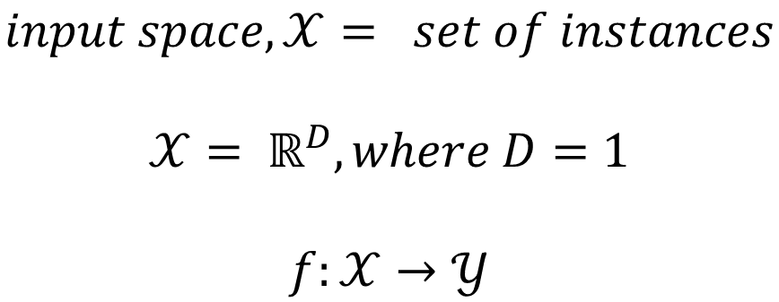
Artificial Neural Network
Input layer
Hidden layer
Output layer
σ
W²₁₁
W¹₁₁
Age
W¹₁₂
W²₁₂
σ
Normal Blood Pressure
σ
BMI
σ
σ
High Blood Pressure
Cholesterol level
σ
$$input space,𝒳= set of instances$$
$$𝒳= ℝ^{D}, where D=1$$
$$f:𝒳→𝒴$$
Notes:
Tabular data

Slide 15
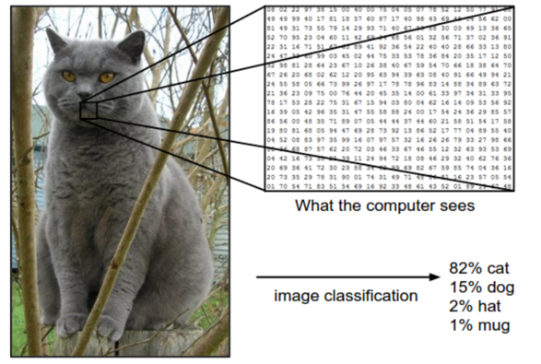

Convolutional Neural Network
When your input is a Grey Scaled Image
$$input space,𝒳= set of images$$
$$𝒳= ℝ^{D}, where D=2$$
$$f:𝒳→𝒴$$
Notes:
Tabular data

Slide 16
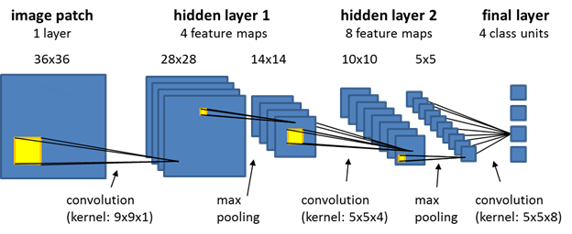
Convolutional Neural Network
Trainable parameters:
Weight in the kernel
Notes:
Image data

Slide 17
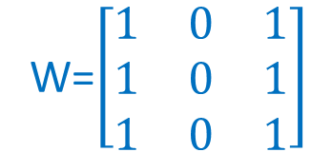
Convolution
1 | 0 | 1 | 1 | 0 | 1
1 | 1 | 1 | 1 | 1 | 0
0 | 0 | 0 | 1 | 1 | 1
0 | 0 | 1 | 1 | 1 | 0
1 | 1 | 1 | 1 | 0 | 0
0 | 1 | 0 | 1 | 0 | 0
Convolution
4
Kernel
W=$\left[\begin{matrix}1 & 0 & 1 \\ 1 & 0 & 1 \\ 1 & 0 & 1\end{matrix}\right]$
Layer i
Layer i+1

Slide 18
CNN
Convolution
CNN
1 | 0 | 1 | 1 | 0 | 1
1 | 1 | 1 | 1 | 1 | 0
0 | 0 | 0 | 1 | 1 | 1
0 | 0 | 1 | 1 | 1 | 0
1 | 1 | 1 | 1 | 0 | 0
0 | 1 | 0 | 1 | 0 | 0
Convolution
4 | 4
Layer i
Layer i+1

Slide 19
CNN
Convolution
CNN
1 | 0 | 1 | 1 | 0 | 1
1 | 1 | 1 | 1 | 1 | 0
0 | 0 | 0 | 1 | 1 | 1
0 | 0 | 1 | 1 | 1 | 0
1 | 1 | 1 | 1 | 0 | 0
0 | 1 | 0 | 1 | 0 | 0
Convolution
4 | 4 | 4
Layer i
Layer i+1

Slide 20
CNN
Convolution
CNN
1 | 0 | 1 | 1 | 0 | 1
1 | 1 | 1 | 1 | 1 | 0
0 | 0 | 0 | 1 | 1 | 1
0 | 0 | 1 | 1 | 1 | 0
1 | 1 | 1 | 1 | 0 | 0
0 | 1 | 0 | 1 | 0 | 0
Convolution
4 | 4 | 4 | 5
Layer i
Layer i+1

Slide 21
CNN
Convolution
CNN
1 | 0 | 1 | 1 | 0 | 1
1 | 1 | 1 | 1 | 1 | 0
0 | 0 | 0 | 1 | 1 | 1
0 | 0 | 1 | 1 | 1 | 0
1 | 1 | 1 | 1 | 0 | 0
0 | 1 | 0 | 1 | 0 | 0
4 | 4 | 4 | 5
4
Convolution
Layer i
Layer i+1

Slide 22
CNN
Convolution
CNN
1 | 0 | 1 | 1 | 0 | 1
1 | 1 | 1 | 1 | 1 | 0
0 | 0 | 0 | 1 | 1 | 1
0 | 0 | 1 | 1 | 1 | 0
1 | 1 | 1 | 1 | 0 | 0
0 | 1 | 0 | 1 | 0 | 0
Repeat the rest
4 | 4 | 4 | 5
4 | 4 | 5 | 4
3 | 3 | 4 | 4
3 | 5 | 3 | 3
Feature extracted
Layer i
Layer i+1

Slide 23
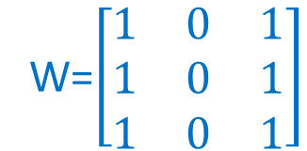
CNN
Convolution
CNN
1 | 0 | 1 | 1 | 0 | 1
1 | 1 | 1 | 1 | 1 | 0
0 | 0 | 0 | 1 | 1 | 1
0 | 0 | 1 | 1 | 1 | 0
1 | 1 | 1 | 1 | 0 | 0
0 | 1 | 0 | 1 | 0 | 0
Repeat the rest
4 | 4 | 4 | 5
4 | 4 | 5 | 4
3 | 3 | 4 | 4
3 | 5 | 3 | 3
W=$\left[\begin{matrix}1 & 0 & 1 \\ 1 & 0 & 1 \\ 1 & 0 & 1\end{matrix}\right]$
Feature extracted
Trainable parameter
Layer i
Layer i+1

Slide 24
CNN
Convolution
CNN
Repeat for next layer
4 | 4 | 4 | 5
4 | 4 | 5 | 4
3 | 3 | 4 | 4
3 | 5 | 3 | 3
24 | 24
22 | 23
W=$\left[\begin{matrix}1 & 0 & 1 \\ 1 & 0 & 1 \\ 1 & 0 & 1\end{matrix}\right]$
Feature extracted
Trainable parameter
Layer i+1
Layer i+2

Slide 25
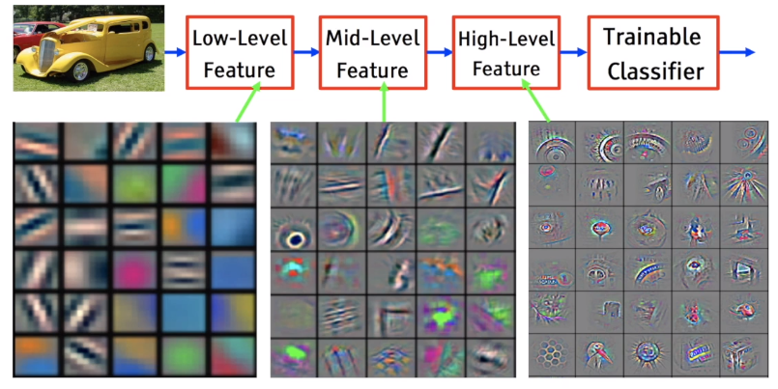
Feature Extraction

Slide 26
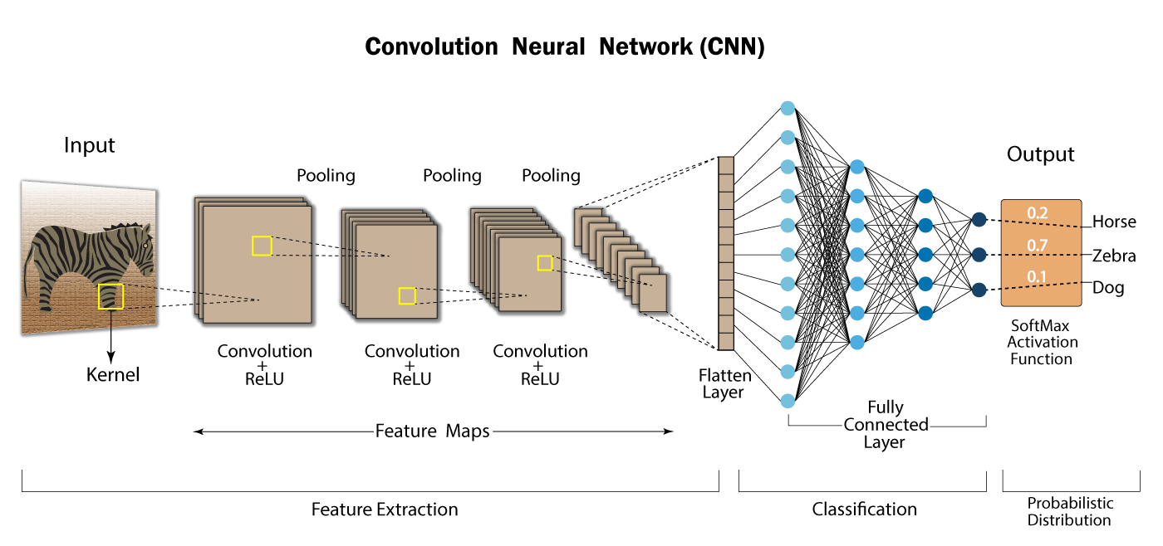
CNN
Supervised Learning - Classification
From https://developersbreach.com/convolution-neural-network-deep-learning/

Slide 27
Hands-on Python Workshop

Slide 28
Breast Cancer Classification - ANN
Faculty of Computer Science and Information Technology
Data Preparation
Data Splitting
Training
Testing
ANN
Model Evaluation using Testing Data
σ
W²₁₁
W¹₁₁
Mean radius
W¹₁₂
W²₁₂
σ
Benign
σ
Mean texture
σ
σ
Malignant
Mean perimeter
σ

Slide 29
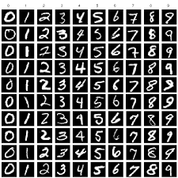
MNIST Classification - CNN
Faculty of Computer Science and Information Technology
Data Preparation
Data Splitting
Training
Testing
CNN
Model Evaluation using Testing Data
MNIST Dataset

Slide 30
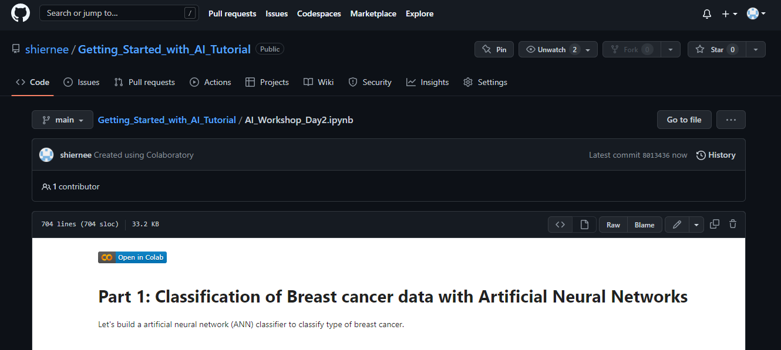
Course Materials
Google Colab Introduction Hands-on Workshop
Faculty of Computer Science and Information Technology
Please go to this link. We will go through the code here.
https://github.com/shiernee/Getting_Started_with_AI_Tutorial/blob/main/AI_Workshop_Day2.ipynb
2. Click “Open in Colab”
3. Save a copy in your drive.
File
Save a copy in Drive

Slide 31
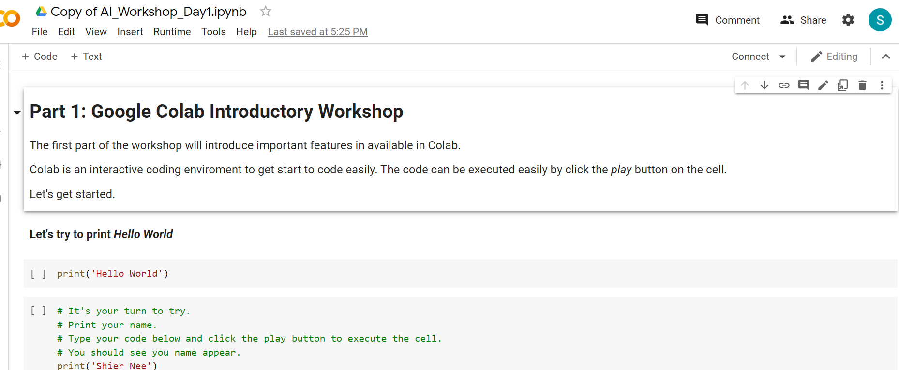
Google Colab
Google Colab Introduction Hands-on Workshop
Faculty of Computer Science and Information Technology
Please go to this link. We will go through the code here.
https://github.com/shiernee/Getting_Started_with_AI_Tutorial/blob/main/AI_Workshop_Day2.ipynb
2. Click “Open in Colab”
3. Save a copy in your drive.
File
Save a copy in Drive
You should see the name change to
“Copy of AI_Workshop_Day2.ipynb”

Slide 32
Day 2 Conclude
Faculty of Computer Science and Information Technology
Multilayer Perceptron
Convolutional Neural Network
Hands-on Python Workshop
Notes:
Arigatogozai-i-mas, matarai-su

Slide 33
Additional Reference
Applied Machine Learning Process - https://machinelearningmastery.com/start-here/#process
Basic Convolutional Neural Network - https://towardsdatascience.com/basics-of-the-classic-cnn-a3dce1225add
How does Convolutional Neural Networks work? https://e2eml.school/how_convolutional_neural_networks_work.html

