Slide 1


Team Details
  Team name: Chilli
  Team leader name: Shieryl Tendilla
  Problem Statement: BFSI – Intelligent Risk, Fraud & Financial Experiences. Fraud analysts reviewing one alert can't see the connected fund movements behind it, or prove them.

Slide 2
Brief about the idea
TraceGuard
A graph-powered AI investigation assistant for fraud operations analysts at banks, e-wallets and fintechs.
It traces suspicious fund movements across accounts and devices, then writes an evidence-linked case brief with Gemini on Vertex AI, where every claim is cited to a real transaction or rule result.
1
Graph evidence
Paths, time windows, sums and rule flags computed by code, never by the model.
2
Cited AI brief
Observations, counterevidence and unknowns. Every ID is validated before display.
3
Honest by design
"Pattern warrants review", never "guilty". It says what the data can't show.
Investigation aid only: it does not block transfers, declare guilt, file regulatory reports or give a risk score. All data is synthetic.

Slide 3
Opportunities
1
How it differs
2
How it solves the problem
3
USP
Shows connections, not single transactions: a time-ordered money trail across accounts and devices.
Separates duties: deterministic graph tools decide; Gemini only explains.
Refuses to guess: unknowns past the data boundary are stated, not filled in.
Retrieves the connected evidence for an alert in one click.
Turns it into a brief with observations, counterevidence, unknowns and next checks.
Each citation highlights its record on the graph and timeline, so it can be checked in place.
Every cited ID and every figure in the brief is validated against tool output. A failing brief is regenerated once, then blocked.
Counterevidence is computed, not invented (e.g. senders not on the shared device).
Careful language enforced in code: no accusations, probabilities or risk scores.

Slide 4
List of features offered by the solution
1
Case queue
3 synthetic alert cases, clearly labelled "synthetic data"
2
Timeline
Each case's transfers in time order; select rows to highlight them
3
Relationship graph
Accounts and devices; one arrow per transfer, so repeats never merge
4
5 deterministic tools
Account context, fund trace, shared devices, rapid forwarding, fan-in
5
AI investigation
Gemini on Vertex AI over retrieved evidence, with a visible tool log
6
Evidence-linked brief
Observations, counterevidence, unknowns, suggested checks
7
Citation navigation
Click an evidence ID to highlight its record on graph and timeline
8
Markdown export
Download the brief with model, run time and evidence list
9
Readable errors
Timeout, quota or permission errors explained; graph stays usable

Slide 5
Process flow diagram or Use-case diagram
1
2
3
4
5
6
Open alert
Pick a case from the queue
Inspect
Graph and time-ordered timeline
Run AI investigation
Fixed workflow runs every graph tool
Validate
Citations, figures and wording checked
Review brief
Click citations to verify each claim
Export
Markdown brief for the case file
Inside steps 3–4 (the trust boundary)
Graph tools compute paths, windows, sums, rule flags and contrasts, so every number is deterministic.
Gemini (gemini-3.5-flash, structured JSON) writes the brief from that evidence only, with no free-form queries and no generated code.
The validator rejects any brief that cites an unknown ID, states a figure not in the tool output, or uses accusatory wording. It regenerates once, then shows a readable error instead of the brief.

Slide 6
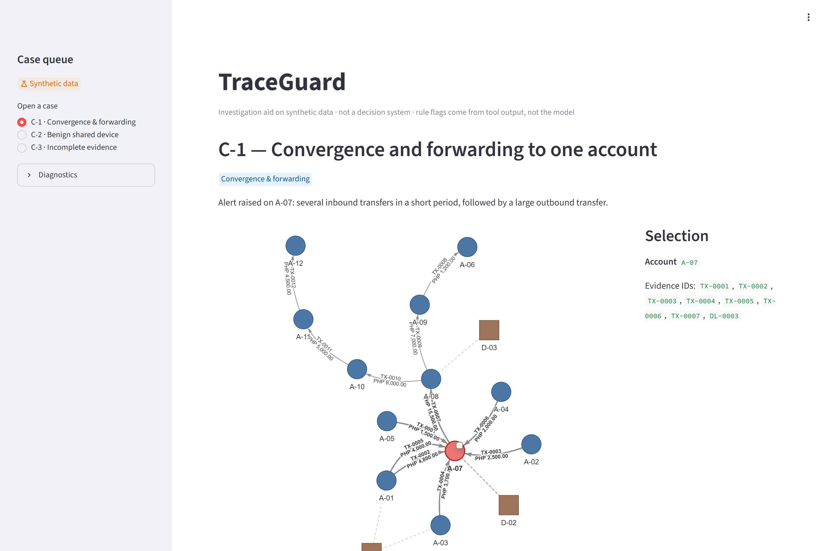
Wireframes/Mock diagrams of the proposed solution (optional): the live investigation page
1
Case queue
Synthetic cases, each labelled
1
2
Case header
Alert description and scenario
2
4
3
3
Relationship graph
Accounts (circles), devices (squares), one arrow per transfer
4
Selection panel
Click a node to list every record that touches it
5
Below the graph
Timeline, AI investigation, brief, citations, export
5

Slide 7
Architecture diagram of the proposed solution
Cloud Run · traceguard
asia-southeast1 · max 2 instances · runtime SA traceguard-run
Gemini on Vertex AI
gemini-3.5-flash
asia-southeast1
google-genai SDK
structured JSON output
Browser
Analyst or judge, public URL
Streamlit app (Python 3.12)
Case queue · graph · timeline · brief · export
ADC
Graph layer: NetworkX MultiDiGraph
5 read-only tools · rule flags · contrasts (ADR-003)
Security and cost
No API keys: Application Default Credentials only
Runtime SA: aiplatform.user only
Build SA: run.builder only · no Editor role in the project
Max instances plus per-call caps (30 s, 4 tool rounds)
AI layer
Fixed retrieval → Gemini JSON brief → citation, figure and wording validation
Synthetic dataset
Seeded, bundled in the image · no database

Slide 8
Technologies to be used in the solution
Layer | Technology | Why
AI | Gemini 3.5 Flash on Vertex AI · google-genai 2.31 | Structured JSON briefs; LOW thinking keeps a brief to 5–8 s
Hosting | Cloud Run (source deploy, Dockerfile) | One public service; scales to zero; max 2 instances
Build | Cloud Build · Artifact Registry | Least-privilege build service account
Graph | NetworkX 3.7 (MultiDiGraph) | Repeated transfers stay separate; time-ordered traces
UI | Streamlit 1.66 · streamlit-agraph | Interactive graph; click a node to see its evidence
Validation | Pydantic 2 schema · custom validators | Citation, figure and wording checks before display
Quality | pytest (156 tests) · mypy strict | Fixture outcomes, boundaries, errors, honesty rules
Two of the theme's suggested Google Cloud technologies (Gemini on Vertex AI, Cloud Run); BigQuery is the scale-up path.

Slide 9
Estimated implementation cost (optional)
We have not published a cost figure: we would rather show the drivers and the caps than guess a number.
1
Cloud Run
Pay per request time; scales to zero when idle; capped at 2 instances.
2
Gemini 3.5 Flash
One call per investigation (two at most, with one regeneration). Evidence payload capped at 60,000 characters.
3
Build and storage
Cloud Build per deploy; one container image in Artifact Registry.
Controls in place: max instances 2; 30 s timeout per call; at most 4 tool rounds and 1 regeneration; budget alerts at 50/90/100%.
At bank scale: cost would be driven by Gemini calls per analyst case and graph storage (BigQuery or Spanner Graph). Estimate with the bank's case volumes before rollout.

Slide 10
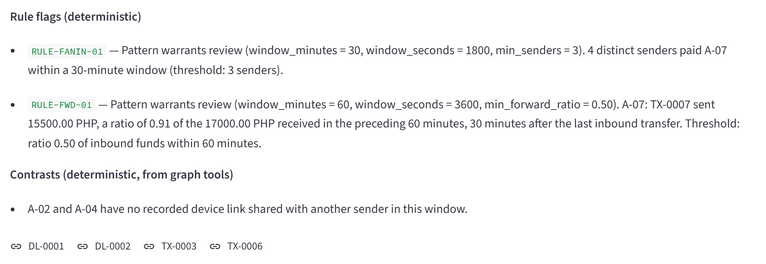
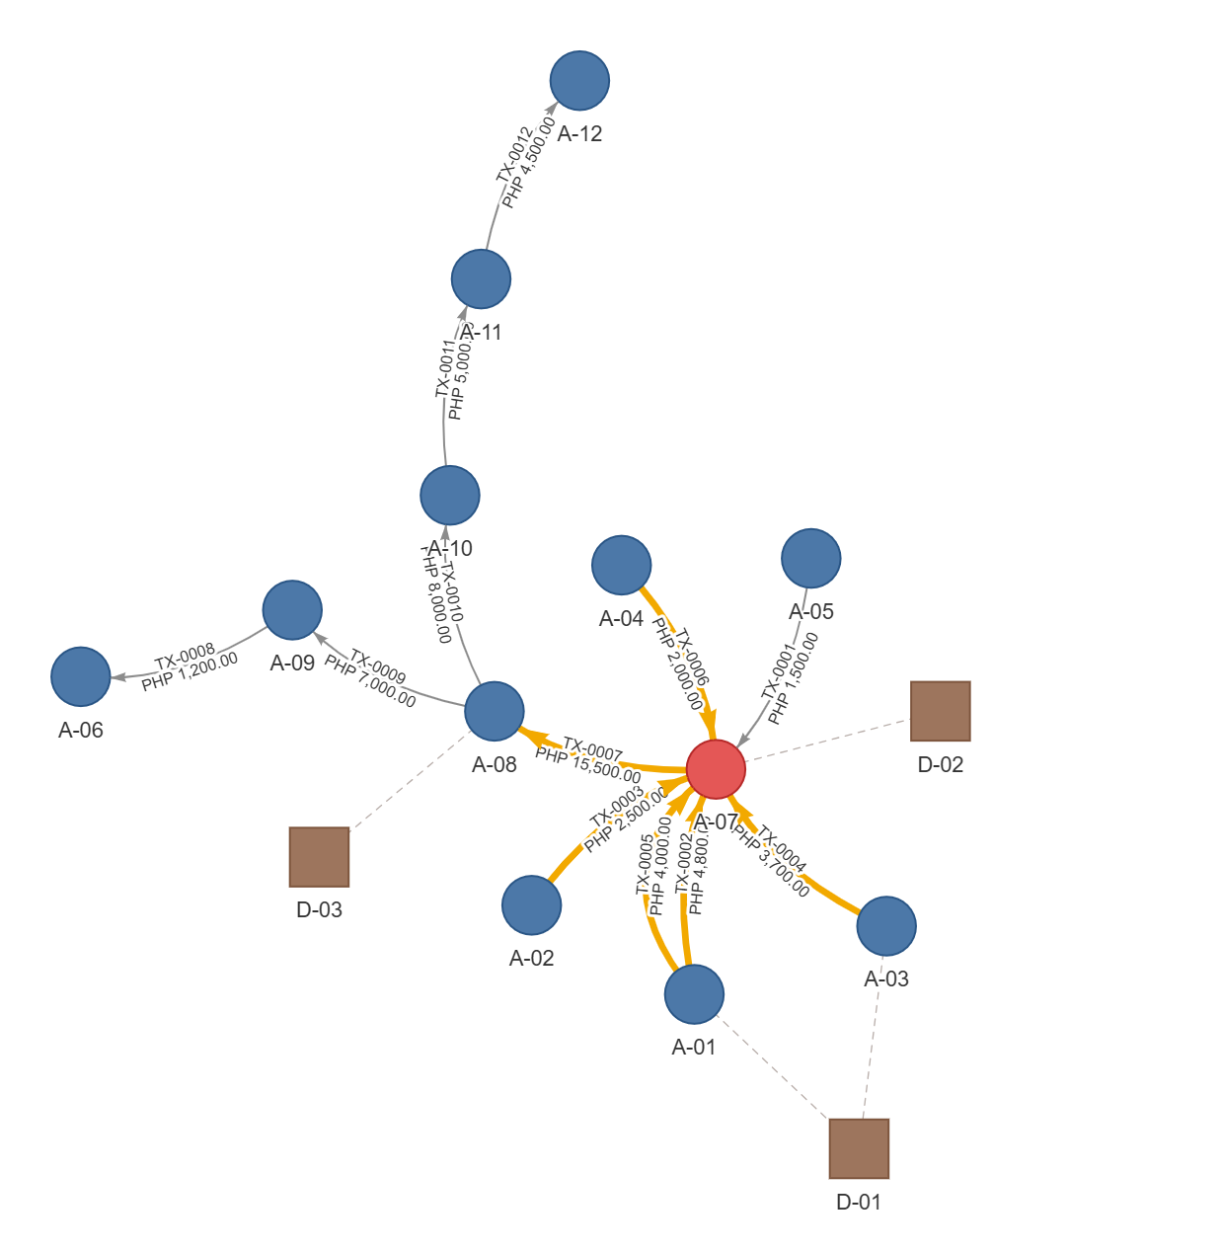
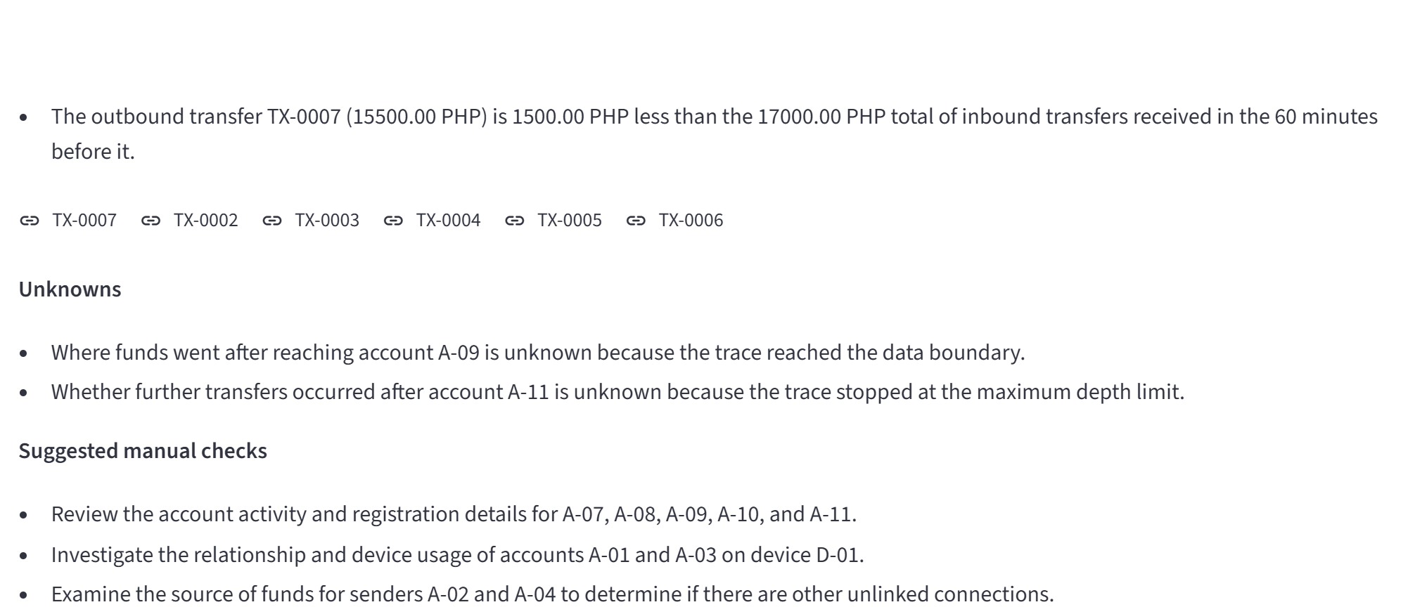
Snapshots of the prototype
Left: live brief on real graph evidence: rule flags with thresholds, computed contrasts, then Gemini's counterevidence and unknowns.
Right: clicking RULE-FWD-01 highlights the records it matched (amber).

Slide 11
Prototype Performance report/Benchmarking
3 / 3
0
5–8 s
11 / 11
cases reach the expected
conclusion on the live URL
invented citations shown
(blocked by design)
live brief, valid on the
first attempt
graph-tool checks match
expected outcomes
Case | Pattern | Expected | Live result (Gemini 3.5 Flash, real graph evidence)
C-1 | Convergence & forwarding | Pattern warrants review | Both rules flag; brief cites 4 senders, ratio 0.91, 30 min; counterevidence names A-02/A-04
C-2 | Benign shared device | Insufficient evidence | No rule matches; device D-04 shown as an observation, not as proof
C-3 | Incomplete evidence | Unknown past the boundary | Next recipient after A-22 stated as unknown; nothing guessed
Latency fix, measured: default thinking 20–28 s per brief (one 504 at the 30 s cap) → LOW thinking 3–9 s, all valid. 156 automated tests; mypy strict. No production accuracy or time-saved claims: the data is synthetic.

Slide 12
Additional Details/Future Development (if any)
1
Scale
Spanner Graph or BigQuery for bank-scale transaction graphs, replacing in-memory NetworkX.
2
Access and audit
Analyst sign-in, case-level access controls, and an audit log of every brief and citation click.
3
Validation
Back-test on the bank's labelled historical alerts, under its governance. Track analyst agreement before any accuracy claim.
4
More patterns
Cycle detection and CSV import (cut from this build); a case-scoped follow-up question with the same citation rules.
Human-led: the analyst always decides. TraceGuard prepares the evidence and the brief.

Slide 13
Provide links to your:
GitHub Public Repository
https://github.com/shieryl-ryle/traceguard
1
Demo Video Link (3 Minutes)
ADD-VIDEO-LINK-BEFORE-SUBMITTING
2
Final Product Link
https://traceguard-343683630064.asia-southeast1.run.app
3
Live app runs C-1, C-2 and C-3 end to end, including a real Gemini call. No sign-in needed.

Slide 14
Limitations and responsible AI
!
Limitations
✓
Safeguards built in
Synthetic data only: 35 accounts, 102 transfers, one currency (PHP).
No measured accuracy or time saved yet.
Fixed workflow: the model does not choose tools (stated plainly, not as autonomy).
No authentication in the prototype.
Model wording varies between runs; the validator rejects bad output rather than preventing it.
Synthetic data only; no employer or customer data (BR-001).
Every cited ID must exist in retrieved evidence (BR-002).
Numbers and flags from code, not the model (BR-003).
No accusations, probabilities or risk scores (BR-004).
Unknowns stated; similar amounts are never called the same money (BR-005).
Live vs cached output always labelled (BR-006).

Slide 15


