Slide 1
EXTENDING A MULTIMODAL PGM FOR BREAST CANCER SURVIVAL PREDICTION
CSE516 Probabilistic Graphical Models | Milestone 4 Final Presentation | Group G02
Dhanya Achari (AU2420163) Shifataj Shaikh (AU2420174) Paarth Jawaharani (AU2420056) Vishrut Patel (AU2340216)
Instructor: Prof. Dhaval Patel

Slide 2
THE PROBLEM
Rank breast cancer patients by survival risk using two views of the same tumour.
TCGA-BRCA cohort
974
95
x
Genomics
y
Histology
patients
deaths observed (9.8%)
Gene expression: molecular state of the tumour
Features from tissue slide images: tumour morphology
5
585/146/243
fixed train / val / test splits
patients per split
Output: a risk score per patient, scored with Harrell's C-index (50 = random, 100 = perfect ranking).

Slide 3
BASE PAPER: CURRENT STATE OF THE ART
Subramanian, Syeda-Mahmood and Do. Modelling-based joint embedding of histology and genomics using canonical correlation analysis for breast cancer survival prediction. Artificial Intelligence in Medicine 149:102787, 2024.
What the paper does
What we found
Learns a joint embedding with penalised CCA: sparse CCA (SCCA) and graph-regularised SCCA (GN-SCCA)
Extracts components with Hotelling (HD), projection (PD) or orthogonalised projection (OPD) deflation
Feeds the embedding to a Cox model and reports C-index
We reran the authors' code: 0.00 difference from their stored results
CCA is used only as a projection: no p(z | x), no uncertainty, no principled missing modality
68.98
best C-index: SCCA/OPD, multimodal

Slide 4
MODEL, LEARNING AND INFERENCE
A generative latent-variable model in place of a projection

Slide 5
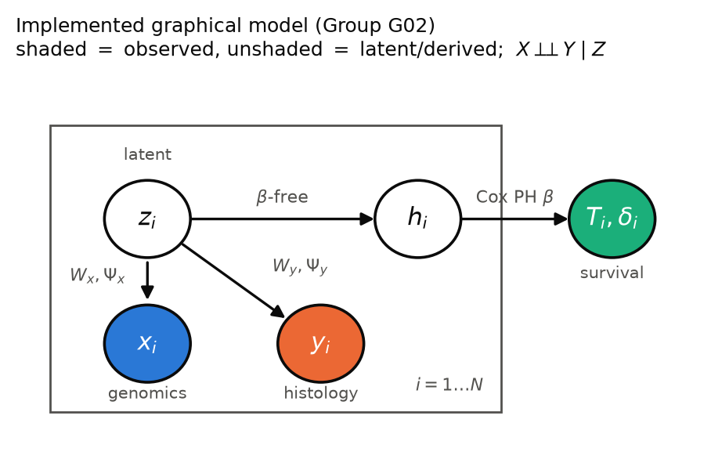
OUR MODEL: PROBABILISTIC CCA
Generative story
z ~ N(0, Id)
x | z ~ N(Wx z + μx, Ψx)
y | z ~ N(Wy z + μy, Ψy)
z: shared latent tumour state (d dimensions)
Block-diagonal Ψ encodes X ⊥ Y | Z: all cross-modal dependence flows through z
Survival enters downstream: Cox PH on the posterior mean of z

Slide 6
LEARNING: TWO ROUTES TO THE MLE
CCA-MLE
EM
closed form (Bach and Jordan, 2005)
our extension
Canonical directions U and correlations P from the sample covariances
Wₓ = ΣₓₓUₓMₓ, Ψₓ = Σₓₓ − WₓWₓᵀ (same for y)
Ridge 10⁻² on Σₓₓ, Σᵧᵧ; one pass, no iterations
E-step: E[z | x, y] and E[zzᵀ | x, y] from the exact posterior
M-step: W = (Σ õ E[z]ᵀ)(Σ E[zzᵀ])⁻¹, Ψ re-estimated and kept block-diagonal
Random init (seed + fold), at most 300 iterations, tolerance 10⁻⁷
Latent dimension d is chosen on the validation split only: CCA-MLE d = 30, EM d = 50 (grid 5, 10, 20, 30, 50).

Slide 7
INFERENCE: EXACT GAUSSIAN POSTERIORS
p(z | x, y)
p(z | x)
p(z | y)
both modalities
genomics only
histology only
S = (I + WᵀΨ⁻¹W)⁻¹
m = S WᵀΨ⁻¹(o − μ)
Sₓ = (I + WₓᵀΨₓ⁻¹Wₓ)⁻¹
mₓ = SₓWₓᵀΨₓ⁻¹(x − μₓ)
Sᵧ = (I + WᵧᵀΨᵧ⁻¹Wᵧ)⁻¹
mᵧ = SᵧWᵧᵀΨᵧ⁻¹(y − μᵧ)
Posterior mean m (= MAP)
Cox PH, L2 penalty 0.1
Risk score βᵀm
C-index on test split
A missing modality just drops its block from W and Ψ: no imputation, and the posterior covariance widens to show the lost information.

Slide 8
EXPERIMENTAL SETUP
1
Data
TCGA-BRCA, 974 patients, 95 deaths; the authors' 5 fixed splits (585 / 146 / 243)
2
Input
Paper's own 50 genomic + 50 imaging principal components, standardised on train
3
Model selection
d and all settings chosen on validation; test split used only for reporting
4
Repeats
5 seeds per split, averaged per split; mean ± SD (n − 1) over 5 splits
5
Baselines
Paper PCA, SCCA and GN-SCCA rerun with authors' code; non-PGM PCA with our Cox
6
Statistics
Paired t-test and Wilcoxon over splits, 95% CI of the paired difference

Slide 9
RESULTS
Discrimination, statistics, probability quality, robustness and cost

Slide 10
MULTIMODAL C-INDEX VS THE PAPER
Reading the chart
Our best model (CCA-MLE, diagonal Ψ) is 1.01 points behind SCCA/OPD; paired p = 0.71
Our block-Ψ models sit with the paper's PCA and GN-SCCA rows
Mean of 5 splits; SD is about 7 points for every method (paper's SD convention gives 68.98 ± 6.16)

Slide 11
WHICH MODALITY CARRIES THE SIGNAL?
Method | Multimodal p(z|x,y) | Genomics p(z|x) | Histology p(z|y)
CCA-MLE, block Ψ | 65.43 ± 7.36 | 67.31 ± 9.63 | 57.34 ± 7.22
EM, block Ψ | 63.34 ± 7.53 | 69.13 ± 8.95 | 56.74 ± 9.50
CCA-MLE, diagonal Ψ | 67.97 ± 7.56 | 71.05 ± 9.62 | 56.93 ± 9.82
EM, diagonal Ψ | 64.39 ± 3.23 | 68.47 ± 9.63 | 62.56 ± 8.41
Non-PGM PCA + Cox | 66.08 ± 7.79 | 67.82 ± 8.25 | 57.64 ± 9.49
Paper SCCA/OPD | 68.98 ± 6.89 | 70.03 ± 8.38 | 55.86 ± 11.26
71.05
~57
x alone
best genomics-only score of any method: CCA-MLE, diagonal Ψ
histology alone reaches only about 57 for most methods
beats x + y in every row: adding histology lowers the C-index

Slide 12
ARE THE DIFFERENCES REAL?
Paired comparison (multimodal) | Mean diff | 95% CI | t-test p | Wilcoxon p | Wins
CCA-MLE − EM | +2.10 | [−4.70, 8.90] | 0.44 | 0.44 | 4 / 1
CCA-MLE − non-PGM PCA | −0.65 | [−10.73, 9.43] | 0.87 | 0.63 | 4 / 1
EM − non-PGM PCA | −2.75 | [−7.53, 2.04] | 0.19 | 0.31 | 1 / 4
CCA-MLE − paper SCCA/OPD | −3.55 | [−13.36, 6.26] | 0.37 | 0.44 | 2 / 3
CCA-MLE diagonal − paper SCCA/OPD | −1.01 | [−8.07, 6.06] | 0.71 | 1.00 | 3 / 2
CCA-MLE diagonal − CCA-MLE block | +2.54 | [−1.86, 6.94] | 0.18 | 0.31 | 4 / 1
Every 95% CI contains zero. With only 5 splits the smallest two-sided Wilcoxon p is 0.0625, so no comparison can pass p < 0.05 with that test. Our models are statistically tied with the paper.

Slide 13
PROBABILITY QUALITY AND CALIBRATION
Method | IBS | Brier 3 y | Brier 5 y | ECE 5 y
CCA-MLE | 0.0461 | 0.0814 | 0.1514 | 0.106
EM | 0.0476 | 0.0856 | 0.1631 | 0.087
CCA-MLE, diagonal | 0.0457 | 0.0803 | 0.1447 | 0.092
Non-PGM PCA | 0.0469 | 0.0832 | 0.1528 | 0.078
Lower is better for every column
Diagonal CCA-MLE has the lowest Brier and IBS
PCA is best calibrated; all gaps are small next to fold spread

Slide 14
ROBUSTNESS
Up to 25% missing costs nothing: z is inferred from the remaining modality. CCA-MLE degrades more slowly under noise (60.7 vs 53.3 at SD 1).
Training-size sweep (25 to 100%) is not monotonic: one subsample per fraction, so we treat it as noise.

Slide 15
ABLATIONS AND COMPUTATIONAL COST
Setting (multimodal C-index) | CCA-MLE | EM
Reference: block Ψ, ridge 10⁻², Cox 0.1 | 65.43 | 63.34
Diagonal Ψ | 67.97 | 64.39
Ridge 10⁻¹ / 10⁻³ | 65.78 / 64.34 | 63.34 / 63.34
Cox penalty 0.01 / 1.0 | 65.50 / 64.35 | 62.21 / 62.32
EM initialised from CCA-MLE | – | 62.31
Cost per fit (paper PCA input)
0.003 s
0.14 s
CCA-MLE, one pass
EM, about 92 iterations
157.1
158.7
CCA-MLE test NLL / patient
EM test NLL / patient
Only the noise structure moves the result by more than a point; ridge and Cox penalty are flat.
Diagonal-Ψ EM hits the 300-iteration cap on every split.

Slide 16
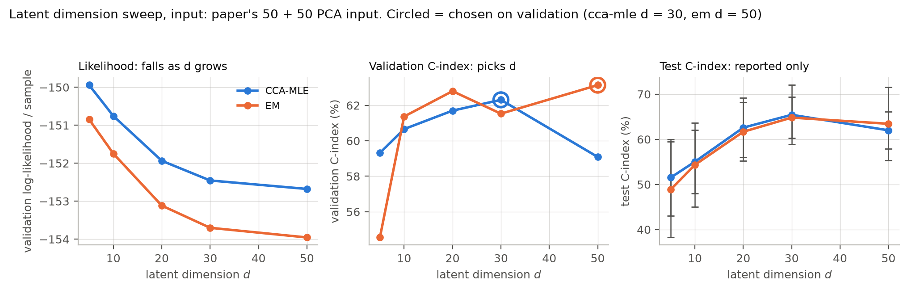
CHOOSING THE LATENT DIMENSION
Validation likelihood falls as d grows, so d is picked by validation C-index: d = 30 for CCA-MLE, d = 50 for EM. Test C-index was never used to choose.

Slide 17
WHERE WE STAND
68.98
67.97
p = 0.71
Paper SCCA/OPD, best published configuration
Ours: CCA-MLE with diagonal Ψ
paired difference −1.01, 95% CI [−8.07, 6.06]
What the PGM adds that the paper's projections cannot
1
Exact p(z | x) and p(z | y) with a covariance, so every risk score carries its uncertainty
2
Missing modality handled by marginalisation: no retraining, no imputation
3
A likelihood: models compared on held-out NLL, d chosen on principled grounds
4
Same accuracy class as the state of the art at a fraction of a second per fit

Slide 18
LIMITATIONS AND FUTURE WORK
Limitations
Future work
5 splits and 95 events give low statistical power
Two-stage pipeline: survival is not a node in the graph
Diagonal Ψ reuses d from the block-Ψ sweep; its EM hits the iteration cap
Paper SCCA uses the full feature sets, ours the 50 + 50 PCA input
Training-size sweep uses one subsample per fraction
Put survival inside the PGM and learn z and β jointly
Repeated cross-validation and an external cohort for power
Tune d separately for diagonal Ψ
Fit on the full genomic and histology feature sets
Non-linear or sparse PCCA to close the remaining gap

Slide 19
REFERENCES AND REPRODUCIBILITY
[1] V. Subramanian, T. Syeda-Mahmood, M. N. Do. Modelling-based joint embedding of histology and genomics using CCA for breast cancer survival prediction. Artif. Intell. Med. 149:102787, 2024.
[2] F. R. Bach, M. I. Jordan. A probabilistic interpretation of canonical correlation analysis. Tech. Rep. 688, UC Berkeley, 2005.
[3] A. P. Dempster, N. M. Laird, D. B. Rubin. Maximum likelihood from incomplete data via the EM algorithm. J. R. Stat. Soc. B 39(1):1–38, 1977.
[4] D. R. Cox. Regression models and life-tables. J. R. Stat. Soc. B 34(2):187–220, 1972.
[5] F. E. Harrell et al. Evaluating the yield of medical tests. JAMA 247(18):2543–2546, 1982.
[6] E. Graf et al. Assessment and comparison of prognostic classification schemes for survival data. Stat. Med. 18:2529–2545, 1999.
Reproduce everything
github.com/shifaa174/CSE-516--PGM_Healthcare_brca
From the repository root:
python M4_G02/Code/run_all.py .
Regenerates baselines, 5-seed results, ablations, robustness, statistics, probability quality and every figure in M4_G02/Results.

Slide 20
THANK YOU
Group G02 | CSE516 Probabilistic Graphical Models | Ahmedabad University

