Slide 1

ONLINE SPEAKING CLASS • 2 PLAYERS
✦
SHOPPING,
BUT MAKE IT
ENGLISH.
Speak. Choose. Pay. Repeat.
Learn the phrases. Build the conversation. Own the roleplay.
✦

Slide 2
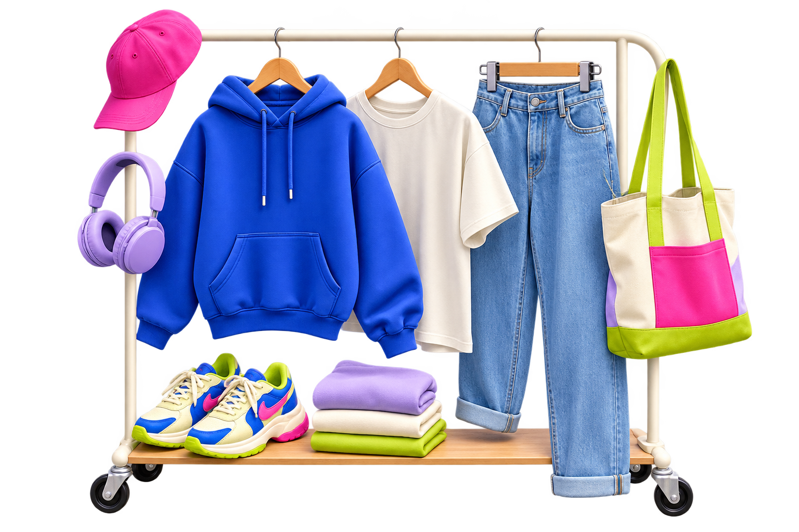
SHOPPING CONVERSATION
WHAT'S IN YOUR CART?
Pick 3 things you would buy today.
Then explain your choices.
I'D BUY...
BECAUSE...
MY BUDGET IS...
02

Slide 3
SHOPPING CONVERSATION
ONE SHOPPING TRIP, FOUR MOVES
01
02
03
04
FIND
ASK
DECIDE
PAY
→
→
→
I'm looking for...
Do you have... ?
I'll take it.
Can I pay by card?
Your goal: keep the conversation moving.
No one-word answers.
03

Slide 4
SHOPPING CONVERSATION
CUSTOMER STARTER PACK
Start
Decide
Hi, I'm looking for a hoodie.
Excuse me, do you have this in blue?
Can I try it on?
It fits well. I'll take it.
Ask
Pay
How much is it?
Do you have a smaller size?
Can I pay by card?
Could I have a receipt, please?
POLITE POWER-UP: add “please,” “excuse me,” or “could I...?”
04

Slide 5
SHOPPING CONVERSATION
SHOP ASSISTANT STARTER PACK
OPEN
Hi! Can I help you?
CHECK
What size are you?
OFFER
Would you like to try it on?
SOLVE
Let me check if we have another color.
CLOSE
Of course. Here's your receipt.
05

Slide 6
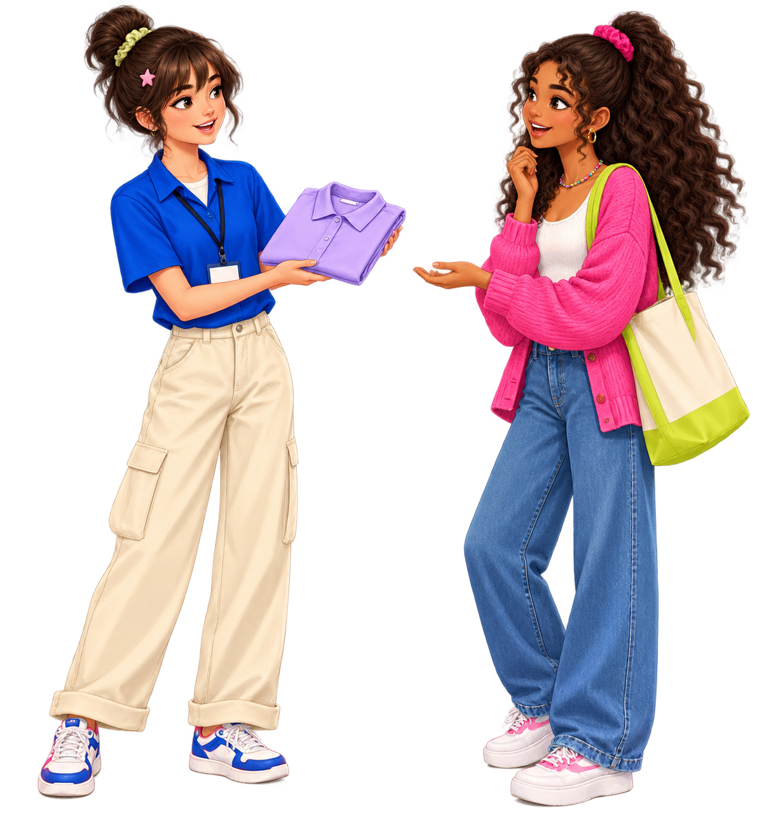
SHOPPING CONVERSATION
WATCH THE CONVERSATION CLICK
ASSISTANT
Hi! Can I help you?
CUSTOMER
Yes, I'm looking for a hoodie.
ASSISTANT
What size are you?
CUSTOMER
Medium. Do you have it in blue?
LISTEN FOR: item • size • color
06

Slide 7
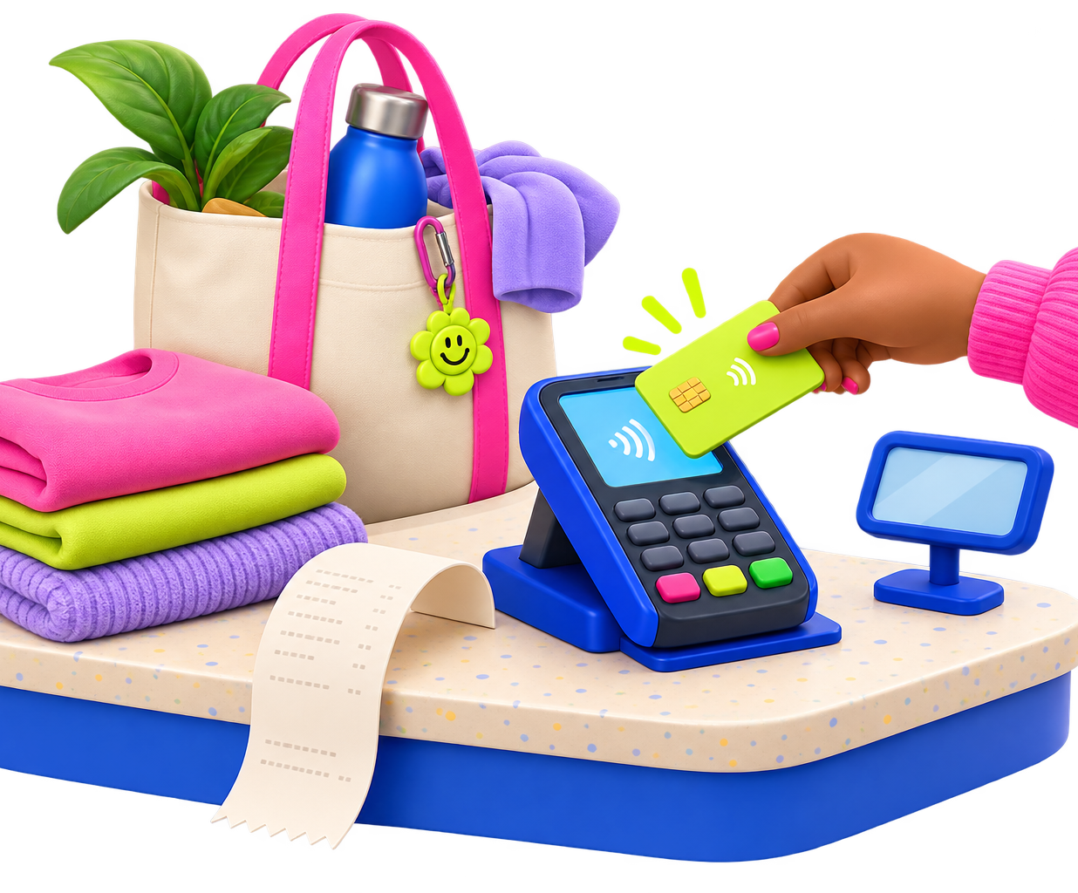
SHOPPING CONVERSATION
FROM FITTING ROOM TO CHECKOUT
CUSTOMER
It fits well. How much is it?
ASSISTANT
It's 350,000 rupiah.
CUSTOMER
Great, I'll take it. Can I pay by card?
ASSISTANT
Of course. Here's your receipt.
Natural closing: “Thank you. Have a nice day!”
07

Slide 8
SHOPPING CONVERSATION
BUILD IT. DON'T READ IT.
Complete the conversation with your own ideas.
CUSTOMER
Hi, I'm looking for ________.
Sure! What ________?
ADD A
SURPRISE
ASSISTANT
CUSTOMER
________, please. Do you have it in ________?
ASSISTANT
Yes. Would you like to ________?
Wrong size?
No stock?
Too expensive?
CUSTOMER
Yes. How much ________?
ASSISTANT
It's ________.
CUSTOMER
Great. I'll ________.
08

Slide 9
SHOPPING CONVERSATION
ROUND 1: THE SNEAKER DROP
STUDENT A
STUDENT B
CUSTOMER
ASSISTANT
You want sneakers.
• Size: 39
• Preferred color: blue
• Budget: Rp500,000
• Ask about a discount
Your shop has:
• Blue: size 38 only
• White: size 39
• Price: Rp475,000
• No discount today
Keep going until you agree on a solution.
09

Slide 10
SHOPPING CONVERSATION
FINAL BOSS: SWAP ROLES
Student B = customer
✦
Find a hoodie • size M • green • under Rp300,000
SPEAK
WITHOUT
THE SCRIPT
Student A = shop assistant
Only pink is available • Rp325,000 • offer another item
WIN THE ROUND
✓ Use 5 shopping phrases
✓ Ask 2 follow-up questions
✓ Solve the problem naturally
✦
Ready? Open the shop!
10

