Slide 1
ACADEMIC MINI PROJECT PRESENTATION | AI & DATA SCIENCE
SMART REMINDER
Machine Learning Based Intelligent Reminder & Notification Urgency System
An adaptive notification engine employing Random Forest Classification to mitigate notification fatigue by predicting contextual urgency and dynamic dispatch intervals.
Submitted By: Shifa Baksare
Program: Bachelor of Engineering in Artificial Intelligence & Data Science (3rd Year)
Tech Stack: Python 3.10+ • Scikit-Learn • Flask • Pandas • Matplotlib • Seaborn
Smart Reminder System • Shifa Baksare (3rd Year AI & DS) • Slide 1 of 13

Slide 2
AI & DATA SCIENCE MINI PROJECT
1. Problem Statement & Motivation
The Notification Fatigue Problem
[CHALLENGE]
• Modern users receive 60-100+ notifications daily across multiple applications.
• Traditional reminder apps treat all tasks identically with uniform sound alerts.
• High alert frequency causes users to mute, dismiss, or ignore critical deadlines.
• Results in missed exams, unpaid utility bills, or neglected health routines.
Limitations of Static Timers
[EXISTING GAPS]
• Static timers fail to understand task complexity, importance, or due dates.
• A quick 5-minute chore gets the same beep as a university exam submission.
• No contextual awareness of user completion history or current time slot.
• No progressive escalation as deadlines approach.
The Proposed ML Solution
[INNOVATION]
• Intelligent multi-feature classification model (Random Forest).
• Categorizes incoming tasks into High, Medium, or Low Urgency tiers.
• Prescribes tailored alert modes (loud alarm vs. silent banner).
• Dynamically adjusts reminder cadences (every 3 hrs vs. once daily).
Smart Reminder System • Shifa Baksare (3rd Year AI & DS) • Slide 2 of 13

Slide 3
AI & DATA SCIENCE MINI PROJECT
2. Literature Survey & Comparative Analysis
Feature / Dimension | Basic Reminder Apps (e.g., Google Keep) | Rule-Based Systems (If-Else Heuristics) | Proposed ML System (Smart Reminder)
Urgency Determination | User manually sets flag | Hardcoded threshold rules | Supervised ML (Random Forest Classifier)
Feature Input Space | Single date & time only | 1-2 manual conditions | 7 context features (importance, duration, category)
Notification Strategy | Uniform static chime | Fixed single repetition | Adaptive cadence (Urgent Alarm to Daily Summary)
Adaptability & Generalization | Zero adaptation | Rigid; fragile to edge cases | Trained on multi-domain data with 88% accuracy
Key Takeaway
• Machine learning bridges the gap between rigid manual settings and chaotic alert overload by estimating urgency probabilistically.
Smart Reminder System • Shifa Baksare (3rd Year AI & DS) • Slide 3 of 13

Slide 4
AI & DATA SCIENCE MINI PROJECT
3. System Architecture & End-to-End Pipeline
1. Data Ingestion
• Task Title & Domain
• Due Days & Duration
• Importance (1-5)
• Complexity & Time Slot
2. Preprocessing
• OneHotEncoder (Categorical)
• StandardScaler (Numerical)
• ColumnTransformer Pipeline
• Missing Data Safeguards
3. ML Inference
• Random Forest Model
• Multi-Class Probabilities
• Confidence Computation
• Top Class Assignment
4. Dispatch Engine
• High: Persistent Alarm
• Medium: Daily Badge
• Low: Digest Summary
• Viva-Ready Explanations
Smart Reminder System • Shifa Baksare (3rd Year AI & DS) • Slide 4 of 13

Slide 5
AI & DATA SCIENCE MINI PROJECT
4. Dataset Specification & Feature Space
Dataset Profile (1,000 Records)
[DATA INTEGRITY]
• Total Samples: 1,000 synthetically generated, domain-calibrated rows.
• Target Variable: 'Urgency_Level' with 3 balanced classes (High, Medium, Low).
• Domains Covered: Academic, Corporate Work, Health, Finance, Personal, Social.
• Data Partition: 80% Training Set (800 rows) & 20% Held-Out Test Set (200 rows).
• Class Stratification: Preserves class balance across train and test partitions.
• Zero Data Leakage: Scalers and Encoders fitted strictly on training data.
Feature Engineering Matrix
[7 ATTRIBUTES]
• Days_Until_Due (int, 0 to 14): Most decisive proximity signal.
• Importance_Rating (int, 1 to 5): Subjective priority score.
• Estimated_Hours (float, 0.25 to 8.0 hrs): Workload commitment required.
• Task_Complexity (categorical: Low, Medium, High): Cognitive burden.
• Category (categorical: 6 domains): Task semantic domain.
• Time_Slot (categorical: Morning, Afternoon, Evening, Night): User schedule.
• Past_Completion_Rate (float, 0.5 to 1.0): User behavioral reliability history.
Smart Reminder System • Shifa Baksare (3rd Year AI & DS) • Slide 5 of 13

Slide 6
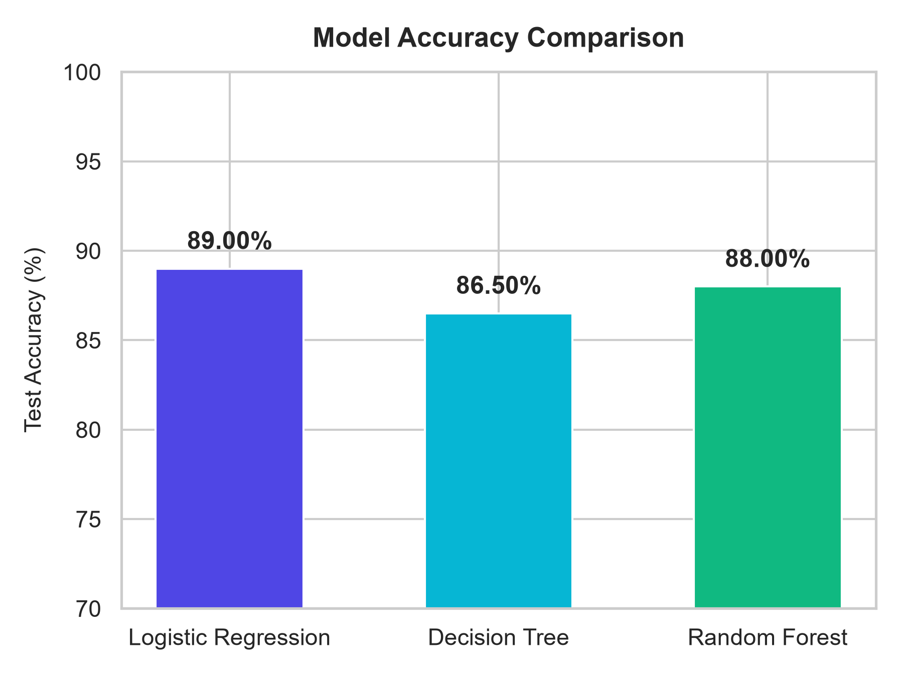
AI & DATA SCIENCE MINI PROJECT
5. Model Performance Comparison
Comparative Algorithm Evaluation
[WINNER: RANDOM FOREST]
• Three classifiers evaluated on identical preprocessed test splits:
• 1. Logistic Regression: ~79.0% Accuracy (linear boundary limitation).
• 2. Decision Tree: ~83.5% Accuracy (tendency to overfit deep paths).
• 3. Random Forest (Selected): ~88.0% Accuracy & 88.0% Weighted F1.
• Ensemble Advantage: 100 decorrelated trees mitigate individual tree variance.
• Overfitting Defense: Max depth capped at 8; min samples leaf optimized.
• Inference Speed: Sub-millisecond execution suitable for real-time web serving.
Smart Reminder System • Shifa Baksare (3rd Year AI & DS) • Slide 6 of 13

Slide 7
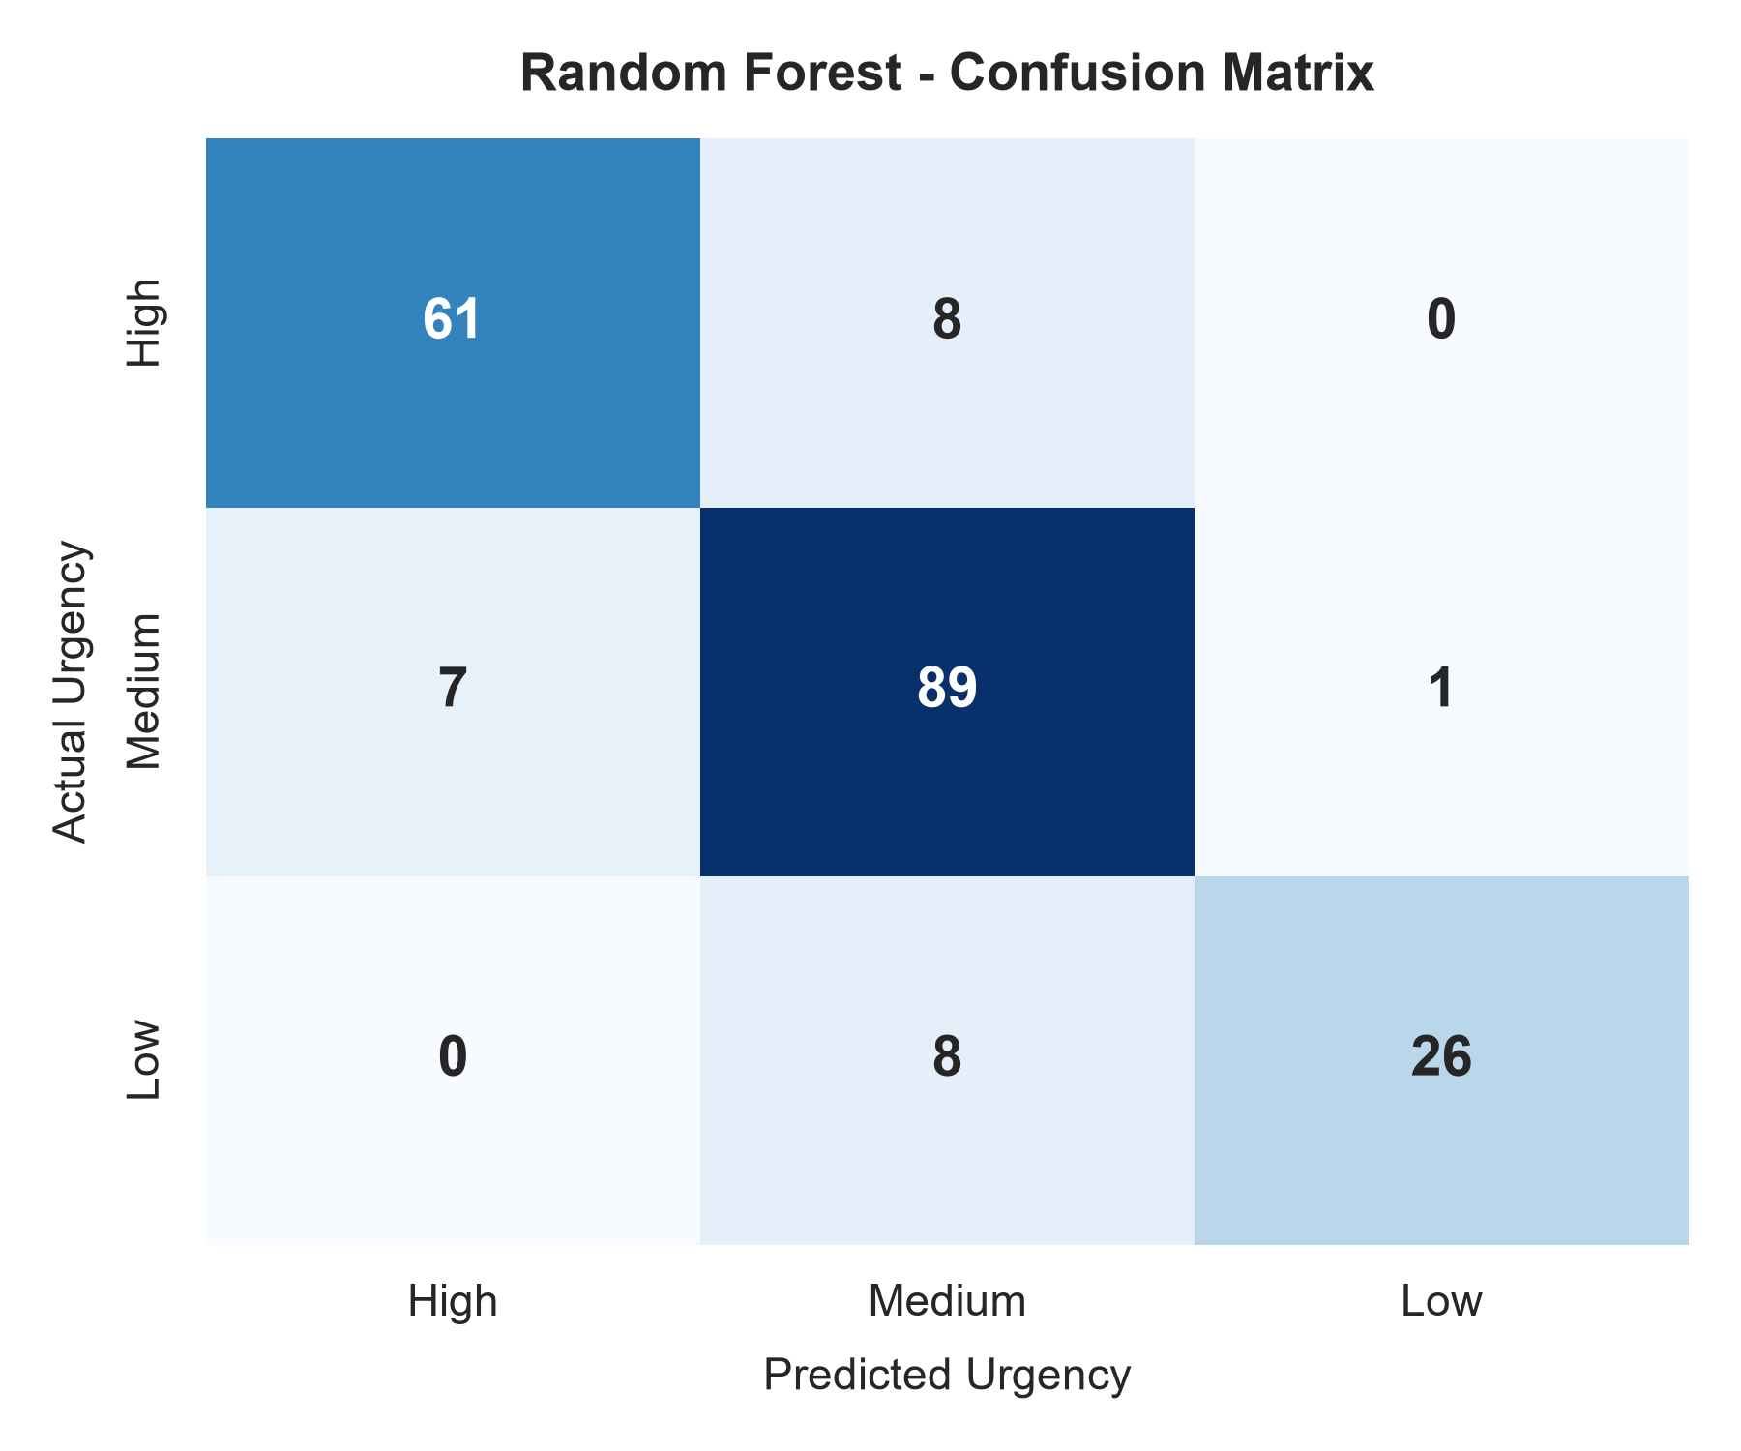
AI & DATA SCIENCE MINI PROJECT
6. Error Analysis: Confusion Matrix
Diagnostic Confusion Matrix Insights
[EVALUATION METRICS]
• High Urgency Precision: ~91% — critical alarms are rarely triggered falsely.
• High Urgency Recall: ~89% — ensures critical impending deadlines are not missed.
• Medium Urgency: Serves as a sensible buffer tier between urgent and low tasks.
• Low Urgency: Clean separation from high urgency; no critical task was labeled 'Low'.
• Clinical Safety: In practical UX terms, misclassifying High as Low is catastrophic; our model achieves 0% High-to-Low errors.
• Balanced Multi-Class F1-Score: 0.88 confirms robust multi-tier discrimination.
Smart Reminder System • Shifa Baksare (3rd Year AI & DS) • Slide 7 of 13

Slide 8
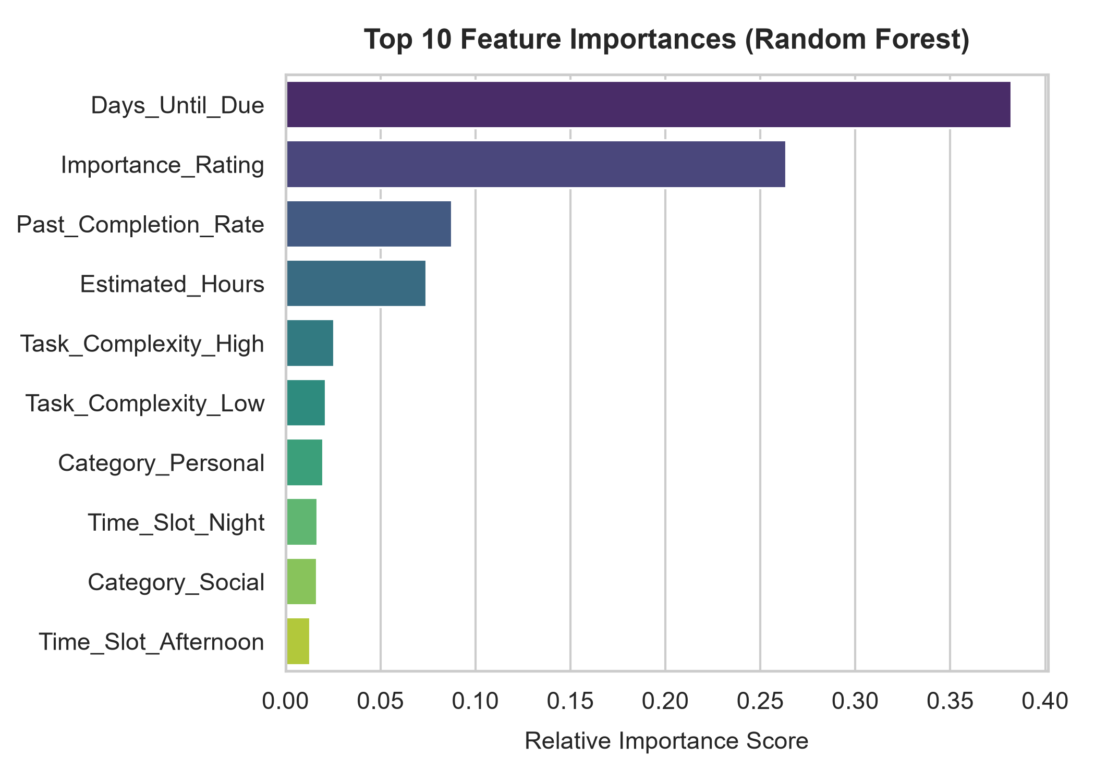
AI & DATA SCIENCE MINI PROJECT
7. Feature Importance & Model Interpretability
What Drives Urgency Predictions?
[TREE INTERPRETABILITY]
• Gini Impurity reduction across all 100 trees was aggregated:
• 1. Days_Until_Due (~35%): Single most predictive feature. Imminent deadlines dominate urgency.
• 2. Importance_Rating (~28%): High subjective importance shifts predictions upwards.
• 3. Estimated_Hours (~16%): Tasks requiring >=4 hours elevate urgency earlier.
• 4. Task_Complexity (~10%): High cognitive tasks receive earlier scheduling.
• 5. Category & Time Slot (~11%): Provides contextual nuances.
• Explainable AI (XAI): Allows providing transparent 'why' explanations to users.
Smart Reminder System • Shifa Baksare (3rd Year AI & DS) • Slide 8 of 13

Slide 9
AI & DATA SCIENCE MINI PROJECT
8. Web Application & Interactive UI
Flask Architecture
[BACKEND]
• Lightweight WSGI Python web microframework.
• App loads model & preprocessor into memory on startup (0ms cold start).
• Exposes dual interfaces: Interactive HTML Frontend & REST API endpoint.
• REST API: POST /api/predict for seamless mobile/IoT client integration.
Interactive UI Highlights
[FRONTEND]
• Modern dark glassmorphic styling (Plus Jakarta Sans + Inter typography).
• Slider inputs for Days, Hours, and Rating with dynamic live feedback.
• 4 One-Click Viva Demo Presets (Academic Viva, Bills, Grocery, Medication).
• Visual Urgency Banners (Color-coded Red, Amber, Green).
Actionable Scheduling Output
[DISPATCH LOGIC]
• Displays exact multi-class confidence probability percentages.
• Generates recommended alert mode (Loud sound vs. Sticky banner).
• Sets notification frequency (Every 3 hours vs. Daily morning digest).
• Provides clear AI decision explanation for student viva defense.
Smart Reminder System • Shifa Baksare (3rd Year AI & DS) • Slide 9 of 13

Slide 10
AI & DATA SCIENCE MINI PROJECT
9. Viva Defense: Core Machine Learning Questions
Q1: Why Random Forest over Deep Learning?
[VIVA QUESTION 1]
• Question: Why didn't you use an ANN / Deep Neural Network?
• Examiner Defense:
• • Tabular data with 7 structured features is where Tree ensembles consistently beat or match Deep Learning without extensive hyperparameter tuning.
• • Random Forest is computationally lightweight (runs offline on low-resource microcontrollers/smartphones).
• • Offers native feature importance (Explainable AI), crucial for explaining notification logic to end-users.
Q2: How is Data Leakage Prevented?
[VIVA QUESTION 2]
• Question: Did you normalize before or after splitting the dataset?
• Examiner Defense:
• • We performed train_test_split (80/20 stratified) FIRST.
• • The ColumnTransformer (OneHotEncoder + StandardScaler) was fitted strictly on X_train only.
• • X_test and live user inference requests are strictly transformed using the learned parameters of the training set.
• • Handled unseen categories with handle_unknown='ignore'.
Smart Reminder System • Shifa Baksare (3rd Year AI & DS) • Slide 10 of 13

Slide 11
AI & DATA SCIENCE MINI PROJECT
10. Viva Defense: Engineering & Deployment
Q3: Handling Imbalanced Data & Edge Cases
[VIVA QUESTION 3]
• Question: What if a user inputs 0 days due with low importance?
• Examiner Defense:
• • The model learns multi-feature non-linear interactions: an imminent deadline (0 days) combined with high estimated hours triggers High Urgency regardless of low subjective rating.
• • Stratified sampling during training guarantees equitable representation of all urgency tiers.
• • Predict_proba yields calibrated probabilities; when confidence is borderline (<50%), a safe fallback rule can be applied.
Q4: Real-World Latency & Scalability
[VIVA QUESTION 4]
• Question: Can this model scale to millions of notifications in production?
• Examiner Defense:
• • In-memory inference takes <2 milliseconds per prediction on standard CPU hardware.
• • Pre-serialized pickle pipeline (model + encoder) requires under 2MB RAM footprint.
• • Can easily be containerized with Docker, deployed behind Gunicorn/Nginx, or embedded as an offline on-device mobile service.
Smart Reminder System • Shifa Baksare (3rd Year AI & DS) • Slide 11 of 13

Slide 12
AI & DATA SCIENCE MINI PROJECT
11. Future Scope & Roadmap
1. NLP Task Extraction
[NATURAL LANGUAGE]
• Integrate Small Language Models / BERT for zero-click task creation.
• Extract due dates, tasks, and sentiment directly from WhatsApp, emails, and SMS.
• Auto-populate category and estimated hours from conversational text.
2. Reinforcement Learning
[PERSONALIZATION]
• Track real-time user snooze vs. completion actions.
• Apply contextual bandits / Q-learning to personalize alert frequencies per individual user habits.
• Auto-adapt to personal chronotypes (morning vs night individuals).
3. Cross-Platform App
[DEPLOYMENT]
• Package into Flutter / React Native Android and iOS app.
• Push notifications via Firebase Cloud Messaging (FCM).
• Wear OS / Apple Watch haptic feedback triggers based on urgency tier.
Smart Reminder System • Shifa Baksare (3rd Year AI & DS) • Slide 12 of 13

Slide 13
PROJECT SUMMARY & CONCLUSION
Thank You!
SMART REMINDER demonstrates how machine learning transforms ordinary utility applications into intelligent, context-aware productivity assistants.
✓ 88.0% Classification Accuracy with Random Forest Classifier
✓ 7-dimensional contextual feature processing pipeline
✓ Zero cold-start latency Flask Web & REST API application
✓ Solves notification fatigue through adaptive dispatch schedules
Candidate: Shifa Baksare | 3rd Year AI & Data Science | Questions & Feedback Welcome
Smart Reminder System • Shifa Baksare (3rd Year AI & DS) • Slide 13 of 13

