Slide 1
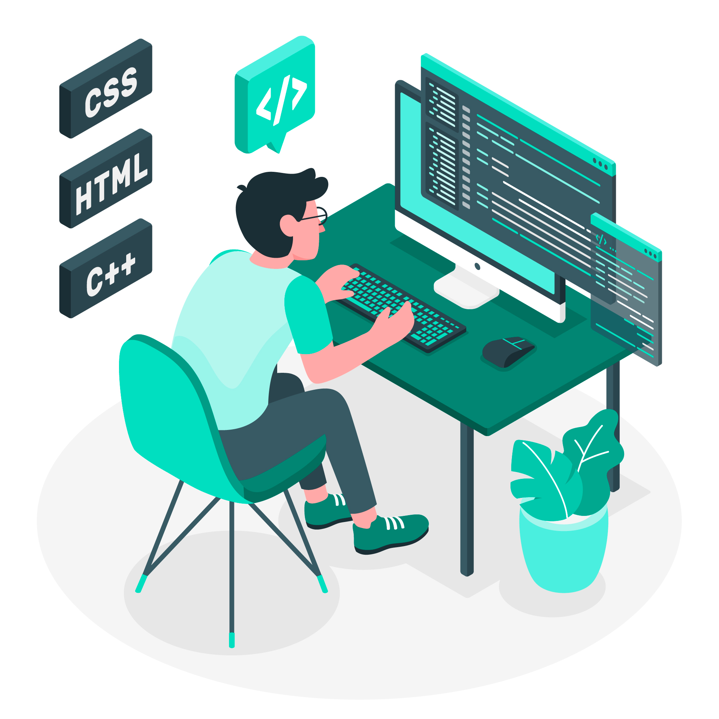
Front End Development Using HTML, CSS and JS.
Shifa Mahveen
1604-19-733-068
CSE - B

Slide 2
Agenda
1
2
3
4
5
Introduction
Skills
Implementation
Projects
Summary

Slide 3
Introduction
The Front end development internship was completed at Prabhavathi Digital Services pvt ltd, which is an IT startup company.
A team of front end developers was created where team of developers work on different modules for a given UI/UX design. As a part of this various projects were designed using skills like HTML, CSS, Bootstrap and JavaScript. The UI design was designed in Figma.

Slide 4
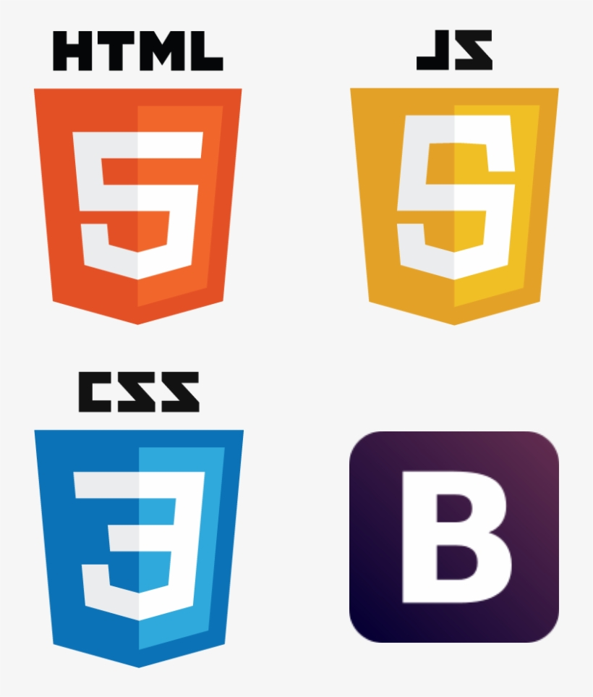
Skills
Skills required for the internship are:
HTML (Hyper Text Markup Language)
CSS (Cascading Style Sheets)
JavaScript
Bootstrap
Figma

Slide 5
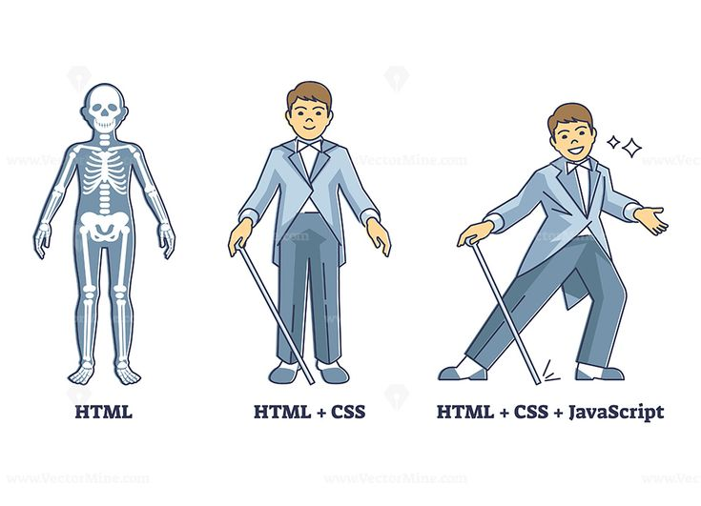
Basic Skills​
HTML
CSS
JS
HTML provides the basic structure of the web pages with no style or functionality. This include use of various tags.
CSS is linked with HTML files to design the sites. It makes use of properties and applies different styles and animations.
JS is linked with HTML files to provide functionality to the web pages to make them dynamic instead of just view only pages.

Slide 6

HTML
HTML stands for Hyper Text Markup Language
It provides structure to web pages
<!DOCTYPE Html> is the tag which tells the browser that the particular web file is HTML5 based.
Html files end with .html extension
These files make use of tags to different sections of the web page

Slide 7
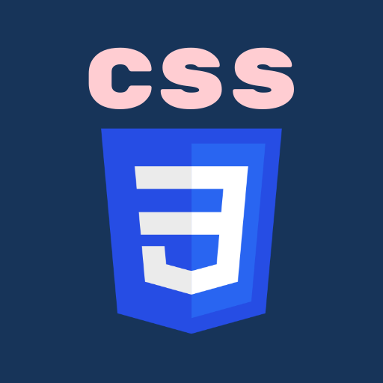
CSS
CSS stands for Cascading Style Sheets
It provides styling to the web pages
Websites without CSS are meant to be nothing or user attractive
CSS files are linked to HTML files using <style> tag either in inline or internal or external styling way
CSS files end with .css extension

Slide 8

JavaScript
JS is a drastically improving scripting language
There are a bunch of JS frameworks and libraries both for front-end and back-end
This is bases on ECMASCRIPT documentation
JS is used to make dynamic web apps or web pages
JS files end with .js extension

Slide 9

Bootstrap
Bootstrap is a free, open source HTML, CSS and JS framework for quickly building responsive websites
It supports responsive design and features predefined design templates
Bootstrap 5 is evolving with each release to better utilize CSS variables for global theme styles, individual components, and even utilities

Slide 10
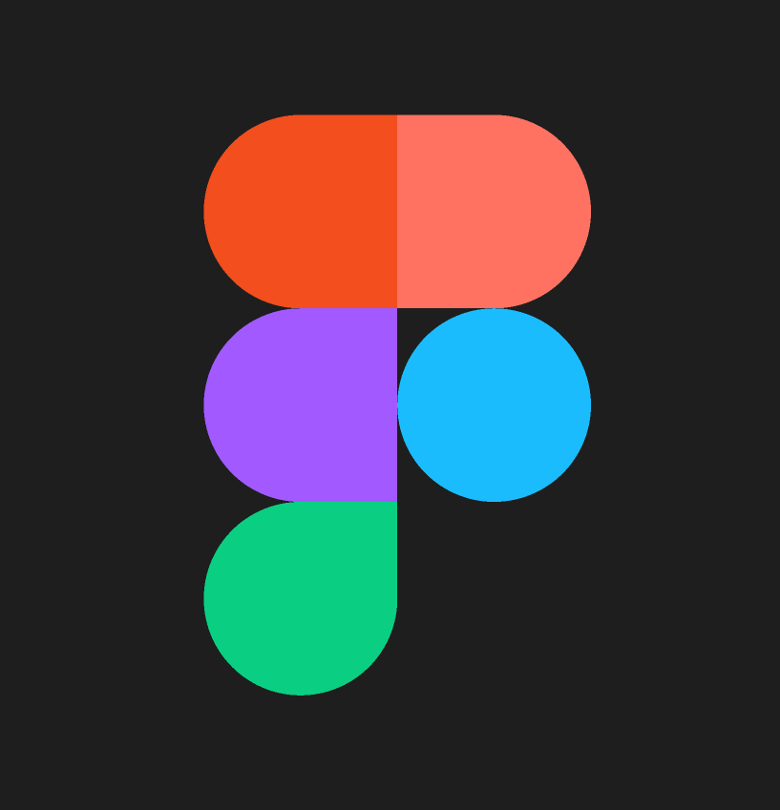
Figma
Figma is a collaborative web application for interface design
Figma's components and design system are perfectly usable
Figma is a free design tool for teams who build products together
It helps the entire product team create, test, and ship better UI/UX design which are further used in development process

Slide 11
Implementation
The UI/UX design team works and collaborates with Front-end development team and the target audience to develop a design suitable for the required purpose. This work is performed on a widely used popular web application called Figma.
Figma design is then assigned to front-end developers team to convert the given design into implemented code. The design is coded using languages like HTML, CSS, Bootstrap and JavaScript. The design is divided into modules where each member works on particular assigned modules and code them. By making the use of modularity, every module is individually implemented and then all the modules are combined to complete the whole project.

Slide 12
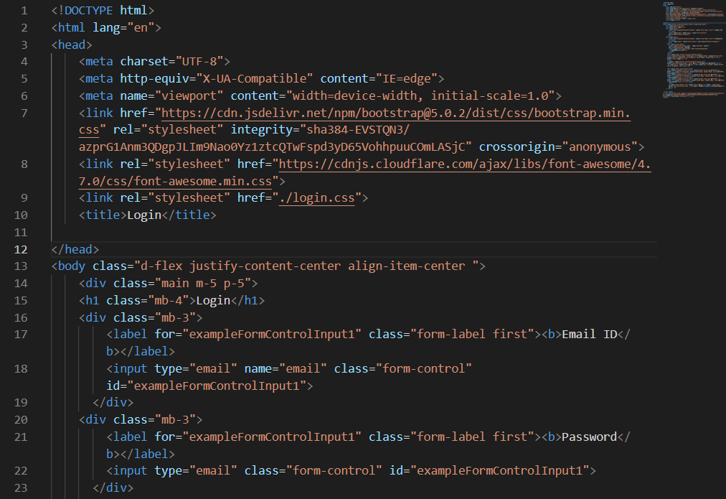
For every code implementation, a code editor is required which provides built in features to efficiently write and debug code. We used Visual Studio Code to convert our UI design to code that can be deployed to web pages.
To test whether our code correctly adheres to the given design, we use chrome developer tools to inspect and check for the correction. It is also used to find out errors and correct them. The shortcut to chrome developer tools is ctrl+shift+I.

Slide 13
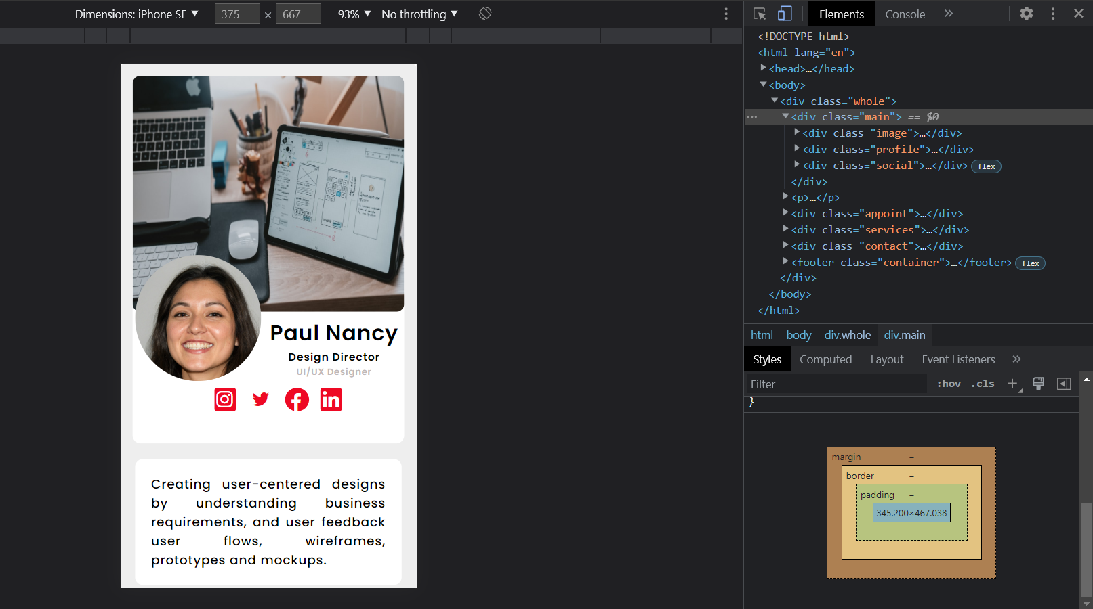
Inspection

Slide 14

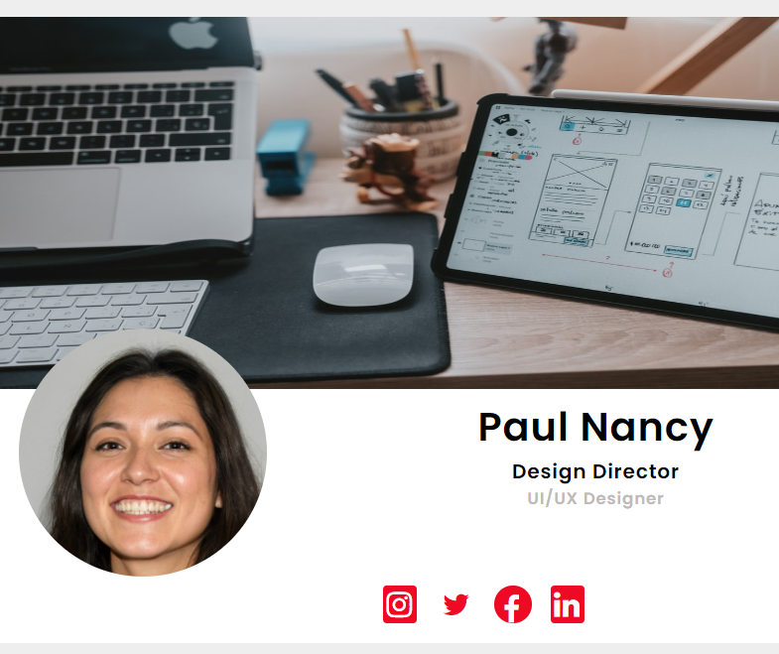
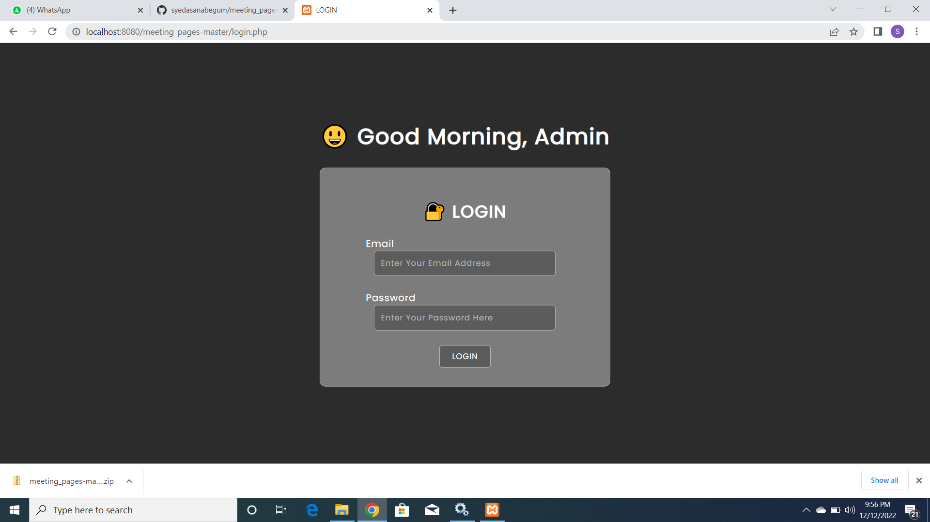


Our Projects Include
Meeting Web Application
Matrimonial Web Application
Ecommerce Website
Visiting Cards

Slide 15
What I have Learnt?
Planning
Properly deciding how the whole design process will take place
Team Work
Coordination is important while working in a team
Modularity
A very efficient way to effectively get work done by team members
Exposure to new terms and technologies
Learning new concepts and gaining experience
Time Management
Management of time is imp when design is to be delivered

Slide 16

Certificate of Completion

Slide 17

Summary
During the internship, working in a professional environment in a team built various skills. Apart from that, various technologies based on front end are learnt such as professionally designing websites, deploying and handling them.
This helped gain experience in mitigate risk to projects, capture knowledge and innovation, minimize project failure, improved communication skills etc.

Slide 18
Thank you
Shifa Mahveen
1604-19-733-068
CSE - B

