Slide 1
Megatron-LM

Slide 2
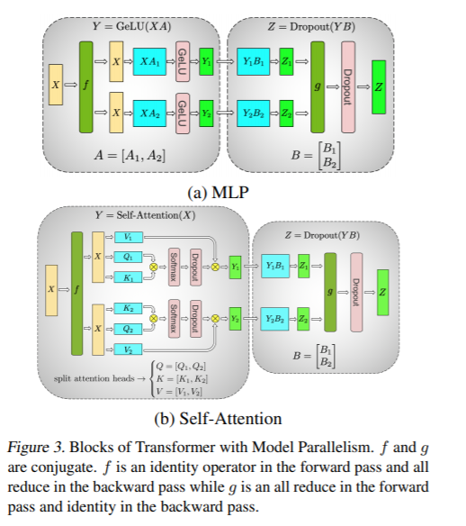
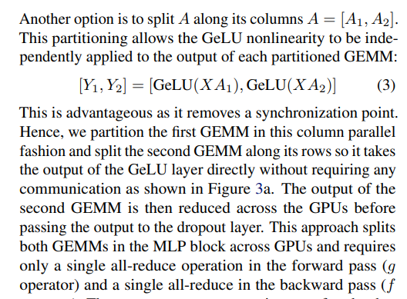
tensor parallel
https://arxiv.org/pdf/1909.08053.pdf

Slide 3
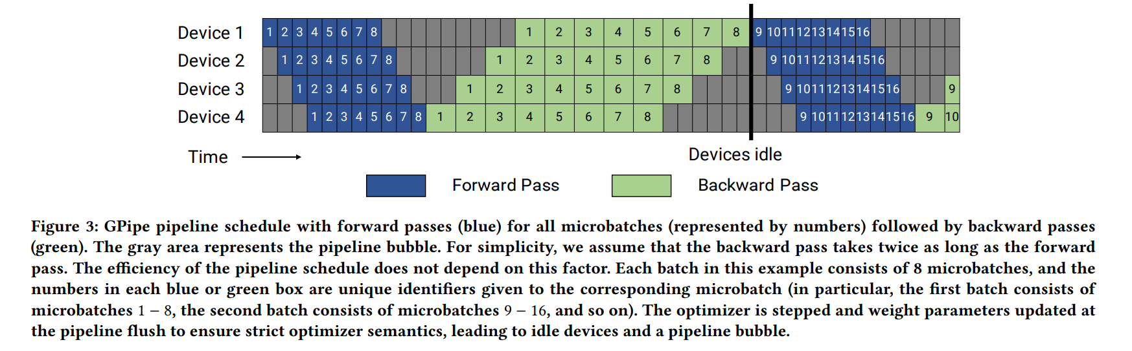
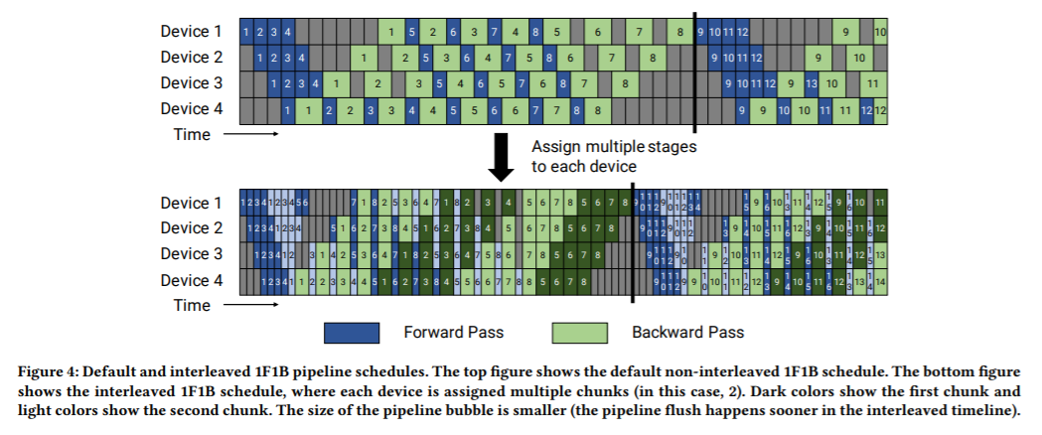
pipeline parallel

Slide 4
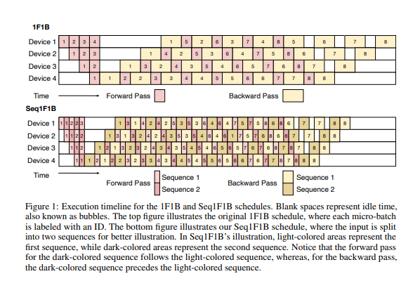
Seq1F1B: (not in Megatron-LM) Efficient Sequence-Level Pipeline Parallelism
https://arxiv.org/pdf/2406.03488

Slide 5
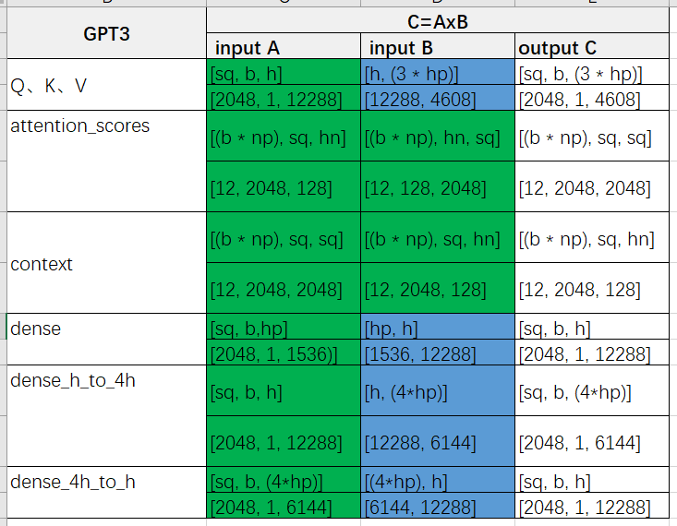
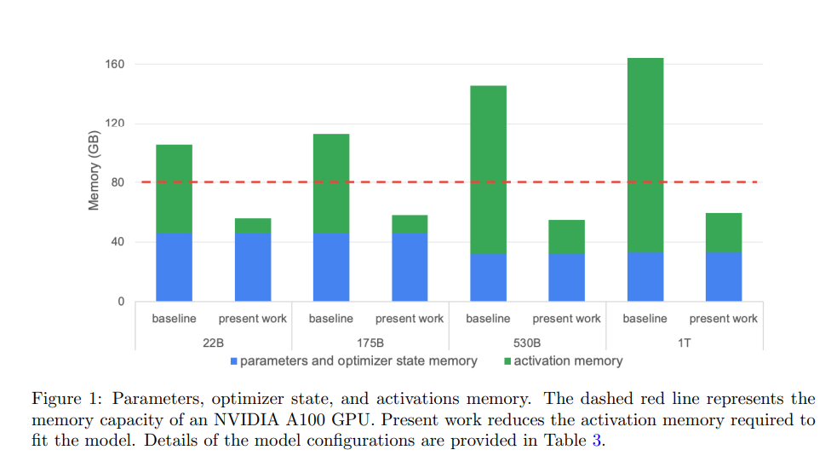
Reducing Activation Recomputation

Slide 6
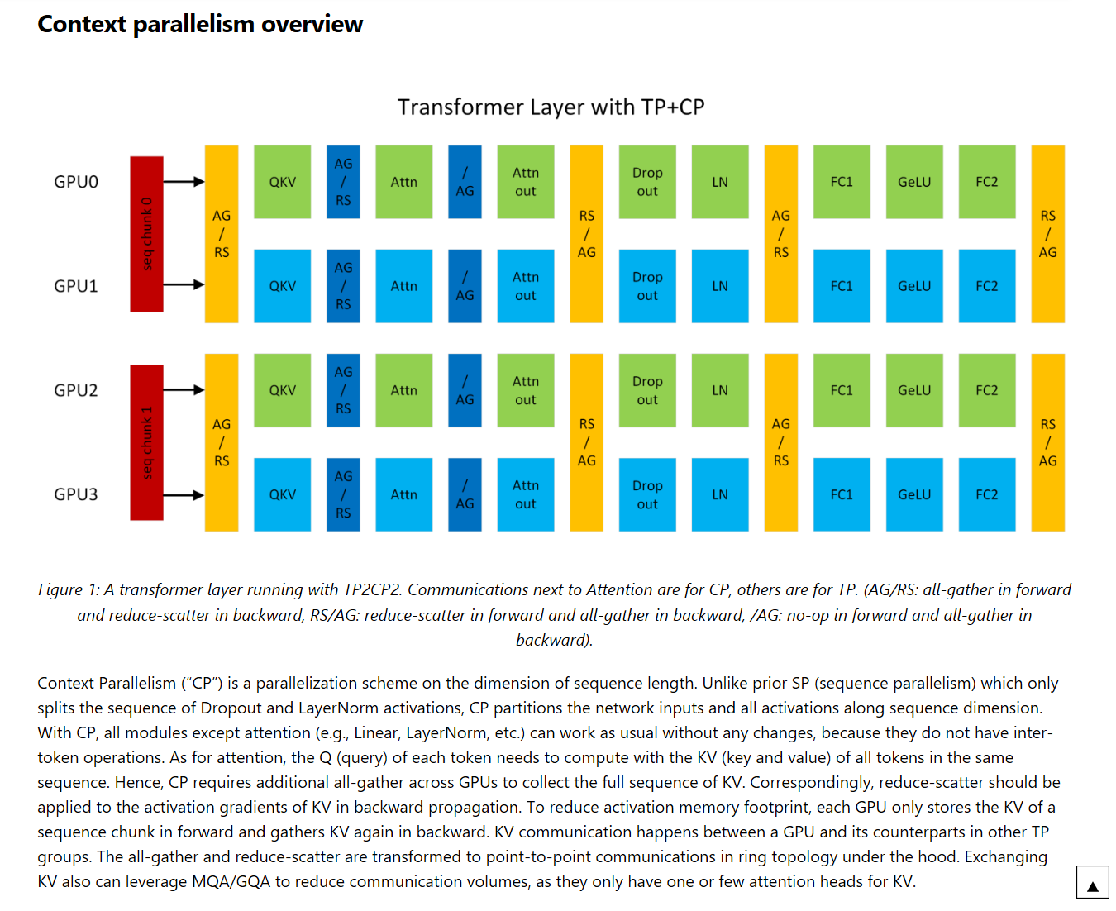
https://docs.nvidia.com/megatron-core/developer-guide/latest/api-guide/context_parallel.html#context-parallelism-overview

Slide 7
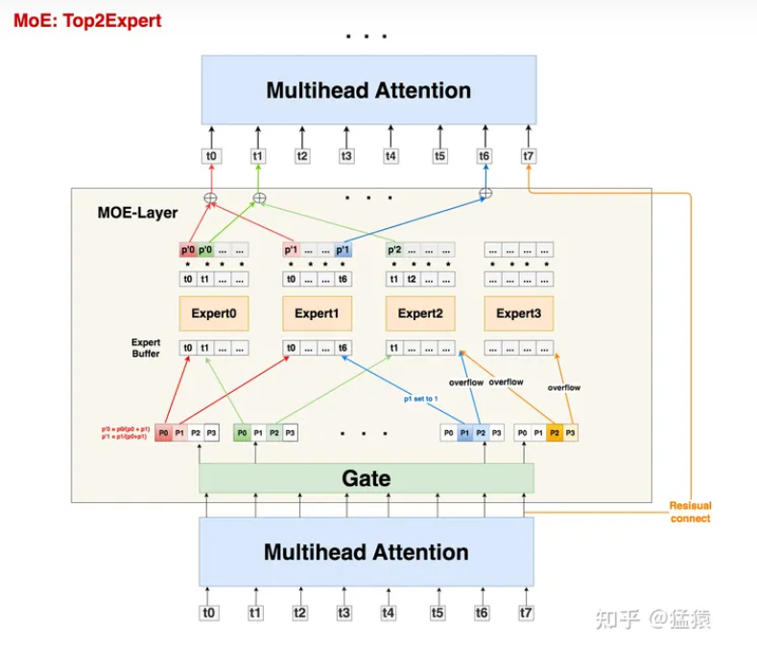
https://zhuanlan.zhihu.com/p/681154742

Slide 9
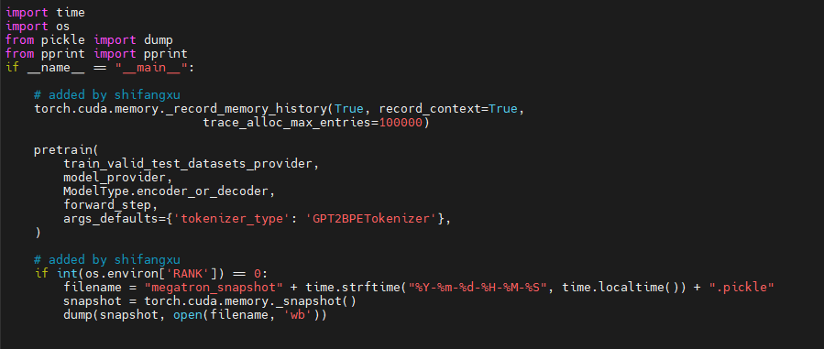
Record memory history (1/3)

Slide 10
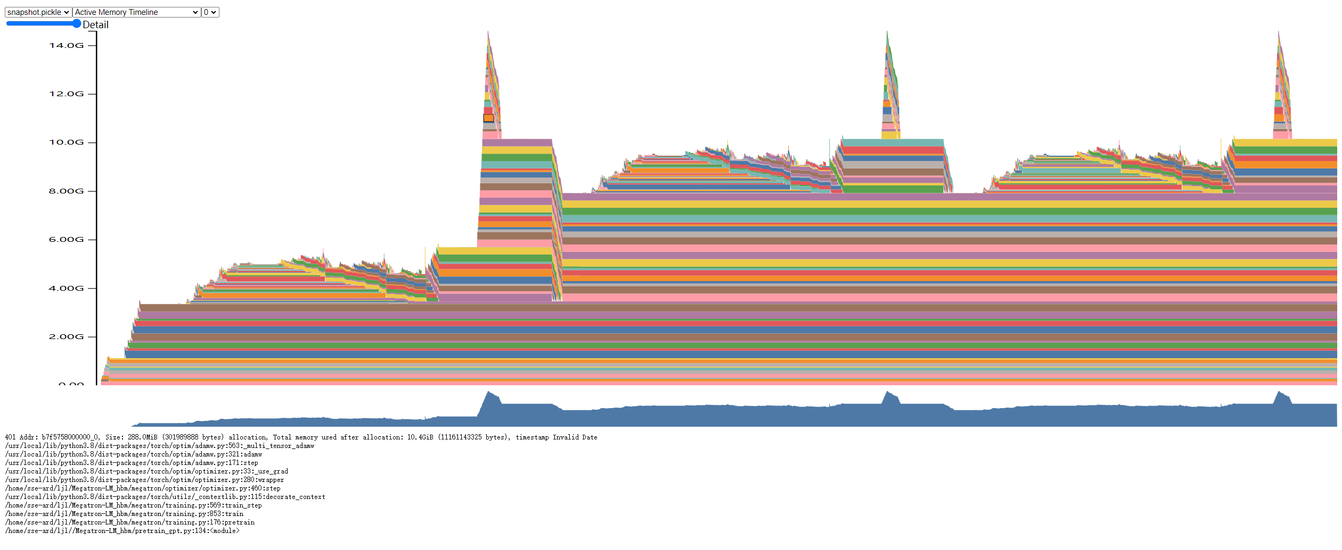
Record memory history (2/3)

Slide 11
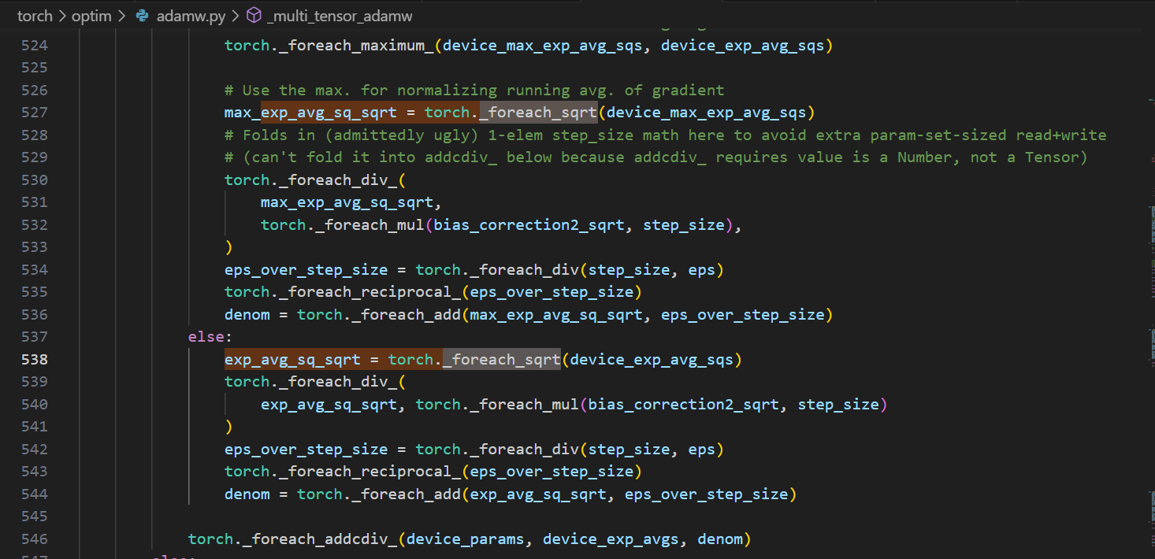
Record memory history (3/3)

