Slide 1



How Far Can a Routine Blood Count Go? Realistic
Performance, Resampling Leakage and External Validation
of CBC-Based Dengue Detection in Bangladesh
CSE 314 · Machine Learning and Deep Learning · Lab Final Project
Group 03
Presented By:
Tashnimul Hasan Shifat · Sultan Ruhul Kuddus Nayan
Anjuma Alam · Fairoj Salim
Department of Computer Science and Engineering
University of Asia Pacific
Notes:
[Speaker 1 - Tashnimul] Good morning, sir. We are Group 03. Our project asks how far the routine blood test that almost every fever patient already gets, the complete blood count, can go in detecting dengue: what its realistic performance is, how much resampling leakage inflates reported results, and whether a model built in one hospital works in another. D-CHSS is our interpretable component.

Slide 2
Authors
TS
Tashnimul Hasan Shifat
ID: 23101142
SN
Sultan Ruhul Kuddus Nayan
ID: 23101159
AA
Anjuma Alam
ID: 23101164
FS
Fairoj Salim
ID: 23101165
Course Teacher
Rashik Rahman, Assistant Professor
Affiliation:
Department of Computer Science and Engineering
University of Asia Pacific, Dhaka, Bangladesh
Notes:
[Speaker 1 - Tashnimul] These are the four members of Group 03 with our IDs. Our course teacher is Rashik Rahman sir. I will present the introduction, Nayan the data and method, Anjuma the results, and Fairoj the web app, demo and conclusion.

Slide 3
Contents
1
Introduction
6
Methodology
2
Problem statement
7
Results
3
Objective & outcome
8
Web application & demo
4
Recent works
9
Conclusion & future works
5
Dataset
10
References
Notes:
[Speaker 1 - Tashnimul] This is the flow of our talk: introduction and problem, related work, our data and method, results, the web application with a short live demo, and our conclusion.

Slide 4
Introduction
Dengue is a mosquito-borne viral infection with no specific antiviral drug; early recognition saves lives
Bangladesh has faced recurring outbreaks since 2000; 2023 was the worst season on record
Confirmatory tests (NS1, IgM/IgG, RT-PCR) are slow or missing in many district hospitals
A complete blood count (CBC) is done for almost every febrile patient, making it a natural first screen
321,179
reported dengue cases in 2023
565,438
cases reported from 2000 to early 2024
2,587
deaths over the same period
Sources: Sharif et al., 2024; Shiddik et al., 2026
Notes:
[Speaker 1 - Tashnimul] Dengue has no specific antiviral drug, so early recognition matters. Bangladesh had its worst season in 2023 with over three hundred twenty-one thousand cases. Confirmatory tests are often delayed outside large hospitals, but a CBC is done for nearly every fever patient. So we ask whether the CBC alone can flag dengue early.

Slide 5




Problem statement
Slow confirmation
NS1 and serology results arrive late or not at all during outbreaks
Research question
How much dengue information does a routine CBC really carry without leakage, and does a model built in one hospital work in another?
Black-box models
Earlier CBC models give a dengue label with no reason a clinician can check
Optimistic evaluation
Accuracy on the same cohort ranges from 84.5% to 96.38%; resampling can leak test data
No uncertainty, no external test
Single split, no confidence intervals; models rarely tested in another hospital
Notes:
[Speaker 1 - Tashnimul] We see four problems: confirmation is slow, earlier models are black boxes, reported results on the same dataset vary from 84 to 96 percent which suggests over-optimistic evaluation, and most studies report a single split with no uncertainty and never test in another hospital. Our research question is on the right.

Slide 6


Objective & outcome
Objective
Outcome
Measure the realistic, leakage-free performance of CBC-only dengue detection
Show how resampling before the split inflates results, and test in another hospital
Use D-CHSS as an interpretable component; deploy a Bengali web app
Stable ceiling of about 0.69 AUC in Jamalpur over 10 repeated splits
Leakage inflates accuracy to 92%; in Dhaka, D-CHSS features reach 0.89 AUC
Live app: dengue-two-delta.vercel.app
Notes:
[Speaker 1 - Tashnimul] Our objectives were to measure the realistic performance of CBC-only dengue detection, to show how resampling leakage inflates results, to test the model in another hospital, and to deploy an interpretable web app. The outcomes: a stable ceiling of about 0.69 AUC in Jamalpur, a clear demonstration that leakage inflates accuracy to 92 percent, an external AUC of 0.89 for D-CHSS features in Dhaka, and a live web app. Now Nayan will continue.

Slide 7
Recent works
Study | Data | Method | Metric | Value | Main gap
Ho et al. [7] | 4,894 ED patients, Taiwan | DNN, DT, LR | AUC | 0.84–0.86 | needs body temperature
Riya et al. [8] | 320 CBC, Dhaka | Stacking | Accuracy | 96.88% | small data
Haque et al. [9] | Hematology data | GA + GAN + DT | Accuracy | 99.49% | synthetic balancing
Tuhin et al. [4] | 1,523 CBC, Jamalpur | Stacking, SHAP | Accuracy | 96.38% | resampling
Hasan et al. [3] | 1,523 CBC, Jamalpur | RF, XGB, SVM | AUC | 0.69 | little interpretation
Ours | 1,511 Jamalpur + 312 Dhaka | D-CHSS + XGBoost | AUC | 0.69 / 0.89* | external: 10 variables only
*Internal test / external Dhaka. Accuracy and AUC cannot be compared directly: calling every patient positive already gives about 68% accuracy on this cohort.
Notes:
[Speaker 2 - Nayan] Two studies used exactly our dataset. Tuhin et al. reported 96 percent accuracy after resampling, while Hasan et al. reported an AUC of only 0.69. That gap on the same patients shows that the evaluation protocol matters, although we cannot say what caused it in their pipeline. We also use the public Dhaka data of Riya et al. as our external test set. None of these works represents the three dengue blood changes as explicit, interpretable components.

Slide 8
Dataset
Public Dengue Fever Hematological Dataset (Mendeley Data, 2024)
Jamalpur 250-Bedded General Hospital, February–September 2024
16 CBC values + age + sex; labels confirmed by NS1, IgM/IgG or PCR
1,523 records → 12 exact duplicates removed → 1,511 patients
Stratified 80/20 split: 1,208 training, 303 test (seed 42, plus 9 repeat seeds)
External test: Riya et al. data, 2 Dhaka hospitals, 2023 → 312 patients, 10 shared variables
68.4% positive, so we report MCC, PR-AUC and specificity, not accuracy alone
Notes:
[Speaker 2 - Nayan] We used a public dataset from Jamalpur hospital: after removing 12 duplicates, 1,511 patients with 16 CBC values, age and sex, confirmed by NS1, antibody or PCR. 68 percent are positive, so accuracy alone is misleading. We split 80 to 20 with stratification, and later repeated the whole pipeline with nine more seeds. For external validation we used a second public dataset from two Dhaka hospitals in 2023, 312 patients, which shares ten variables with ours and was never used for training.

Slide 9
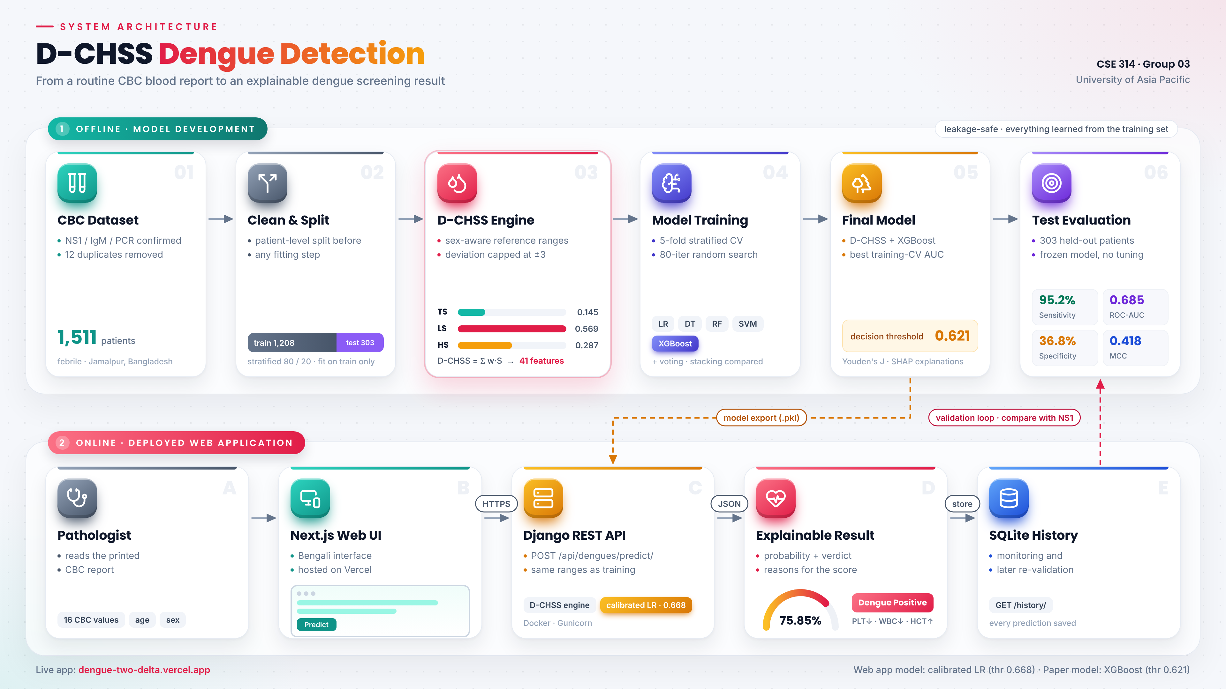
Methodology
Fig. 1: System architecture (offline model development and deployed web application)
Notes:
[Speaker 2 - Nayan] This is our full system. The top lane is offline model development: clean and split the data, build the D-CHSS features, train five baselines and our XGBoost, pick the model and threshold on training data only, then test. The bottom lane is the deployed web app: the pathologist enters the CBC, the Django API computes the same features and returns a probability with reasons, and every prediction is stored.

Slide 10
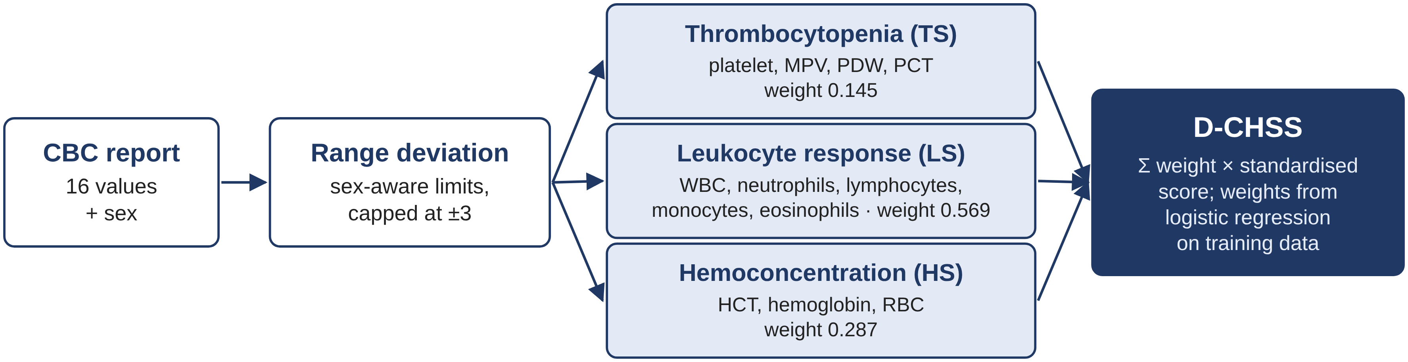
Methodology
D-CHSS feature engineering
Fig. 2: Construction of the D-CHSS signature
1
Deviation
2
Weights
3
Models
Each value vs. its sex-aware reference range, capped at ±3
Logistic regression on training data only: |β| normalised
LR, DT, RF, SVM, XGBoost + 41-feature XGBoost; each model gets its own Youden threshold
Notes:
[Speaker 2 - Nayan] Each CBC value becomes a deviation from its reference range, capped at plus or minus three. The deviations form three clinical scores: thrombocytopenia, leukocyte response and hemoconcentration. A logistic regression on the training set learns their weights; the leukocyte score got the largest weight, 0.569. With raw values, deviations and five ratios we get 41 features for XGBoost. For a fair comparison, every model gets its own threshold by the same Youden rule. Now Anjuma will show the results.

Slide 11
Results
Model | Threshold | Recall | Specificity | F1 | ROC-AUC | MCC
Logistic regression | 0.444 | 0.885 | 0.337 | 0.809 | 0.622 | 0.265
Decision tree | 0.488 | 0.923 | 0.368 | 0.835 | 0.633 | 0.361
Random Forest | 0.701 | 0.889 | 0.453 | 0.831 | 0.663 | 0.384
SVM (RBF) | 0.637 | 0.938 | 0.347 | 0.839 | 0.658 | 0.368
XGBoost (raw CBC) | 0.686 | 0.909 | 0.432 | 0.838 | 0.658 | 0.396
Ours: D-CHSS + XGBoost | 0.621 | 0.952 | 0.368 | 0.850 | 0.685 | 0.418
Web-app LR (calibrated) | 0.668 | 0.875 | 0.484 | 0.829 | 0.711 | 0.392
Table 1: Test-set performance (303 patients); every model uses its own Youden threshold from training data
Ours has the best ROC-AUC, F1 and MCC. RF and raw XGBoost reach higher specificity but miss more dengue cases.
Notes:
[Speaker 3 - Anjuma] All models were tested on the same 303 patients, and every model used its own threshold chosen on training data, so the comparison is fair. Our model has the highest ROC-AUC, F1 and MCC with 95 percent sensitivity. Random Forest and raw XGBoost have higher specificity, but they miss more dengue cases. The web-app model has a slightly higher AUC, but the difference is not significant.

Slide 12
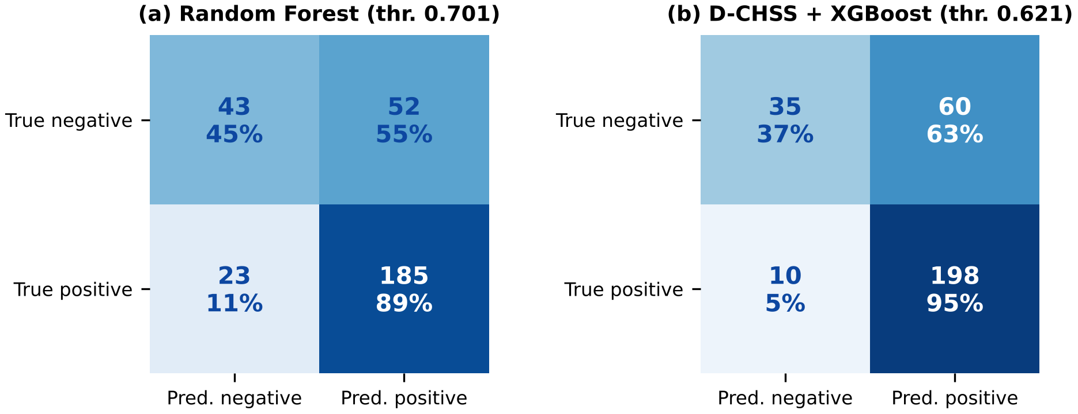
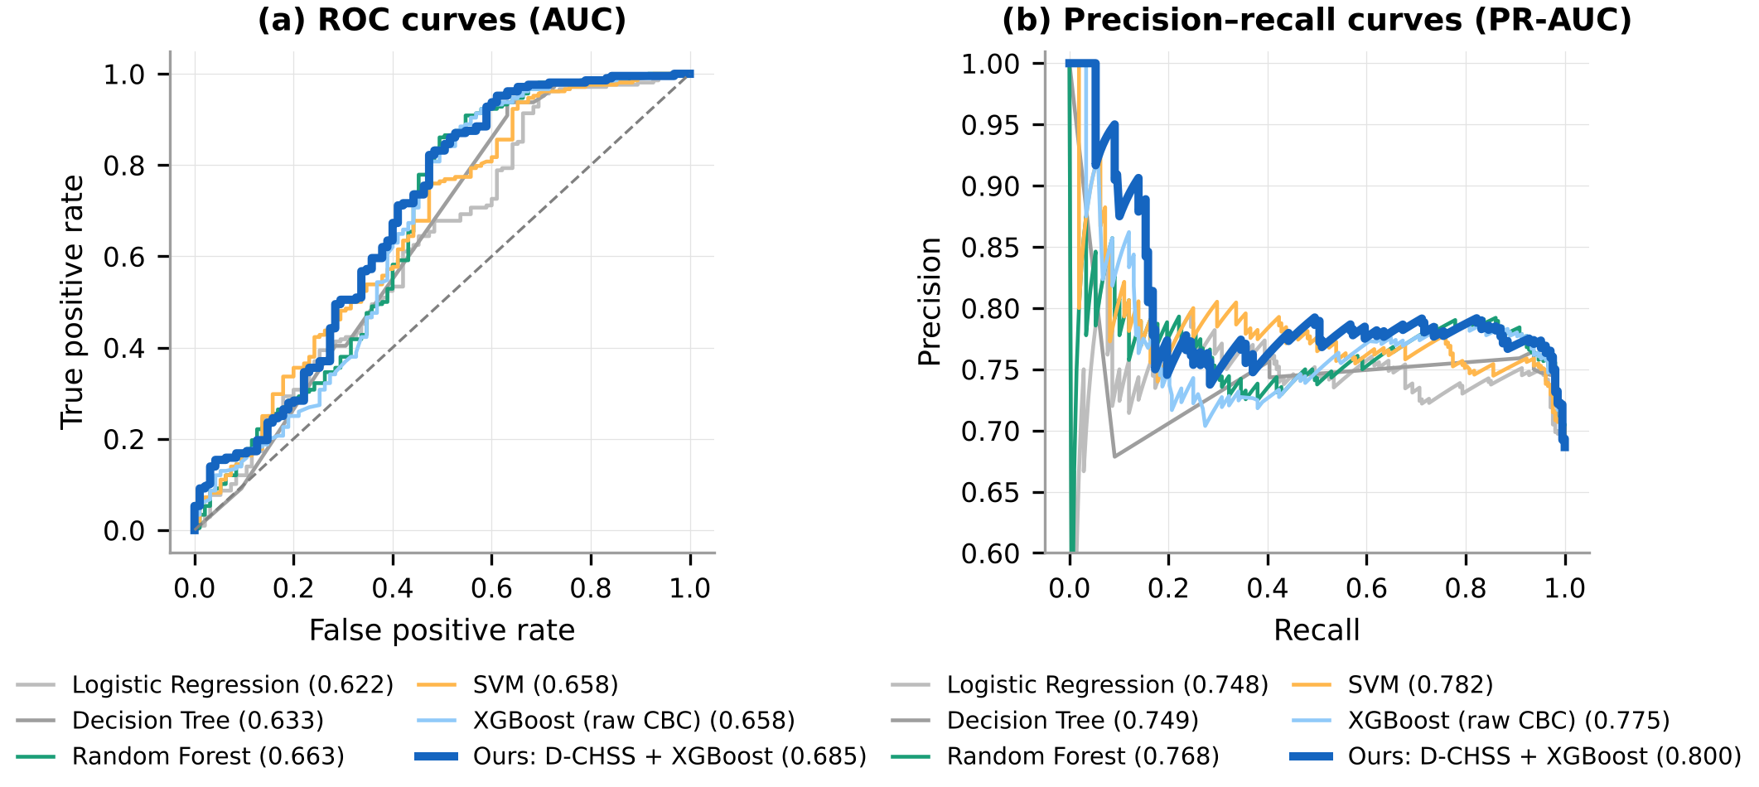
Results
Fig. 3: Confusion matrices (own thresholds)
Fig. 4: ROC and precision–recall curves
Ours misses only 10 of 208 dengue cases (RF misses 23) but raises 8 more false alarms (60 vs. 52); it has the largest area under both curves.
Notes:
[Speaker 3 - Anjuma] On the left, compared with Random Forest at its own threshold, our model misses only 10 dengue cases instead of 23, at the cost of 8 more false alarms. On the right, our curves have the largest area under both ROC and precision-recall.

Slide 13
Results
Is the result stable?
0.688 ± 0.030
our mean AUC over 10 splits (seed 42: 0.685)
0.615–0.757
95% bootstrap CI of our test AUC
p = 0.229
DeLong test vs. Random Forest: not significant
Notes:
[Speaker 3 - Anjuma] One split can be lucky, so we re-ran the entire pipeline ten times with different splits. Our model had the highest mean AUC, 0.688, but Random Forest and raw XGBoost are within 0.005, far less than the variation between splits, and the DeLong test is not significant. So our seed-42 result is typical, and the honest conclusion is that routine CBC data reach a ceiling of about 0.69 AUC.

Slide 14
Results
Why do other papers report 96%?
Resampling before the split puts copies of the same patients in both train and test
Leaky protocols: 92% accuracy, 0.96 AUC
Leak-free protocols: about 75% and 0.67, matching our model and Hasan et al.
Above about 80% appeared only when the test set was contaminated
Notes:
[Speaker 3 - Anjuma] We tested why other papers report much higher accuracy. When we oversampled the data before splitting, copies of the same patients ended up in both train and test, and accuracy jumped to 92 percent. With a leak-free protocol it stayed around 75 percent with AUC 0.67, the same as our model. This does not show that any other paper leaked; it only shows that, on this cohort, accuracy above 80 percent appeared only with a contaminated test set.

Slide 15
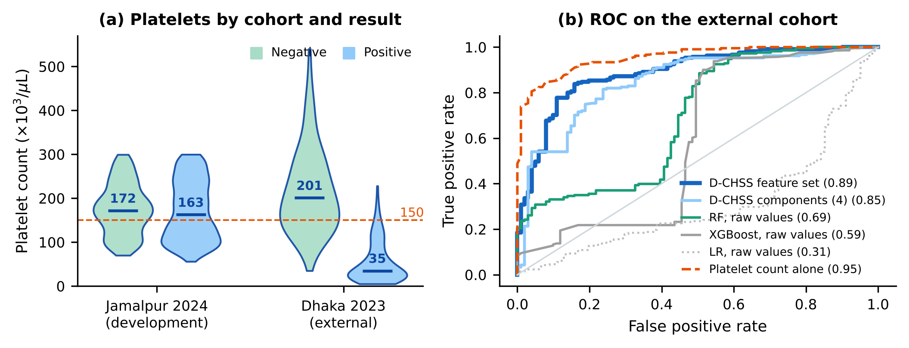
Results
Does it work in another hospital?
Fig. 5: Trained in Jamalpur (2024), tested once on 312 Dhaka patients (2023)
0.31–0.69
0.89
0.95 vs 0.53
raw-value models in Dhaka: poor transfer
D-CHSS features in Dhaka (95% CI 0.85–0.92)
platelet alone: Dhaka vs Jamalpur
Notes:
[Speaker 3 - Anjuma] We also tested in another hospital. We trained on all Jamalpur patients using the ten variables both datasets share, and tested once, without any tuning, on 312 patients from two Dhaka hospitals. Models trained on raw values transferred poorly, from 0.31 to 0.69 AUC. Our D-CHSS features, which are deviations from fixed clinical reference ranges, reached 0.89. But the platelet count alone reached 0.95 in Dhaka and only 0.53 in Jamalpur: on the left you can see that Dhaka dengue patients had very low platelets, Jamalpur patients did not. So how well a CBC works depends on the kind of patients. Now Fairoj will continue.

Slide 16
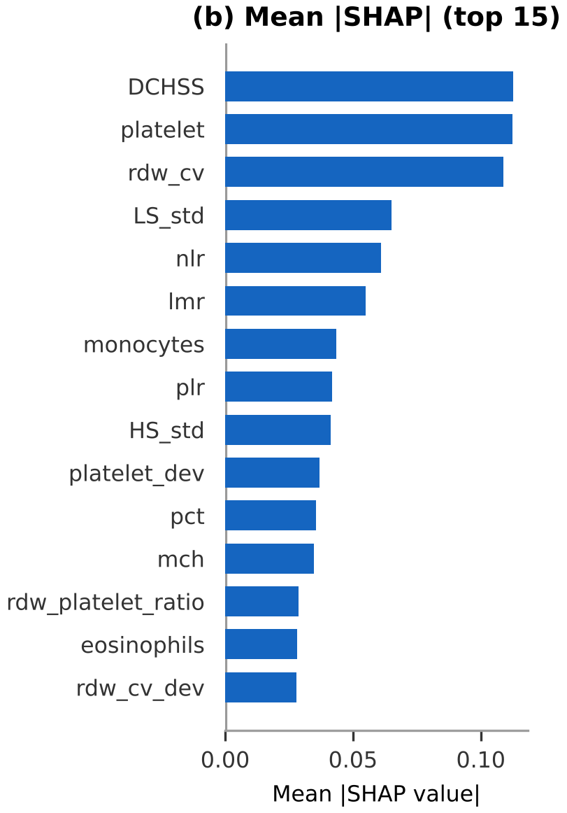
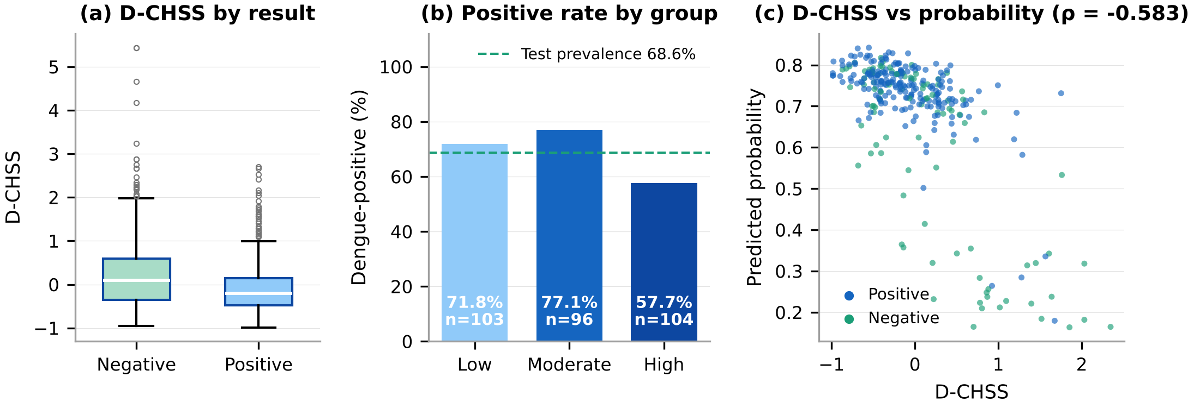
Results
What did the model learn?
Fig. 7: D-CHSS by result, by group and vs. probability
D-CHSS, platelet count and RDW-CV drive predictions; low platelets push toward dengue
Surprise: D-CHSS was higher in dengue-negative patients in all 10 Jamalpur splits, but not in Dhaka
"Abnormal" does not mean "dengue": other fevers also disturb the blood count
Fig. 6: Top SHAP features
Notes:
[Speaker 4 - Fairoj] SHAP shows that D-CHSS, platelet count and RDW-CV drive the predictions, and low platelets push toward dengue, as clinicians expect. But we also report a surprise honestly: D-CHSS was higher in negative patients, in all ten splits. The negatives were patients with other fevers, which also disturb the blood count, so abnormal does not mean dengue in this cohort. In Dhaka the direction was not reversed, so this is a property of the Jamalpur patients rather than of D-CHSS itself.

Slide 17
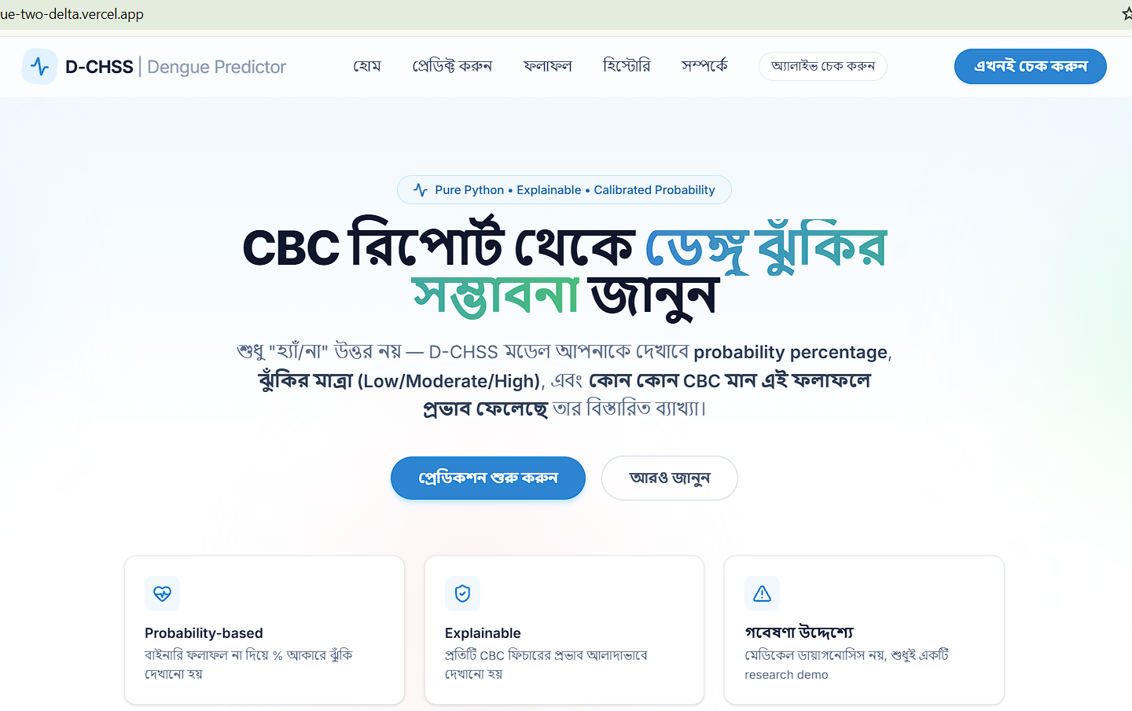
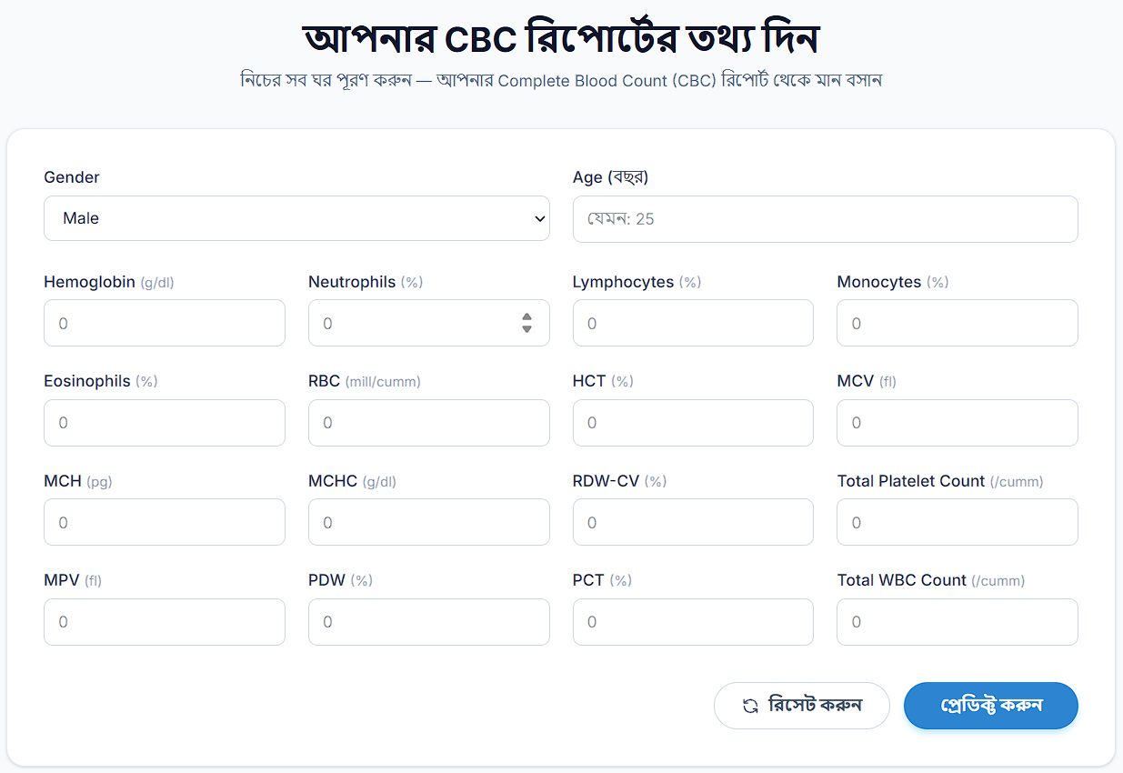
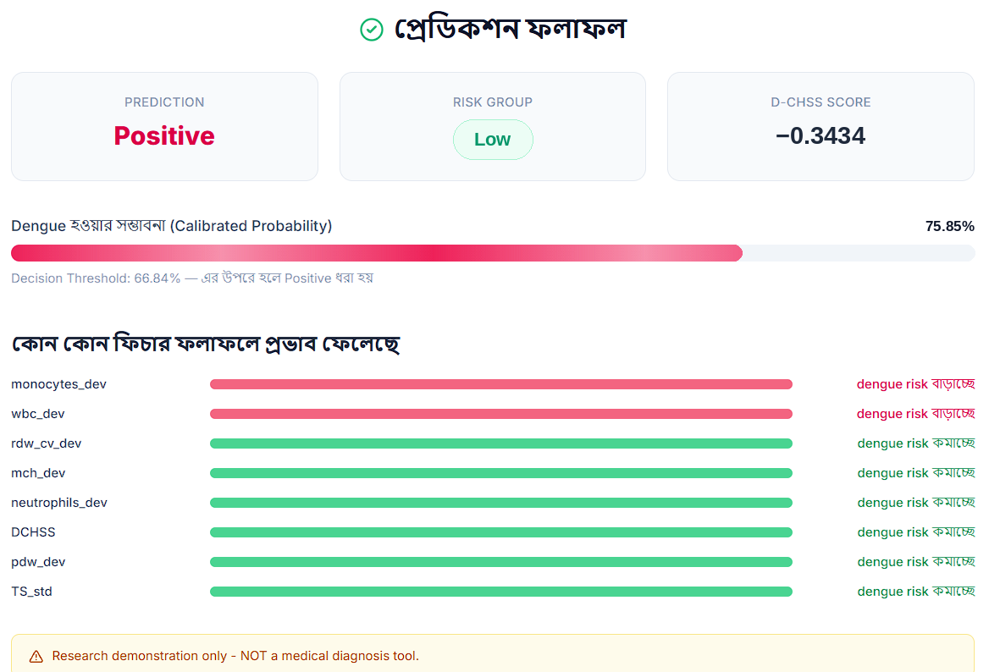
Web application
Fig. 8: Home (Bengali)
Fig. 9: CBC input form
Fig. 10: Result with reasons
Next.js (Vercel) + Django REST API · calibrated logistic regression · threshold 0.668
Same 303 test patients: sensitivity 87.5%, specificity 48.4%, AUC 0.711
dengue-two-delta.vercel.app
LIVE DEMO
2–3 min
Notes:
[Speaker 4 - Fairoj] This is our deployed web app. The pathologist fills in the CBC values in a Bengali form and gets a calibrated probability, the D-CHSS group and the features that raised or lowered the risk. The app uses a light logistic regression; on the same 303 patients it had 87.5 percent sensitivity and an AUC of 0.711. Let me show it live. DEMO: open dengue-two-delta.vercel.app, go to Predict, enter one sample report, show the result and the reasons, then open History.

Slide 18
Conclusion
Routine CBC carries a real but cohort-dependent dengue signal: about 0.69 AUC in Jamalpur, stable over 10 splits
Resampling before the split inflated accuracy from about 75% to 92%; high accuracy alone does not prove leakage
In Dhaka, D-CHSS features transferred well (0.89) while raw-value models did not; platelet alone reached 0.95
D-CHSS is an interpretable, transportable component; a negative result is fairly reassuring, a positive one needs NS1
0.69
ROC-AUC ceiling in Jamalpur (10 splits)
0.89
external AUC of D-CHSS features (Dhaka)
97%
NPV at a realistic 20% prevalence
Notes:
[Speaker 4 - Fairoj] To conclude: routine CBC carries a real dengue signal, but how strong it is depends on the patients. In Jamalpur every strong model stops at about 0.69 AUC, and resampling before the split can make it look like 92 percent accuracy. In Dhaka, features built on clinical reference ranges transferred well. D-CHSS is most useful as an interpretable, transportable component, and the tool is live as a web app. A negative result is fairly reassuring; a positive one must be confirmed.

Slide 19


Future works
Limitations
Future works
External cohort shares only 10 variables; full 41-feature model untested there
Illness day unknown; case mix and selection cannot be separated
Specificity only 36.8% in Jamalpur; gain over RF within noise
Test set reused to check the web app
Multi-center data with the full CBC panel and illness day
Recalibrate the threshold at each new site
Signed D-CHSS with pediatric ranges
Uncertainty estimates and input checks in the app
Notes:
[Speaker 4 - Fairoj] Our main limitations: the external data share only ten variables, so the full model could not be tested there; illness day is unknown; and specificity is low in Jamalpur. In future we want multi-center data with the full CBC and illness day, a threshold recalibrated at each site, a signed D-CHSS with pediatric ranges, and uncertainty estimates in the app.

Slide 20
References
[1] World Health Organization, Dengue: Guidelines for Diagnosis, Treatment, Prevention and Control. Geneva: WHO, 2009.
[2] N. Sharif et al., "Evolving epidemiology, clinical features, and genotyping of dengue outbreaks in Bangladesh, 2000–2024," Front. Microbiol., vol. 15, 2024.
[3] M. M. I. Hasan et al., "A novel hematological machine learning framework for predictive modeling of dengue diagnosis using CBC parameters in Bangladesh," Proc. IDAA 2025, 2026.
[4] I. A. Tuhin et al., "An interpretable machine learning model for dengue detection with clinical hematological data," Healthcare Analytics, vol. 8, 2025.
[5] "Dengue Fever Hematological Dataset," v2, Mendeley Data, 2024.
[6] T. Chen and C. Guestrin, "XGBoost: A scalable tree boosting system," Proc. ACM SIGKDD, 2016.
[7] T.-S. Ho et al., "Comparing machine learning with case-control models to identify confirmed dengue cases," PLoS Negl. Trop. Dis., 2020.
[8] N. J. Riya, M. Chakraborty, and R. Khan, "Artificial intelligence-based early detection of dengue using CBC data," IEEE Access, vol. 12, 2024.
[9] M. E. Haque et al., "A novel interpretable and real-time dengue prediction framework...," Front. Artif. Intell., vol. 8, 2025.
[10] S. M. Lundberg and S.-I. Lee, "A unified approach to interpreting model predictions," NeurIPS, 2017.
[11] S. Kapoor and A. Narayanan, "Leakage and the reproducibility crisis in machine-learning-based science," Patterns, vol. 4, 2023.
[12] E. R. DeLong et al., "Comparing the areas under two or more correlated ROC curves," Biometrics, vol. 44, 1988.
Notes:
[Speaker 4 - Fairoj] These are our main references; the full list of 39 references is in the IEEE report.

Slide 21
That's a
wrap!
Thank you!
Questions?
Try the app: dengue-two-delta.vercel.app
Notes:
[Speaker 4 - Fairoj] Thank you, sir. We are happy to take your questions.

