Slide 1



TITLE : ONLINE TURF BOOKING SYSTEM
KONGU ENGINEERING COLLEGE
PERUNDURAI ERODE-638060
DEPARTMENT OF COMPUTER APPLICATION
TEAM MENTOR : Dr. T. KAVITHA MCA., M.Phil., Ph.D.,
Assistant Professor (Sr.G)
TEAM MEMBERS : MOHAMUDHA SHIFA THAHSINA J
(24MCR066)
SUJITH CHINNUSAMY S (24MCR110)
VARSHINI T (24MCR122)
TEAM NO : 24

Slide 2
PROJECT OVERVIEW
The Online Turf Booking System using the MERN Stack (MongoDB, Express.js, React, Node.js) is a comprehensive platform designed for booking sports fields like football, cricket, and tennis courts.
It aims to provide a simple, user-friendly platform for booking sports turfs online, managing real-time availability, processing secure payments, a0nd helping administrators track bookings and payments efficiently.
Further, AI-powered slot recommendation feature can analyze user preferences and booking patterns to suggest ideal slots, improving convenience and optimizing turf utilization.

Slide 3
EXISTING SYSTEM
Existing Online Turf Booking Systems have problems such as few payment options, no real-time updates, hard-to-use interfaces, and complicated booking steps. They may not work well with other systems, don't always work on mobile, and have strict cancellation rules.
Older systems can also have issues with growth, security, and reporting, which affects user experience and business efficiency.

Slide 4
DRAWBACKS OF EXISTING SYSTEM
The disadvantages of the existing system are:
Inflexible Payment Systems.
User Interface (UI) Complexity.
Maintenance Scheduling Challenges.
Inability to Handle Cancellations/Reschedules Efficiently.

Slide 5
PROPOSED SYSTEM
This system provides an easy-to-use platform for both customers and turf administrators, making bookings faster and simpler. With more people playing sports and recreational games, the demand for a good booking system has grown.
The system allows customers to easily check turf availability, book slots, make payments, and manage reservations online.
Features like real-time slot updates, customer profiles, reminders, and payment gateways ensure a smooth experience. It also supports group bookings, cancellations, and rescheduling for added flexibility.

Slide 6
ADVANTAGE OF PROPOSED SYSTEM
User friendliness is provided in the application with various controls.
It can be accessed over the internet.
Enhancing the growth of turf booking and management.
Customer can pay using different mode of payment through UPI.

Slide 7
TECHNOLOGIES USED
FRONT-END
BACK-END
DATABASE
React JS
Tailwind CSS
DaisyUI
Redux
Node JS
Express JS
MongoDB

Slide 8
MODULE DESCRIPTION
The project contains the following modules such as:
Home Page
Login Page
List of Turfs
Turf details
Booking Turf
Payment Page
Admin Dashboard
Transaction History

Slide 9
Administrator Module
The Admin Module is the platform's management center, allowing administrators to oversee all activities, from user and turf management to transaction monitoring.
User Module
The User Module is designed to facilitate the entire customer journey, from browsing available turfs to booking time slots and leaving feedback.
Owner Module
The Owner Module allows turf owners to manage their turfs, view bookings, and interact with users who have rated or reviewed their services.

Slide 10
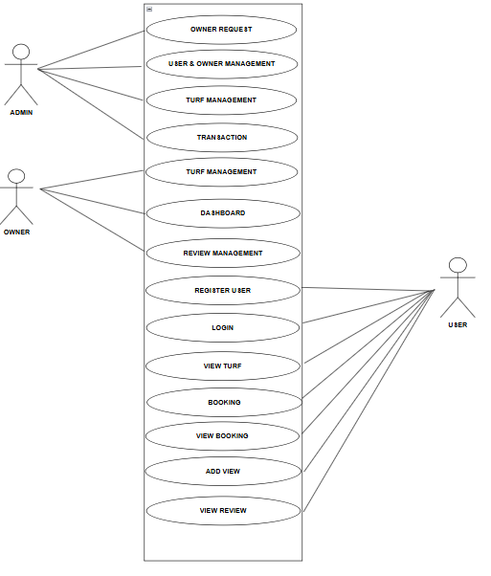
USE CASE DIAGRAM

Slide 11
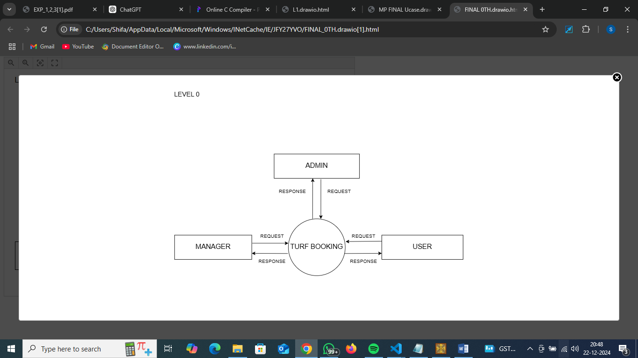
Level 0
DATA FLOW DIAGRAM

Slide 12
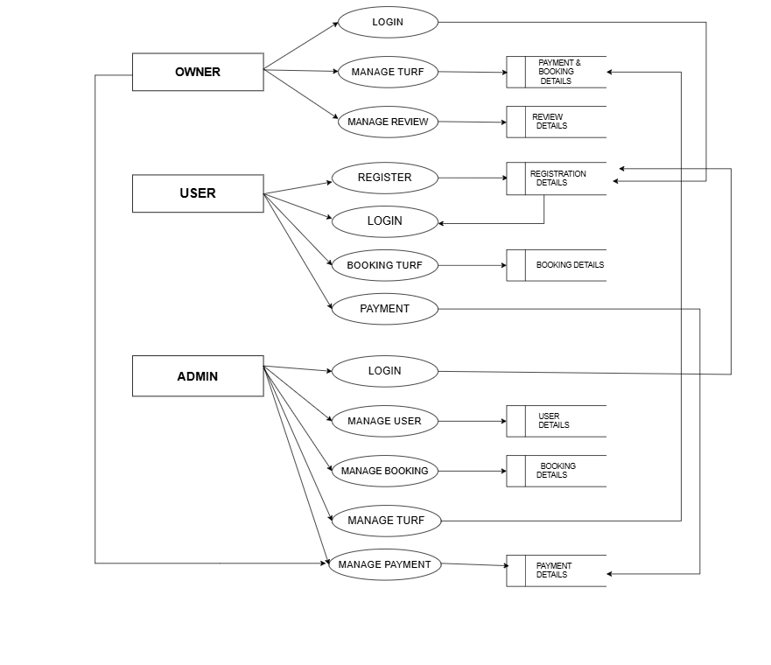
Level 1

Slide 13
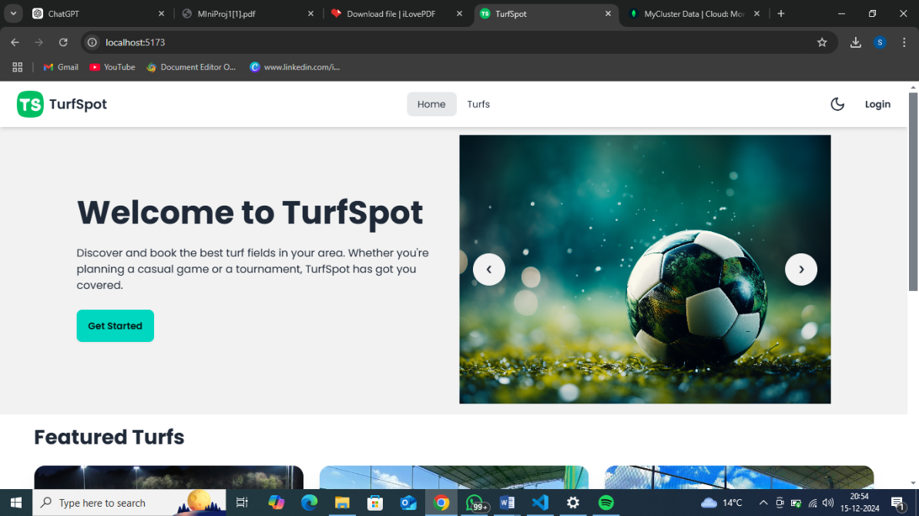
HOME PAGE

Slide 14
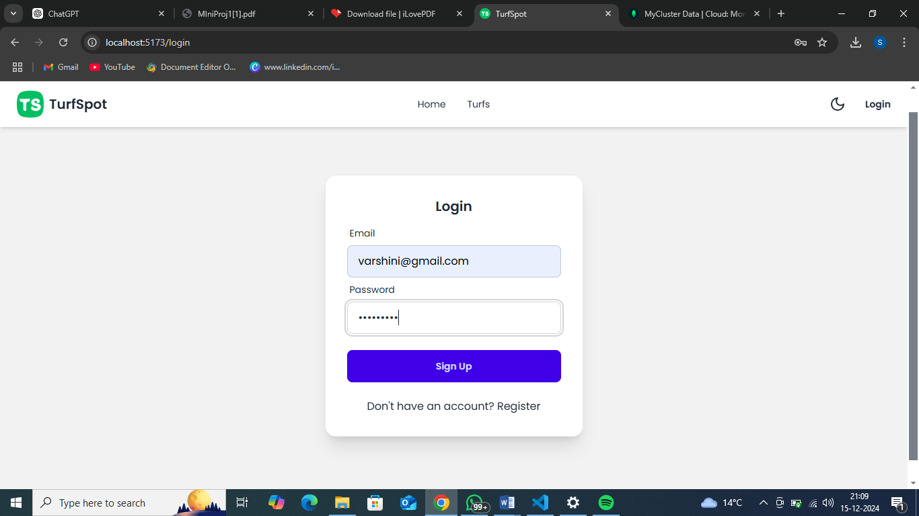
LOGIN PAGE

Slide 15
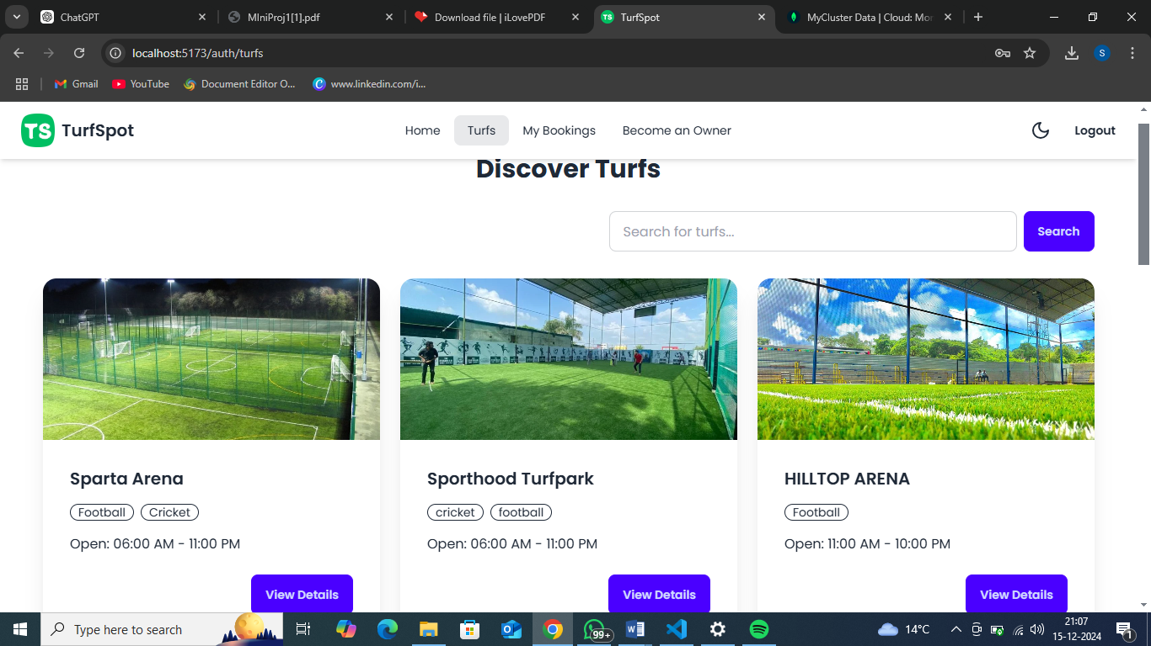
LIST OF TURFS

Slide 16
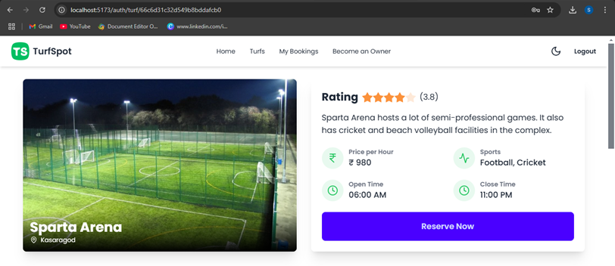
TURF DETAILS

Slide 17
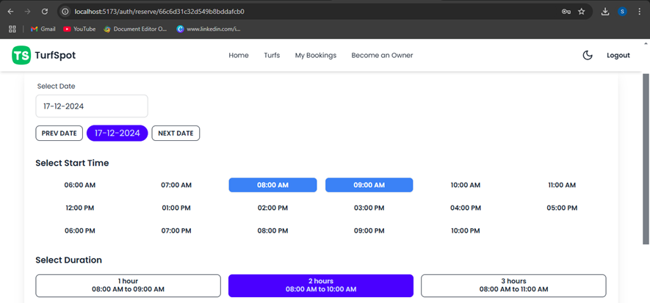
BOOKING TURF

Slide 18
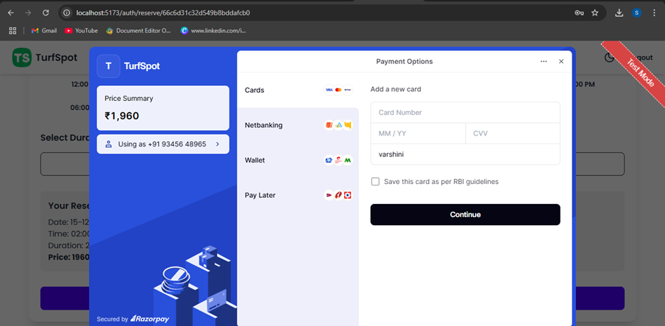
PAYMENT PAGE

Slide 19
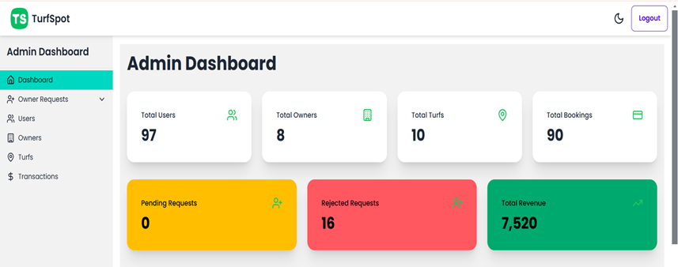
ADMIN DASHBOARD

Slide 20
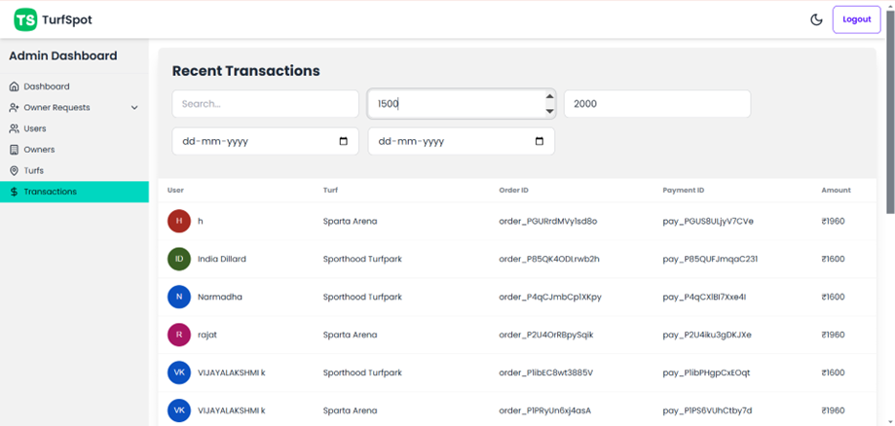
TRANSACTION HISTORY

Slide 21
CONCLUSION
In conclusion, the system is strong, easy to maintain, and makes booking simple. It offers quick access to turf details and works well. It can be connected to other systems and is ready to grow for multiple branches.
Its designed for fast and smooth use. Future updates, like turning it into a web app, will help it grow and improve efficiency while keeping users happy.

Slide 22
THANK YOU

