Slide 1
IBM and the Algol project
Exploring the challenges and dilemmas of early computer science research
5!7
David Nofre
HaPoP Oxford
March 23, 2018

Slide 2
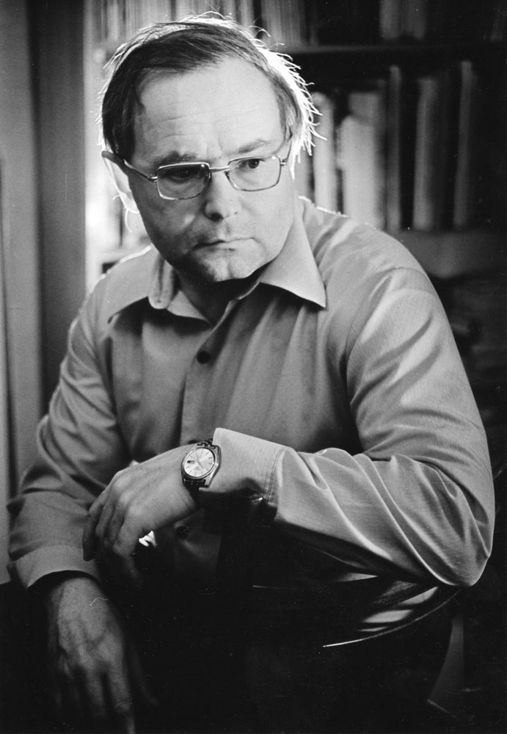
Ershov’s question
“why ALGOL, with a history that would seem more dissapointing than thriumphant, changed the face of current programming.”
Ershov to Halpern, March 28, 1968
(trans. Allen Reiter. Ershov Archive Online)

Slide 3
Algol 58 & Algol 60 implementation By early 1963 : less than 10% operating computers
Data for Algol implementations:
CACM, Datamation, AB, Software Preservation Group
Data for total number of commercial computers:
Computer Comparison & Census Chart, annually in Business Automation
Computer Characteristics Quarterly, by Charles W. Adams Associates Inc.
Survey of Domestic Electronic Digital Computing Systems, BRL
Computers in Europe 1966 (Amsterdam, 1966)

Slide 4
Understanding Algol’ s limited adoption
Algol community favors open-ended research
IBM & SHARE favor stability and maintenance
Threat of “common languages”: Algol, Cobol

Slide 5
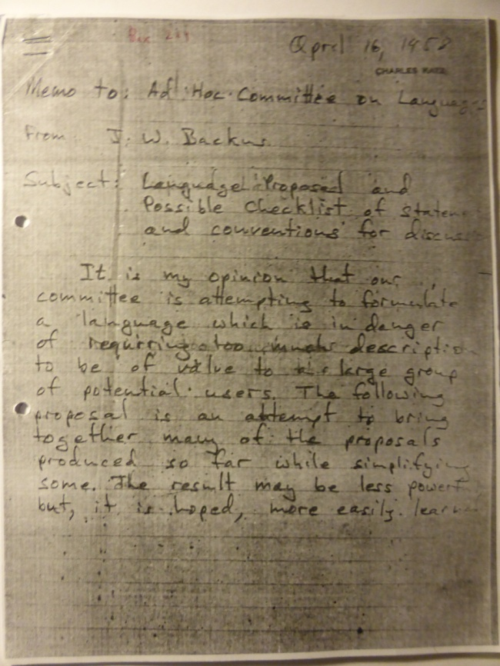
IBM’s early involment : John Backus
“the goals of SHARE would be greatly advanced by recognizing and using [the Zurich language proposal]”.
Backus to SHARE Members, August 14, 1958 (Computer Standards Collection, NMAH)
ACM Ad Hoc Committee on Languages, April 16, 1958
(Unprocessed Collection, NMAH)

Slide 6
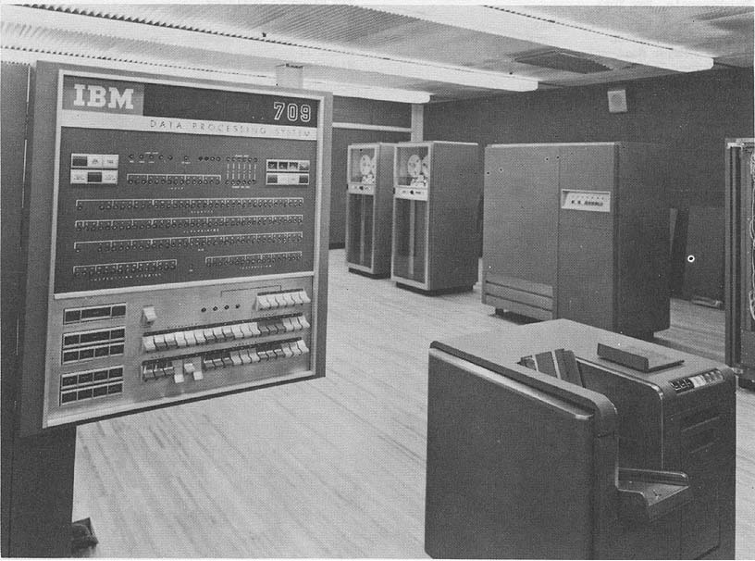
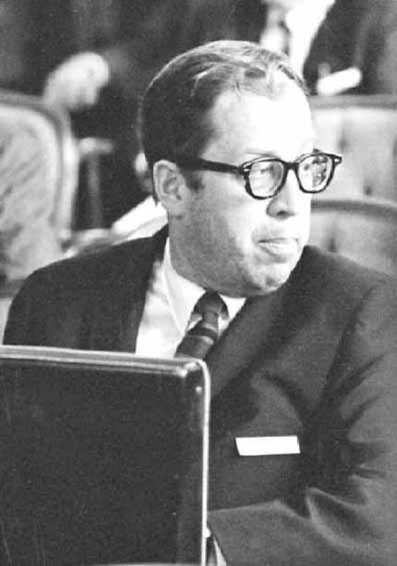
IBM : IAL/Algol as experimental tool
Robert Bemer’s IBM Applied Programming Systems :
IAL experimental compiler for the IBM 7090

Slide 7
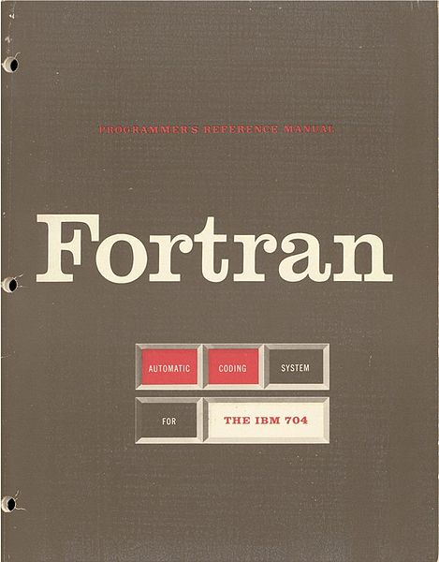
Will Algol make Fortran obsolete ?
“ALGOL will replace (...) FORTRAN. Since FORTRAN is a mappable subset of ALGOL it should be feasible to machine-convert customer FORTRAN programs on a service basis.”
Robert Bemer to Charles DeCarlo , William McWhirter, December 8, 1959
(Computer Standards Collection, NMAH)
Notes:
William McWhirter, Director IBM Data Systems Divison, with the Poughkeepsie, N.Y. site was responsible for development and manufacture of larger systems
McWhirter answered Charles DeCarlo that he shared “some of [Bemer’s] enthusiasm”. He went on saying that the promise for delivery of the Algol compiler for the IBM 709 was May 1960, and “it would make a fine prestige builder if we were able to test this out very thoroughly and present it either on –or ahead of- schedule. I assume that if we do this, we will do it with complete fanfâre.”

Slide 8
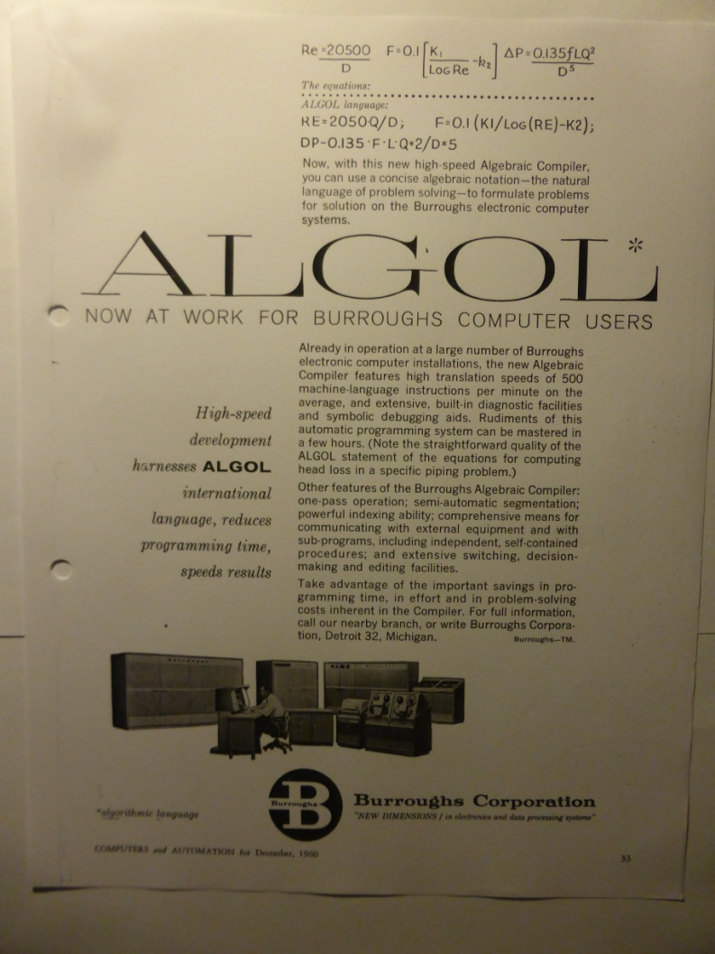
On the way to Algol 60 : US
Academic “ALGOL constructors”:
applied / fundamental research
SHARE “catalyst” for IBM
Military Computer Users Group:
IAL for real-time problems (JOVIAL, NELIAC)

Slide 9
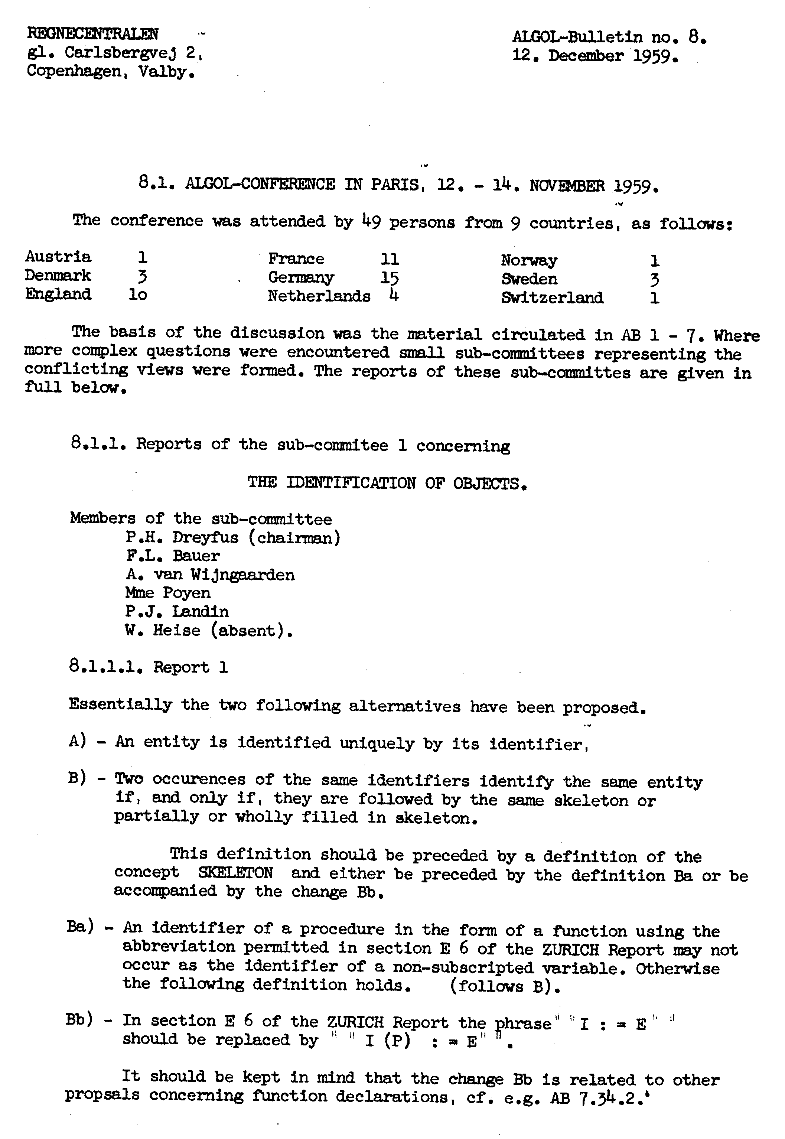
On the way to Algol 60 : Europe
“The question whether ALGOL will have only (compatible) extensions or whether also (incompatible) changes can be allowed, found lively interest.”
F. L. Bauer, On the European ALGOL Conference, November 12-14, 1959
(Computer Standards Collection, NMAH)
Notes:
+ Internal IBM documents confirm that IBM expected “Mark I language specs official by January 1960“ - refers to the 1st version of a weapon or military vehicle and is sometimes used in similar fashion in civic product development.

Slide 10
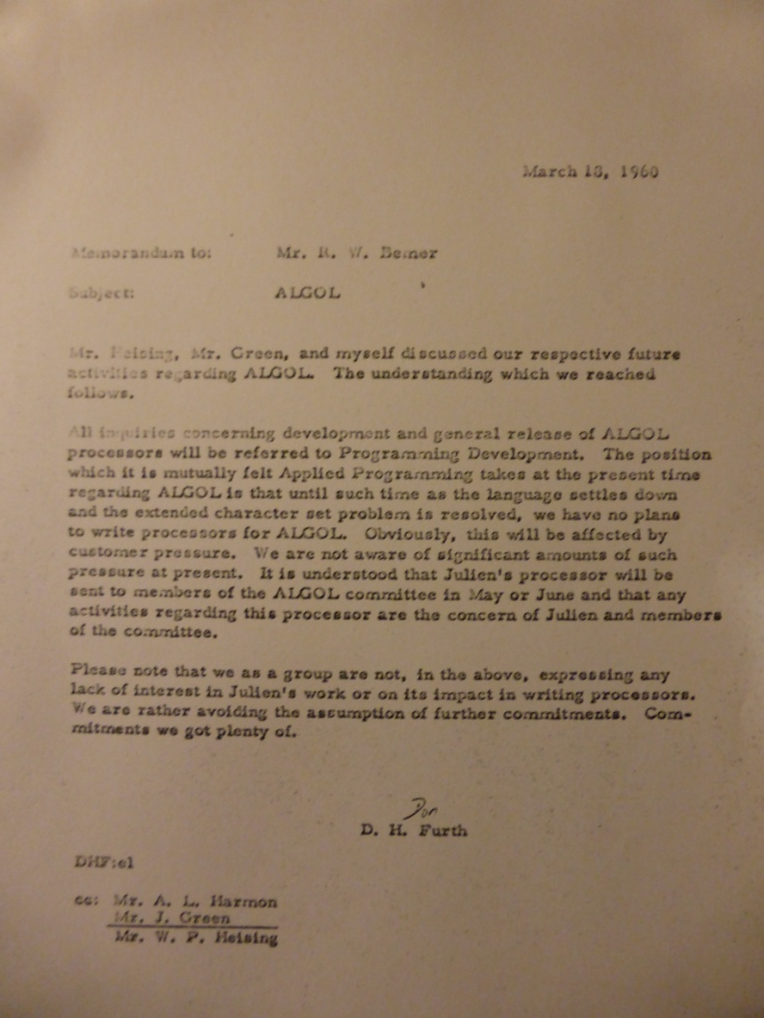
Algol 60 : “a major setback” (K. Samelson)
“from the viewpoint of a person who has written a translator for ALGOL 58, the changes introduced by ALGOL 60 are monumental – requiring a complete rewrite of approximately half the translator.”
Forman Acton to John Carr, March 1, 1960
(Computer Standards Collection, NMAH)
(Computer Standards Collection, NMAH)

Slide 11
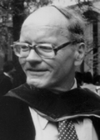
IBM : more Fortran
Customer pressure :
Algol features to Fortran
No more ALGOL compilers by IBM
“IBM has apparently decided to sabotage the Algol effort ”
John Carr to Joseph Wegstein, May 1, 1961
(Computer Standards Collection, NMAH)

Slide 12
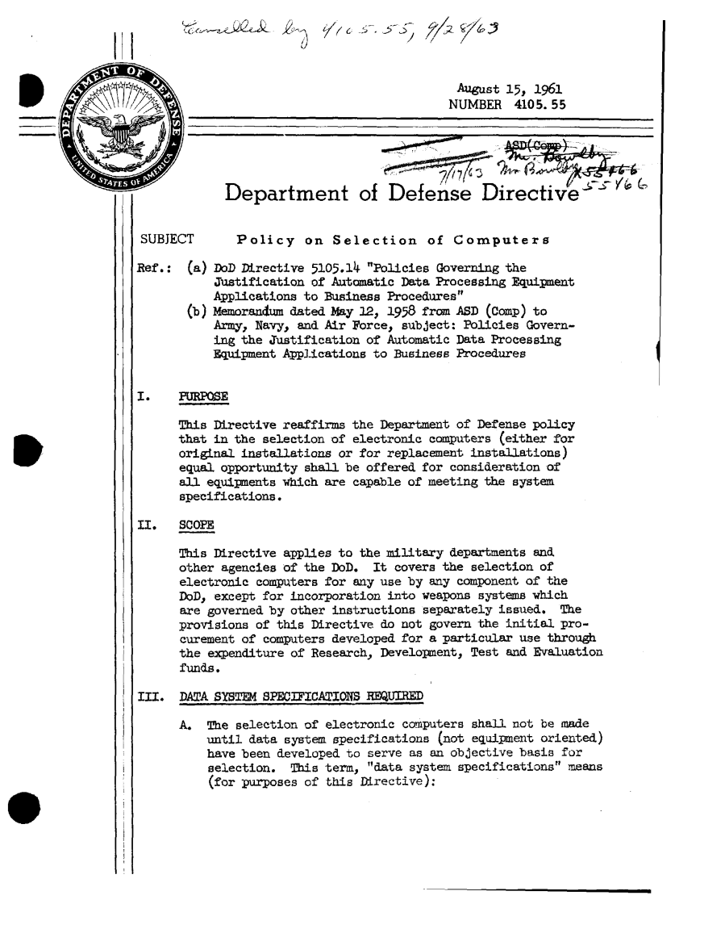
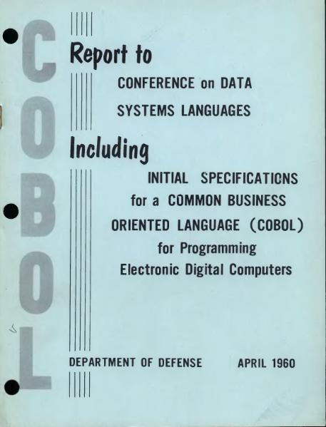
US DoD & “common languages”

Slide 13
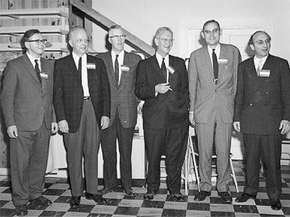
Pressure on IBM in Europe
“I had several private talks with Bauer and Van der Poel at mealtimes. Bauer was at one time so furious at IBM that he banged his fist and rattled the dishes.”
Robert Bemer to W. E. Andrus, IBM Dir. of Standards, Nov. 2, 1961
(NMAH, Comp. Stand. Coll.)
F. L. Bauer (right), 1964

Slide 14
IBM: Algol & Fortran ?
IBM ALGOL/FORTRAN Policy Commitee, December 1961
Cost of Algol 60 & Fortran II across machine lines ?
Loss of revenue by not having Algol ?
Time development Algol compilers ?
Moving to an Algol type of language ?

Slide 15
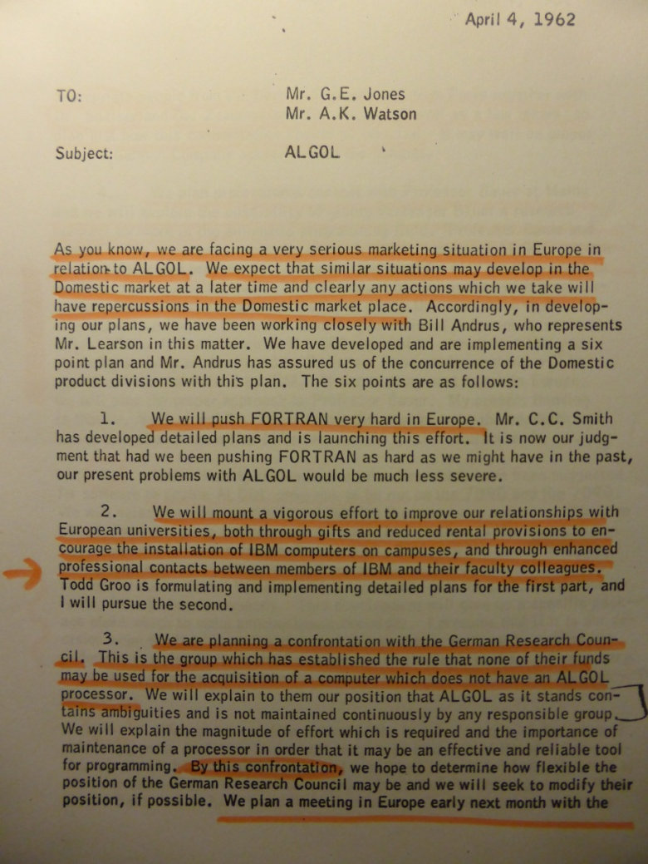
Facing “a very serious marketing situation”
“We will push FORTRAN very hard in Europe”.
“improve our relationships with European universities”.
“confrontation with the German Research Council”.
“professional contact with Professor Bauer”
“enable ALGOL programs ... on the 7090 and the 7040” at IBM La Gaude.
Need to understand evolution compilers.
NMAH, Computer Standards Collection

Slide 16
Conclusions - what can we learn?
Languages related to each other in unexpected ways
‘Peripheries’ do shape developments in the ‘center’
Instrumentality vs. intelligibility in computer science ?

