Slide 1


Exploration of programming misconceptions: Their implications, and future work
Alaaeddin Swidan
Felienne Hermans
Fourth Symposium on the History and Philosophy of Programming
23 March 2018. Oxford, UK.

Slide 2

Background
Alaaeddin Swidan
Bachelor of Computer Engineering
MSc. ICT Management
Ph.D. candidate @Delft University of Technology
Software Engineering Research Group (SERG)
Thesis focus:
End-users producing software artifacts: challenges, and needed support to better software
Supervisors: Dr. Felienne Hermans and Dr. Arie van Deursen
Notes:
This work target the extraction of data from spreadsheets
Spreadsheets are widespread and important

Slide 3
Key elements of the talk
Misconceptions in education
Definition
Programming misconceptions
What we know, so far
Effect on CS education
Counter the misconception
Why is it difficult
What should we “still” do?

Slide 4
A misconception is
An incorrect understanding of a concept/phenomenon or a set of related concepts/phenomena with the learner’s belief that they know how “it works” from prior knowledge.

Slide 5



Misconceptions in education
Existing Knowledge
With (Pre-conceptions)
Correct Concept
New Knowledge
No (or partial) understanding
Misconceptions:
Incorrect understanding +
False perception of knowledge

Slide 6
Misconceptions in education
Existing phenomena:
Day and night, year
Correct Concept:
A year (~365 days)
Earth rotation around the sun
No (or partial) understanding
I do not know?
How much does it take for Earth to
go around the Sun?
Misconception:
Obviously a day

Slide 7
Misconceptions: how they develop
The learner relate “new knowledge” to an observable reality
For learners’ perspective
Use of prior knowledge and common sense/logic
Generalization
Approximation
Assumptions
For educators: could “cause” misconceptions:
Teaching method: descriptive/over-simplifying
Used materials: metaphors and bad examples
Notes:
A human cell is like a building block

Slide 8
Misconceptions in programming education
“It is difficult to learn programming”
And to teach it as well
Programming Misconceptions is one area of difficulties
Programming misconceptions is PL-dependant
In some case, paradigm-dependent like OOP
Not limited to advances concepts
Basic concepts such as:
Variables
Control flow
Sequential nature of execution
Notes:
Challenges
Software program is the outcome of the machine executing software code:
Which is the observable artefact for learners?
code ➔ machine ➔ program

Slide 9
Research on programming misconceptions
The origin of a misconception is crucial
In programming education: similar to other sciences
Prior knowledge, common sense, and teaching method
A special influence: lack of understanding of the “notional machines”
The notional machine:
Introduced by du Boulay^{[1]}
Defined as the “general properties that a student assumes of the machine executing their code”
Including the understanding of compiling code, memory management, computer autonomy, and interactivity.
[1] B. Du Boulay. 1986. Some Difficulties of Learning to Program. Journal of Educational Computing Research 2, 1 (1986), 57–73.
Notes:
People do not have a natural thinking like a computer
“there is a hidden, intelligent mind within the computer that helps the programmer to achieve their
goals”, or “forgetting about alternative branches because they are too obvious to merit consideration”.

Slide 10

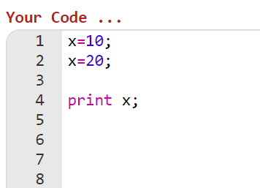
Examples of programming misconceptions
A variable holds multiple values
A variable remembers old values
Possible answers with misconceptions effect:
10, 20
10
30

Slide 11
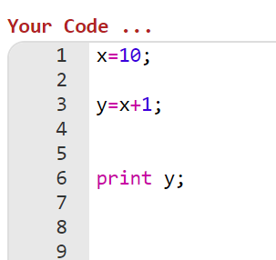
Examples of programming misconceptions
A variable holds expressions not values
Possible answers with misconceptions effect:
x+1

Slide 12
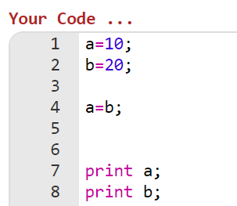
Examples of programming misconceptions
Difficulty to understand assignment direction
Opposite way? Swapping values?
Possible answers with misconceptions effect:
a=10, b=10 (opposite direction)
a=20, b=10 (swap)

Slide 13
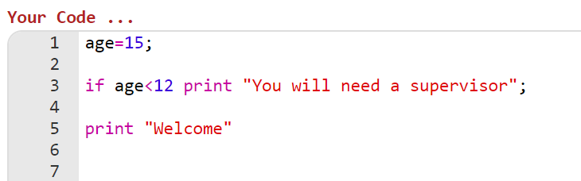

Examples of programming misconceptions
Condition statements without ELSE stops execution when condition is false
Possible answers with misconceptions effect:
Prints nothing

Slide 14
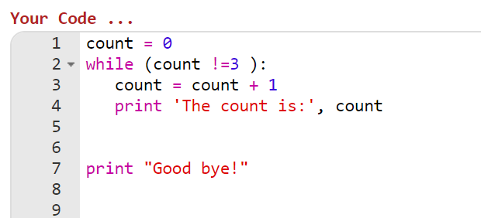
Examples of programming misconceptions
Loop exits as soon as condition becomes false
Adjacent code gets executed
Possible answers with misconceptions effect:
The count is: 1
The count is: 2
Good bye!
The count is: 1
Good bye!
The count is: 2
Good bye!
The count is: 3
Good bye!

Slide 15
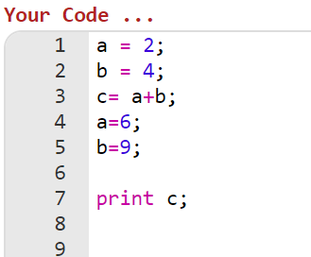
Examples of programming misconceptions
Difficulty to recognize the sequence of execution
Possible answers with misconceptions effect:
6
Notes:
Challenges to identify misconceptions in programming
To determine the misconception and its origin in computer science is even more difficult than other sciences
Programming exercises involve a great deal of problem solving: connecting the pieces from different concepts together to come up with a solution. Usually it is diffcult to isolate only one concept in a realistic way
the assesment of students knowledge in programming is usually done through questions that requires tracing and debugging a pieace of code, and some students struggle with that and lack that skill in particular

Slide 16
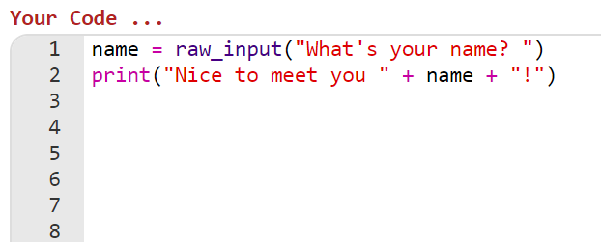

Examples of programming misconceptions
Difficulty to recognize the sequence of execution
Possible misconceptions:
Not recognizing the necessity to user-input
Notes:
Challenges to identify misconceptions in programming
To determine the misconception and its origin in computer science is even more difficult than other sciences
Programming exercises involve a great deal of problem solving: connecting the pieces from different concepts together to come up with a solution. Usually it is diffcult to isolate only one concept in a realistic way
the assesment of students knowledge in programming is usually done through questions that requires tracing and debugging a pieace of code, and some students struggle with that and lack that skill in particular

Slide 17
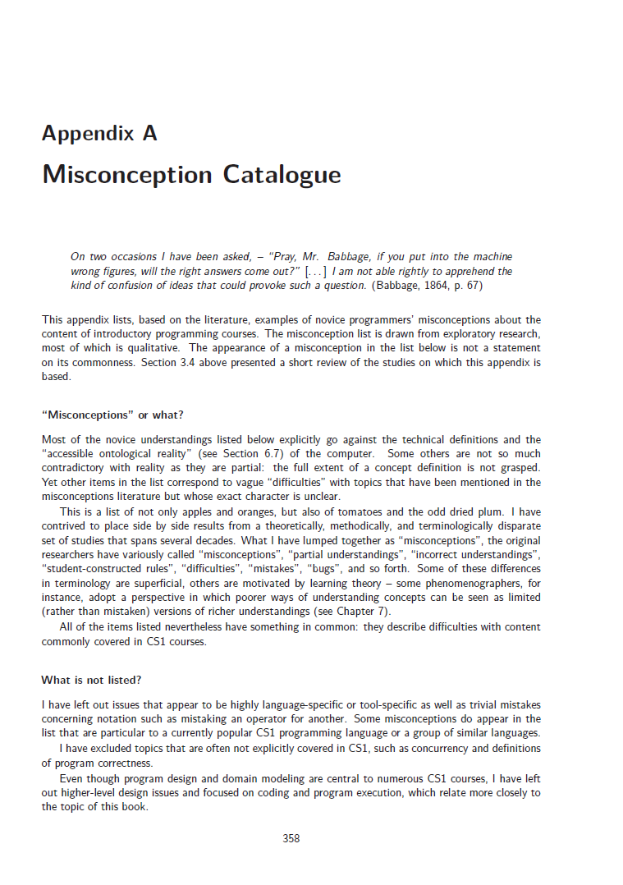
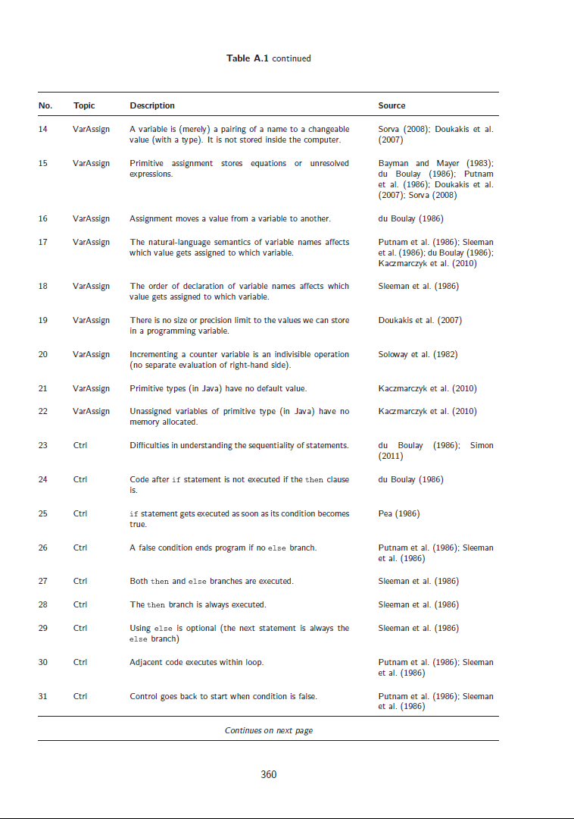
Examples of programming misconceptions
162 misconceptions
J. Sorva. 2012. Visual program simulation in introductory programming education. http://urn.fi/URN:ISBN:978-952-60-4626-6

Slide 18
Effect of misconceptions
Misconceptions increases the sense of programming difficulty
Cause direct errors/mistakes in code comprehension and code writing
For students and novices:
Misconceptions on the long run cause the students to drop programming education (as early as the introductory courses)^{[2]}
[2] L. Ma. 2007. Investigating and improving novice programmers mental models of programming concepts. PhD Thesis. University of Strathclyde, UK.

Slide 19
Eliminating the (effect of) misconceptions
Challenging characteristics:
Misconceptions start early
Misconceptions are stubborn and persistent
Ego-centric: what I think is important
In programming education it is more difficult to identify the origin:
Programming involve a great deal of problem solving
Exercises require tracing/debugging skills
Notes:
Programming exercises involve a great deal of problem solving: connecting the pieces from different concepts together to come up with a solution. Usually it is difficult to isolate only one concept in a realistic way
the assessment of students knowledge in programming is usually done through questions that requires tracing and debugging a piece of code, and some students struggle with that and lack that skill in particular
Countering
It is difficult for people (students included) to reject their own ideas
In psychology this is understandable within the ego-centric human nature: what “I” think is important
Therefore educators should carefully address
the approach: only instructive knowledge is not helpful, people should discover by themselves: concept outline + guided exercise with enough scaffolding support then followed by free exploaration
Do not use outline the wrong ideas, embrace them and move from there
Self-observing is key
Misconceptions are countered best by allowing students to observe wrongful thought

Slide 20
Eliminating the (effect of) misconceptions
Developing teaching approaches and materials that
Recognize misconceptions based on age, language/paradigm
Contain thoughtful examples [less likely to induce misconceptions]
Include guided exploration with enough scaffolding
Allow self-observation by students
Notes:
Programming exercises involve a great deal of problem solving: connecting the pieces from different concepts together to come up with a solution. Usually it is difficult to isolate only one concept in a realistic way
the assessment of students knowledge in programming is usually done through questions that requires tracing and debugging a piece of code, and some students struggle with that and lack that skill in particular
Countering
It is difficult for people (students included) to reject their own ideas
In psychology this is understandable within the ego-centric human nature: what “I” think is important
Therefore educators should carefully address
the approach: only instructive knowledge is not helpful, people should discover by themselves: concept outline + guided exercise with enough scaffolding support then followed by free exploaration
Do not use outline the wrong ideas, embrace them and move from there
Self-observing is key
Misconceptions are countered best by allowing students to observe wrongful thought

Slide 21
What is still needed:
More focus on visual languages
With programming part of school curricula
Do VL/Block-based languages induce other misconceptions?
Do the children at that age suffer from same/different misconceptions?
Do the use of VL induce transfer-misconceptions when moving to textual languages?
IDE support to detect and suggest corrections to misconceptions
Similar to code smells and refactoring

Slide 22
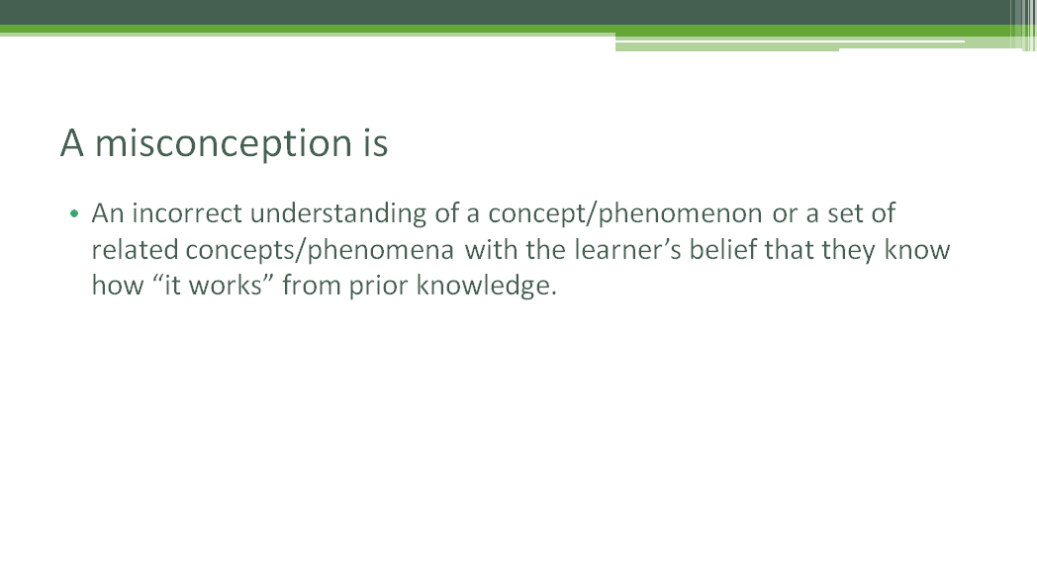
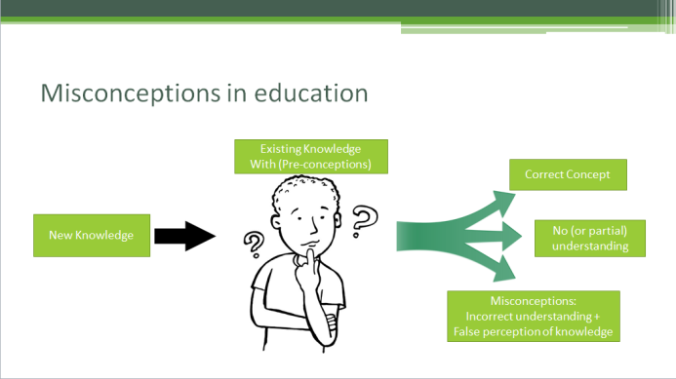
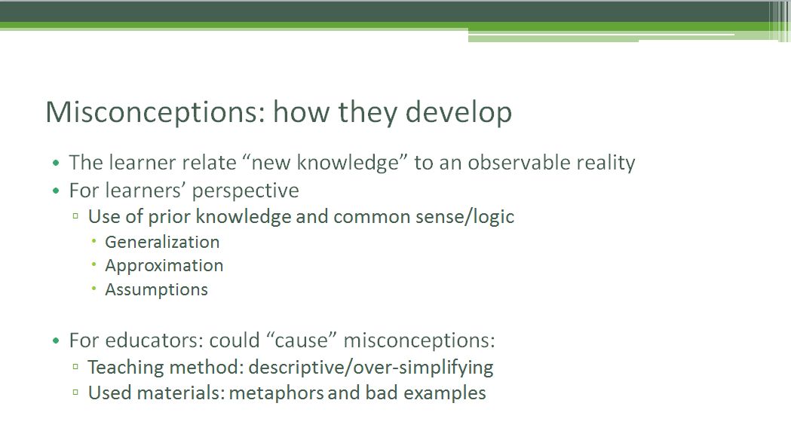
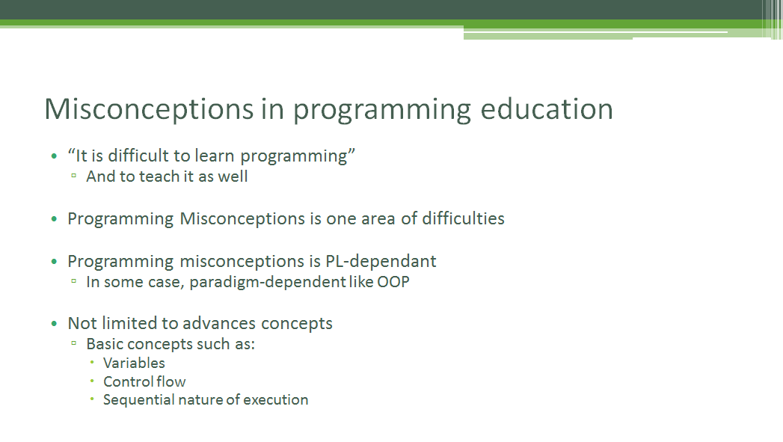
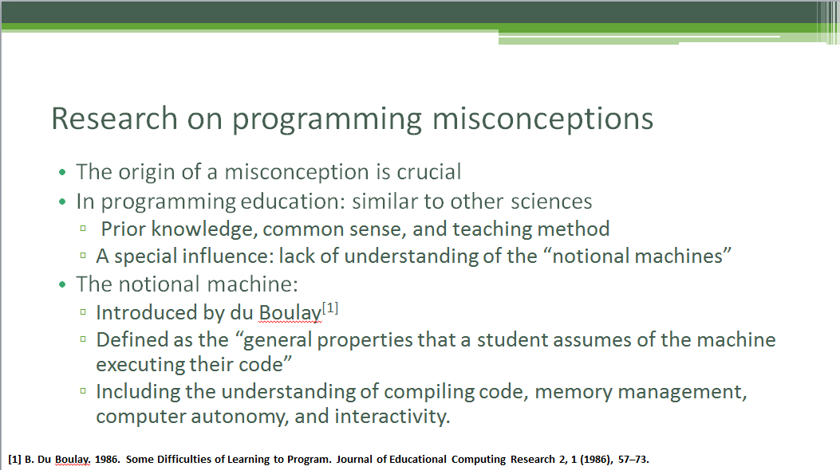
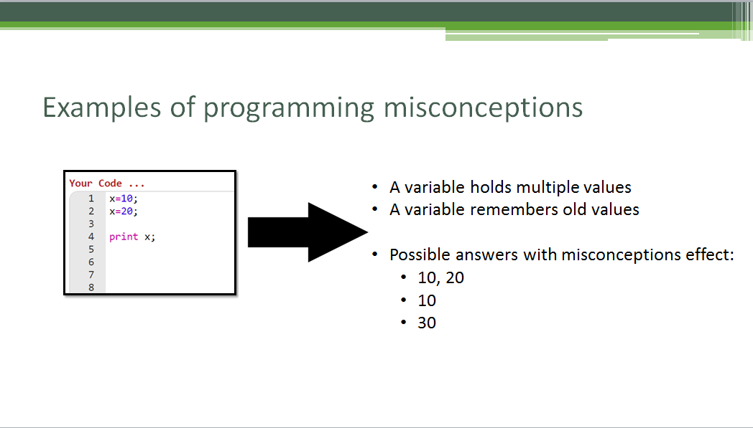
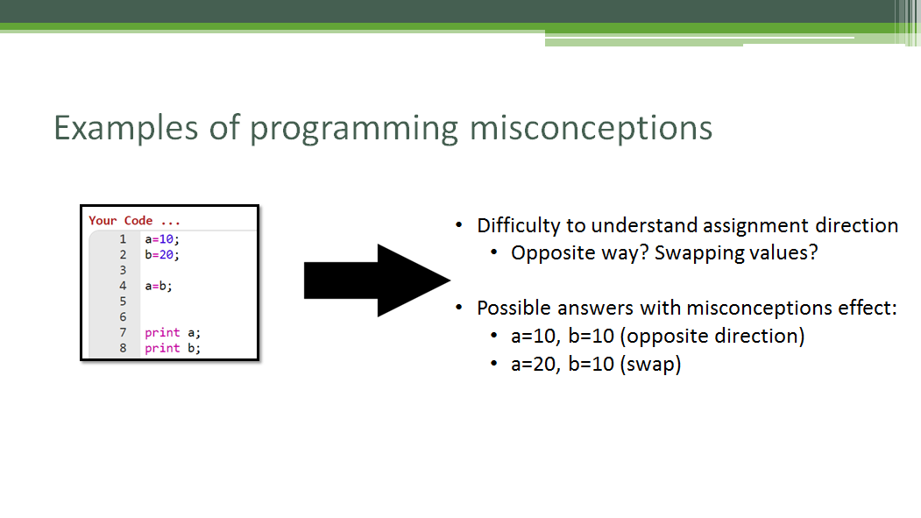
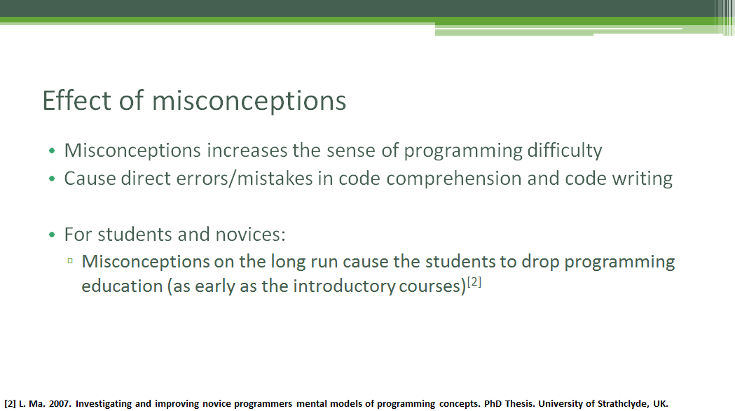
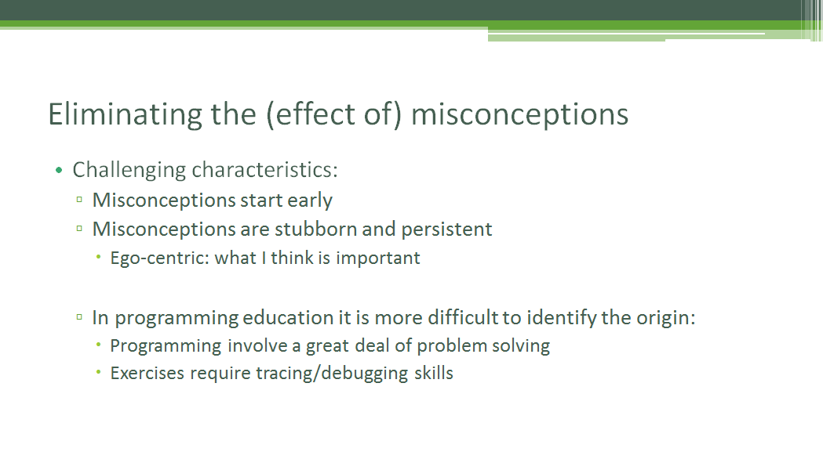
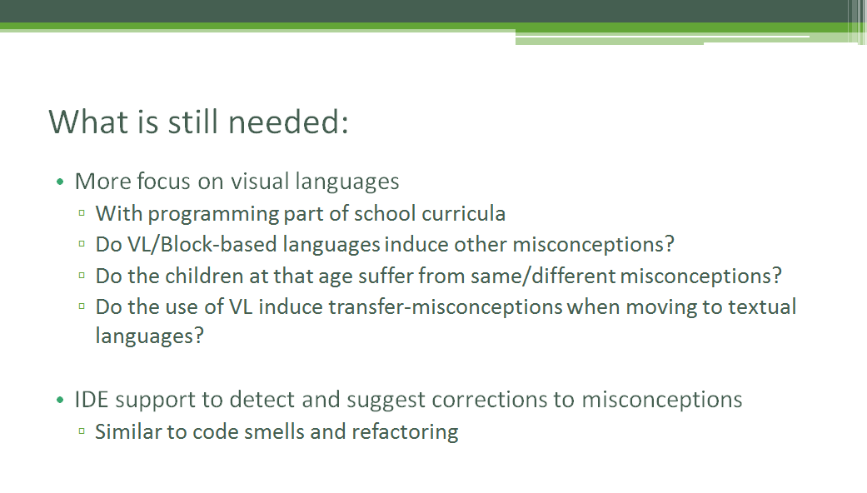

Slide 23
Thank you!
Discuss further ideas and collaborations? Ping me
Alaaeddin.Swidan [at] {tudelft.nl | live.com}
Twitter: @aeswidan

