Slide 1
Programming Misconceptions

Slide 2
Agenda
Programming misconceptions: definition and history
Misconceptions on which (programming) language
(Some) Examples and categories of programming misconceptions
Effect of programming misconceptions on CS Education
Origins of programming misconceptions
A lot is done. What do we need to do still?

Slide 3
A programming misconception
An incorrect understanding of a concept or a set of concepts, which leads to making mistakes in writing or reading programs

Slide 4
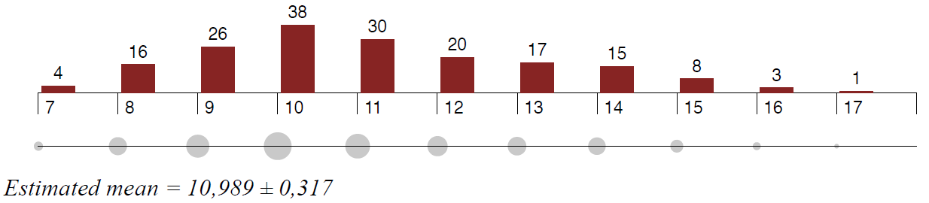
Participants: 178 school-age children

Slide 5
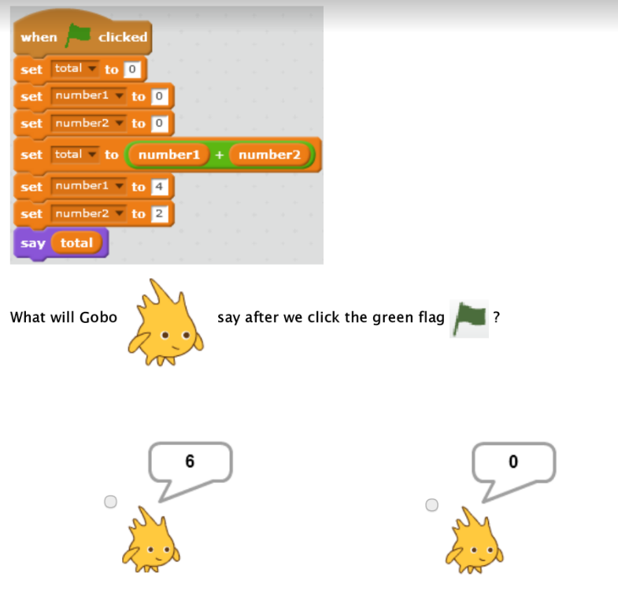
M23: Diffculties in understanding the sequentiality of statements

Slide 6
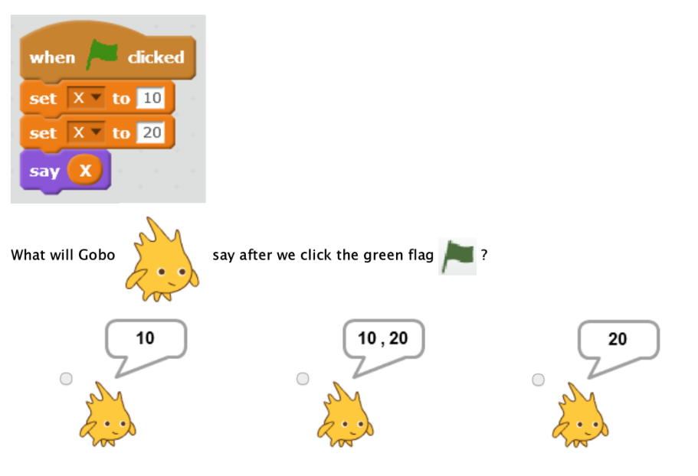
M9: A variable can hold multiple values at a time

Slide 7
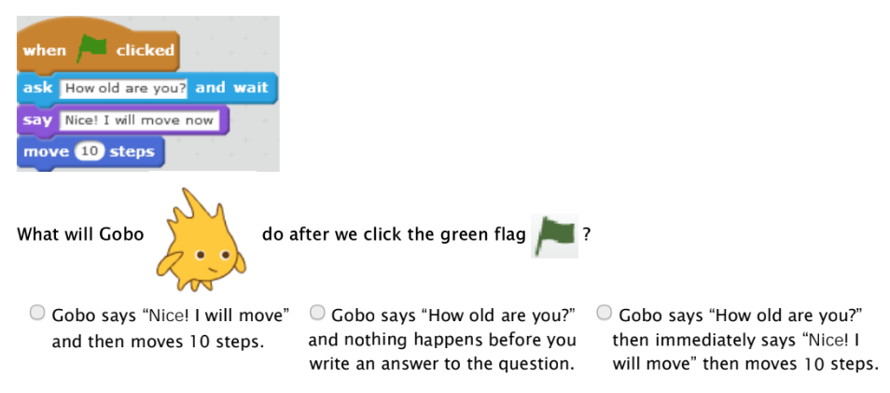
M150: Diffculties understanding the eﬀect of input calls on execution

Slide 8
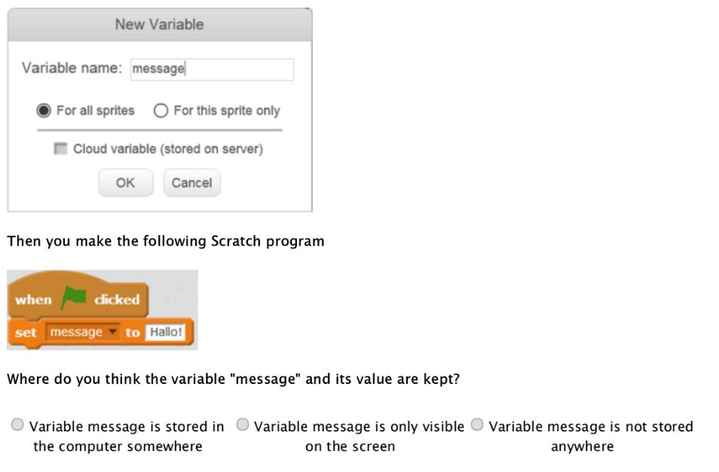
M14: A variable is a pairing of a name to a changeable value. It is not stored inside the computer

Slide 9
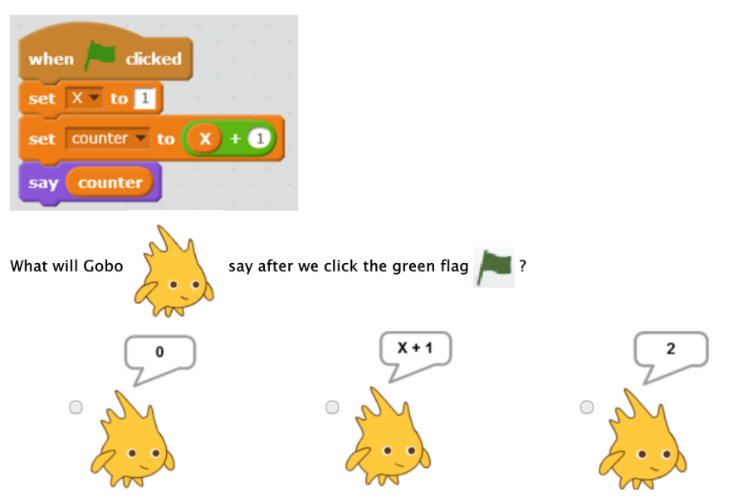
M15: Primitive assignment stores equations or unresolved expressions

Slide 10
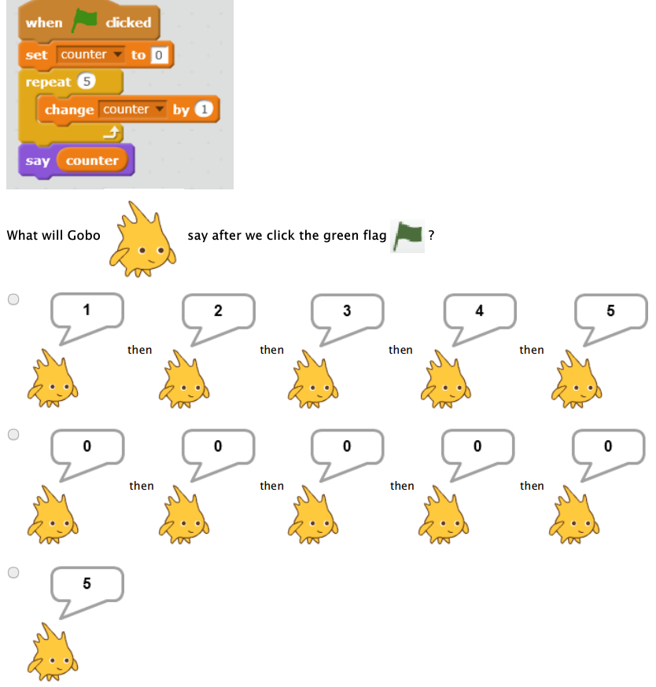
M30: Adjacent code executes within loop

Slide 11
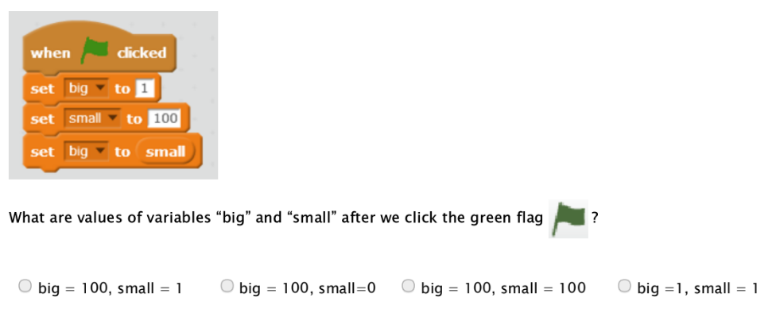
M17: Natural-language semantics of variable names aﬀects which value gets assigned to which variable

Slide 12
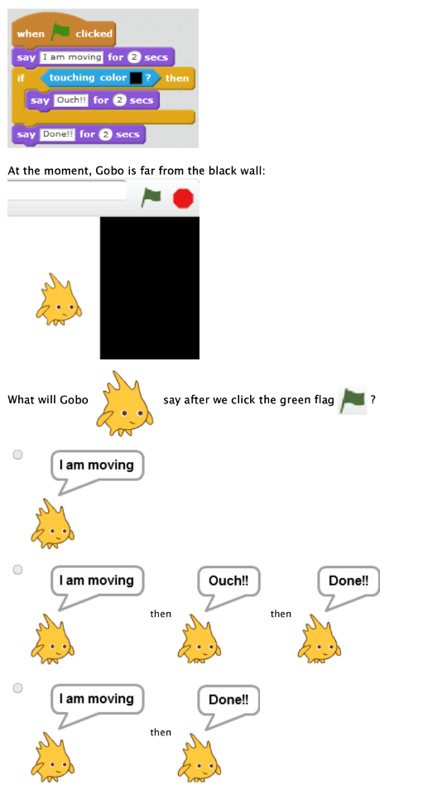
M31: Control goes back to start when condition is false

Slide 13
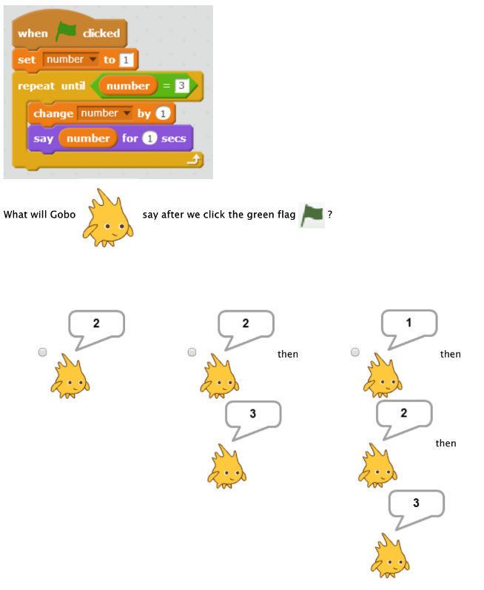
M33: Loops terminate as soon as condition changes to false

Slide 14
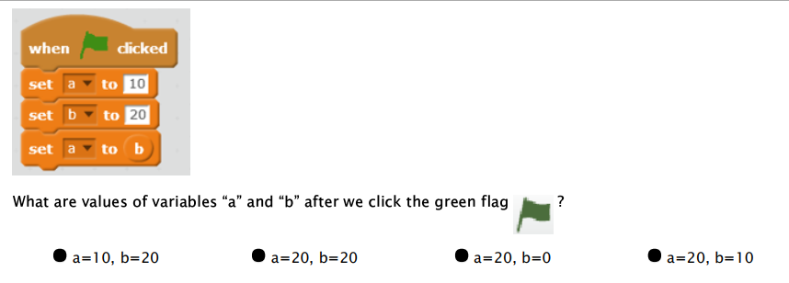
M11: Primitive assignment works in opposite direction

Slide 15
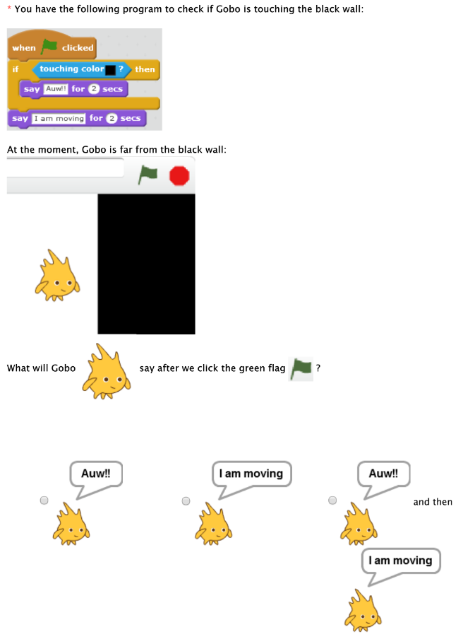
M26: A false condition ends program if no else branch exists

Slide 16
