Slide 1
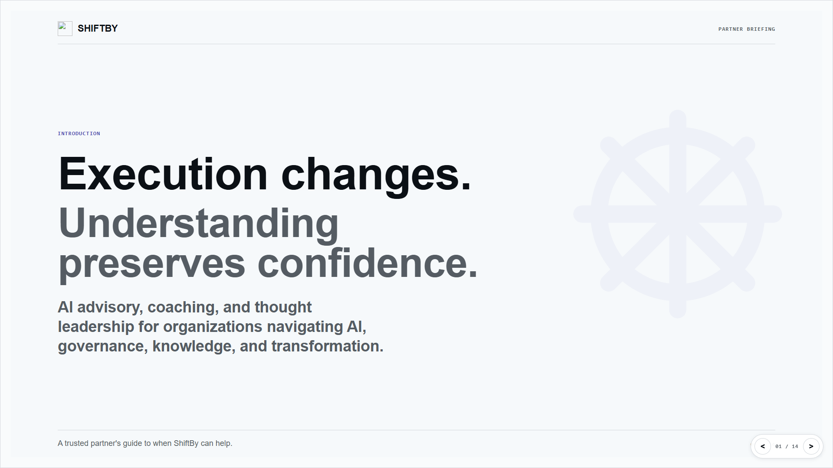

Slide 2
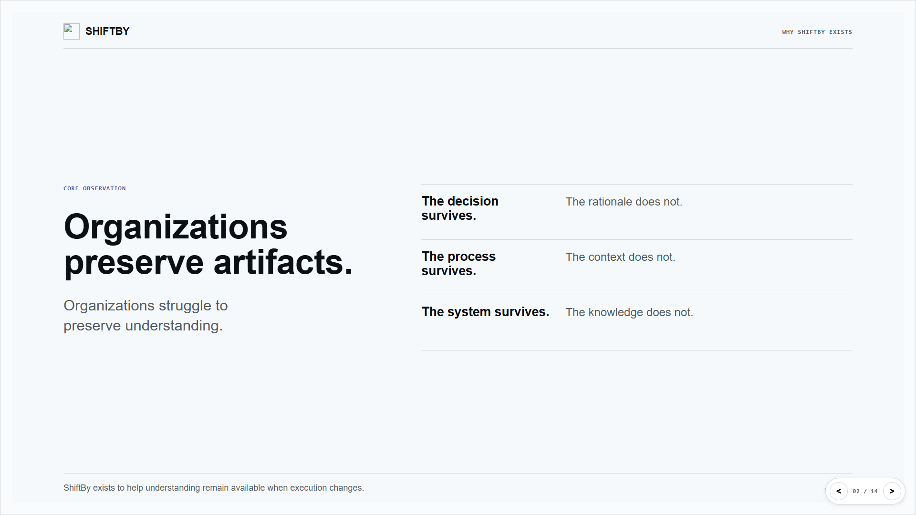

Slide 3
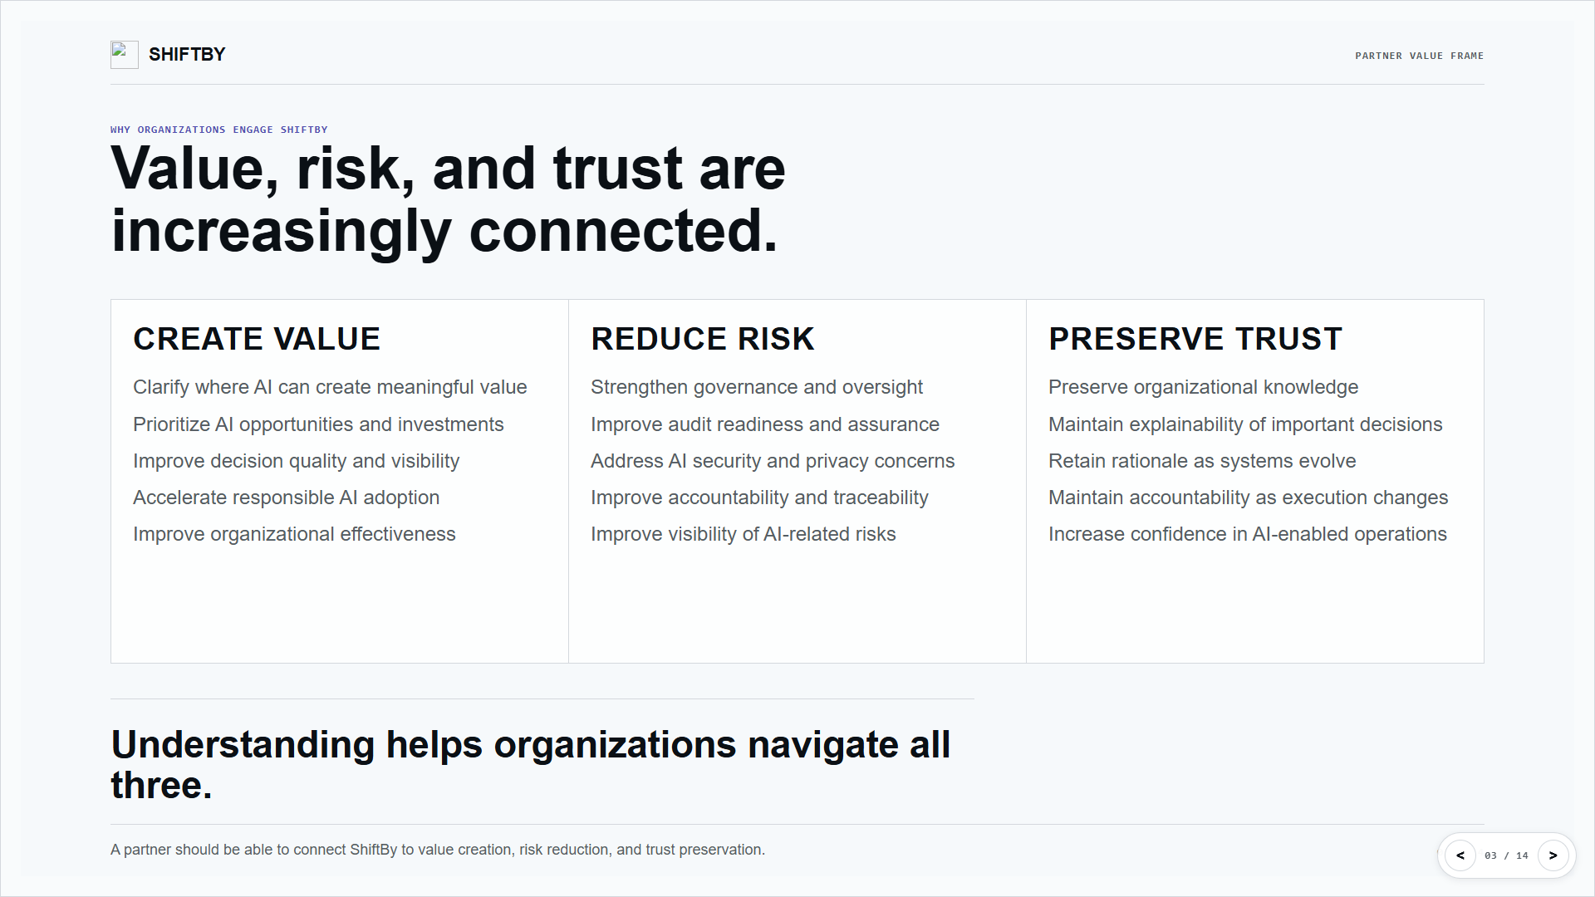

Slide 4
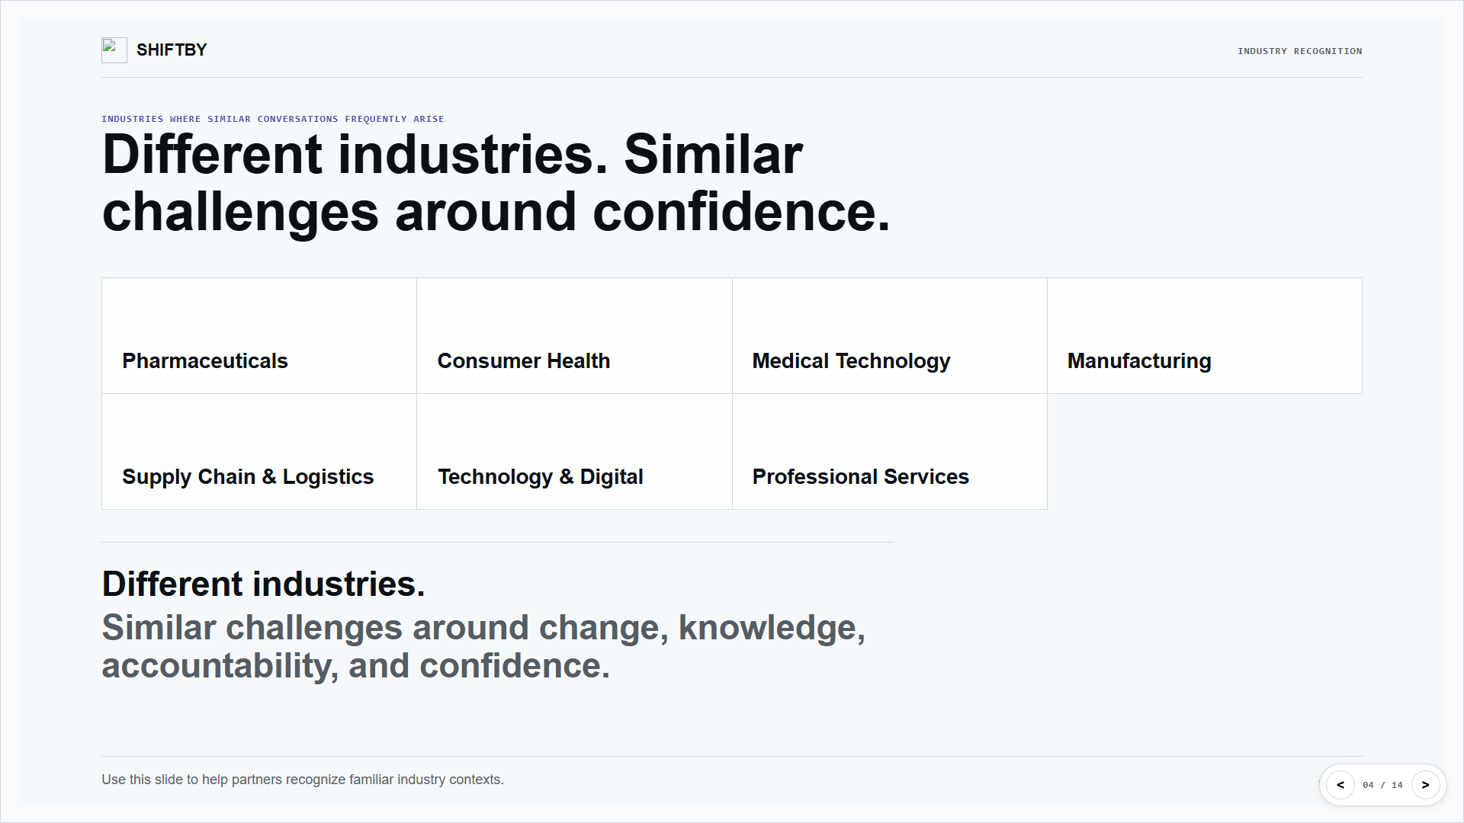

Slide 5
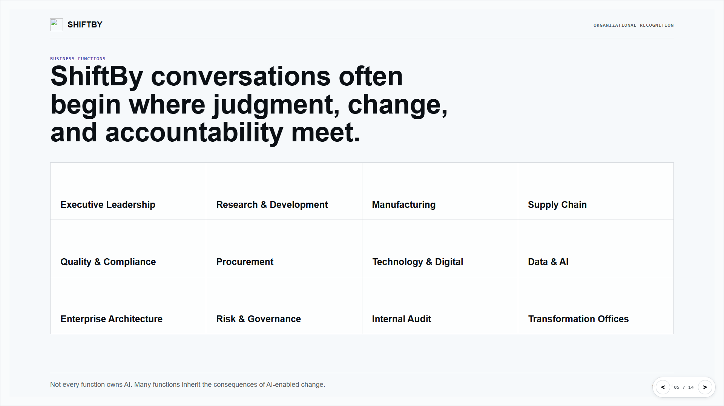

Slide 6
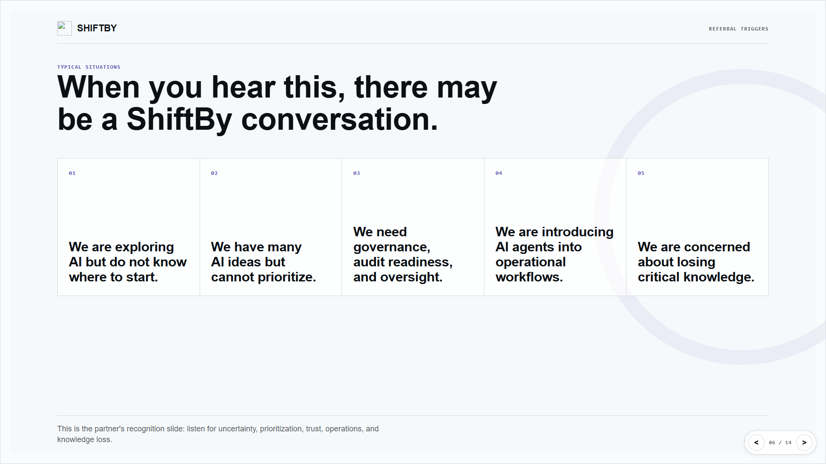

Slide 7
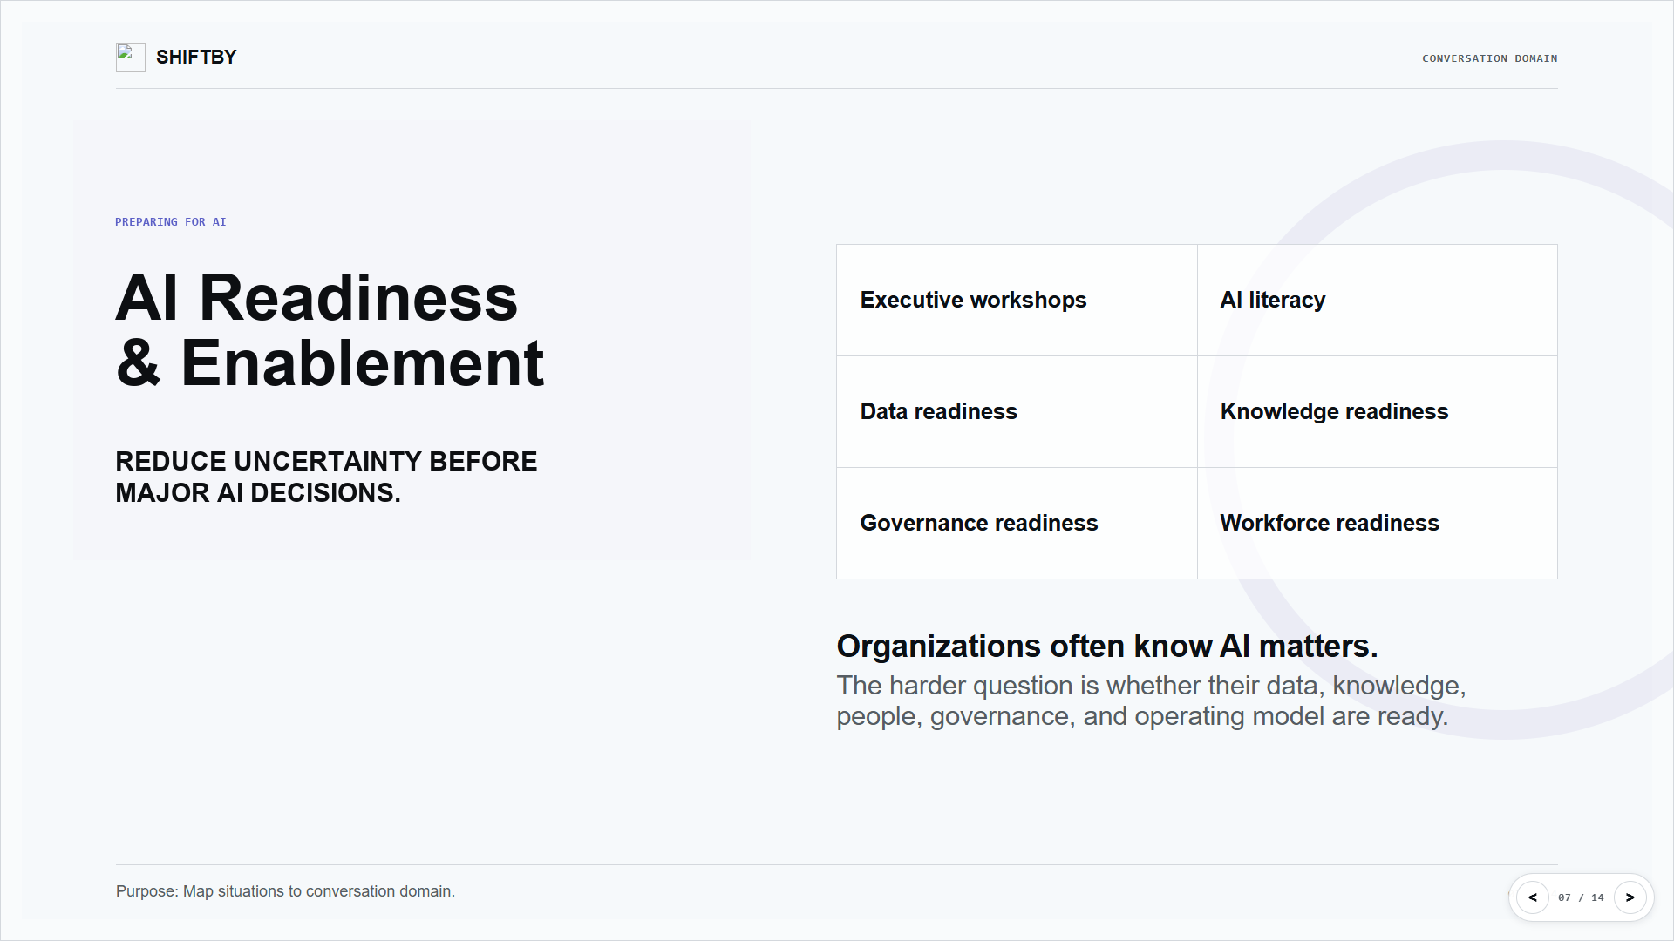

Slide 8
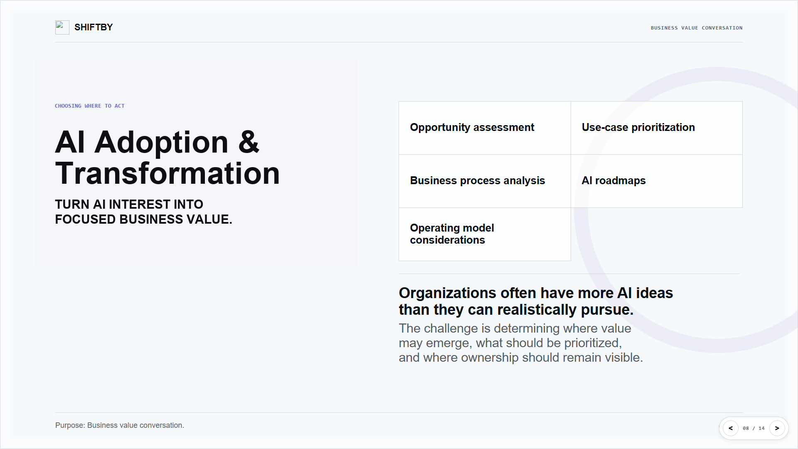

Slide 9
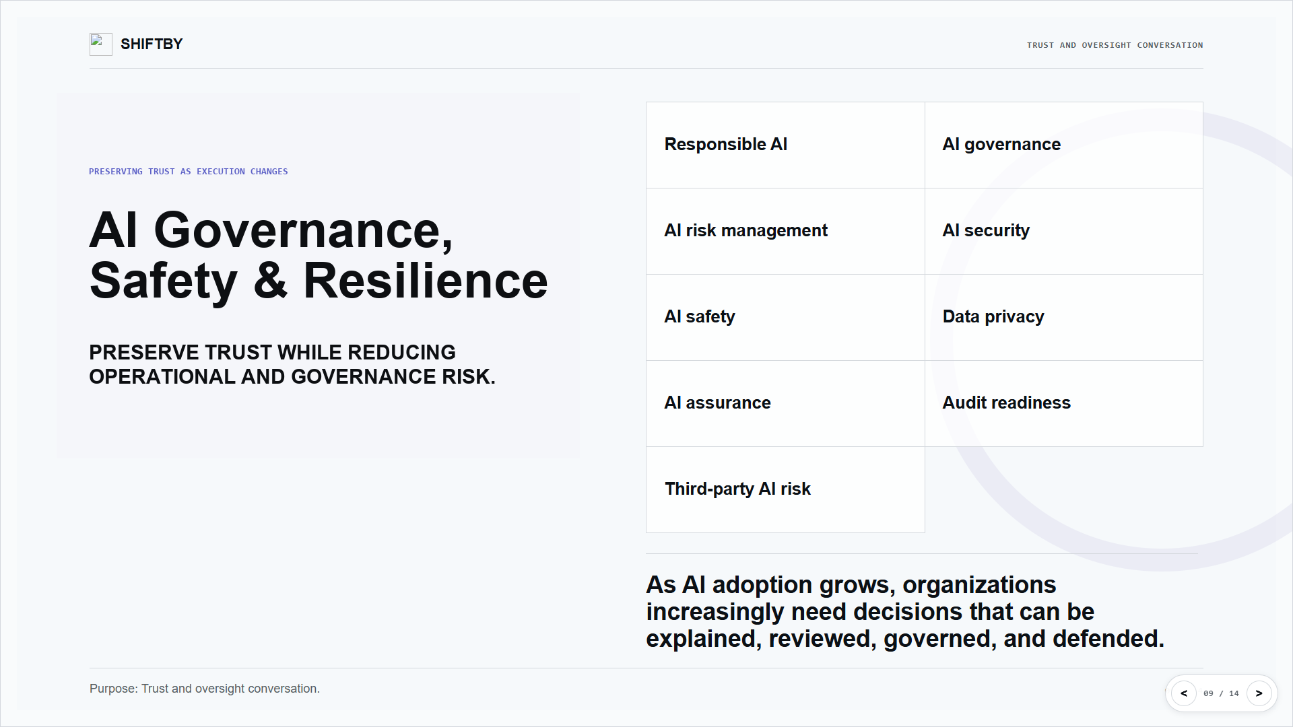

Slide 10
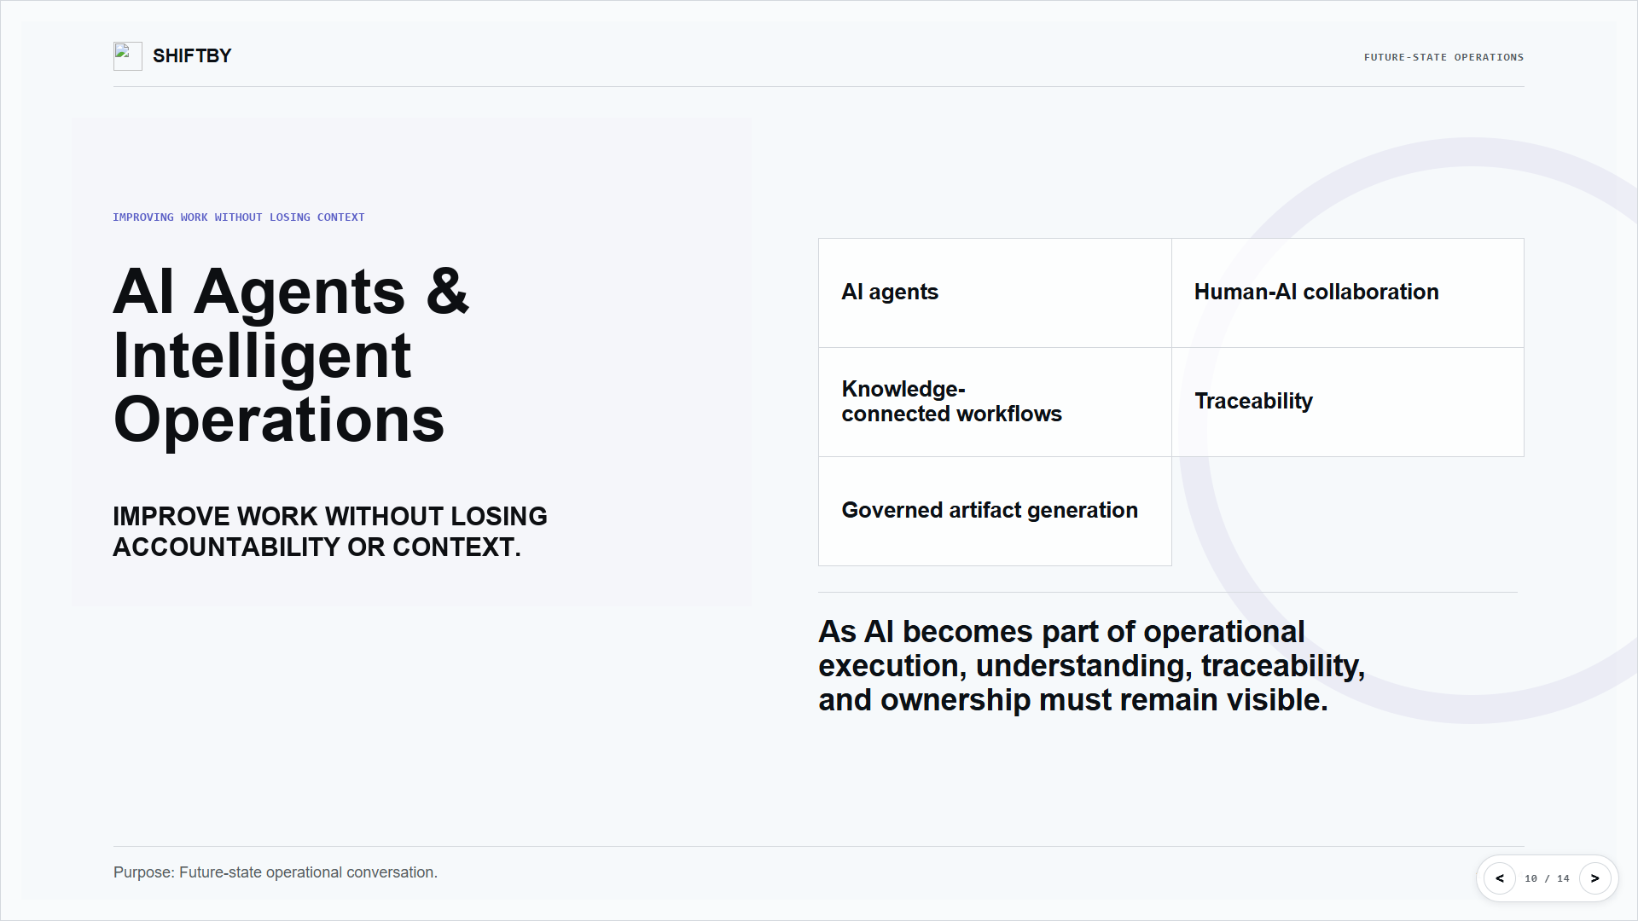

Slide 11
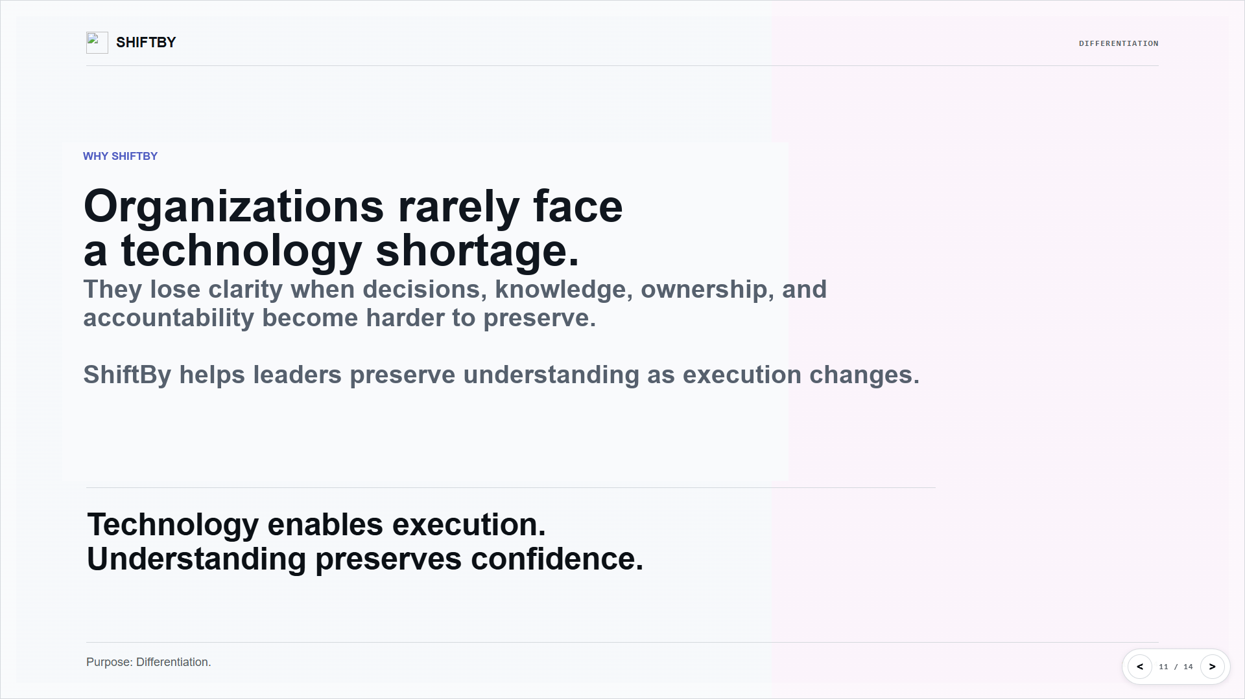

Slide 12
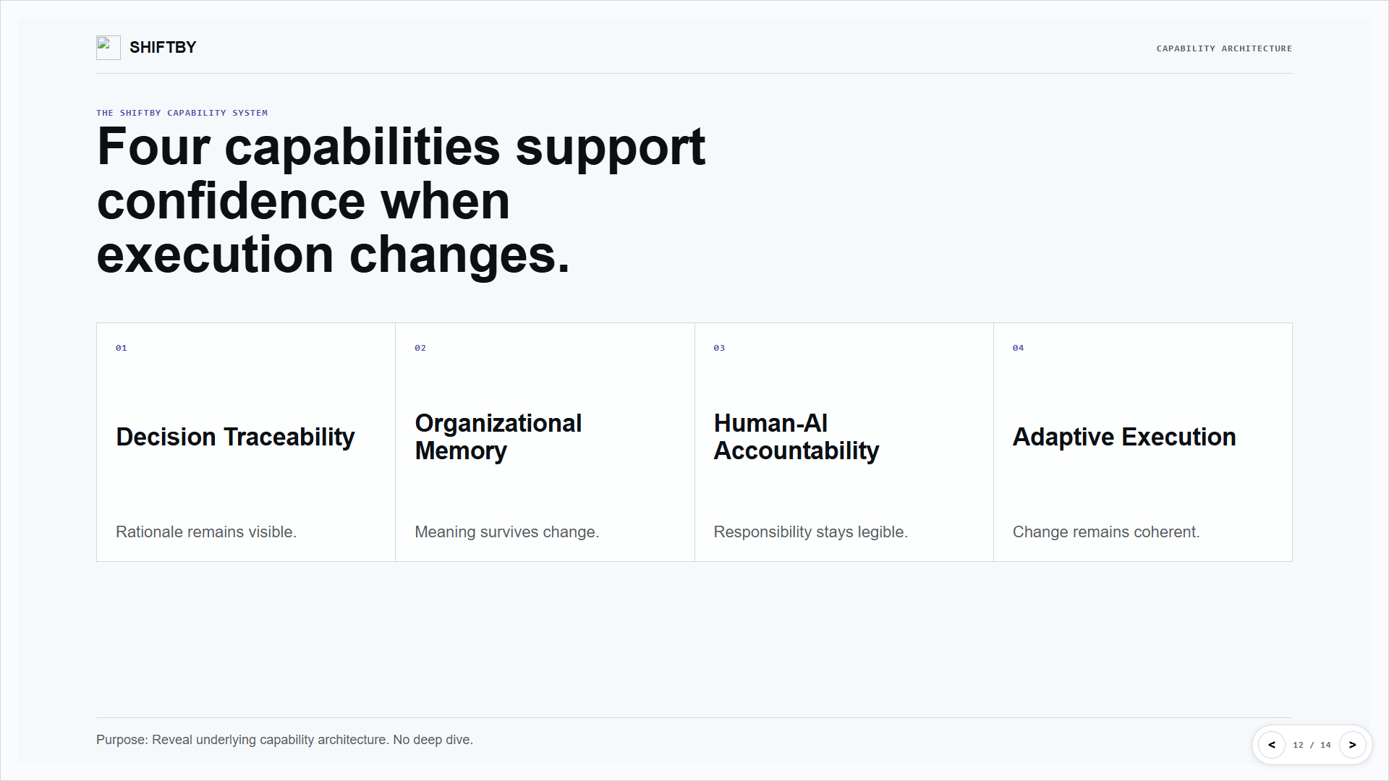

Slide 13
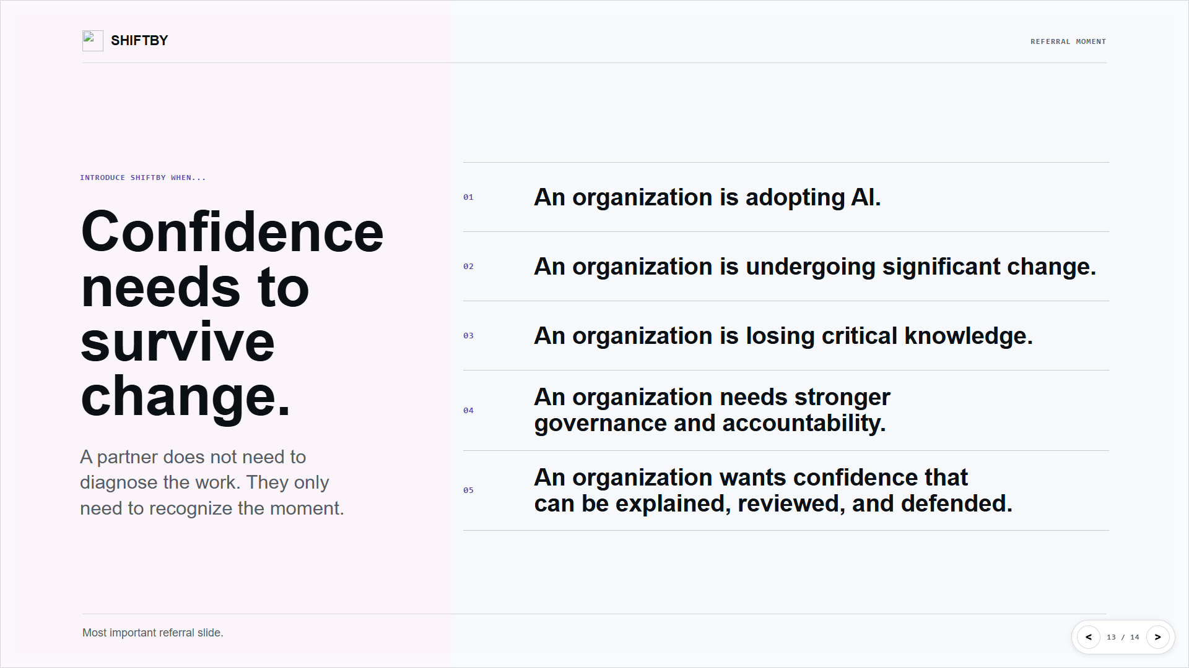

Slide 14
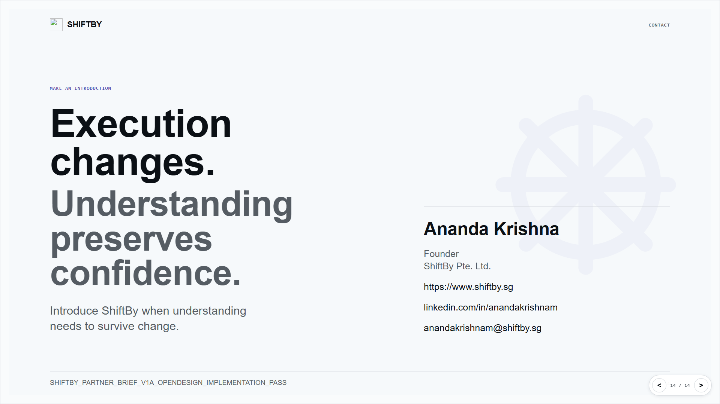

Slide 15

SHIFTBY
POSITIONING
POSITIONING
How partners should position ShiftBy in 20 seconds.
Say this
ShiftBy helps leaders preserve understanding when execution changes.
It is most useful when decisions, knowledge, ownership, and accountability become harder to keep connected.
ShiftBy is a Singapore-based, founder-led advisory practice. It helps leaders preserve understanding when execution becomes distributed across people, systems, suppliers, automation, and AI.
Best used when a customer says:
AI adoption
Governance and assurance
Knowledge loss and drift
Partner talk track: make the value easy to repeat.
15 / 18

Slide 16
SHIFTBY
ENGAGEMENT MODEL
ENGAGEMENT MODEL
How ShiftBy engages.
The work usually starts with a focused advisory conversation, then expands only where the organization needs more clarity, confidence, and action.
Advisory
Workshops
Capability mapping
Ongoing support
Clarify direction, decisions, and priorities before work broadens.
Align leadership teams around the challenge and the next move.
Map traceability, memory, accountability, and execution into a working picture.
Stay with the work as priorities, risks, and decisions continue to change.
Start small. Move fast. Deepen only where the organization needs it.
Commercial clarity: how ShiftBy typically engages.
16 / 18

Slide 17
SHIFTBY
TYPICAL OUTCOMES
OUTCOMES
What a good engagement should leave behind.
Clearer decisions
Recoverable context
Stronger accountability
A sharper view of what is being decided, who owns it, and why it matters.
The aim is not more discussion. It is better decision quality.
A better ability to reconstruct the rationale, evidence, and change history behind important work.
That makes the organization easier to explain and defend.
Clearer ownership across teams, systems, suppliers, automation, and AI.
Confidence becomes easier to preserve when responsibility stays visible.
The outcome is practical: more confidence, less drift, and a better basis for action.
Commercial value: what the engagement should leave behind.
17 / 18

Slide 18
SHIFTBY
SINGAPORE / APAC
SINGAPORE CONTEXT
Built for Singapore conversations, with APAC leadership context.
ShiftBy is positioned for Singapore-based leaders and partner conversations where AI, governance, knowledge, and execution intersect.
Singapore-based
APAC leadership
Local contact signal
Founder-led advisory work rooted in Singapore and relevant for local enterprise conversations.
Useful for regional operating environments where execution, governance, and knowledge move across teams.
Vision Exchange, 2 Venture Drive, #19-18, Singapore 608526.
anandakrishnam@shiftby.sg
ShiftBy Pte. Ltd.
For partner sharing in Singapore and the region.
Singapore context: local, founder-led, APAC-aware.
18 / 18

