Slide 1
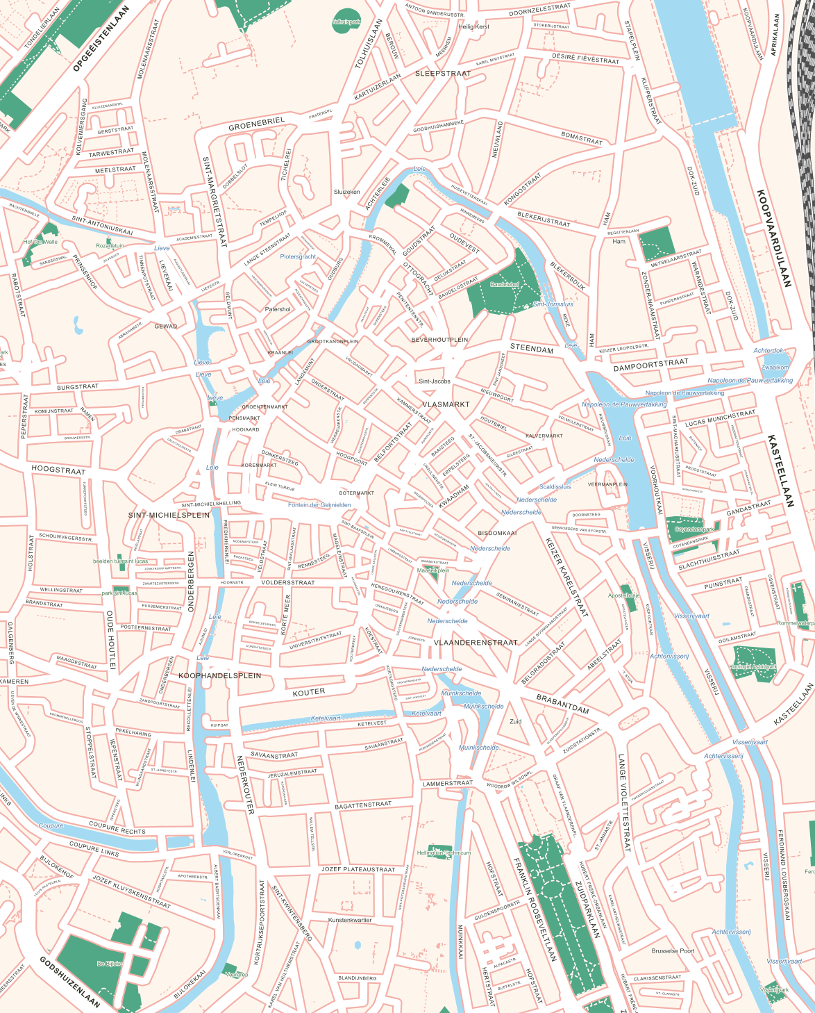
USE-IT DESIGN WORKSHOP
MAP
EXPORT
Your city.
An editable map.
coen.at/mapexport
Map data © OpenStreetMap contributors
Notes:
Welcome. Today we will turn a city area into an editable SVG, explore its layers, then export our own cities. Suggested flow: 10 minutes introduction, 5 minutes live demo, 20 minutes hands-on and 10 minutes discussion. Timings are adjustable. The map shown is the live Gent export included with this deck.
Sources: live https://coen.at/mapexport/ inspected and exported 13 September 2026; repository README.md, script.js and references/How to draw a good street map.md. Map data © OpenStreetMap contributors (ODbL), https://www.openstreetmap.org/copyright .

Slide 2
THE PROBLEM
LESS REPETITION. MORE LOCAL CHARACTER.
Before you can tell the story
of a city, you need a base map.
What if the
first draft
was already
there?
01
Trace streets and blocks
Build a clear street hierarchy.
02
Place and check names
Keep labels readable and editable.
MAPEXPORT / USE-IT · Map data © OpenStreetMap contributors
02
Notes:
Ask for a quick show of hands: who has traced a base map manually? MapExport tackles repetitive groundwork: streets, blocks and street labels. Do not promise a measured time saving. The amount of cleanup depends on the city and the source data.
Sources: live https://coen.at/mapexport/ inspected and exported 13 September 2026; repository README.md, script.js and references/How to draw a good street map.md. Map data © OpenStreetMap contributors (ODbL), https://www.openstreetmap.org/copyright .

Slide 3
THE RESULT
A BASE MAP YOU CAN MAKE YOUR OWN
Editable SVG
Separate layers and groups
Vector shapes and street labels
A starting point for your
USE-IT visual language
Gent / live export
MAPEXPORT / USE-IT · Map data © OpenStreetMap contributors
03
Notes:
Point out water, roads, parks and blocks. SVG is a vector file: it can be scaled and edited in a vector editor. This is a base map, not a complete travel guide. Sample: presentations/assets/ghent-demo.svg.
Sources: live https://coen.at/mapexport/ inspected and exported 13 September 2026; repository README.md, script.js and references/How to draw a good street map.md. Map data © OpenStreetMap contributors (ODbL), https://www.openstreetmap.org/copyright .

Slide 4
HOW IT WORKS
FROM OPEN DATA TO YOUR DESIGN
01
Choose an area
Find your city and draw a rectangle.
02
Get the map features
MapExport retrieves OpenStreetMap data.
03
Build the base map
It draws roads, derives blocks and places labels.
04
Continue in your editor
Download an SVG and open it in Illustrator or Inkscape.
MAPEXPORT / USE-IT · Map data © OpenStreetMap contributors
04
Notes:
OpenStreetMap provides geographical data. MapExport transforms those features into a designed SVG, including computed city blocks and road labels. City blocks are areas between roads, not individual building footprints. Data coverage and quality vary by location.
Sources: live https://coen.at/mapexport/ inspected and exported 13 September 2026; repository README.md, script.js and references/How to draw a good street map.md. Map data © OpenStreetMap contributors (ODbL), https://www.openstreetmap.org/copyright .

Slide 5
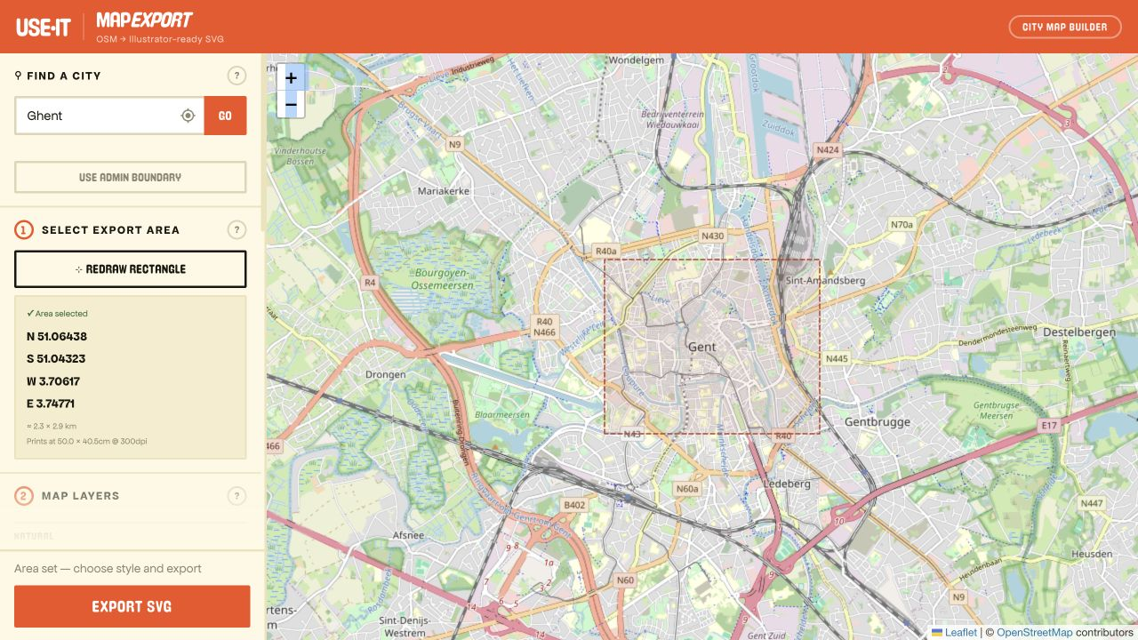
IN THE BROWSER
MEET YOUR WORKSPACE
1 Find a city
2 Draw an area
3 Choose layers
MAPEXPORT / USE-IT · Map data © OpenStreetMap contributors
05
Notes:
Open https://coen.at/mapexport/ . The controls are on the left, the map on the right. Search, pick the matching location and use Draw rectangle. Screenshot captured from the live site, 13 September 2026. Live controls may evolve.
Sources: live https://coen.at/mapexport/ inspected and exported 13 September 2026; repository README.md, script.js and references/How to draw a good street map.md. Map data © OpenStreetMap contributors (ODbL), https://www.openstreetmap.org/copyright .

Slide 6
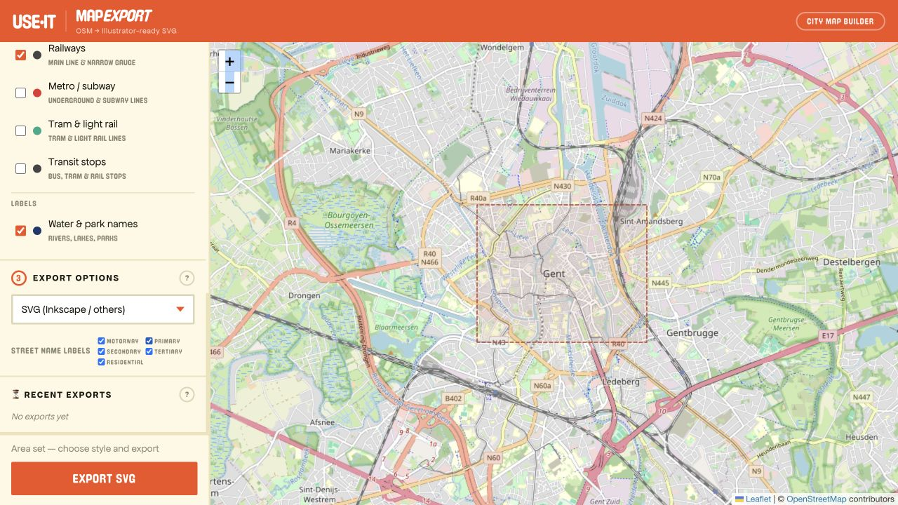
CHOOSE YOUR AREA
START WITH A WALKABLE CITY CENTRE
Keep the first area small.
Include a recognisable landmark.
Check the area and printed size.
Leave room for your eventual layout.
MAPEXPORT / USE-IT · Map data © OpenStreetMap contributors
06
Notes:
For the first exercise choose a manageable central neighbourhood, not an entire metropolitan area. In the sample the rectangle is roughly 2.3 × 2.9 km. The live interface shows approximate printed dimensions. Avoid implying that the website has an A3 selector. A larger export has more objects and may take longer.
Sources: live https://coen.at/mapexport/ inspected and exported 13 September 2026; repository README.md, script.js and references/How to draw a good street map.md. Map data © OpenStreetMap contributors (ODbL), https://www.openstreetmap.org/copyright .

Slide 7
LAYERS
CHOOSE WHAT YOUR MAP NEEDS
The essentials
Roads and city blocks
Water and green space
Street names
Add detail with purpose
For example: transit or pedestrian routes.
Keep only what helps your reader.
MAPEXPORT / USE-IT · Map data © OpenStreetMap contributors
07
Notes:
Show the layer checkboxes on the live site. Available options include water bodies, waterways, city blocks, parks/green space, roads, railways and transit features. Street-name controls include road categories. Explain that all available detail does not necessarily improve a printed USE-IT map. City blocks do not represent each individual building.
Sources: live https://coen.at/mapexport/ inspected and exported 13 September 2026; repository README.md, script.js and references/How to draw a good street map.md. Map data © OpenStreetMap contributors (ODbL), https://www.openstreetmap.org/copyright .

Slide 8
DOWNLOAD
EXPORT FOR YOUR EDITOR
ILLUSTRATOR
INKSCAPE
Choose “SVG (Illustrator)”
Choose “SVG (Inkscape / others)”
Export SVG → Download
Then use File → Open.
Export SVG → Download
Then use File → Open.
Keep the original export. Save your edits as a separate file.
MAPEXPORT / USE-IT · Map data © OpenStreetMap contributors
08
Notes:
These are the option labels observed on the live site. Use File > Open, rather than placing the SVG as a linked image in another document. Inspect Layers or Layers and Objects after opening; group/layer presentation differs between editors. Keep the original SVG for recovery.
Sources: live https://coen.at/mapexport/ inspected and exported 13 September 2026; repository README.md, script.js and references/How to draw a good street map.md. Map data © OpenStreetMap contributors (ODbL), https://www.openstreetmap.org/copyright .

Slide 9
INSIDE THE SVG
FIND THE LAYER. EDIT THE RIGHT THINGS.
Map content
Open the Layers panel.
City blocks
Expand Map content.
Toggle a layer to see what it contains.
Keep groups intact while you explore.
Parks & green space
Roads
Street names
MAPEXPORT / USE-IT · Map data © OpenStreetMap contributors
09
Notes:
This is a simplified layer list, not a screenshot of an editor. The actual Gent SVG has a Background layer and a clipped Map content parent. Expand Map content to find City blocks. Exact grouping can differ by export version and editor. Keep the crop/clipping group intact: ungrouping everything can expose geometry outside the selected area.
Sources: live https://coen.at/mapexport/ inspected and exported 13 September 2026; repository README.md, script.js and references/How to draw a good street map.md. Map data © OpenStreetMap contributors (ODbL), https://www.openstreetmap.org/copyright .

Slide 10
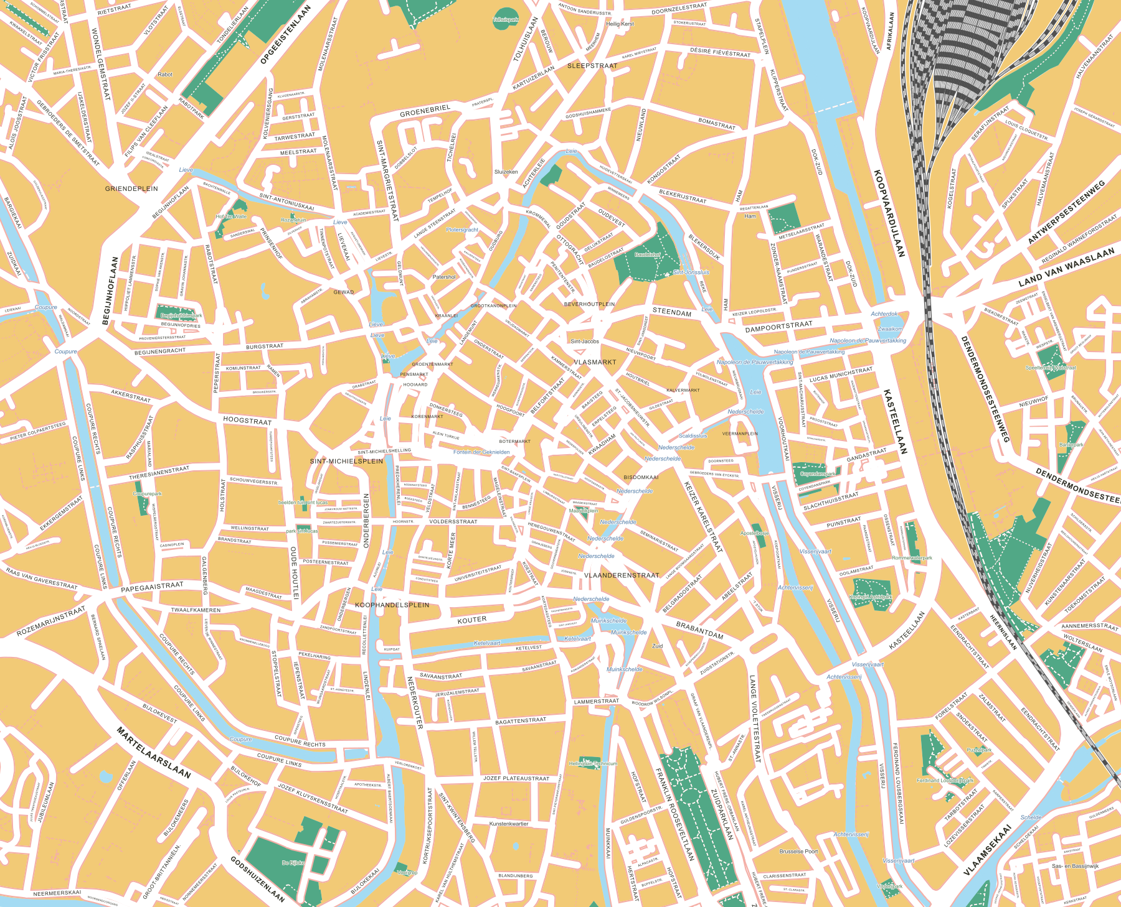
INKSCAPE / ABOUT 5 MINUTES
LIVE DEMO: CHANGE ALL THE BLOCKS
1 Open the SVG
2 Find City blocks
3 Select its blocks
4 Change the fill
BEFORE
ONE COLOUR CHANGE
581 blocks in this example. Roads, water and parks keep their colours.
MAPEXPORT / USE-IT · Map data © OpenStreetMap contributors
10
Notes:
DEMO SCRIPT
Open presentations/assets/ghent-demo.svg in Inkscape. Fit the page to the window (5). Open Layer > Layers and Objects and expand Map content. Find City blocks. Enter that layer and select its child paths, or select one block and use Edit > Select Same > Fill Color. Verify that only the city-block paths are selected: this sample contains 581. Lock unrelated layers first if their objects share the same fill. Click a palette colour or use Object > Fill and Stroke to change Fill (do not Shift-click, which changes Stroke). Water, roads and parks should retain their colours. Undo once to show that all blocks changed together. Save a separate edited SVG.
The preview on the right changes every child path in city_blocks to #F2CA76 and nothing else. It was rendered by Inkscape from the actual export. This slide is a prompt to switch to a live editor, not a recording of UI clicks. Backup: ghent-recoloured.svg.
Inkscape Select Same documentation: https://inkscape.org/en/doc/tutorials/basic/tutorial-basic.pt_BR.html/ .
Sources: live https://coen.at/mapexport/ inspected and exported 13 September 2026; repository README.md, script.js and references/How to draw a good street map.md. Map data © OpenStreetMap contributors (ODbL), https://www.openstreetmap.org/copyright .

Slide 11
FROM BASE MAP TO USE-IT MAP
YOU BRING THE LOCAL KNOWLEDGE
MapExport supplies
the groundwork.
Choose and position your local tips.
Add illustrations, symbols and character.
Check names and the street hierarchy.
Proof the map at its final printed size.
You decide what
matters to visitors.
Keep OpenStreetMap attribution in the finished map.
MAPEXPORT / USE-IT · Map data © OpenStreetMap contributors
11
Notes:
The tool does not choose the local tips, judge every label or make the final page composition. Designers still simplify, edit and proof. Before publication, check that the map is readable at the intended size, including labels and contrast. The SVG contains OSM attribution metadata, but that is not a substitute for visible attribution in the finished publication. Attribution guidance: https://www.openstreetmap.org/copyright .
Sources: live https://coen.at/mapexport/ inspected and exported 13 September 2026; repository README.md, script.js and references/How to draw a good street map.md. Map data © OpenStreetMap contributors (ODbL), https://www.openstreetmap.org/copyright .

Slide 12
HANDS-ON / SUGGESTED 20 MINUTES
YOUR CITY. YOUR TURN.
Export a small area.
Open it in your editor.
Make one change.
coen.at/mapexport
MAPEXPORT / USE-IT · Map data © OpenStreetMap contributors
12
Notes:
Invite participants to work individually or in pairs. Allow about 20 minutes, adjusting for the group. Everyone should have Illustrator or Inkscape available. Have ghent-demo.svg ready for anyone whose export is delayed so they can still practise editing.
Sources: live https://coen.at/mapexport/ inspected and exported 13 September 2026; repository README.md, script.js and references/How to draw a good street map.md. Map data © OpenStreetMap contributors (ODbL), https://www.openstreetmap.org/copyright .

Slide 13
HANDS-ON / PART 1
YOUR FIRST EXPORT
01
Find your city
Draw a rectangle around a familiar central area.
02
Choose your layers and SVG format
Pick the format that matches your editor.
03
Export, download and open
Use File → Open in Illustrator or Inkscape.
Success: you can see your city and inspect its layers or groups.
MAPEXPORT / USE-IT · Map data © OpenStreetMap contributors
13
Notes:
Walk around and help participants with the boundary, format choice and opening the file. Ask them to keep the original download. A successful first export matters more than choosing the perfect final map extent.
Sources: live https://coen.at/mapexport/ inspected and exported 13 September 2026; repository README.md, script.js and references/How to draw a good street map.md. Map data © OpenStreetMap contributors (ODbL), https://www.openstreetmap.org/copyright .

Slide 14
HANDS-ON / PART 2
MAKE THE FILE YOURS
01
Change all city blocks to a new colour
Select the block paths together. Keep roads and water unchanged.
02
Explore the structure
Hide one layer, restore it, then find a street label.
03
Save a working copy
Keep one observation to share with the group.
Done early? Compare the result with a place you know well.
MAPEXPORT / USE-IT · Map data © OpenStreetMap contributors
14
Notes:
Participants can use either editor. Inkscape: use the demo workflow. Illustrator: expand the relevant group in Layers, select its child block paths and change Fill; Select > Same > Fill Color can help if only the intended objects use that colour. Check the selection before recolouring. Ask participants to note one concrete issue or useful feature for discussion.
Sources: live https://coen.at/mapexport/ inspected and exported 13 September 2026; repository README.md, script.js and references/How to draw a good street map.md. Map data © OpenStreetMap contributors (ODbL), https://www.openstreetmap.org/copyright .

Slide 15
WORKSHOP HELP
KEEP MOVING IF SOMETHING GETS STUCK
01
Export taking a while?
Watch the progress message. Try a smaller area for the next export.
02
Need a file to practise with?
Use the included Gent SVG while your own export finishes.
03
File looks unexpected in your editor?
Check the SVG format, fonts and layer visibility.
A useful bug report: city + selected area + editor + what you expected.
MAPEXPORT / USE-IT · Map data © OpenStreetMap contributors
15
Notes:
MapExport relies on public map-data services, which can be slow or temporarily unavailable. Do not have everyone repeatedly click export at once. For workshop continuity, use presentations/assets/ghent-demo.svg. If text looks different, inspect any missing-font warning and compare with the browser preview. Record precise reproduction steps and, where useful, a screenshot.
Sources: live https://coen.at/mapexport/ inspected and exported 13 September 2026; repository README.md, script.js and references/How to draw a good street map.md. Map data © OpenStreetMap contributors (ODbL), https://www.openstreetmap.org/copyright .

Slide 16
OPEN DISCUSSION
WHAT SHOULD MAPEXPORT DO BETTER?
What saved you work?
What was confusing?
What is missing for your city?
SHOW ONE
EXAMPLE.
Then tell us the one
change that would
help you most.
Collect: observation → impact on your workflow → suggested improvement
MAPEXPORT / USE-IT · Map data © OpenStreetMap contributors
16
Notes:
End here and invite an open discussion. Collect feedback in three columns on a board or shared document: observation, impact and desired change. Capture the city, area and editor for reproducible problems. Ask for concrete examples and let other participants add their experience before prioritising. Distinguish bugs, usability issues and feature wishes. Finish by asking each person for the one improvement that matters most; do not promise delivery dates.
Sources: live https://coen.at/mapexport/ inspected and exported 13 September 2026; repository README.md, script.js and references/How to draw a good street map.md. Map data © OpenStreetMap contributors (ODbL), https://www.openstreetmap.org/copyright .

