Slide 1
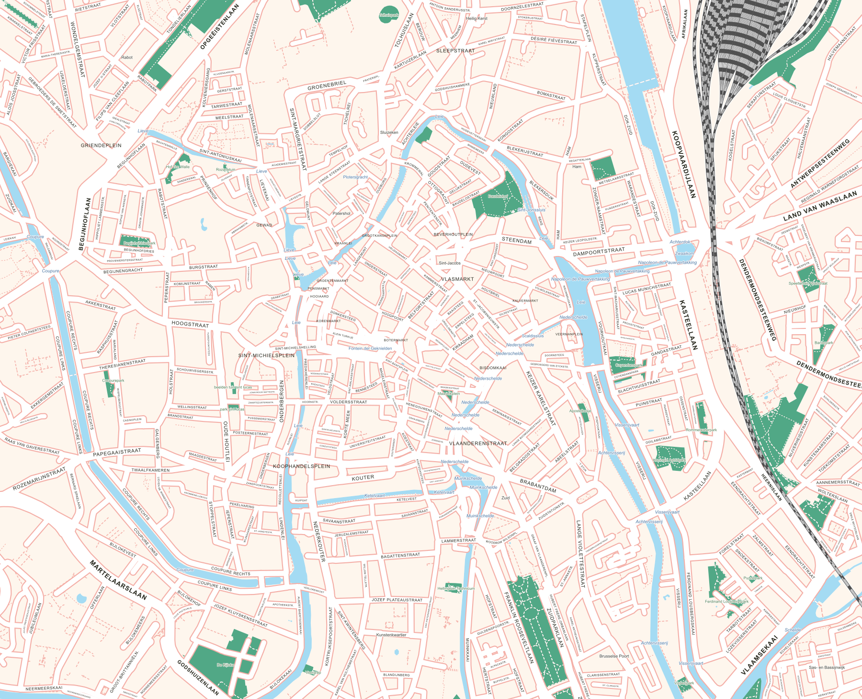
USE-IT DESIGN WORKSHOP
MAP
EXPORT
coen.at/mapexport
Map data © OpenStreetMap contributors
Notes:
Welcome. Today we will turn a city area into an editable SVG, explore its layers, then export our own cities. Suggested flow: 10 minutes introduction, 5 minutes live demo, 20 minutes hands-on and 10 minutes discussion. Timings are adjustable. The map shown is the live Gent export included with this deck.

Slide 2
THE PROBLEM
GETTING SCALABLE & EDITABLE BASE MAPS IS A P.I.T.A.
Tracing from Google Maps
asking local governments
obscure PDF’s online…
“OSM already has everything we need, why not use that?”
MAPEXPORT / USE-IT · Map data © OpenStreetMap contributors
02
Notes:
Ask for a quick show of hands: who has traced a base map manually? MapExport tackles repetitive groundwork: streets, blocks and street labels. Do not promise a measured time saving. The amount of cleanup depends on the city and the source data.
Sources: live https://coen.at/mapexport/ inspected and exported 13 September 2026; repository README.md, script.js and references/How to draw a good street map.md. Map data © OpenStreetMap contributors (ODbL), https://www.openstreetmap.org/copyright .

Slide 3
THE SOLUTION
AN INSTANT BASE MAP YOU CAN MAKE YOUR OWN
Editable SVG
Separate layers and groups
Vector shapes and street labels
A starting point for your
USE-IT map
MAPEXPORT / USE-IT · Map data © OpenStreetMap contributors
03
Notes:
Point out water, roads, parks and blocks. SVG is a vector file: it can be scaled and edited in a vector editor. This is a base map, not a complete travel guide. Sample: presentations/assets/ghent-demo.svg.
Sources: live https://coen.at/mapexport/ inspected and exported 13 September 2026; repository README.md, script.js and references/How to draw a good street map.md. Map data © OpenStreetMap contributors (ODbL), https://www.openstreetmap.org/copyright .

Slide 4
HOW IT WORKS
FROM OPEN DATA TO YOUR DESIGN
01
Choose an area
Find your city and draw a rectangle.
02
Get the map features
MapExport retrieves OpenStreetMap data.
03
Build the base map
It draws roads, derives blocks and places labels.
04
Continue in your editor
Download an SVG and open it in Illustrator or Inkscape.
(or any other editor that understands SVG)
MAPEXPORT / USE-IT · Map data © OpenStreetMap contributors
04
Notes:
OpenStreetMap provides geographical data. MapExport transforms those features into a designed SVG, including computed city blocks and road labels. City blocks are areas between roads, not individual building footprints. Data coverage and quality vary by location.
Sources: live https://coen.at/mapexport/ inspected and exported 13 September 2026; repository README.md, script.js and references/How to draw a good street map.md. Map data © OpenStreetMap contributors (ODbL), https://www.openstreetmap.org/copyright .

Slide 5
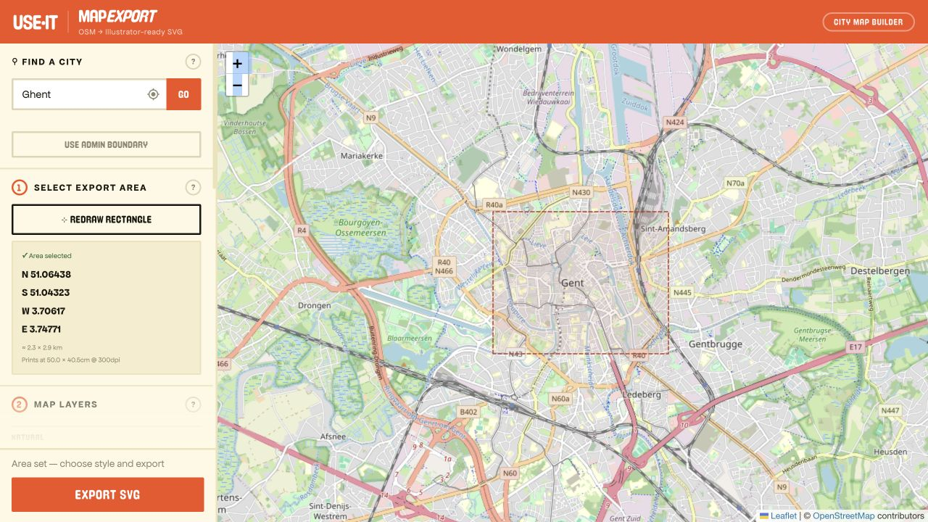
IN THE BROWSER
MEET YOUR WORKSPACE
1 Find a city
2 Draw an area
3 Choose layers
MAPEXPORT / USE-IT · Map data © OpenStreetMap contributors
05
Notes:
Open https://coen.at/mapexport/ . The controls are on the left, the map on the right. Search, pick the matching location and use Draw rectangle. Screenshot captured from the live site, 13 September 2026. Live controls may evolve.
Sources: live https://coen.at/mapexport/ inspected and exported 13 September 2026; repository README.md, script.js and references/How to draw a good street map.md. Map data © OpenStreetMap contributors (ODbL), https://www.openstreetmap.org/copyright .

Slide 6
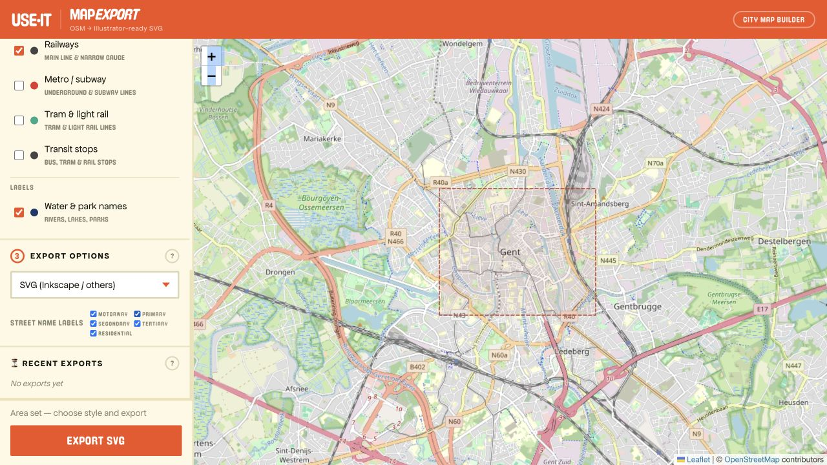
CHOOSE YOUR AREA
START WITH A WALKABLE CITY CENTRE
Keep the first area small.
Include a recognisable landmark.
Check the area and printed size.
Leave room for your eventual layout.
MAPEXPORT / USE-IT · Map data © OpenStreetMap contributors
06
Notes:
For the first exercise choose a manageable central neighbourhood, not an entire metropolitan area. In the sample the rectangle is roughly 2.3 × 2.9 km. The live interface shows approximate printed dimensions. Avoid implying that the website has an A3 selector. A larger export has more objects and may take longer.
Sources: live https://coen.at/mapexport/ inspected and exported 13 September 2026; repository README.md, script.js and references/How to draw a good street map.md. Map data © OpenStreetMap contributors (ODbL), https://www.openstreetmap.org/copyright .

Slide 7
LAYERS
CHOOSE WHAT YOUR MAP NEEDS
The essentials
Roads and city blocks
Water and green space
Street names
Add detail only when you’ll need it
For example: transit or pedestrian routes.
Keep only what you will actually use.
MAPEXPORT / USE-IT · Map data © OpenStreetMap contributors
07
Notes:
Show the layer checkboxes on the live site. Available options include water bodies, waterways, city blocks, parks/green space, roads, railways and transit features. Street-name controls include road categories. Explain that all available detail does not necessarily improve a printed USE-IT map. City blocks do not represent each individual building.
Sources: live https://coen.at/mapexport/ inspected and exported 13 September 2026; repository README.md, script.js and references/How to draw a good street map.md. Map data © OpenStreetMap contributors (ODbL), https://www.openstreetmap.org/copyright .

Slide 8
DOWNLOAD
EXPORT FOR YOUR EDITOR
ILLUSTRATOR
INKSCAPE
Choose “SVG (Illustrator)”
Choose “SVG (Inkscape / others)”
Export SVG → Download
Then use File → Open.
Export SVG → Download
Then use File → Open.
Keep the original export. Save your edits as a separate file.
MAPEXPORT / USE-IT · Map data © OpenStreetMap contributors
08
Notes:
These are the option labels observed on the live site. Use File > Open, rather than placing the SVG as a linked image in another document. Inspect Layers or Layers and Objects after opening; group/layer presentation differs between editors. Keep the original SVG for recovery.
Sources: live https://coen.at/mapexport/ inspected and exported 13 September 2026; repository README.md, script.js and references/How to draw a good street map.md. Map data © OpenStreetMap contributors (ODbL), https://www.openstreetmap.org/copyright .

Slide 9
INKSCAPE
LIVE DEMO: LAYERS & COLOR CHANGES
MAPEXPORT / USE-IT · Map data © OpenStreetMap contributors
10
Notes:
DEMO SCRIPT
Open presentations/assets/ghent-demo.svg in Inkscape. Fit the page to the window (5). Open Layer > Layers and Objects and expand Map content. Find City blocks. Enter that layer and select its child paths, or select one block and use Edit > Select Same > Fill Color. Verify that only the city-block paths are selected: this sample contains 581. Lock unrelated layers first if their objects share the same fill. Click a palette colour or use Object > Fill and Stroke to change Fill (do not Shift-click, which changes Stroke). Water, roads and parks should retain their colours. Undo once to show that all blocks changed together. Save a separate edited SVG.
The preview on the right changes every child path in city_blocks to #F2CA76 and nothing else. It was rendered by Inkscape from the actual export. This slide is a prompt to switch to a live editor, not a recording of UI clicks. Backup: ghent-recoloured.svg.
Inkscape Select Same documentation: https://inkscape.org/en/doc/tutorials/basic/tutorial-basic.pt_BR.html/ .
Sources: live https://coen.at/mapexport/ inspected and exported 13 September 2026; repository README.md, script.js and references/How to draw a good street map.md. Map data © OpenStreetMap contributors (ODbL), https://www.openstreetmap.org/copyright .

Slide 10
HANDS-ON
YOUR TURN
coen.at/mapexport
IF YOU GET STUCK
01
Export a small area
Export taking a while?
Open the SVG in Illustrator or Inkscape.
Watch progress. Try a smaller area
for your next export.
02
Recolour all city blocks
Export too slow? Practise with the Gent SVG:
Select the block paths together. Keep roads
and water unchanged.
coen.at/ghent.svg
03
Explore the structure
File looks unexpected?
Hide a layer, restore it, then find a street label.
Check SVG format, fonts and
layer visibility.
04
Save a working copy
Keep one observation to share with the group.
Bug report: city + selected area
+ editor + what you expected.
Done early? Compare the result with a place you know well.
MAPEXPORT / USE-IT · Map data © OpenStreetMap contributors
11
Notes:
Keep this slide on screen throughout the hands-on exercise. Allow about 20 minutes. Participants can work individually or in pairs. Start with a small central area and choose the SVG format for the editor. Use File > Open and keep the original download. Select only the City blocks paths before changing Fill. Keep roads and water unchanged. Hide and restore a layer, then find a street label. Save a separate working copy and note one concrete observation for the discussion. Done early? Compare the map with a place you know well. If an export is delayed, use https://coen.at/ghent.svg (local backup: presentations/assets/ghent-demo.svg). Watch the progress message and try a smaller area next time. If the file looks unexpected, check SVG format, fonts and layer visibility. Useful bug reports include city, area, editor and expected result.
Sources: live https://coen.at/mapexport/ inspected and exported 13 September 2026; repository README.md, script.js and references/How to draw a good street map.md. Map data © OpenStreetMap contributors (ODbL), https://www.openstreetmap.org/copyright .

Slide 11
OPEN DISCUSSION
WHAT SHOULD MAPEXPORT DO BETTER?
What’s good?
What needs improving?
What feature is missing for your city?
How easy was it to work with the export file?
SHOW AN
EXAMPLE.
Then tell us the
changes that would
help you.
MAPEXPORT / USE-IT · Map data © OpenStreetMap contributors
12
Notes:
End here and invite an open discussion. Collect feedback in three columns on a board or shared document: observation, impact and desired change. Capture the city, area and editor for reproducible problems. Ask for concrete examples and let other participants add their experience before prioritising. Distinguish bugs, usability issues and feature wishes. Finish by asking each person for the one improvement that matters most; do not promise delivery dates.
Sources: live https://coen.at/mapexport/ inspected and exported 13 September 2026; repository README.md, script.js and references/How to draw a good street map.md. Map data © OpenStreetMap contributors (ODbL), https://www.openstreetmap.org/copyright .

