Slide 1
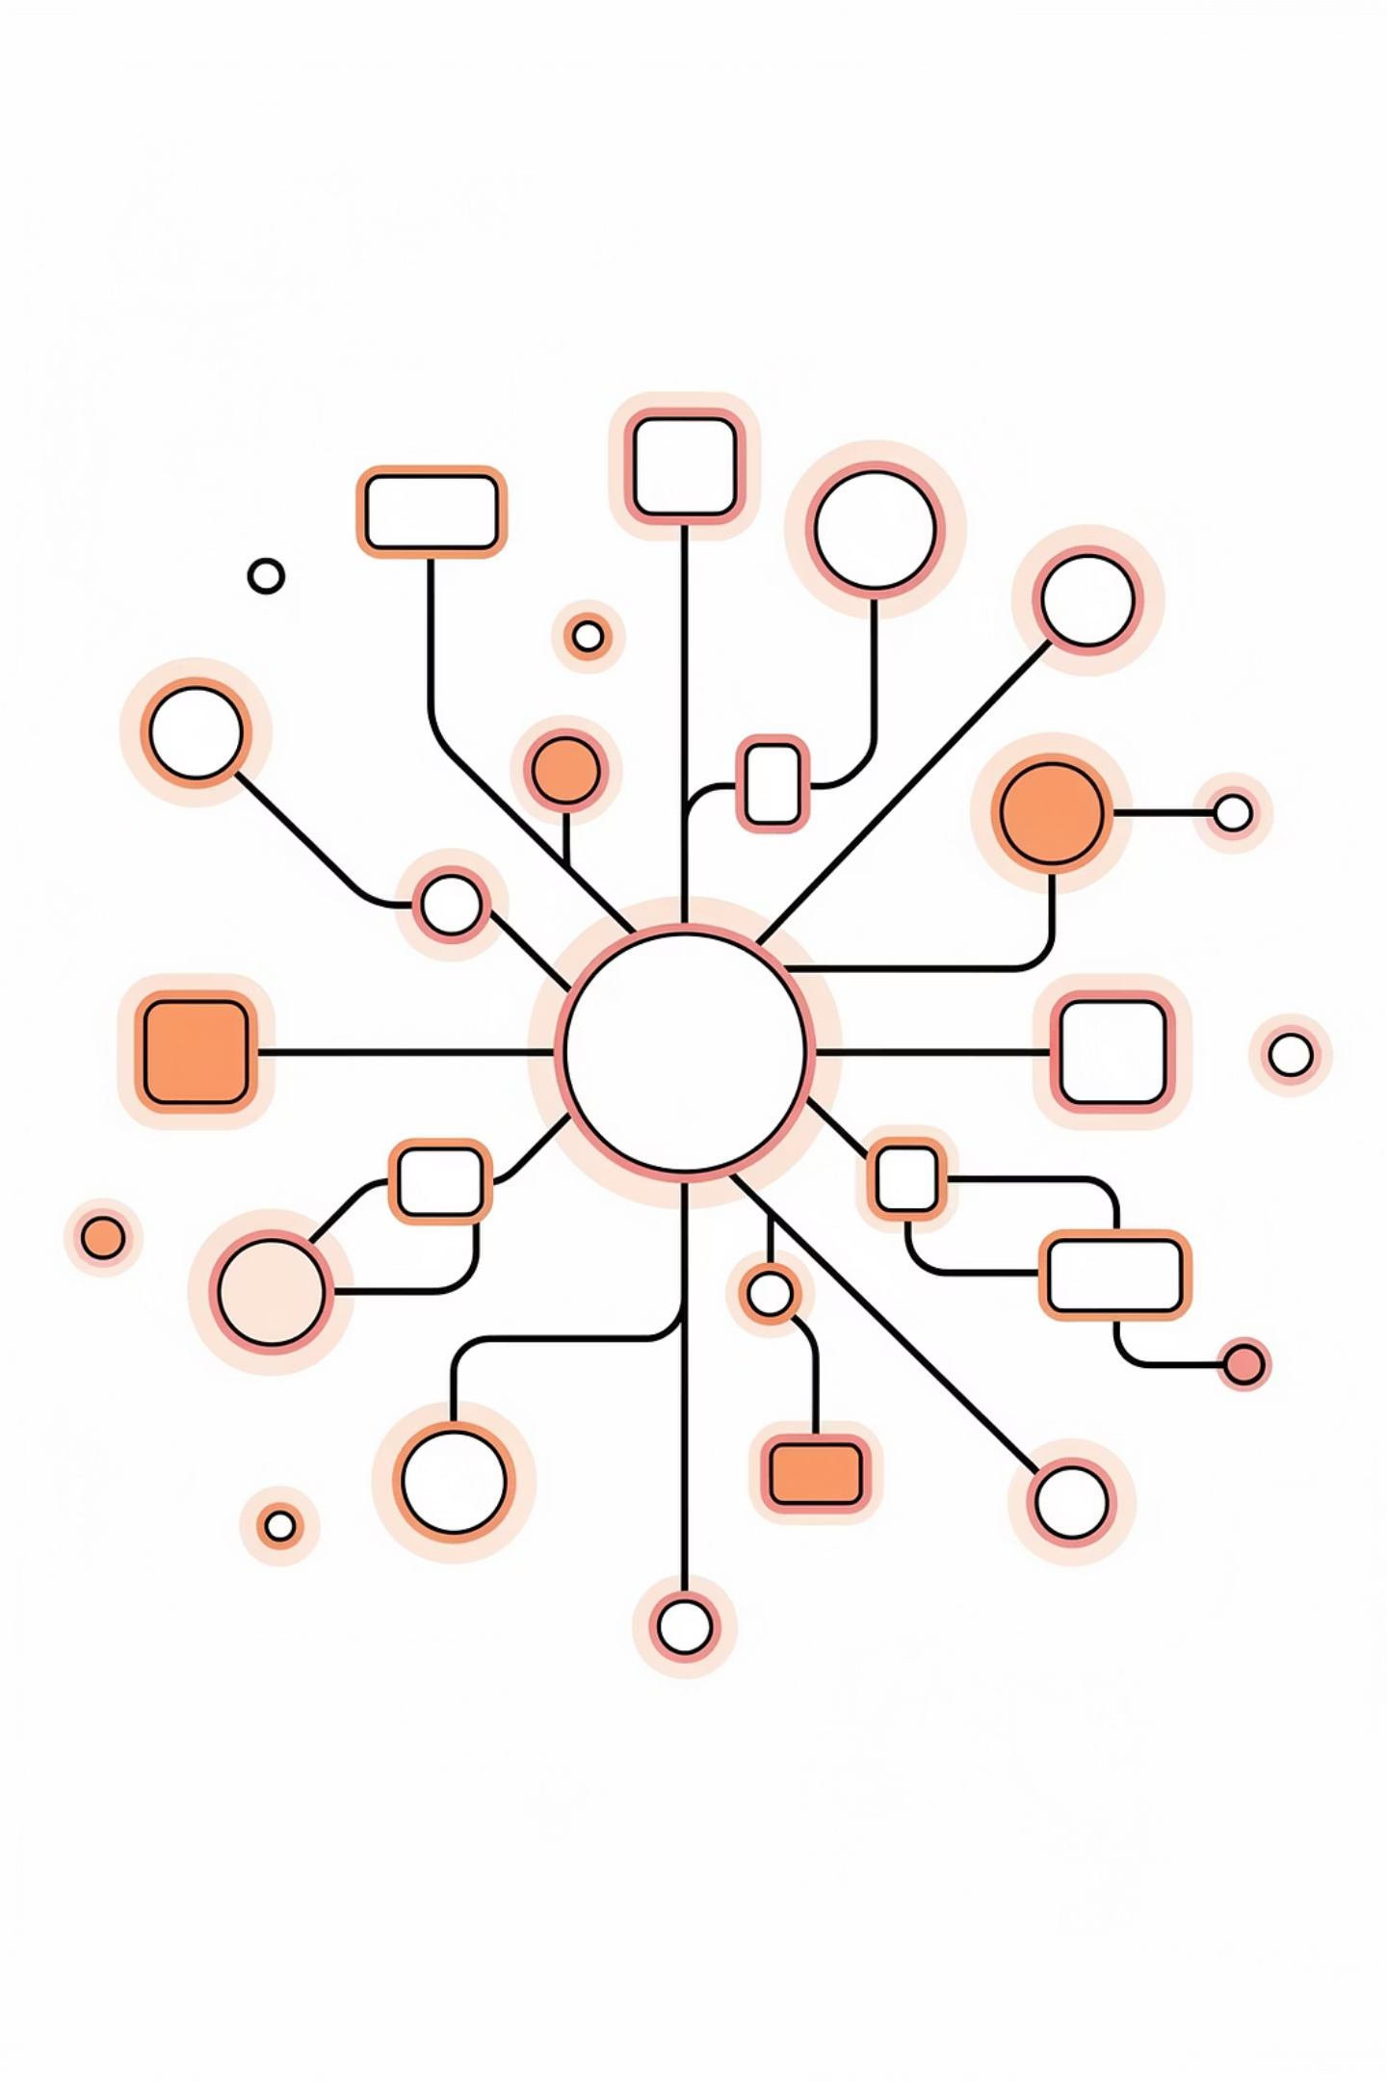
Database After Graduation
Week 4 — Transactions, Concurrency & Consistency
By Narges Yarahmadi · Feb 2026

Slide 2
Table of Contents
01
02
Transactions: The Atomic Unit of Work
Race Conditions
ACID properties, Commit & Rollback
The concurrency nightmare — lost updates, overselling
03
04
Transaction Isolation Levels
Tools of the Trade
Dirty Read, Non-Repeatable Read, Phantom Read
Transactor Pattern, Concurrency Testing, Read Replicas

Slide 3
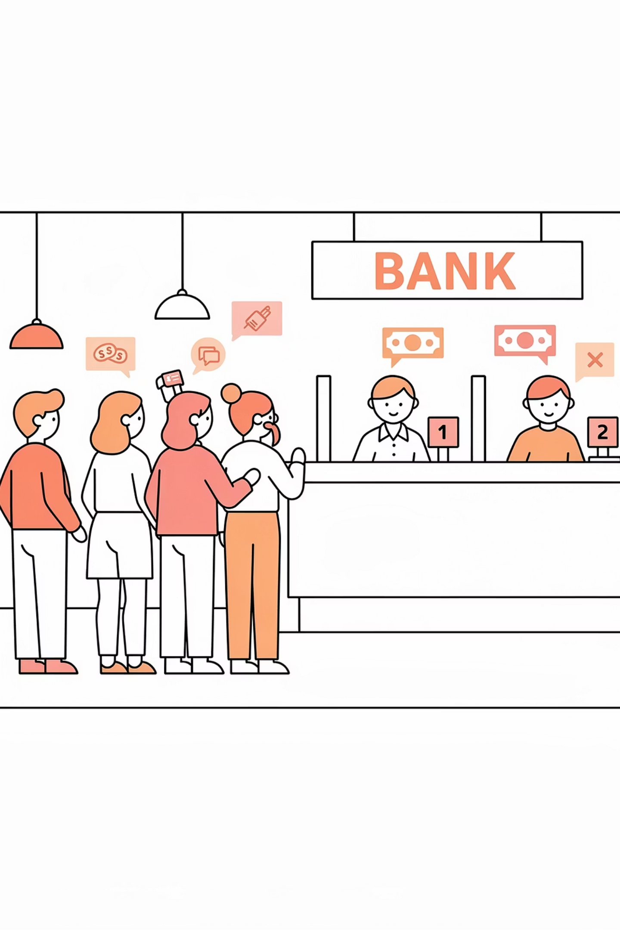
Why Concurrency Matters in Real Systems
In academic environments, database queries often execute sequentially. In production systems, this assumption immediately breaks.
The Banking Example
Where Concurrency Happens
Account Balance = $100
Request A withdraws $80
Request B withdraws $50
Both read balance = 100 simultaneously.
Multiple users & API requests
Microservices & background workers
Scheduled jobs & distributed servers
Result: Data inconsistency
— the final stored balance is wrong.
Mobile app, web client, admin dashboard, and background billing jobs all hit the same database simultaneously.

Slide 4
Transactions
A transaction is a sequence of one or more operations (reads/writes) executed as a single logical unit of work. Transactions bring predictability to state changes.
Notes:
A transaction is a sequence of one or more operations (reads/writes) executed as a single logical unit of work. Transactions bring predictability to state changes.

Slide 5
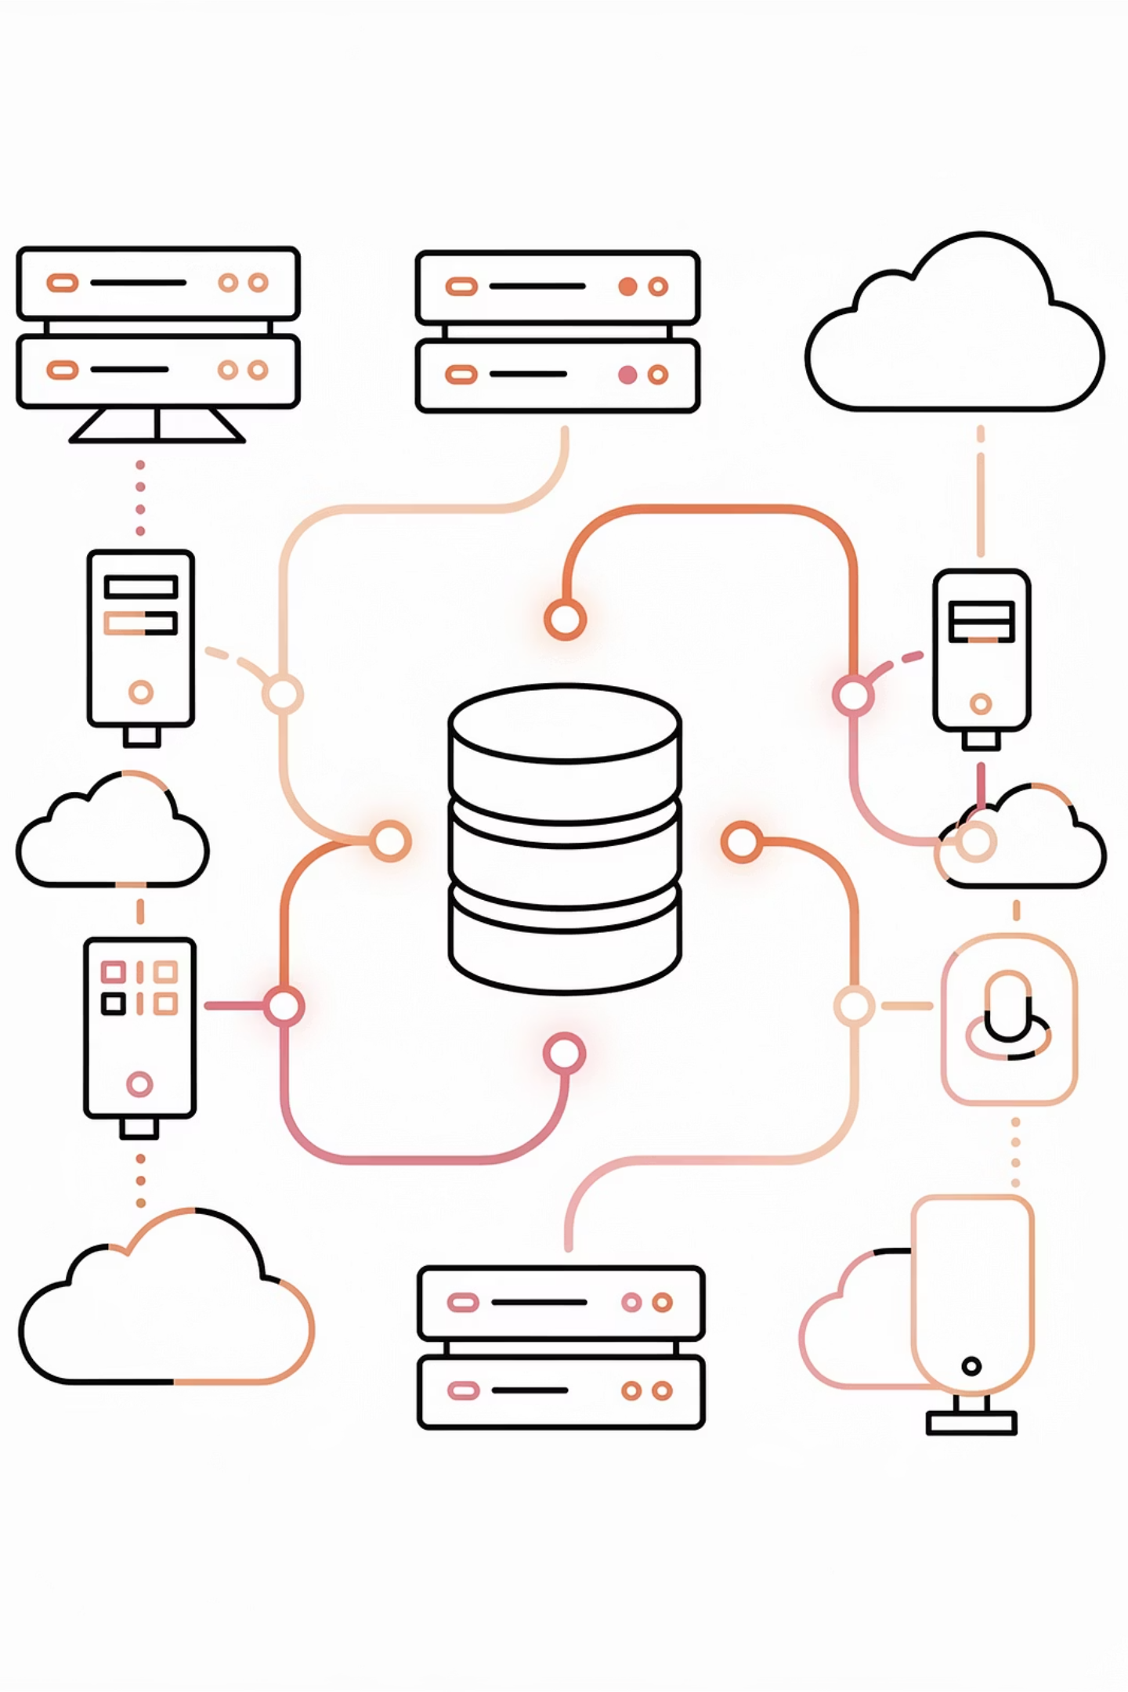
The ACID Properties Define Reliable Transaction Processing

Slide 6
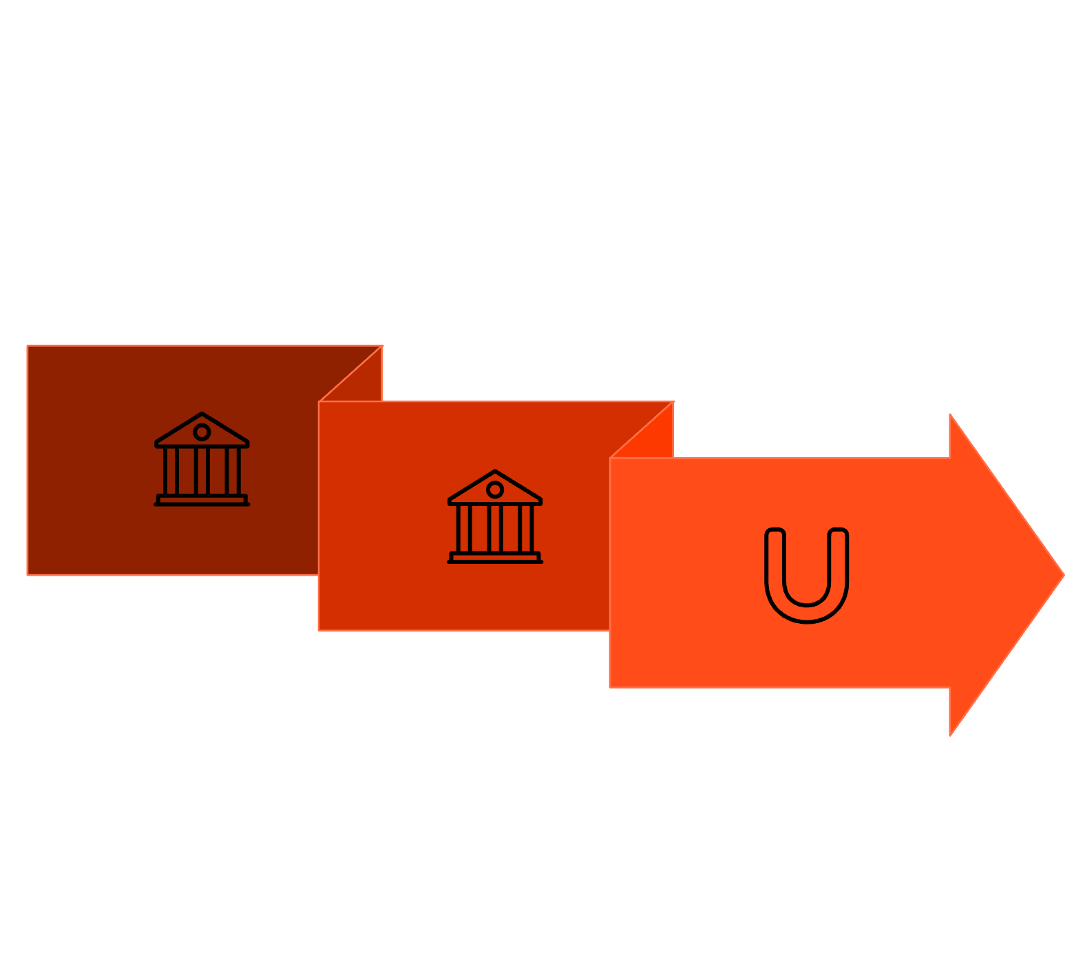


Atomicity: All or Nothing
If the system crashes mid-process, the transaction is rolled back.
All operations complete or none do. Example in Money transfer:
Debit A
Rollback
Debit Account A → Credit Account B
If credit fails → Debit must rollback.
Credit B

Slide 7
Consistency: Valid State to Valid State
A transaction brings the database from one valid state to another, preserving defined rules (constraints, triggers).
Database moves from one valid state to another. Constraints remain preserved. Example:
Balance cannot be negative
Foreign keys remain valid
Isolation: Independent Execution
Concurrent execution of transactions results in a state that is equivalent to some serial (sequential) execution.
Transactions should not interfere with each other. Users should behave as if operations run independently.

Slide 8



Durability: Committed Forever
Once a transaction is committed, it remains so, even in the event of a power loss or crash.
Once committed, Data survives crashes. Handled using:
Write-ahead logging
Disk persistence
Replication

Slide 9



The ACID Properties
Atomicity
Consistency
All operations complete or none do. If credit fails, debit must rollback.
Database moves from one valid state to another. Constraints (e.g., no negative balance) remain preserved.
Isolation
Durability
Transactions don't interfere with each other — equivalent to serial execution.
Once committed, data survives crashes via write-ahead logging, disk persistence, and replication.

Slide 10

Commit and Rollback: Save & Undo
The Three Commands
Banking Transfer Example
BEGIN TRANSACTION
BEGIN TRY
BEGIN TRANSACTION TransferFunds;
UPDATE Accounts
SET balance = balance - 100
WHERE id = 'A';
UPDATE Accounts
SET balance = balance + 100
WHERE id = 'B';
COMMIT TRANSACTION;
END TRY
BEGIN CATCH
ROLLBACK TRANSACTION;
SELECT 'TRANSACTION FAILED';
END CATCH;
Marks the starting point of a transaction.
COMMIT
Saves all modifications permanently. Changes become visible to other transactions.
ROLLBACK
Aborts the transaction, undoing all modifications. Used when errors occur, validation fails, or business rules are violated.
Takeaway: Never assume a multi-step operation succeeds until the COMMIT is acknowledged.

Slide 11

Race Conditions: The Concurrency Nightmare
When multiple threads access shared data concurrently and the outcome depends on execution timing, you have a race condition
one of the most common production failures.

Slide 12



Example A: Ticket Booking
Two users purchase last seat.
Check available seats
Reserve seat
Confirm purchase
Both requests read availability simultaneously.
⚠️ The Problem
Result is Overselling.
Two users both see 1 seat available and both proceed to book it — resulting in a double booking of the same seat.

Slide 13

Example B: The "Lost Update" Problem
Bank Account Analogy
Imagine a bank account with $1000. Two concurrent requests arrive:
1. Request A (Credit)
2. Request B (Debit)
Add $100.
Subtract $50.
The Race:
Thread A reads balance: 1000
Thread B reads balance: 1000
(Thread A hasn't written yet)
Thread A calculates new balance: 1000 + 100 = 1100
Thread B calculates new balance: 1000 - 50 = 950
Thread A writes: 1100
(Thread B's write overwrites this if done after)
Thread B writes: 950
Result: Despite two valid operations, the final balance is $950, not the correct $1050. One update was "lost".

Slide 14
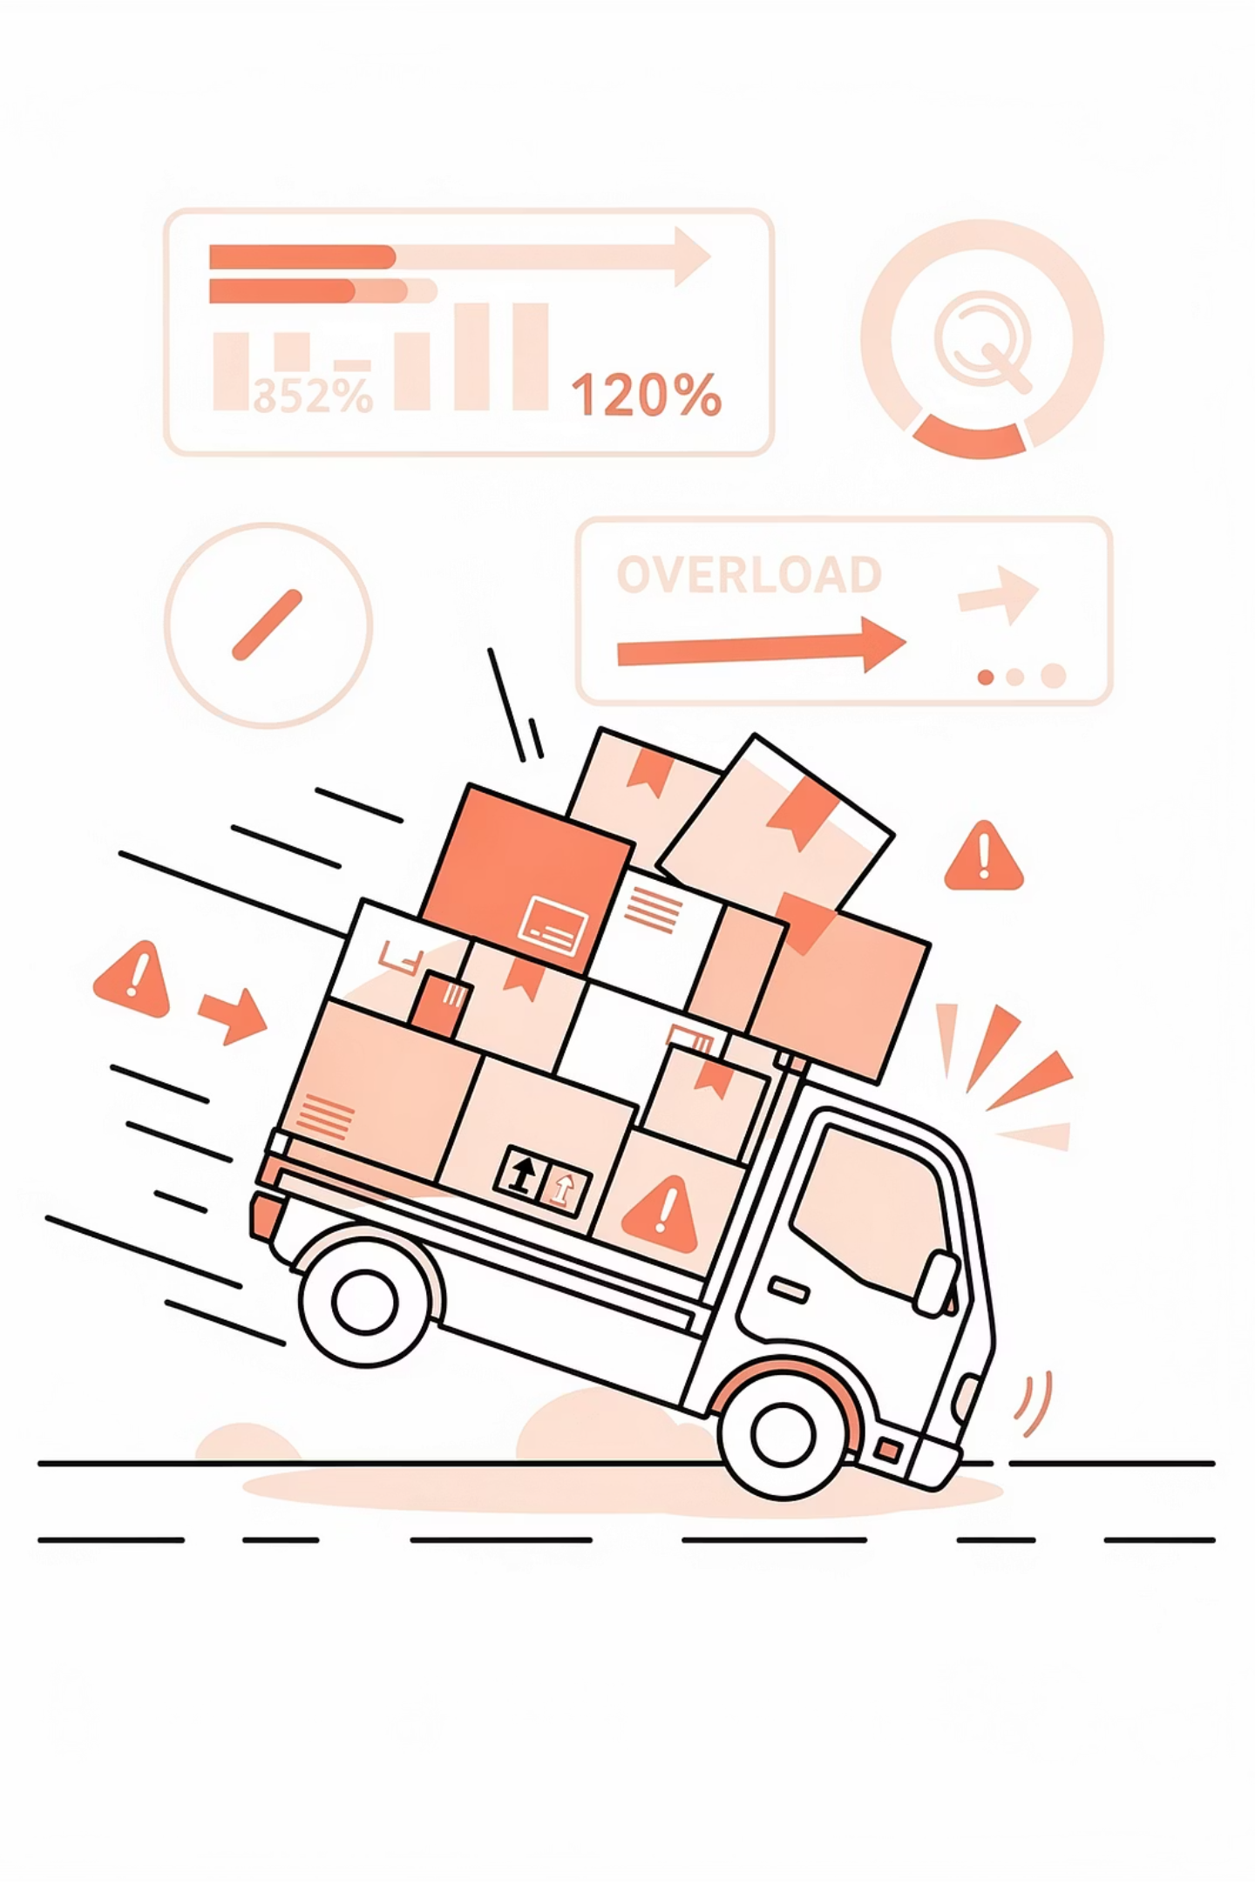
Real-World Bug (False Mutex)
A common flaw is implementing a lock that only protects part of the system.
Consider a batch process (executeBatch) that uses a flag isProcessingBatch to prevent concurrent runs. However, if the standard API endpoint (/assignParcel) ignores this flag, a race condition occurs:
1
Batch reads capacity (0/100).
2
API reads capacity (0/100) before Batch commits.
3
Both assign parcels (50kg + 60kg).
4
Result: Truck capacity is violated (110kg/100kg).

Slide 15
Transaction Isolation Levels
To prevent race conditions without forcing all transactions to run one at a time (which kills performance), databases offer Isolation Levels. These levels define how transaction changes are visible to each other. They balance consistency against concurrency.
Imagine a database handling thousands of transactions at the same time.
If the database forced this:
Transaction A finishes completely
✅ Perfect correctness
❌ Terrible performance
then Transaction B starts
then Transaction C starts
Modern systems instead allow transactions to run concurrently, but they must control how much transactions can see each other's changes.
Isolation levels are therefore: Rules that define what one transaction is allowed to observe from another transaction.
They balance:
Consistency ↔ Performance
Safety ↔ Speed
First, we define the phenomena we are trying to prevent:

Slide 16





Transaction Isolation Levels
To prevent race conditions without forcing serial execution (which kills performance), databases offer Isolation Levels — rules defining how much one transaction can observe from another. They balance Consistency ↔ Performance and Safety ↔ Speed.
Serializable
Repeatable Read
Read Committed
Read Uncommitted
First, we must understand the three phenomena these levels are designed to prevent: Dirty Read, Non-Repeatable Read, and Phantom Read.

Slide 17

Dirty Read
A dirty read occurs when a transaction reads data written by a concurrent uncommitted transaction. Applications make decisions based on data that never officially existed.
The Scenario
Why This Is Dangerous
Transaction A sets balance = 0 but hasn't committed.
Transaction B reads balance = 0.
Transaction A crashes → ROLLBACK.
Actual balance returns to 500.
Transaction B already used wrong data.
Financial systems absolutely forbid dirty reads. A payment approval based on a balance that was never real can cause catastrophic errors — funds released that don't exist, fraud windows opened, and audit trails corrupted.
This is why Read Uncommitted isolation is rarely used in critical systems.

Slide 18
Non-Repeatable Read Phantom Read
Non-Repeatable Read
Phantom Read
Reading the same row twice in one transaction and getting different values because another transaction modified and committed it in between.
Running the same query twice and getting a different set of rows because another transaction inserted or deleted matching rows.
Example A:
Transaction A reads balance = 100.
Transaction B updates it to 200 and commits.
Transaction A reads again: 200.
Inside the same transaction.
Transaction A queries orders WHERE amount > 1000 → 5 rows. Transaction B inserts a $1500 order and commits.
Transaction A re-runs the same query → 6 rows. A new row appeared like a ghost.
Critical in: reporting, inventory checks, fraud detection, analytics.
Example B:
This breaks multi-step operations like:
calculate interest → verify funds → approve payment
where values change mid-process.

Slide 19
Isolation Levels Comparison

Slide 20
Level | Dirty Read | Non-Repeatable | Phantom Read | Use Case & Analogy | Prevents | Performance
Read Uncommitted | Allowed | Allowed | Allowed | "The Gossip": Reading data instantly, even if it's not finalized. High risk, rarely used in critical financial systems. | ❌ Dirty Reads ❌ Non-repeatable reads ❌ Phantom reads | Very High
Read Committed | Prevented | Allowed | Allowed | Default in PostgreSQL/Oracle. "The Official Statement." You only see data that has been officially committed. Prevents gossip, but data can change mid-transaction. | ✅ Dirty Reads ❌ Non-repeatable reads ❌ Phantom reads | High
Repeatable Read | Prevented | Prevented | Allowed | Default in MySQL/InnoDB. "The Snapshot." If you read a row, you see the same value even if someone else changes it. However, new "phantom" rows can appear. | ✅ Dirty Read ✅ Non-repeatable Read ❌ Phantom Reads (conceptually) | Medium
Serializable | Prevented | Prevented | Prevented | "The Vault." Transactions execute as if they were queued one after another. Highest consistency, lowest concurrency. | ✅ Dirty Read ✅ Non-repeatable Read ✅ Phantom Reads (conceptually) | Lower

Slide 21
SET TRANSACTION ISOLATION LEVEL SERIALIZABLE;

Slide 22





TOOLS OF THE TRADE
Managing Concurrency in the Application Layer
Databases provide transactions and isolation levels. But in modern systems, most concurrency mistakes actually happen in the application layer, not inside SQL.
API Server
Receives concurrent requests
Business Logic
Orchestrates operations
Repositories / ORM
Accesses the database
Database
Executes transactions
Consistency must be controlled above the database as well. Transaction logic lives in your application code.

Slide 23
Application-Level Transaction Management
Consider creating a task (like Jira/Trello). A single business operation requires multiple steps:
The Multi-Step Problem
Why This Is Dangerous
1
Insert Task
If step 3 fails but steps 1 and 2 already succeeded, the database becomes inconsistent:
2
Insert Comments
Task exists ✅
Comments exist ✅
Project counter incorrect ❌
3
Update Project Statistics
This is why we need one transaction covering the entire business operation. Writing raw SQL transactions everywhere is error-prone — developers forget commit(), rollback(), and error handling.
4
Log Activity

Slide 24

The Repository & Transactor Pattern
Repositories (TaskRepository, CommentRepository, UserRepository) handle data access for their domain but operate independently — they don't coordinate transactions across operations.
Industrial Pseudo-code
The Transactor Pattern
class CreateTaskUseCase {
constructor(
private taskRepository: TaskRepository,
private repositoryTransactor: RepositoryTransactor
) {}
async handle(request) {
return this.repositoryTransactor
.run(async () => {
const task = Task.create(
request.taskName
);
await this.taskRepository
.insert(task);
// Auto-rollback if this fails
return task;
});
}
}
A supervisory layer that controls the full transaction lifecycle: BEGIN → execute business logic → COMMIT or ROLLBACK. If any step fails, it automatically triggers a rollback.
When repositoryTransactor.run(async () => { ... }) executes, a BEGIN TRANSACTION is implicitly started. All repository operations inside share that context.
The developer never needs to manually call commit() or rollback() — the Transactor handles it, eliminating human error.

Slide 25
Why Industry Favors the Transactor Pattern
Eliminates Human Error
Use Case–Level Boundaries
Widely Adopted
No forgotten rollbacks, partial writes, or dangling data. The framework manages commits and rollbacks automatically.
Transactions belong at the Use Case level (e.g., CreateOrderUseCase), not inside individual repository methods. Fragmenting transactions breaks atomicity.
Standard in NestJS, Spring Boot, Go-based services, and Domain-Driven Design systems. Framework responsibility, not individual developer concern.
Without Transactor
With Transactor
Transaction safety = developer's full responsibility → high error risk in complex workflows.
Transaction control = framework responsibility → developers focus on business logic.

Slide 26
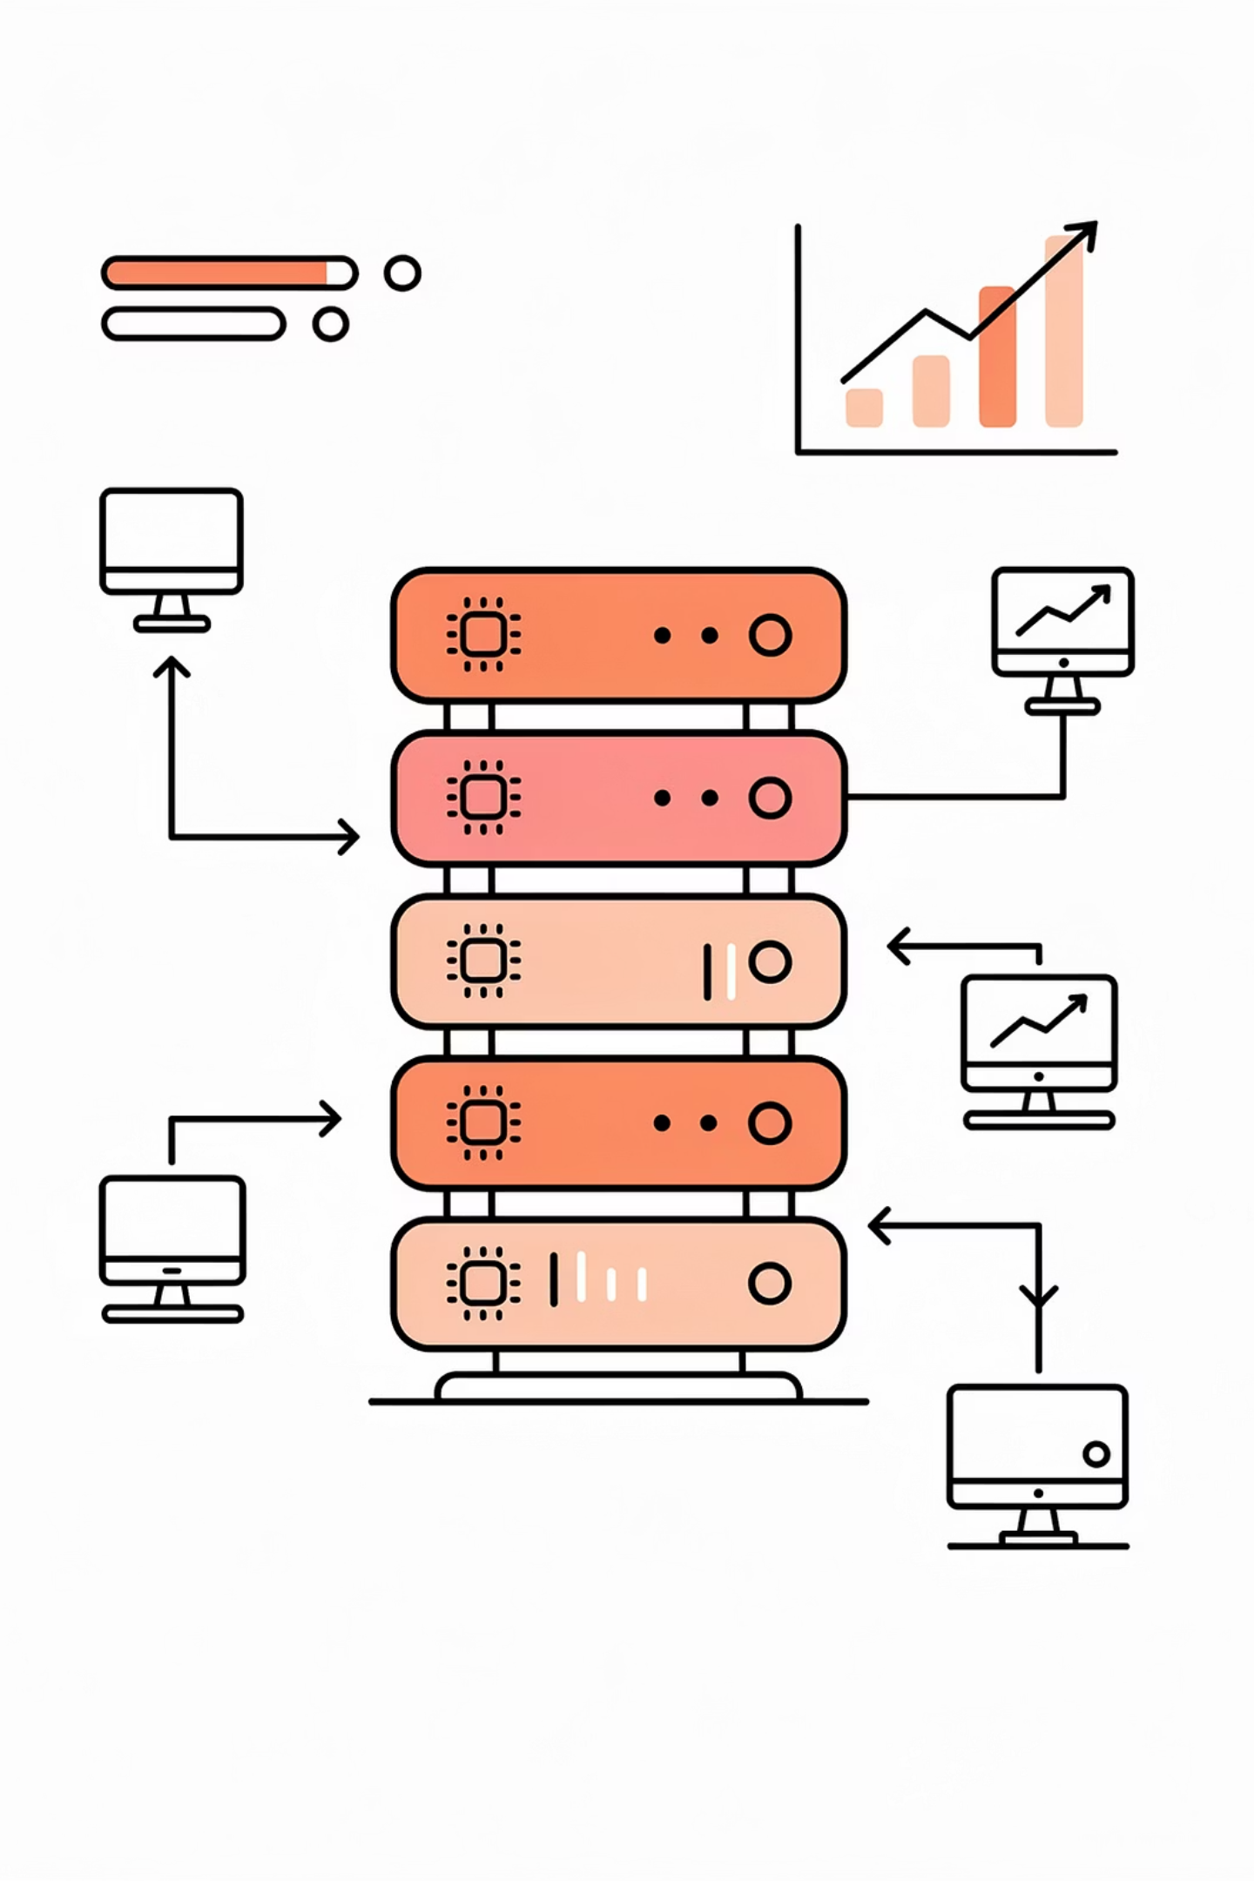



API-Based Concurrency Testing
Race conditions rarely appear during development with single requests. In production, hundreds of users interact simultaneously. Engineers intentionally stress the application to expose hidden synchronization problems.
Apache JMeter
Industry standard, heavily used in banking and telecom. Simulates thousands of users, workflows, and authenticated sessions via a graphical interface.
K6
Modern, scriptable load testing tool written in JavaScript. Widely integrated into CI/CD pipelines.
CLI Benchmark Tools
Lightweight command-line tools to quickly hammer API endpoints without complex setup.

Slide 27
Interpreting Concurrency Test Results
Example Test Command
Reading the Results
A beginner sees 998 successes and assumes good performance. An engineer immediately investigates any failure.
# 100 concurrent users, 1000 total requests
./benchmark -c 100 -n 1000 \
-u http://localhost:3000/api/transfer \
-m POST
# Output:
# Successful requests: 998
# Failed requests: 2
# Status distribution:
# 200: 998
# 409: 2 ← HTTP 409 Conflict
HTTP 409 Conflict may mean the database successfully prevented an unsafe concurrent update via optimistic locking — a positive outcome.
It can also signal deadlocks or logical race conditions requiring log analysis.
Industrial objective: Always prefer safe failure — a controlled error is far better than a corrupted financial transfer.
-c 100 = 100 concurrent users
-n 1000 = 1000 total requests

Slide 28
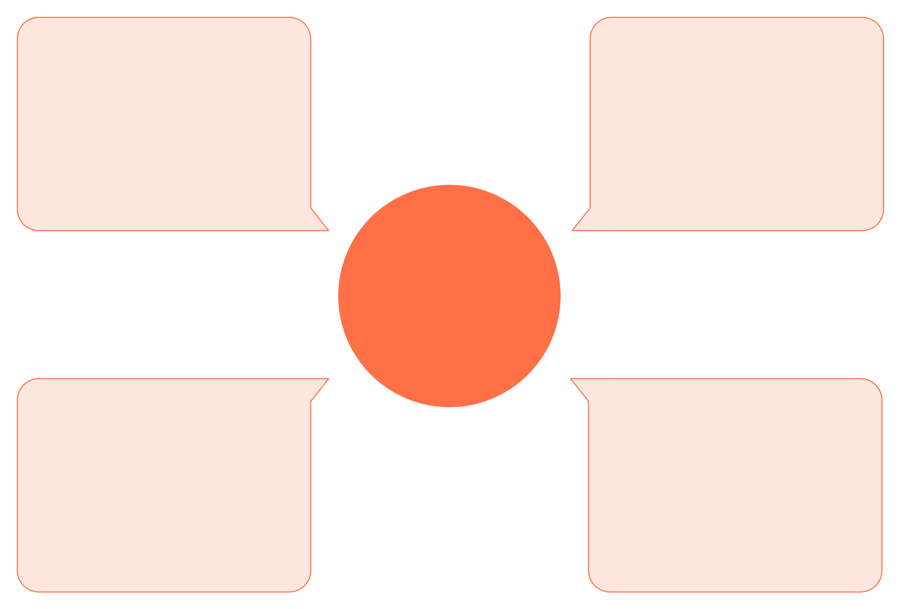
Read Replicas & Consistency Trade-offs
As systems scale, the primary database gets overloaded with read queries. Read Replicas are copies that handle only SELECT queries — but they introduce a critical trade-off.
Replica 2 (Reader)
Primary (Writer)
Handles INSERT/UPDATE/DELETE
Serves SELECT queries
Read Replica Architecture
Replica 1 (Reader)
Asynchronous Replication
Serves SELECT queries
Changes sent to replicas with delay
Replication is usually asynchronous for performance, meaning a replica is always slightly behind the primary — this is called replication lag.

Slide 29
The Replication Lag Bug & Solutions
The Bug Scenario
Solutions
1
User A posts a comment → goes to Primary
Read-After-Write Consistency
GTID Consistent Reads
2
User A is redirected to the comment page
Remember that User A just wrote something. For the next 5–10 seconds, route their reads to the Primary, not the Replica.
Advanced setups (MySQL with GTID) allow the replica to wait until it has caught up to the specific transaction ID before returning data.
3
Load balancer routes read to a Replica that hasn't received the new comment yet
4
User A sees "Comment posted!" but the page shows no comments

Slide 30






Summary: Key Takeaways
Transactions
COMMIT/ROLLBACK provide atomicity to prevent partial failures in multi-step operations.
Race Conditions
Concurrent operations interleaving incorrectly lead to lost updates, overselling, and data corruption.
Isolation Levels
Read Committed → Serializable: tools to balance performance against consistency guarantees.
Read Replicas
Scale read throughput but introduce eventual consistency — requiring application-level logic to handle stale reads.
Next Step: Try the activity.pdf file — test your endpoints under concurrency and analyze the results firsthand.

