Slide 1
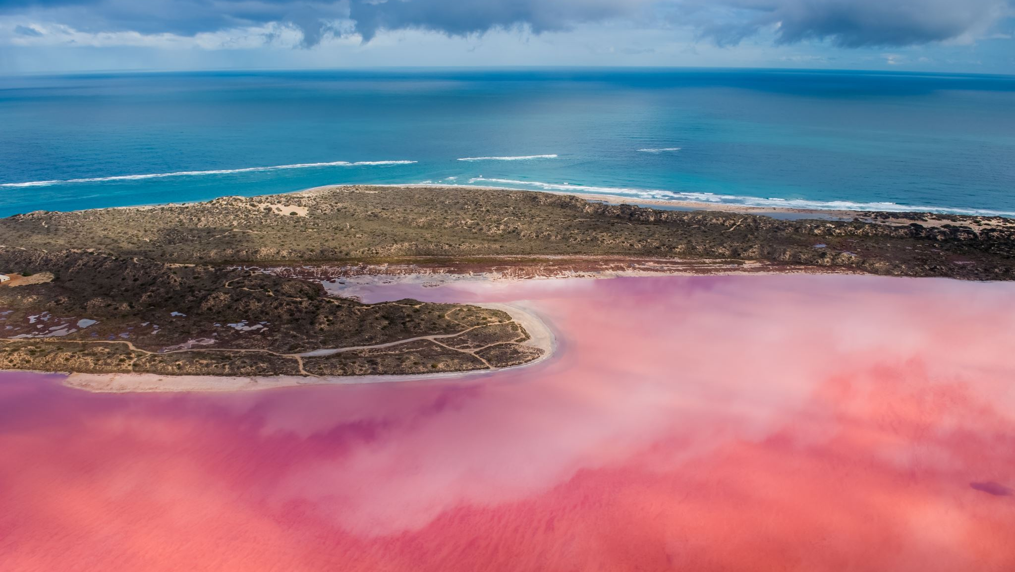
Automated Shoreline Monitoring near Kouchibouguac National Park using RADARSAT Data
Detecting Coastal Change with Open Data & Tools
Author: Abdul Rahim
Event: Mission Accepted Space Hackathon Hackathon - Oct 24-26, 2025

Slide 2

Our Coasts Are Changing Rapidly
The sensitive coastline near Kouchibouguac National Park and communities like Baie-Sainte-Anne is vulnerable to erosion.
This threatens unique ecosystems (dunes, marshes), infrastructure, and cultural sites.
Traditional monitoring methods can be slow, expensive, and weather-dependent. We need faster, reliable ways to track these changes.

Slide 3
Automated Monitoring with Free Satellite Data
Developed a rapid workflow using RADARSAT Constellation Mission (RCM) SAR data – sees through clouds and darkness!
Processed using ESA SNAP (free, open-source scientific software).
Analyzed and mapped using QGIS (free, open-source GIS software). Provides a cost-effective and repeatable method for shoreline change detection.

Slide 4
From Satellite Pixels to Shoreline Change
Download RCM Data (EODMS Portal, ~2020 & ~2024 images)
Pre-Process in SNAP (Calibrate -> Speckle Filter -> Terrain Correct)
Extract Shorelines in QGIS (Polygonize -> Filter Land -> Polygons to Lines)
Compare & Visualize (Overlay lines on map)
Key Benefit: SAR data provides reliable, all-weather monitoring.

Slide 5
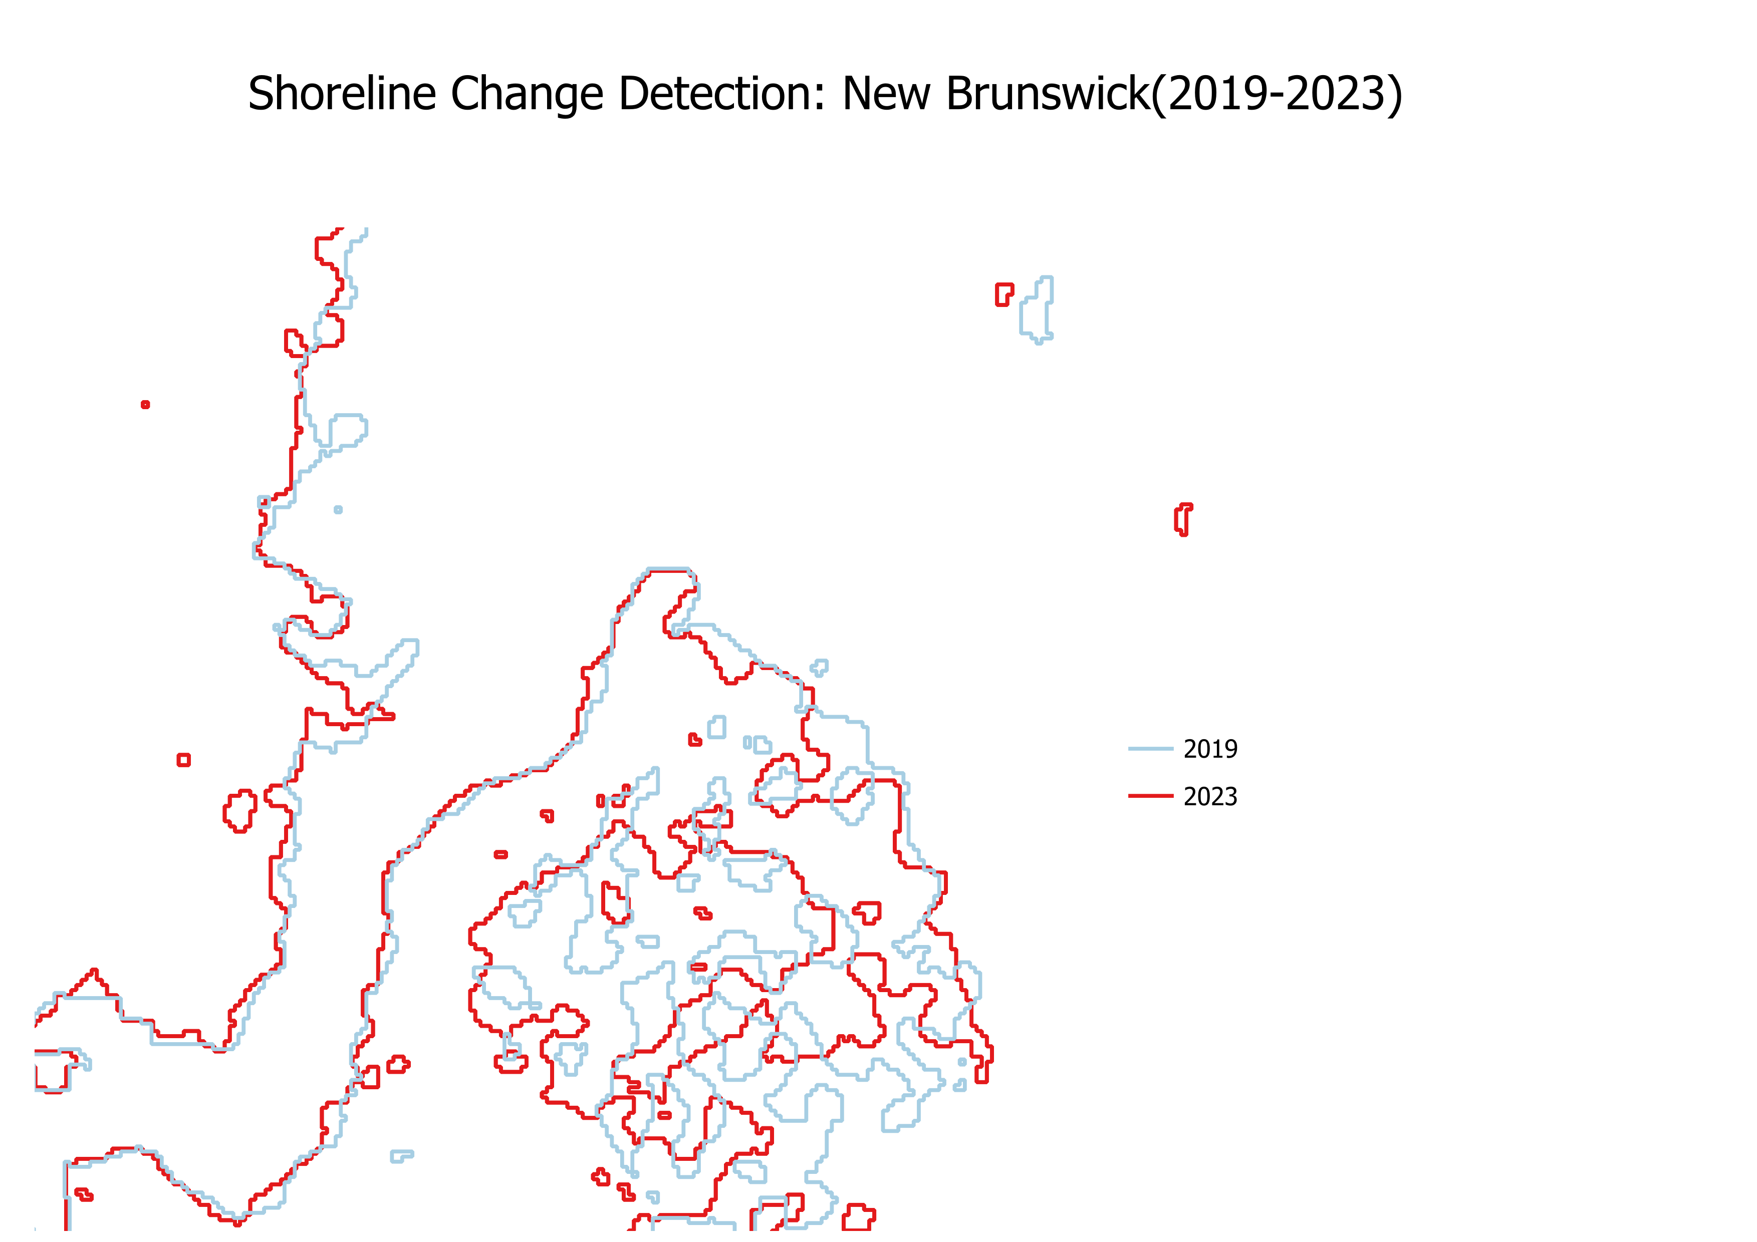
Measurable Shoreline Change Detected (2020-2024)
Key Finding: Erosion detected where red line is inland from blue. Measured up to 130 meters of retreat. This workflow successfully quantifies coastal change near Kouchibouguac.

Slide 6
Actionable Insights & Scalable Potential Impact:
Provides evidence-based data for park managers & communities.
Helps prioritize areas for conservation or adaptation. Future Work:
Scale Up: Apply to larger regions.
Automate: Script the entire process.
Web App: Create an interactive dashboard.
Predict: Use AI to forecast future erosion risk.

Slide 7

Thank you

