Slide 1








VM
https
uptime robot
nginx
MeteorJS App
https
backup
client
VM
Backup to external DB

Slide 2
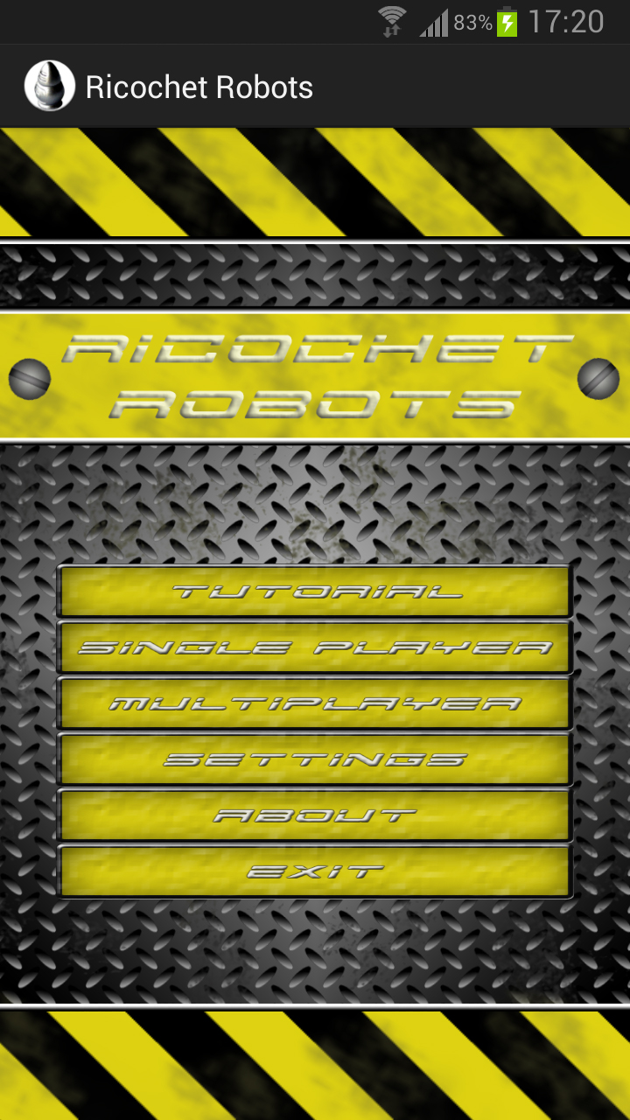
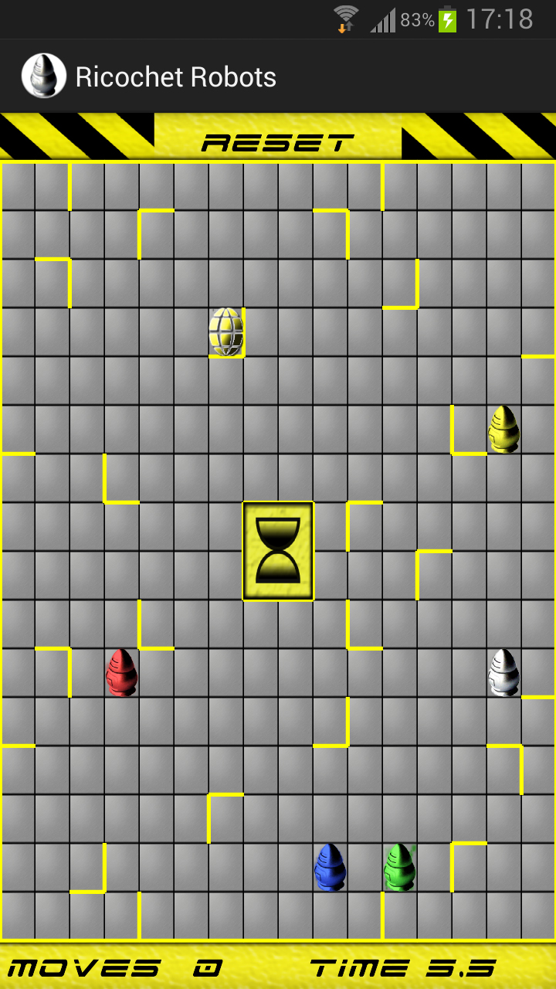

Slide 3













VM
Garden irrigation
Lights
Multimedia
Multi-Room Audio
Window blinds
AWS Web Service
nginx
Home Assistant
Logitech Media Server
Weather station
NAS
RPi 4
RPi 4

